Slide 1

Developing stories from child labor data
National Press Foundation
May 8, 2023
Jennifer Sherer
Economic Policy Institute
www.epi.org

Slide 2

Greetings from EPI - the Economic Policy Institute
Core research and policy areas:
Jobs and employment
Wages and labor standards
Economic inequality
Race and ethnicity
Unions and collective bargaining

Slide 3
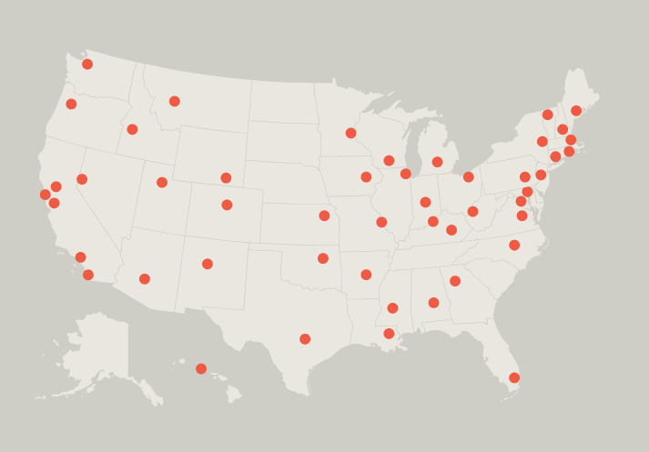
Network of over 55 state and local groups in 45 states and DC
Hosted and supported by EPI since 1998

Slide 4
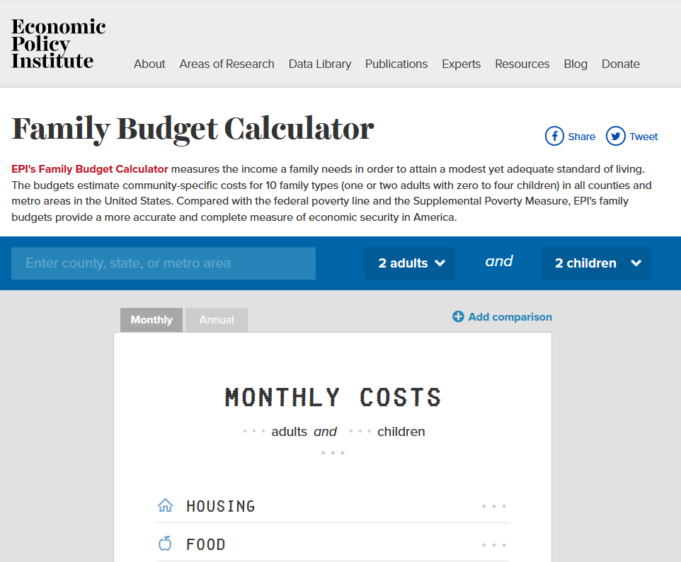
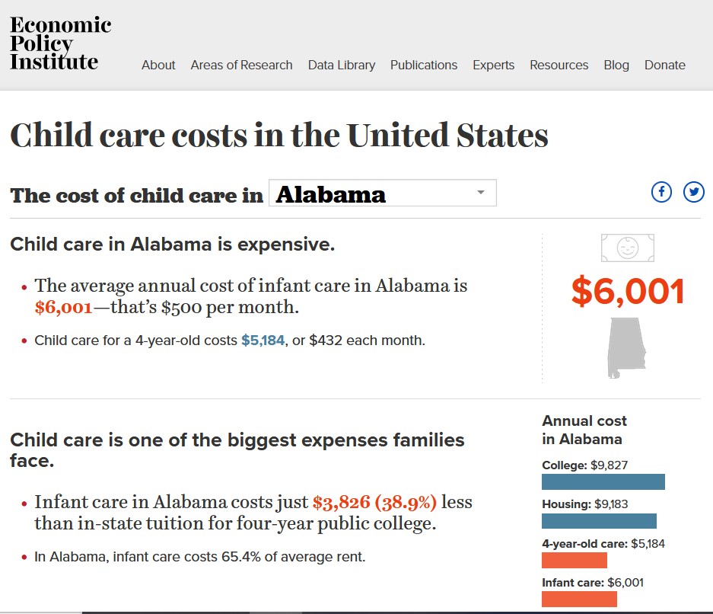
Examples of EPI/EARN data tools
Examples of EPI data tools

Slide 5
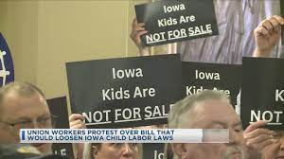

Child labor policy debates raise core values questions
The “labor question” in political economy:
“Who will do the work, and under what conditions?”
Notes:
Work, childhood, state, family, race, immigration
Work
Childhood
State
Family
Employers
EPI / EARN network
CLPEP, grandmother, teens

Slide 6



First job stories – almost everyone has one!

Slide 7
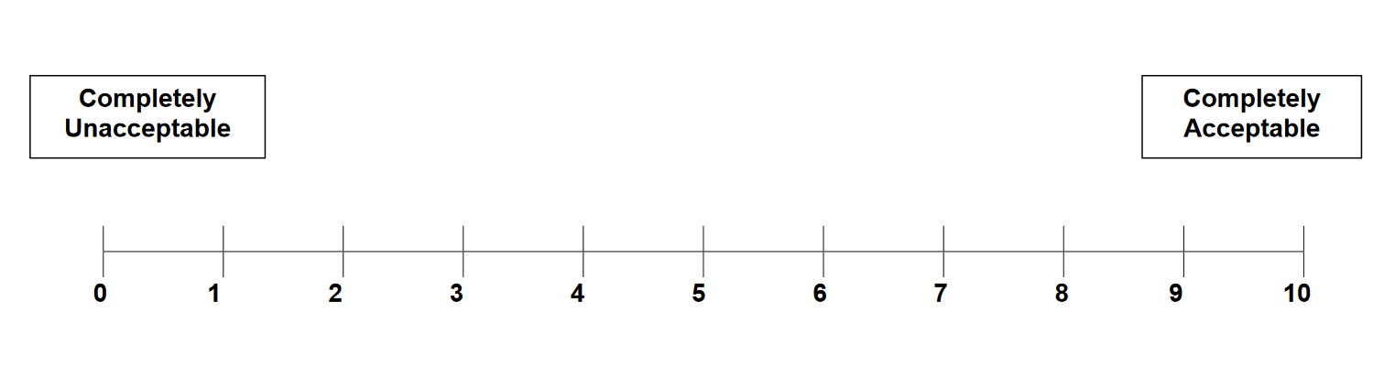
How do we define acceptable work for children, teens, youth?

Slide 8
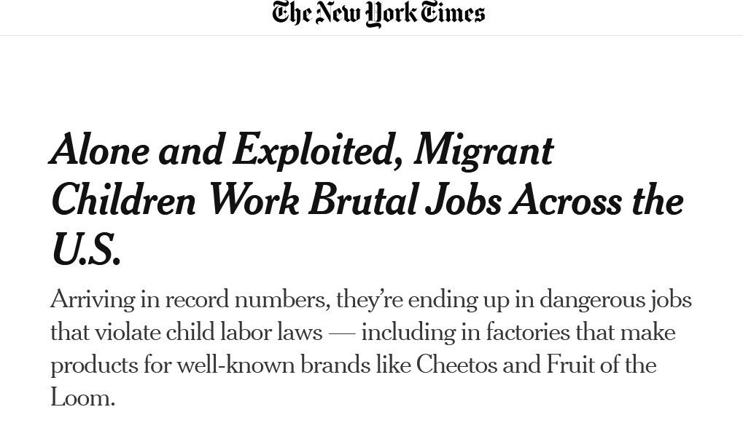
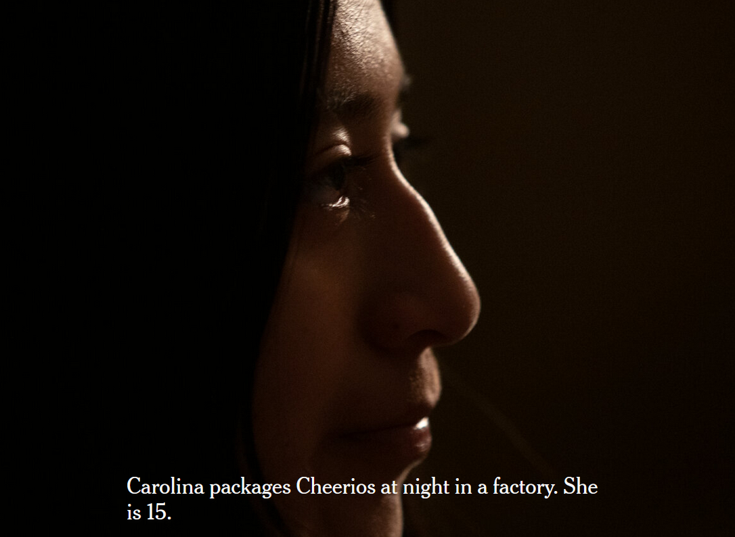

Notes:
Carolina Yoc, back right, worked on math problems after a night shift at a Grand Rapids food plant. The 13-year-old girl sitting next to her said she also worked nights at a factory.

Slide 9
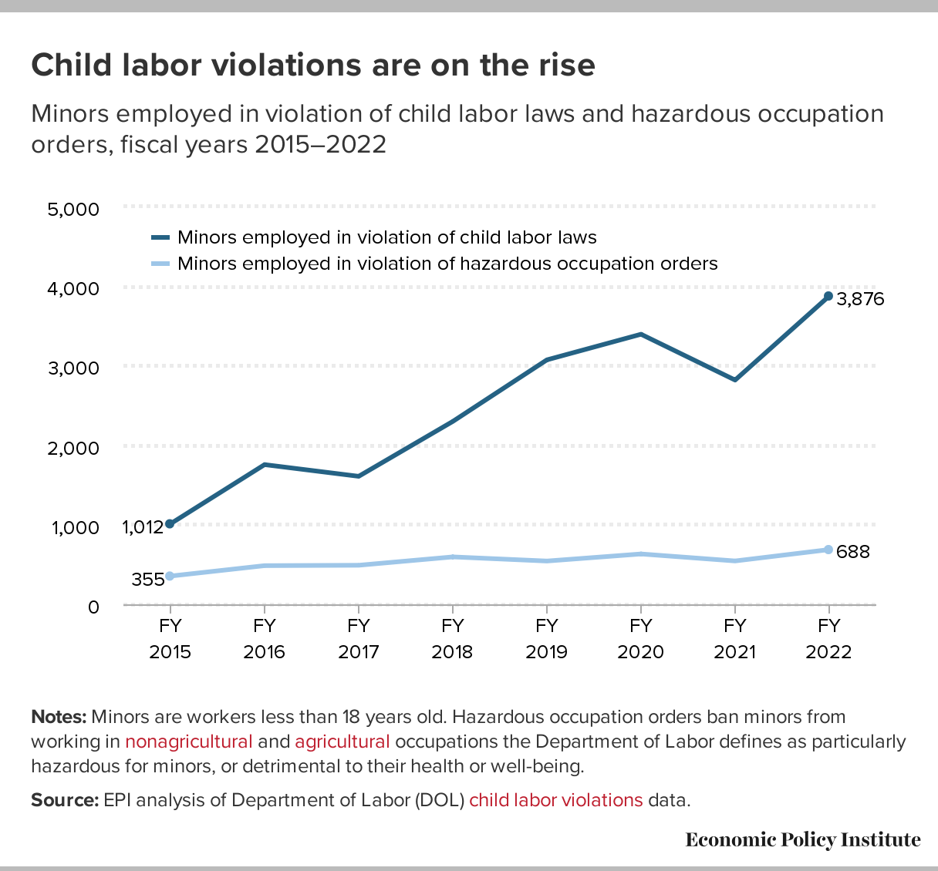

Slide 10
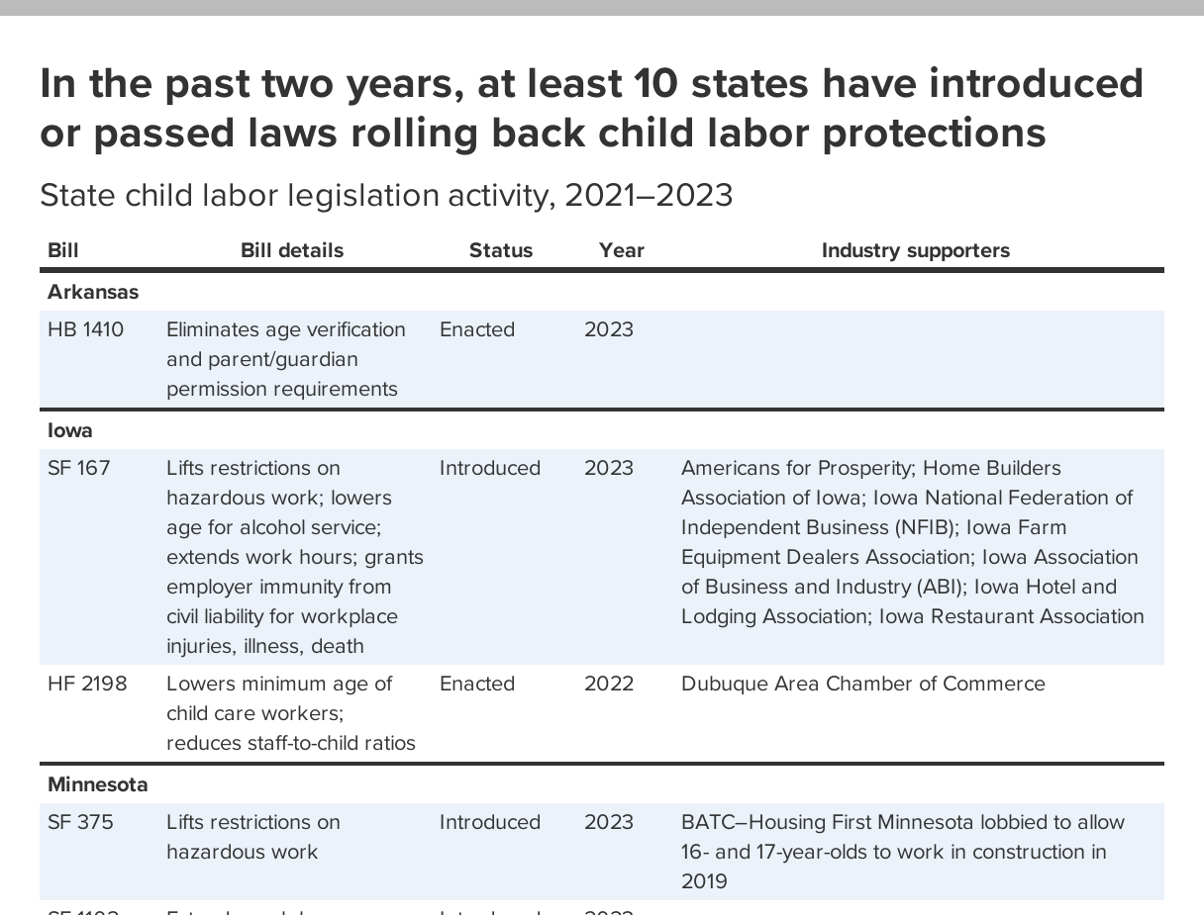

Slide 11
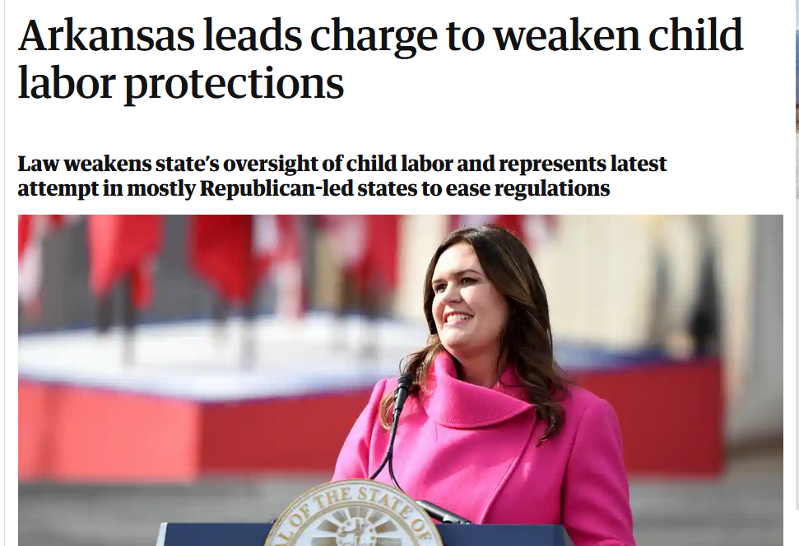
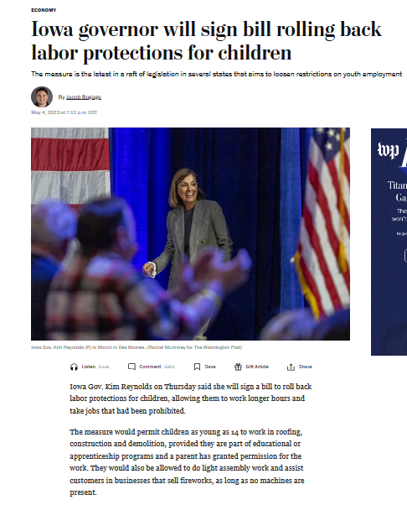
2023 state legislation enacted

Slide 12
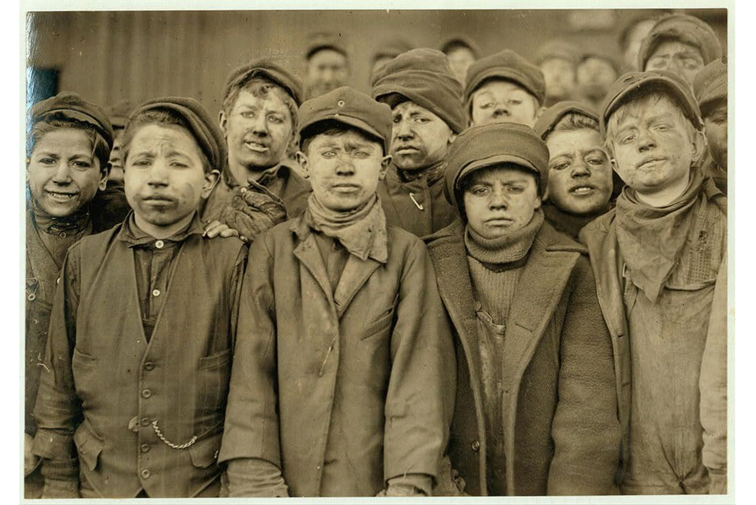
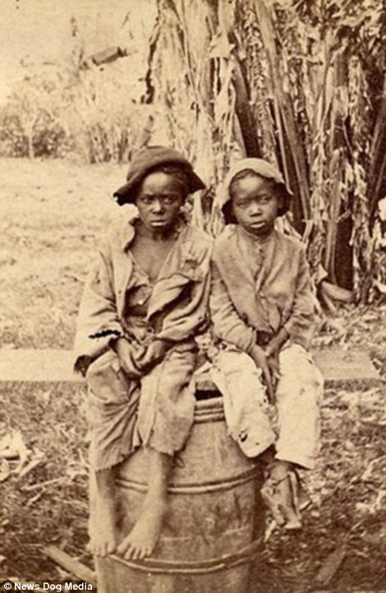
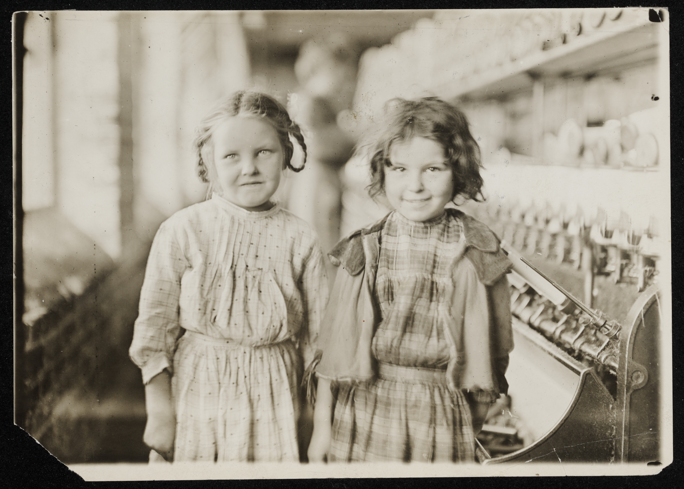
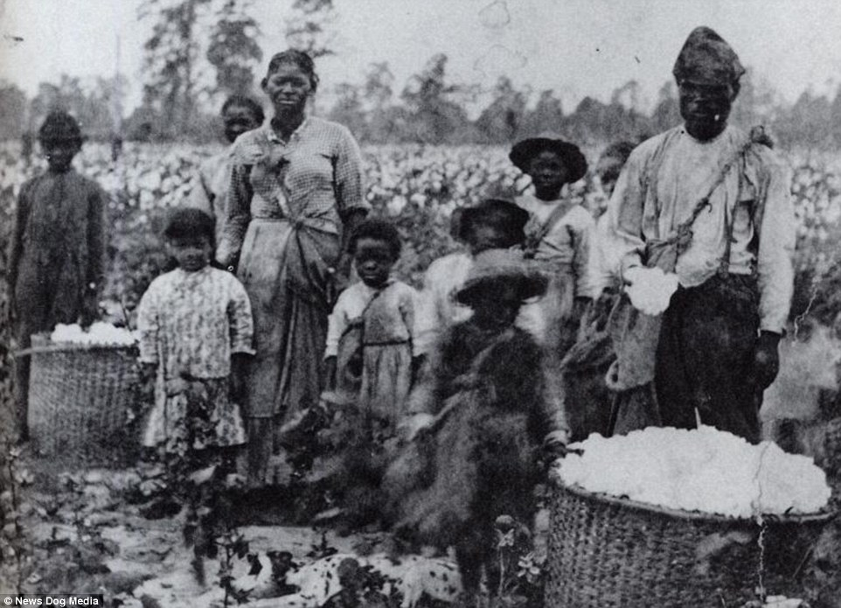
US has been built on many forms of child labor, in many different industries

Slide 13
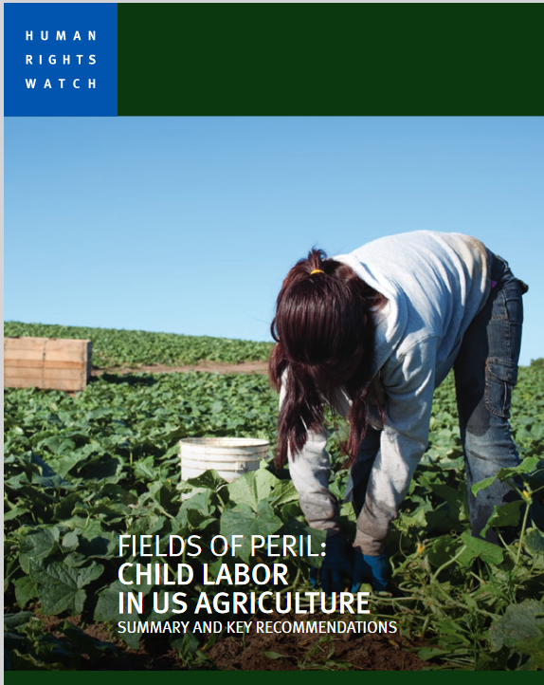
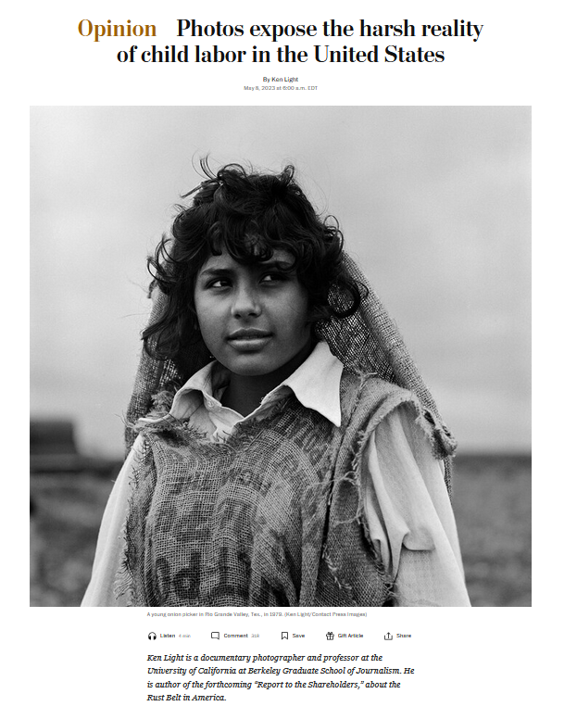
Child labor remains commonplace in US agriculture

Slide 14
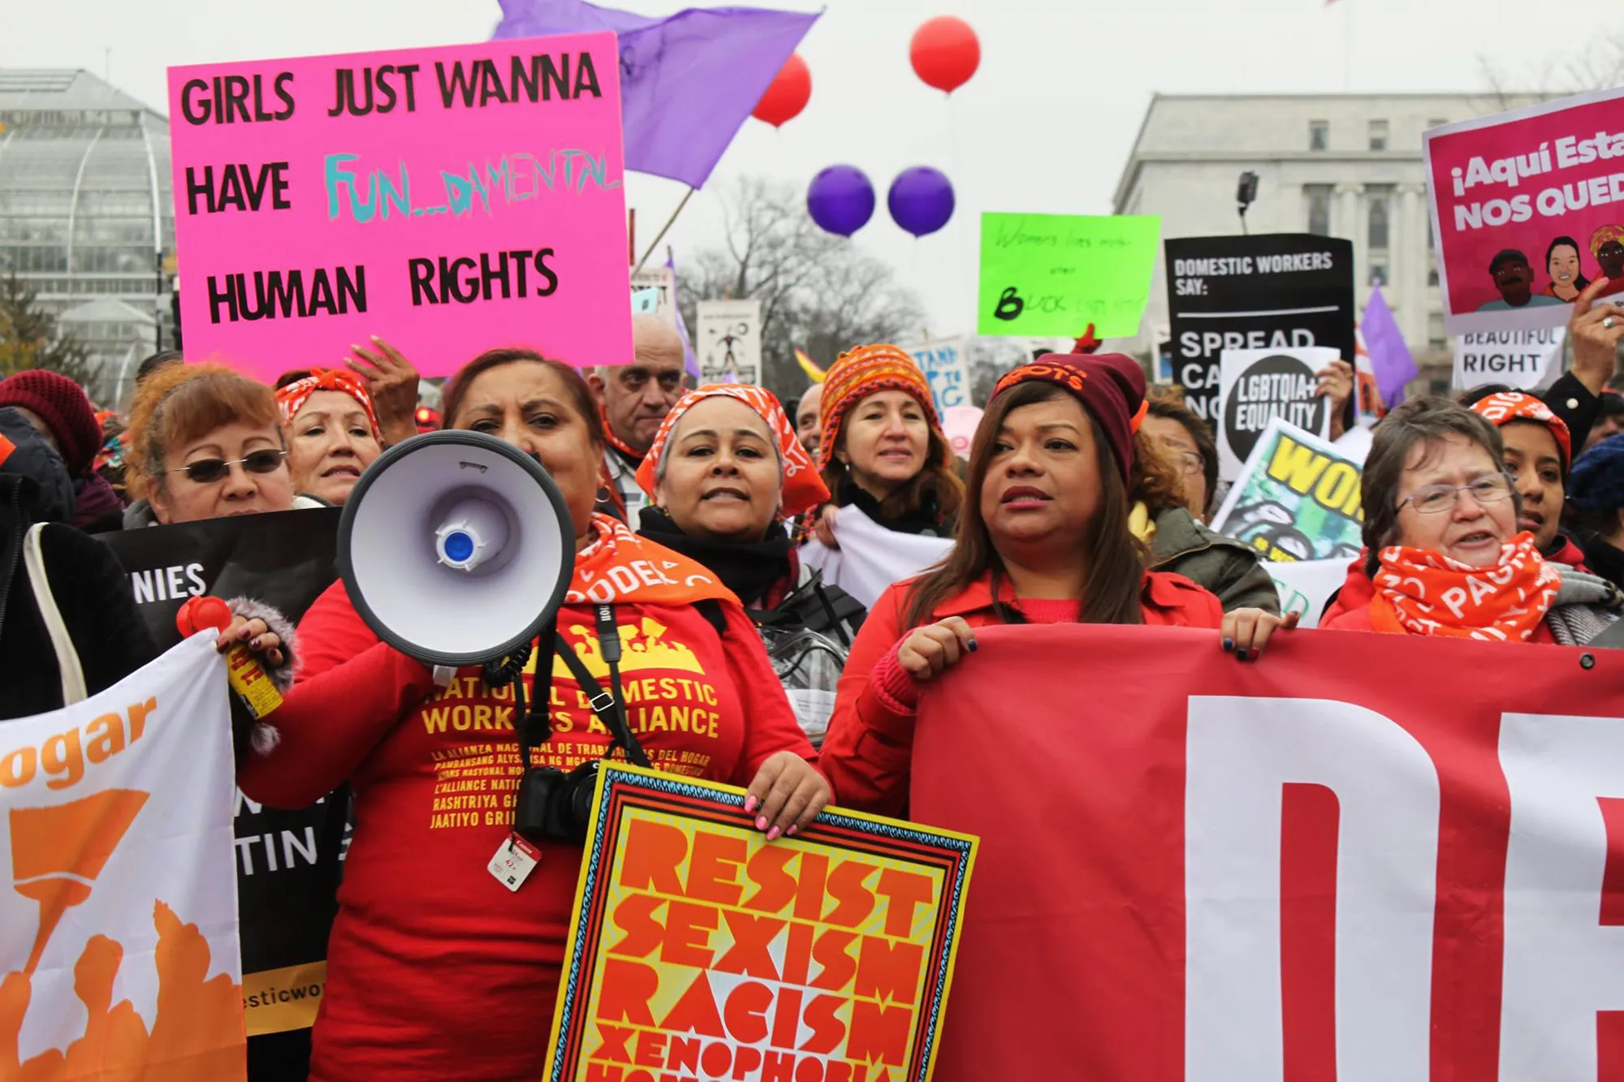
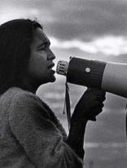
Transformative New Deal laws included racist occupational carveouts
1935 National Labor Relations Act
1938 Fair Labor Standards Act
Who gets left out?
Farmworkers and domestic workers
Public employees
Health care workers (initially)
Independent contractors

Slide 15
States have historically been primary sites of child labor regulation
The first Child Labor Law in Iowa was enacted in 1880, requiring that the age limit for boys working in mines should be 12 years. The Knights of Labor conducted the agitation for this initial statute. The State Mine Inspector, in his reports, declared that this law was being continually violated, and in the year 1884 it was made mandatory on parents to furnish affidavits as to the age of their boys before they were permitted to go to work in the mines.
In 1886, Mr. W. W. Dodge, of Burlington, a member of the State Senate, introduced a comprehensive Child Labor bill at the instance of the organizations of labor in the State. That bill was killed in committee. In 1888, Mr. Dodge secured the passage of a resolution directing the newly appointed Commissioner of Labor to investigate child labor in the State, but provided no funds for the Commissioner to prosecute this work. Nevertheless, the Commissioner gathered information from 85 cities in the State, showing 1,765 children under 14 at work. But this report of the Commissioner produced little or no impression upon the Legislature. The organizations of labor becoming stronger numerically, increased their activity, and urged Mr. Dodge to press the matter again in 1890. Again it was indefinitely postponed by the General Assembly . . .
-Arthur E. Holder, Past President, Iowa State Federation of Labor

Slide 16
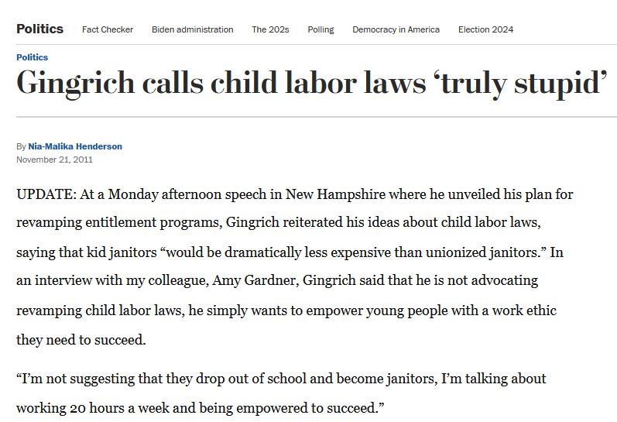
Never settled: Child labor an always contentious part of “the labor question”
1906 fed child labor law proposal → sidelined
1916 first fed child labor law passed → struck down by SCOTUS
1920 push for constitutional amendment → defeated by industry opposition
Notes:
“parents’ rights” arguments used before Supreme Court then
Business interests central to public debates on child labor … from textile mills in the South to fast food restaurants today

Slide 17
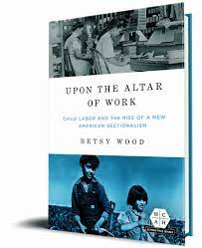
1920s campaign for child labor constitutional amendment
“The new battle broke down largely along urban-rural lines,” says Wood, as farm families across the rural U.S. bought into the fear that the planned amendment “was a surreptitious effort to interfere with parental rights.”
Notes:
1920s legislation widely popular but defeated by organized opposition, rallied voters with fear-based appeals to gov’t interference with parental and family rights

Slide 18
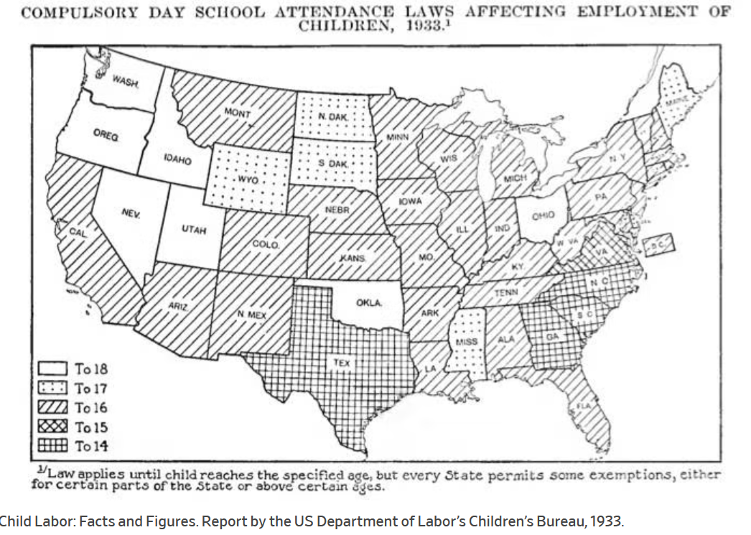
Notes:
https://slate.com/human-interest/2014/01/child-labor-history-maps-showing-regulation-of-kids-work-in-the-1930s.html

Slide 19
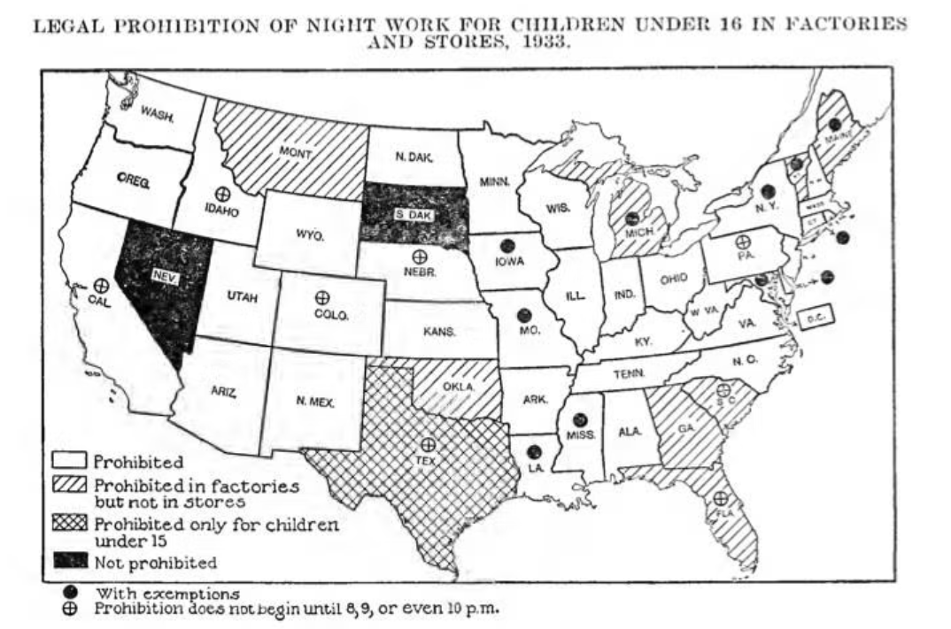
Notes:
https://slate.com/human-interest/2014/01/child-labor-history-maps-showing-regulation-of-kids-work-in-the-1930s.html

Slide 20
1938 Fair Labor Standards Act
Minimum wage, overtime, child labor
Federal law sets new “floor”: States can exceed (but not diminish) federal standards

Slide 21
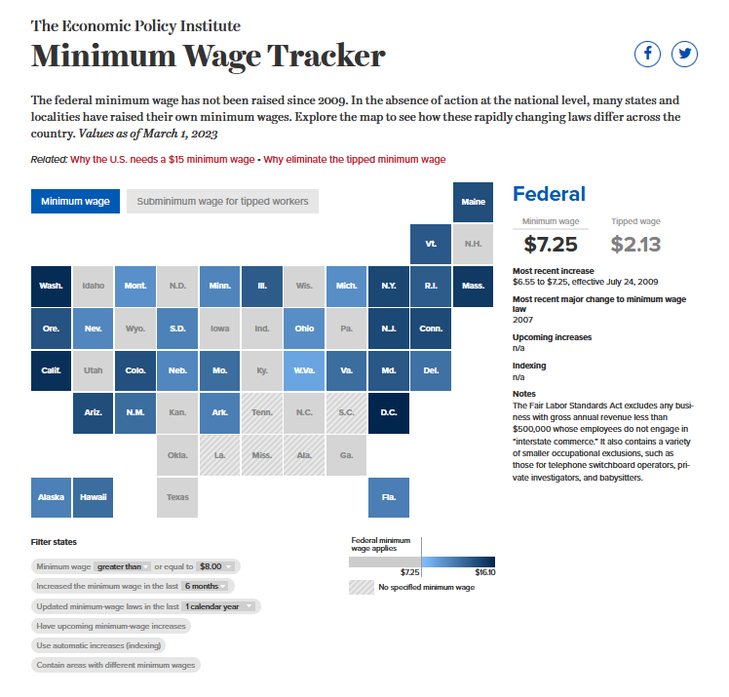

Slide 22
Fair Labor Standards Act: Protections against “oppressive” child labor
Employers may not use "oppressive child labor in commerce or in the production of goods for commerce."
Under 18 years: no work "in any occupation which the Secretary of Labor shall ... declare to be particularly hazardous for the employment of children ... or detrimental to their health or well-being."
16 years of age: usual minimum age for employment.
14 to 16 years of age: employment permitted in work not deemed "oppressive," that does not interfere with schooling, and that is not detrimental to "health and well-being."

Slide 23
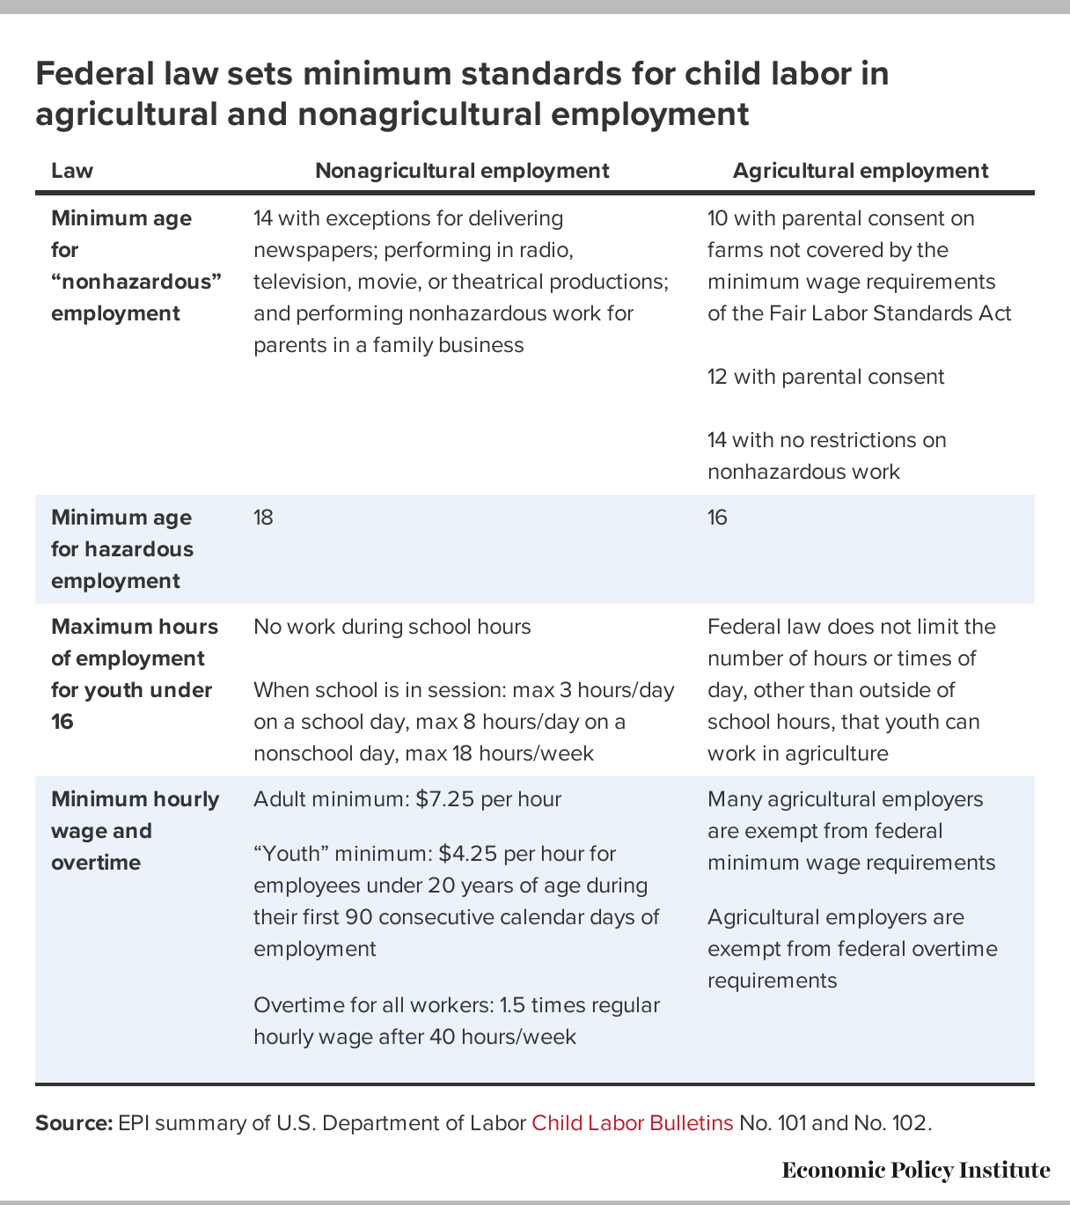
Notes:
in March, Philadelphia passed a law extending the city’s COVID-19 paid sick leave to cover more workers, including low-wage earners and gig workers. Seattle established an emergency minimum wage standard for delivery workers during the COVID-19 pandemic. Commentators suggest that supporters of the Seattle measure may soon push to apply the law permanently.
New York City recently announced a series of laws establishing protections for third-party food delivery and courier service workers. Among other things, these laws would set minimum per-trip payments; guarantee that workers receive the full amount of consumer-provided tips; allow workers to set distance limits for travel requirements; require delivery companies to pay the workers at least once a week; and require services to add a contractual provision with restaurants to allow workers to use their restroom if the worker is picking up a delivery.
Similarly, in California, lawmakers recently passed a bill requiring meal delivery companies to disclose to customers third-party fees and commissions and how much restaurants make on their order.
Local models extremely important illustrations of what is possible for the whole country. Right now: companies have non-profitable business model
Their market capitalization is certainly premised on this model … at one point Uber is worth $70M … don’t think market cap would be zero with EEs, but would be lower b/c prices would be higher and net profits would be smaller …
Could system engage workers in flexible way but WITH rights of employment – YES. Businesses reorganize themselves within new rules all the time, they figure out how to make profits, those profits might be less then they would be without the rules, but if you’re moving toward a model of zero rules, then everything unwinds. We’re trying to structure a system with baseline protections, within which businesses find a way to operate. Instead we’re allowing companies to unglue so many rules… if we need to simulate how they operate with rules in place: Uber/Lyft operating in system with true costs of employment: the test case is called NYC, where they pay a minimum wage, compensate people for all time not just drive time, and still operate at a profit.

Slide 24
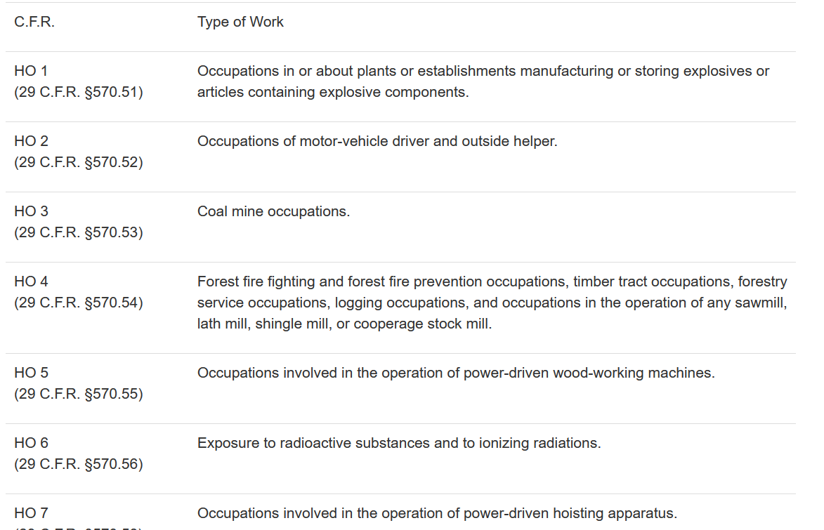
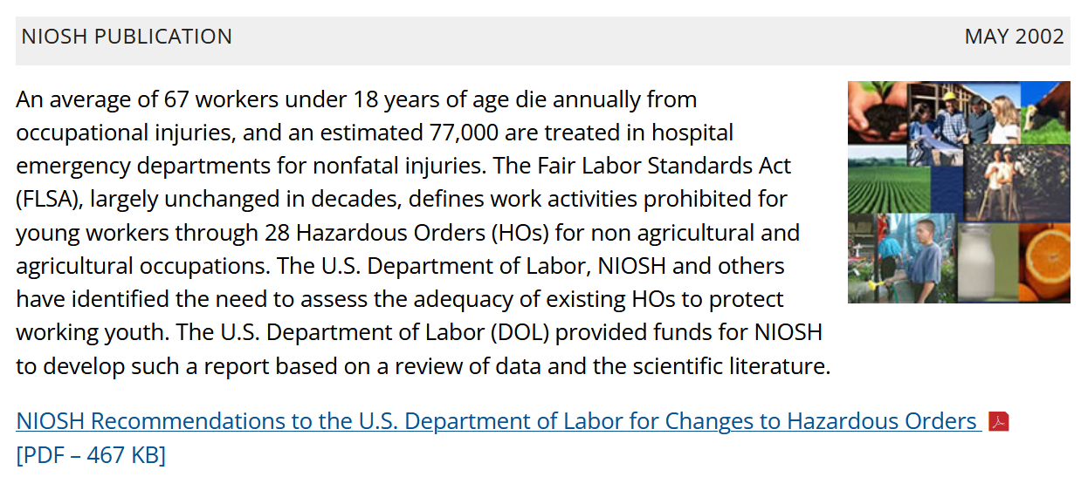
Hazardous occupation orders: Most recent updates based on NIOSH research

Slide 25
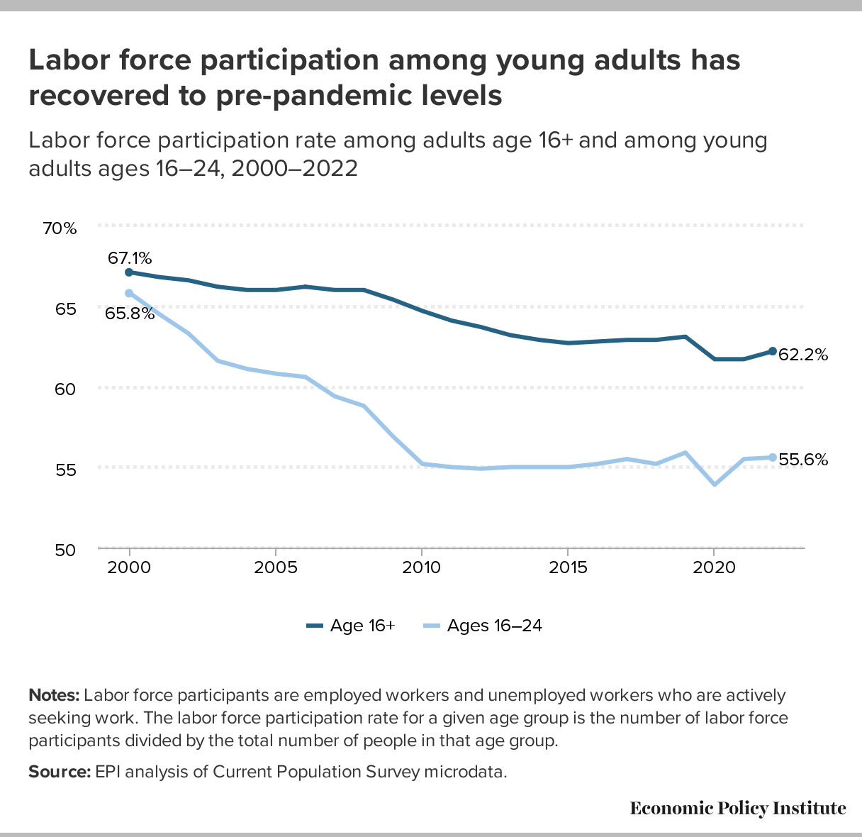
What does labor market data tell us about young workers?
Notes:
Share mention of recent EPI work on gig work and preview of state policy analysis forthcoming
Digital platform companies have constructed a business model on the premise that they do not employ their workforce. Instead, digital platform or “gig” companies treat workers who perform the services they offer not as employees but as independent contractors. While these companies claim that their workforce benefits from this classification, there are significant consequences for both workers and their employer when using the independent contractor classification in terms of jobs protections, tax obligations, and eligibility for employment-based benefits.

Slide 26
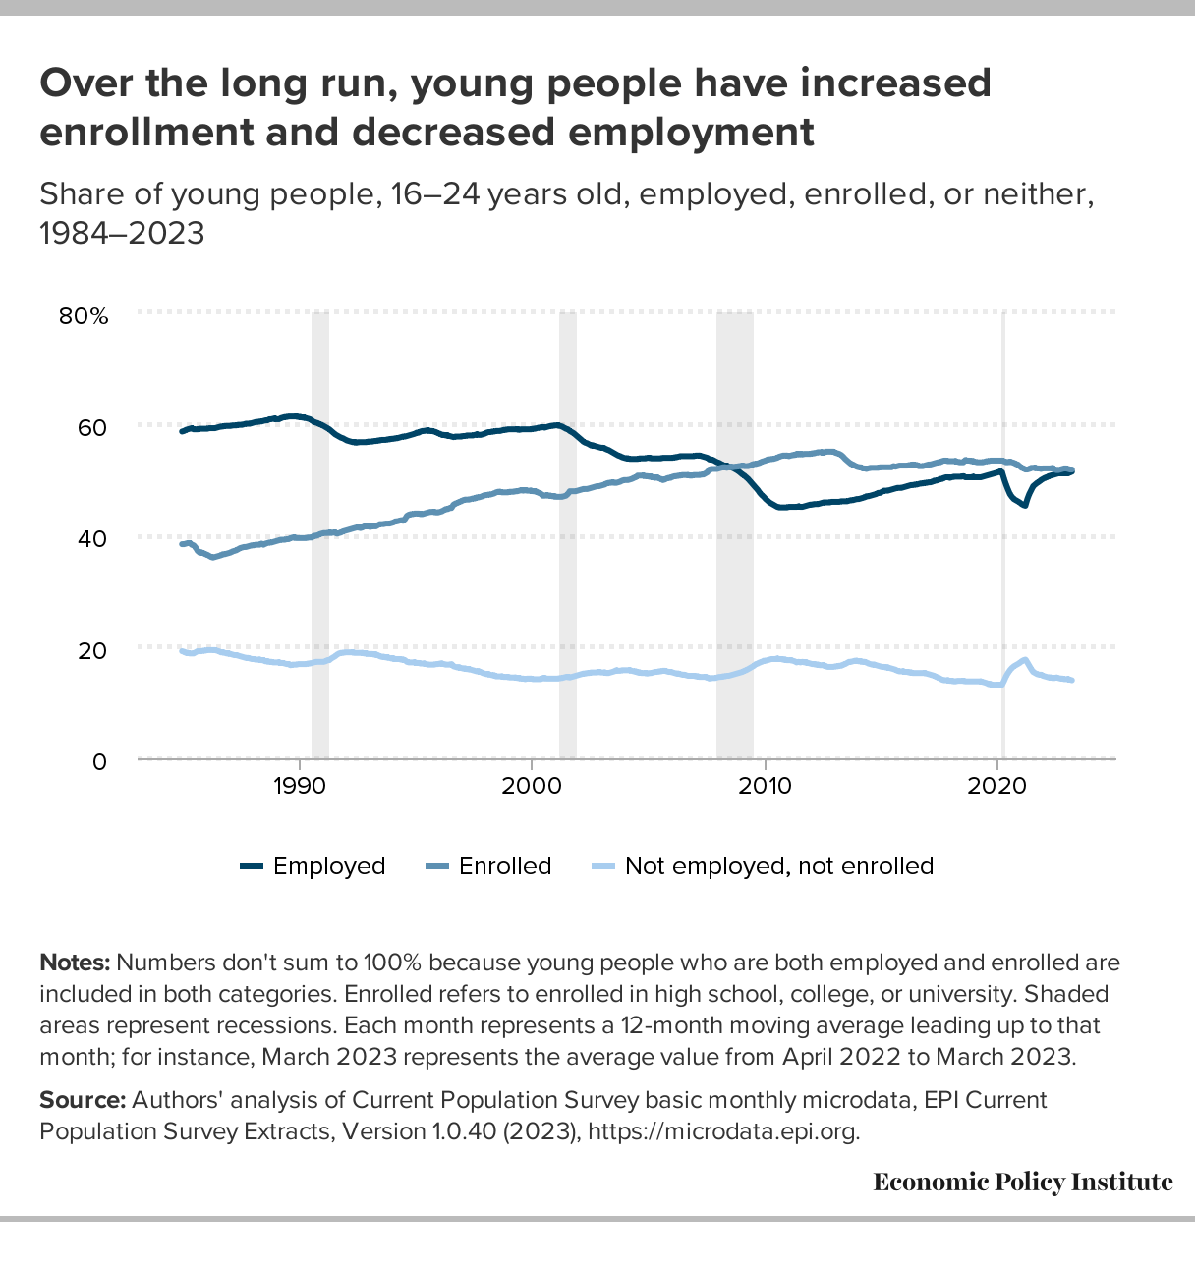

Slide 27
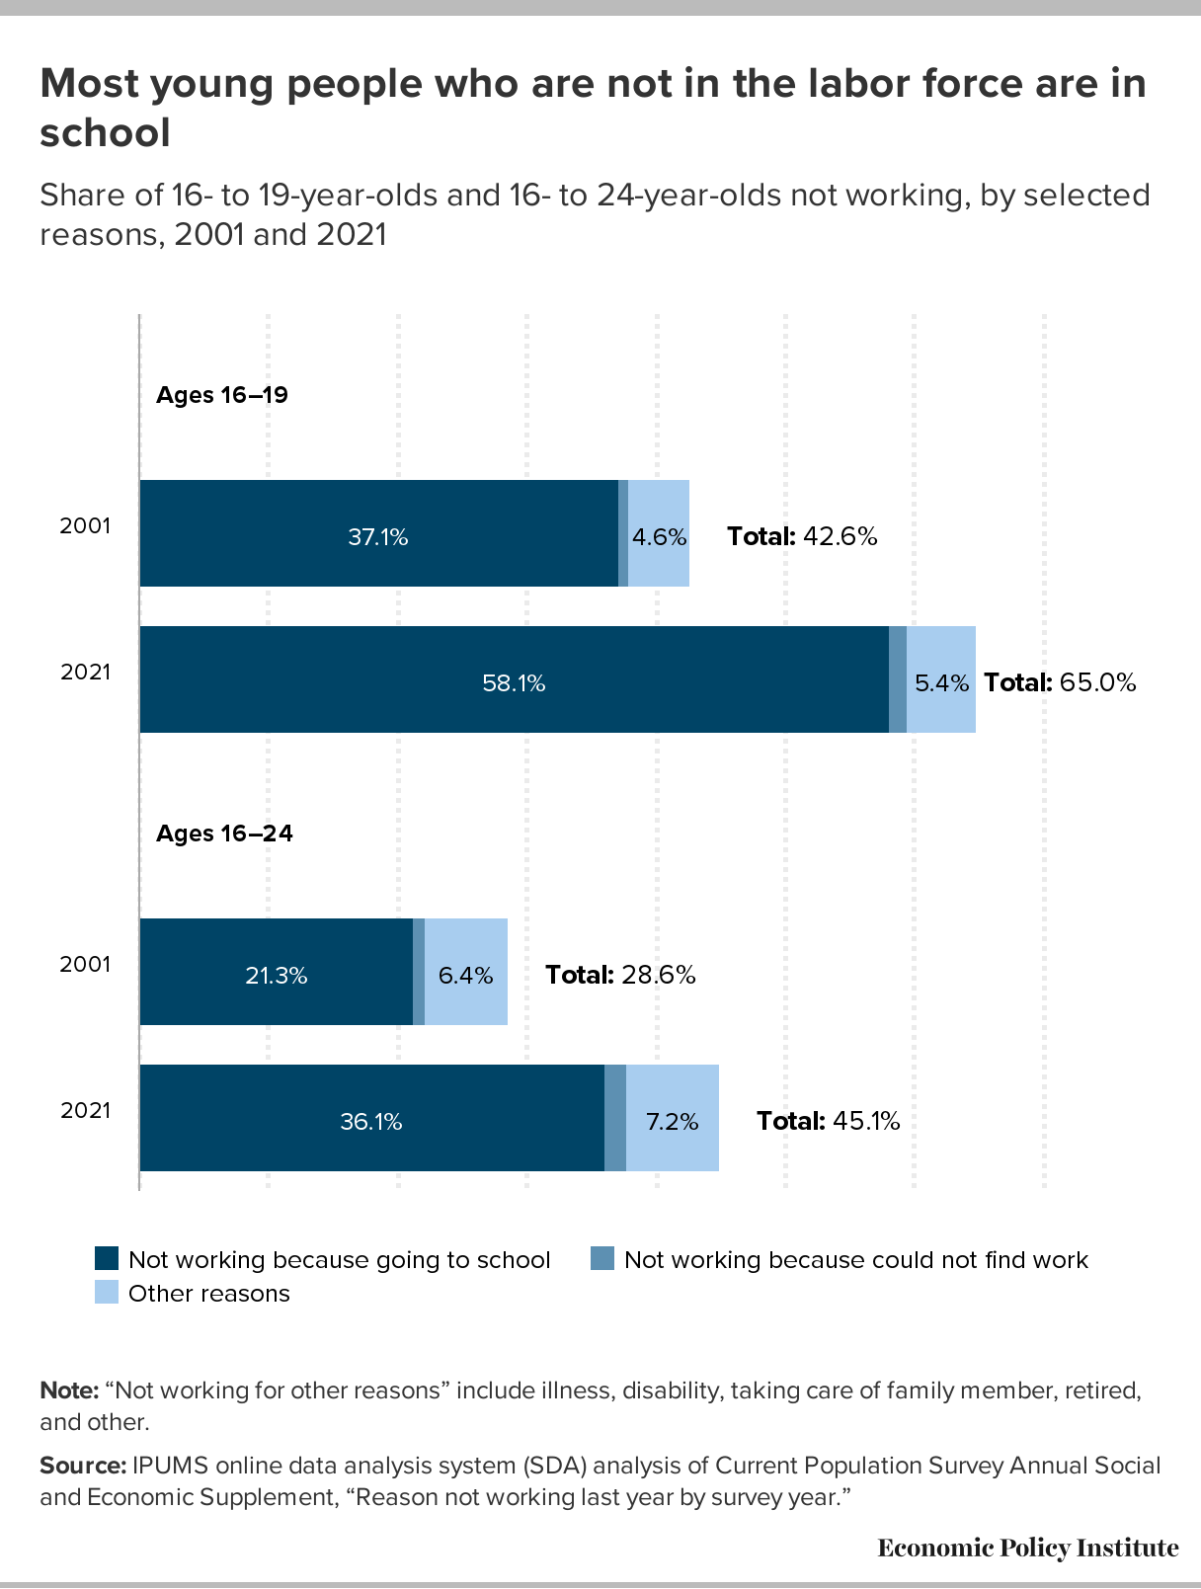

Slide 28
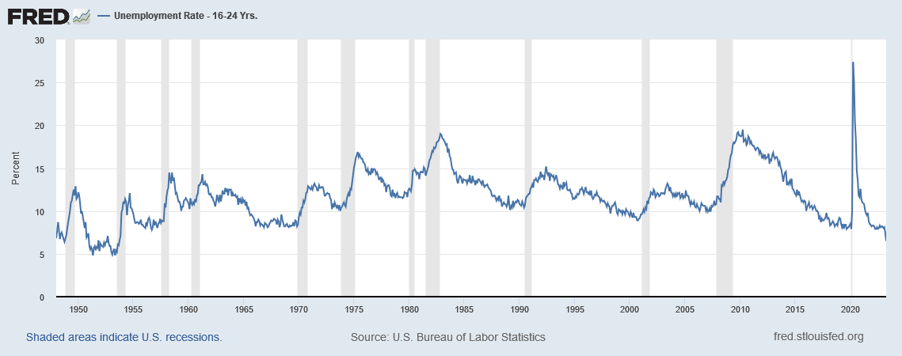
Young worker unemployment rate is already at historic low

Slide 29
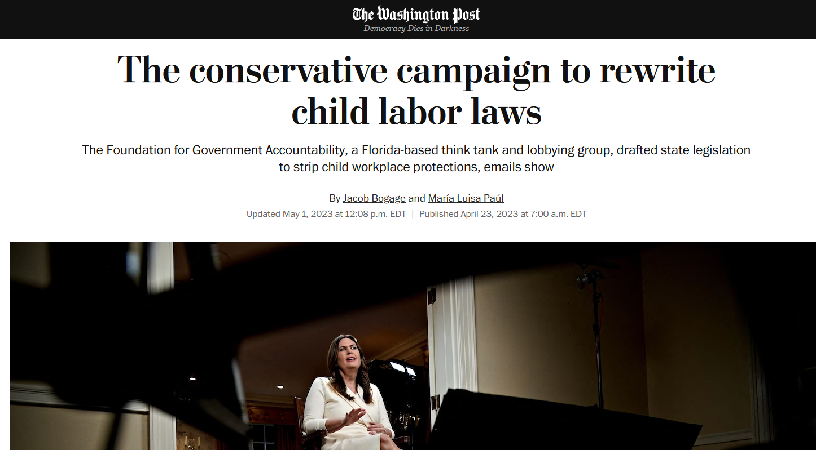
Who’s behind the current push to weaken state child labor laws?
National Restaurant Association
National Federation of Independent Business
Hotel and Lodging Associations
Homebuilders Association

Slide 30





Multi-industry campaign: State chapters of national business lobby groups

Slide 31
Off the shelf? Today’s state legislation echoes past federal proposals
1982 Reagan DOL proposals:
open more occupations to employment of 14 and 15-year-olds;
extend number of hours per day and per week that children can be employed;
allow employment of child workers in jobs once considered too hazardous; and
make it easier to employ full-time students at less than the standard minimum wage.

Slide 32
State by state agenda for federal reform
Lawmakers in Ohio accompanied their 2022 proposal to extend hours for youth work covered under state law with concurrent resolutions calling on Congress to “change [the] Fair Labor Standards Act re: minors,” bringing federal standards in line with the looser rules proposed for Ohio.
2022 Dusty Johnson (SD) bill to lift limits on work hours for teens 14 and 15. The bill would extend work hours to 9:00 p.m. and increase the number of workable hours to 24 per school week for young workers nationwide. The South Dakota Retailers Association, the National Restaurant Association, and the National Fireworks Association supported the bill.

Slide 33

What’s left to cover? Room for federal and state action to improve protections
Enforcement
Two-tiered system for child labor in agriculture
Broken immigration system
Youth “subminimum” wages
Rights of young workers

Slide 34
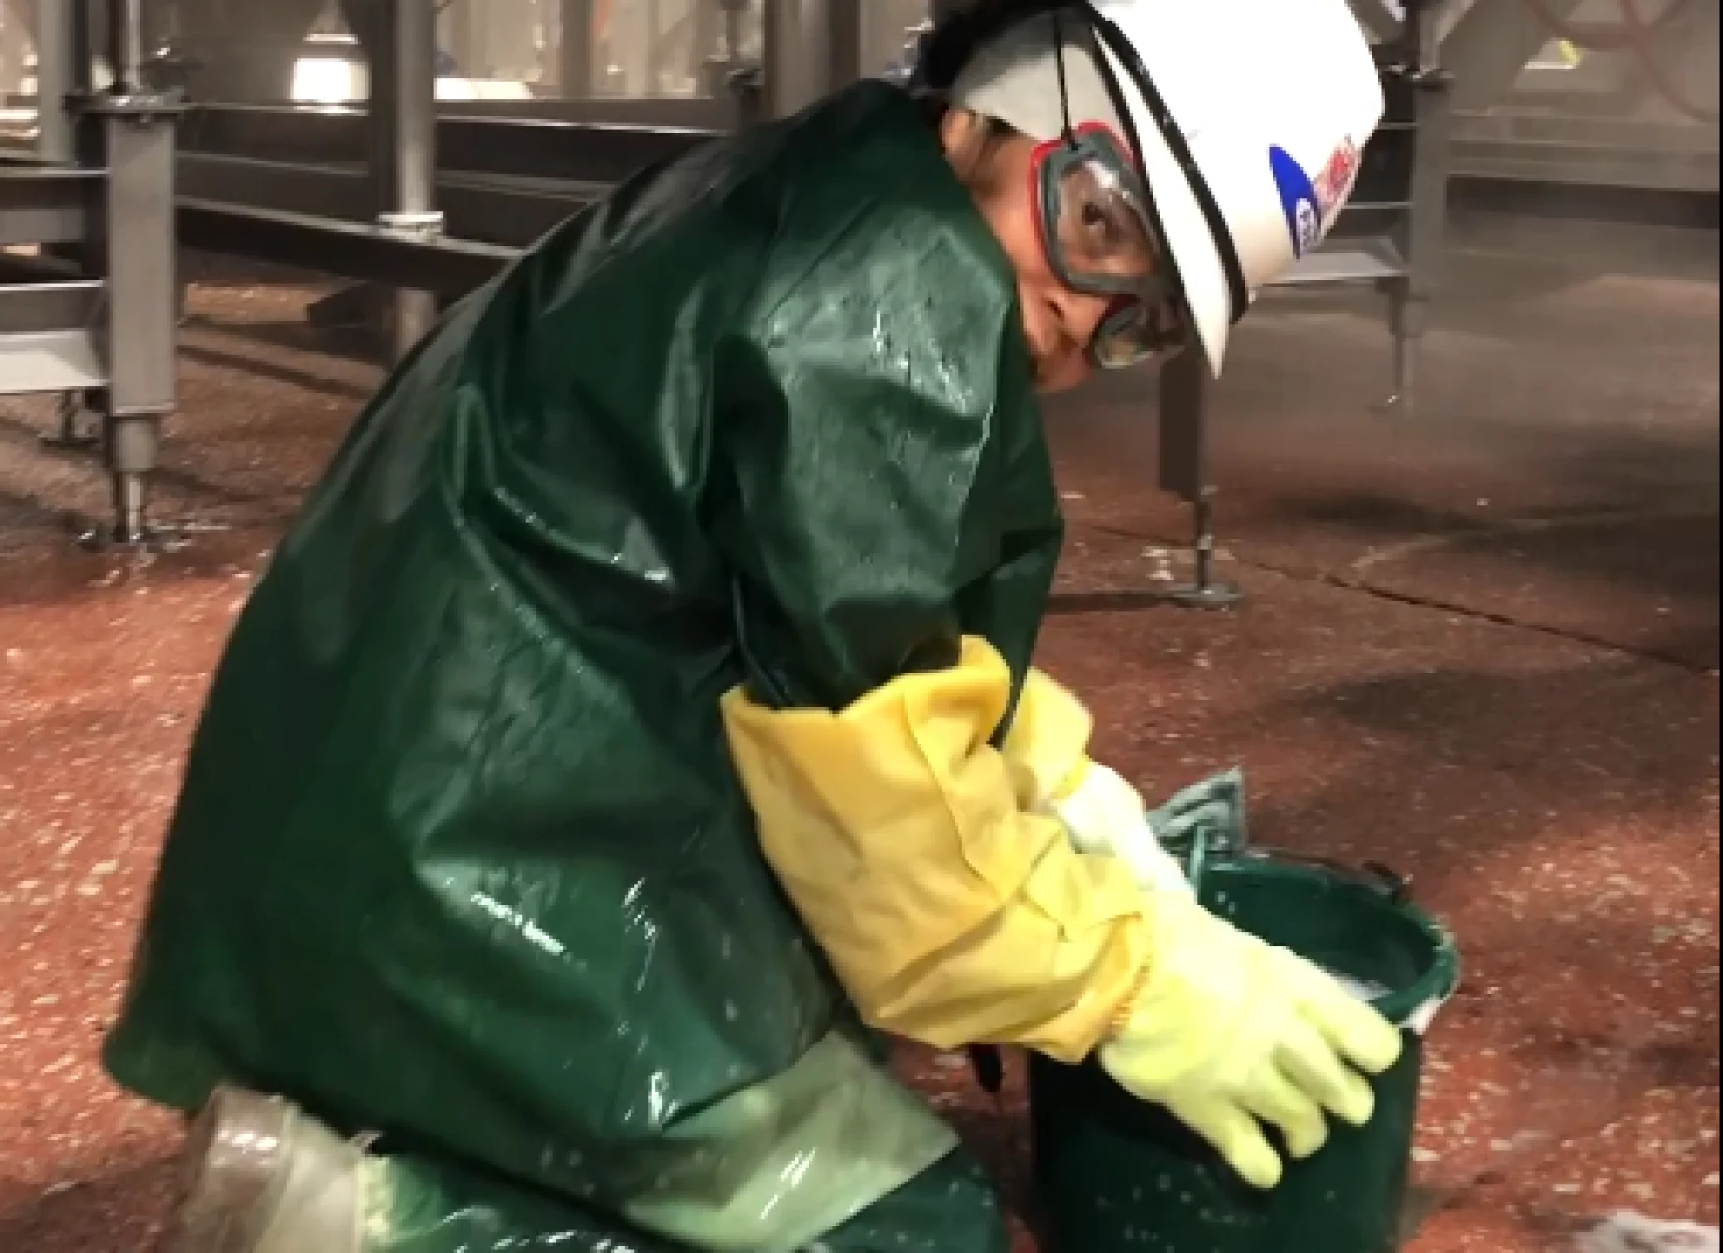
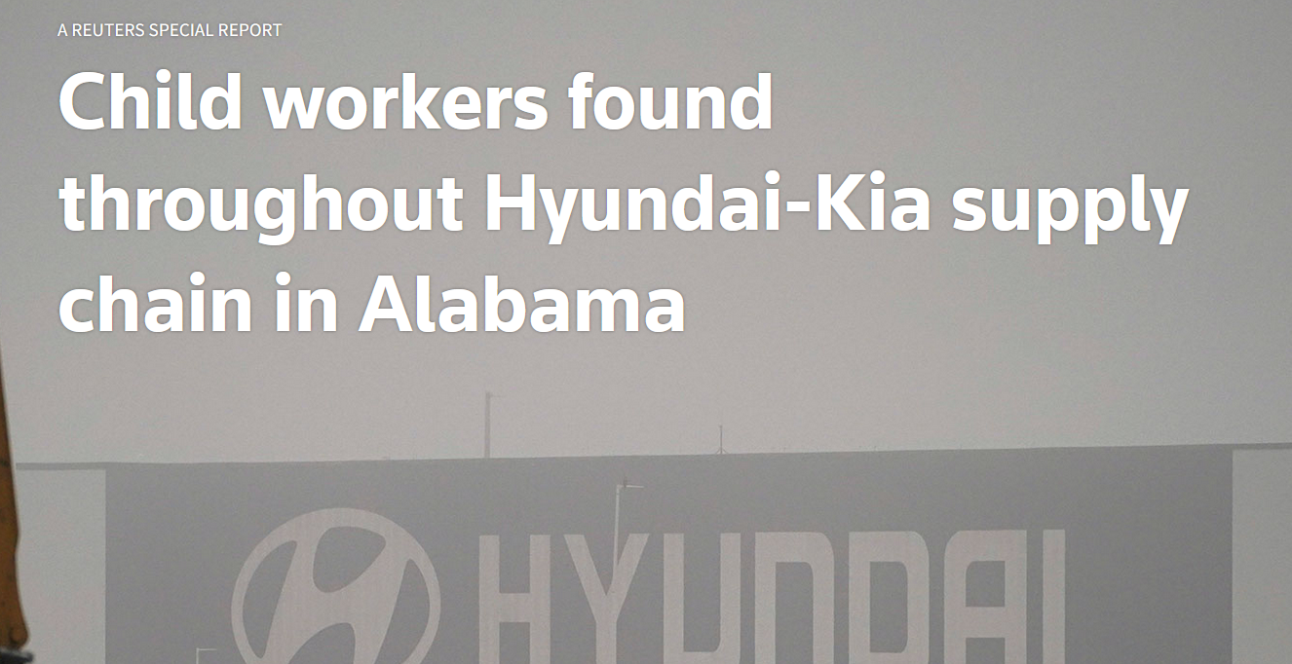
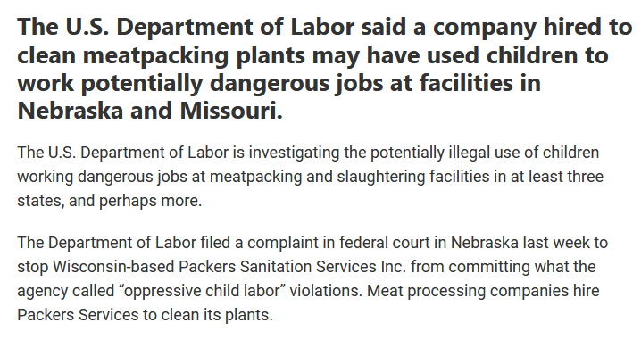
The fissured workplace: Staffing agencies, contractors, labor brokers

Slide 35
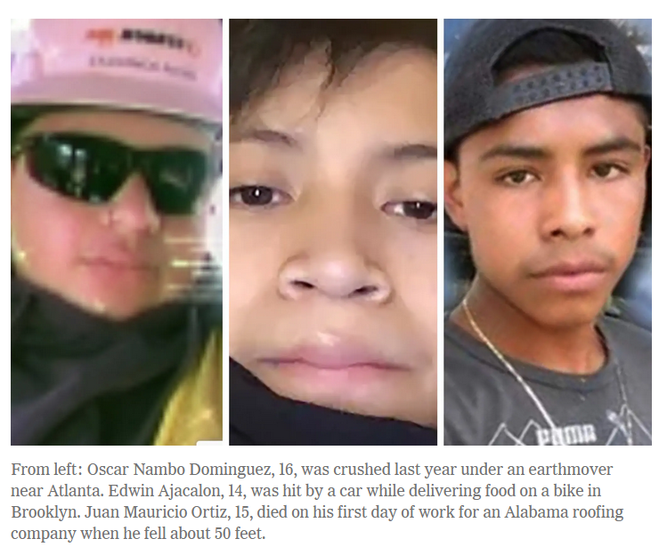
Injuries and deaths: Erosion of workers’ compensation and limits on employer liability

Slide 36
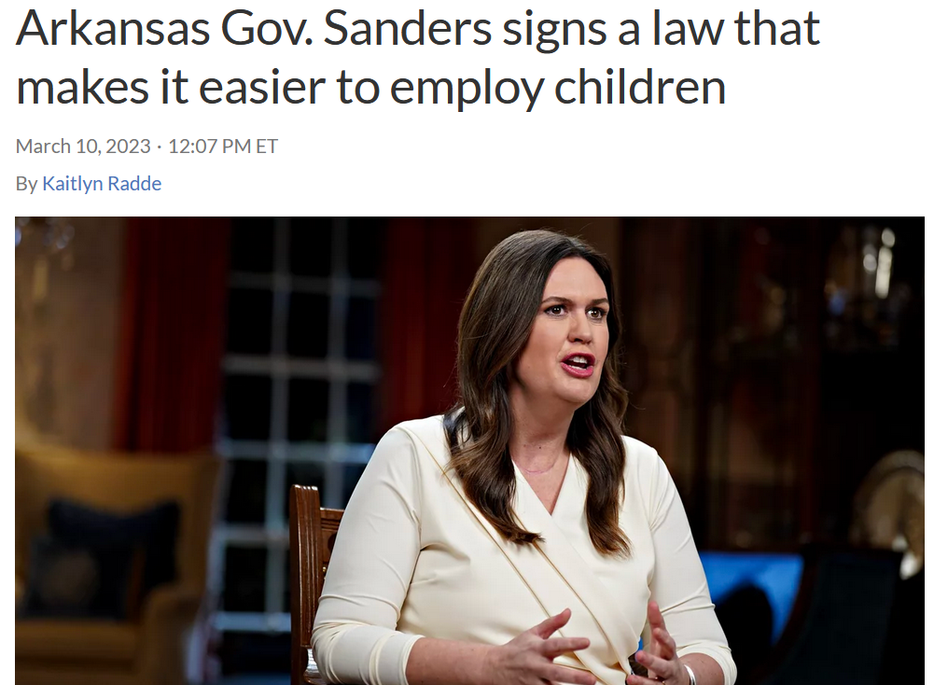
Why work permits & age verification matter: State agency roles in oversight

Slide 37
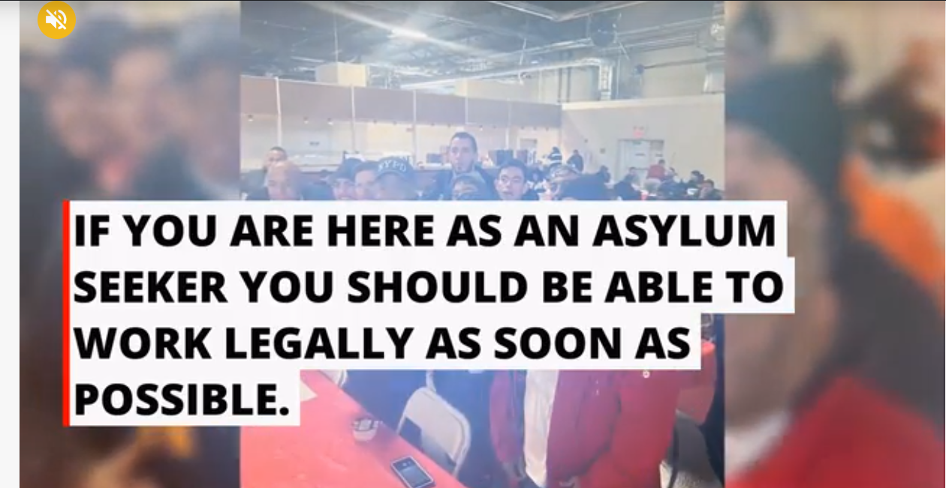
How work authorization could transform options for migrant youth

Slide 38
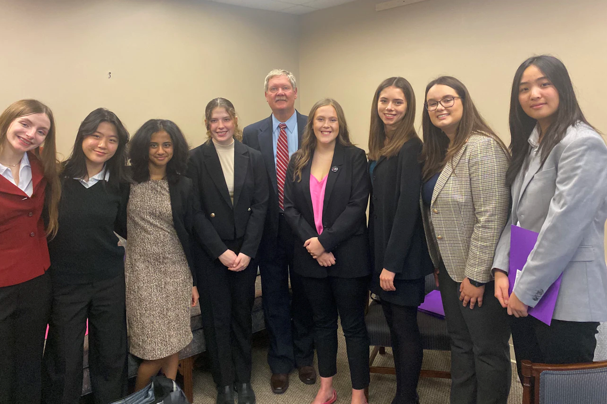
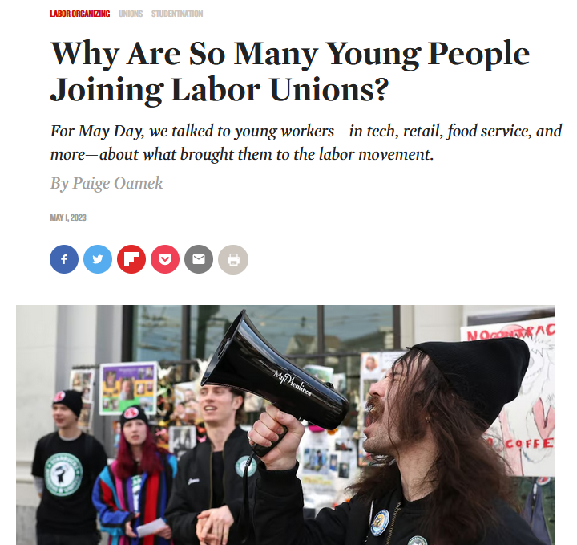
Youth voices, young worker organizing
“I am still just shining from the power that we had,” said 17-year-old Abby Garber.
She and other youth activists helped bring down a Virginia bill aiming to pay teens under 18 less than minimum wage.

Slide 39
Survey: “Would you vote for a union in your workplace if you had the chance?”
Notes:
From a 2018 nationally representative survey of 4,203 non-self-employed workers, subsetting only to workers not currently in a union and excluding DKs; BLS union membership (2020). – AHF research, Young workers and the labor movement

Slide 40
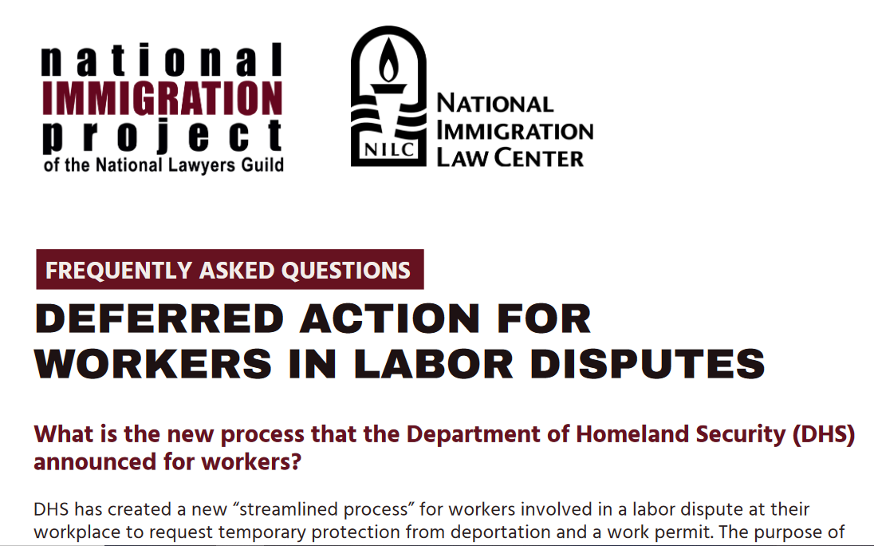
New protections for undocumented workers during labor investigations

Slide 41
Rooted in racism and exclusion: The uneven landscape of state labor standards and enforcement
What is state’s child labor history?
What is state’s existing enforcement framework? Penalties? Permits? Investigators?
What state data is available?
What’s next in states that have weakened laws? DOL roles? Community, school, co-enforcement roles?

Slide 42

What does high-quality work-based learning look like?
Registered apprenticeship, pre-apprenticeship
Career and technical education
Access to OSHA and other worker rights training

Slide 43
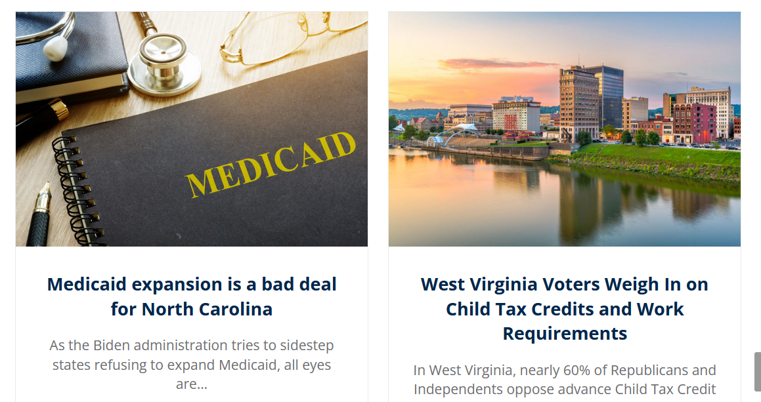
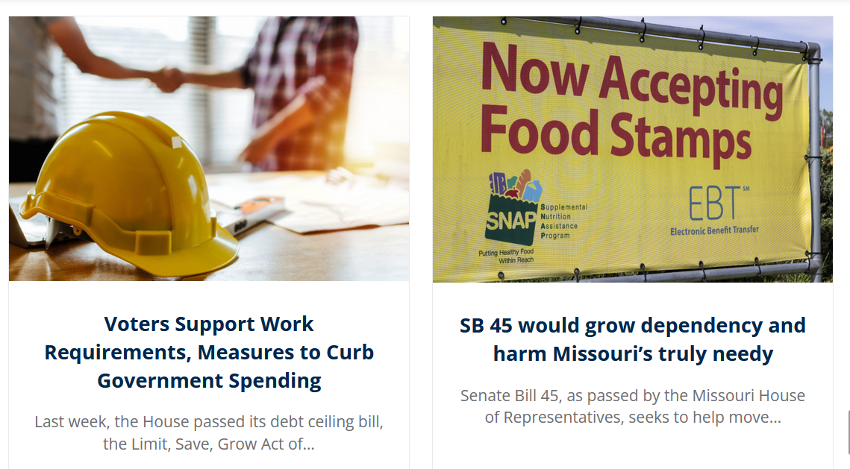
How are attacks on state child labor laws linked to attacks on anti-poverty programs?
Core FGA/OSP state priorities:
Restrict Medicaid access
Means testing and work requirements for SNAP and safety net benefits
Weaken child labor laws
Notes:
Foundation for Gov’t Accountability / Opportunity Solutions Project

Slide 44

Stay in touch!
Jennifer Sherer, Senior State Policy Coordinator, EARN Worker Power Project, Economic Policy Institute
jsherer@epi.org
319-321-8320
www.earn.us
www.epi.org

