Slide 1
Going Upstream: Social Determinants of Health in the Pediatric Population
5/9/2023
Roopa Thakur, MD
Pediatrician and Advocate

Slide 2
Social Determinants Of Health

Slide 3
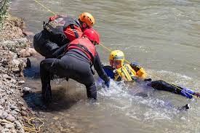
Primary Prevention

Slide 4
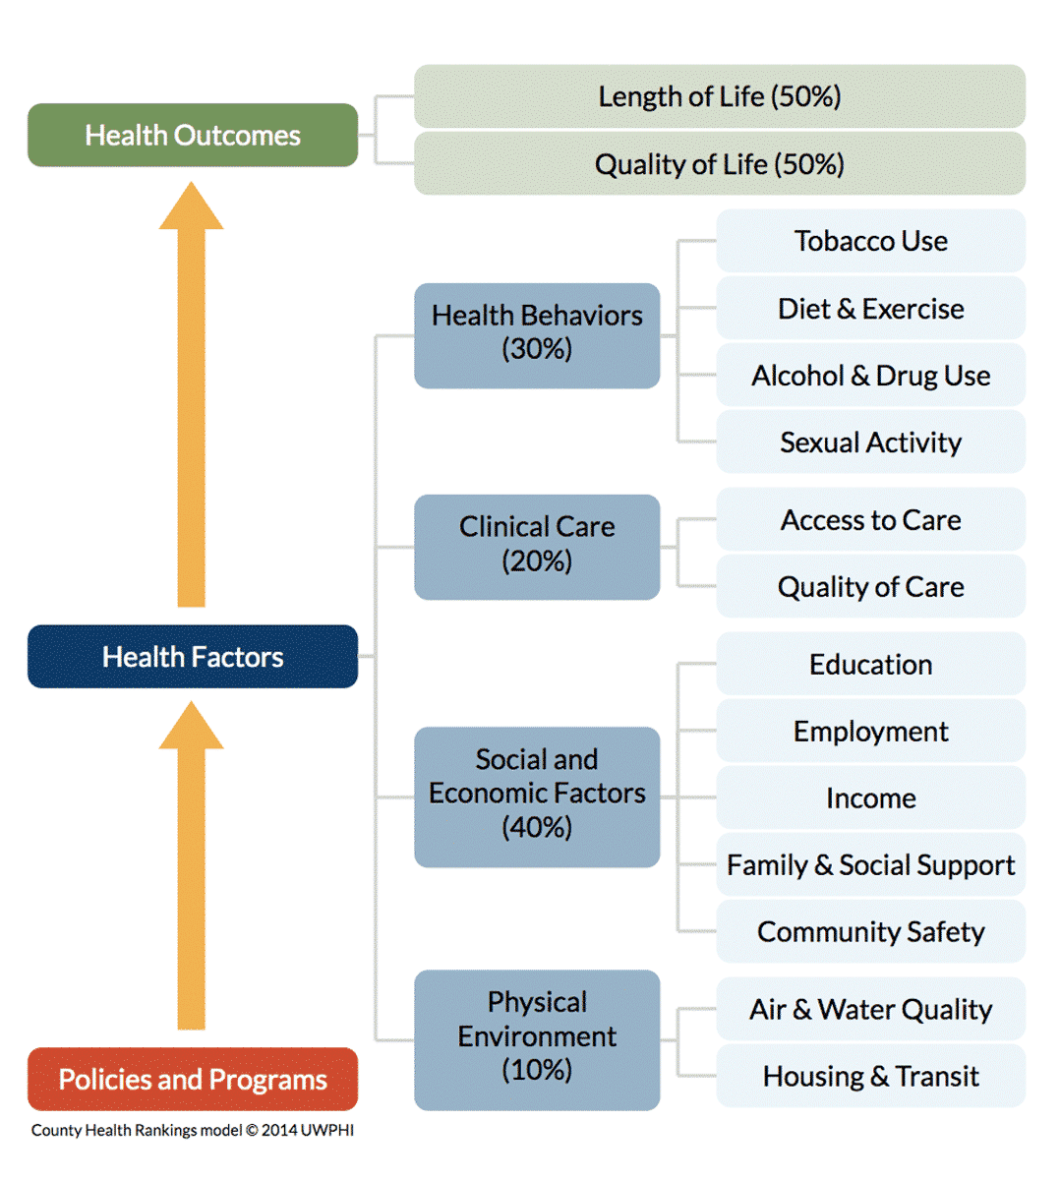
Only 20% of a population’s health is determined by the clinical care it receives
Notes:
We know that “health” does not happen within our Cleveland Clinic walls. It happens where people live, eat, work, learn, and play. This is why we focus on social determinants of health – recognizing that the root causes of our population’s health concerns are shaped by the politics, economics and structure of our community. To put this in numbers, only 20% of a population’s health is determined by the clinical care it receives. Policies and programs that influence the physical environment and socioeconomic factors can have more than double that impact. The effect of the choices a person makes every day based on the resources that they have access to also exceeds that of clinical care alone.

Slide 5
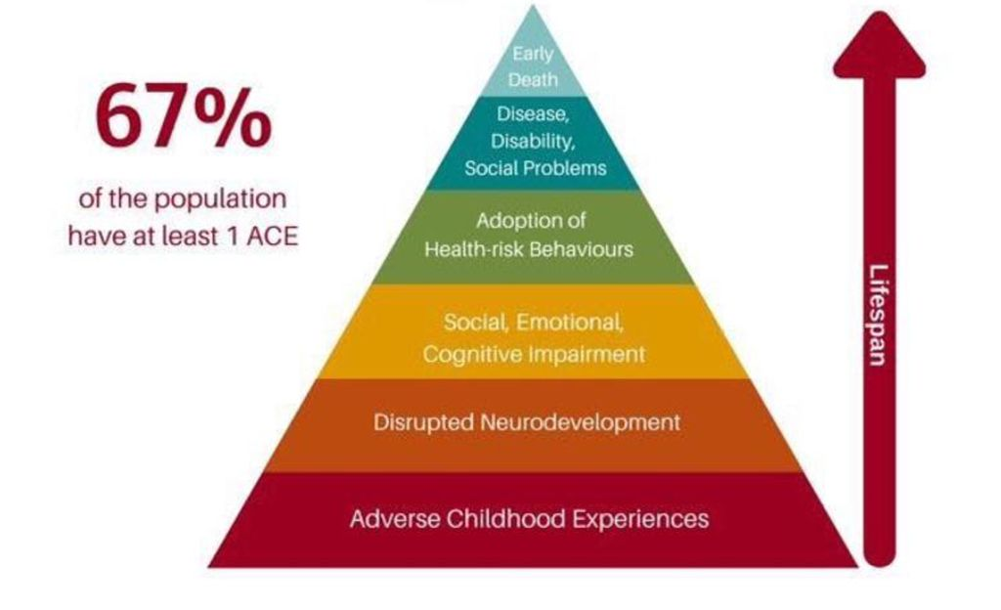
Adverse Childhood Events (ACEs)

Slide 6
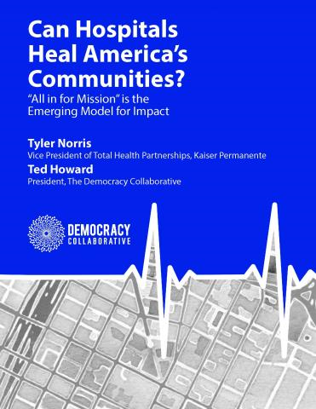
The Anchor Mission
Anchor institution strategy to apply an institution’s
Economic power
Human Capital
For the mutual benefit of both the community and the enterprise
Notes:
By leveraging our business practices around inclusive, local hiring and workforce development, local and diverse sourcing, and place-based investing, we can tackle these underlying causes of poor health by investing in the social and economic well-being of the communities we serve. This means that we apply the Cleveland Clinic’s economic power and human capital to programs or initiatives that mutually benefit the community and ourselves.

Slide 7
HEAL
HIRE
INVEST
Most Vulnerable Populations
Focus on Community Health Needs
Address Root Causes
Increase our caregiver workforce hired from within the City of Cleveland
Invest in programs and partnerships that foster job readiness and create an employee pipeline
Leverage our status as an anchor institution to support local workforce
Local Youth Education to Workforce Development
Job Readiness Programs and Partnerships
Employee Pipeline
Buy local when possible
Partner with community leaders to attract and support businesses
Commit to a community investing plan
Improve local built environments
LEVERS FOR CHANGE
Partnerships, Education, Programs, Advocacy, Funding
Notes:
We use the biennial Community Health Needs Assessment to screen within Cleveland Clinic’s footprint to identify which specific communities have the greatest needs, and what specific needs those are. The CHNA determines the who, where, and what of our Community Health Strategy for the next 2 years. We then think about the how. How can we leverage partnerships with community agencies or business to close those specific gaps for the populations we’ve identified, and what metrics will we use to ensure that these initiatives or programs are successful?
We aim to HEAL our most vulnerable populations, addressing the root causes of suboptimal health outcomes by focusing on specific community health needs, as identified by our Community Health Needs Assessment. We work to connect individuals to social and healthcare resources and identify ways to ensure the increase in closure rates by incorporating services such as patient navigation, community health workers, or integrating healthcare into the community (i.e. Langston Hughes, El Centro). We are focusing on COVID response, distance health access, and collaborating with community partners (such as United Way, Legal Aid, etc) to address social needs. We actively participate in regional efforts around infant and maternal health in collaboration with First Year Cleveland, Better Health Partnerships, community health workers, and other partners. We’re looking at how changing the community’s perception of and access to a healthy diet can affect overall outcomes through prescription food programs and community teaching kitchens.
We aim to HIRE locally by operationalizing workforce development and “hire local” efforts. We leverage signature internships as well as partnerships with school districts, institutions, and other key stakeholders to implement strategic efforts to hire from within the local community.
INVEST refers to operationalizing and demonstrating our investment in the community by buying locally. Through partnerships, we invest in businesses in our local neighborhoods, which improves the economic standing of the community. When we think about HIRE and INVEST, we’re keeping our role as an anchor institution in mind. And with all of these efforts, our levers for change are partnerships, education, strategic programming, advocacy and funding.

Slide 8
Fairfax Community

Slide 9
Current State Fairfax - Home (E. 106th – 93rd Cedar)
Infant mortality and chronic disease
High incidences of crime
70% vacant land and blighted buildings
Increasing unemployment
Declining population
Notes:
We are all aware of the Fairfax community, our neighbors around Main Campus. We know that this community experiences high rates of infant mortality and chronic disease, the population is declining. Simultaneously, we see that lots are going vacant and rates of crime and unemployment are rising. Our neighbors are suffering economically, socially, and of course in terms of healthcare access. For this reason, Fairfax and communities like it are the primary focus of the Community Health Strategy.

Slide 10
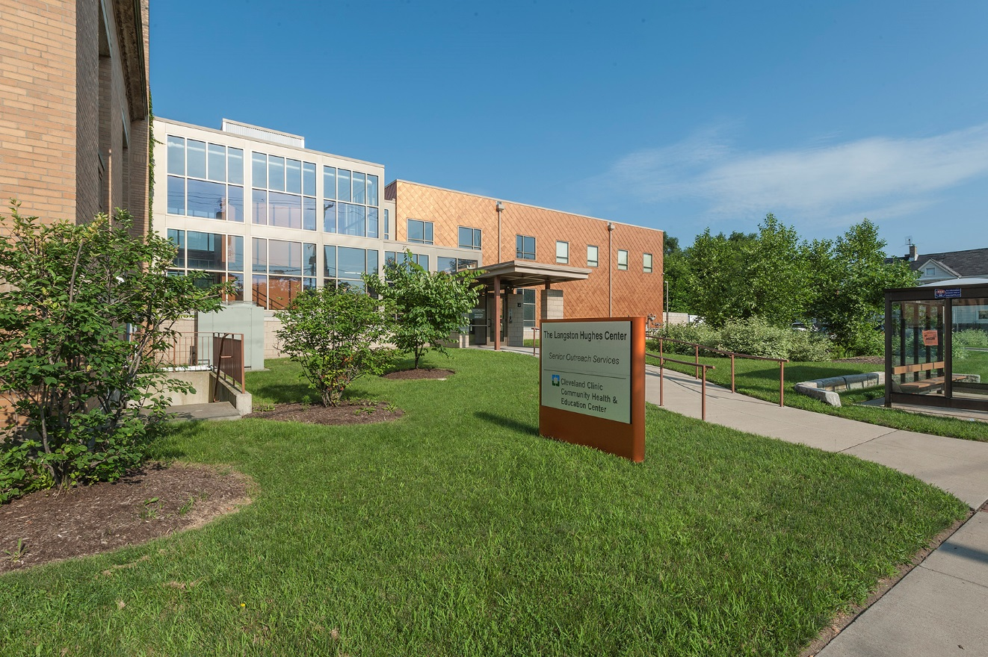
Langston Hughes
Community Center
Notes:
HEAL – One of the most well-known successes of our work in the Fairfax community is the Langston Hughes Community Center, where residents can access primary care, navigation services, a teaching kitchen, a prescription gym, and other resources to address their needs across the lifespan. During the pandemic, LH has also served as an essential COVID vaccination site for the community.

Slide 11
Green Space
Notes:
We’re thinking about how to re-envision those empty lots, providing green space for all ages to play, exercise, recharge, and come together as a community.

Slide 12
Hire & Invest Initiatives
E. 100th Street Healthy Communities Initiative
Youth education to workforce development
Pipeline/Pathways programs across the regions
Warrensville Heights Student Pathways
Goodyear program collaboration with Akron General and Akron Public Schools
Anchor Initiatives
Minimum wage, Evergreen coop initiative
OneTen coalition
Supplier Diversity program
Meijer grocery store and housing project
Digital C broadband services
Tree canopy and reducing carbon footprint
Notes:
Additional Hire and Invest strategies include our workforce development programs and partnerships with local businesses to supply or provide necessary services to keep our enterprise functioning. One example is our partnership Evergreen Cooperative Laundry. For those who are unfamiliar, the Evergreen Cooperatives of Cleveland allow local residents to earn an ownership stake as they build their businesses, and they partner with University Circle anchor institutions to create green jobs that drive economic stability in neighboring communities. Evergreen Cooperative Laundry is one of the few commercial laundry operators headquartered in the City of Cleveland, offering a cost-effective and green option for clients in the hotel, hospital and nursing home industries. Cleveland Clinic is proud to do business with them!

Slide 13
Community Investment Approach
Innovation Square - approved $6M investment and $150K predevelopment loans
 | Proposed 10-year Strategy and Targets | Pilot Model: Year 1
Overview | Create $100M place-based investment portfolio to invest over 10 years Prioritize investments in Community Health Strategy priority areas (e.g., Built Environment) Collaborate with and leverage the resources of other key partners for greater impact | Year 1 recommended investments (~$10M) Innovation Square $6M, 80 units of mixed-income housing $1M, equity in healthy food access & job creation and business attraction Greater University Circle $1.5M, deposit to Urban League/JumpStart to support small and minority business development loans and diversity of workforce in construction $1M, targeted for projects that improve the environment $500K, targeted for projects that improve access and affordability to broadband internet
Notes:
Innovation Square is a strategic investment project that targets and catalyzes real estate development in the Fairfax neighborhood.

Slide 14
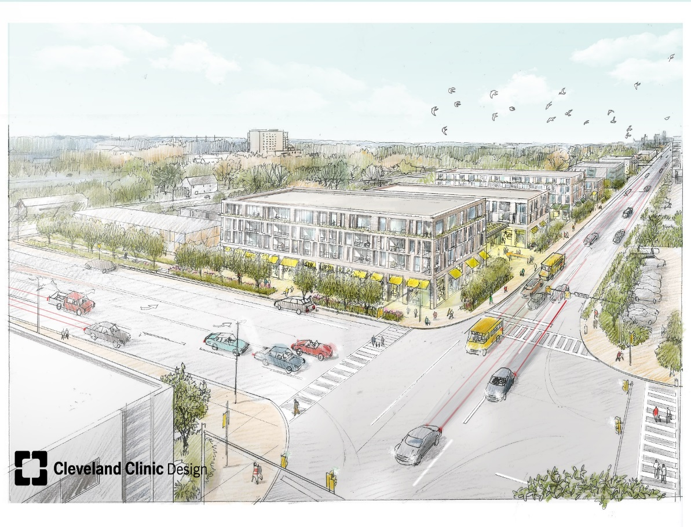
Innovation Square
80 unit mixed-income building
Meijer Grocery Store
GCIC
Bio-repository
IBM
Retail, Office
Community Park
500 housing units
Notes:
The project is designed to provide new, improved, and varied housing options to expand the residential population and bring new employment and cultural opportunities to the neighborhood. Reinvestment in arts and civic amenities will help fuel community pride, starting with green space. And neighborhood-serving retail will enhance economic stability on main street blocks.

Slide 15
Lead Poisoning: A Replicable Model?

Slide 16
Problem
Ohio has the 3rd highest percentage of children <6 years with elevated blood levels of lead (EBLL)
41% of Ohio kids with EBLL in Cuyahoga County
Effects are irreversible
Notes:
Is Cleveland in a lead crisis? The answer is YES! We know that Ohio has the 3rd highest percentage of elevated blood lead levels in the country, and that 41% of those children live in Cuyahoga County. Of 13,030 patients tested in the county, 1,218 confirmed cases were from the City of Cleveland.

Slide 17
Housing Issue
80% of Ohio’s lead poisoning cases result from lead-contaminated dust created by deteriorating lead-based paint in houses built before 1978
Nearly 90% of Cleveland housing stock built before 1978
Notes:
Where is all this lead coming from? We know that 80% of Ohio’s lead poisoning cases are related to our housing stock. Lead-contaminated dust from deteriorating paint in homes built before 1978 is the leading cause of lead poisoning, and nearly 90% of Cleveland’s housing stock was built before 1978!
Of note, Cleveland and Cuyahoga County actually have very good water supply. Tap water contamination is less likely in our area but still a consideration in homes that may have lead pipes, and I would still recommend counseling around safe water usage (which we will get to in a moment).

Slide 18
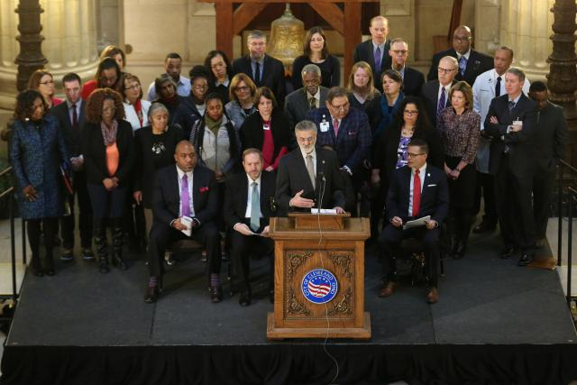
Partners

Slide 19
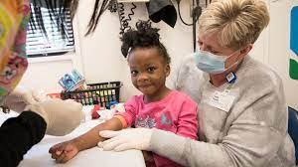
Interventions
Lead Safe Home Fund
HB 587
Testing in childcare centers
Lead Monitoring Program

Slide 20
Key Takeaways
Partnerships for policy change
Local residents
Community-facing agencies
Content experts
Partnerships for reaching those at risk
Trusted members/agencies of community
Experts in service delivery
Community health workers

Slide 21
Childhood Hunger
In the US, 9M food insecure children
In Ohio, 1.3M people are hungry
386,000 or 1 in 7 children are hungry
40.3% of households receiving SNAP benefits have children
Cuyahoga county had highest food insecurity rates in the state
59% live in food deserts

Slide 22
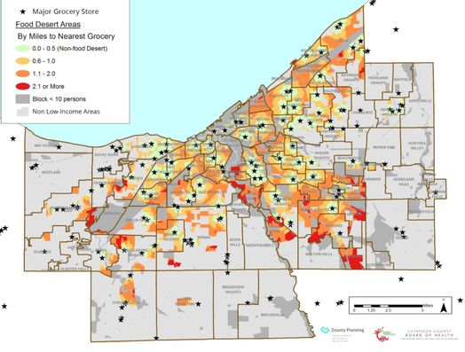
Childhood Hunger

Slide 23
Food as Medicine
Universal Screening
School backpack programs
Instacart, Meijer, Dave’s partnerships
Food pharmacies
Teaching kitchen
Join local collaborative

Slide 24
Infant Mortality
Cuyahoga County
Consistently among the worst infant mortality rates (IMR) in the nation for 50+ years
2015 IMR was 10.5, 3x the national average
City of Cleveland
2018 IMR for black babies was 17.5, white babies was 3.0

Slide 25
Infant Mortality
Clinical opportunities
Centering Pregnancy and Parenting programs
Breastfeeding Medicine
CHW pilot with Birthing Beautiful Communities
Expanding OB access in high need communities
Quality improvement around high risk OB patients
Community baby showers
Legislative advocacy
Join local collaboratives

Slide 26
Other Considerations

Slide 27
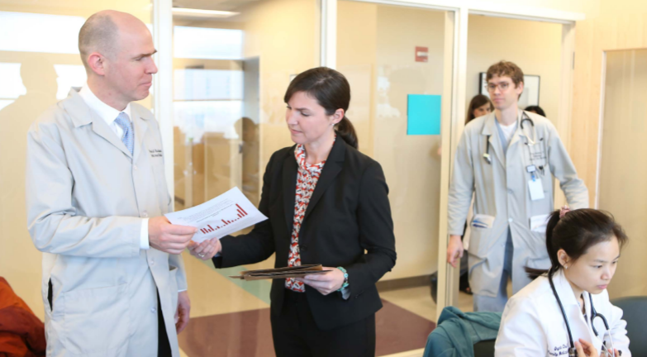
Medical-Legal Partnership
Remove legal barriers to health
Educate multi-disciplinary teams
Engage in collaborative and cross disciplinary community legal education, outreach and advocacy

Slide 28
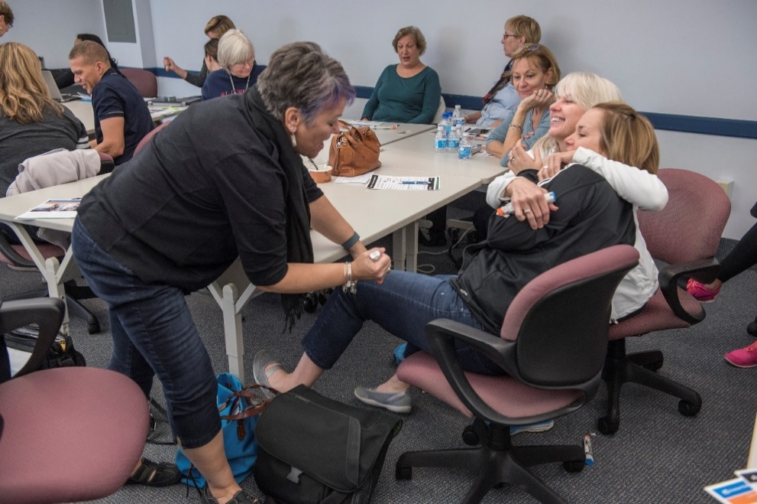

School-Based Health
WCC (aka yearly or sports physical)
Acute illness care
Chronic condition followup
Mental health
Virtual Care
Community Services

Slide 29
Workforce Development
“Opportunity youth”
High School Internships
Science, Louis Stokes, Discovery Accelerator, Student Pathways
College Internships
All Akron Student Engineering Program
Certification Programs
Kent State CHW certification program

