Slide 1
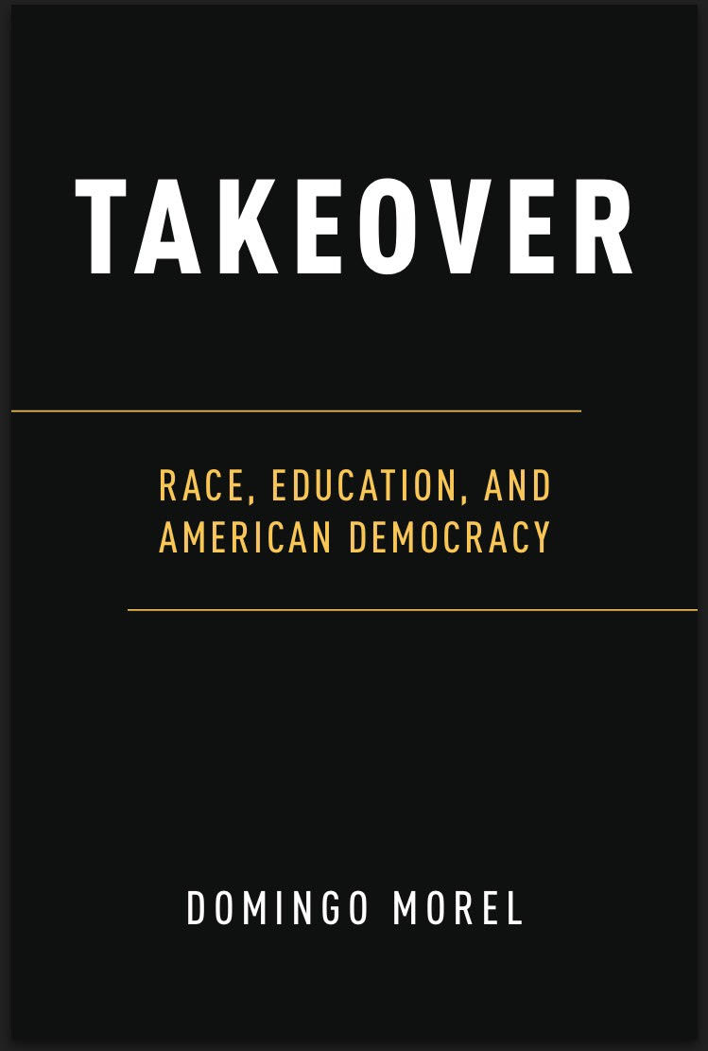

Slide 2
State Takeovers of Local School Districts
A takeover is when “the state legislature, the state board of education or a federal court charges the state department of education or another designated entity, such as a mayor, with managing a school district” (Zeibarth 2002).
First state takeover of a school district was in 1989 (Jersey City Schools, NJ)
Since then, there have been over 100 state takeovers of local school districts in 22 states.

Slide 3
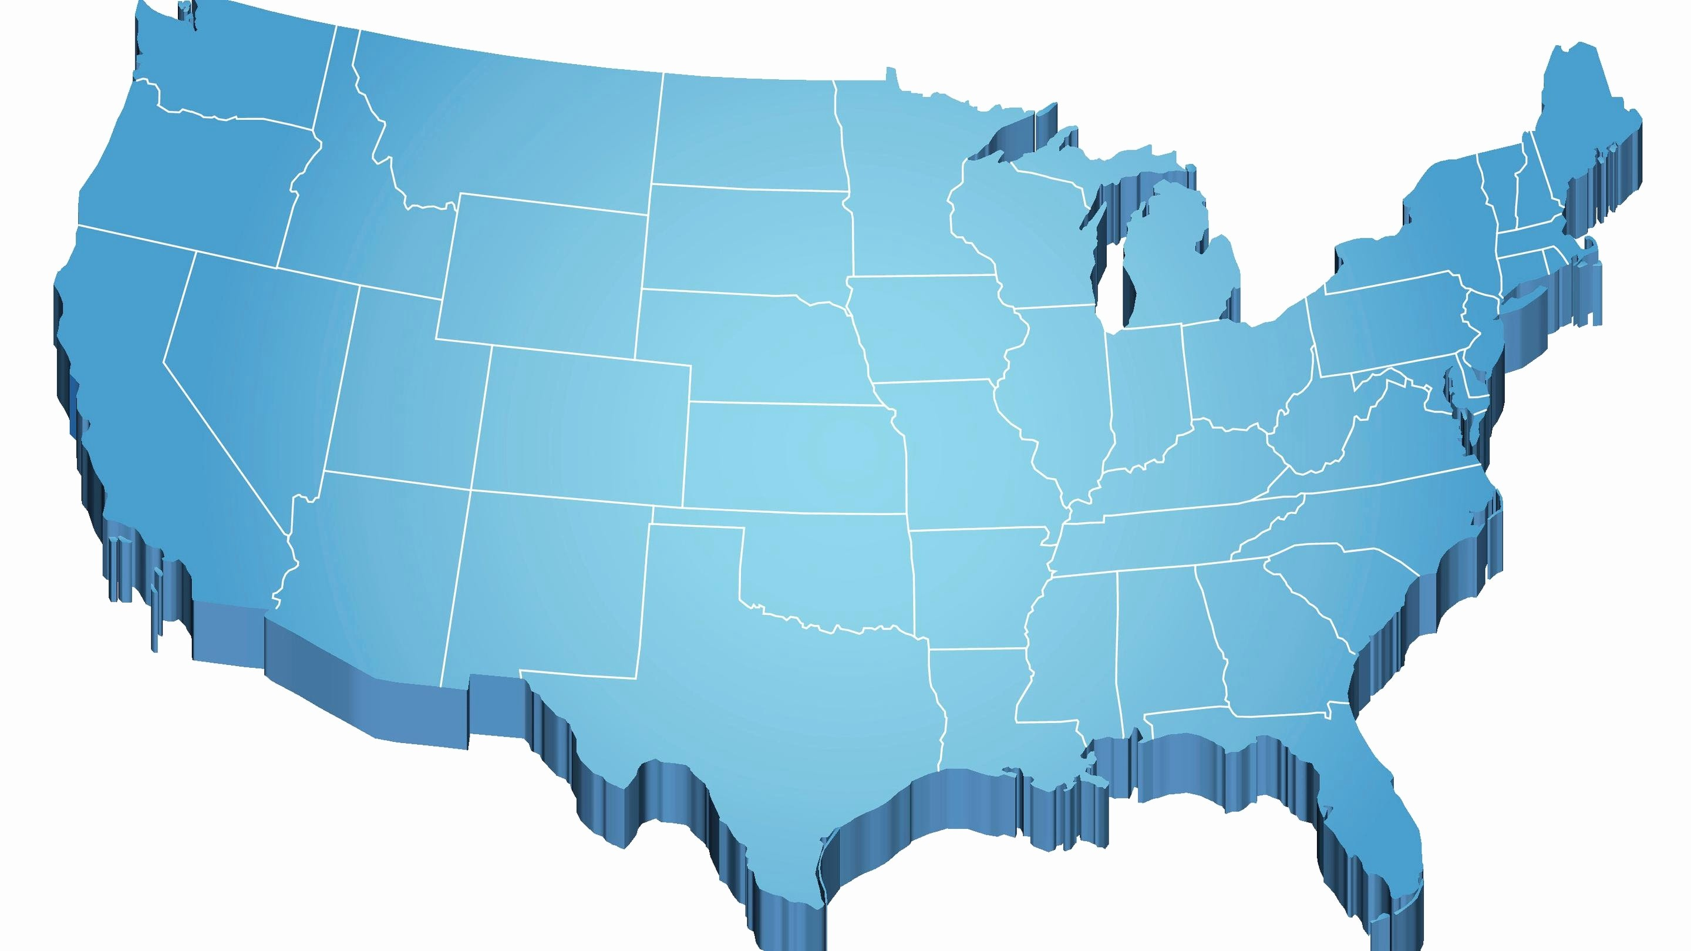
State Takeovers of Local School Districts, Selected Cities
Detroit 1999
New York City 2002
Boston 1991
Chicago 1995
Oakland 2003
St. Louis 2008
Newark 1995
Cleveland 2003
Philadelphia 2001
Compton 1993
Washington DC 1995
Baltimore 1997
New Orleans 2003

Slide 4
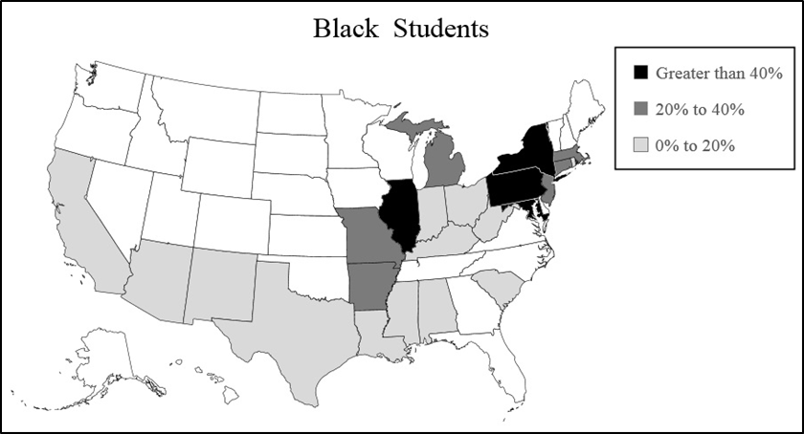
Percent of States’ Black Public School Students in School Districts that are, or have been, under State Control as of 2010
Notes:
Maryland, 60%; Illinois and Pennsylvania 50%; Arkansas 40%; CT and MI roughly one-third.

Slide 5
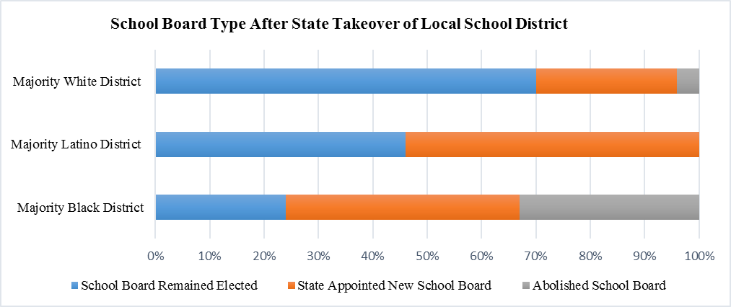
Type of School Board Following a Takeover

Slide 6
Research Questions
Why take over?
Why do state takeovers disproportionately affect Black communities?
Additionally, why do Black communities disproportionately experience the most punitive forms of a state takeover?

Slide 7
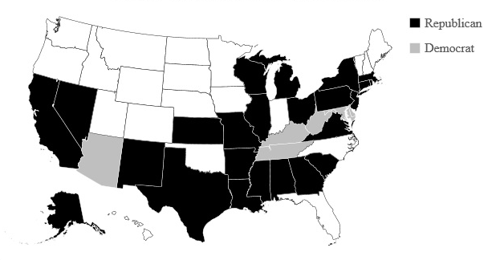
Party of Governor when States Passed Takeover Laws (as of 2015)

Slide 8
Research Questions
Why would Republican state officials take the lead in proposing state takeover laws, and initiating state takeovers of local school districts, when the ideological and conservative principles would suggest an approach that favors local control, rather than state centralization?

Slide 9


Slide 10
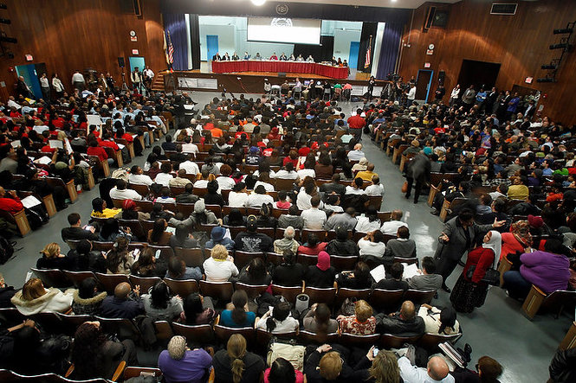

Slide 11


Slide 12
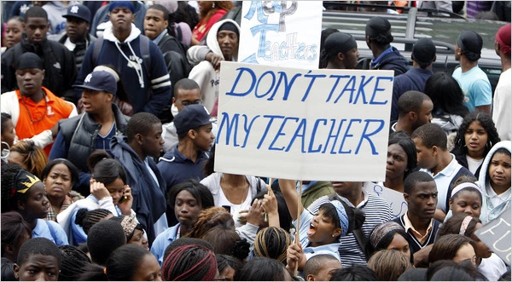

Slide 13
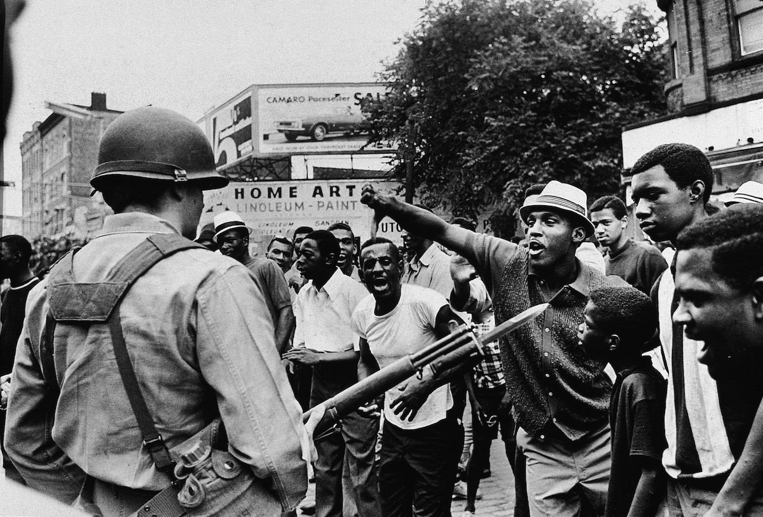

Slide 14
Governor's Select Commission on Civil Disorders
The report attributed the controversial school board appointment as one of the factors that “helped set the stage for the July riot.”
In addition to referencing lack of representation on the school board as a key factor, the report also cited the “state of educational crisis” in the Newark public schools.
The dropout rate was at 32%
Dilapidated buildings and shortage of teaching personnel
By the mid-1960s the Newark public schools did not have the physical space to educate every Newark student.

Slide 16
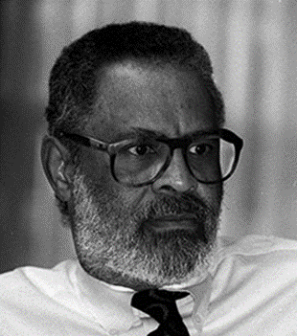

Collision Between NJ Cities and State Government
Newark Superintendent Eugene Campbell, “28 districts would be receiving a significant increase in funds. The children of New Jersey stand to benefit by this change in funding to school districts in need.”
John Dorsey, the Republican senate minority leader from Morris, one of the wealthier districts in New Jersey, stated that the new funding formula required “working class people in middle class communities who drive around in Fords to buy Mercedes for people in the poorest cities because they don’t have cars.”

Slide 20
The “Education Governors”
By the 1980s, governors assume greater authority over local schools
At the 1986 annual meeting of the National Governors Association, the governors announced a plan that would be part of a “second wave of reform in American public education” and introduced the policy of “state takeovers of districts that failed to meet toughened minimum standards.”

Slide 21
Party of Governor when States Passed Takeover Laws (as of 2015)

Slide 22
School Funding Plaintiff Victories, 1980-2000
State | Year of Plaintiff Victories in Courts | Year of takeover law
Alabama | 1993 | 1995
Alaska | 1999 | 2003
Arizona | 1994 | 2008
Arkansas | 1983 (2002)* | 2004
Connecticut | 1996 | 1997
Kentucky | 1989 | 1993
Massachusetts | 1993 | 1993
Missouri | 1993 (2005)* | 2007
Montana | 1989 | No Takeover Law
New Jersey | 1985, 1990 | 1989
New Mexico | 1999 | 2002
North Dakota | 1994 | No Takeover Law
Ohio | 1997 | 1998
Tennessee | 1993 | 2004
Texas | 1989 | 1995
Vermont | 1997 | No Takeover Law
West Virginia | 1984 | 1992
Wyoming | 1980 | No Takeover Law

Slide 23
Data
Original Dataset of Universe of State Takeovers
Years: 1991-2006
Primarily Relying on:
Education Commission of the States
US Census
Joint Center for Political and Economic Studies’ National Roster of Black Elected Officials
National Association of Latino Elected and Appointed Officials’ (NALEO) Directory of Latino Elected Officials
U.S. Department of Education’s National Center for Education Statistics (NCES) Common Core of Data (CCD)
Dependent Variable:
Takeover (0,1)
Method:
Logistic Regression
N
# of Districts: 988

Slide 24
Independent Variables
Empowerment Variables Black Mayor (0,1) Latino Mayor (0,1) Black Seats on City Council (%) Latino Seats on City Council (%)
Control Variables City Population City Black % of Population City Latino % of Population City White % of Population School District Total Population District Black % of Population District Latino % of Population District White % of Population School District Local Revenue School District State Revenue School District Federal Revenue District % Free Lunch

Slide 25
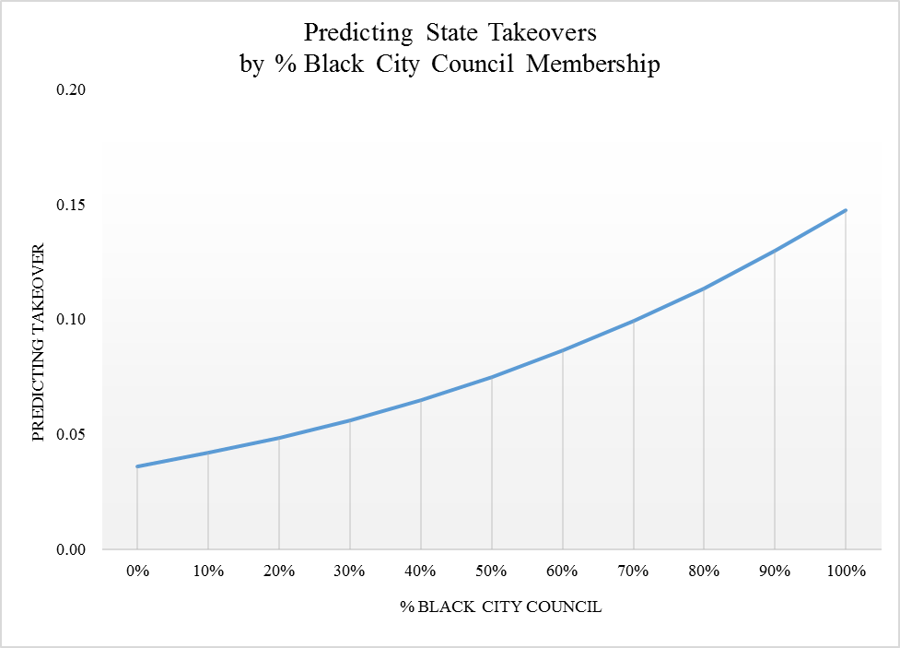

Slide 26
Implications
States began to take over school districts precisely at a moment when school districts were beginning to get the resources that communities demanded.
The emergence of state takeovers in the 1980s and 1990s represents a shift from the idea of the undeserving Black student – an idea systematically challenged in the 1950s and 1960s – to a focus on the undeserving stewards of the education of Black children.
The political collision between state governments and urban communities that create the conditions for a takeover, are incapable of producing the collaborative environment that is necessary for sustainable school improvement.
The systematic political disempowerment of Black communities through the state takeover of local school districts show how education is central to the project of state-sanctioned political inequality.

Slide 27
Thank You!

Slide 28
Policy Discussion
Asserting greater levels of local control is an important and necessary aspect of democratizing the process of education. In addition, local democracy can be promoted by increasing the role of the federal government in the public schools.
Local control can be bolstered by a more robust federal presence in public education in three key areas:
1)Funding
2)Establishing stronger links between the federal government and cities
3)Providing equal rights protections to communities of color that are politically marginalized by the actions of state governments.

