Slide 1
Let’s Step Back Together
National Press Foundation
May 8, 2023 - Cleveland, Ohio
Fred Wulczyn, Ph.D
Director, Center for State Child Welfare Data
Chapin Hall
University of Chicago

Slide 2
Recognize This Story?
50,000 to Under 7,000
1996 to 2023
Change in the NYC foster care population

Slide 3
4.5 Million
For the past 40 years, states have trusted me with the records they keep pertaining to foster care children
We started with no one - today the archive represents the records of 4.5 million children and young people who lived away from their parents for some period in their life
It is, as best we can assemble, a record of their lived experience with the foster care system
I study their time in care, in some way, almost every day
I want to share what I have learned in the last few years, now that the archive of their stories has reached its own age of maturity

Slide 4
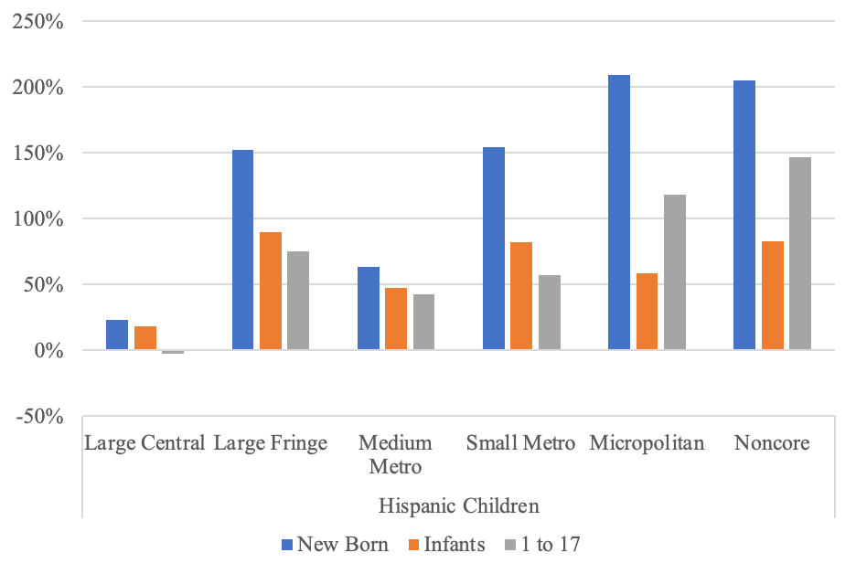
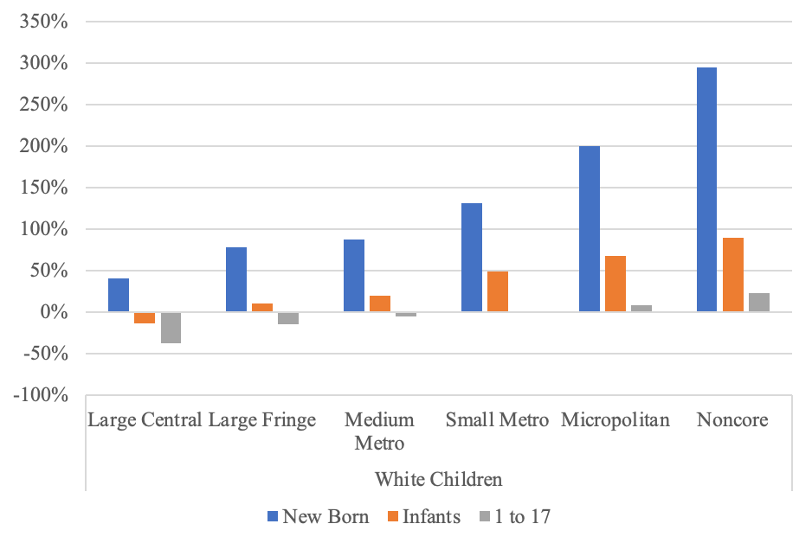
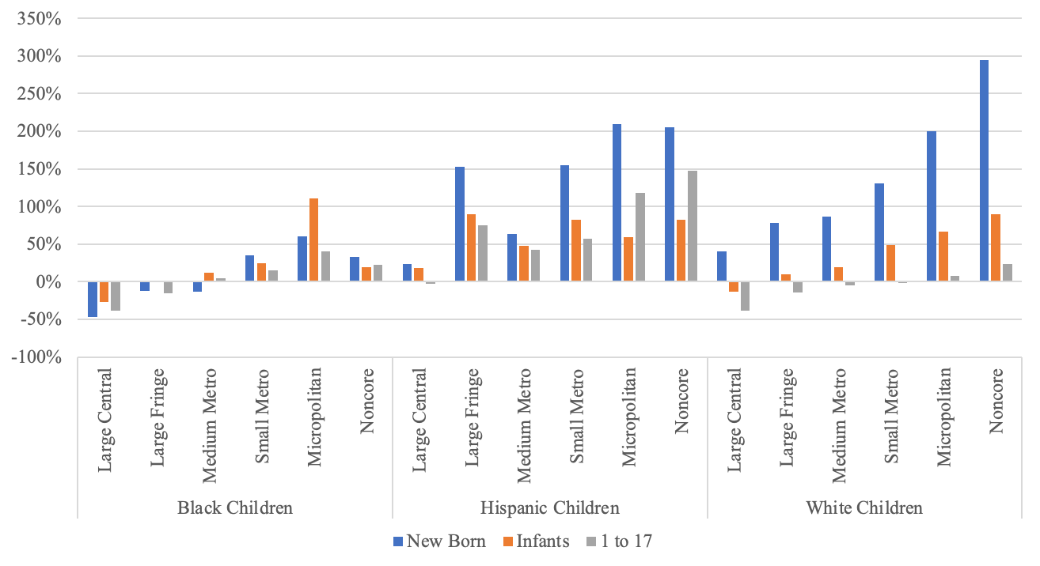
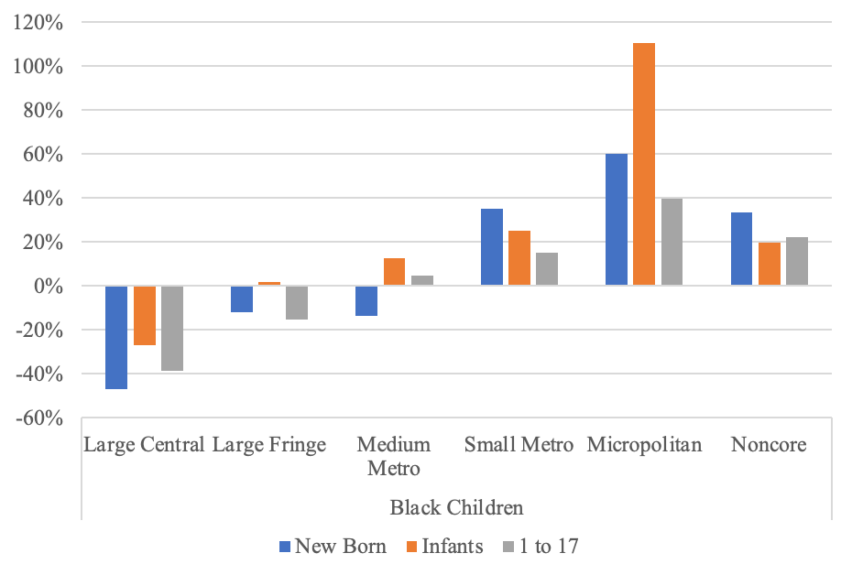
Tell Us About Yourself

Slide 5
What Can You Tell Me About Where You Are From
Poverty is important to what we say about where foster care is most common
I am speaking today about counties and what can be said about counties as contexts where foster care may be more common
  Poverty has changed since 2000
  How has that change affected the geography of foster care?
  Should we expect to find more foster care being used where poverty rates are higher?
  Should we expect the same answer whether we are talking about Black poverty and White poverty?

Slide 6
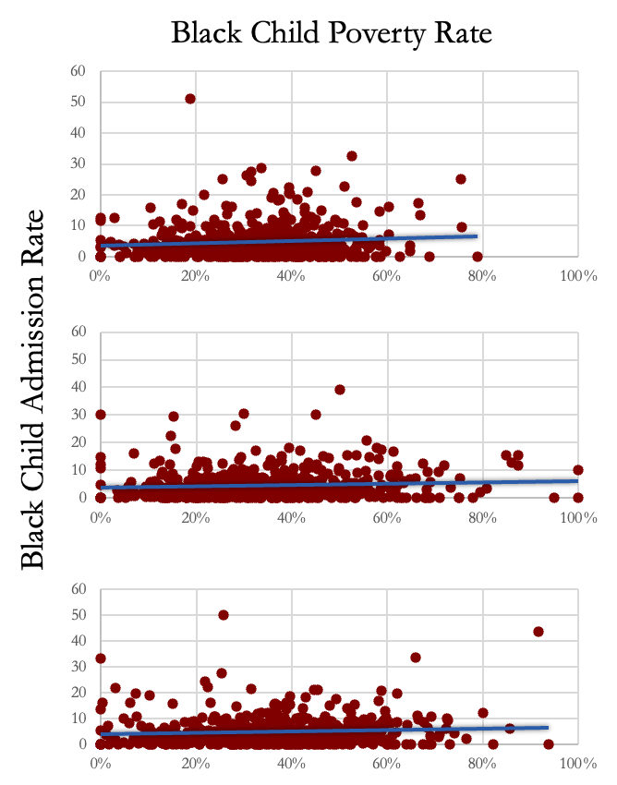
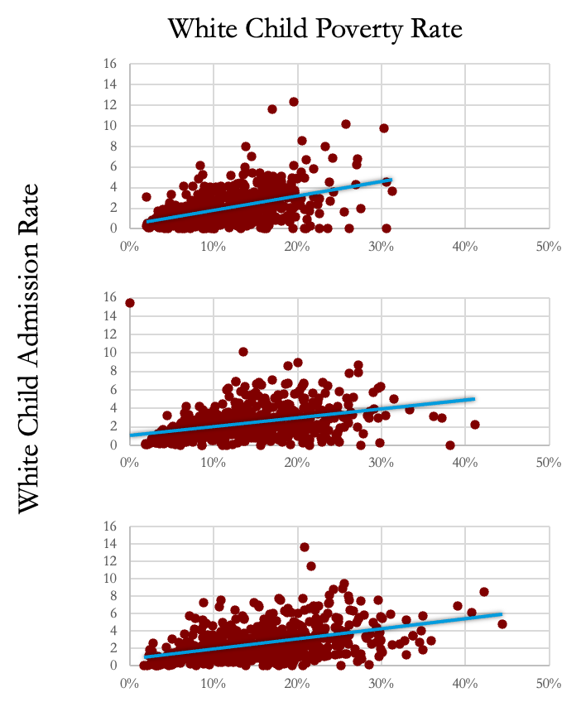

Poverty, Placement, and Change Over Time

Slide 7
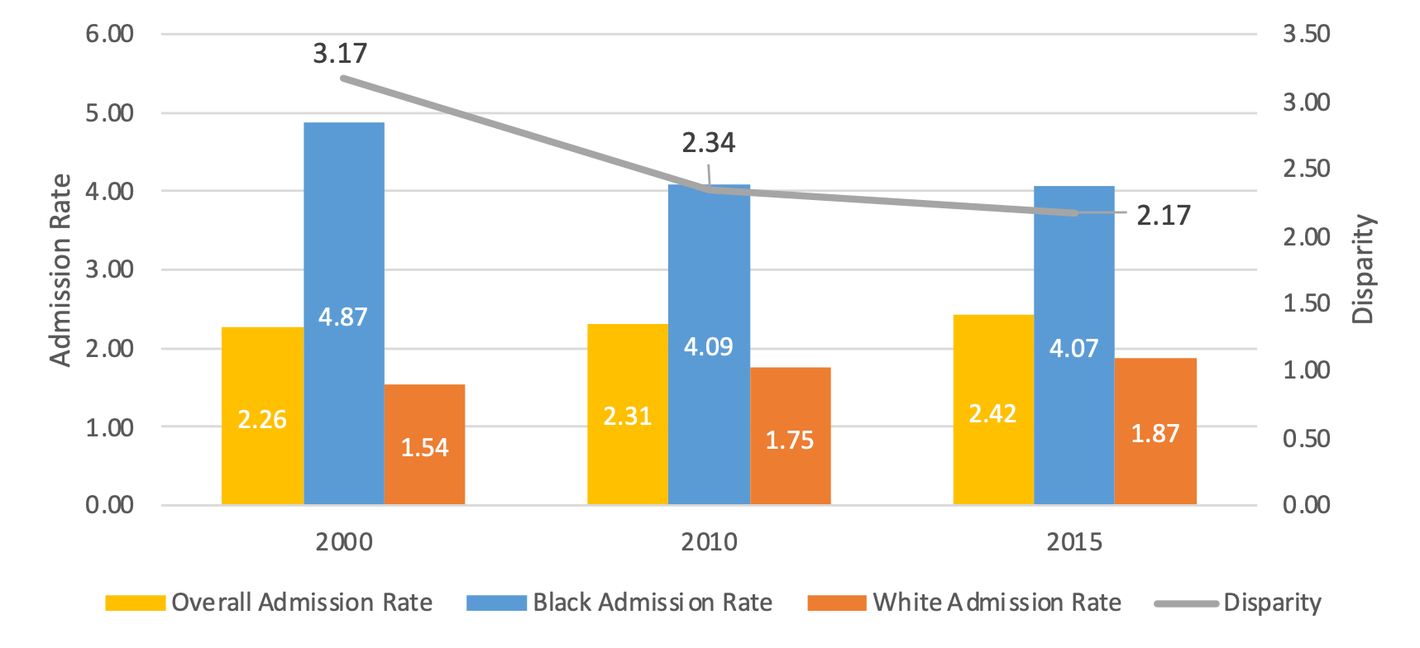
What Can You Tell Us About Disparity?
In the midst of all this change, how have racial differences changed if at all

Slide 8
Lets Talk More About Where You Are From
How much did the changes in poverty affect placement rates?
At the county level, we want to acknowledge the fact that Black families and White families (not to mention all the other families) live together in the same general area
Their presence is part of where they live
We should ask how often we use foster care in places where White poverty rates are elevated and vice versa - for both Black and White children

Slide 9
Where is Placement Most Common and for Whom?
Placement is more common in counties where poverty is more common
As poverty increases so too does the placement rate
Black children are more likely to spend some time in foster care than White children but that is not true everywhere and poverty is one of the reasons why
When you look at counties you see a wide diversity of people and places
In places where White child poverty increased, both Black and White child placement become more common than seen previously seen
In places where Black child poverty increased, placement frequency for Black and White children increased but less so than the impact of White poverty
Notes:
These individual county narratives are important pieces of the picture we use to see the system as a whole

Slide 10
How Long Were You in Care?
This is a complicated story
  Age matters - when foster care happens says a lot
    Did you grow up in foster care?
      No, this is rare
    Did you spend what’s left of your childhood in foster care given when you entered care?
      Not likely, though it depends on a child’s age at first admission
        If you entered care for the first time before turning age 14, it has become less likely
        It has become more likely among older teens entering care for the first time
    Among all children, the children who will have spent the largest share of their childhood in foster care are the children who enter care as babies

Slide 11
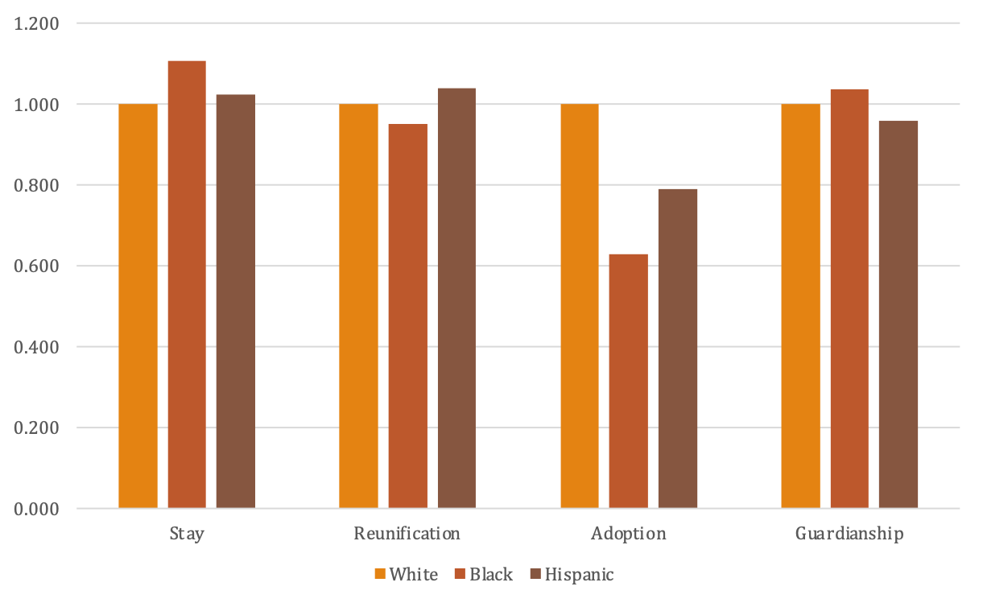
What About Race and Ethnicity?
Do Some Children Spend More in Foster Care Than Other
The difference in how long Black children spend in care as compared to White children is not what it once was
  In a number of states, time in foster care for Black children is shorter than it is for White children
  The answer depends whether we are talking about reunification, adoption, and guardianship

Slide 12
How Much Do We Spend on Foster Care?
Another hard question - depends on the cost of group care
  Infants use family care so we don’t have to account for the cost of group care
  Most cost estimates focus on the cost of a day of care
  I am going to take population view - how much do we spend here vs. there
Per capita spending
  $1.3 million on the low side
  $2.9 million on the high side
How does this align with poverty?
  As poverty disparity goes down spending goes up

