Slide 1
Pediatric and Adolescent Long-COVID: An Epidemic in our Midst
Presenters:
Dr. Amy Edwards, MD
Director, Rainbow Pediatric Long-Haul Recovery Clinic
Dr. David W. Miller, MD, LAc,
Director of Pediatric Integrative Medicine, UH Connor Whole Health
Co-Director, Rainbow Pediatric Long-Haul Recovery Clinic
Medical Director, Family and Child Life Services
May 8, 2023

Slide 2
Disclosures
None

Slide 3
Objectives
Understand what currently defines “Long-Covid”
Recognize the prevalence and impact of long-Covid in the pediatric population.
Identify the most common presenting complaints and how to identify individuals who may have long-Covid.
Explore gaps in understanding on long-Covid and help correct this through targeted story telling.

Slide 4
Names for Long-Covid
Long-Covid
long-haulers
COVID-long haul
post-acute sequelae of COVID-19 (PASC)
post-COVID
COVID syndrome

Slide 5
What is Long-Covid
Long-COVID is a heterogeneous multisystemic condition for which there is still no precise definition and includes signs and symptoms that persist, develop, or fluctuate after SARS-CoV-2 infection.
LONG COVID IS A SYMPTOM CLUSTER DEVELOPING SHORTLY AFTER OR PERSISTING CONTINUALLY FROM A KNOWN OR REASONABLY SUSPECTED CASE OF COVID-19.
Long Covid is not one-thing – it is a cluster of symptoms
Lopez-Leon, S., Wegman-Ostrosky, T., Ayuzo del Valle, N.C. et al. Long-COVID in children and adolescents: a systematic review and meta-analyses. Sci Rep 12, 9950 (2022). https://doi.org/10.1038/s41598-022-13495-5

Slide 6
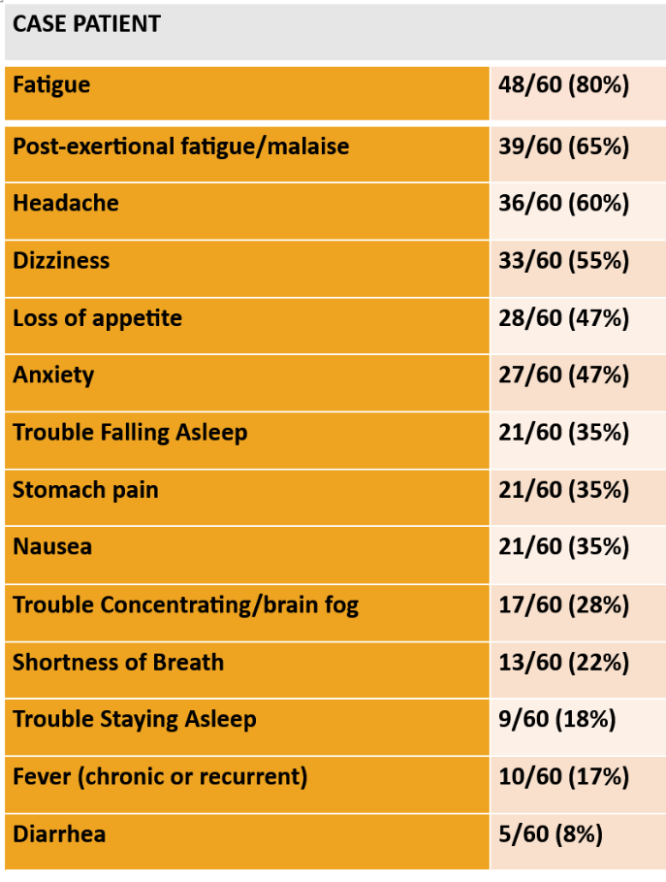
Symptom Review – 1st 60 patients at RBC
Fatigue | 48/60 (80%)
Post-exertional fatigue/malaise | 39/60 (65%)
Headache | 36/60 (60%)
Dizziness | 33/60 (55%)
Loss of appetite | 28/60 (47%)
Anxiety | 27/60 (47%)
Anosmia/parosmia | 23/60 (38%)
Dysgeusia | 23/60 (38%)
Trouble Falling Asleep | 21/60 (35%)
Stomach pain | 21/60 (35%)
Nausea | 21/60 (35%)
Trouble Concentrating/brain fog | 17/60 (28%)
Trouble Waking Up | 16/60 (27%)
Limb pain/Pain syndrome | 16/60 (27%)
Mood instability | 14/60 (23%)
Shortness of Breath | 13/60 (22%)
Trouble Staying Asleep | 9/60 (18%)
Fever (chronic or recurrent)2 | 10/60 (17%)
Chest pain | 9/60 (15%)
Weight Loss | 9/60 (15%)
Loss of Limb Function (lost ability to walk) | 8/60 (13%)
Depression | 8/60 (13%)
Cold Intolerance | 6/60 (10%)
Diarrhea | 5/60 (8%)
Weight Gain | 4/60 (7%)
Vomiting | 3/60 (5%)
Constipation | 3/60 (5%)
Rash | 2/60 (3%)
Tics | 2/60 (3%)
These patients are complex and take a lot of work! We need resources to treat them. We need investment in interprofessional communication, research, funding of primary clinical care.
National Long COVID Conference on October 3^{rd,} 2o22 Long COVID Project
National Center for Health Research 1001 Connecticut Ave, Suite 1100 Washington, DC 20036 www.center4research.org

Slide 7
Number of symptoms at time of presentation
Multiple symptoms create complexity beyond the skills of virtually all individual doctors.
This creates doubt and difficulty in recognition.
Graph 1. Distribution of patients and the number of symptoms they present with at the time of first presentation to the Pediatric COVID Recovery Clinic.

Slide 8
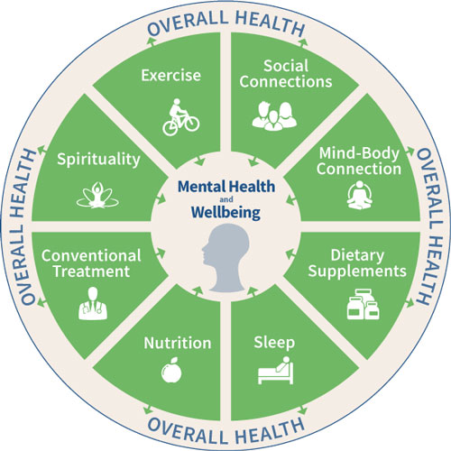
Pediatric Long-Haul Covid – The Quintessential Integrative Medicine Condition
https://www.stanfordchildrens.org/en/pediatric-associates/integrative-medicine

Slide 9
Patient Appearance
There are thousands of compelling patient stories that have not been told.
They frequently appear in such a way that the given diagnosis is only ‘anxiety’. Proper questions are not being asked to reveal the condition.
They receive EXTREMELY variable treatment in ER’s.
The complex relationship of ERs with Long-Covid patients would be a great story.
Neither doctor seemed to know what long haul covid was. One asked us if it means you cough a lot. Literally NO IDEA what it is and said they'd never even heard of it. That was disturbing. - clinic patient’s parent

Slide 10
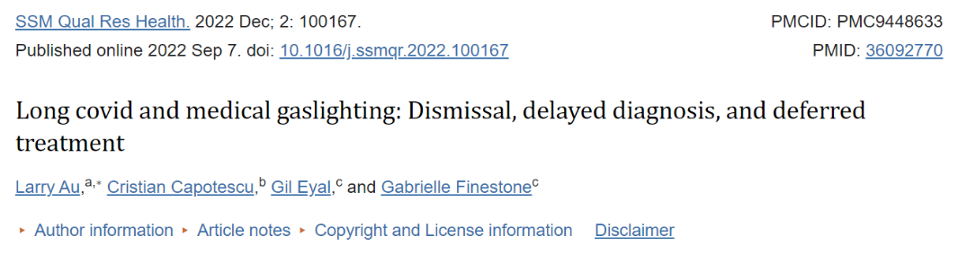

Where do Doctor’s Stand in their Beliefs around L-C?

Slide 11


These symptoms must last 4-12 weeks after infection
In October 2021, the WHO proposed a clinical definition for post-COVID-19 through a Delphi consensus stating it generally occurs three months from the onset of COVID-19, with symptoms lasting at least two months and cannot be explained by an alternative diagnosis⁶.
On February 2nd, 2022, the National Institute for Health and Care Excellence (NICE) published a guideline defining long-COVID as signs and symptoms that continue or develop after acute COVID‑19. This includes ongoing symptomatic COVID-19 (from 4 to 12 weeks) and post‑COVID-19 syndrome (12 weeks or more)⁷. Other organizations, such as the National Institutes of Health (N.I.H.), also define long-COVID as post-acute symptoms after 4 weeks⁸.
Generally occurs – this is a work in progress. Active call:
The Online Public Comment Portal is now open until June 12, 2023
https://www.nationalacademies.org/our-work/examining-the-working-definition-for-long-covid

Slide 12
Patient Concerns
Philanthropic Opportunity for Impact is great
Isolation
School accommodations
Social disruption
Suicidality
Failure
Being disbelieved
Not having a medical system that recognizes their condition
Dating
Work and College – needing to PACE!!

Slide 13
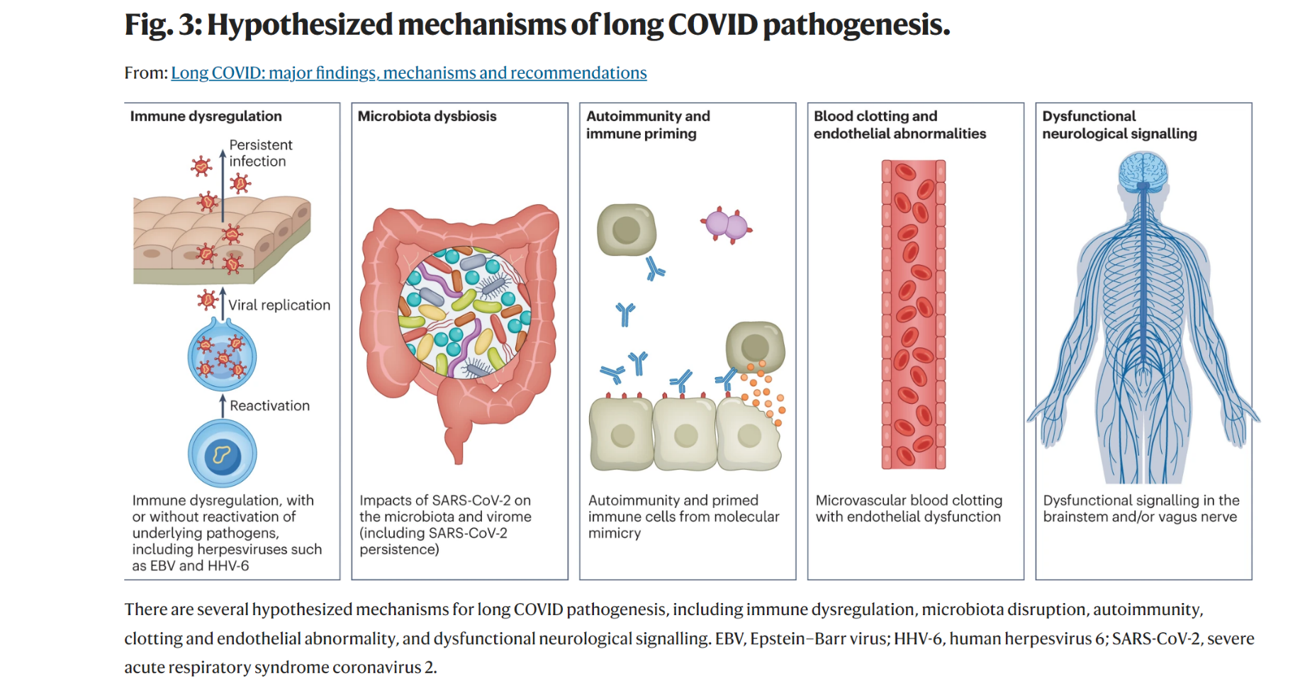
Davis, H.E., McCorkell, L., Vogel, J.M. et al. Long COVID: major findings, mechanisms and recommendations. Nat Rev Microbiol 21, 133–146 (2023). https://doi.org/10.1038/s41579-022-00846-2
Long COVID: major findings, mechanisms and recommendations

Slide 14
How Common? - variable reporting and definitions, issues with testing, changing virus, pre/post-vaccine
The incidence of at least 1 systemic, syndromic, or medication feature of PASC was 41.9% (95% CI, 41.4-42.4) among viral test-positive children vs 38.2% (95% CI, 38.1-38.4) among viral test-negative children¹
The literature search yielded 8373 publications, of which 21 studies met the inclusion criteria, and a total of 80,071 children and adolescents were included. The prevalence of long-COVID was 25.24%, and the most prevalent clinical manifestations were mood symptoms (16.50%), fatigue (9.66%), and sleep disorders (8.42%).²
The prevalence of long COVID symptoms varied considerably between studies from 4 to 66%.³
Adult Data: The incidence is estimated at 10–30% of non-hospitalized cases, 50–70% of hospitalized cases and 10–12% of vaccinated cases⁴
¹Rao S, Lee GM, Razzaghi H, Lorman V, Mejias A, Pajor NM, Thacker D, Webb R, Dickinson K, Bailey LC, Jhaveri R, Christakis DA, Bennett TD, Chen Y, Forrest CB. Clinical Features and Burden of Postacute Sequelae of SARS-CoV-2 Infection in Children and Adolescents. JAMA Pediatr. 2022 Oct 1;176(10):1000-1009. doi: 10.1001/jamapediatrics.2022.2800. PMID: 35994282; PMCID: PMC9396470.
²Lopez-Leon, S., Wegman-Ostrosky, T., Ayuzo del Valle, N.C. et al. Long-COVID in children and adolescents: a systematic review and meta-analyses. Sci Rep 12, 9950 (2022). https://doi.org/10.1038/s41598-022-13495-5
³Zimmermann P, Pittet LF, Curtis N. How Common is Long COVID in Children and Adolescents? Pediatr Infect Dis J. 2021 Dec 1;40(12):e482-e487. doi: 10.1097/INF.0000000000003328. PMID: 34870392; PMCID: PMC8575095.
⁴Davis, H.E., McCorkell, L., Vogel, J.M. et al. Long COVID: major findings, mechanisms and recommendations. Nat Rev Microbiol 21, 133–146 (2023). https://doi.org/10.1038/s41579-022-00846-2

Slide 15
What role does the vaccine play in COVID long-haul?
While there is no published data to this effect, we know anecdotally that about 30-40% of patients will report improvement in symptoms after COVID vaccination
Somewhere around 10-15% of long-haulers report worsening of symptoms after vaccination
While there have been case reports of breakthrough cases leading to COVID long-haul, early data out of the UK indicates that the vaccine may cut the risk of COVID long-haul by as much as 47%
Source – Amy Edwards, MD
Infectious Disease, RBC

Slide 16
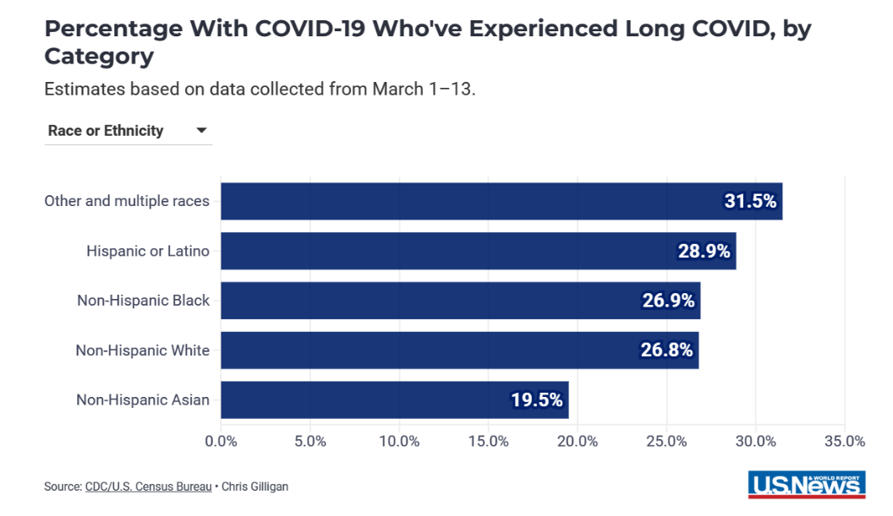
Who Gets Long COVID? (hint: we don’t know)
Unpublished data from our first 60 patients
53% are female and 82% are Caucasian
Mean age at first COVID infection is 13.4 years
75% report some disruption to school and/or activities
We are expanding this to look at the first 200+ patients
It’s hitting teens hard!
Adults - The Demographics of Long COVID | Healthiest Communities | U.S. News (usnews.com) – March 2023
Children of color are not being referred to our clinic

Slide 17
Demographics of Ohio, Cuyahoga County, and Clinic Population

Slide 18
Lab Testing
In general, the following tests come back normal:
CBC
CMP
MRIs
CTs
Ultrasounds
EKGs
CRP/Sed Rate
Thyroid
A.M Cortisol & ACTH
Autoimmune markers
Frequently abnormal (not necessarily causal):
Vitamin D
Ferritin/Iron
Orthostatic testing
Cost of the workup can be considerable!
Vastly increases medical cost – systemic/personal

Slide 19
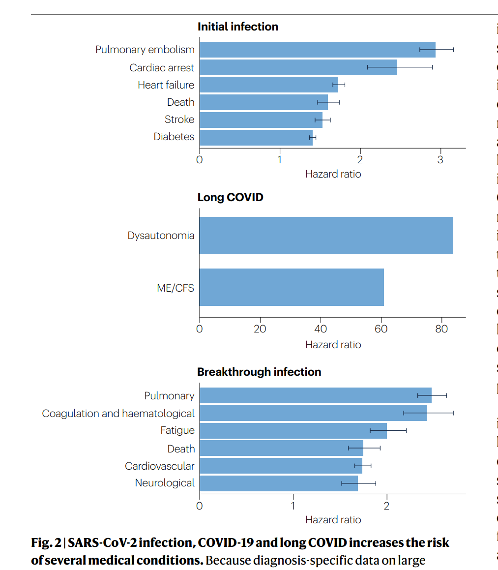
Some differences between adults and pediatrics
Different
Potentially Similar
Different
Davis, H.E., McCorkell, L., Vogel, J.M. et al. Long COVID: major findings, mechanisms and recommendations. Nat Rev Microbiol 21, 133–146 (2023). https://doi.org/10.1038/s41579-022-00846-2

Slide 20
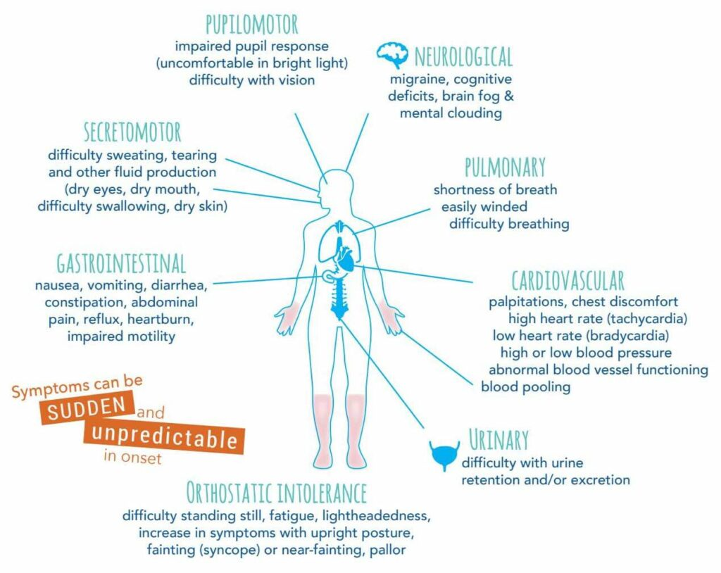
Dysautonomia appears common in long-Covid
https://thedysautonomiaproject.org/identifying-dysautonomia/#

Slide 21
Other Resources
https://www.longcovidkids.org/
Pediatric Covid Clinics - Long Covid Families
https://www.cdc.gov/coronavirus/2019-ncov/long-term-effects/index.html?s_cid=11840:cdc%20long%20covid%20symptoms:sem.ga:p:RG:GM:gen:PTN:FY23
ME/CFS
https://www.cdc.gov/me-cfs/index.html
https://www.iacfsme.org/
https://meassociation.org.uk/
https://ammes.org/
https://solvecfs.org/
https://solvecfs.org/me-cfs-long-covid/
https://mecfscliniciancoalition.org/

Slide 22
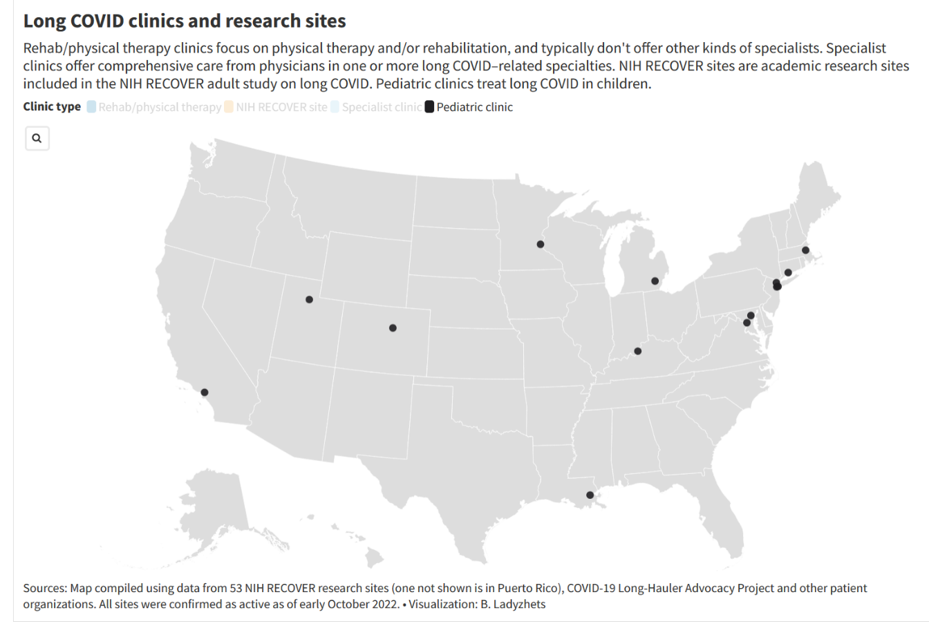
Peds Covid Clinics
Connecticut
Yale New Haven Children’s Post-COVID Comprehensive Care Program
https://www.ynhh.org/childrens-hospital/services/pulmonology/post-covid-care-program
California Children’s Hospital Los Angeles ​​Long COVID Recovery Care https://www.chla.org/long-covid-recovery-care
Colorado COVID-19 Assessment Program (CAP) National Jewish Health for Kids COVID-19 Assessment Program
Kentucky
Norton Healthcare COVID-19 Long-Term Care Clinic at Novak Center for Children’s Health https://nortonhealthcare.com/services-and-conditions/infectious-disease/services/coronavirus-covid-19/long-term-clinic/
Louisiana
Children’s Hospital New Orleans https://www.chnola.org/documents/Covid-Clinic-Card-20-8914.pdf
Maryland Kennedy Krieger Institute https://www.kennedykrieger.org/patient-care/centers-and-programs/pediatric-post-covid-19-rehabilitation-clinic
Massachusetts Children’s Boston https://www.childrenshospital.org/programs/post-covid-clinic
Michigan
Michigan Medicine https://www.uofmhealth.org/conditions-treatments/infectious-disease/post-covid-19-long-covid-19-clinic
Minnesota
Fairview Health Services – Pediatric Covid Clinic https://mhealthfairview.org/resources/covid19/long-term-covid-care/pediatric-covid-19-clinic
New Jersey
Pediatric Post-COVID CARE Program https://www.rwjbh.org/saint-barnabas-medical-center/treatment-care/covid-recovery/pediatric-covid-recovery/
New York
Richmond University Medical Center
Ohio
University Hospitals – Rainbow Babies & Children’s COVID Recovery Clinic https://www.uhhospitals.org/services/uh-covid-recovery-clinic
Texas UTHealth COVID-19 Center of Excellence
https://www.utphysicians.com/uthealth-covid-19-center-of-excellence/
Washington, D.C. Children’s National Pediatric Post-COVID Program https://childrensnational.org/departments/post-covid-program
https://longcovidfamilies.org/healthcare/pediatric-covid-clinics/
Pediatric Covid Clinics - Long Chttps://longcovidfamilies.org/healthcare/pediatric-covid-clinics/ovid Families

Slide 23
Summary of Stories
Pediatric long-COVID is currently underserved – we see patients without sustainable reimbursement, we don’t have the resources to offer comprehensive and coordinated care, and current research and clinical trials are focused on adults.
Children/young adults have unique needs and experiences in relation to long-COVID. They are experiencing this condition in critical stages of development.
Presenting with multiple conditions and being a child leads to dismissal and disbelief by providers, parents, and schools.
Some families are going to great lengths to help their kids. The financial burden is extreme, and the disruption to life extreme. When a child has long-Covid, the whole family is affected. (What are the sibling stories?)
What do doctors, teachers, coaches and others working with kids think about long-COVID? If they’re skeptical, why and what do they need to learn?
Those with severe disease are easy to identify, especially if they were high achieving before - the dramatic shift in behavior is obvious, what about those with mild and moderate disease? What about kids who were not high achieving prior to having long-COVID?

Slide 24
Summary of Stories
How do the various pieces of Long-Covid present, and how can we recognize them? “Brain Fog”, POTS, Orthostatic Intolerance (“dizziness”), non-epileptic seizures, headaches/pain…
There is a huge racial disparity in the children who present to our long-COVID clinic. Why? Are white children more likely to get long-COVID or are white children more likely to be DIAGNOSED with long-COVID?
Even when the WHO or CDC set up groups to define long-COVID and create strategies around long-COVID they are primarily focused on adults and not children.
How is long-COVID driving awareness of Chronic Fatigue Syndrome?
What role do nutrition, mind-body practices, acupuncture, and other integrative care strategies play in the management of long-COVID?
What is the pediatric story, and what stories do the kids have to tell?

Slide 25

RBC – Peds Long-Haul Recovery
Amy Edwards, MD – Director
David W. Miller, MD, LAc – Co-Director
Dan Goodall, RN – patient navigation, nursing
Latishia Harris -- scheduling
216-285-4070 for scheduling
Psychiatry – Kevin Makino, MD
Biofeedback/Hypnosis/Devel Peds – Fatima Malik, MD
GI – Mary Alice Dombrowski, RN
Nutrition – Abby Reinier, RD
Rheum, Neuro, PT, ENT, Cardiology, Nephrology, Neuroopthomology, Neuropsych, Psychology

Slide 26

Thank you and Questions!

