Slide 1

Childhood Obesity Future of the American Child National Press Foundation
May 7, 2023
Roy Kim, MD, MPH
Pediatric Endocrinologist
Cleveland Clinic Children’s Hospital

Slide 2
Why Talk About Childhood Obesity?
Common
Impact
Stigma & Myths
Treatable
Disclosures: None

Slide 3
Topics
Obesity General Background
Definitions
Complications
Social Dimension
Evidence in Medical Science
Treatments: Diets, Medications & Surgery

Slide 4
Notes:
Y axis %, X axis time: 80s to 2000s sharp increase in obesity in all children age groups

Slide 5
Child obesity prevalence: race/ethnicity, income
Characteristic | No. | %
 |  | All | Race/Hispanic origin
 |  |  | White, non-Hispanic | Black, non-Hispanic | Asian, non-Hispanic | Hispanic
Total | 6,878 | 17.0 | 14.7 | 19.5 | 8.6 | 21.9
Females | 3,371 | 17.1 | 15.1 | 20.7 | 5.3 | 21.4
Males | 3,507 | 16.9 | 14.3 | 18.4 | 11.8 | 22.4
Household income relative to federal poverty level
Total
≤130% | 3,131 | 18.9 | 15.5 | 19.4 | 13.2 | 22.8
>130% to ≤350% | 1,974 | 19.9 | 18.0 | 19.9 | 8.9 | 23.7
>350% | 1,256 | 10.9 | 11.0 | 19.8 | 4.4 | 11.8
https://www.cdc.gov/mmwr/volumes/67/wr/mm6706a3.htm?s_cid=mm6706a3_w#T1_down
Notes:
Obesity rates are different in socioeconomic groups. Race differences and income differences;

Slide 6
Food Insecurity
Food insecurity – limited or uncertain access to food
1) “We worried whether our food would run out before we got money to buy more.”
2) “The food we bought just didn't last and we didn't have money to get more.”
Notes:
Food insecurity may be associated with child obesity

Slide 7
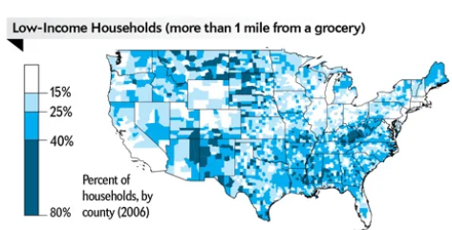
Food Deserts & Swamps
Notes:
Food deserts may be associated. Map showing prevalence of lowincome households living in a food desert. Obesity maps and Diabetes maps are closely superimposable on this map

Slide 8
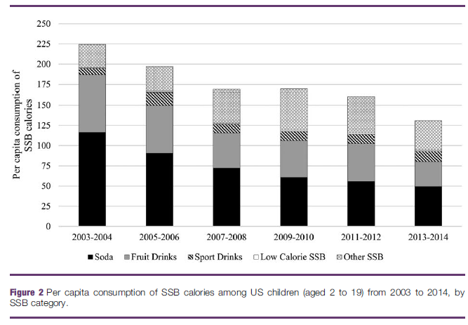
Trends in sugary drink consumption
Bleich Obesity 2018
Notes:
Sugary drink consumption is a strong risk factor and contributor. It is going down in all age groups, but still high esp teens

Slide 9
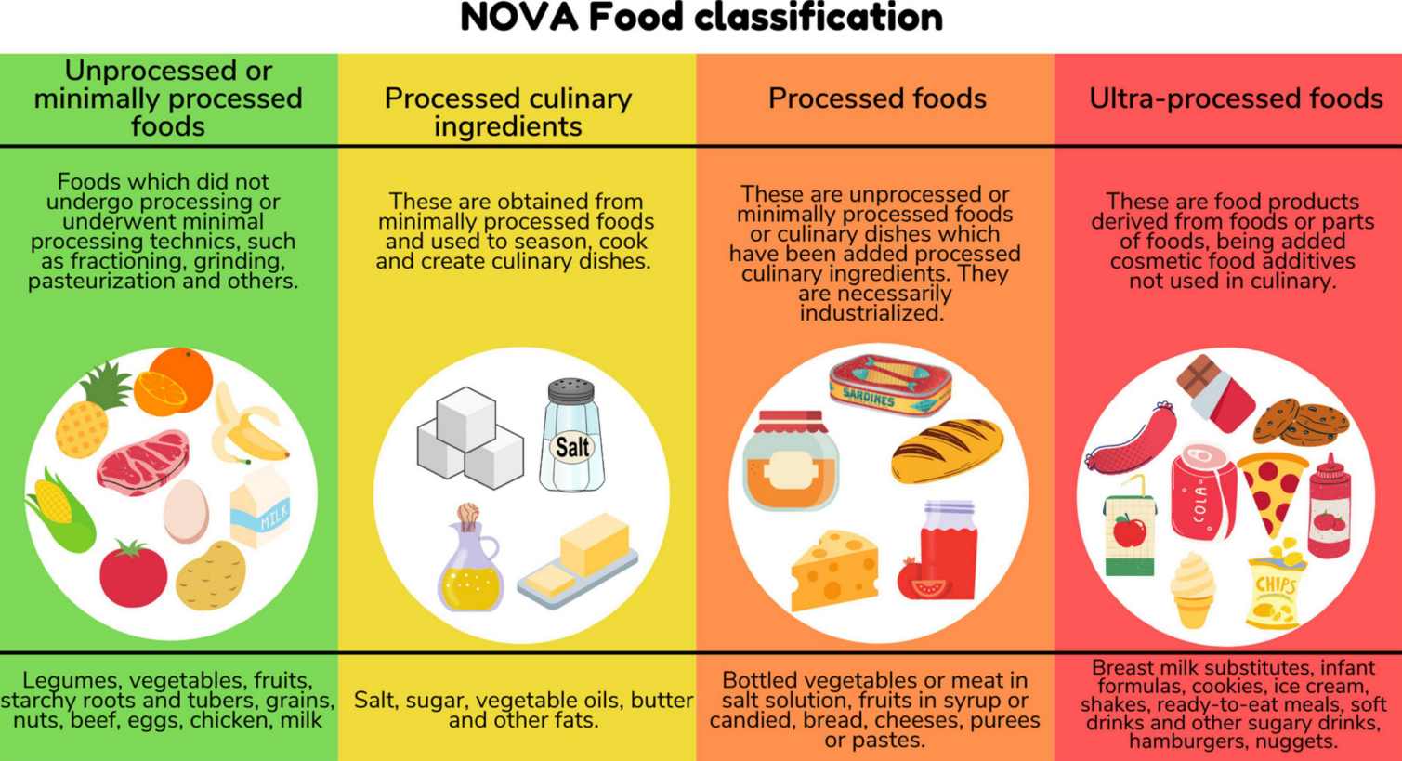
Ultra-processed Foods

Slide 10
Pediatric Obesity: What is it?
 | Adult (BMI) | Pediatric (BMI %)
Overweight | 25-30 kg/m² | 85-95th %
Obese | ≥ 30 kg/m² | ≥ 95th %
Class I | 30-35 kg/m² | 95th-120% of 95th %ile
Class II | 35-40 kg/m² | 120-140% of 95th %ile
Class III | ≥ 40 kg/m² | ≥ 140% of 95th %ile
Skinner et al. Obesity 2016
Notes:
Obesity is defined by % body fat. Weight for height is a surrogate.

Slide 11
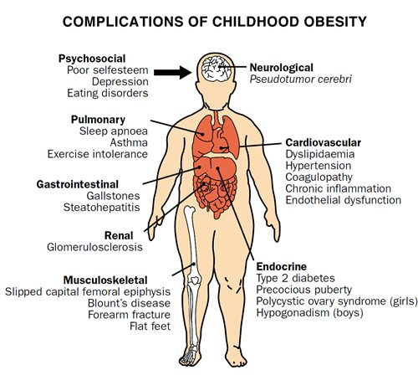
Ebbeling Lancet 2002

Slide 12
Medical Complications of Obesity
Increased blood pressure
Liver disease
Kidney failure
Heart disease
High cholesterol
Diabetes
Stroke
Vision loss

Slide 13
Financial Cost of Child Obesity
$19,500 per child with obesity at age 10 years (US)
$14 billion lifetime costs
$116 - $310 per year per child with obesity

Slide 14

Prevention
Notes:
Prevention central tenet

Slide 15
Primary Prevention
Prenatal
Infants
Breast feeding
Delaying introduction of solids until 6 months
Diet
Limit sugary drinks including juice
Vegetables / fruits 5 servings
https://www.hsph.harvard.edu/obesity-prevention-source/obesity-causes/prenatal-postnatal-obesity/
https://www.aap.org/en-us/advocacy-and-policy/aap-health-initiatives/HALF-Implementation-Guide/Age-Specific-Content/Pages/Infant-Food-and-Feeding.aspx/ [verified 2/9/19]
Dietary Guidelines for America 2020-2025
Notes:
Dietary recommendations for prevention of CV disease

Slide 16
Primary Prevention
Screen time < 1-2h
Physical Activity
Promote family physical activity 1x/wk
Age 5+: add moderate/vigorous activity 1h/d (Grade A)
Sleep
Encourage regular sleep and wake times
NHLBI 2012, USDHHS 2018
Notes:
Moderate/vigorous activity = baseball; muscle streng: playground, tree climb, tug of war, weights / resistance band; Bone: run, jump rope, tennis, basketball, hopscotch (can also be aerobic)

Slide 17


Secondary Prevention (Managing a Child with Obesity)
Prevent future complications
Evaluate Risk
Blood pressure
Lipids & Diabetes
Other complications

Slide 19
Obesity management
Notes:
Prevention central tenet

Slide 20
Stigma & Myths
Stigma - beliefs (bias) based on weight, which can result in actions taken against the target of the bias (discrimination)
Haqq Child Obes 2021

Slide 21
Myths vs Reality
Myths:
Obesity is a failure of self control
Blaming will motivate individuals to change
“Obesity” is a medical term and not pejorative
Reality:
Obesity is due to many factors outside one’s control
Blaming can have the opposite effect
Terms can be stigmatizing

Slide 22
Pernicious cycles of obesity
Low physical fitness
Musculoskeletal pain
Stigma
Teasing/bullying/blaming
↓ Exercise
Adverse Coping strategies
Depression/anxiety
Obesity
↓ energy expenditure
Disordered eating
Social withdrawl
Avoiding physical activity
Low motivation

Slide 23
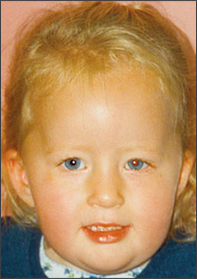
Prader Willi Syndrome
Most common obesity syndrome
Low muscle tone at birth & poor feeding
Insatiable appetite later in childhood
Hormone problems
Distinct physical features:
Short stature
bitemporal narrowing
thin upper lip
small hands and feet
Developmental delay, autism
Caused by genetic change: loss of father’s stretch of chromosome 15
American Family Physician

Slide 24
Bardet Biedl syndrome
Findings:
Severe obesity starting early childhood
Eye disease of retina
Polydactyly
Kidney anomalies
Low puberty hormones

Slide 25
Medical Evidence: levels of strength
Case studies
a description about one or a few patients
Cohort studies – of a large group
can find links or associations
may not be causation
Clinical trial
Strongest type of evidence
FDA

Slide 26
Medical Recommendations: levels of strength
Grade C
based on practice based experience, a few cases, expert opinion
Grade B
Based on cohort studies or limited clinical trials
Grade A
Based on consistent, high quality clinical trials

Slide 27
Motivational Interviewing: tool to overcome stigma
Counseling technique that…
respects autonomy of patient
allows patient to decide whether and what to change
May enhance adherence & efficacy

Slide 28
Weight Loss Goals
Without comorbidities:
weight maintenance
With comorbidities:
Age 2-11y: ↓ 1 LB/mo
Adolescents: ↓ 2 LB/wk
NHLBI, AAP

Slide 29
Healthy Habits
Weight loss is difficult
“Diets” may work but are hard to sustain
Weight loss may be followed by regain
Focus on knowledge, building and sustaining healthy habits
Measuring success: fitness, function, body composition, lab results, behavior change, etc.

Slide 30
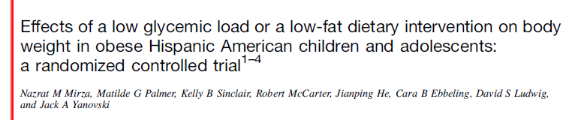
Mirza Am J Clin Nutr 2013

Slide 31
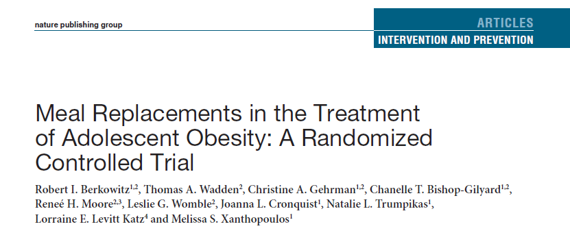
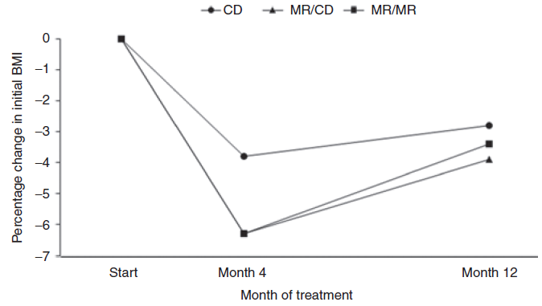
Berkowitz Obesity 2011

Slide 32
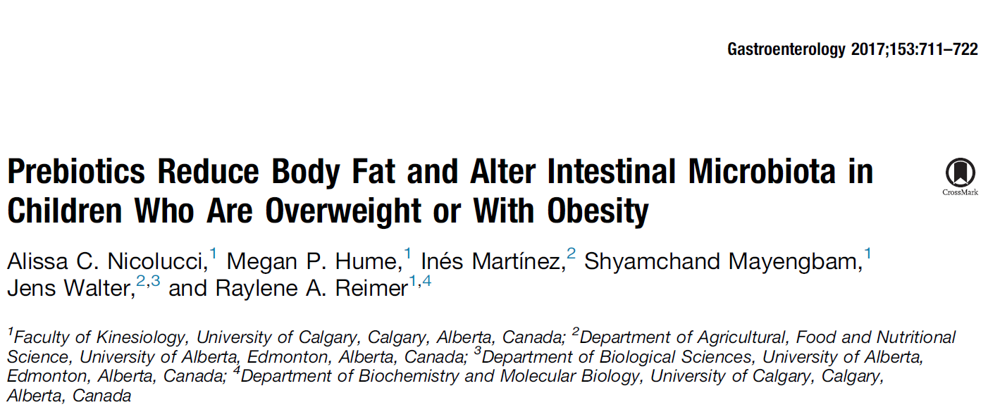

Slide 33
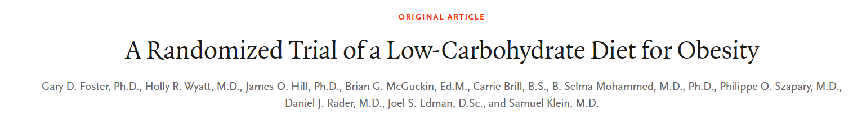

Slide 34
Vidmar et al. Nutrients 2021

Slide 35
General Recommendations
No single diet has been identified as most effective
Combining exercise and diet is more effective than either alone
Exercise training improves insulin, BP, lipids and body composition
Reducing screen time / sedentary behaviors is effective

Slide 36
Other Recommendations
US Preventative Services Task Force 2017 found effective programs had the following:
26+ contact hours
Targeted parent and child
Provided information on diet, activity, nutrition labels
Stimulus control, contingent rewards
Goal setting and self monitoring
Supervised physical activity
USPSTF 2017

Slide 37
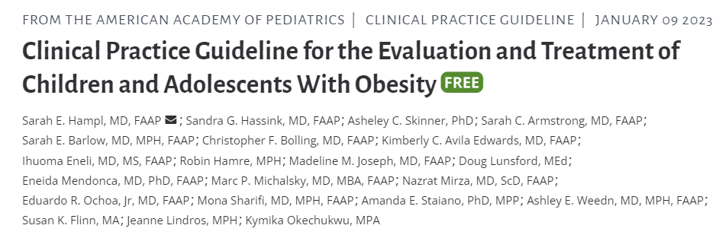
Management in “medical home” (primary care)
Equity
Team approach
Medications and Surgery

Slide 38
Medications for obesity
Drug | Mechanism | Brand | Wt Loss | Age
Metformin | Insulin sensitizer | - | 1-2% | *
Orlistat | Inhibit fat absorption | Alli | 3% | 12-16y
Liraglutide or Semaglutide | GLP-1RA | Exenatide, Wegovy | 6-14% | 12+
Bupropion-naltrexone | Dopa/noradrenergic- opiate antag | Contrave | 6% | na
Phentermine-topiramate | Dopa/noradrenergic - GABA activator | Qsymia | 10% | 12+

Slide 39
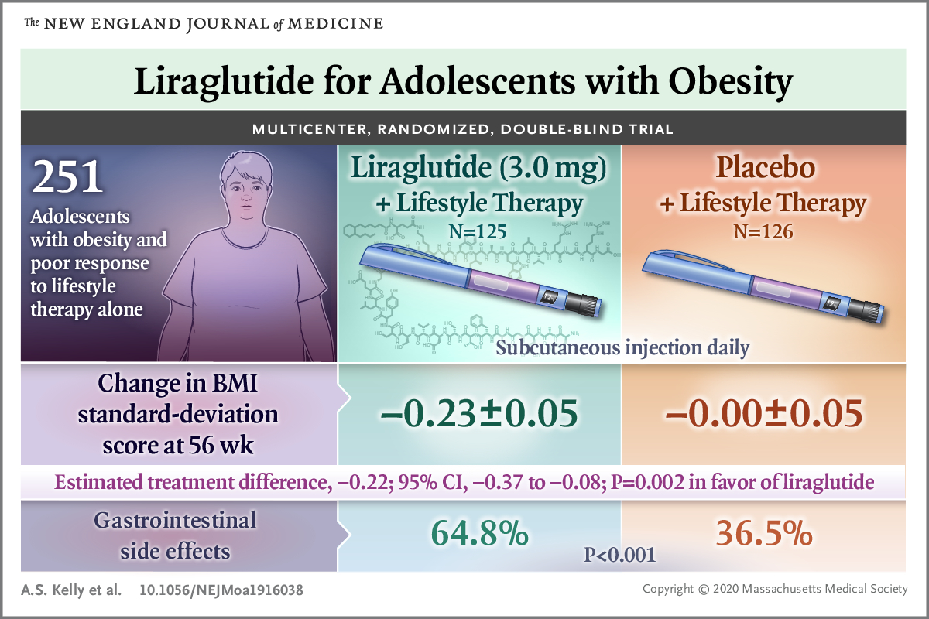

Slide 40
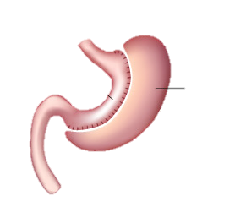
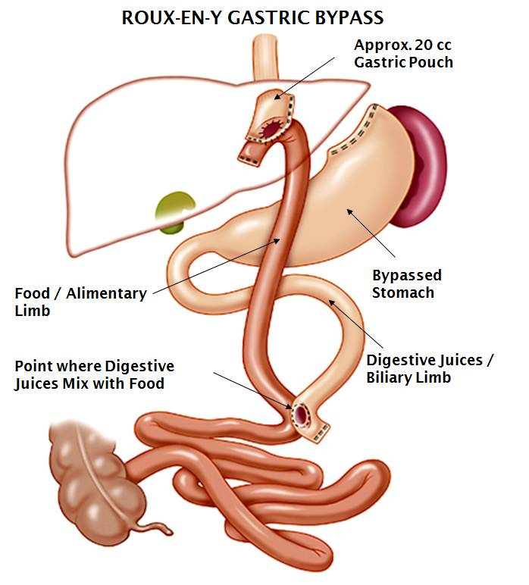
Bariatric Surgery
Gastric Bypass
Vertical Sleeve Gastrectomy
Gastric sleeve
Removed portion of stomach

Slide 41
Surgical Criteria
BMI
BMI > 35 kg/m² and serious comorbidity
OR
BMI > 40 kg/m² and less serious comorbidity
All of the following:
Through most of puberty and near adult height
Knowledgeable of risks, benefits
Supportive family

Slide 42
Results of bariatric surgery in teens
Inge NEJM ‘19
Notes:
mortality zero, 8% major complications e.g reoperation

Slide 43
TEEN-LABS
Inge NEJM ‘19
Notes:
comorbidities improved however follow-up was quite limited

Slide 44
Obesity and the Public Health
Treatment costs
Wegovy (weekly shot) $1600/month
Qsymia (daily pill) $250/month
Bariatric surgery $30,000
Obesity as a chronic disease
Savings from reduced disease burden

Slide 45
Summary
Obesity among children is common, increasing, and differentially affects low-income children, and children of color
The health and public health impacts are severe
Treatments focus on healthy lifestyle habits, and medications and surgery for severe cases
Dispelling myths and lowering stigma are a priority

Slide 46
Public Space
Stigma surrounding weight harms the individual, impedes treatment, and is based on misinformation
Societal and economic factors can help or be an obstacle to lowering childhood obesity rates
Medical systems are not the main answer for helping children avoid or reduce problems with excess body weight.

Slide 47
Thank you!

Slide 48
References
Berkowitz, R. I., Wadden, T. A., Gehrman, C. A., Bishop-Gilyard, C. T., Moore, R. H., Womble, L. G., . . . Xanthopoulos, M. S. (2011). Meal replacements in the treatment of adolescent obesity: a randomized controlled trial. Obesity (Silver Spring), 19(6), 1193-1199. doi: 10.1038/oby.2010.288
Collins, C. E., Okely, A. D., Morgan, P. J., Jones, R. A., Burrows, T. L., Cliff, D. P., . . . Baur, L. A. (2011). Parent diet modification, child activity, or both in obese children: an RCT. Pediatrics, 127(4), 619-627. doi: 10.1542/peds.2010-1518
Expert Panel on Integrated Guidelines for Cardiovascular, H., Risk Reduction in, C., Adolescents, National Heart, L., & Blood, I. (2011). Expert panel on integrated guidelines for cardiovascular health and risk reduction in children and adolescents: summary report. Pediatrics, 128 Suppl 5, S213-256. doi: 10.1542/peds.2009-2107C
Guthrie, J. F., & Morton, J. F. (2000). Food sources of added sweeteners in the diets of Americans. J Am Diet Assoc, 100(1), 43-51, quiz 49-50. doi: 10.1016/s0002-8223(00)00018-3
Inge et al. (2016) Weight Loss and Health Status 3 Years after Bariatric Surgery in Adolescents, New England Journal of Medicine.
Jansen, E., Mulkens, S., & Jansen, A. (2011). Tackling childhood overweight: treating parents exclusively is effective. Int J Obes (Lond), 35(4), 501-509. doi: 10.1038/ijo.2011.16
McGuire, M. M., Nadler, E. P., & Qureshi, F. G. (2014). Laparoscopic vertical sleeve gastrectomy for adolescents with morbid obesity. Semin Pediatr Surg, 23(1), 21-23. doi: 10.1053/j.sempedsurg.2013.10.021
Mirza, N. M., Palmer, M. G., Sinclair, K. B., McCarter, R., He, J., Ebbeling, C. B., . . . Yanovski, J. A. (2013). Effects of a low glycemic load or a low-fat dietary intervention on body weight in obese Hispanic American children and adolescents: a randomized controlled trial. Am J Clin Nutr, 97(2), 276-285. doi: 10.3945/ajcn.112.042630
Nicolucci et al. (2017) Prebiotics reduce body fat and alter intestinal microbiota in children who are overweight or with obesity. Gastroenterology. 153:711-5
Bakhach et al. (2016) The protein sparing modified fast diet. Global Ped Health 3:1-6
Bleich et al. (2021) Time limited eating and continuous glucose monitoring in adolescents with obesity: a pilot study. Nutrients 13(11)3697.

