Slide 1

How to Cover the Federal Budget So People Understand
March 6, 2023

Slide 2
About TCS
Taxpayers for Common Sense is an independent and nonpartisan voice for taxpayers working to increase transparency and expose and eliminate wasteful and corrupt subsidies, earmarks, and corporate welfare.
Oversight of the federal budget – legislative tracking and analysis, investigations, and advocacy
Breadth of issues – energy and natural resources, national security, transportation, agriculture, and water resources
Credibility for quality and nonpartisanship with the media and policymakers
Mission and track record that aligns conservatives, moderates, and liberals behind common sense solutions

Slide 3
Where To Look
Read. The. Bill.
Congressional Budget Office
Joint Committee on Taxation
Government Accountability Office
Congressional Research Service
President’s Budget Request and Budget Justification Sheets
Taxpayers for Common Sense

Slide 4
What to Look For
Year-to-Year Changes
Items Not in Press Release
Generic or Reference Items
Oddities
Press Releases
Assets/Campaign Contributions
Assistance Outside District/State

Slide 5
Generic or Reference Items: Dog River
“… undertake the project authorized by section 518 of Public Law 106-53, at full federal expense.”
“… $1.5 million for a pilot project, in cooperation with non-Federal interests, to restore natural water depths in the Dog River, Alabama.”
Notes:
CARES authorized $9.5 emergency approps and reimbursed CCC $14 billion spending power.
Industry estimates $50 billion in losses (March)
CFAP (May) - $9.5 approps and $6.5 CCC that was available
CFAP payments = $10.2 billion
CFAP 2 (Sept) - Utilizes the $14 billion made available by CARES
CFAP2 = $6.1 billion

Slide 6
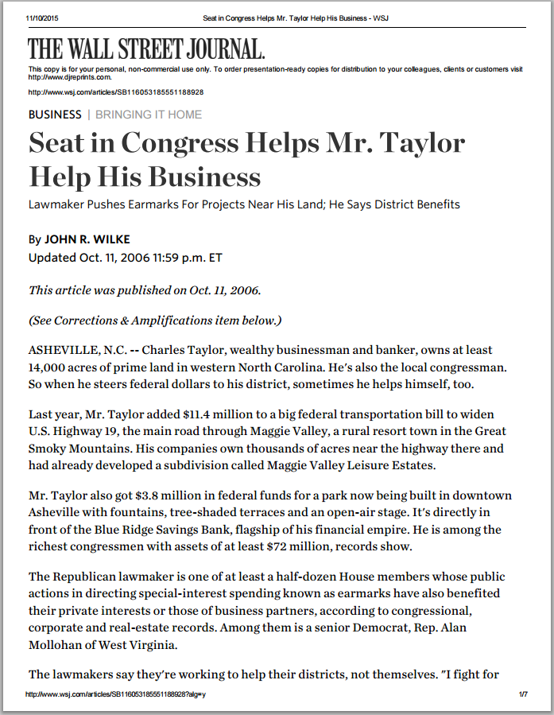
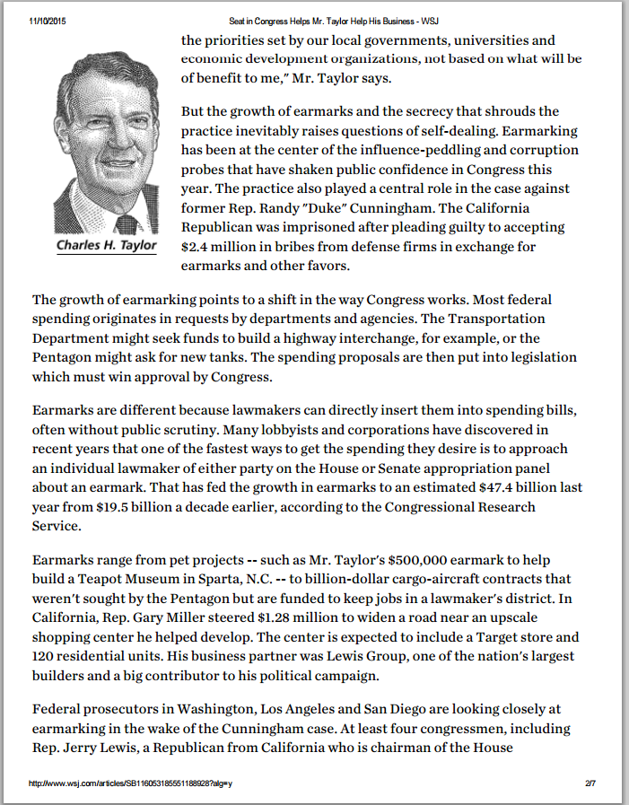
Assets/
Campaign Contributions
Notes:
Spouse gets a separate payment limit; every family member over 18 if "active manager"; every entity in a complex family corporation
*Cattle, Corn, Dairy, Hogs
*Specialty Crops about $700 million thus far. Might get $1 billion though 30-40% of market and quite affected by COVID
*Govt Subs 40-50% of income = highest level since at least 2004

Slide 7
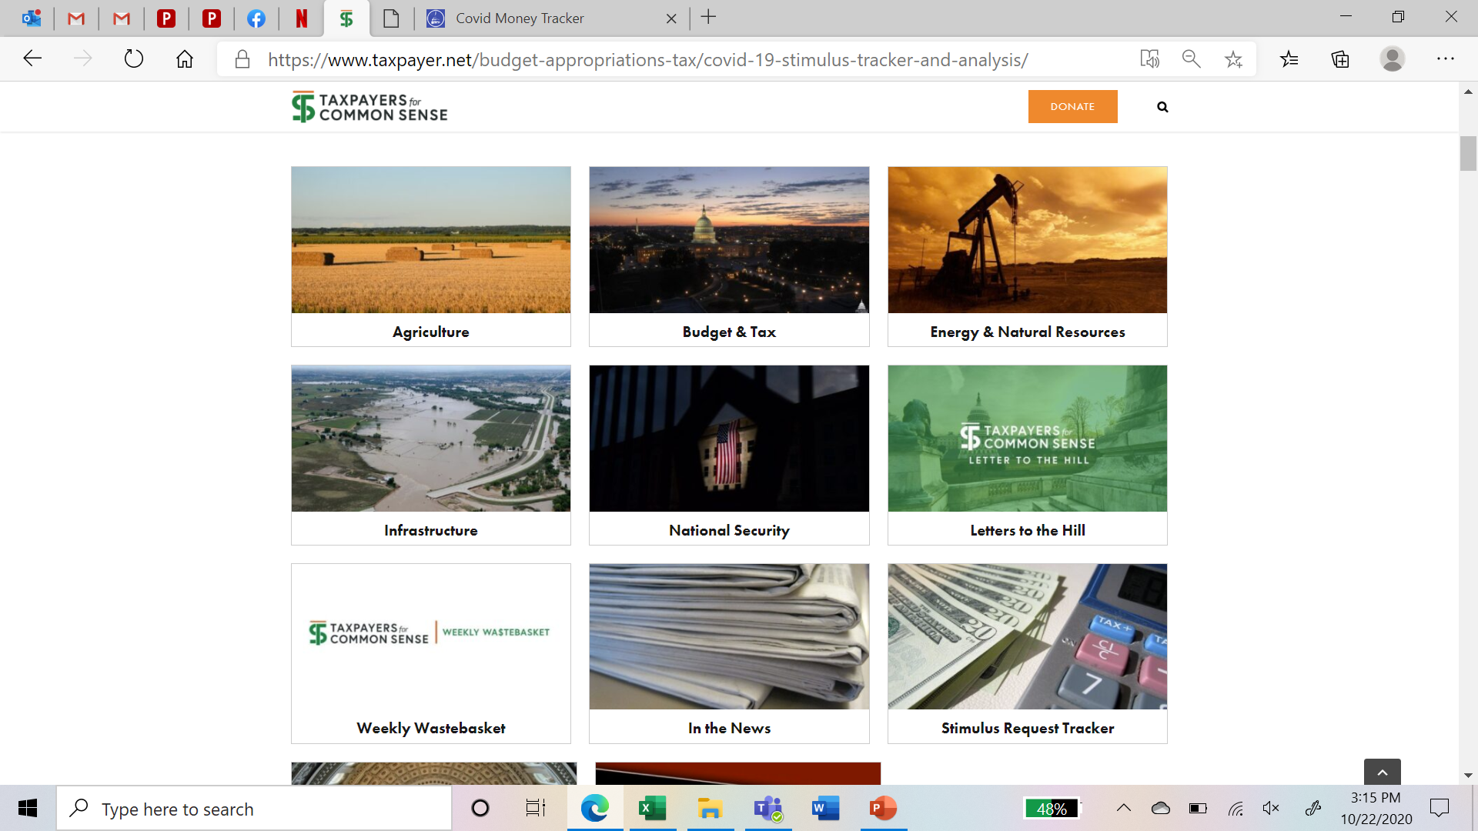
Oversight and Transparency

Slide 8
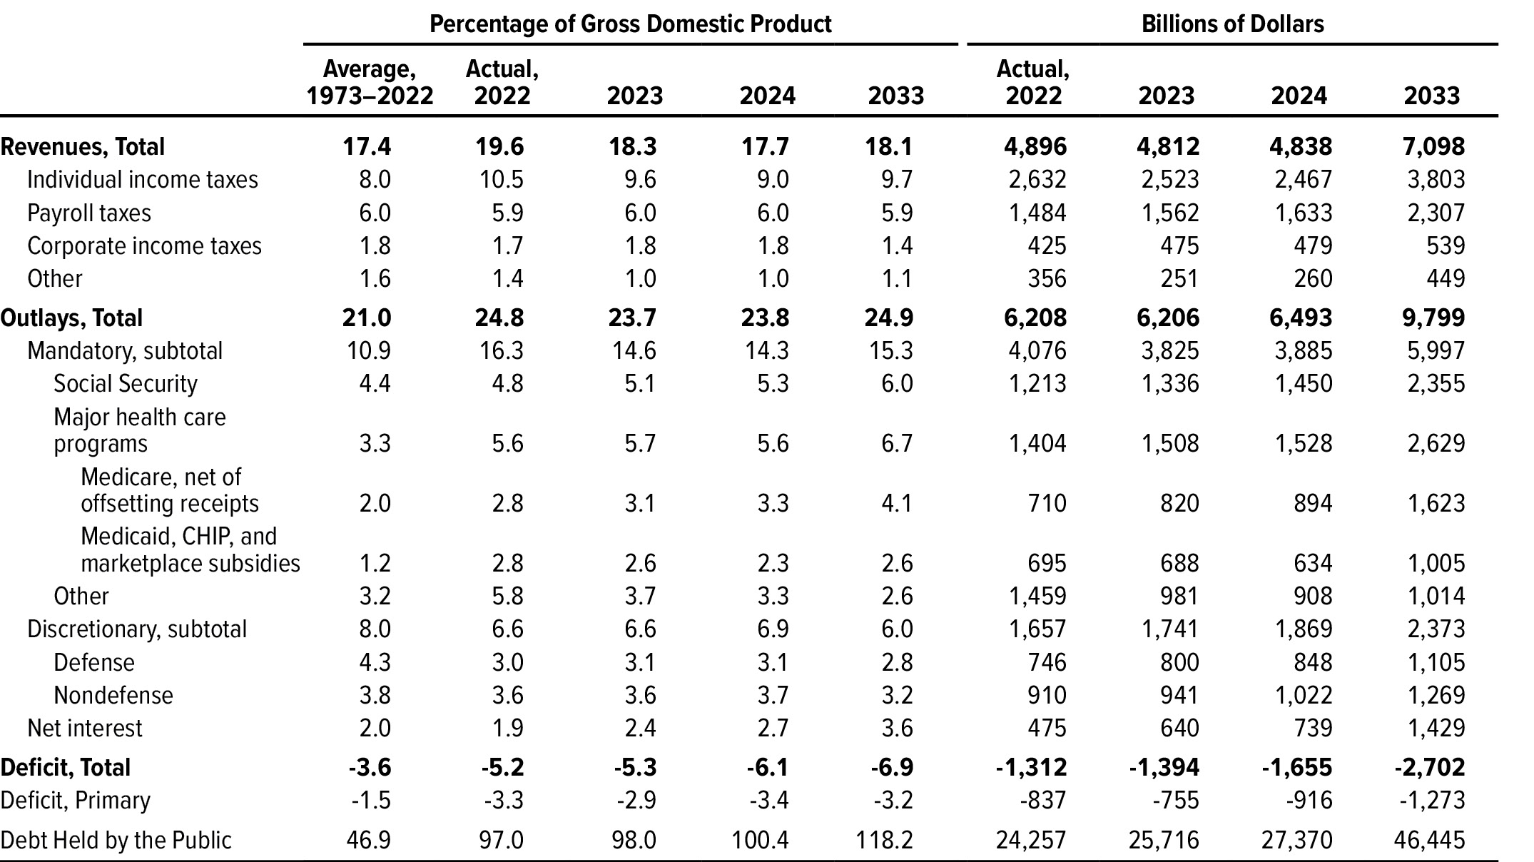
By the Numbers

Slide 9
Budget Impact
Deficits $1.32T in FY22 Down from $2.8 trillion in fiscal year 2021 (2nd largest since 1945 as % of GDP)
Debt Total $31.4T End CY22 or 120 percent of GDP; Public $26.1T or 94% of GDP
Outlays $6.2T in FY22 Down from $6.8 trillion in fiscal year 2021
Revenues $4.9T in FY22 Down from $4.0 trillion 18.1 percent of GDP in 2021
What’s a trillion?

