Slide 1
Covering Youth Justice
National Press Foundation Meeting
“Future of the American Child”
McAllen, TX
January 25, 2023

Slide 2
Pew and pspp
The Pew Charitable Trusts is a nonprofit organization that applies a rigorous, analytical approach to improve public policy, inform the public, and stimulate civic life. In every project we are:
fact-based and dedicated to the power of research
nonpartisan and committed to bringing together key stakeholders
results-oriented
Pew’s public safety performance project (pspp) works with states to advance data-driven, research-informed, fiscally sound policies and practices in the criminal and juvenile justice systems.

Slide 3
Agenda
Setting the Stage
Identifying Trends
Changing the Narrative
Seizing the Moment

Slide 4

Sending Kids to Court Doesn't Help
Sending Kids to Court Doesn't Help Them. Here’s What Will. (The Pew Charitable Trusts)
Source: https://www.pewtrusts.org/en/research-and-analysis/video/2023/sending-kids-to-court-doesnt-help-them-heres-what-will

Slide 5
As youth arrests have fallen nationally, so have commitments.
Since 1997, commitment rates have fallen 74% while the youth arrest rate fell 75% .
Youth Arrest Rates and Commitment Rates in the United States, 1997 – 2019; Rates per 100,000.
Source: OJJDP Statistical Briefing Book. Online. Available: http://www.ojjdp.gov/ojstatbb/crime/JAR_Display.asp?ID=qa05200&selOffenses=1. July 08, 2022

Slide 6
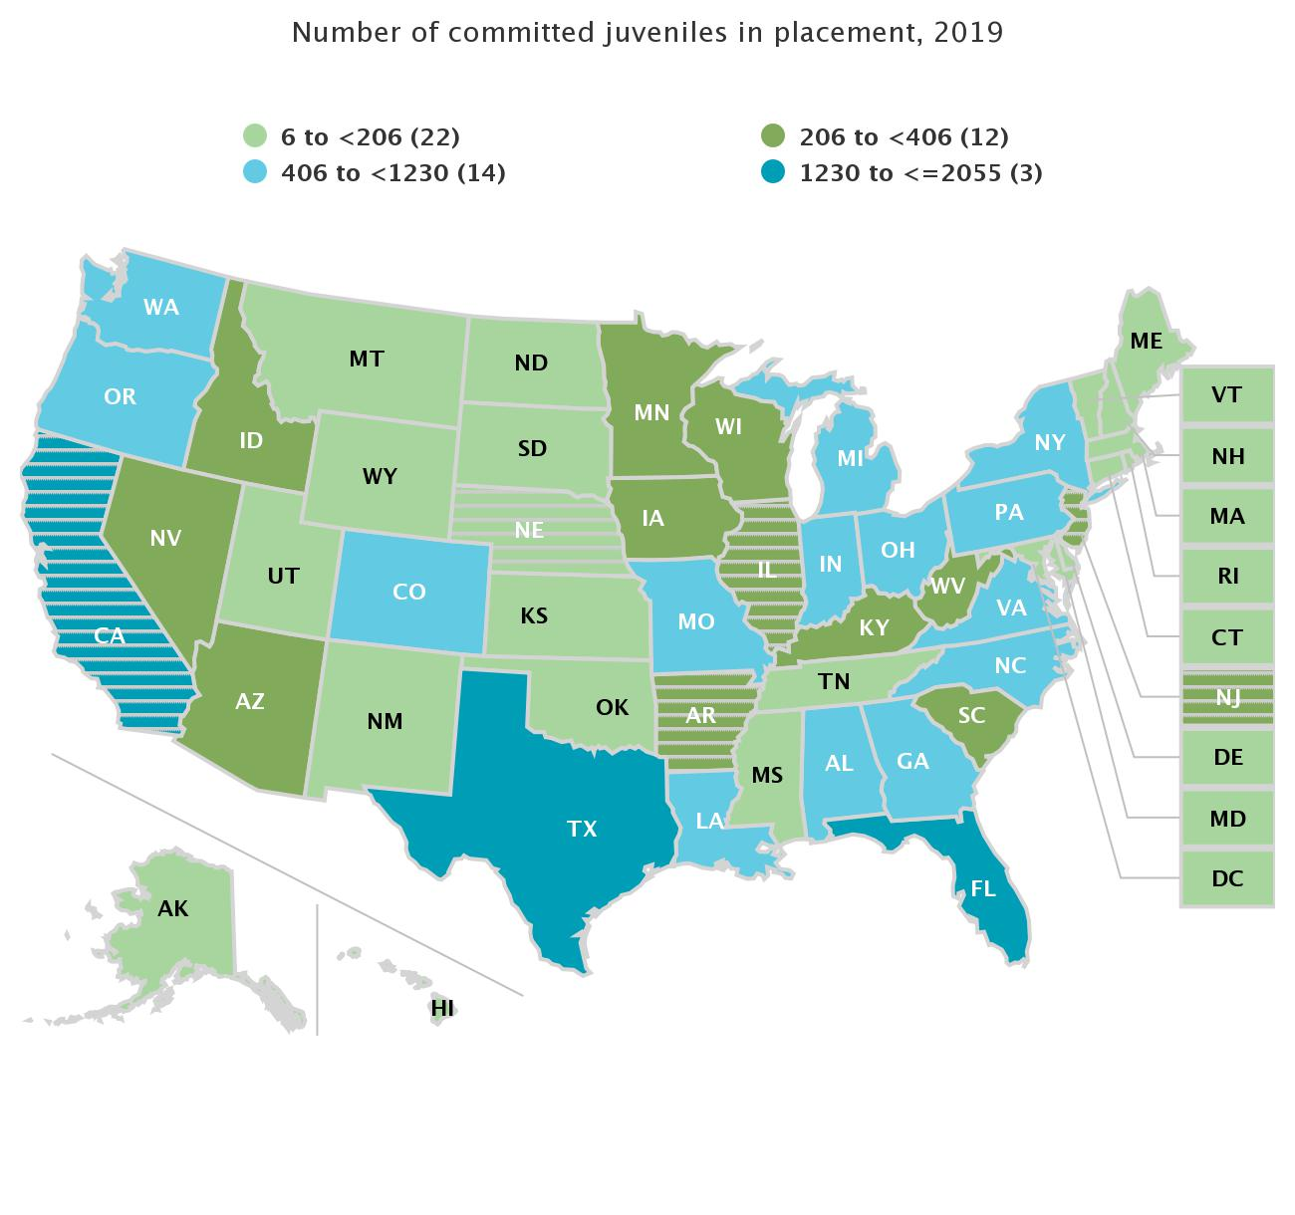
Commitment rates vary by state.
*Striped states: 30% or more of data was imputed
Placement rate for youth committed to residential facilities, 2019; Rates per 100,000.
Source: Sickmund, M., Sladky, T.J., Puzzanchera, C., and Kang, W. (2021) "Easy Access to the Census of Juveniles in Residential Placement." Online. Available: https://www.ojjdp.gov/ojstatbb/ezacjrp/

Slide 7
Changes in state commitment rates vary.
Commitment rate changes 2006 -2019 by state group
Declines of 80% or more | Declines of less than 50% or increases
Tennessee | Idaho
New Hampshire | Michigan
Connecticut | Nevada
Oklahoma | Missouri
South Dakota | Oregon
New York | North Carolina
Illinois | Nebraska
Vermont | West Virginia
Massachusetts | Alaska
Placement rate for youth committed to residential facilities, 2019; Rates per 100,000.
Source: Sickmund, M., Sladky, T.J., Puzzanchera, C., and Kang, W. (2021) "Easy Access to the Census of Juveniles in Residential Placement." Online. Available: https://www.ojjdp.gov/ojstatbb/ezacjrp/

Slide 8
Nationally, racial and ethnic disparities have persisted over time.
Juvenile Commitment Rates in the United States by Race and Ethnicity, 1997 – 2019; Rates per 100,000.
Source: OJJDP Statistical Briefing Book. Online. Available: https://www.ojjdp.gov/ojstatbb/special_topics/qa11803.asp?qaDate=2019. Released on May 21, 2021.

Slide 9
Black and Hispanic youth have worse case outcomes.
Share of juvenile disposition in the United States, 2019
Source: Sickmund, M., Sladky, A., and Kang, W. (2021). Easy Access to Juvenile Court Statistics: 1985-2019. Online. Available: https://www.ojjdp.gov/ojstatbb/ezajcs

Slide 10
In Utah, racial and ethnic disparities grew at each deeper level of system involvement.
Share of group by race and ethnicity, Stages of System Involvement, Utah, 2015
Source: Utah Juvenile Justice Task Force

Slide 11
Nationally, two thirds of kids were committed for non-person offenses.
In 2006, 26.6% of placements were for offenses against persons.
Share of Placements by Offense Type, United States, 2019
Source: Sickmund, M., Sladky, A., and Kang, W. (2021). Easy Access to Juvenile Court Statistics: 1985-2019. Online. Available: https://www.ojjdp.gov/ojstatbb/ezajcs/

Slide 12
In Utah in 2015, most youth in state custody were not there for felonies.
Youth in Placement by Offense Severity, Placement Type, Utah, 2015
Source: Utah Juvenile Justice Task Force

Slide 13
Almost half of kids in placement in the US were 15 or younger in 2019.
Youth in Placement by Age, United States 2019
Source: Sickmund, M., Sladky, A., and Kang, W. (2021). Easy Access to Juvenile Court Statistics: 1985-2019 Online. Available: https://www.ojjdp.gov/ojstatbb/ezajcs/

Slide 14
Key Takeaways
Overall, crime and incarceration are down
But, aggregate trends at the national level do not necessarily imply proactive steps to reduce incarceration.
Nor do they indicate an absence of need for ongoing change.
Racial and ethnic disparities remain pervasive.
particularly among those youth who are prosecuted as if they were adults and those who are placed out-of-home.
Non-violent offenses drive commitment.
Youth under sixteen make up a significant portion of the committed population.
Other?

Slide 15
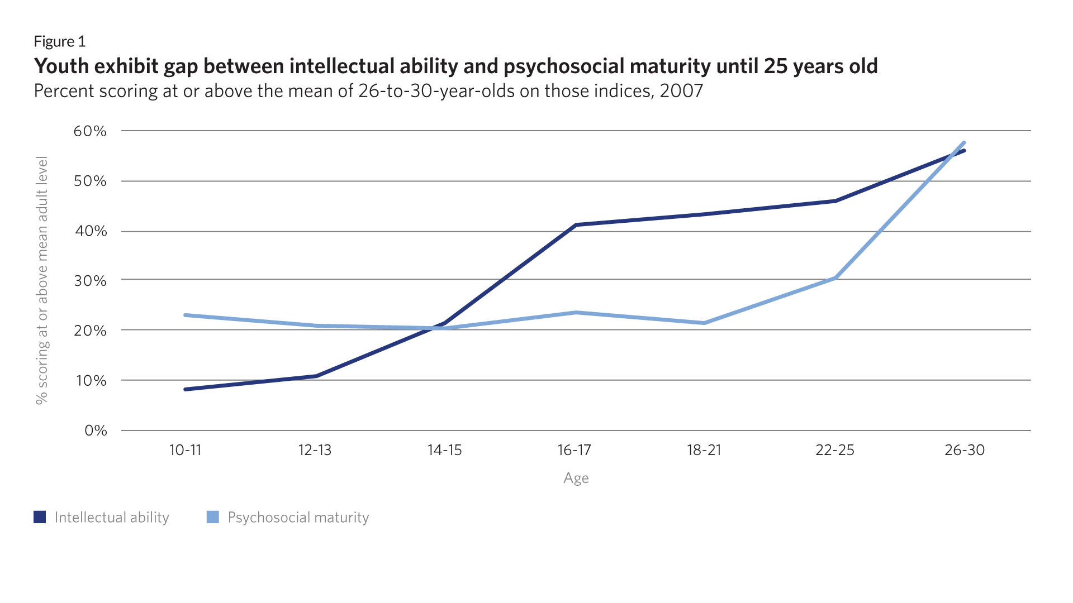
Source: Steinberg et al. 2007, “Are Adolescents Less Mature than Adults?’’ https://www.apa.org/pubs/journals/releases/amp-64-7-583.pdf

Slide 16
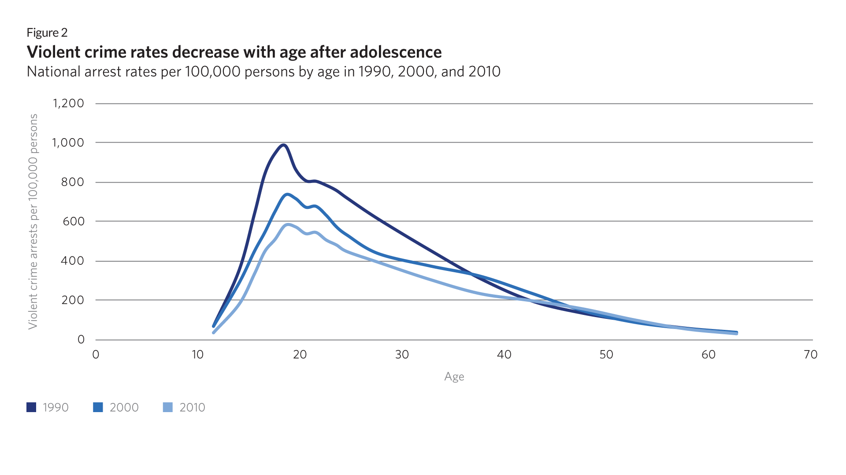
Source: Snyder, Howard N.; Cooper, Alexia D.; and Mulako-Wangota, Joseph. Bureau of Justice Statistics.

Slide 17
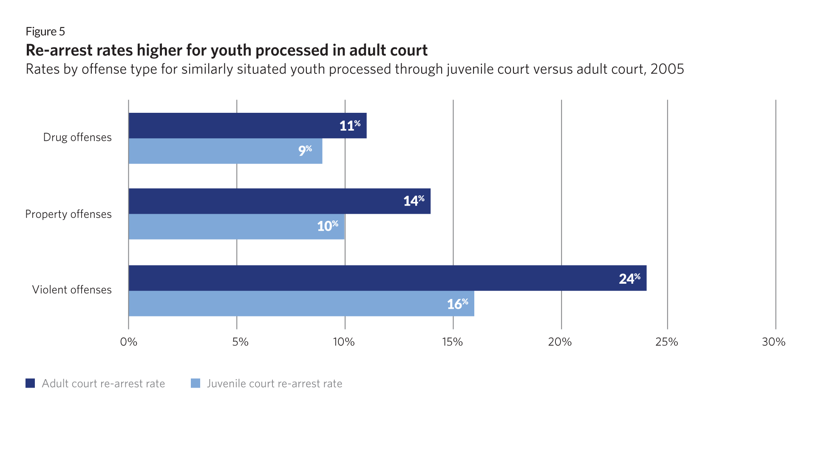
Source: Lonn Lanza-Kaduce et al., “Juvenile Offenders and Adult Felony Recidivism: The Impact of Transfer,” Pages 59-77 | Published online: 10 Jan 2012 https://www.tandfonline.com/doi/abs/10.1080/0735648X.2005.9721207?journalCode=rjcj20

Slide 18
Effect of Placement on Re-Arrest
Mulvey, et al: Pathways to Desistance Finding:
No significant differences between groups in rate of re-arrest
Source: Edward P. Mulvey et al., “Trajectories of Desistance and Continuity in Antisocial Behavior Following Court Adjudication Among Serious Adolescent Offenders,” Development and Psychopathology 22 (November 2010): 453–75, doi: 10.1017/S0954579410000179.

Slide 19
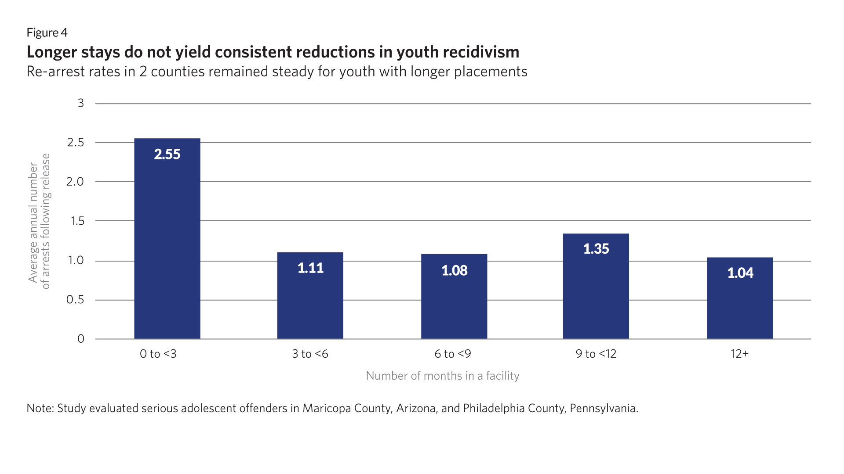
Source: Thomas A. Loughran et al., “Estimating a Dose-Response Relationship Between Length of Stay and Future Recidivism in Serious Juvenile Offenders,” Criminology 47, no. 3 (2009), 699–740, http://www.ncbi.nlm.nih.gov/pmc/articles/PMC2801446/.

Slide 20
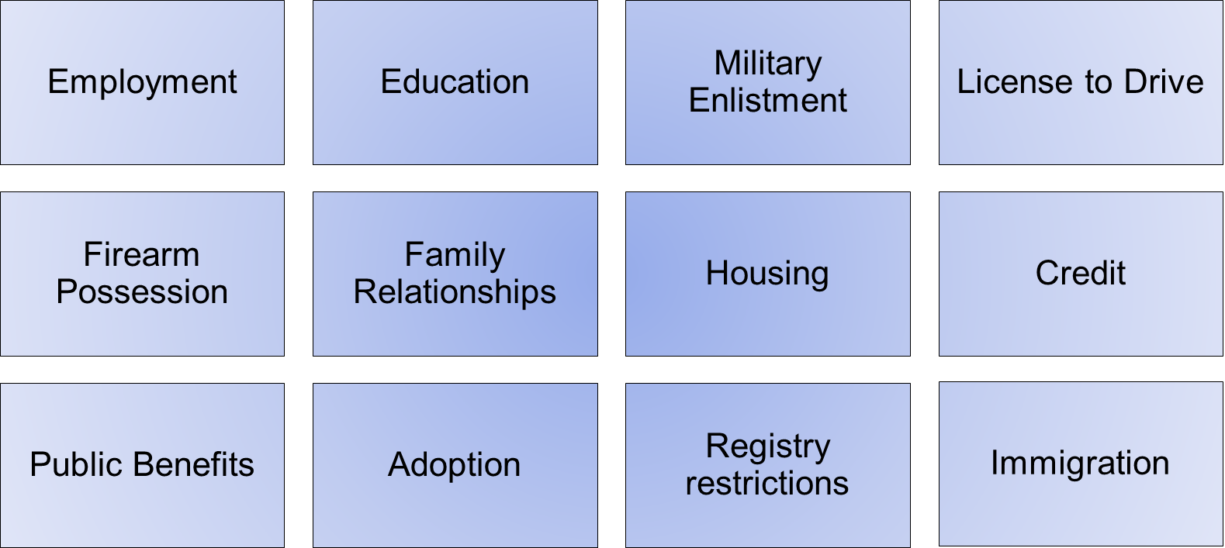
Opportunities Denied

Slide 21
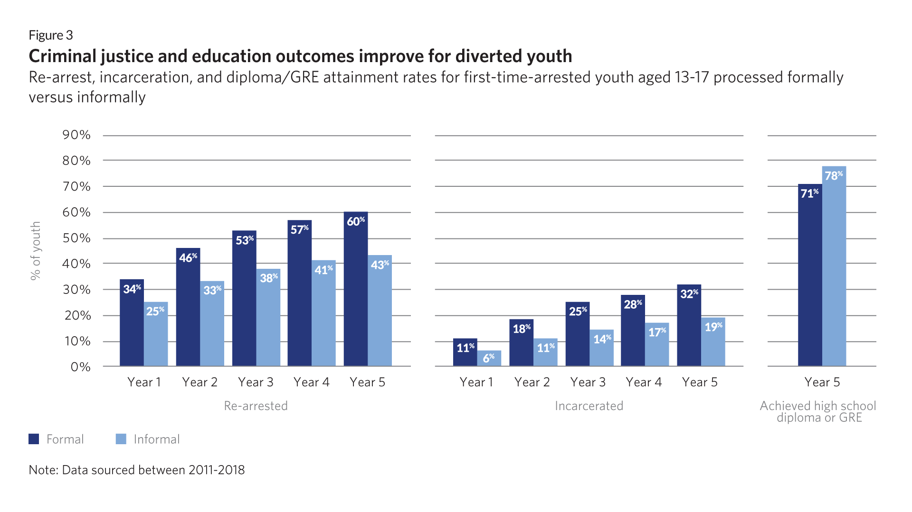
Source: Cauffman et al. 2020, “Crossroads in juvenile justice: The impact of initial processing decision on youth 5 years after first arrest” (https://faculty.lsu.edu/pfricklab/pdfs/juvenilejustice-pdfs/dpcauffmanetalmaincrossroadsweb.pdf).

Slide 22
In Utah, recidivism rates were better for youth when diverted on their first charge.
Recidivism rates for youth on first charge, diverted versus petitioned, Utah
Source: Utah Juvenile Justice Task Force

Slide 23
Key Takeaways
Making mistakes is an important part of growing up.
Most kids, even those who commit serious violent crime, will desist, if we don’t intervene inappropriately.
We can and should hold young people accountable, we just need to do it in a way that is developmentally appropriate.
Current juvenile legal system practices routinely undercut the safety and stability of families and communities.
Less is more: Diverting kids from courts can hold them accountable without upending their lives.
Other?

Slide 24
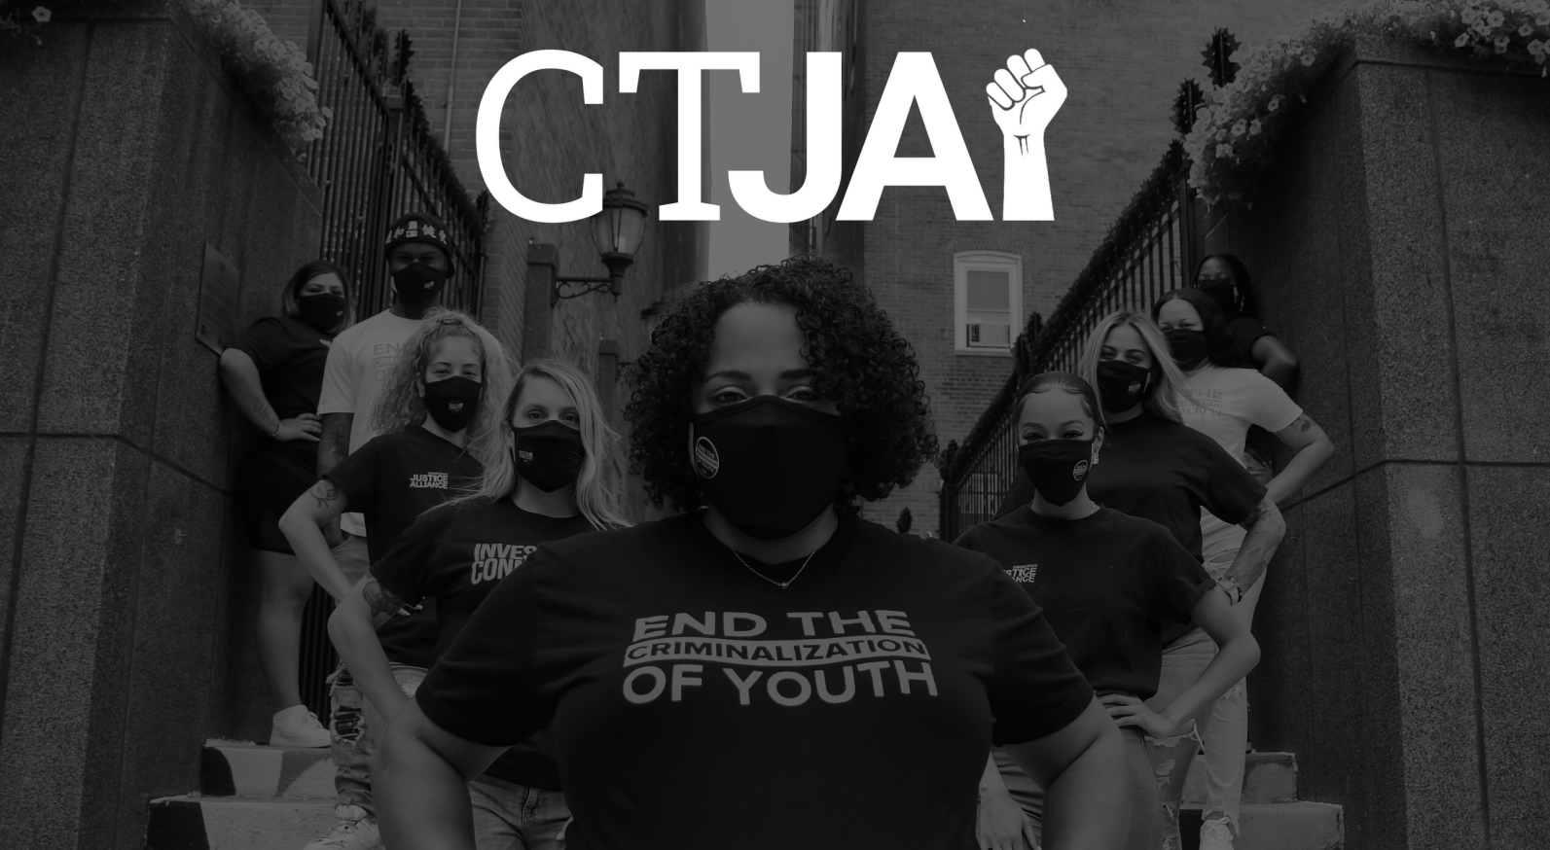

Slide 25
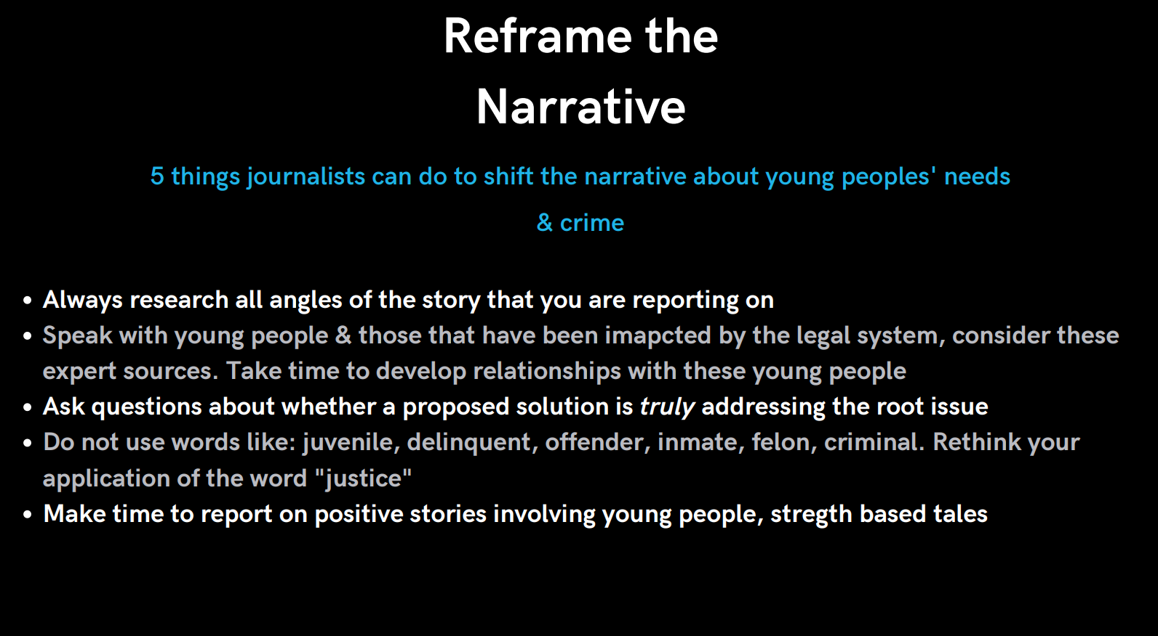

Slide 26
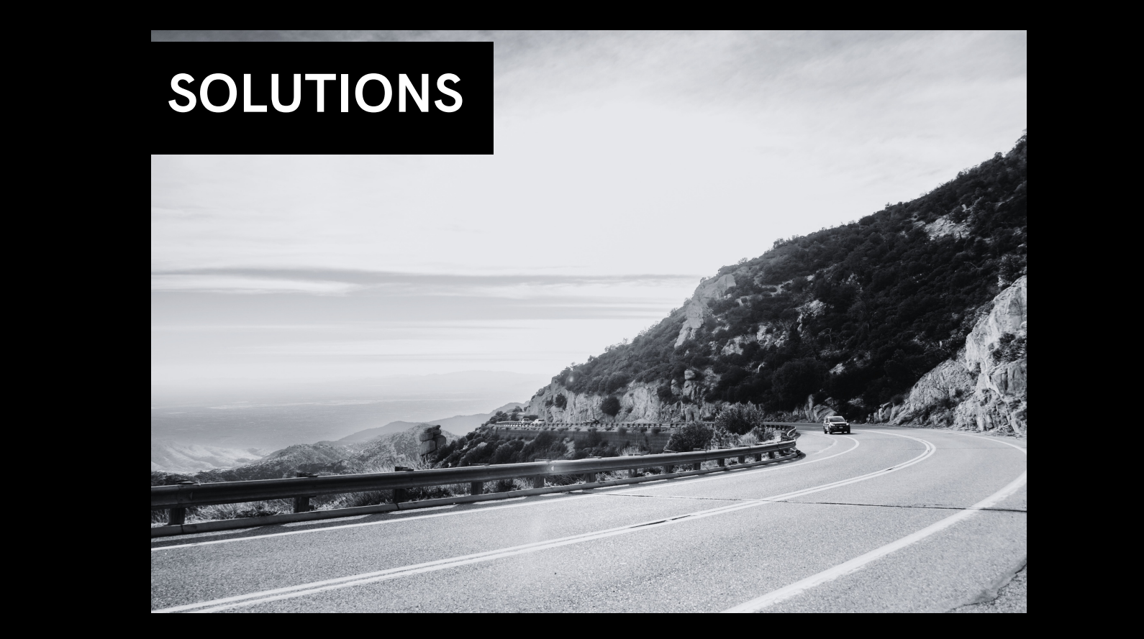

Slide 27
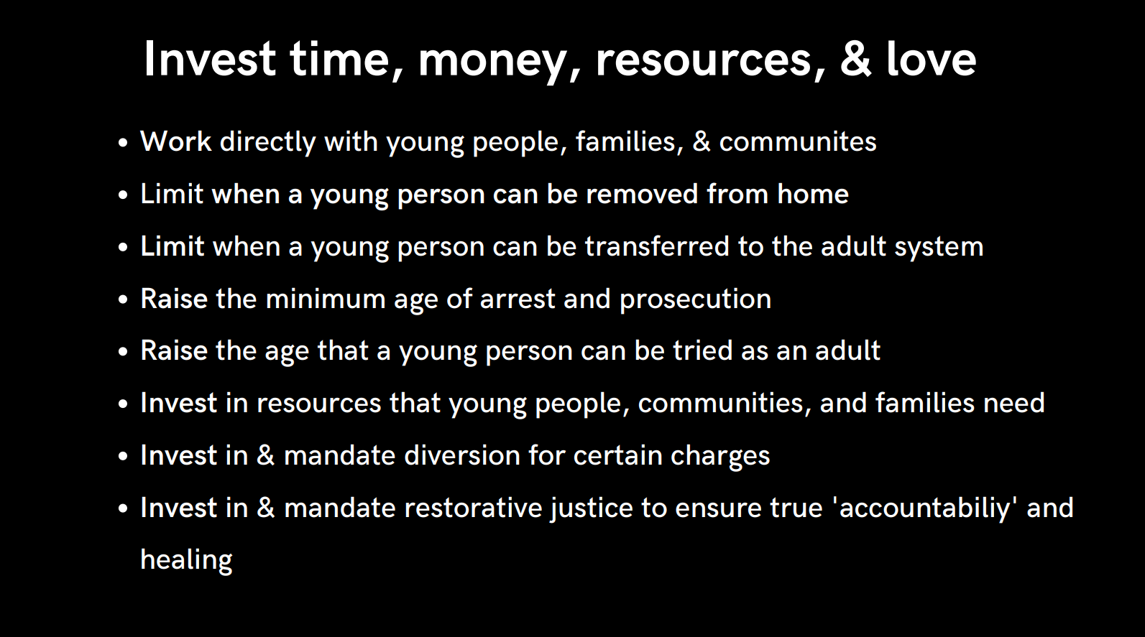

Slide 28
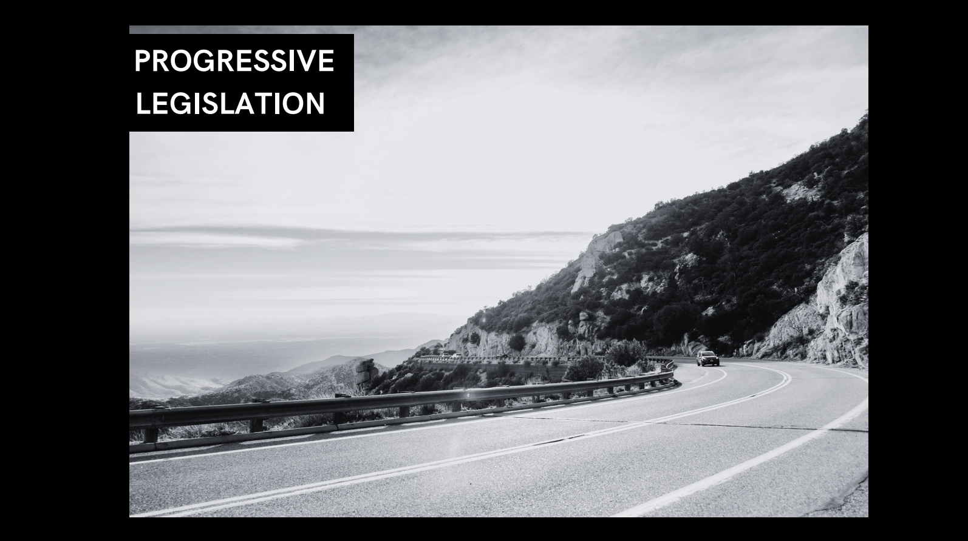

Slide 29
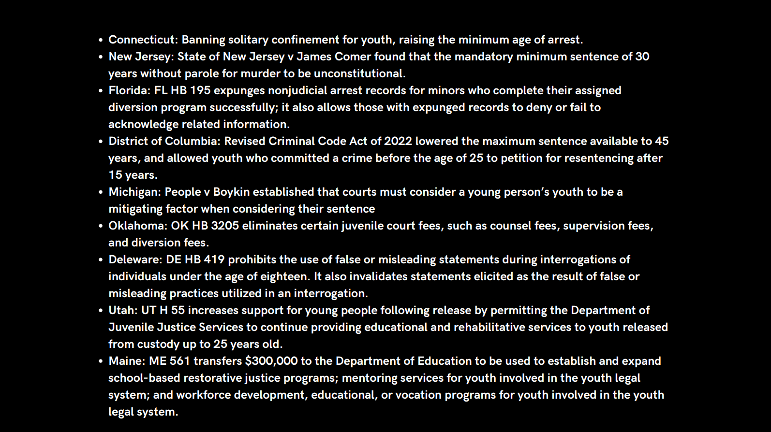

Slide 30
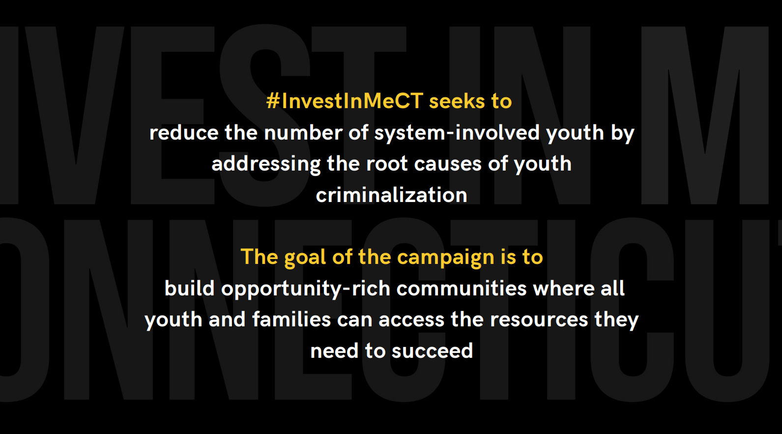

Slide 31
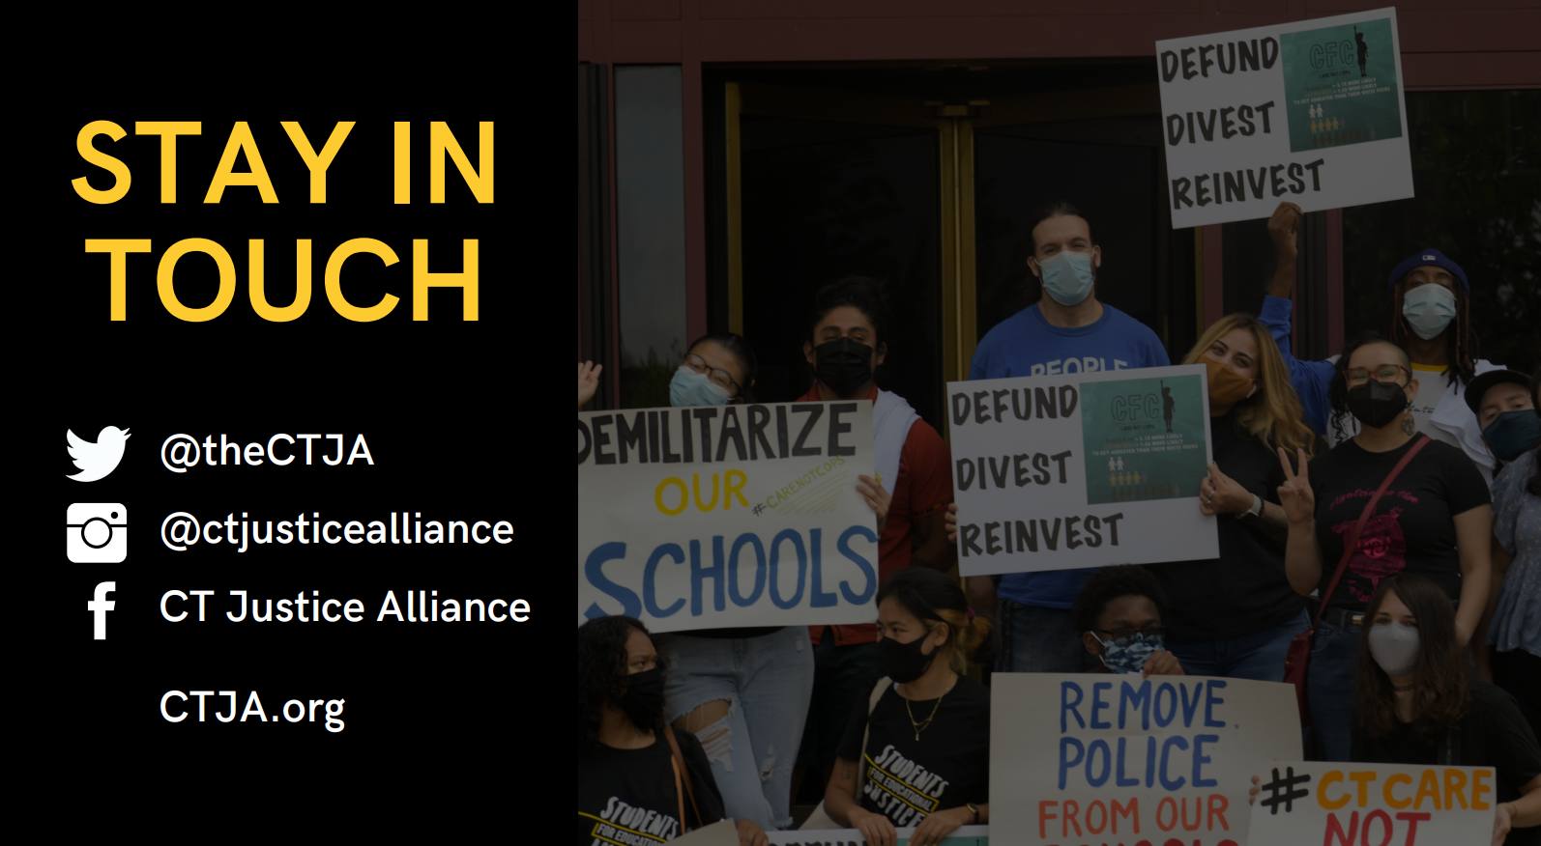

Slide 32
Contact Information
Ruth Rosenthal
The Pew Charitable Trusts
202-680-4547
rrosenthal@pewtrusts.org
pewtrusts.org/juvenilejustice
Christina Quaranta
CT Juvenile Justice Alliance
203-814-8452
christina@cttja.org
ctja.org

