Slide 1


2022 NAEP Mathematics & Reading Results at Grades 4 and 8
Embargoed
Grady Wilburn, Ph.D.
National Center for Education Statistics
Future of the American Child
January 23, 2023

Slide 2
Agenda
What is National Assessment of Educational Progress?
NAEP results
Questions and discussion

Slide 3

What is NAEP?

Slide 4








What is the National Assessment of Educational Progress?
Known as The Nation’s Report Card
Congressionally mandated project administered by the National Center for Education Statistics (NCES)
Common measure of student achievement across the country in a variety of subject areas since 1969
Gold standard of large-scale assessments

Slide 5
Why are the new NAEP data so important?
Detailed findings about how student achievement has changed since the pandemic began
  Changes in reading and math scores, from 2019 to 2022
  Results for the nation, states/jurisdictions, and large urban districts
  Breakdowns by race/ethnicity, gender, disability status, and other factors
Contextual data from surveys of students, teachers, and school administrators about the pandemic learning experience

Slide 6
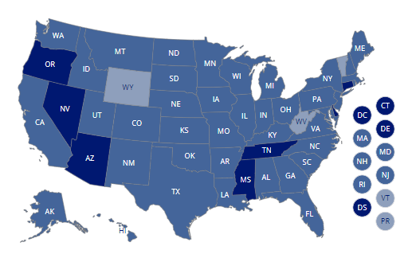
Main NAEP
2022 main NAEP findings for grades 4 and 8, with trends back to the 1990s and early 2000s for:
  The nation
  53 states/jurisdictions
  26 urban districts
  Math and reading achievement
  Student experiences

Slide 7
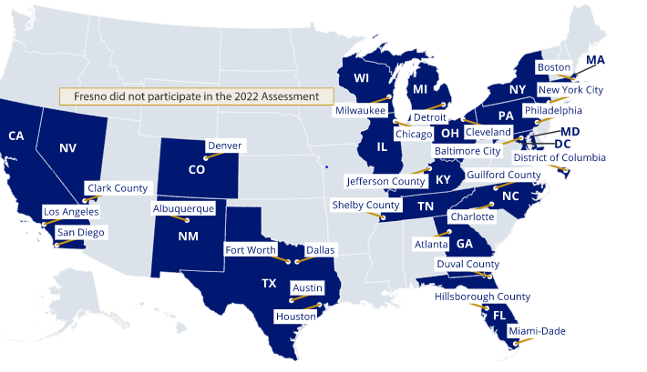
Main NAEP
2022 main NAEP findings for grades 4 and 8, with trends back to the 1990s and early 2000s for:
  The nation
  53 states/jurisdictions
  26 urban districts
  Math and reading achievement
  Student experiences

Slide 8


Overview of 2022 NAEP assessments
Data collected from January – March 2022
National, state, large urban district samples
  224,000 grade 4 students participated from approximately 5,700 schools
  222,000 grade 8 students participated from approximately 5,100 schools
Reported as average scores, percentiles, and NAEP achievement levels
School, teacher, and student survey questions
  Including questions related to learning during the pandemic

Slide 9

Mathematics Results National Overview

Slide 10
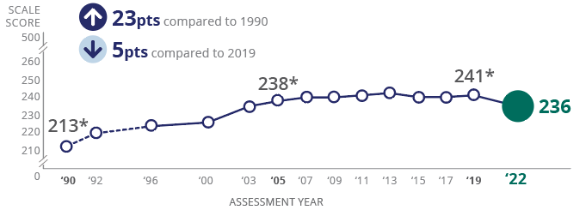
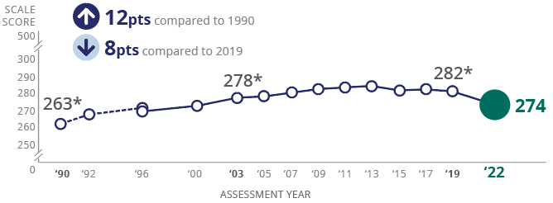
Largest ever score declines in mathematics
Grade 4
Grade 8
* Significantly different (p < .05) from 2022.

Slide 11
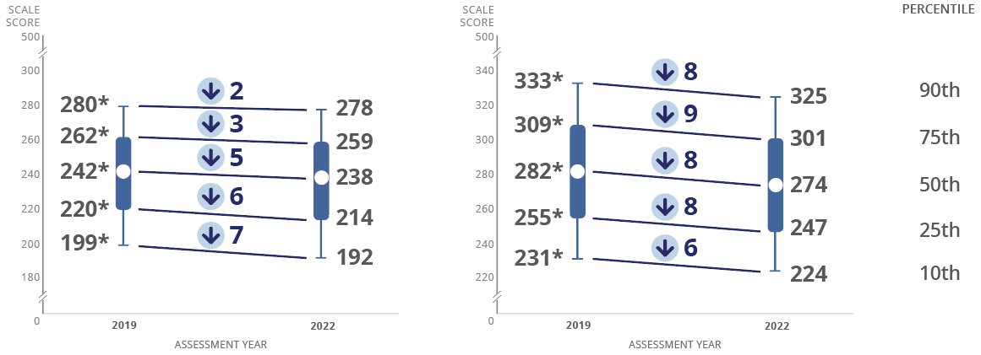
Since 2019, declines across percentiles; larger declines for lower performers at grade 4
Grade 4
Grade 8
* Significantly different (p < .05) from 2022.
NOTE: Arrow indicates significant difference (p < .05) in 2022.

Slide 12

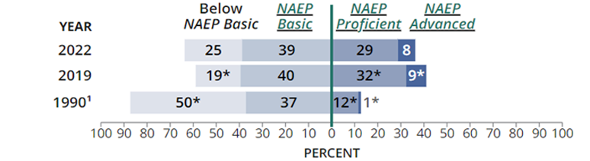
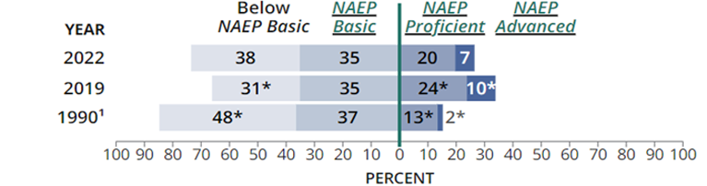
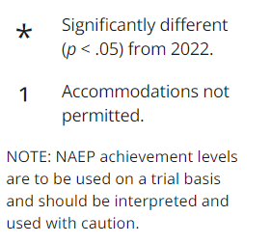
Decrease in students performing at NAEP Proficient
Grade 4
Grade 8
12
Notes:
Mathematics – Grade 4
Fourth-grade students performing at the NAEP Basic level can likely determine place value of whole numbers up to hundred thousands.
Fourth-grade students performing at the NAEP Proficient level can likely demonstrate an understanding of the relationships between the four operations (addition, subtraction, multiplication, and division).
Fourth-grade students performing at the NAEP Advanced level can likely compare and order whole numbers, fractions, and decimals to hundredths.
Mathematics – Grade 8
Eighth-grade students performing at the NAEP Basic level can likely find a missing angle in a triangle given two angles and understand that angles of a triangle add to 180 degrees.
Eighth-grade students performing at the NAEP Proficient level can likely apply problem-solving strategies to solve Pythagorean Theorem problems.
Eighth-grade students performing at the NAEP Advanced level can likely determine relative positions of points using the geometric ideas of midpoint involving directionality on the coordinate plane.

Slide 13
Largest declines ever for Black and Hispanic students at grade 4
 | Grade 4 |  | Grade 8
Group | 2022 Score | Change from 2019 | 2022 Score | Change from 2019
White | 246 |  | 285
Black | 217 |  | 253
Hispanic | 224 |  | 261
Asian | 259 |  | 306
Native Hawaiian/Pacific Islander | 224 |  | 264
American Indian/Alaska Native | 221 |  | 258
Two or more races | 239 |  | 276
3
8
7
7
7
7
4
7
-2
-1
6
-4
5
10
NOTE: Arrow indicates significant difference (p < .05) in 2022. Diamond indicates no significant change in 2022.

Slide 14
Lower scores across most student groups
 | Grade 4 |  | Grade 8
Group | 2022 Score | Change from 2019 | 2022 Score | Change from 2019
Male | 239 |  | 275
Female | 233 |  | 273
Economically disadvantaged | 223 |  | 260
Students with a disability | 212 |  | 243
English learner | 216 |  | 241
Public school | 235 |  | 273
Catholic school | 246 |  | 288
3
7
6
9
6
7
2
4
4
-2
5
8
#
6
NOTE: Arrow indicates significant difference (p < .05) in 2022. Diamond indicates no significant change in 2022. # Rounds to zero.

Slide 15

Mathematics State and District Results

Slide 16
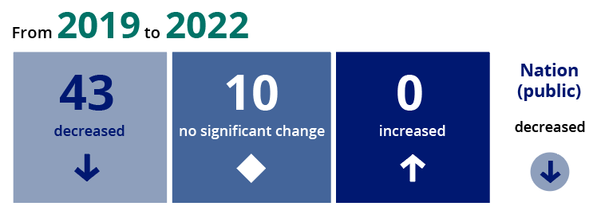
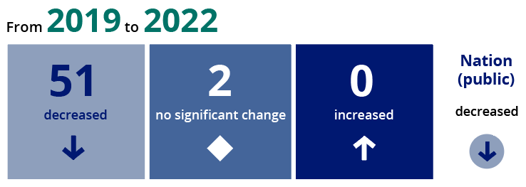
Scores decline across states during pandemic
Grade 4
Grade 8

Slide 17
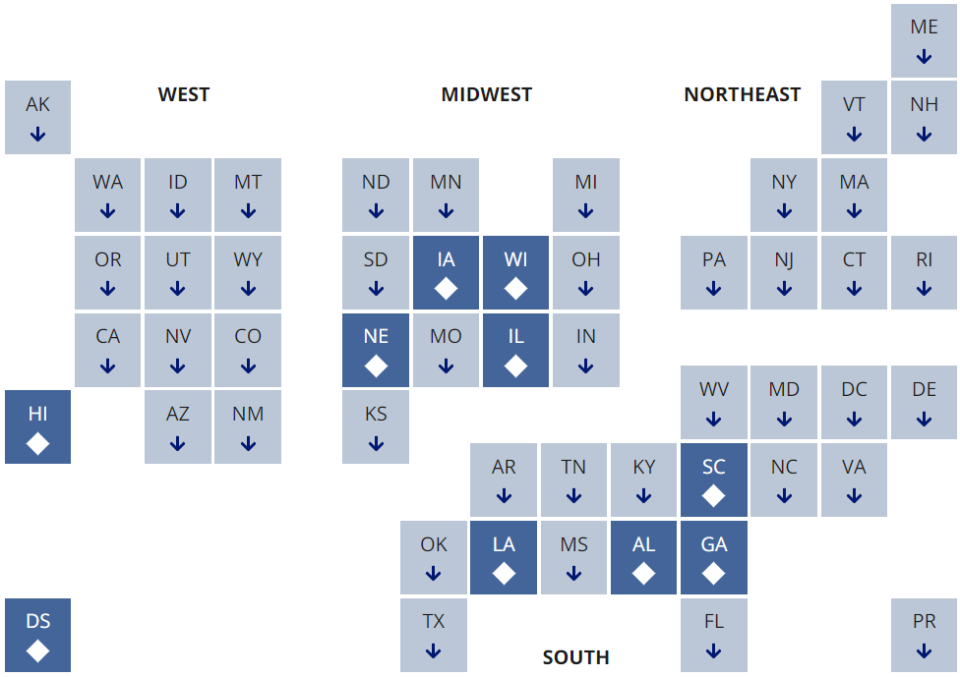
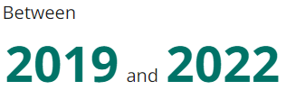
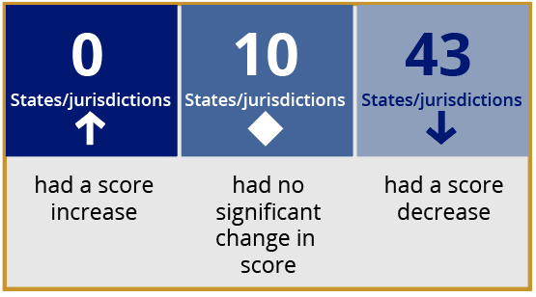
Grade 4 scores lower in 43 jurisdictions

Slide 18
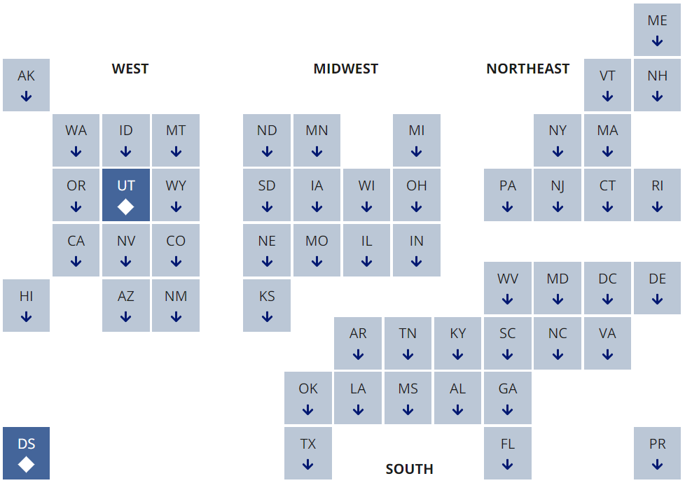
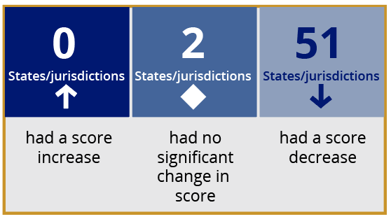
Grade 8 scores lower in nearly all jurisdictions

Slide 19
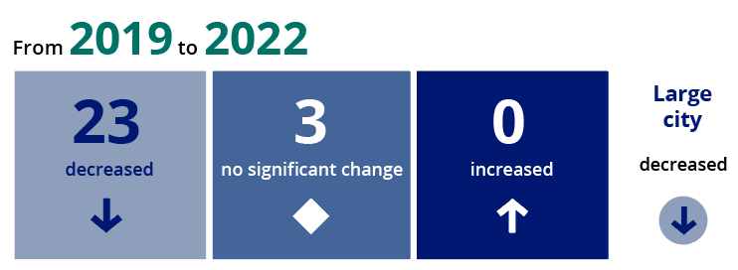

Scores decline in nearly all districts at both grades
Grade 4
Grade 8

Slide 20
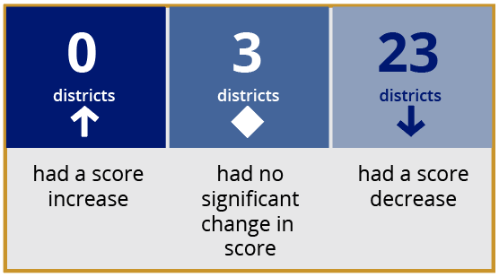
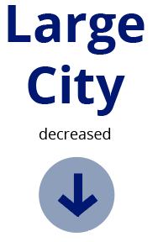
Grade 4 scores decline in 23 of 26 urban districts

Slide 21
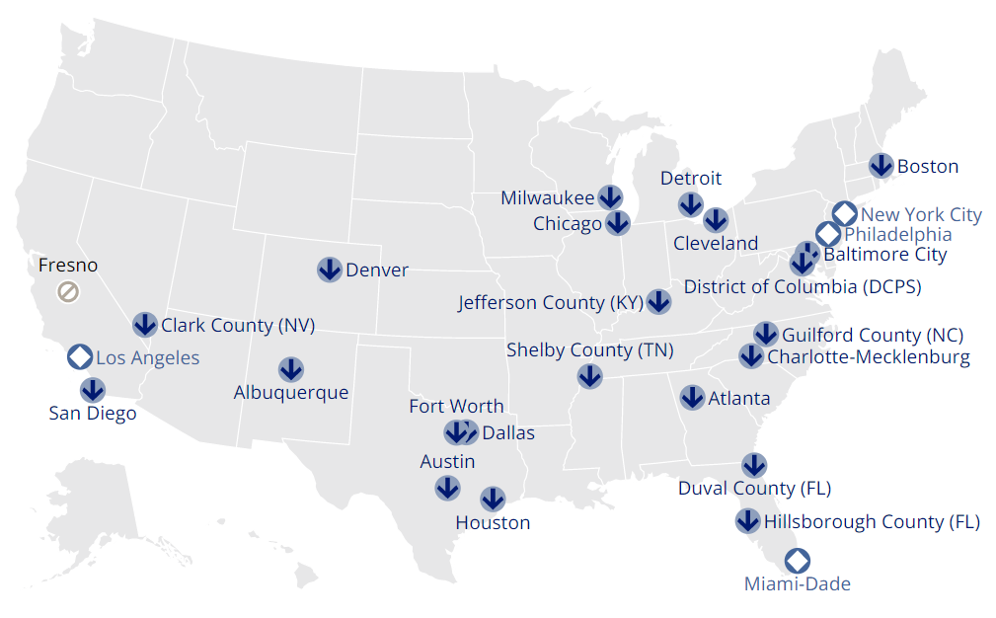
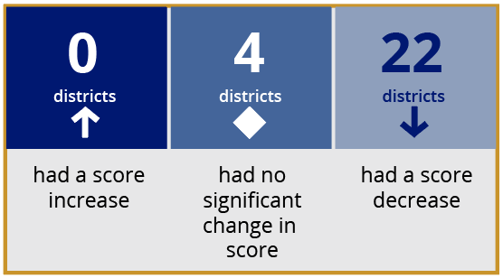
Grade 8 scores decline in 22 of 26 urban districts

Slide 22

Reading Results National Overview

Slide 23
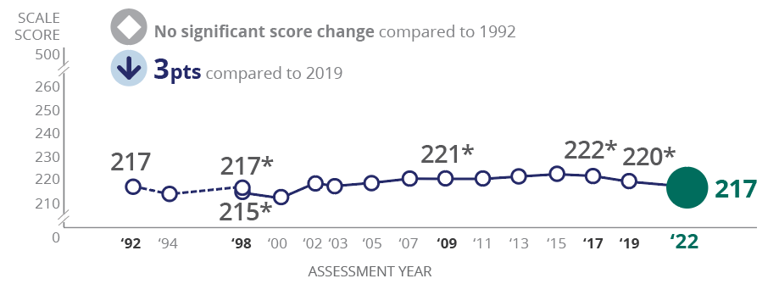
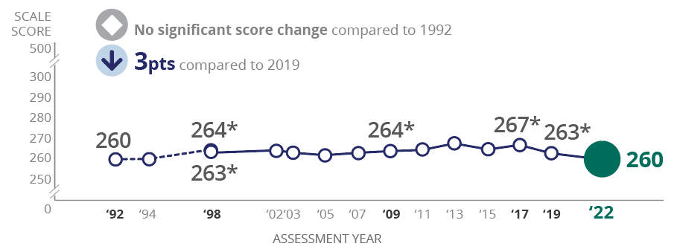
Reading scores declined during pandemic
Grade 4
Grade 8
* Significantly different (p < .05) from 2022.

Slide 24
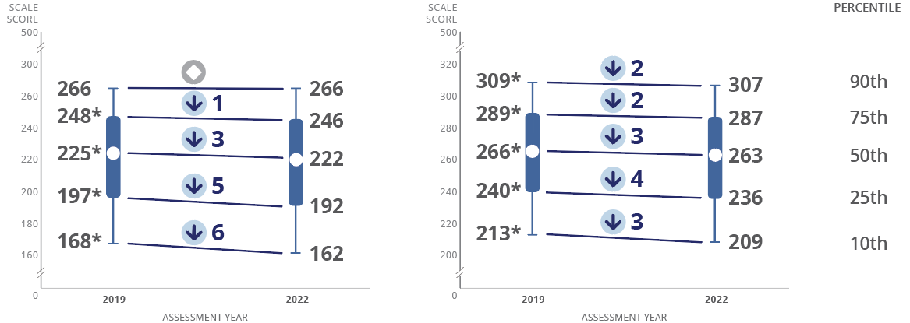
Higher-performing grade 4 students held steady
Grade 4
Grade 8
* Significantly different (p < .05) from 2022.
NOTE: Arrow indicates significant difference (p < .05) in 2022. Diamond indicates no significant change in 2022.

Slide 25

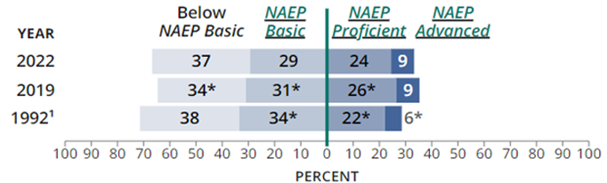
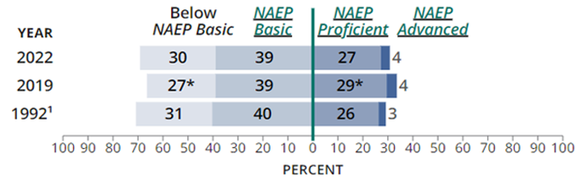
Decrease in students performing at NAEP Proficient
Grade 4
Grade 8
25
Notes:
Reading – Grade 4
An example of what fourth-grade performing at the NAEP Basic level can likely do is make a general reference to an appropriate section of literary text or provide some support for ideas related to the plot or characters.
An example of what fourth-grade performing at the NAEP Proficient level can likely do is identify the key events to determine main idea and make complex inferences about the characters’ actions, motivations, or feelings, using relevant evidence within or across literary texts.
An example of what fourth-grade performing at the NAEP Advanced level can likely do is identify relevant details to support a detailed judgment about a character and infer a character’s development from the beginning of the literary text to the end.
Reading – Grade 8
An example of what eighth-grade students performing at the NAEP Basic level can likely do is determine the main idea or purpose of the informational text using explicit features from the text.
An example of what eighth-grade students performing at the NAEP Proficient level can likely do is offer an opinion about the evidence an author uses to support a claim or argument in informational text.
An example of what eighth-grade students performing at the NAEP Advanced level can likely do is synthesize information across related informational texts and fully support their ideas with evidence from both texts.

Slide 26
Scores held steady for nearly all racial/ethnic groups at grade 8
 | Grade 4 |  | Grade 8
Group | 2022 Score | Change from 2019 | 2022 Score | Change from 2019
White | 227 |  | 268
Black | 199 |  | 244
Hispanic | 205 |  | 251
Asian | 241 |  | 283
Native Hawaiian/Pacific Islander | 207 |  | 254
American Indian/Alaska Native | 197 |  | 246
Two or more races | 223 |  | 265
3
4
5
#
4
-1
+2
-1
-5
+1
7
-2
-3
-2
NOTE: Arrow indicates significant difference (p < .05) in 2022. Diamond indicates no significant change in 2022. # Rounds to zero.

Slide 27
Greater score declines for females compared to males at grade 8
 | Grade 4 |  | Grade 8
Group | 2022 Score | Change from 2019 | 2022 Score | Change from 2019
Male | 214 |  | 256
Female | 221 |  | 265
Economically disadvantaged | 203 |  | 248
Students with a disability | 183 |  | 229
English learner | 190 |  | 225
Public school | 216 |  | 259
Catholic school | 233 |  | 279
2
1
4
4
4
2
-1
#
-1
4
3
3
-2
+1
NOTE: Arrow indicates significant difference (p < .05) in 2022. Diamond indicates no significant change in 2022. # Rounds to zero.

Slide 28
Reading State and District Results

Slide 29
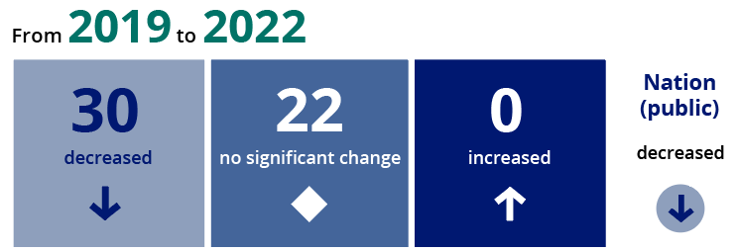
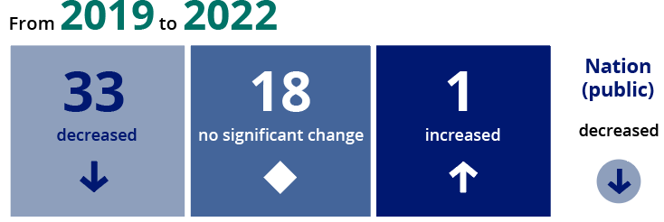
Scores declined across majority of jurisdictions across both grades
Grade 4
Grade 8

Slide 30
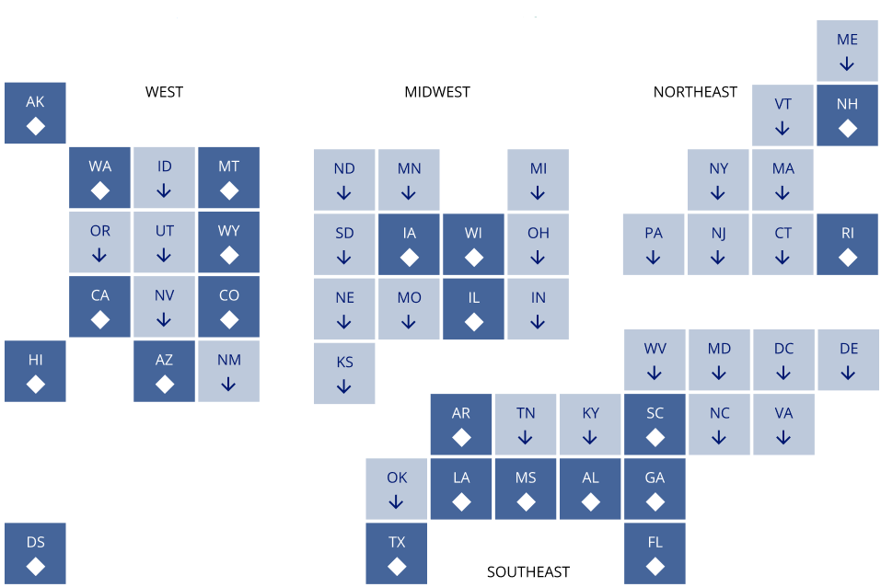
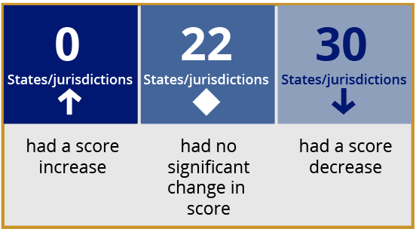
Grade 4 scores lower in 30 jurisdictions
West
Midwest
Northeast
South

Slide 31
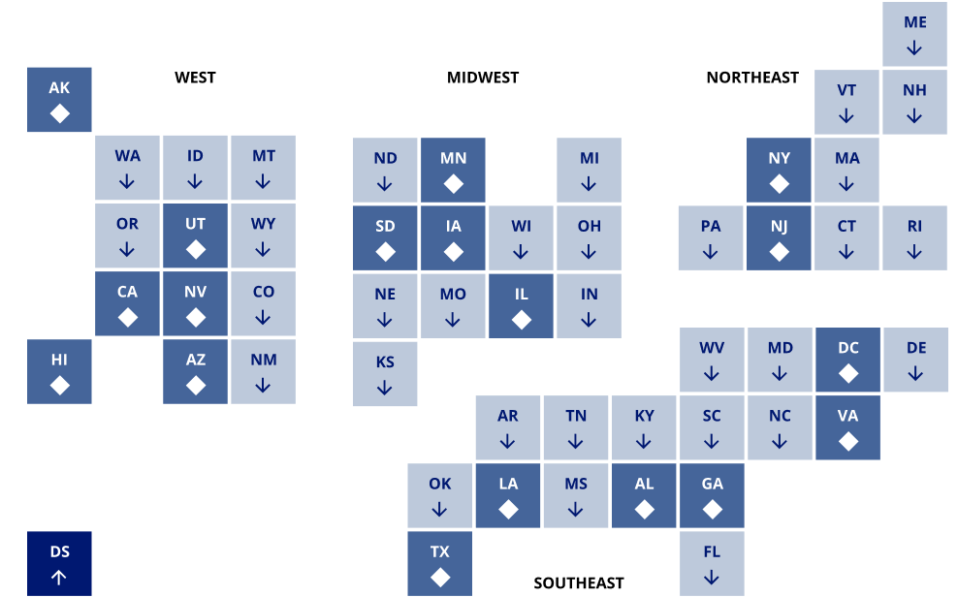
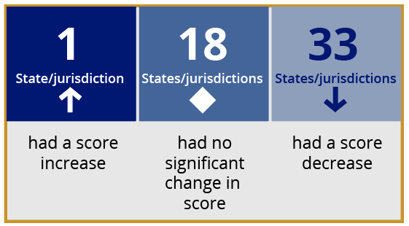
Grade 8 scores higher in 1 jurisdiction and lower in 33
West
Midwest
Northeast
South

Slide 32
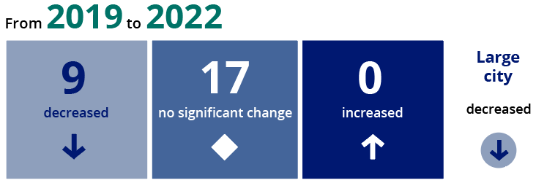
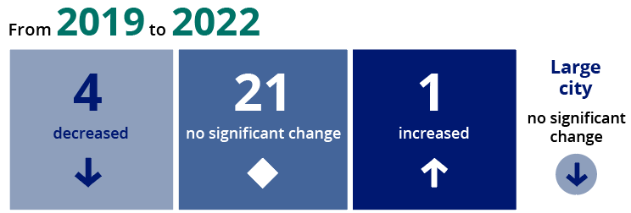

Majority of district scores remained stable compared to 2019
Grade 4
Grade 8

Slide 33
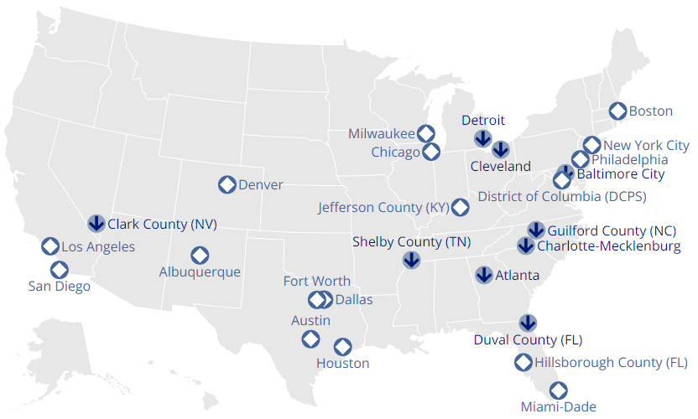
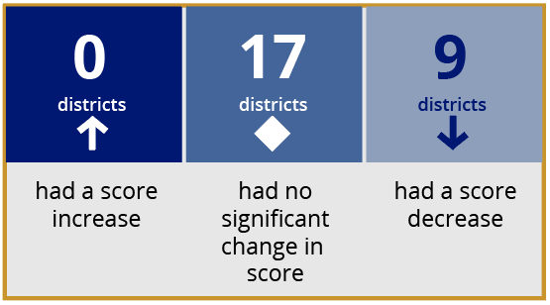
Grade 4 scores decline in 9 of 26 urban districts

Slide 34
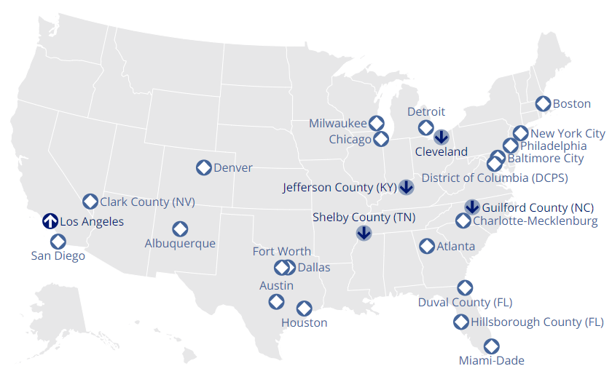
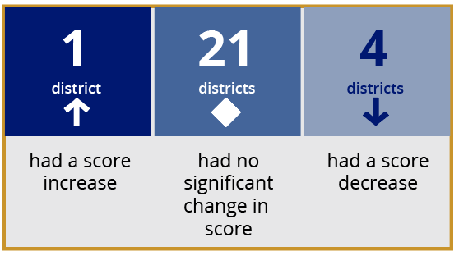
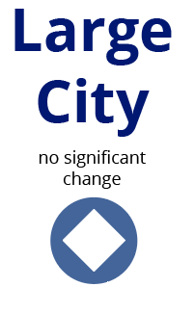
Grade 8 scores decline in 4 of 26 urban districts; increase in 1 district

Slide 35

Learning Opportunities and Disruptions During the Pandemic

Slide 36
Eighth-graders’ reports of learning remotely last year (2020-21) vary across states

Slide 37

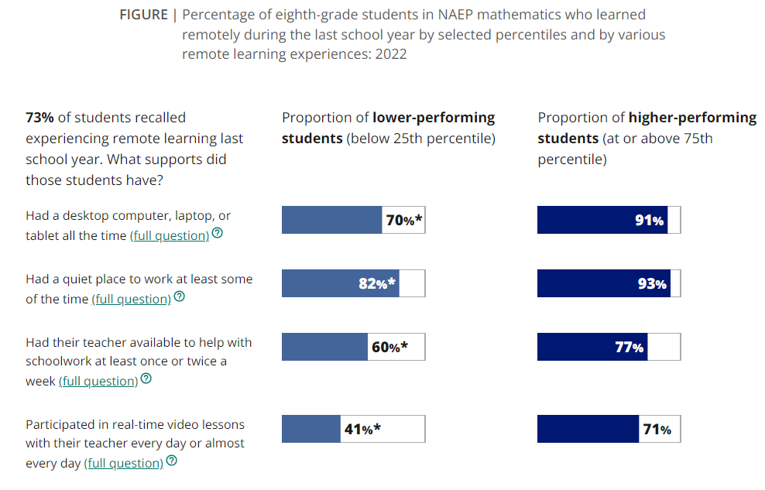


Higher-performing eighth-graders have more access to resources while learning remotely
* Significantly different (p < .05) from students performing at or above the 75th percentile.

Slide 38

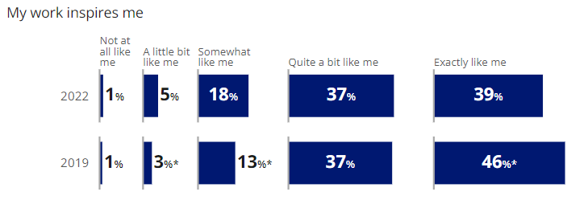

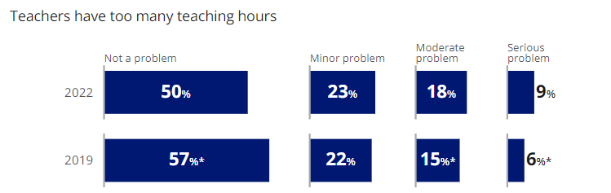

Shift in teachers’ attitudes towards work compared to 2019
* Significantly different (p < .05) from 2022.

Slide 39

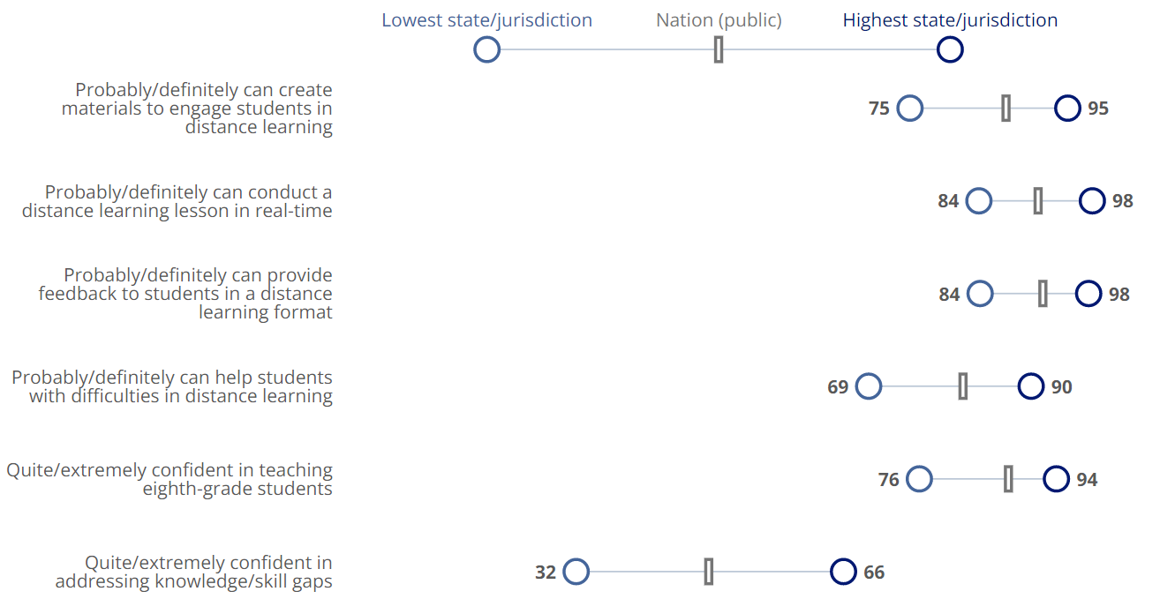



Teacher confidence low in addressing knowledge/skills gap across states
Ranges in percentages of eighth-grade public school students in NAEP mathematics whose teachers reported how confident they are in performing several tasks related to remote instruction by state/jurisdiction: 2022

Slide 40

Summary

Slide 41

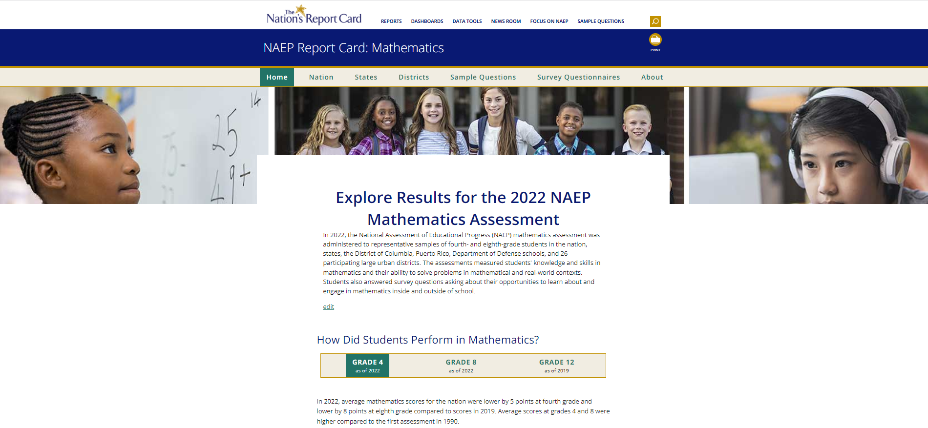


For More Information
www.nationsreportcard.gov
@NAEP_NCES
41

Slide 42
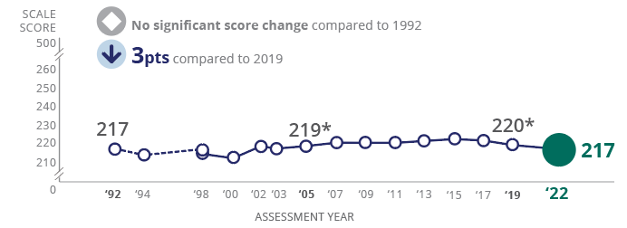
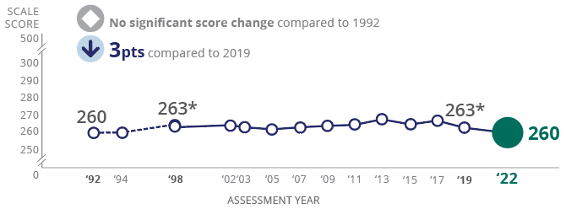
Scores decline during pandemic
Mathematics
Reading
4
8
*Significantly different (p < .05) from 2022.

Slide 43
Largest score declines in mathematics since 1990
Grade 4 mathematics
5 points compared to 2019
Larger declines for lower-performing students than higher performers
Larger declines for Black and Hispanic students than White students
Larger decline for female students than male students
No score change for Catholic school students
Score declines for 43 states/jurisdictions and 23 districts

Slide 44
Largest score declines in mathematics since 1990
Grade 8 mathematics
8 points compared to 2019
Consistent score declines across the percentiles
Consistent score declines for White, Black, Hispanic, and Asian students
No score change for English learners
Score declines for 51 states/jurisdictions and 22 districts

Slide 45
Scores decline in reading during pandemic; no score change since 1992
Grade 4 reading
3 points compared to 2019
Larger declines for lower-performing students than higher performers (no change at 90th percentile)
Declines for White, Black, Hispanic, and American Indian/Alaska Native students
No score change for students with disabilities
No score change for Catholic school students
Score declines for most states/jurisdictions (30), few districts (9)

Slide 46
Scores decline in reading during pandemic; no score change since 1992
Grade 8 reading
3 points compared to 2019
  Consistent score declines across the percentiles
  Score decline for White students
  No score change for Black or Hispanic students
  No score change for students with disabilities
  Score gain for English learners
  No score change for Catholic school students
  Score declines for most states/jurisdictions (33), few districts (4)
  Score gain in Los Angeles

