Slide 1
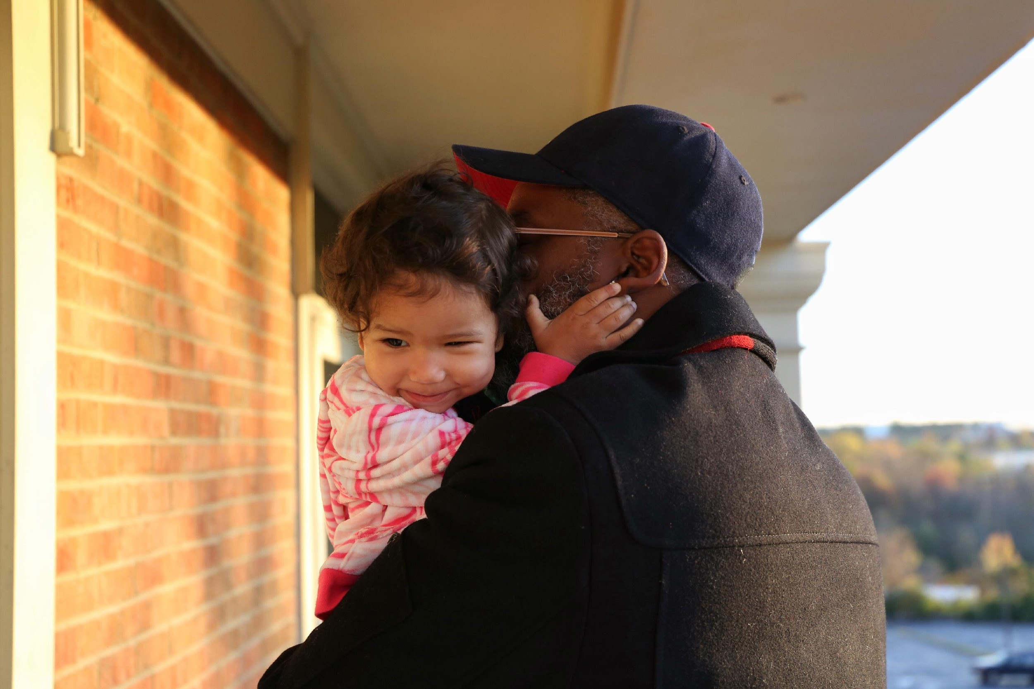
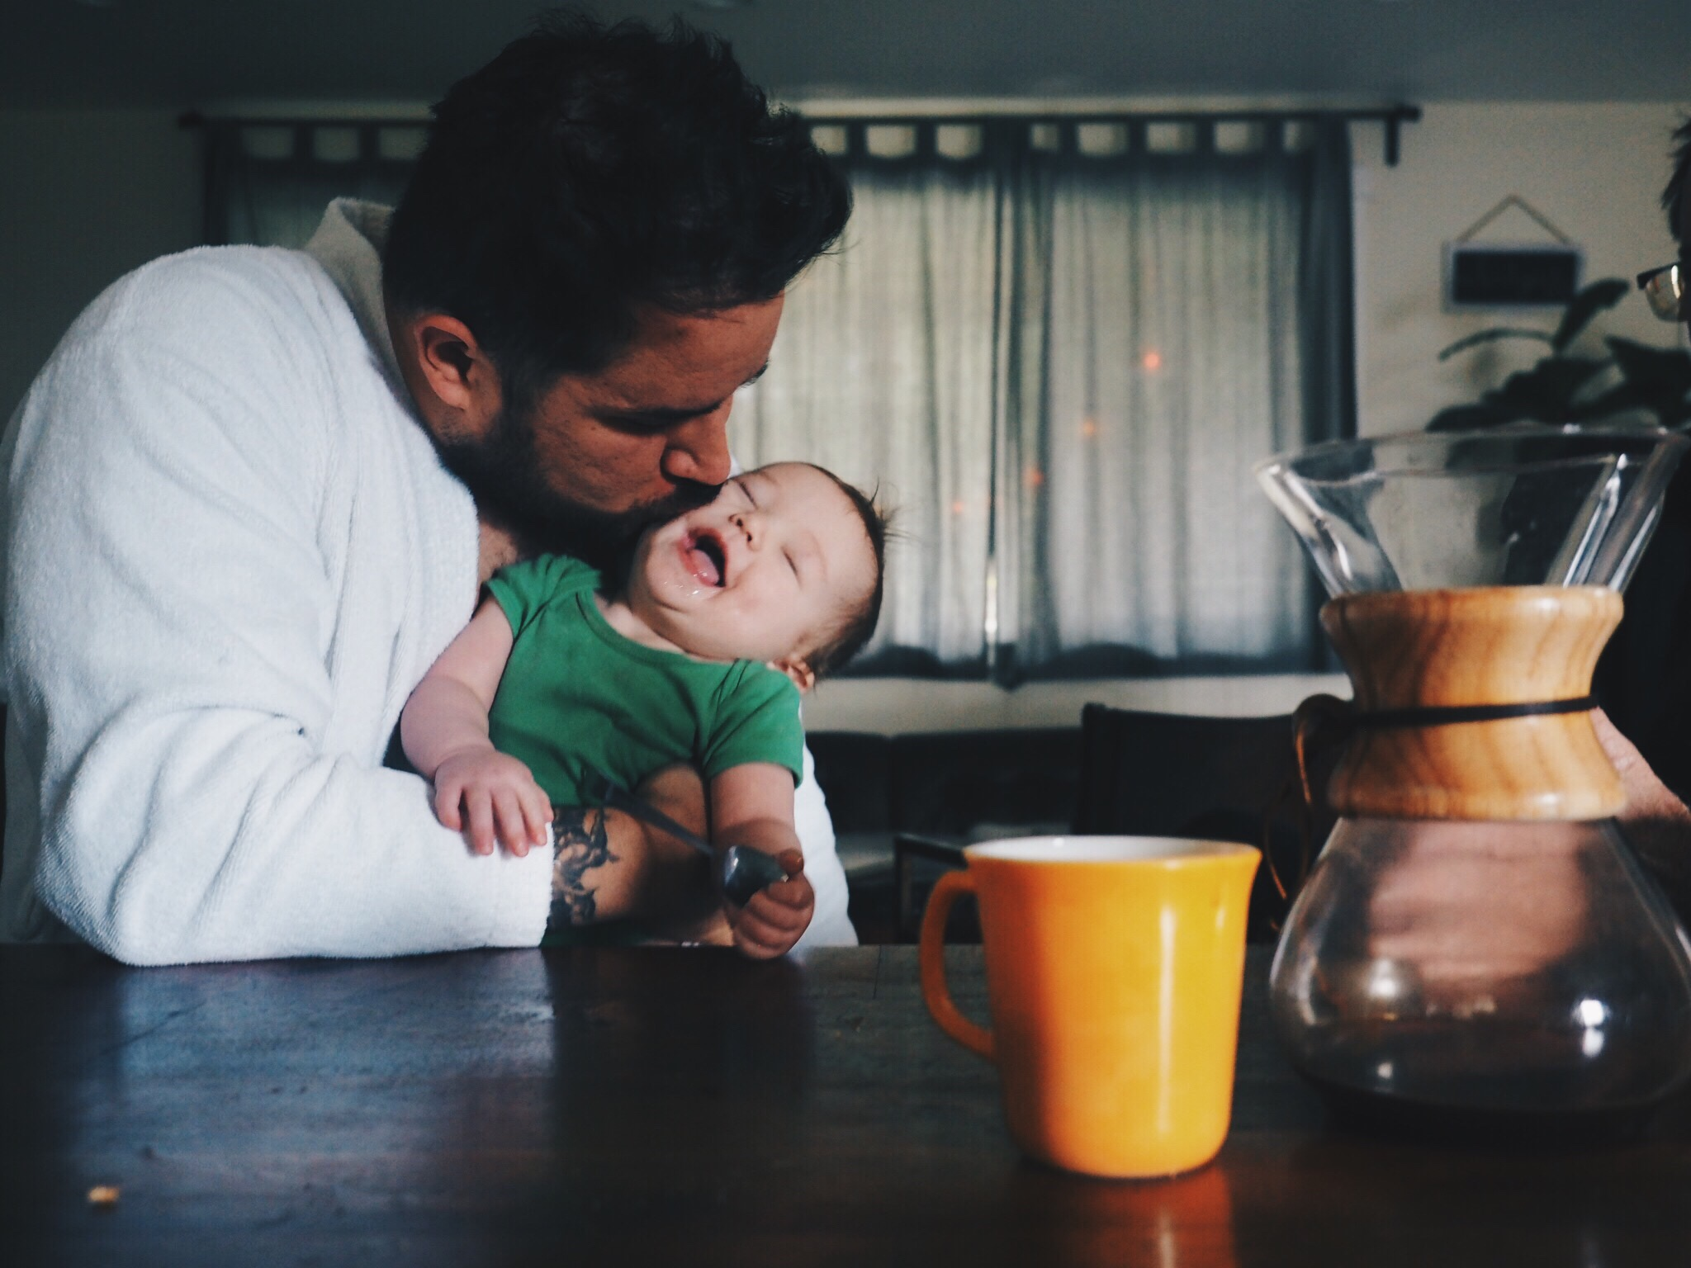
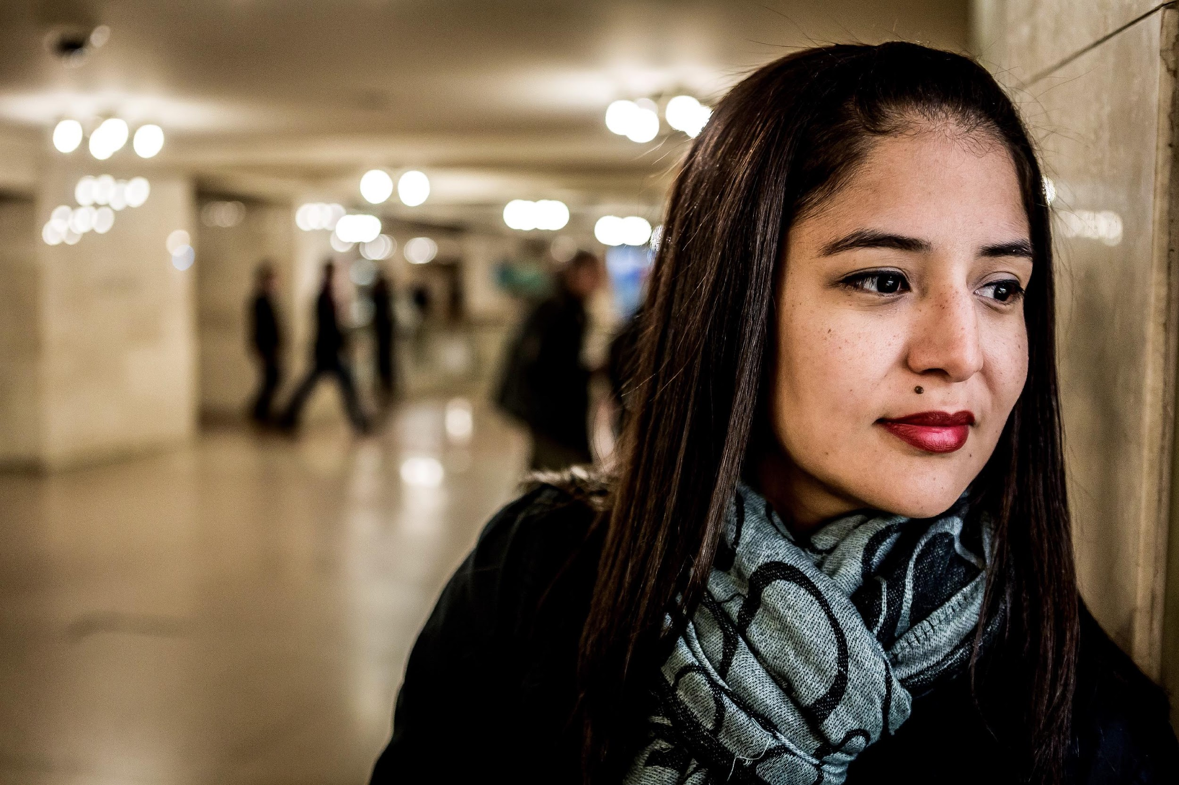
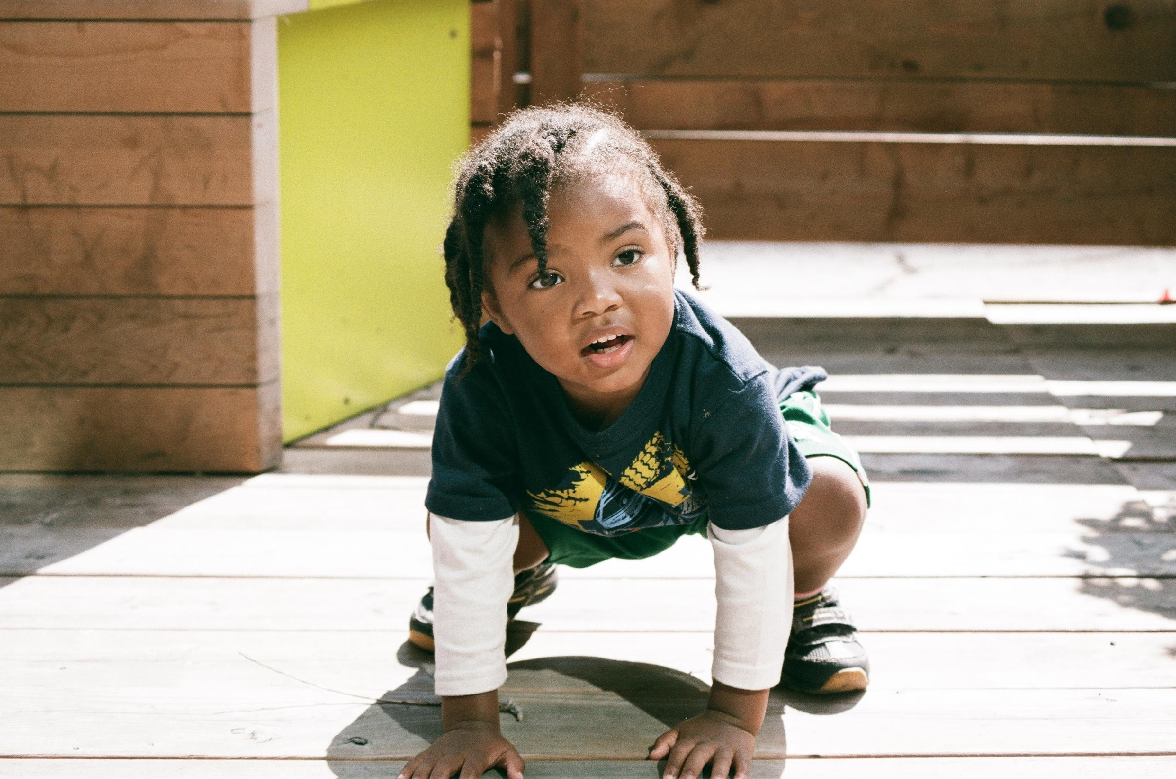






DISMANTLING CHILD WELFARE: THE WAY FORWARD?
Alan Dettlaff, PhD, MSW
@alandettlaff
www.upENDmovement.org

Slide 2
Overview
Review the common myths and misunderstandings of the ”child welfare” and “foster care” systems
Review what we know about racial disproportionality and disparities in the child welfare system.
Review evidence of the harm that results to children and families from child welfare intervention and the disproportionate harm that results to Black children and families.
Introduce abolition as the solution to ending the racism and harm that results from child welfare intervention.

Slide 3
Myths & Realities of the Child Welfare System

Slide 4
Myths of “Child Welfare”
The child welfare system is a “helping” system.
It is necessary to separate children from their parents to ensure their safety.
When children are separated from their parents, they live in safe and loving foster homes.
Parents are offered services to address their needs and it is their fault if their children are not returned to them.

Slide 5
Realities of “Child Welfare”
More than 70% of children in foster care have been separated from their parents due to “neglect.”
Only 17% of children in foster care have experienced physical or sexual abuse.
Family separation causes immense harm and is a source of lifelong trauma for children.
Rates of physical and sexual abuse in foster care are 2-3x the rates of abuse in the general public.
Parents receive no support or services to address their actual needs.
Significant racial disparities have impacted Black children since the earliest origins of the system and remain to this day.

Slide 6
Racial Disproportionality & Disparities

Slide 7
Racial Disproportionality
Racial disproportionality has been observed in the child welfare system for over 60 years yet persists as a national problem.
Disproportionality occurs when the proportion of children in foster care is proportionately larger (overrepresented) than the same group in the general population.
Disproportionality has most significantly impacted Black children, who represent more than 25% of children in foster care, although they represent only 12%-15% of the general population.
Racial disproportionality also exists among Native American and Latinx children, but to a lesser degree and with variations by state.

Slide 8
Racial Disproportionality (FY2020)

Slide 9
Racial Disparities
Racial disproportionality exists because of racial disparities that occur along the child welfare service pathway that impact both entries into and exits from the system.
Beginning with the point of initial referral, Black children are more likely than White children to be:
Reported for suspected maltreatment
Confirmed/substantiated for maltreatment
Removed from their homes and placed in foster care
Black children are also less likely than other children to exit to reunification and spend longer time in foster care.

Slide 10
Why Racial Disproportionality & Disparities Exist

Slide 11
Why Racial Disproportionality Exists
There is no evidence of differential rates of maltreatment by race.
Four predominant theories based on available evidence:
Disproportionate need resulting from poverty and related risks
Racial bias among child welfare staff and mandated reporters, as well as institutional racism in policies and practices of child welfare agencies
Child welfare system factors, including a lack of resources to address the needs of families of color
Geographic context, including neighborhood conditions of concentrated poverty
Each of these factors result from a common underlying factor – structural and institutional racism.

Slide 12
External Factors
Historical lens: Enslavement & dehumanization; Forced family separation; Laws & Policies to maintain white supremacy
RACISM
-Income & wages
-Wealth
-Education
-Employment
Poverty
-Health disparities
-Human development &
parenting contexts
-PTSD/PTSS
Health & Stress
-Racial residential segregation
-Housing
-Concentrated poverty
-Mass incarceration
Geographic Contexts
Dettlaff, A. J., & Boyd, R. (2020). Racial disproportionality and disparities in the child welfare system: Why do they exist and what can be done to address them? ANNALS of the American Academy of Political and Social Science, 692, 253-274.

Slide 13
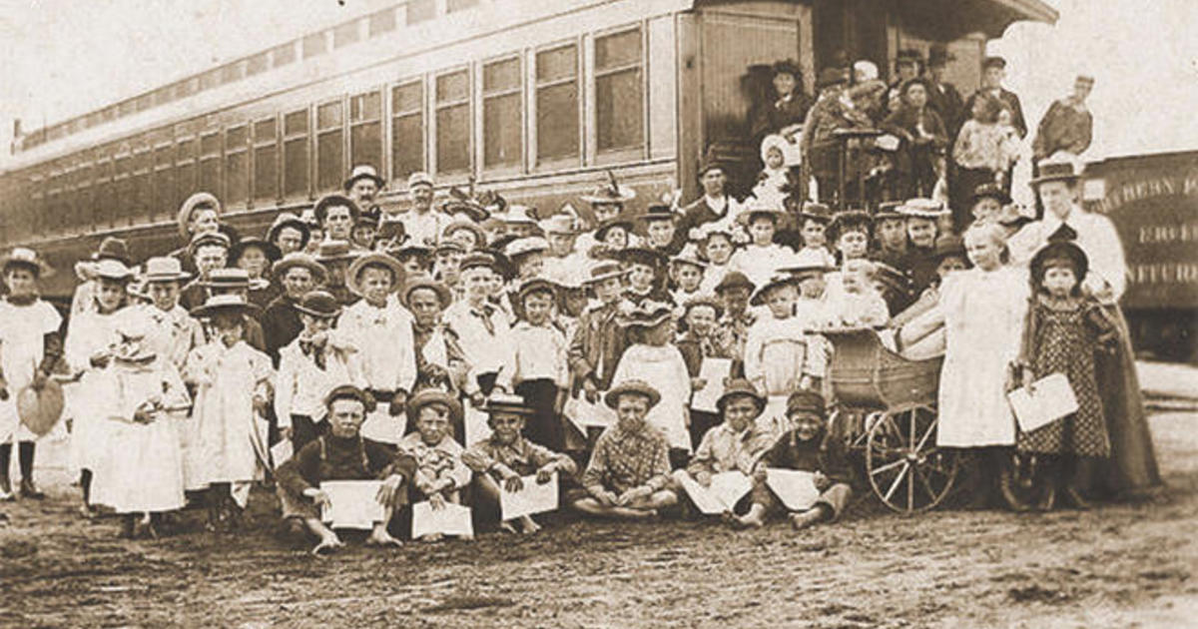
The History of the Child Welfare System

Slide 14
The History of the Child Welfare System
Passage of Social Security Act and Aid for Families with Dependent Children
The Flemming Rule
Child Abuse Prevention and Treatment Act (CAPTA)
Adoption and Safe Families Act (ASFA)
Best Interests of the Child Standard
Court Appointed Special Advocates (CASA)

Slide 15
Internal Factors: Evidence of Bias
Decision Point Studies in Texas (2008-2011) examined cases reported to DFPS between 2003 - 2005 (N = 176,734)
Two decision-points: Substantiation & Services/Removal Decision
Need for Intervention (Services vs. Closed)
Type of Intervention (Removal vs. Family-Based Services)
Controlled for family income and caseworkers’ assessment of risk, as well as other factors
Dettlaff, A. J., Rivaux, S. R., Baumann, D. J., Fluke, J. D., Rycraft, J. R., & James, J. (2011). Disentangling substantiation: The influence of race, income, and risk on the substantiation decision in child welfare. Children and Youth Services Review, 33, 1630-1637.
Rivaux, S. L., James, J., Wittenstrom, K., Baumann, D., Sheets, J., Henry, J., & Jeffries, V. (2008). The intersection of race, poverty, and risk: Understanding the decision to provide services to clients and to remove children. Child Welfare, 87, 151-168.

Slide 16
Internal Factors: Evidence of Bias
When controlling for poverty and risk:
Black children are 15% more likely than Whites to be involved in a substantiated case
When controlling for poverty and risk:
Among all maltreated children, Black children are 20% more likely than White children to be involved in a case that is opened for services
Of cases opened for services, Black children are 77% more likely than White children to be removed in lieu of in-home services

Slide 17
Internal Factors: Evidence of Bias

Slide 18
Language Is Important
Racial Disproportionality
Racial Disparities

Slide 19
Language Is Important
X
X
Racial Disproportionality
Racial Disparities
Racist Inequities

Slide 20
Disproportionate Involvement Causes Disproportionate Harm

Slide 21
Family Separation
Research shows the act of forcible separation of children from their parents is a source of significant and lifelong trauma.
Trauma associated with parental separation has been shown to result in cognitive delays, increased aggression, poor educational achievement, and adverse health outcomes including hypertension, difficulty sleeping, obesity, and diabetes.
Following separation, children who spend time in foster care are more likely to experience a host of adverse outcomes.
https://www.americanbar.org/groups/litigation/committees/childrens-rights/trauma-caused-by-separation-of-children-from-parents/

Slide 22
Outcomes of Foster Care
In studies that specifically compared children who were removed from their homes to children who had experienced similar forms of maltreatment but remained at home, children who were removed:
had two to three times higher delinquency rates;
had higher teen birth rates;
had lower earnings as adults;
were twice as likely to have learning disabilities and developmental delays;
were six times more likely to have behavioral problems;
were more likely to have substance-related disorders, psychotic or bipolar disorders, and depression and anxiety disorders; and
had arrest rates two to three times higher and are more likely to have criminal convictions for violent offenses.
https://www.nccprblog.org/2018/08/and-now-there-are-at-least-five-still.html

Slide 23
Disproportionate Risk of Harm
While these risks exist for all children who enter foster care, the risk of experiencing these outcomes is exacerbated for children of color due to the ongoing legacy of racism and inequality.
Black children in America are already at risk of poor outcomes over the course of their lives including economic hardship, poor health, low educational attainment, teen births, criminal legal system involvement, emotional distress, and suicidal ideation.
For children who experience the added trauma of forced separation and placement in foster care, the risk of experiencing these outcomes is increased.

Slide 24
Questions to Consider
Can a system that began with a racist intent evolve into a system that achieves racial equity?
Can decades of racist policies be revised to no longer produce racist outcomes?
Is racial equity an appropriate goal for a system that produces harm?

Slide 25
The upEND Movement to Abolish the Child Welfare System

Slide 26
Why upEND?
Decades of research have documented not only the existence of racial disproportionality, but also the harmful effects of disproportionality on Black children and families.
Despite decades of reforms and attempts to address this, racial disproportionality persists, and the harm that results to Black children and families continues.
Given the inability of the current system to address this, it is time to consider a new framework that reimagines how we care for children.

Slide 27
Why upEND?
Reforms are no longer sufficient.
Eliminating racial disproportionality and disparities, and the harm they cause, will only be achieved when the forcible and involuntary separation of children from their parents is no longer viewed as an acceptable form of intervention.
The harm that results from family separation, and the families that are destroyed as a result, will only end through a fundamental reimagining of how we support child, family, and community safety and well-being.

Slide 28
What is the upEND Movement?
An emerging, collaborative movement aimed at:
ending the use of involuntary separation of children from their families; and
increasing meaningful supports so families and communities can care for their children.
Seeks to rethink state sanctioned separation of children from their families as a response to social problems like food insecurity, poverty, lack of affordable and safe housing, and lack of meaningful prevention services.

Slide 29
Abolition
“…abolition is not merely the absence of police, it’s eliminating the root causes of harm, and its eliminating the kind of society that could rely on police to solve that harm.” – Derecka Purnell
“Abolition works to dismantle systems that cause harm and reallocate funds to social and economic resources, and to develop new systems of community controlled public safety and restorative justice.” – Robin D. G. Kelley
While abolition intends to end harmful, racist systems, its focus is on building a new liberated society–a society free from violence and oppression where all members are truly equal.
In this way, abolition is not simply about ending harmful, racist systems–it is about building a society where the need for harmful, racist systems is obsolete.
Notes:
In applying this vision to policing and prisons, abolition seeks to build a society where individuals have everything they need to thrive - where divesting from the police will not only reduce police violence, but will allow us to reinvest in the things that truly keep us safe–housing, jobs, well-funded public schools, access to mental health services, and other resources that families and communities need. Similarly, the movement to abolish the child welfare system seeks to build a society where all children and families have everything they need to experience safety in their homes and their communities, free of violence and harm, and free of the societal conditions that create violence and harm.

Slide 30
Abolition
By abolition, we mean the elimination of the current child welfare system, which is built on a model of surveillance and separation of families, and a fundamental reimagining and recreating of the ways in which we support children, families, and communities.
Abolition of child welfare does not mean abandoning the need to care for children.
It means building new ways of protecting and supporting families while also dismantling coercive systems of surveillance and punishment.
Abolition is a process.

Slide 31
Reimagining
Re-imagining is a process of co-creation with community organizers, parents, youth, and advocates:
Strong systems of support that enable families to have access to the resources in their community that they need to truly thrive.
Creating and improving systems of community-based support that provide a child allowance, safe and affordable housing, jobs that pay sustainable wages, mental health services, food, domestic violence supports, and substance use programs.
What reimagining will look like:
All families have concrete supports; residents of communities intervene when needed; community members provide support to those who need it; a sufficient community array of supports and interventions exist; and there is a community system of care that can minimize and address harm.

Slide 32
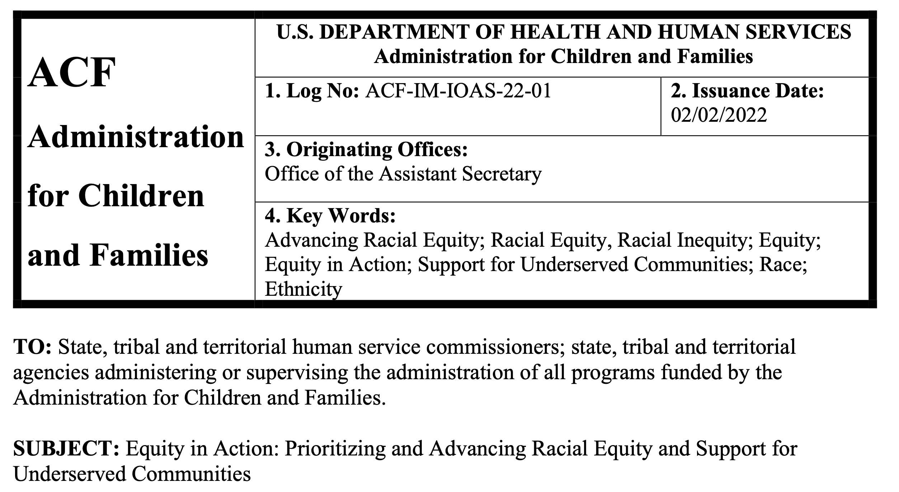
What “Racial Equity” Obscures

Slide 33
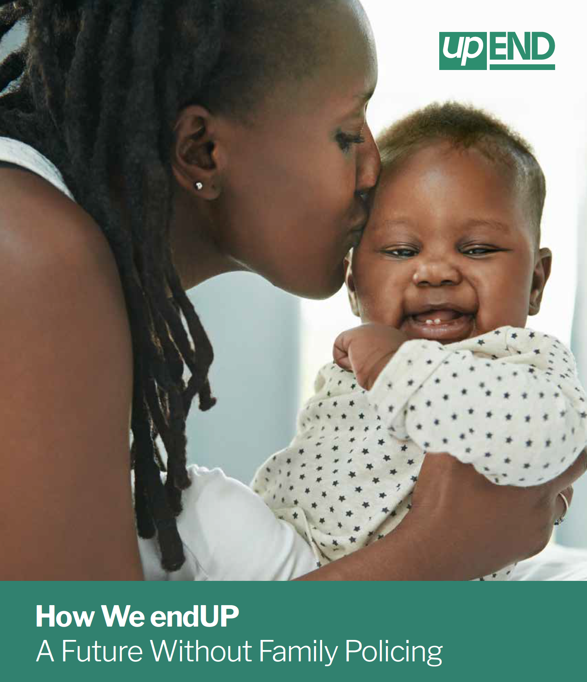
How We endUP: A Future Without Family Policing
End Involuntary Separation of Children
Reunite Children Currently In Care
End Surveillance of Families
Prioritize Care Over Punishment
Transform Societal Conditions
Reimagine Care for Children and Families
Shift Power to Families as First Responders

Slide 34
Five Take Aways
Family separation causes immense harm – the child welfare system forcibly separates over 250,000 children from their parents every year.
More that 70% of family separations are the result of poverty.
Black children have been disproportionately harmed by child welfare intervention since the system’s earliest origins – no reform has ever reduced this harm – this is not an unintended consequence.
Ending the use of family separations – by ending the system that supports this – is the only way to end the harms that result.
Abolition is more than the negative aspect of tearing down – it is about the positive aspect of building and creating something new.

Slide 35
The upEND Movement
Abolition is about presence, not absence.
Abolition is a way of seeing. Abolition makes you ask, when you look, what are you seeing, and what would you rather see?
~ Ruth Wilson Gilmore

Slide 36
The upEND Movement
Questions / Discussion
@alandettlaff

