Slide 1


Undocumented Children and Youth: Protecting Their Rights and Safety
Dalia Castillo-Granados, Director, CILA
Aimee Korolev, Legal Director, ProBAR
January 23, 2023

Slide 2
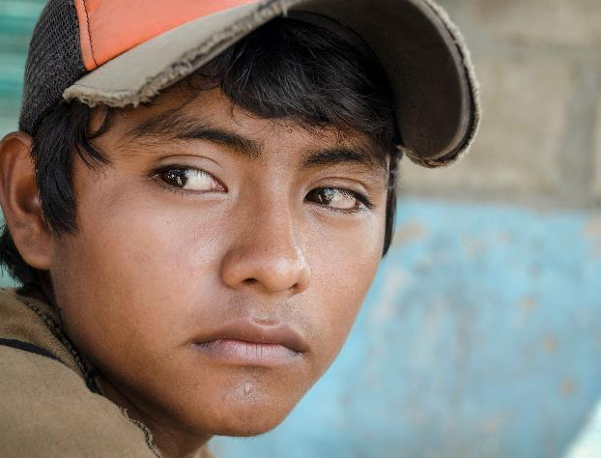

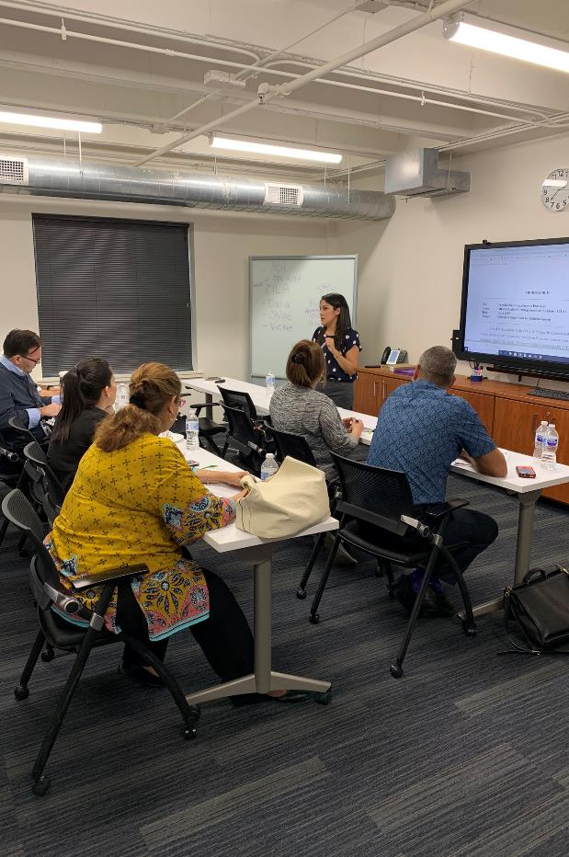
CHILDREN’S IMMIGRATION
LAW ACADEMY (CILA)
CILA IS A PROJECT OF THE AMERICAN BAR ASSOCIATION’S COMMISSION ON IMMIGRATION.
WE ARE A LEGAL RESOURCE CENTER.
WE ARE A CAPACITY BUILDING ORGANIZATION.
WE THINK EVERY CHILD SHOULD HAVE REPRESENTATION.
Notes:
CILA is a project of the ABA.
We are a legal resource center.
We are a capacity building organization.
We don’t think children should have to go to court alone and that’s a primary reason we are doing this work.

Slide 3
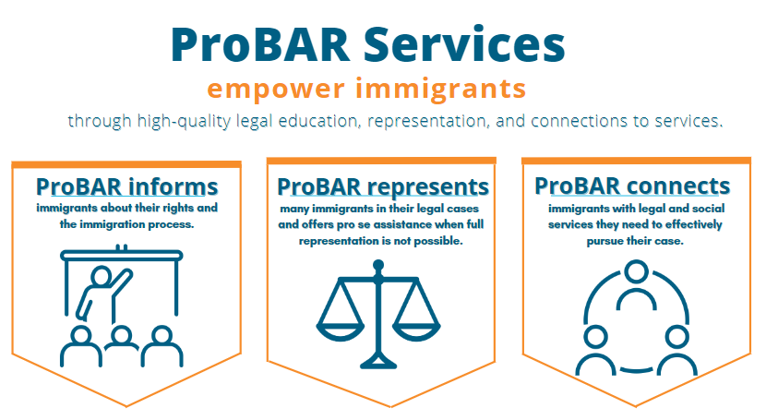

Slide 4
Humanitarian Migration

Slide 5




Who is an
Unaccompanied Child?
Under 18 years of age
No lawful immigration status
No parent or legal guardian in the U.S. available to provide care and physical custody
Notes:
Legal definition of UAC. A child who enters the U.S. without a valid entry document and who was not accompanied by a parent or legal guardian.
UC Definition: “Unaccompanied Alien Child” (UC/UAC) defined by the Homeland Security Act of 2002 and the Trafficking Victims Protection Reauthorization Act of 2008 (TVPRA):
(1) Under 18 years of age; (2) No lawful immigration status; (3) No parent or legal guardian in the U.S. available to provide care and physical custody

Slide 6
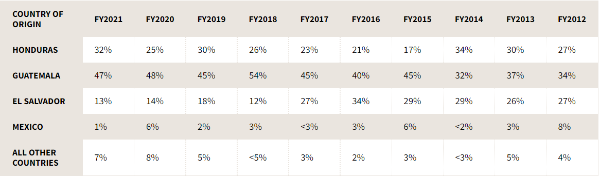
Migrant Children from Central America
https://www.acf.hhs.gov/orr/about/ucs/facts-and-data

Slide 7
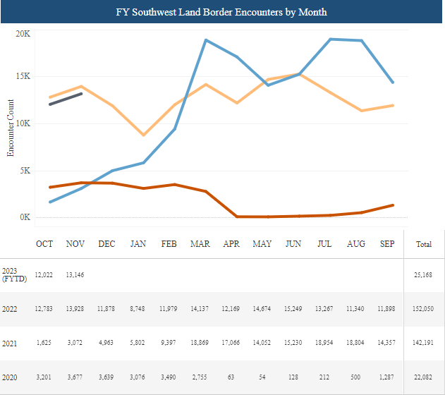
By the Numbers- Unaccompanied Children
https://www.cbp.gov/newsroom/stats/southwest-land-border-encounters
Notes:
Unaccompanied children should not be expelled under Title 42

Slide 8
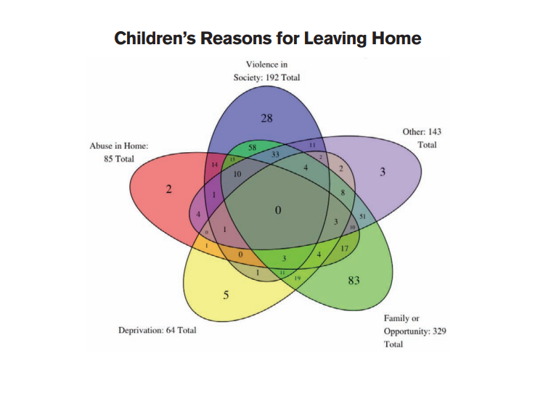
UNHCR – Children on the Run Report
https://www.unhcr.org/56fc266f4.html
Notes:
Children’s reasons for leaving are often multi-faceted. This chart from the UNHCR report documents the journeys of 404 unaccompanied children. All of those circles on the inside show where there are intersecting reasons for migrating.
The root causes of migration could include targeted violence because of the child or their family’s race or ethnicity, religion, sexual orientation, political opinion, refusal to become a gang member or a girlfriend of a gang member, sexual violence or child abuse, or because their parent or caregiver suffered harm.
Every child has a unique story. It is important to discuss these matters in detail, and the option of asylum as a potential form of relief
Sometimes a child might express one reason the first time they talk to you and as they build rapport with you will begin to share other reasons. So the first reason might be for family or opportunity. You might later learn a child was being recruited, threatened or hurt by a gang, by a family member, or targeted

Slide 9
The Border-
It is Only the Beginning of the Story

Slide 10
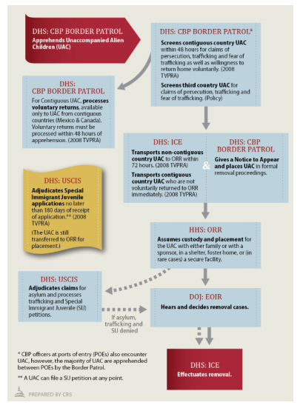
Understanding the Process at the Border
The Agencies involved:
Department of Homeland Security (DHS)
Customs and Border Protection (CBP)
Immigration and Customs Enforcement (ICE)
US Citizenship & Immigration Services (USCIS)
Department of Justice (DOJ)
Executive Office for Immigration Review (EOIR) – Immigration Court
Department of Health and Human Services (HHS)
Office of Refugee Resettlement (ORR)
https://fas.org/sgp/crs/homesec/IN10107.pdf
Notes:
It’s helpful to have an understanding of the process UCs go through upon entering the US. There are a lot of agencies involved so I included a list and flowchart here.
Usually starts with CBP, with apprehension.
If the UC is coming from the contiguous country – Canada/Mexico, will do screening for trafficking, persecution and will be sent voluntarily home.
If not a contiguous country, then should be transported within 72 hours to ORR under HHS.
UC will be placed with a sponsor or ORR care (could be shelter or secure facility).
A Notice to Appear, a charging document has been issued. The UC is in removal proceedings.
A lot of UCs seek asylum and Special Immigrant Juvenile Status (SIJ). USCIS will adjudicate claims for asylum and SIJ.
Often, when UC turns 18 if in ORR custody, then will be referred to ICE and will be detained.

Slide 11
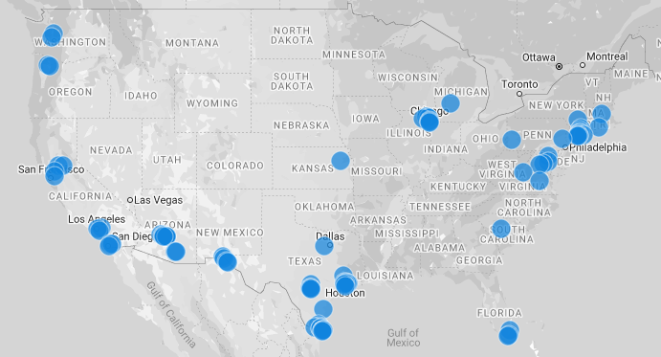
Office of Refugee Resettlement
(ORR) Shelters
200 state-licensed facilities and programs in 22 states funded by ORR.
On 12/18/22: 10,775 children in HHS care.
At the end of November 2022, the average length of UC care was 28 days.
In FY 2021, approximately 72% of all children referred were over 14 years of age, and 66% were boys.
On 10/31/2022, age of children:
Age | # of children
0-5 | 301
6-12 | 1,059
13-14 | 1,081
15-16 | 3,629
17+ | 3,832
https://projects.propublica.org/graphics/migrant-shelters-near-you
https://www.hhs.gov/sites/default/files/uac-program-fact-sheet.pdf
https://www.hhs.gov/programs/social-services/unaccompanied-children/latest-uc-data-fy2023/index.html
Notes:
60 different types of shelters Shelters In Texas, map was done in 2018, a lot has changes since then, but you can see generally the spread around the country.

Slide 12


What Happens at the ORR Shelter?
Typical process for a child
Placement at ORR facility within 72 hours of apprehension by CBP
ORR assessment: biographic intake, medical exam, mental health evaluation
“Know Your Rights” presentation, legal screening by legal service provider

Slide 13



ORR works to identify sponsor and complete reunification
Child released to the sponsor if a reunification option is available. If no reunification option is available, the child may:
Seek voluntary departure or an order of removal;
Transfer to a long-term foster care; or
Age out of care
Child may be referred to a nonprofit organization for pro bono representation once released

Slide 14
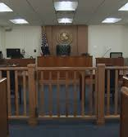



Removal Proceedings
Charging document begins removal proceedings
Contest NTA or claim relief from deportation
No right to appointed counsel, even for children
Few child-friendly court procedures
Immigration judge adjudicates application for relief
Grant, voluntary departure, or order of removal

Slide 15
Humanitarian-based Immigration
 | Special Immigrant Juvenile Status (SIJS) | Asylum | U Visa | T Visa | VAWA
Eligibility Criteria | - Unmarried and under age 21 - Declared dependent on a state “juvenile” court or legally committed to or placed under the custody of an agency or department of State, or an individual or entity appointed by a State court - Judicial determination that reunification with one or both parents not viable due to abuse, abandonment, neglect, or a similar basis found under state law - Judicial determination that it would not be in the child’s best interest to be returned to their country of origin. | - Past persecution and/or a well-founded fear of future persecution - Nexus (“on account of”) - Protected ground (Race, religion, nationality, membership in a particular social group, or political opinion) - Failure of state to protect * Special procedures for unaccompanied children seeking asylum | - Must have suffered substantial physical or mental abuse as a result of having been a victim of certain criminal activity; - Must possess information concerning the criminal activity; - Must have been helpful, currently being helpful, or is likely to be helpful in the investigation or prosecution of the criminal activity; - Must obtain certification from federal, state, or local law enforcement authority regarding helpfulness; and - The criminal activity must have occurred in the U.S. | - Is or has been a victim of a severe form of trafficking in person (sex trafficking or labor trafficking through the use of force, fraud, or coercion); - Is physically present in the U.S. on account of trafficking; - Has complied with any reasonable request for assistance from law enforcement agencies; and - Would suffer extreme hardship involving unusual and severe harm upon removal. | - Spouse/child of a U.S. citizen or Lawful Permanent Resident or parent of adult U.S. citizen; - Subject to battery or extreme cruelty; - Lived with the abuser; - If based on marriage, must show “good faith” marriage; and - Must show good moral character
Assess eligibility criteria & obtain evidence
Apply for protective status
Apply for Lawful Permanent Residence (green card)
Notes:
SIJS is one form of humanitarian-based immigration relief available to children. Other forms of relief, such as asylum, U nonimmigrant status, T nonimmigrant status, and VAWA are covered in other 101 webinars that are part of this series.

Slide 16
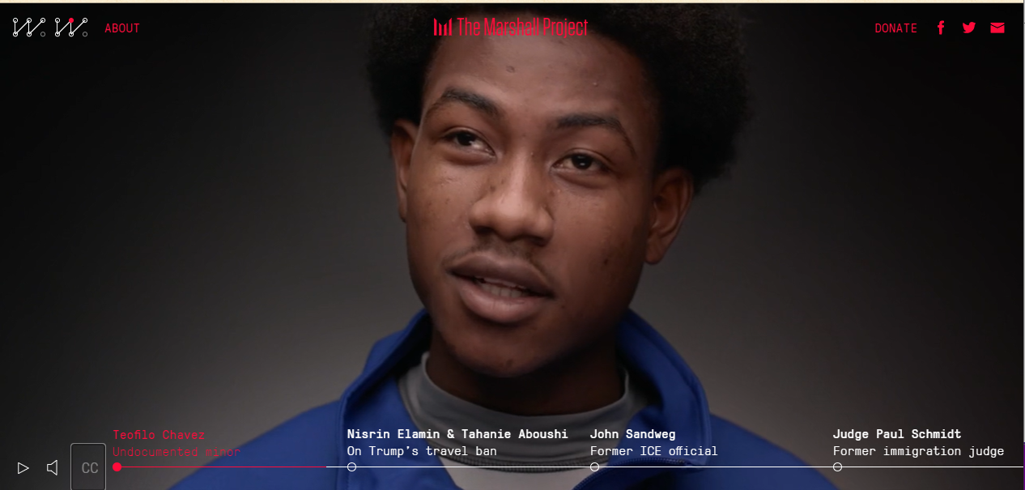
Video Feature of an Unaccompanied Child – Teofilo Chavez
https://www.themarshallproject.org/we-are-witnesses/immigration/teofilo-chavez
Notes:
I think it’s important to center the voices of our clients themselves so want to show a video feature done by the Marshall Project on Teofilo Chavez, an unaccompanied child to learn more about his story. It’s about 5 minutes.
How do you feel after watching that? One thing that resonates with me is the hope and positive outcome

Slide 17
Immigration Law- How it Really Works

Slide 18





Family-based Immigration
Diversity Lottery
Humanitarian-based Immigration
Employment-based Immigration
Protection from Removal
Notes:
FY21 62,500 refugees

Slide 19
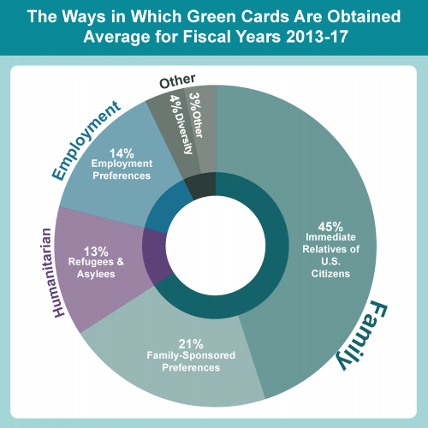
Immigration Methods
Some perspective
Notes:
Title 42 now exempts unaccompanied children
MPP program has been terminated

Slide 20
Pathway to Citizenship
Immigrant Visa/Humanitarian Status
Lawful Permanent Residence (LPR)
U.S. Citizenship
Undocumented Immigrant
Nonimmigrant
Notes:
John Oliver did a NSFW presentation on immigration
O-1 visa extraordinary talent

Slide 21
Legal Protections for Unaccompanied Children
Flores Settlement Agreement
In response to the detention of children in the early 1980s.
Guarantees the “least restrictive setting” for children.
Requires state licensed facilities.
Homeland Security Act of 2002
Transferred the care of children from INS to Health and Human Services.
Created child advocate program.
Defined unaccompanied child.
Trafficking Victims Protection Reauthorization Act (TVPRA) of 2008
Guarantees children will be placed in removal proceedings.
Expands protection for child subject to parental mistreatment.
Provides children an opportunity to present their asylum case in a non-adversarial setting.
Notes:
Immigration and Naturalization Service (INS)

Slide 22
Asylum
Refugee v. Asylee
Refugee
Asylee
Designated OUTSIDE the United States
Designated INSIDE the United States

Slide 23
Asylum
Basic Requirements
Person is unable or unwilling to return to their country or avail themselves of the country’s protection because they have suffered
Past persecution
Well- founded fear of future persecution
On account of 5 protected grounds:
or
Race | Religion | Nationality | Political opinion | Particular social group

Slide 24



Special Immigrant Juvenile Status
SIJS provides a pathway to citizenship
What is SIJS?
Who qualifies?
What happens after SIJS is granted?
A form of humanitarian-based immigration relief for non-citizen children in the U.S. who have suffered parental mistreatment.
Children in the state’s foster care system.
Children in the care of the Office of Refugee Resettlement.
Children living with a non-parent caretaker.
Children living with one parent.
SIJS beneficiaries can seek Lawful Permanent Residence (a “green card”) once it is their turn in the queue (in other words, once a visa number becomes available).
Notes:
subject to state juvenile court proceedings related to abuse, neglect, abandonment, or similar basis.
If the other parent abused, abandoned, or neglected the child.

Slide 25
The Need-
More Attorneys & Legal Staff

Slide 26
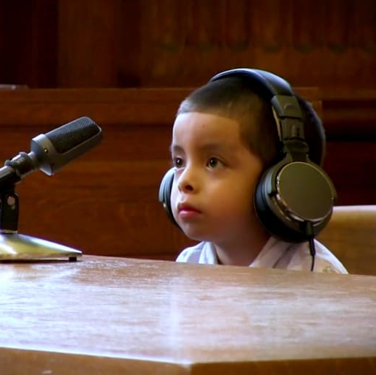
No Right to Appointed Counsel
8 U.S.C. 1232(c)(5)Access to counsel
The Secretary of Health and Human Services shall ensure, to the greatest extent practicable and consistent with section 292 of the Immigration and Nationality Act (8 U.S.C. 1362), that all unaccompanied alien children who are or have been in the custody of the Secretary or the Secretary of Homeland Security, and who are not described in subsection (a)(2)(A), have counsel to represent them in legal proceedings or matters and protect them from mistreatment, exploitation, and trafficking. To the greatest extent practicable, the Secretary of Health and Human Services shall make every effort to utilize the services of pro bono counsel who agree to provide representation to such children without charge.

Slide 27
Why is having an attorney so important?
A child or an adult without an attorney in immigration court must do the following alone: ​
Undergo an adversarial hearing by an opposing trained government lawyer before an immigration judge​
Plead to allegations set forth in a charging document​
Request relief under the U.S. immigration law​
Testify under oath, including about traumatic events​
File forms and supporting documents in English by a specific deadline​
Meet the burden of proof in an adversarial hearing​
Try to understand complex proceedings and the consequences of an immigration judge’s order.

Slide 28
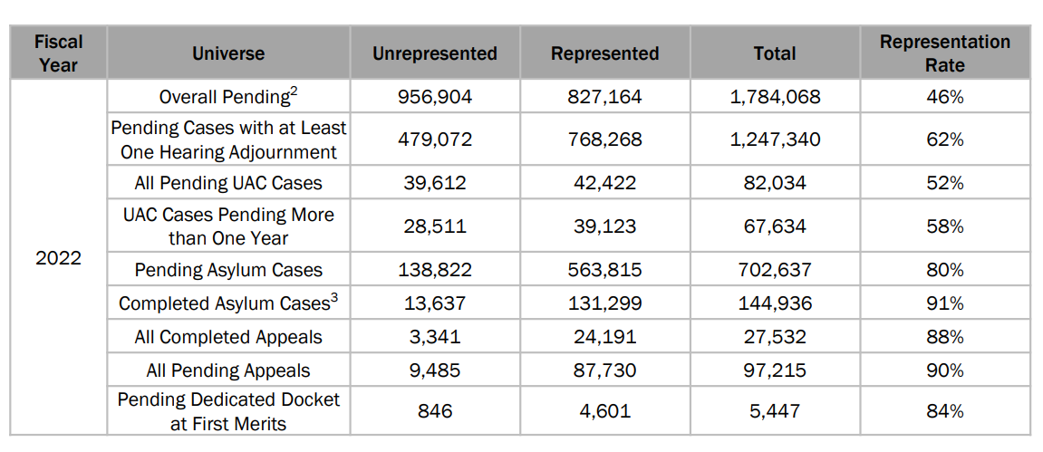
EOIR Rates of Representation
Notes:
Nationally, only ~51.7% of unaccompanied children with pending cases before EOIR were represented in FY2022 = Thousands of unaccompanied children face immigration court alone each year

Slide 29
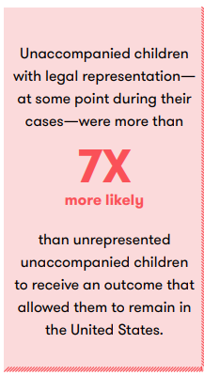
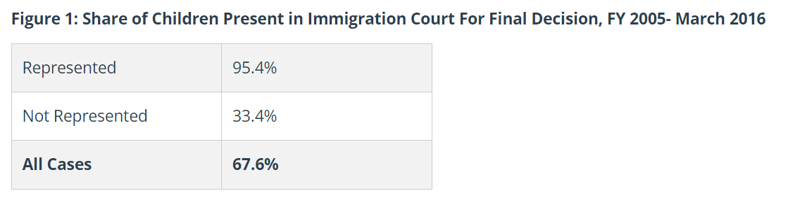
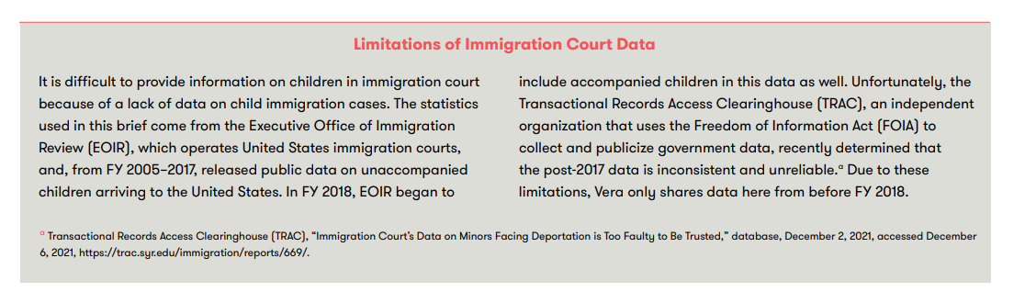
representation-matters.pdf (vera.org)
Children in Immigration Court: Over 95 Percent Represented by an Attorney Appear in Court | American Immigration Council

Slide 30
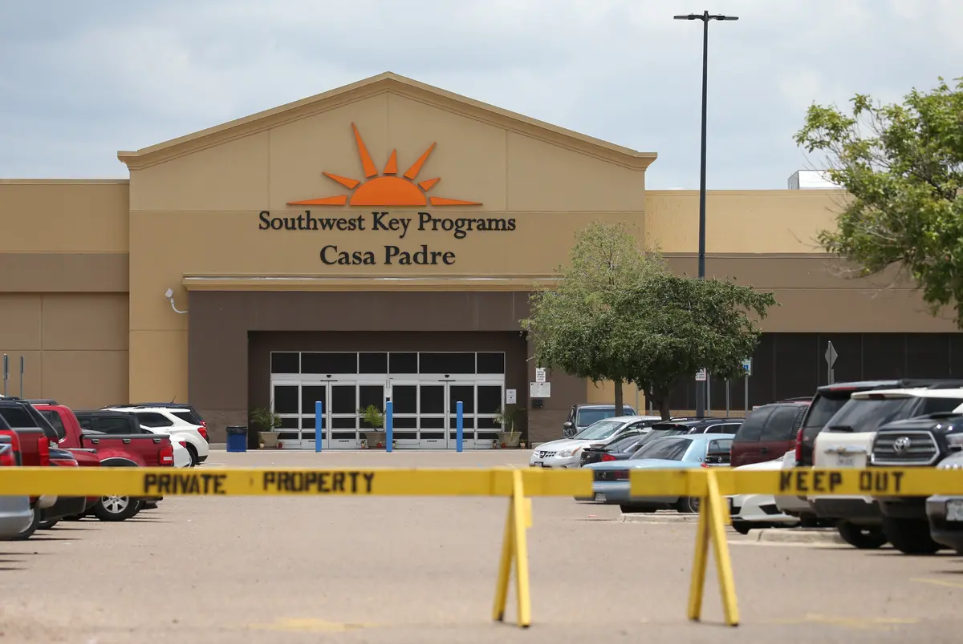
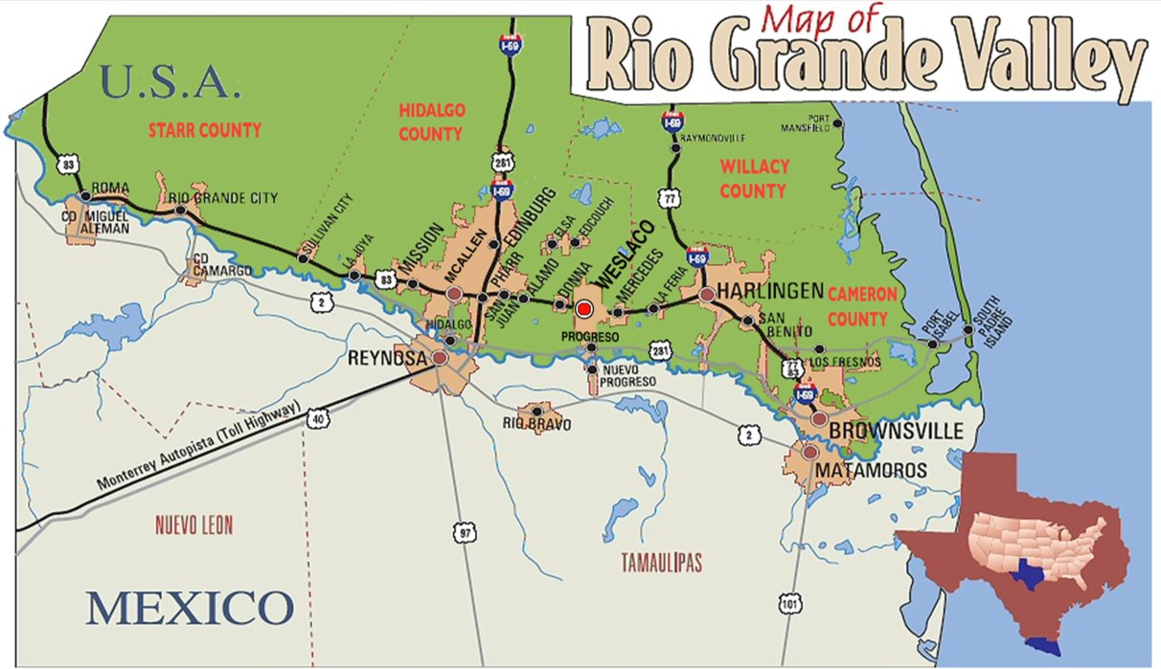
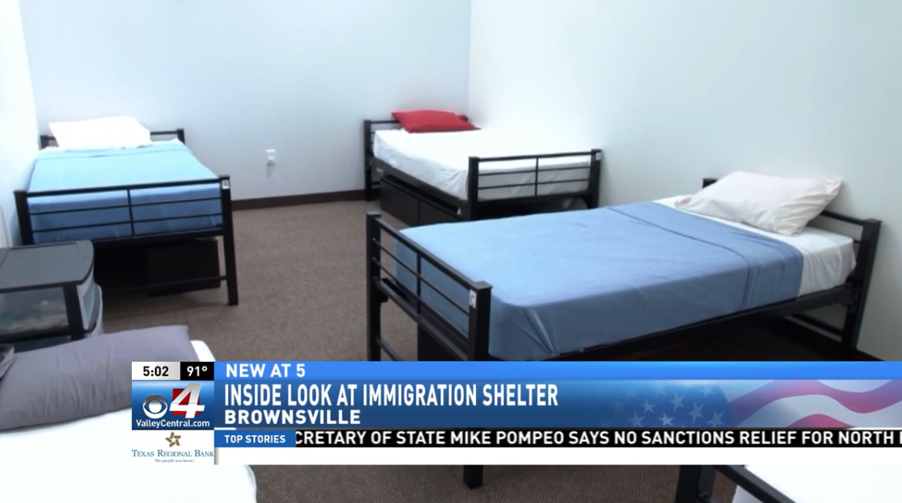
The Need: 23 shelters for unaccompanied children in the RGV
Contracted by the Office of Refugee Resettlement
Children aged 0-17

Slide 31
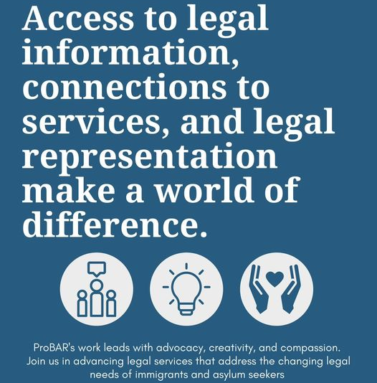


Slide 32
The Need-Trauma-Informed Practices

Slide 33
Trauma Informed Care
Resist Re-Traumatization
Respond
Realize
Recognize
Safety
Trustworthiness and Transparency
Empowerment, Choice, and Collaboration
Culture Humility
Notes:
Many unaccompanied children experience life changing events before, during, and after their journey. often times these events have been emotionally traumatic.
Trauma informed care is an important approach, especially when working with traumatized children, as it recognizes the occurrence of trauma and the impacts it can have not only on the child but their family and community as whole.
By realizing and recognizing this, allows the advocate to respond in a holistic manner centered on the core principles of a trauma informed approach, which can help mitigate re-traumatization:
1. Safety-Individuals, especially children who have experience trauma, often find it hard to trust and feel safe with others. Providing a safe environment, both physically and emotionally, will support the youth to feel comfortable to communicate and engage. This is even more true with unaccompanied immigrant youth, as they face extra stressors such as adjusting to a new everything-environment, language, customs, culture, and often with little external support.
2. Trustworthiness and Transparency – This means just like it sounds, be honest and transparent always, rapport will only occur if you are honest and transparent in all your advocacy efforts.
3. Empowerment, Choice, and Collaboration – Someone who has experience trauma often feel as they have lost the power and control over their life. As an advocate you can help them find their power and control again. This can be done by focusing on their strengths, and by forming a collaboration between them and you. It is important that they know and feel that they have a say and choices on what happens in their life. The goal is to create an environment conducive for collaboration, control, and empowerment.
4. Culture Humility: It is also important to understand the concepts of cultural humility and culture competence when working with unaccompanied children. It is a regular part of our practice as immigration advocates to work to be culturally competent and cultural humble because culture frames every interaction we have, every experience. The type of trauma we experience and how we respond is also informed by culture, and it helps to use a cultural lens in discussing traumatic experiences with these children. This is an ongoing process of self-reflection and self-awareness of your own cultural identity, biases, and power inequalities between you and your client.

Slide 34

Question??

