Slide 1

How to use the new Jail Data Initiative for explorations of race and other topics

Slide 2
Quick overview of jails
Multi-use local correctional facilities: about 3,000
On average over past decade, over 10 million admissions annually, with over 700,000 people in jail at any one time
Average length of stay is 32.8 days (a 44% increase since 2011)
About 15% of people in jail at midyear 2021 (95,000 people) were in jails operating over 100% of their rated capacity

Slide 3
Why is current and detailed jail data important?
Jails are disease incubators and poor places for people with health issues
They are expensive: about $34,000 per person per year ($25 billion a year cost to counties)
Officials, the public and the media should know who is being held in jail, for how long and why
Good decision-making relies on good and timely data

Slide 4
Why create the Jail Data Initiative?
Federal BJS data:
Released 18 months after data collection date
Provides limited demographic info
Most data is aggregated to national level only
In 5 years out of 6, just use a sample of ~900 jails
No charge types
JDI:
Data goes through end of prior month
Data by race, sex, age
Trend and point in time data by jail, county, state, or U.S.
Charge data when available
Length of stay data
Customizable reports & downloadable data
Now covers ~1300 jails

Slide 5
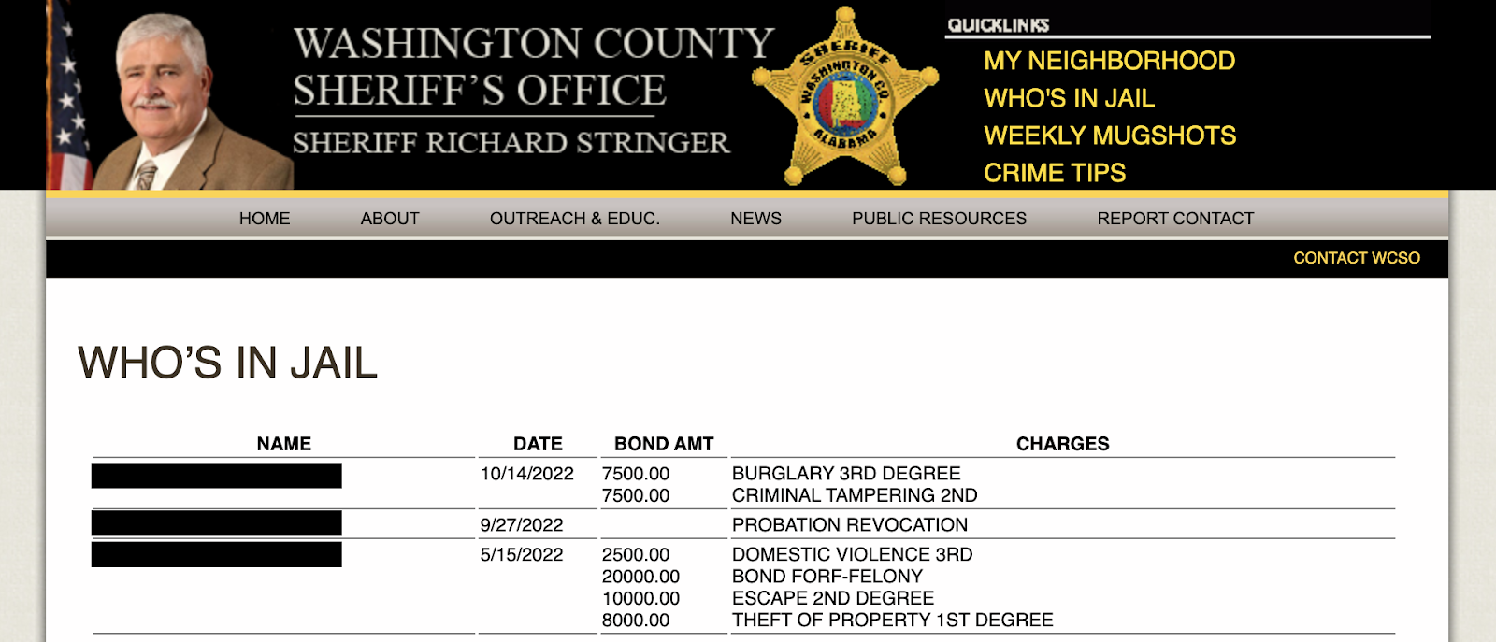
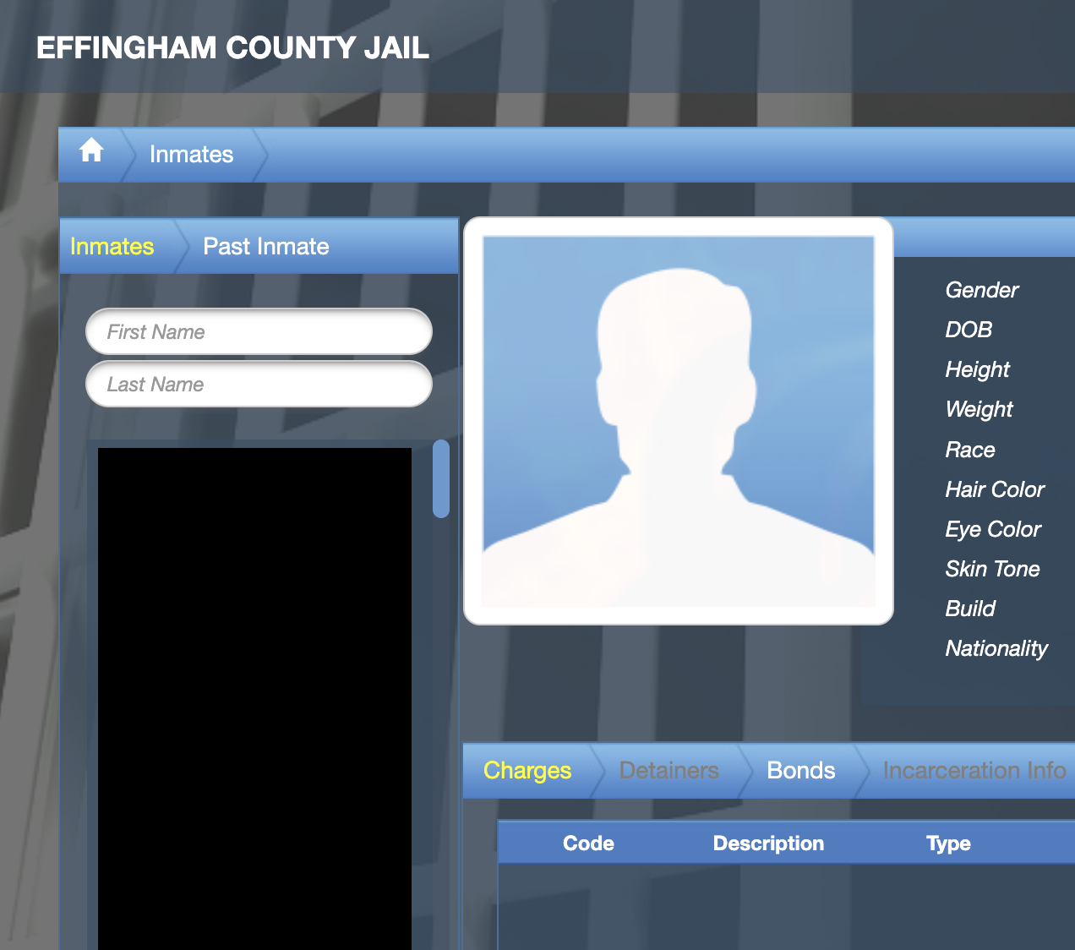
JDI electronically scrapes & stitches together online jail rosters

Slide 6
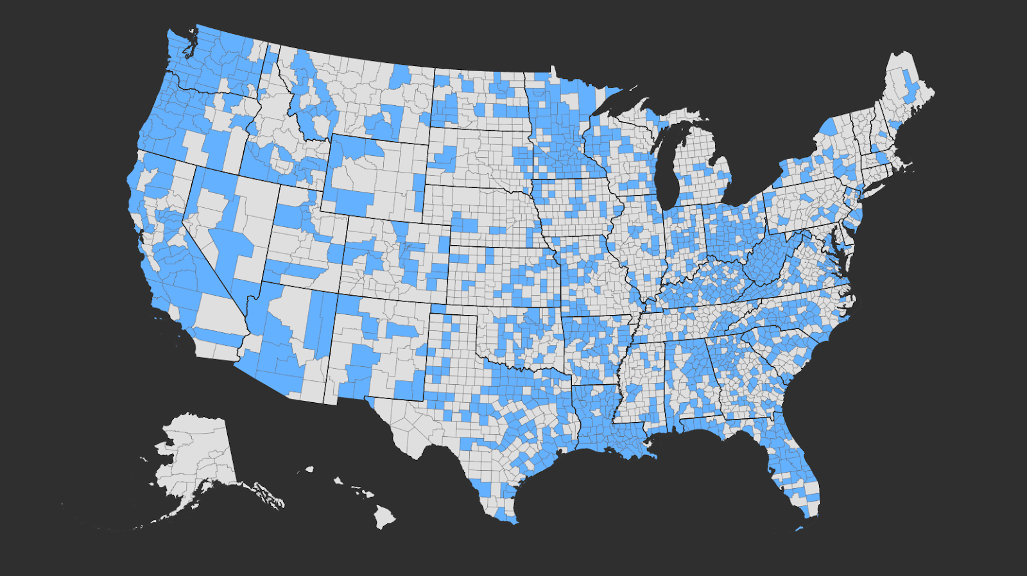
Geographic scope
JDI collects data from about 1,300 jails

Slide 7
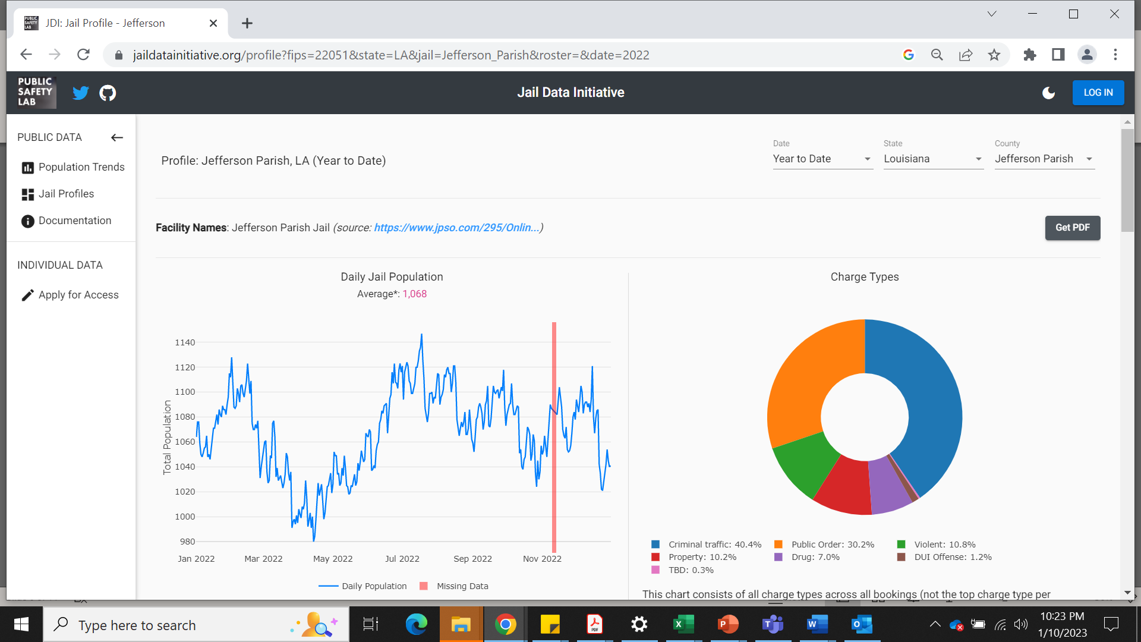
Notes:
Dr. Anna Harvey, director of NYU Public Safety Lab, launched project and her team began scraping data from online daily local jail rosters in 2019
Data available on site from March 2020 to now; with funding from Pew, able to connect daily rosters to create “term records” that allow deeper analysis of length of stay and repeat admissions to jail
Our current database contains at least one scrape from over 1,000 facilities (approx. ⅓ of all jails)

Slide 8
What did JDI show about racial disparities in jails?

Slide 9
Black People were over-represented in almost all JDI jails; in almost 3 in 10 jurisdictions Black people’s share of the jail was 4x or more that of the locality
Note: 595 jails had data available by race for both the jail and the local jurisdiction.

Slide 10
Black Individuals Saw A Larger Post-Pandemic Rebound in the Jail Population
Note: Data from 349 jails with data available by race over the time period.

Slide 11
Black people spent more time on average in jail than White people in 2022
Note: Data from 641 jails with data available by race

Slide 12
The admission rate for Black people in 2022 was four times that of White people
Note: Data is from 595 jails and counties with breakdowns by race available for the studied period.

Slide 13
JDI allows analysis by race AND sex
Black women saw the largest increase in admissions since the pandemic
White women had a slightly larger increase in admissions than their male counterparts

Slide 14
JDI Demo jaildatainitiative.org

Slide 15
Discussion/Questions
Tracy Velázquez, tvelazquez@pewtrusts.org

