Slide 1
CRIME STATS, CRIME STORIES, AND PUBLIC PERCEPTIONS OF SAFETY:
LESSONS FROM THE RESEARCH & DATA
Insha Rahman
Vice President, Advocacy & Partnerships

Slide 2
Nothing triggers emotion like issues of crime and public safety. A FiveThirtyEight study from 2020 found that Americans grossly overestimated the risk of being a victim of crime. An annual Gallup poll on crime and safety has found that Americans consistently believe crime is rising—even when crime rates are down.

Slide 3
Data and numbers on crime, safety, mass incarceration, and justice

Slide 4





10.5 million arrests annually, with 80 percent for low-level infractions and less than 5 percent for violent crime. (Vera Institute’s Arrest Trends Dashboard)
10.6 million criminal cases pending in courts nationwide. (NCSC’s Court Statistics Project)
Almost 2 million people incarcerated on any given day in more than 1,500 state prisons and almost 2,900 local jails, as well as juvenile detention facilities, hospitals, and immigration detention centers. (Prison Policy Initiative)
Police case clearance rates are below 50 percent for many crimes, including homicides in 2021 (48 percent). (Jeff Asher’s Crimealytics dashboard)
The U.S. spends ~$284 billion on policing, courts, and jails and prisons. (Vera Institute’s budget justice analysis)

Slide 5
Research and results on crime, safety, mass incarceration, and justice

Slide 6
The STAR Program in Denver used civilian specialists to respond to low-level crisis situations with treatment, instead of arrest, and reduced low-level crime in the neighborhood by 34 percent. (Stanford University evaluation)
More than 44,000 collateral consequences exist as a result of an open criminal case or criminal conviction. (U.S. Commission on Civil Rights 2019 report)
Even 24 hours in jail makes a person more likely to be arrested in the future because of the destabilizing effects of incarceration. (Arnold Ventures)
More than 50 percent of victims do not report a crime and, of those who do, almost two-thirds receive no counseling or assistance. (Crime Survivors for Safety and Justice annual report)
$250M for Community Violence Intervention in Safer Communities Act.

Slide 7
A few examples that shape public perceptions about crime, safety, and justice

Slide 8
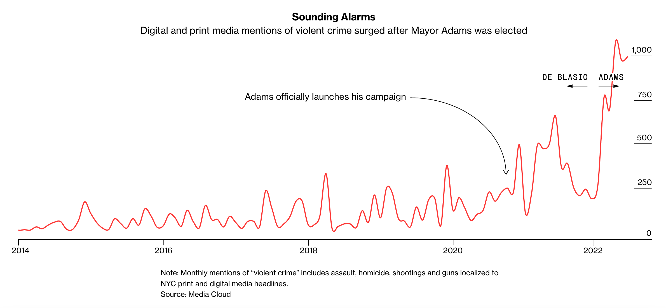
New York City

Slide 9
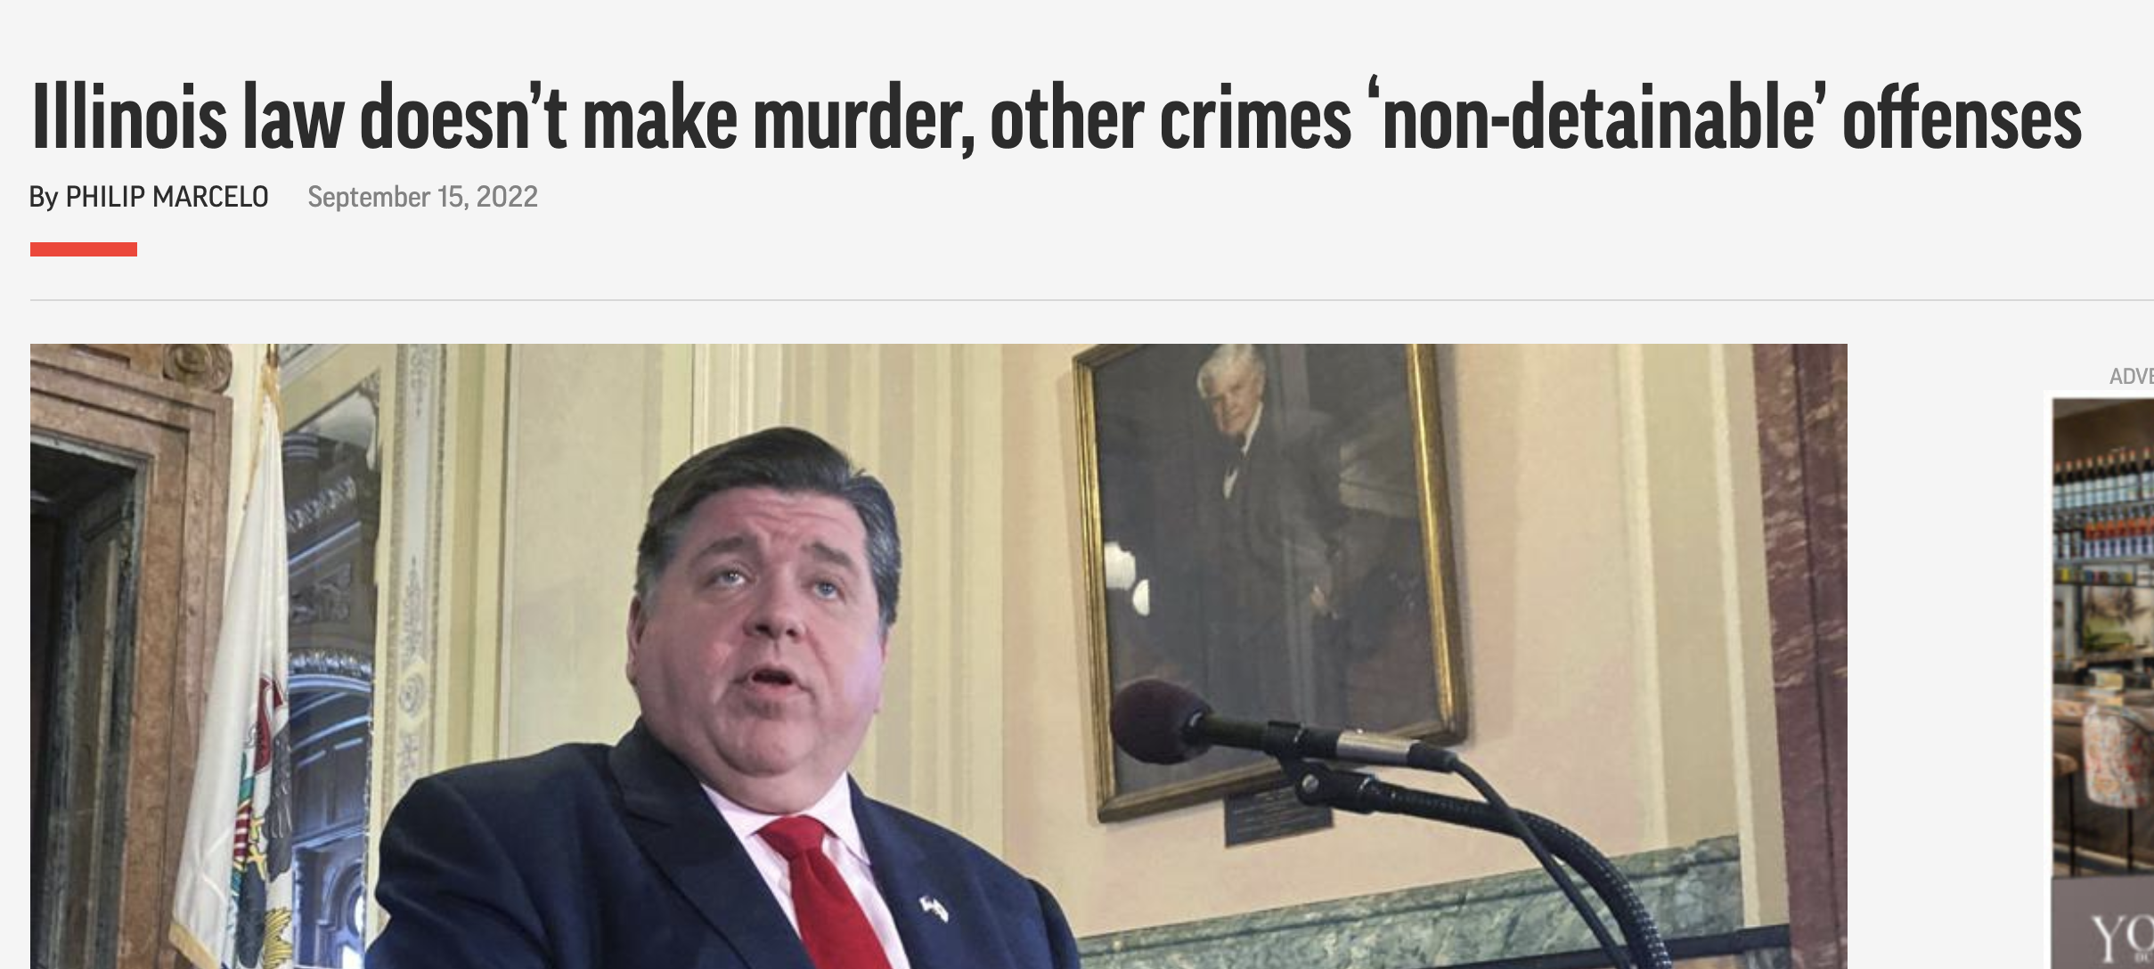
Illinois

Slide 10
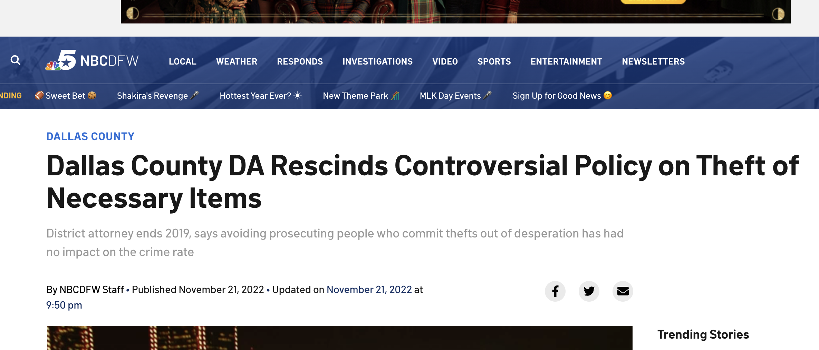
Dallas

Slide 11
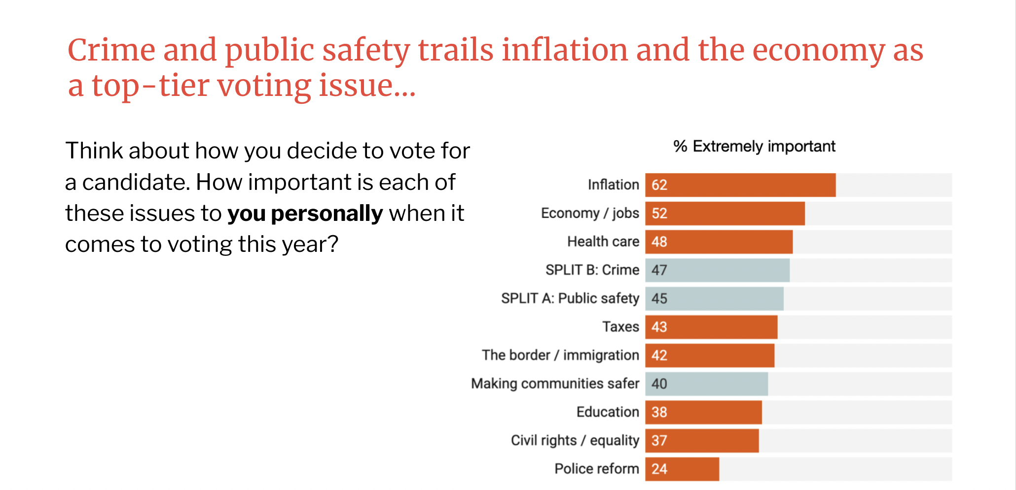
Source: Perry Undem and Hart Research Associates poll commissioned by Vera Action

Slide 12
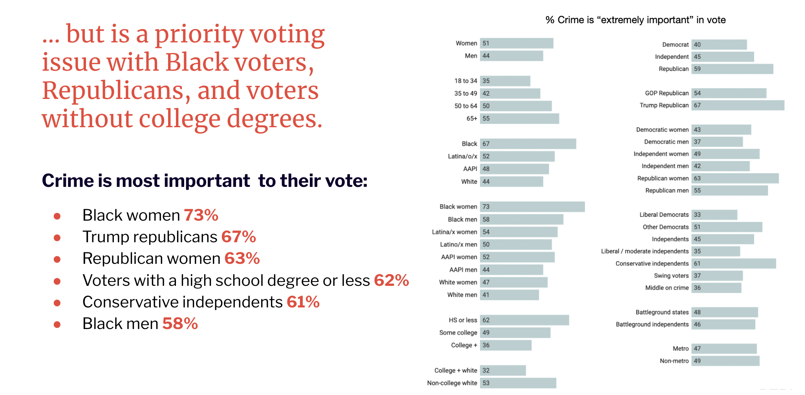
Source: Perry Undem and Hart Research Associates poll commissioned by Vera Action

Slide 13
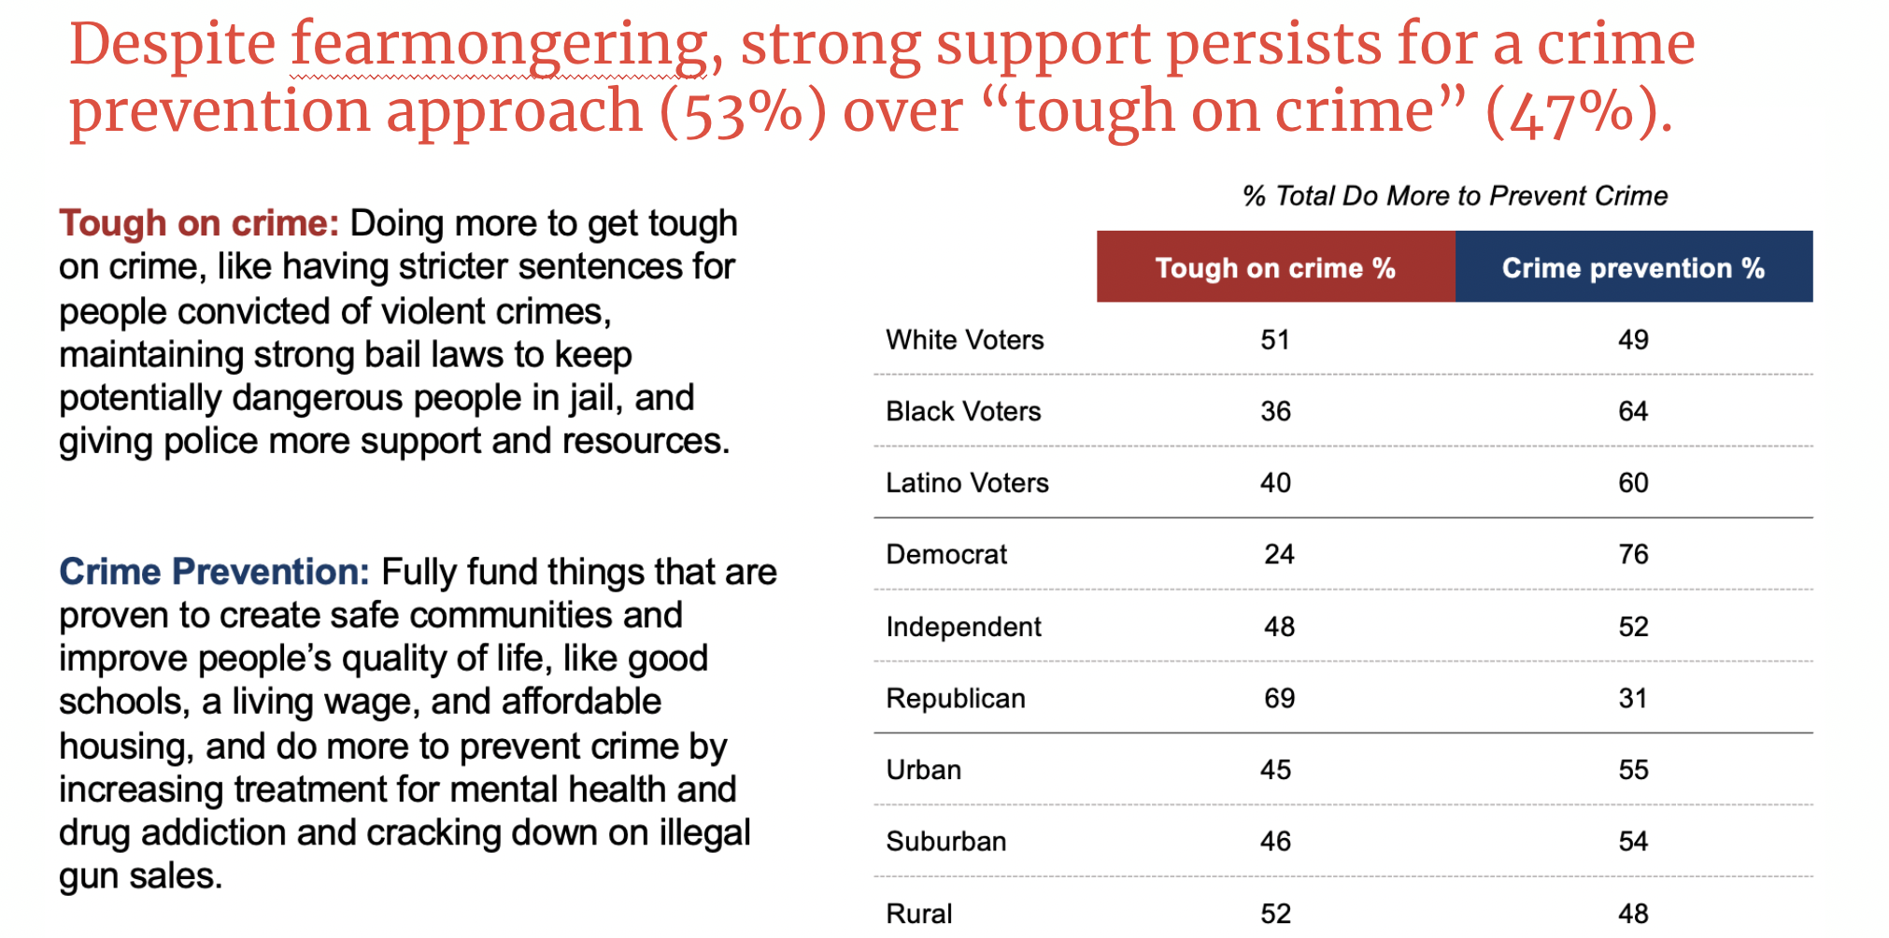
Source: Perry Undem and Hart Research Associates poll commissioned by Vera Action

Slide 14
Tips for evidence-based and data-driven crime and safety reporting

Slide 15
What shifts public opinion?
Ongoing coverage of what isn’t working with the status quo.
Ongoing coverage of success stories and key outcomes of reform.
Highlighting unity and collaboration among stakeholders.
When covering high-profile incidents, doing it in a nuanced way that puts the crime into context for the public.

Slide 16
A few takeaways for journalists
When covering a high-profile outlier case, lead with data for context about the thousands of other cases that go unreported.
Include experts, researchers, and advocates in your stable of sources for every story and build open lines of communication.
Verify claims about data and statistics, especially from stakeholders who have a political agenda.
Use “people first” language to avoid bias.

Slide 17
Contact:
Insha Rahman
irahman@vera.org
(646) 284-8221

