Slide 1

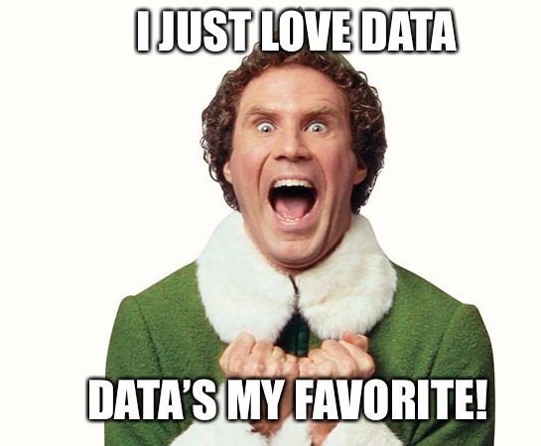
Ash Dhammani
ad1766@georgetown.edu
@edunomicslab
January 23, 2023
©2023 Edunomics Lab, Georgetown University

Slide 2
“Pandemic learning loss could reduce the lifetime earnings of students by $70,000. Without action, not only will individuals in the COVID cohort of students suffer long-term income losses, but also the individual states will see shrunken economic activity”
~ Eric Hanushek¹
Education is important for health and vigor of an individual and its community. We’re developing citizens who will give back to their community ²
1 https://www.thecentersquare.com/national/pandemic-learning-loss-could-cost-students-70-000-in-lifetime-earnings/article_2c856a32-8b78-11ed-b914-6b616b35e202.html
2 https://habitatbroward.org/blog/benefits-of-education/
3 https://leverageedu.com/blog/importance-of-education-in-society/
©2023 Edunomics Lab, Georgetown University

Slide 3

Which district do you think is in the BOTTOM 1% of all US districts (>5000 students) in terms of per pupil funding?
San Jose Unified, CA
White Plains, NY
Pocatello, ID
Chelsea, MA
Duvall County, FL
Camden City, NJ
Alpine District, UT
Tupelo, MS
$ 6,925
$ 6,646
NERD$
edunomicslab.org/nerds
©2023 Edunomics Lab, Georgetown University

Slide 4
Which district do you think is in the TOP 1% of all US districts (>5000 students) in terms of per pupil funding?
San Jose Unified, CA
White Plains, NY
Pocatello, ID
Chelsea, MA
Duvall County, FL
Camden City, NJ
Alpine District, UT
Tupelo, MS
$ 28,632
$ 27,900
NERD$
edunomicslab.org/nerds
©2023 Edunomics Lab, Georgetown University

Slide 5

Do some schools spend more than others? Does that seem fair?
Are certain schools under performing? Why?
How much do schools by me spend per student?

Slide 6

How much do schools by me spend per student?
ESSA – requires the reporting of spending by school!

Slide 7
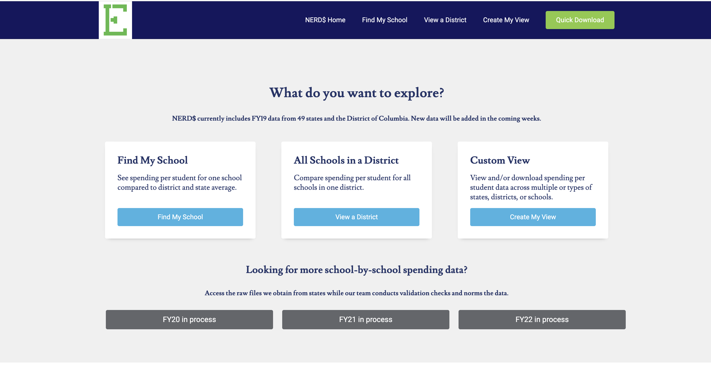
What you can learn in NERD$
NERD$
edunomicslab.org/nerds
©2023 Edunomics Lab, Georgetown University

Slide 8
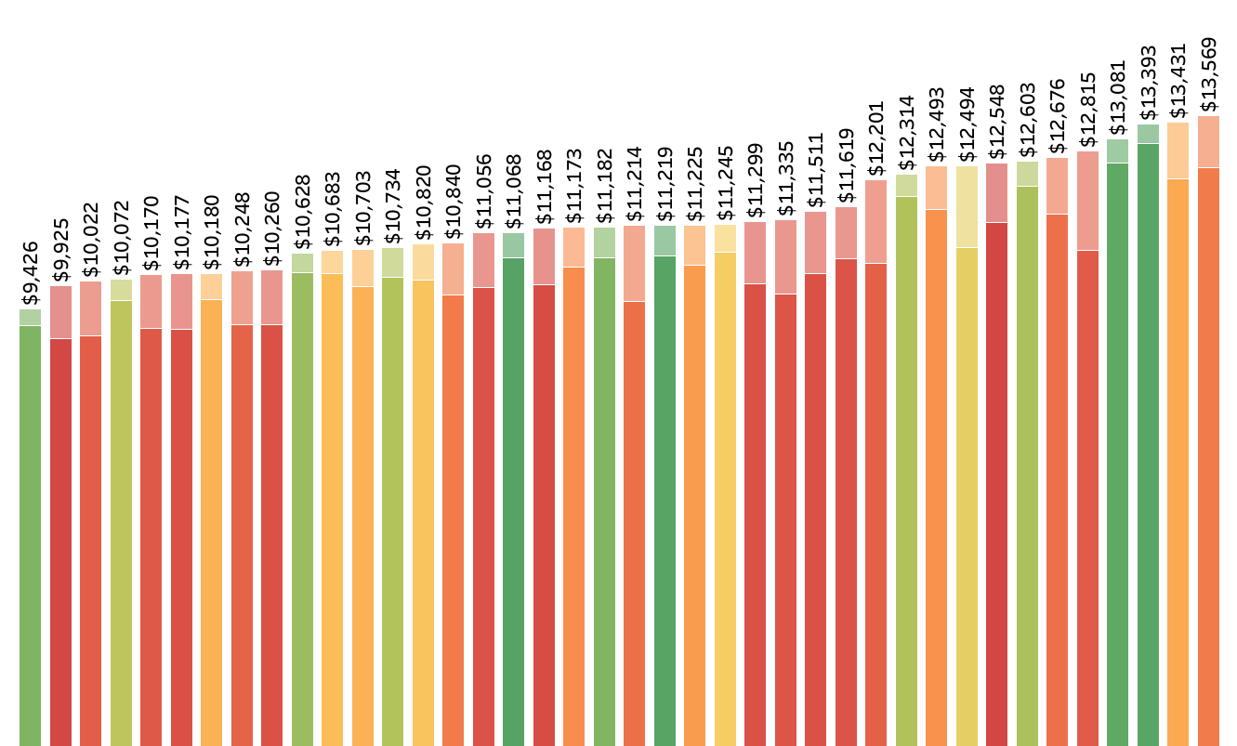
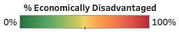
Per-pupil expenditures for all elementary schools in XYZ District
Spending from federal sources
Oak ES
Spending from state & local sources
SSOS
compcenternetwork.org/ssos
©2023 Edunomics Lab, Georgetown University

Slide 9
Which is NOT a reason that per-pupil spending could be higher in one school than another in the same district?
One gets Title I funds; the other does not
One has a special program (program for SWD; magnet)
One has senior teachers who receive higher salaries
Both have the same staff counts but one costs more per pupil because it is smaller/under-enrolled
One has a music teacher (or social worker) while the other doesn’t
One is in a neighborhood with higher property values
These are district decisions
©2023 Edunomics Lab, Georgetown University

Slide 10
Do some schools spend more than others? Does that seem fair?

Slide 11
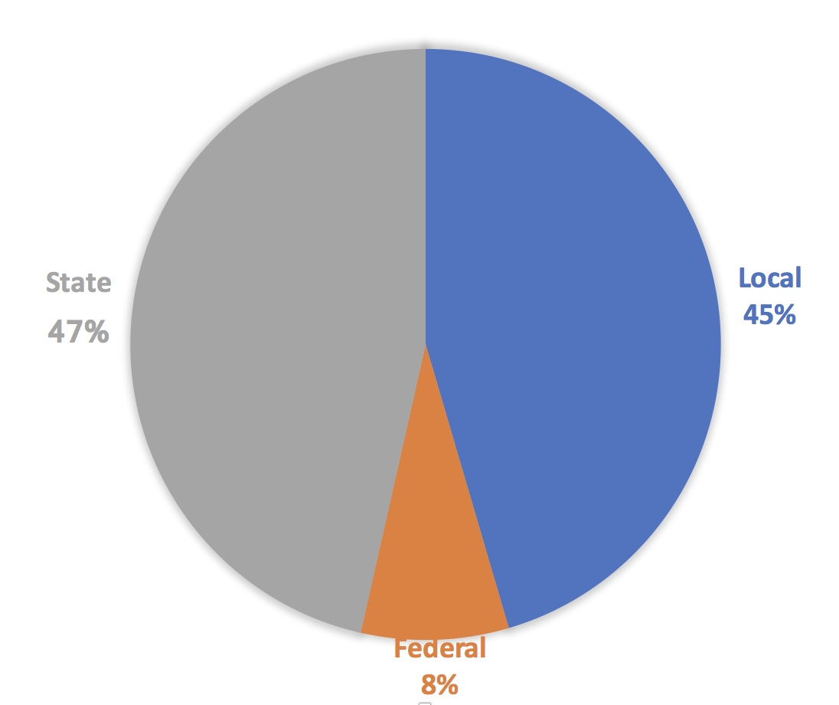
Chart shows averages but the shares depend on the district/state.
LARGEST ONE-TIME INFUSION OF FUNDS
State funds often distributed to offset local funds from property wealth, so lower wealth districts tend to be more reliant on state funds.
= $640/student
= + $270/student
= + $1,100/student
= + $2,400/student
Annual fed Title/IDEA
+ March CARES (ESSER I)
+ Dec. CRRSA (ESSER II)
+ ARP (ESSER III)
NCES, The Condition of Education, Data from 2015-16. https://nces.ed.gov/programs/coe/indicator_cma.asp
©2018Edunomics Lab, Georgetown University
©2022 Edunomics Lab, Georgetown University
©2023 Edunomics Lab, Georgetown University

Slide 12
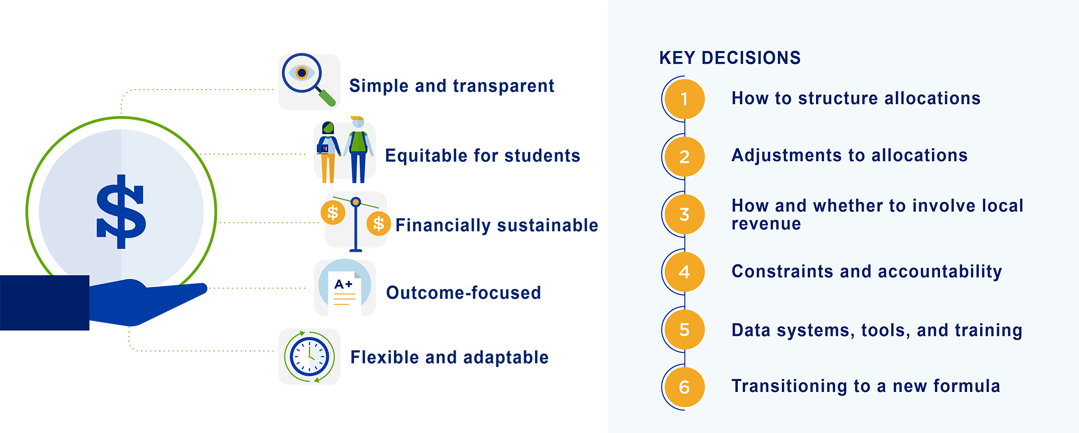
Key Decisions on State Ed Funding Formula Design
Decision Tree
edunomicslab.org/state-decision-tree
©2023 Edunomics Lab, Georgetown University
©2022 Edunomics Lab, Georgetown University

Slide 13
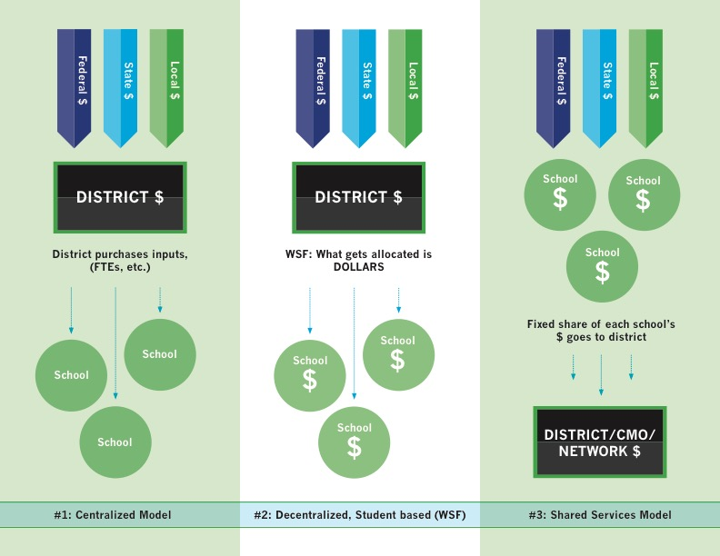
Schools get their allocations via one of three distribution mechanisms
©2023 Edunomics Lab, Georgetown University

Slide 14
Are certain schools under performing? Why?

Slide 15
Think of a school you know well or near your home.
How would you characterize the school?
Higher spending and higher outcomes
Higher spending and lower outcomes
Lower spending and lower outcomes
Lower spending and higher outcomes
©2023 Edunomics Lab, Georgetown University

Slide 16
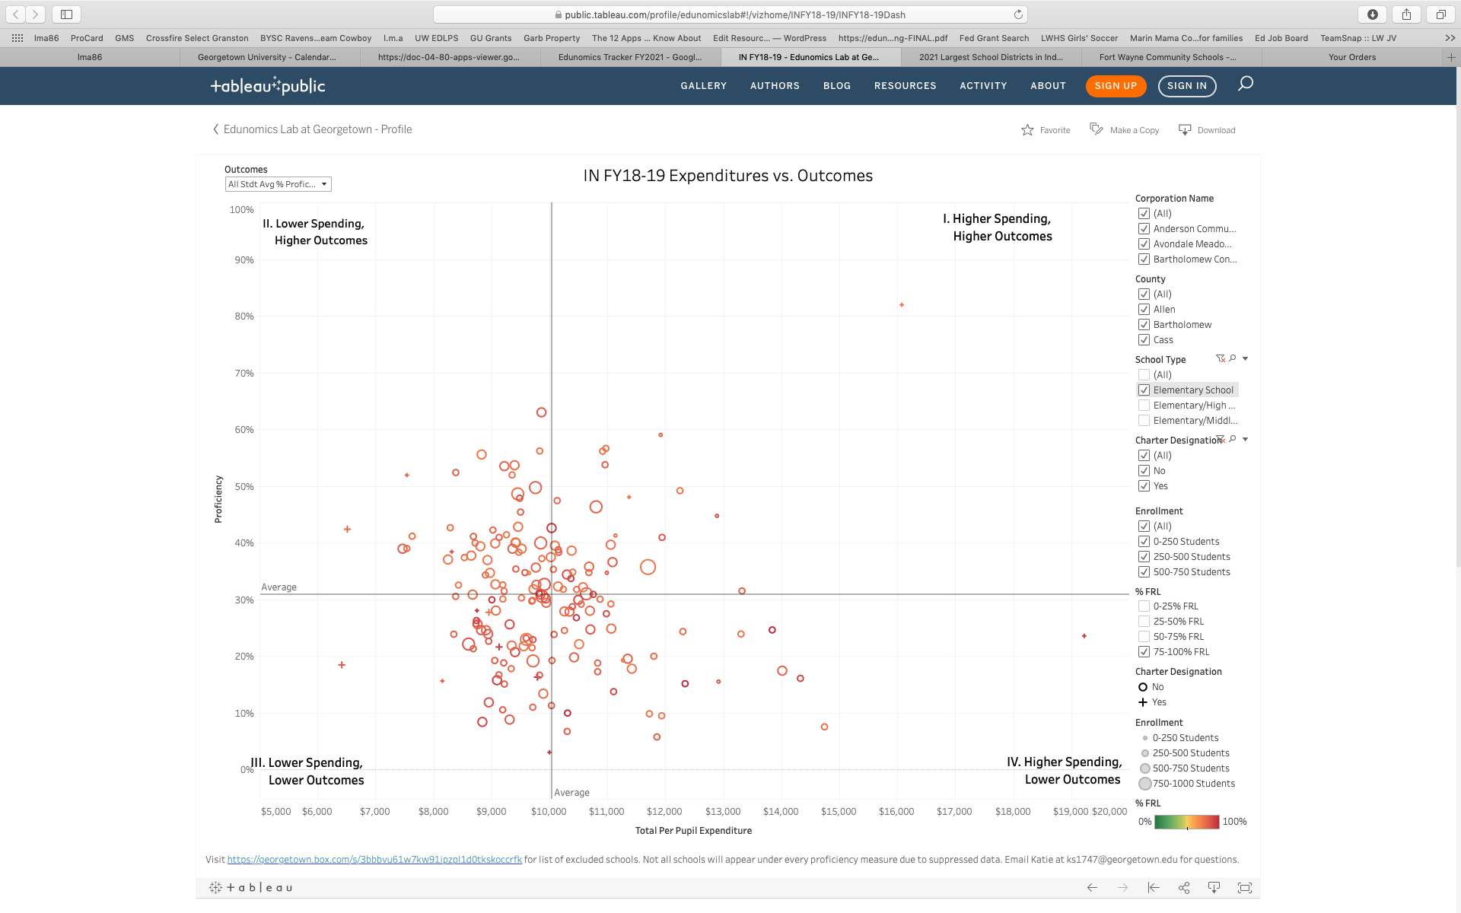
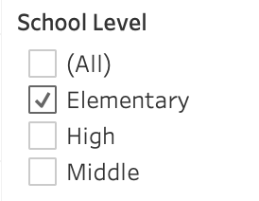
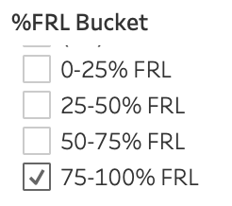

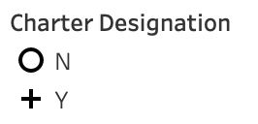
Spending vs. outcomes filtered for similar schools in a state Elementary schools >75% FRL
II. Lower spending, higher outcomes
I. Higher spending, higher outcomes
School C = ROI superstar! (Better able to leverage limited dollars to do more for students)
School A is successful with its students but at with more public dollars.
A
C
School B is also receiving more dollars than peers but unable to leverage them for student outcomes.
B
School D receives fewer dollars than peers and has low outcomes.
IV. Higher spending, lower outcomes
D
III. Lower spending, lower outcomes
SSOS
compcenternetwork.org/ssos
©2023 Edunomics Lab, Georgetown University

Slide 17
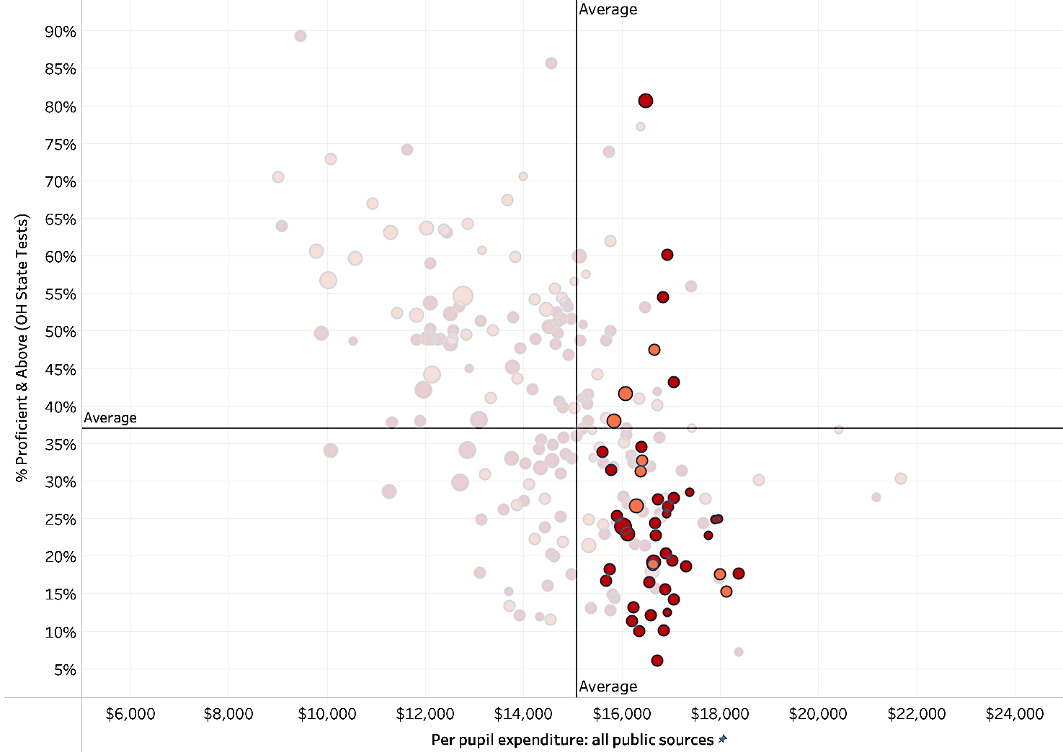
One district’s high poverty elementary schools as compared to all other similarly high poverty schools in the state
II. These schools spend fewer public dollars than their peers and have higher student outcomes.
I. These schools spend more public dollars than their peers and have higher student outcomes.
III. These schools spend fewer public dollars than their peers and have lower student outcomes.
IV. These schools spend more public dollars than their peers and have lower student outcomes.
SSOS
compcenternetwork.org/ssos
©2023 Edunomics Lab, Georgetown University

Slide 18
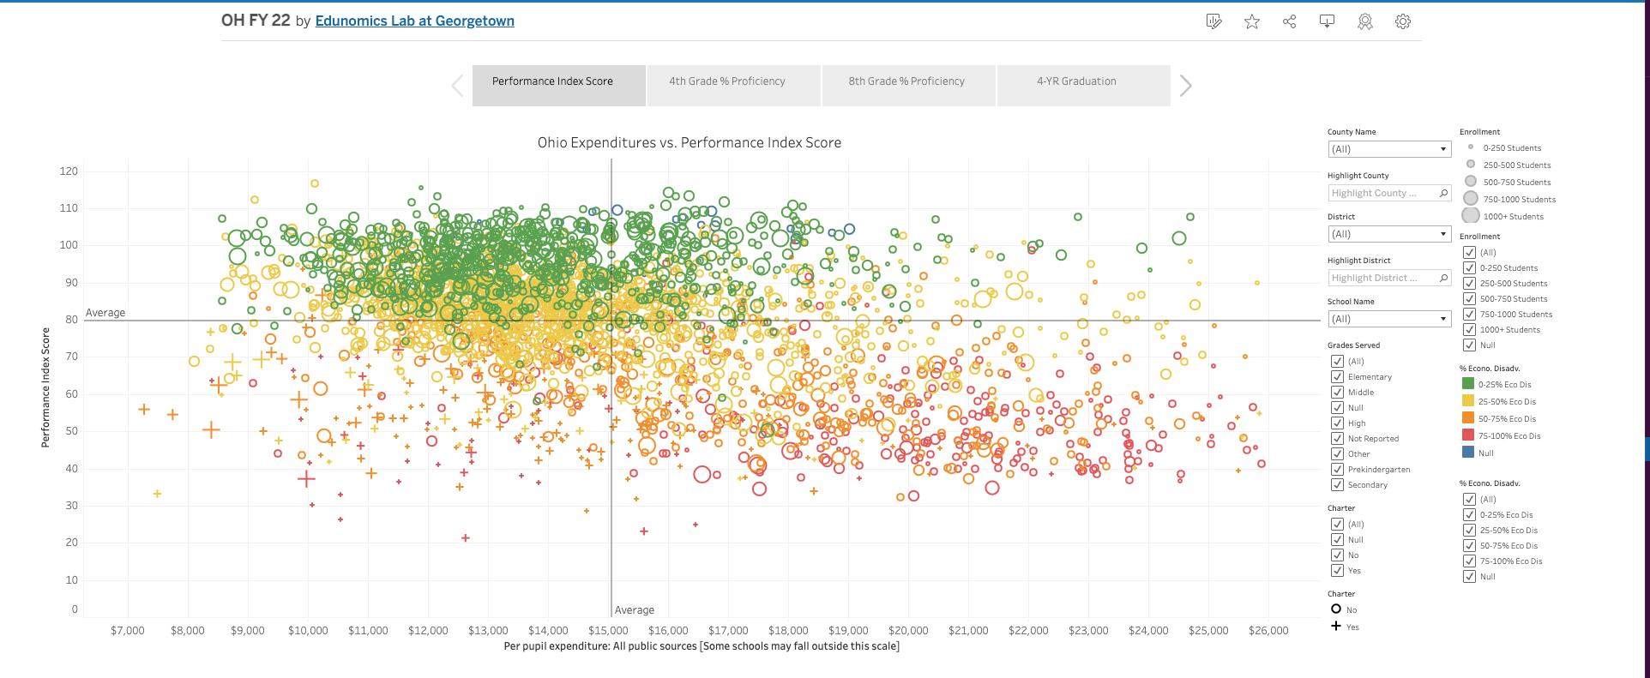
Spending v Outcomes
Scatterplots
edunomicslab.org/spending-v-outcomes
©2023 Edunomics Lab, Georgetown University

Slide 19
Do some schools spend more than others? Does that seem fair?
Are certain schools under performing? Why?
How much do schools by me spend per student?
How is ESSER spending going?

Slide 20
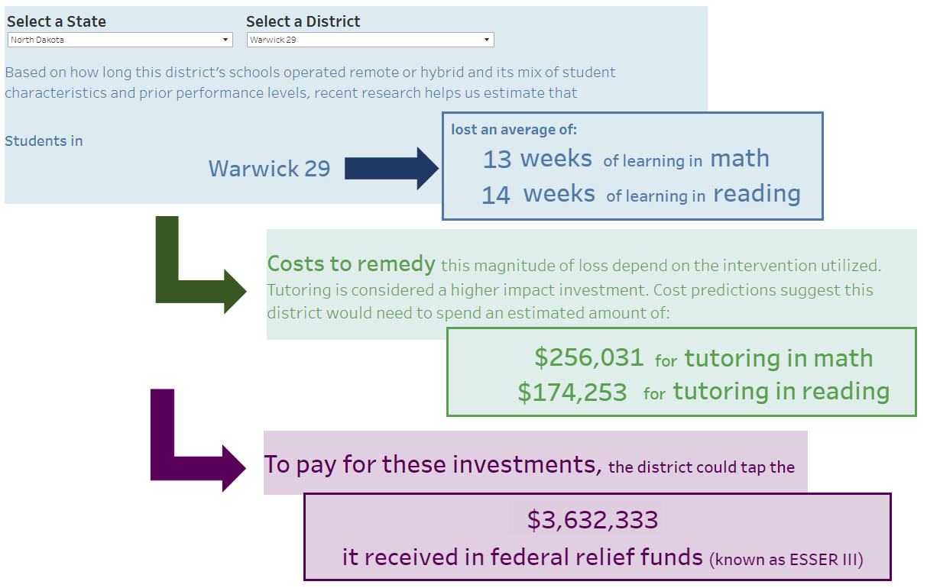
Estimating learning loss
Learning Loss Calculator
edunomicslab.org/calculator
What data does the district have?
Based on the data has the district changed course?
Is this more than the 20% set aside?
Does the district have funds it can use to support investments that exceed its available ESSER III funds?
©2023 Edunomics Lab, Georgetown University

Slide 21
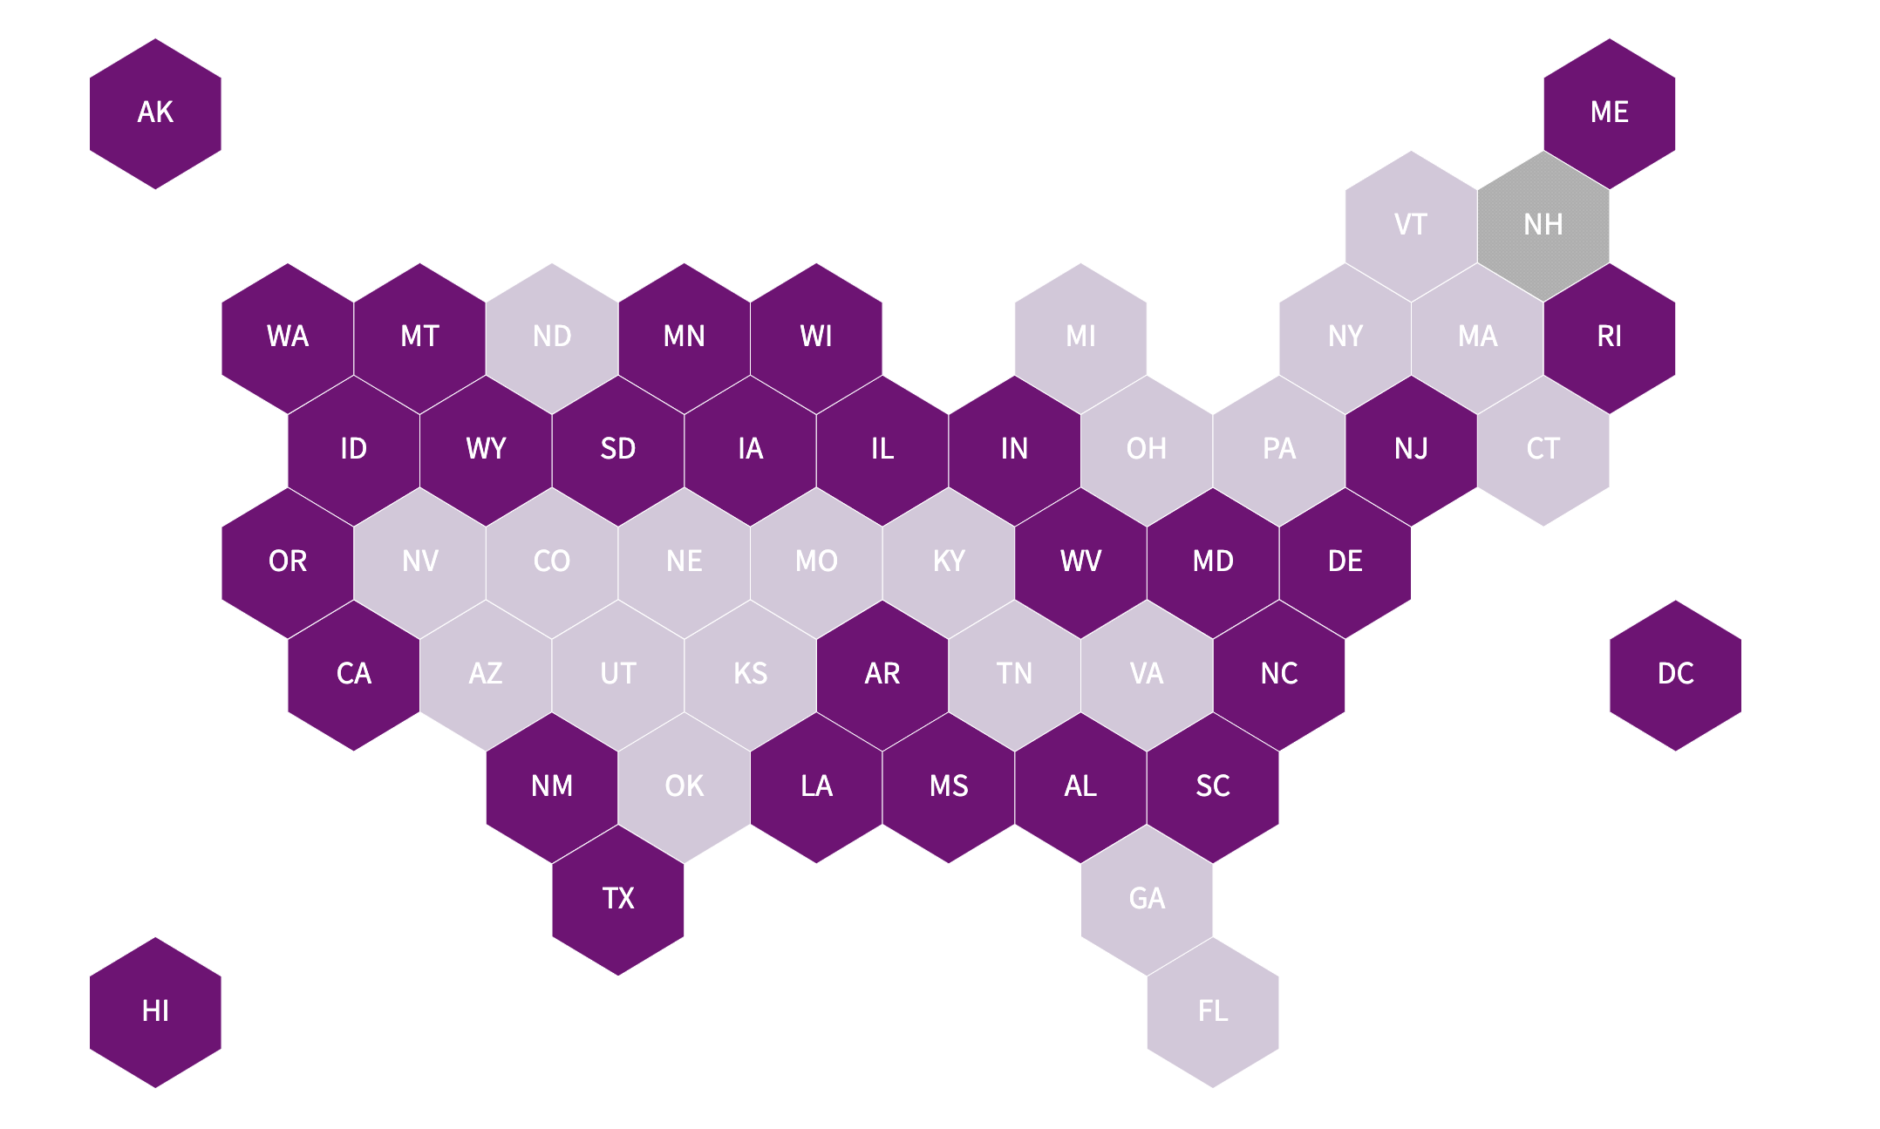
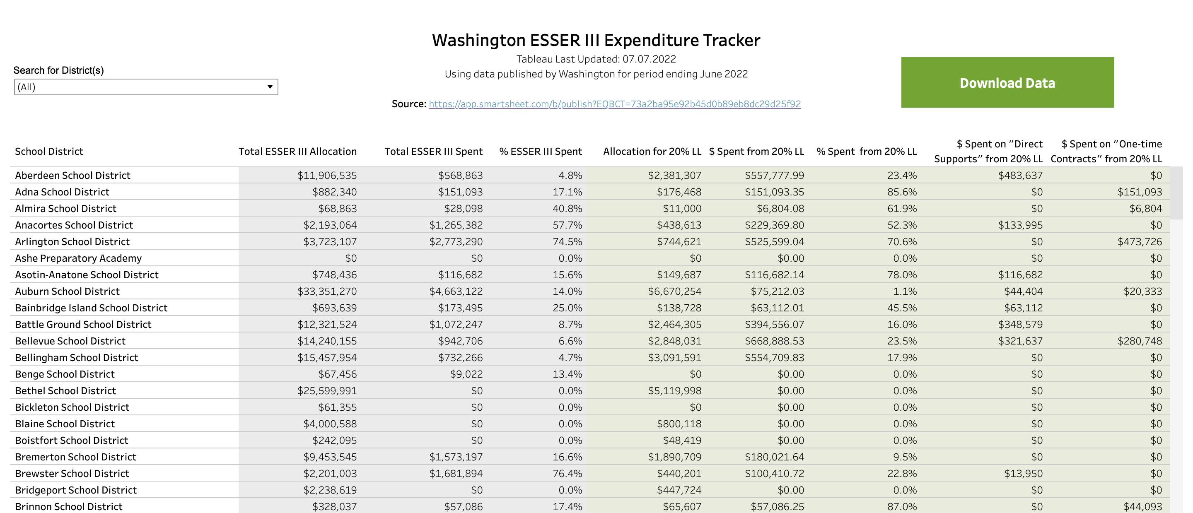
Examining ESSER spending
ESSER Spending Dashboard
edunomicslab.org/esser-spending
©2023 Edunomics Lab, Georgetown University

Slide 22
Do some schools spend more than others? Does that seem fair?
How much do schools by me spend per student?
Are certain schools under performing? Why?
How is ESSER spending going?

Slide 23
Story Ideas for Journalists:
NERD$
edunomicslab.org/nerds
Which schools in our district spend the most / least per student?
Do students of color and/or from low-income families get a fair share?
Do small schools get more? Should they?
Does the district spend fairly across regions or school types?
Are uneven teacher salaries a concerning factor?
Are any schools beating the odds with the money they have?
Which schools are getting more ARP $?
Scatterplots
edunomicslab.org/spending-v-outcomes
©2023 Edunomics Lab, Georgetown University

Slide 24

Always use per pupil costs
Do not over value federal investment (10%)
School boards and districts decide how to spend the dollars
Connect spending and performance
Never doubt school effects matter
©2023 Edunomics Lab, Georgetown University

Slide 25

Questions?
Choose a cohort:
March 29-30 in New York City
April 12-13 in Los Angeles
Let’s stay in touch:
EdunomicsLab.org
@EdunomicsLab
@MargueriteRoza
Ash Dhammani
ad1766@georgetown.edu
Sign up for our newsletter: http://bit.ly/EdFiNews
Visit EdunomicsLab.org for resources.
©2018Edunomics Lab, Georgetown University
©2021 Edunomics Lab, Georgetown University

