Slide 1

The Intergenerational Workforce – Fueling the Longevity Economy
Jean C. Accius, PhD | Senior Vice President, Global Thought Leadership

Slide 2

The Future of Work is now
COVID Changed the Workforce & Workplace
The Drivers of the “Great” Migration
The War on Talent is REAL
Age Diversity: The Last Frontier

Slide 3

I just quit my job I'm gonna find new drive Damn, they work me so damn hard Work by nine, then off past five And they work my nerves That's why I cannot sleep at night
… I'm lookin' for motivation I'm lookin' for a new foundation, yeah And I'm on that new vibration I'm buildin' my own foundation, yeah Hold up, oh, baby, baby
… You won't break my soul (na, na) You won't break my soul (no-no, na, na) You won't break my soul (no-no, na, na) You won't break my soul (na, na) I'm tellin' everybody, na, na

Slide 4

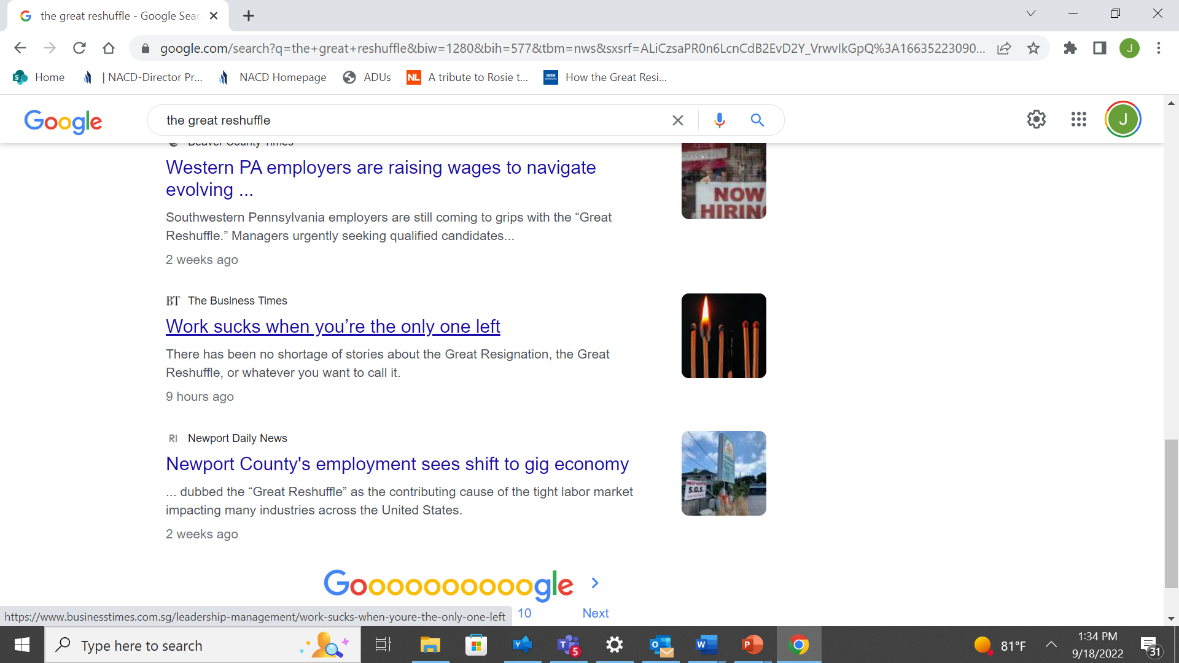
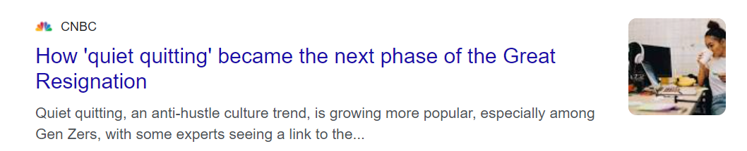
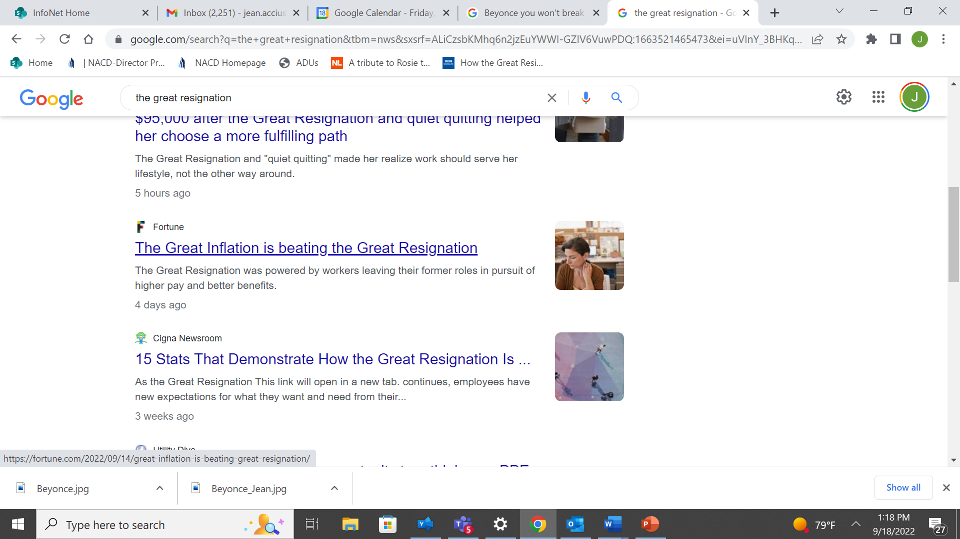
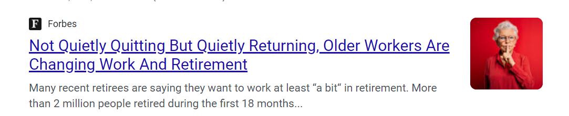

Slide 7
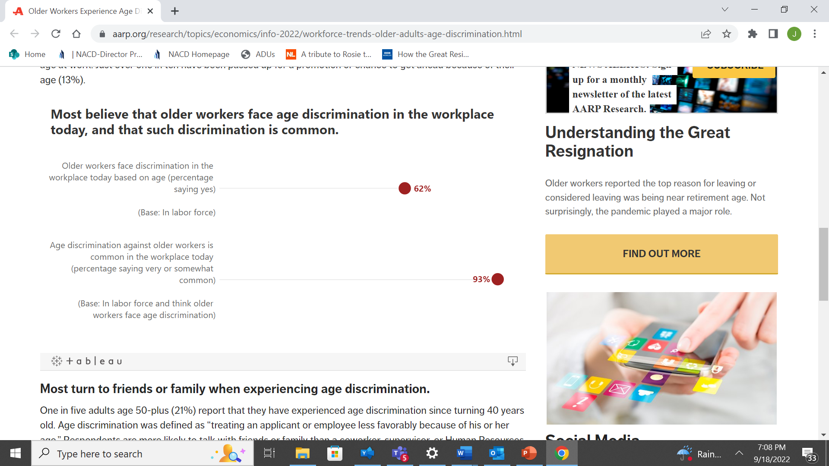

Slide 8
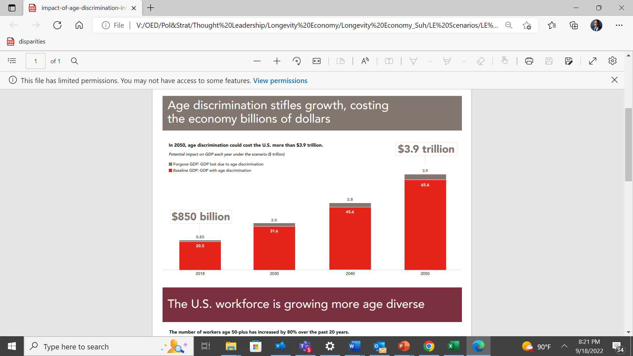

Slide 9
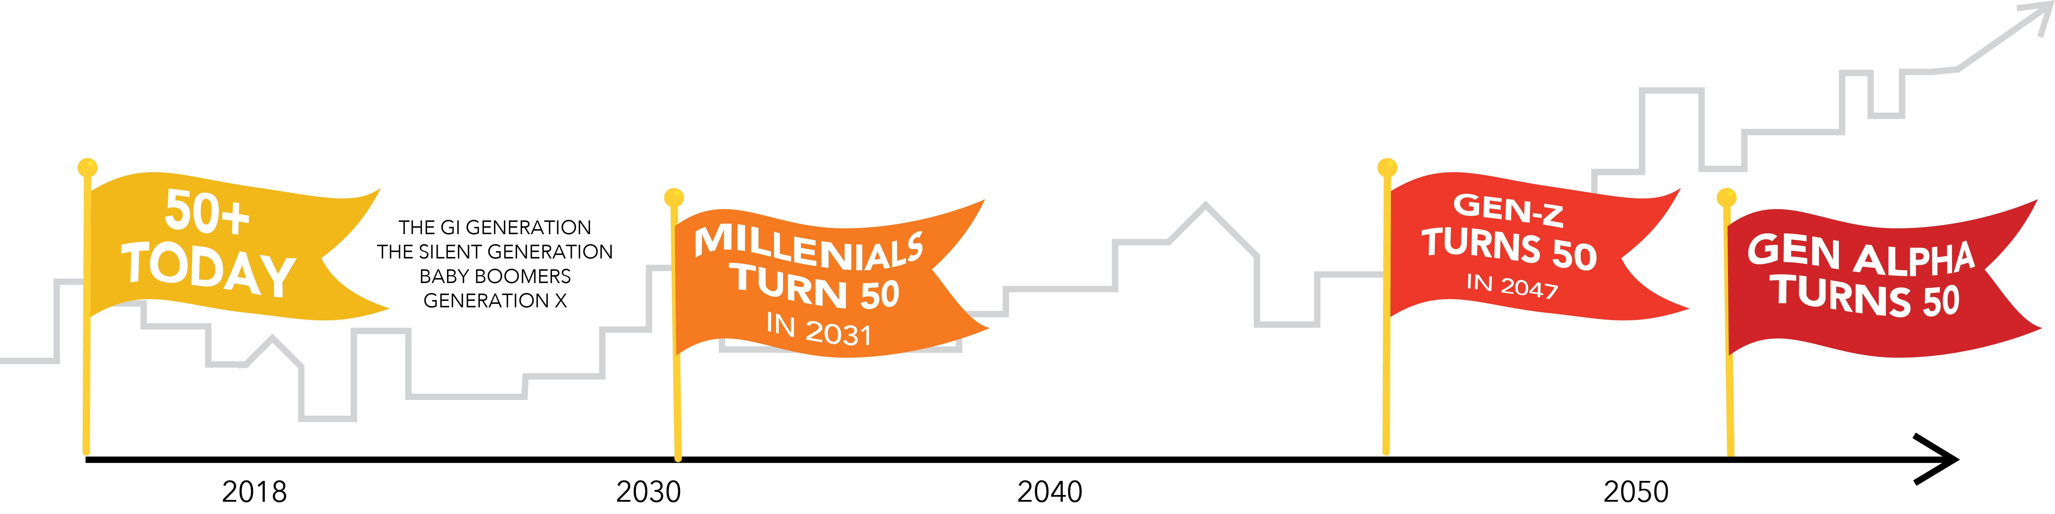
We are all aging and, in some cases, living longer and healthier lives.

Slide 10
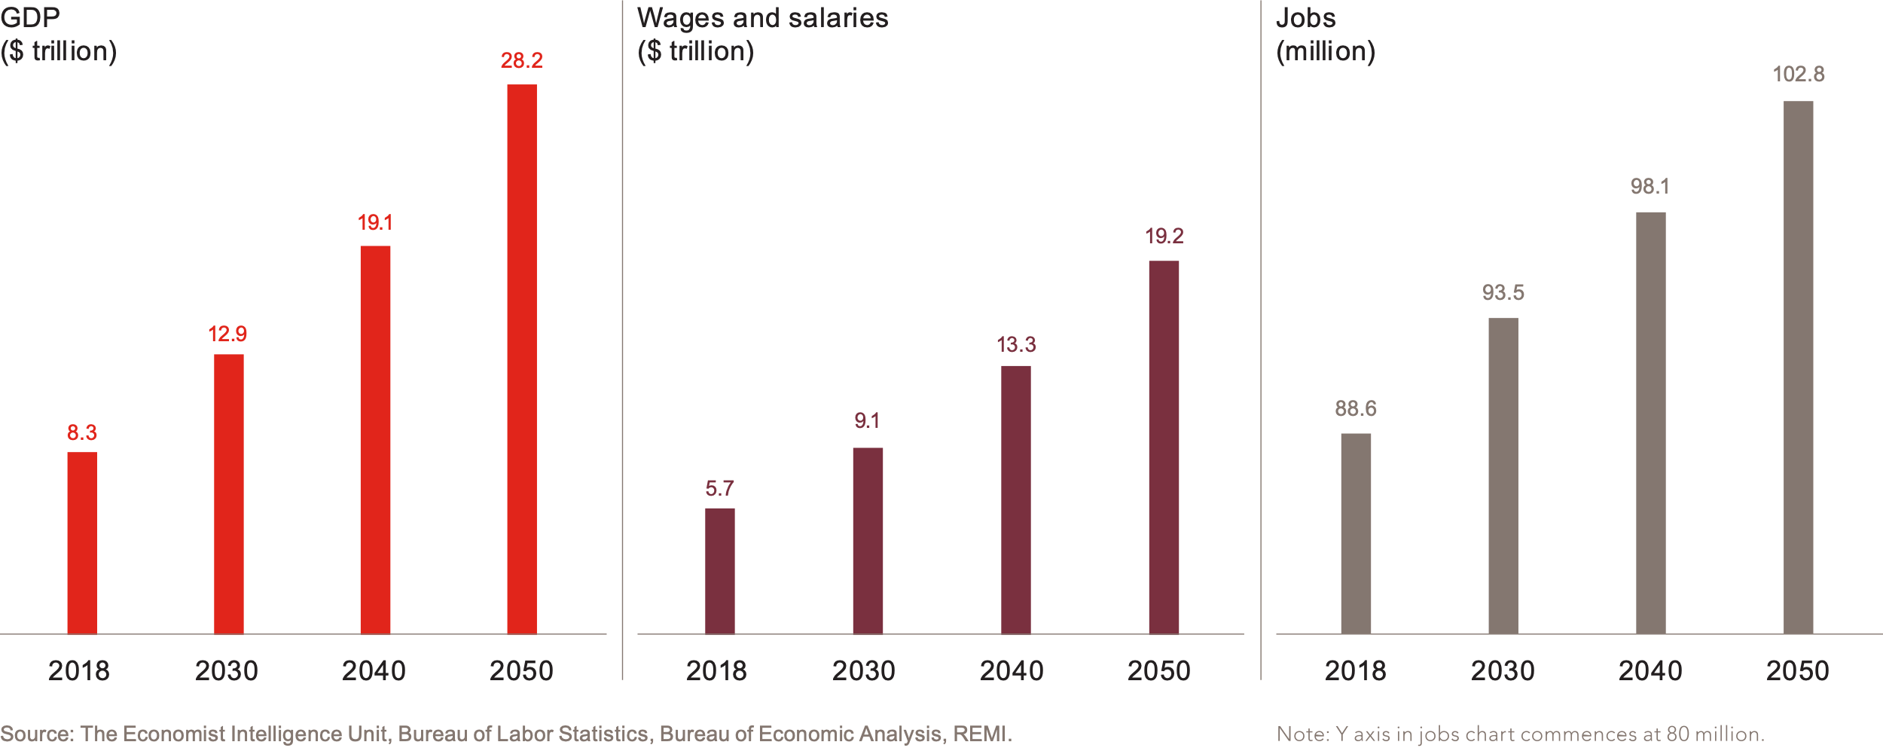
The contributions of people 50-plus benefit society now and in the future

Slide 11


The contributions of people 50-plus benefit society now and in the future
56 cents in 2018
61 cents in 2050
People 50-plus spent 56 cents of every dollar on goods and services in 2018.By 2050, this will grow to 61 cents of every dollar.

Slide 12
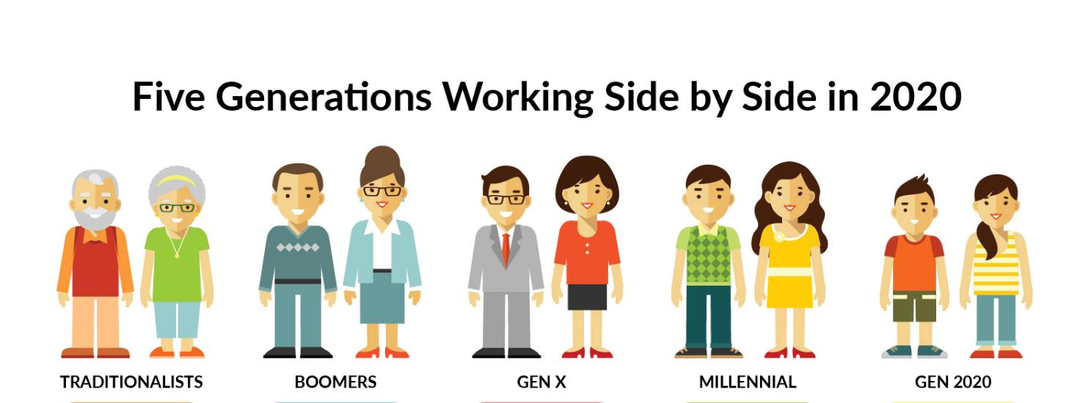
The New Normal

Slide 13
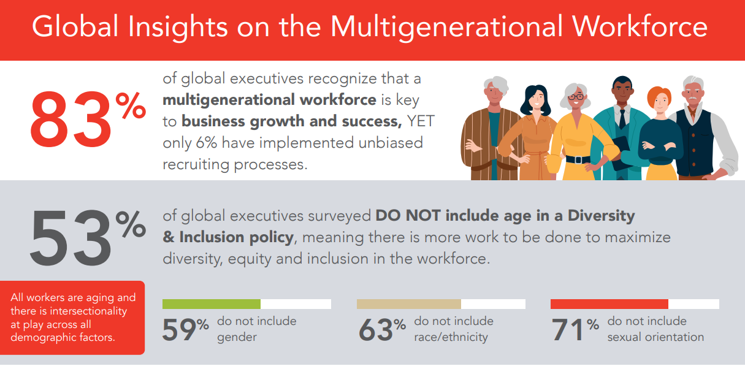

Slide 14
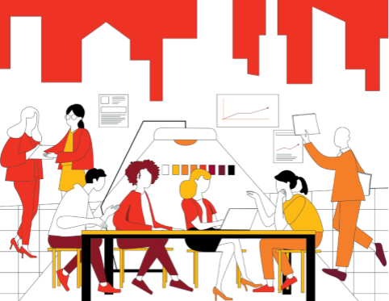
Greater diversity supports higher innovation revenue and profit margins. | A multigenerational workforce improves employee productivity.
Companies with above-average diversity in age, gender, nationality, career path, industry background, and education on their management teams report innovation revenue that is 19 percentage points higher and profit margins that are 9 percentage points higher than companies with below-average diversity.¹ | The relative productivity of both older and younger workers is significantly higher in companies that used mixed-age teams than in companies that do not.² A study of 18,000 German companies found that a 10% increase in age heterogeneity at innovative companies increases annual productivity by approximately 3.5%.³
Sources:
“How Diverse Leadership Teams Boost Innovation.” Boston Consulting Group, 2018
“Are personnel measures effective in increasing productivity of old workers?” Labour Economics, 2013
“The Impact of Aging and Age Diversity on Company Performance.” SSRN, 2009

Slide 15
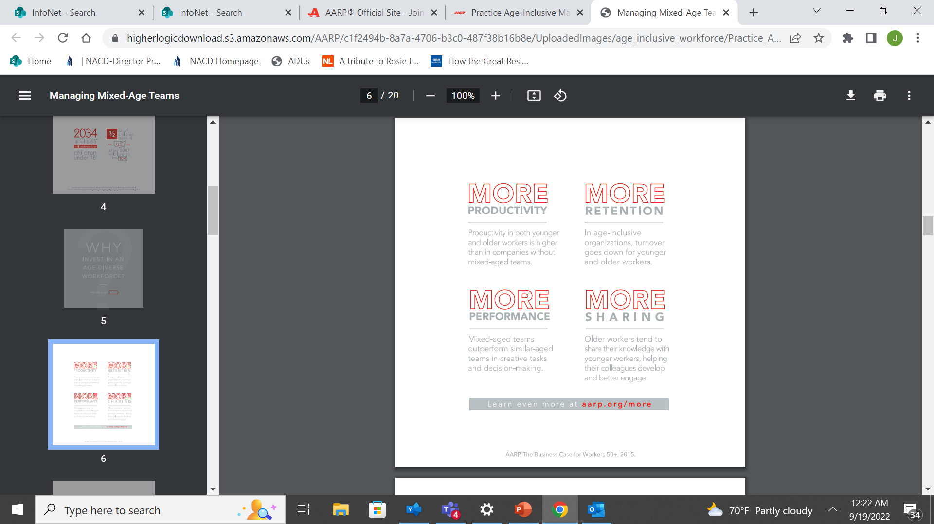
Why Invest in An Age Diverse Workforce?

