Slide 1
Covering Democracy After Election Day
November 14, 2022
Jaisal Noor, Democracy Cohort Manager, Solutions Journalism Network

Slide 2
What we’ll do today
1
2
3
What is solutions journalism?
Why cover democracy with a solutions lens?
Audience Q/A
Notes:
MIKHAEL

Slide 3
The Problem:
Why cover democracy with a solutions lens?
The Solution:
Solutions journalism can be more time consuming and resource intensive than traditional journalism. So why do it?
=
But we can change
- Just 1 in 4 Americans generally trust the media
-Nearly 40% of Americans often or sometimes avoid the news¹
“Solutions-focused reporting on the threats to elections, including cyber security, voter purges, and aging voting machines, was more likely to leave readers feeling enthusiastic about voting — and less anxious, sad, or angry –– than stories that simply described the threat.”²
Reuters Institute 2. University of Texas, Cited by SJN
Notes:
Sojo can increase trust, revenue and engagement

Slide 4

SOLUTIONS JOURNALISM IS:
rigorous, evidence-based reporting on responses to social problems.
Notes:
(1 min)
Ask them to name the key elements of soljo before moving to the next slide with the four pillars

Slide 5
Why these four pillars?
If the response is worth featuring, it’s worth its own story, not just a short mention.
RESPONSE
Aren't results what make the story newsworthy?
EVIDENCE
What we can show that would be useful in addressing systemic problems, fulfilling our mission to serve society?
INSIGHT
This makes the story journalism, not advocacy or PR. We’re examining the response, not promoting it.
LIMITATIONS

Slide 6
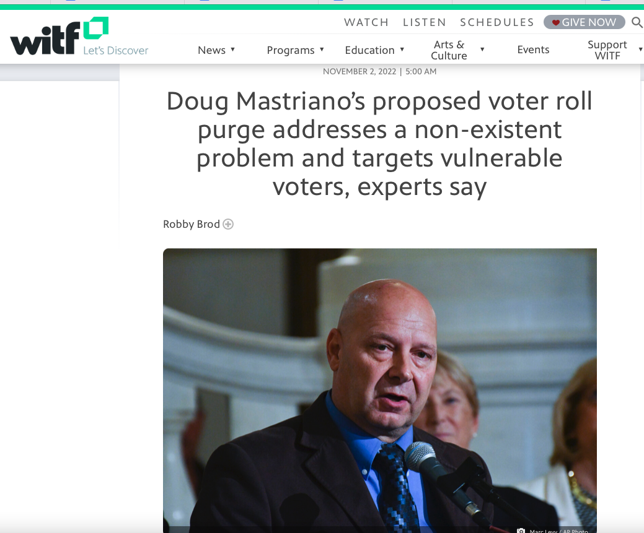
1
Find evidence and explain how it happened.
While there is no evidence of widespread voter fraud in Pennsylvania, some Republicans claim that the voting system is not secure. This story examines what the state has done to ensure its elections are safe.
Notes:
NOTES
Realistic mockups of text, articles, photos and videos on web browsers, mobile devices and tablets.
Sample platforms for mockups: freepik.com, unblast.com and mrmockup.com
Reminder: Make sure headline is big.

Slide 7
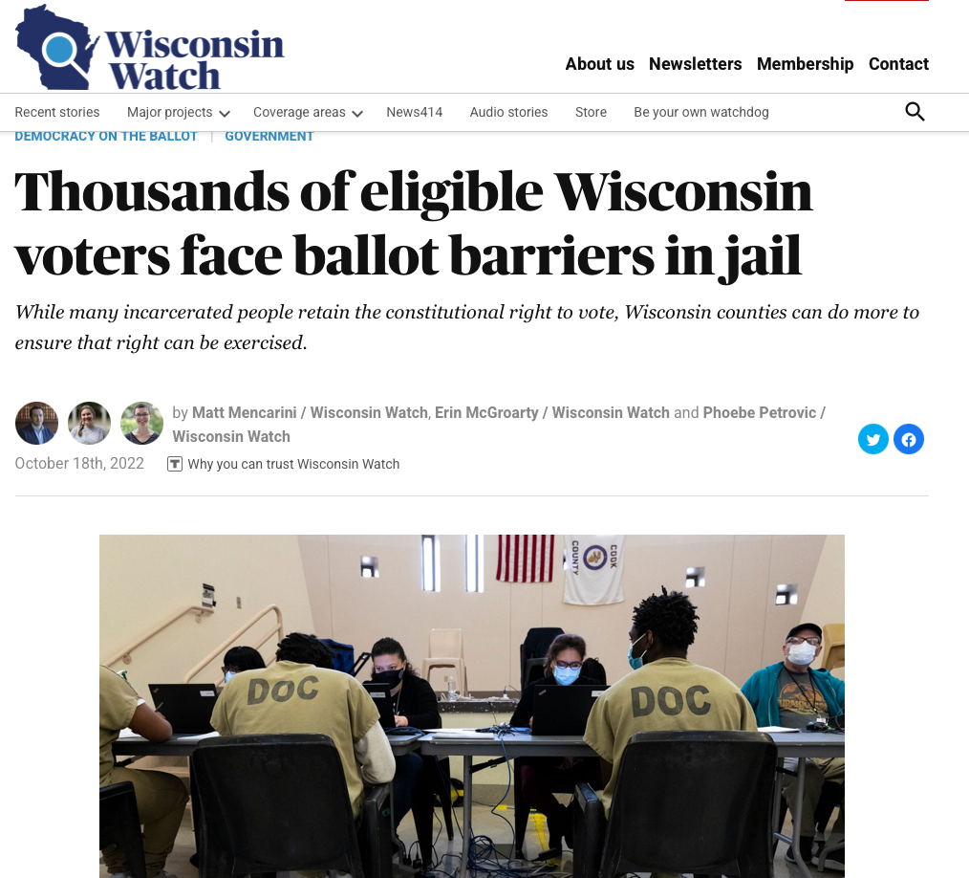
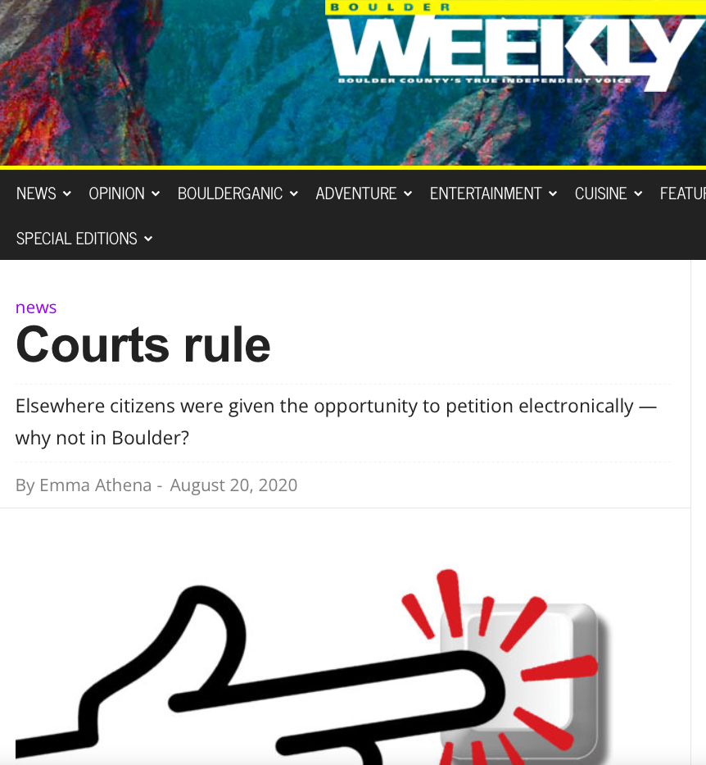
2
Who is doing it better?
What can Wisconsin learn from jails in Illinois and Texas are expanding voting access for people who are incarcerated by coordinating with voting rights advocacy groups and bringing polls on-site?
Notes:
NOTES
Realistic mockups of text, articles, photos and videos on web browsers, mobile devices and tablets.
Sample platforms for mockups: freepik.com, unblast.com and mrmockup.com
Reminder: Make sure headline is big.

Slide 8
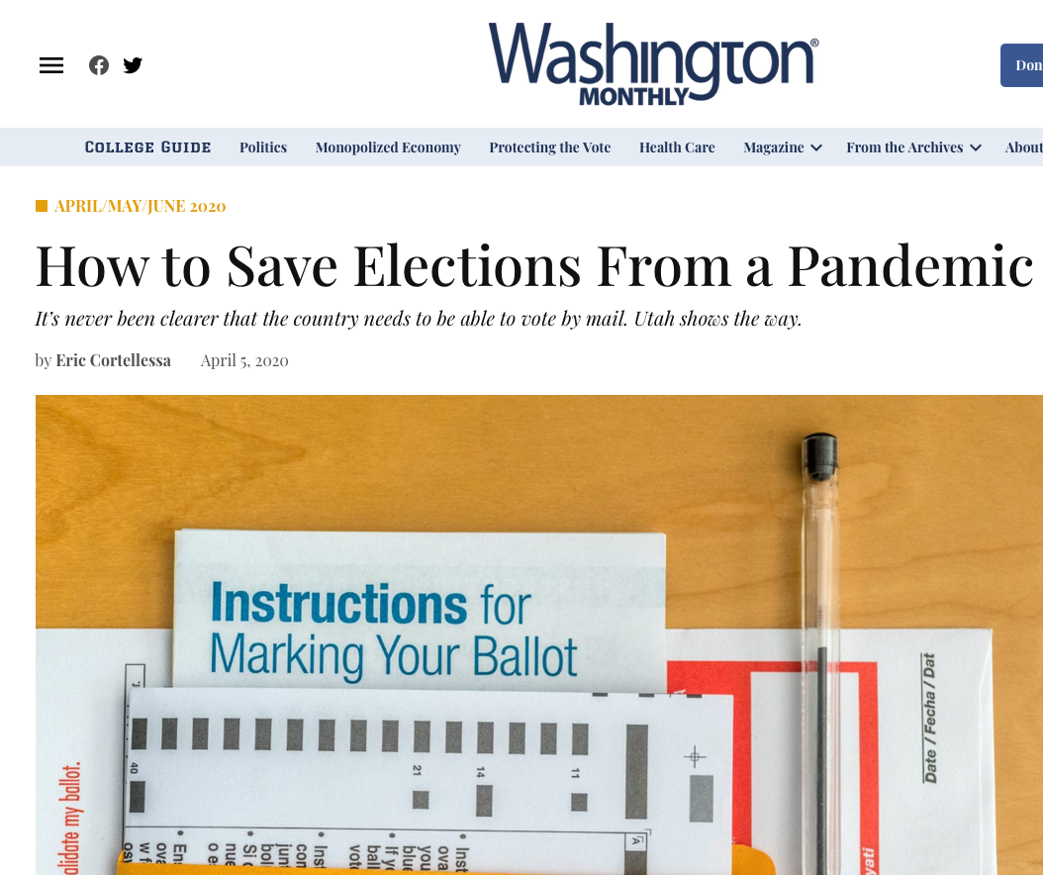
3
Who is doing it better?
The coronavirus pandemic prevented people from going to the polls cast their votes in primary elections but vote-at-home offered an alternative. Oregon, Washington, Colorado, and now Utah have all implemented statewide all-mail election campaigns that not only improve voter turnout, but also cost less to taxpayers than only relying on in-person polling booths.
Notes:
NOTES
Realistic mockups of text, articles, photos and videos on web browsers, mobile devices and tablets.
Sample platforms for mockups: freepik.com, unblast.com and mrmockup.com
Reminder: Make sure headline is big.

Slide 9
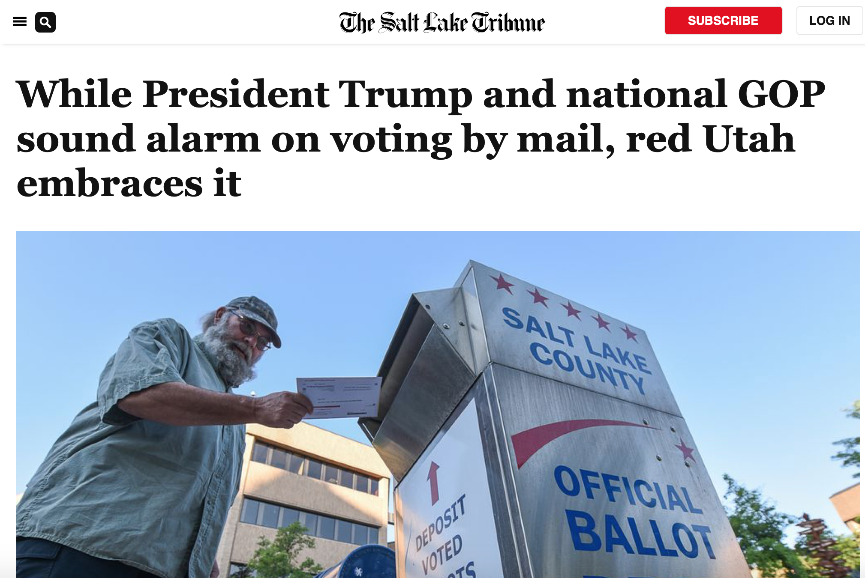
4
Accountability journalism
-Vote by mail doubled GOP turnout
-Few and isolated instances of voter fraud
Notes:
NOTES
Realistic mockups of text, articles, photos and videos on web browsers, mobile devices and tablets.
Sample platforms for mockups: freepik.com, unblast.com and mrmockup.com
Reminder: Make sure headline is big.

Slide 10
It’s solutions journalism if it:
Features not just a person, but a __________ to a systemic problem and how it happened
Provides available ________ of results, looking at ______________ — not just intentions

Slide 11
It’s solutions journalism if it:
Seeks to provide ______________
that can help others respond, too — not just inspiration
Discusses __________ and avoids reading like a puff piece

Slide 12


KEY QUESTIONS FOR SOLUTIONS STORIES
How does the response work?
What metrics matter?
Who is the response NOT working for?
What does the research say?
What do critics say?
Is it being replicated elsewhere?
What are the barriers to replication?
Notes:
https://thewholestory.solutionsjournalism.org/24-questions-to-frame-your-solutions-reporting-on-covid19-fe363525ff7?source=---------3-----------------------

Slide 13
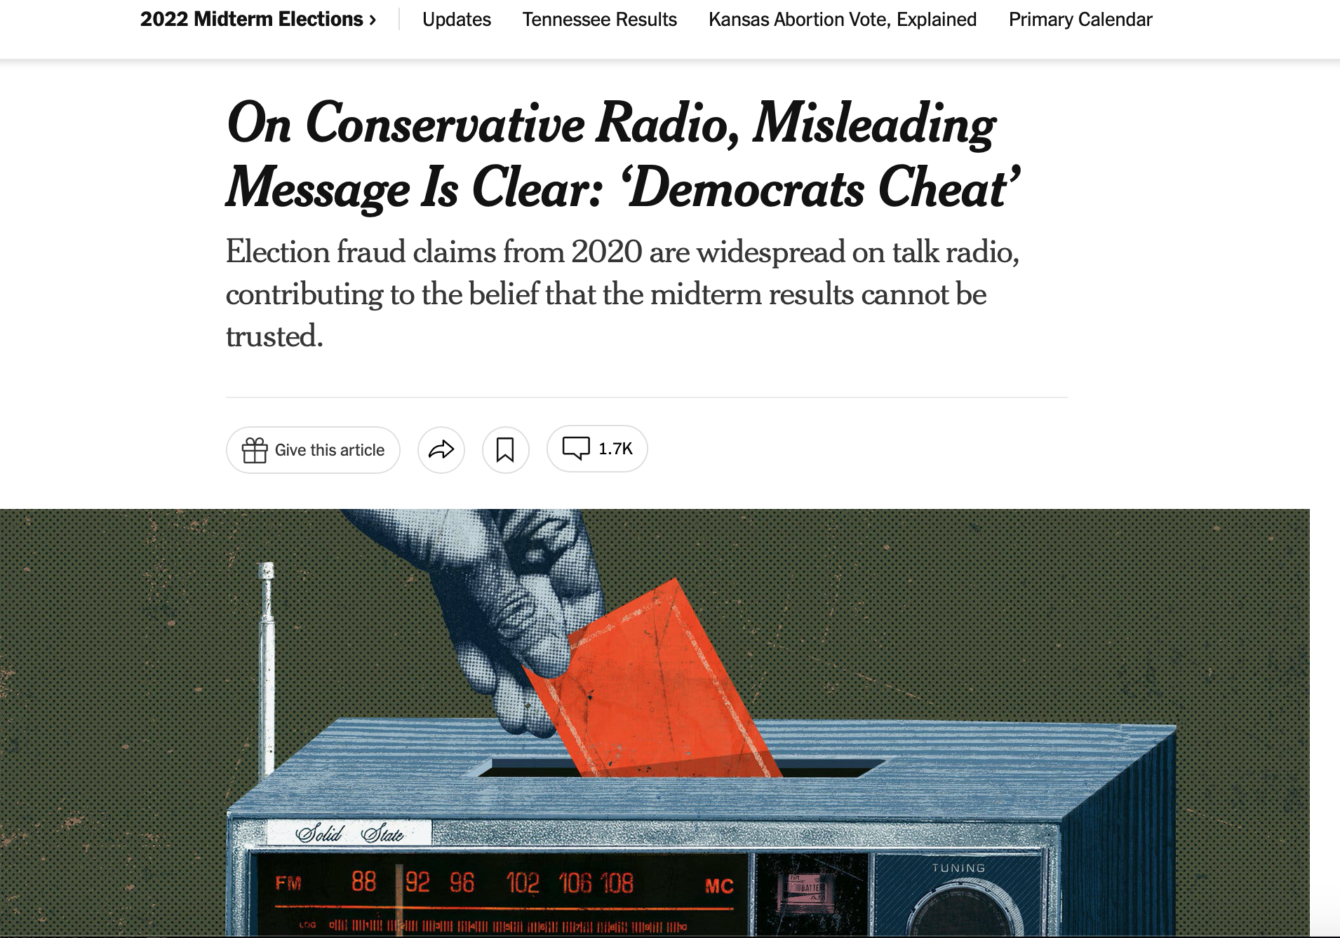
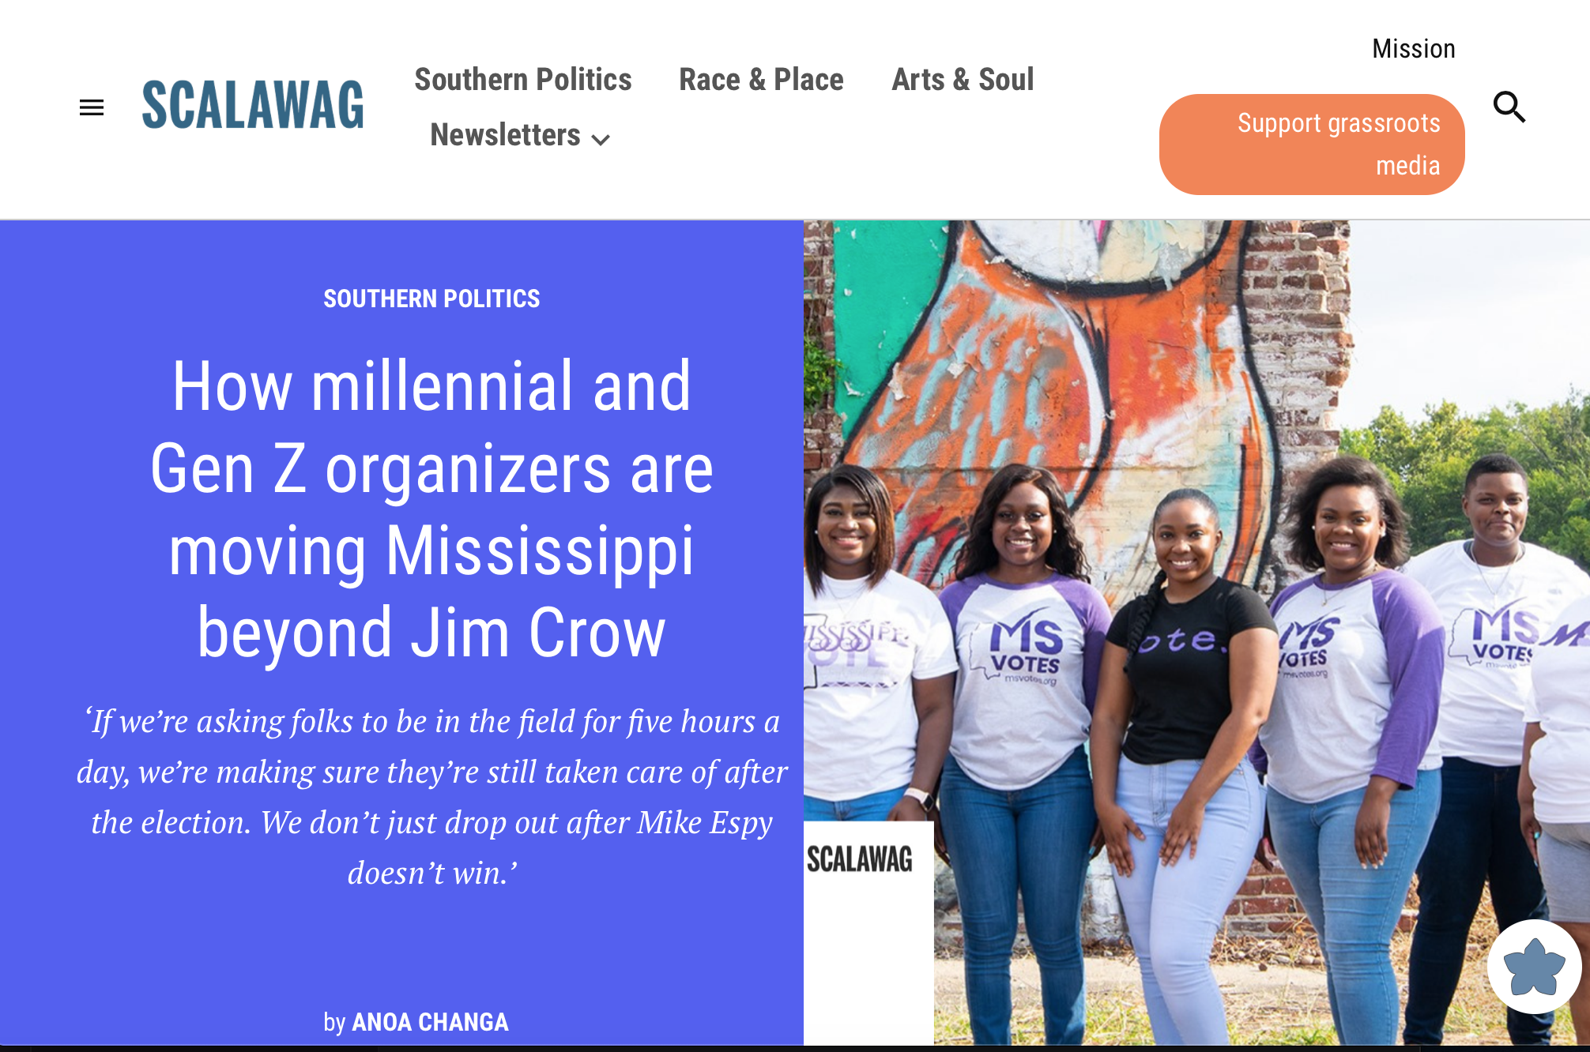
Which is a solutions story and why?
NYT: On Conservative Radio, Misleading Message Is Clear: ‘Democrats Cheat’
How millennial and Gen Z organizers are moving Mississippi beyond Jim Crow
Notes:
NOTES
Realistic mockups of text, articles, photos and videos on web browsers, mobile devices and tablets.
Sample platforms for mockups: freepik.com, unblast.com and mrmockup.com
Reminder: Make sure headline is big.

Slide 14
Top reasons why stories don't make it into the tracker
The response is just a plan/too early
No evidence yet exists
The reporting is about raising awareness about a response, and doesn't include any evidence beyond that awareness
Story lacks compelling evidence
Includes evidence of the problem, not solution
Need limitations to avoid becoming a “puff piece”
No limitations of the approach
How do we know if the
solution is effective?
Notes:
2. 3. NO LIMITATIONS OF THE APPROACH

Slide 15
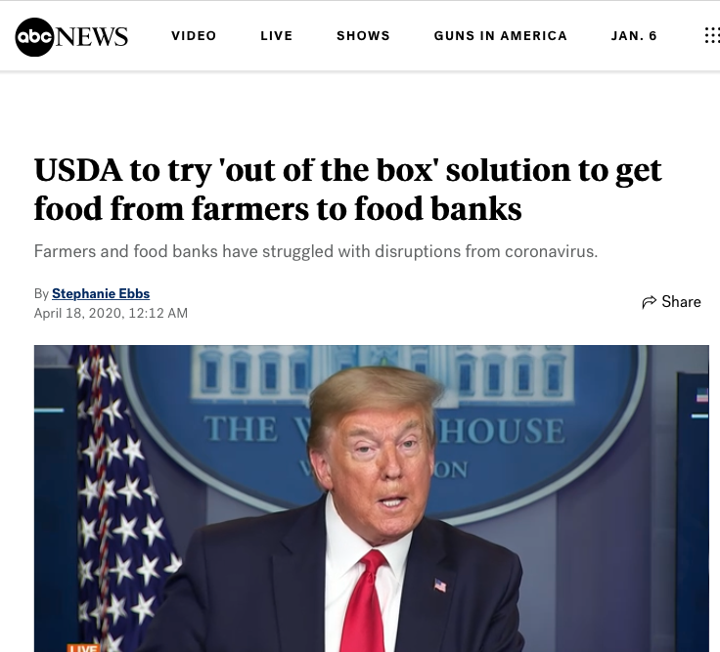
1
Just a plan/It’s Too Early
USDA to try 'out of the box' solution to get food from farmers to food banks
Notes:
NOTES
What if there isn’t enough evidence? Then the story might be...
Just A Plan / It's Too Early:
The story is about a plan with little or no progress happening yet. At this stage, the response has been announced or launched, but there is no information yet about its impact or effectiveness.
This story talks about a new program to connect farmer’s food with food banks, but the initiative was just announced and there’s no information about if it was successful or not.

Slide 16
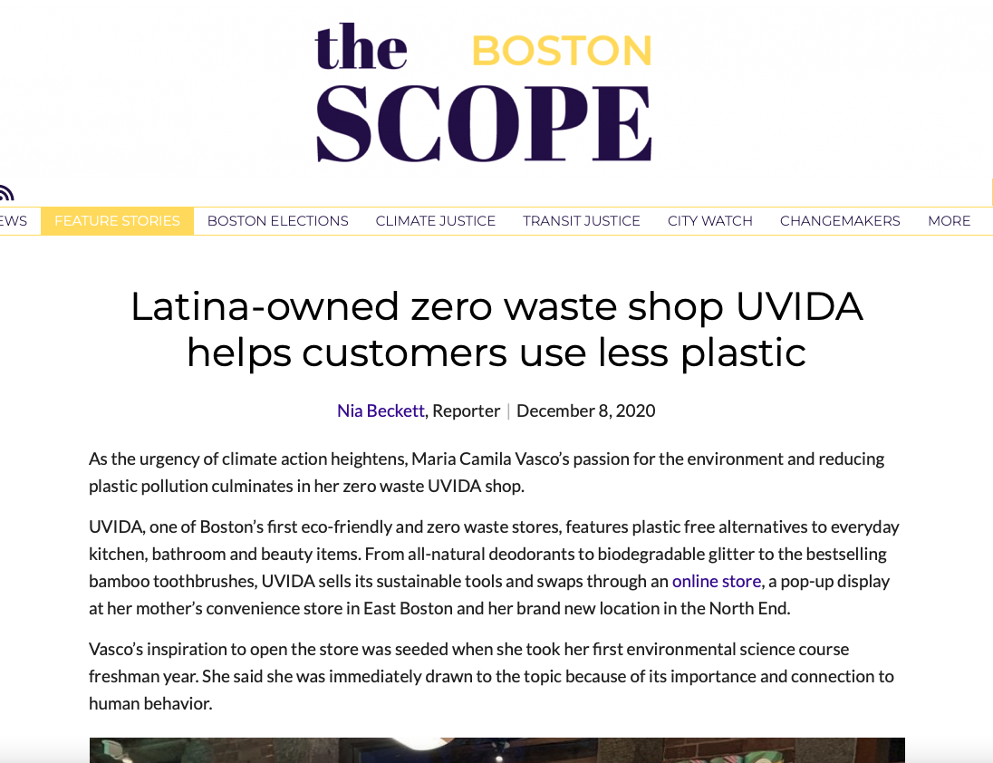
2
Raises awareness but lacks evidence
Latina-owned zero waste shop UVIDA helps customers use less plastic
Notes:
NOTES
Raises Awareness without Evidence
The reporting in this story is focused on raising awareness about a response, but doesn’t describe anything beyond its happening. As a result, insight and evidence of its impact are not present. While raising awareness is important, solutions journalism requires evidence to show how a response is working or not working in that effort.
This story talks about a story that encourages its customers to use less plastic. While it’s an interesting response, the author doesn’t describe the impact the store has on the community or present evidence of its effectiveness in its goal.

Slide 17
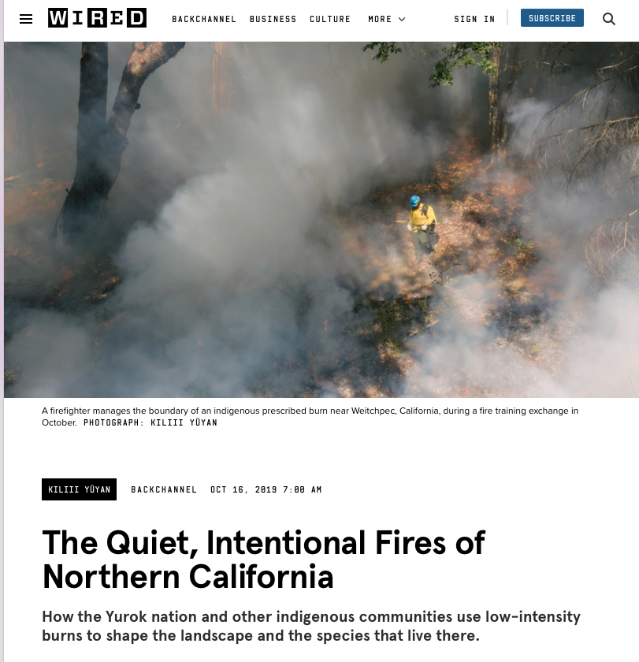
3
No Limitations
The Quiet, Intentional Fires of Northern California: How the Yurok nation and other indigenous communities use low-intensity burns to shape the landscape and the species that live there.
Notes:
NOTES
The story does not discuss the limitations or shortcomings of the response or places the response in meaningful context. As a result, the story of the response is incomplete and the insight is limited.
This photo essay talks about how Indigenous communities use prescribed burns to prevent wildfires. However, the author does not present any limitations or challenges to the response that would inform readers about the difficulties of attempting such an approach.
Just A Plan / It's Too Early:
The story is about a plan with little or no progress happening yet. At this stage, the response has been announced or launched, but there is no information yet about its impact or effectiveness.
This story talks about a new program to connect farmer’s food with food banks, but the initiative was just announced and there’s no information about if it was successful or not.

Slide 18
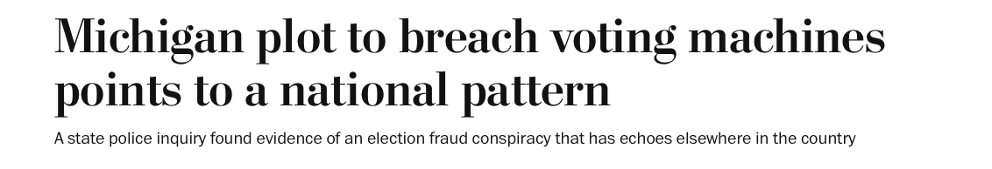
CHALLENGE
How would you turn these into a solutions-focused story?

Slide 19
Evidence
Notes:
LINDA

Slide 20
Evidence can come from many sources
Data collected by the people involved (quantitative)
Data collected by others – state, county, city, researchers, nonprofits (quantitative)
Data from similar effort that has been around longer (quantitative)
Academic studies (qualitative or quantitative)
Experts or other people who are knowledgeable about the response (qualitative)
Interviews with the people affected by a response, or by a similar response elsewhere (qualitative)
Notes:
Independent evidence

Slide 21
Exercise:
Work shopping your
solutions story plan
Notes:
LINDA: BREAKOUTS for 15 minutes Bring s solutions story idea to the next meeting, where we will start on developing a reporting for it.

Slide 22
Praise: Strengths as solutions story
Probe: Which pillars could be stronger?
Polish: How could any of the pillars be strengthened?
Notes:
LINDA 5-10 minutes

Slide 23
USE THE LINK IN THE CHAT TO OPEN THE GOOGLE DOC TO FIND THE PLANNING SHEET FOR YOUR NEWSROOM.
SOLUTIONS STORY PLANNING
Problem -- or piece of the problem | Response you’ll feature
Evidence: What you have/what you know you can find/what you’d like to find | Limitations/Caveats:Ones you know about or need to explore
The Howdunnit: What’s been done and how, including bumps in the road and potential ones ahead | Insights/lessons: What can this story teach us?

Slide 24
Thank You
Jaisal Noor
jaisal@solutionsjournalism.org
Linda Shaw
linda@solutionsjournalism.org

