Slide 1
The Senior-cession
Julia Pollak, ZipRecruiter Chief Economist
Notes:
For more layouts, icons, and tips, check out our Internal Deck Guide
Updated 02.05.21

Slide 2
The economic recovery generation gap

Slide 3
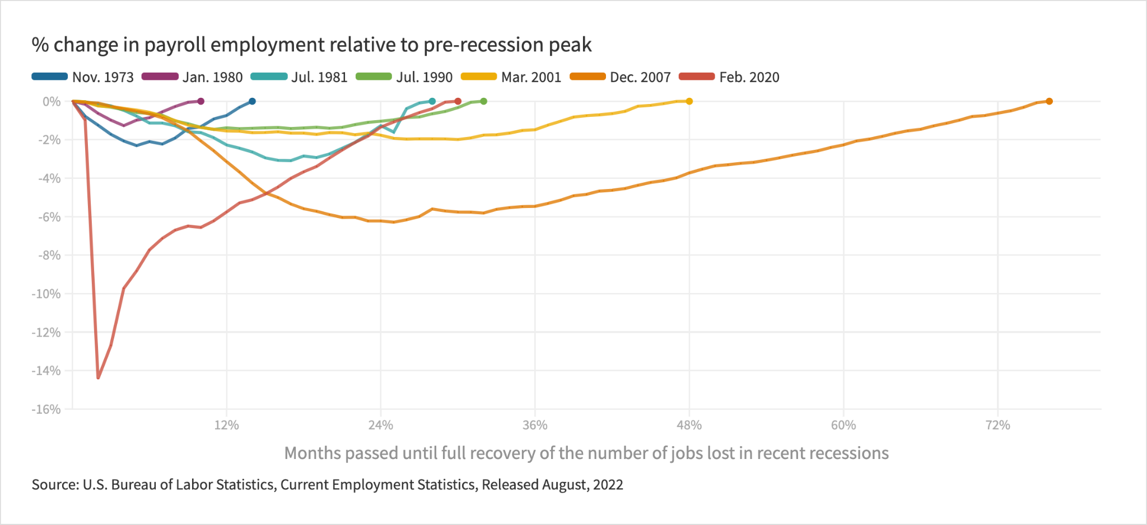
Compared to the great recession, the pandemic saw more than 2x the job losses, but more than 2x the pace of recovery.

Slide 4
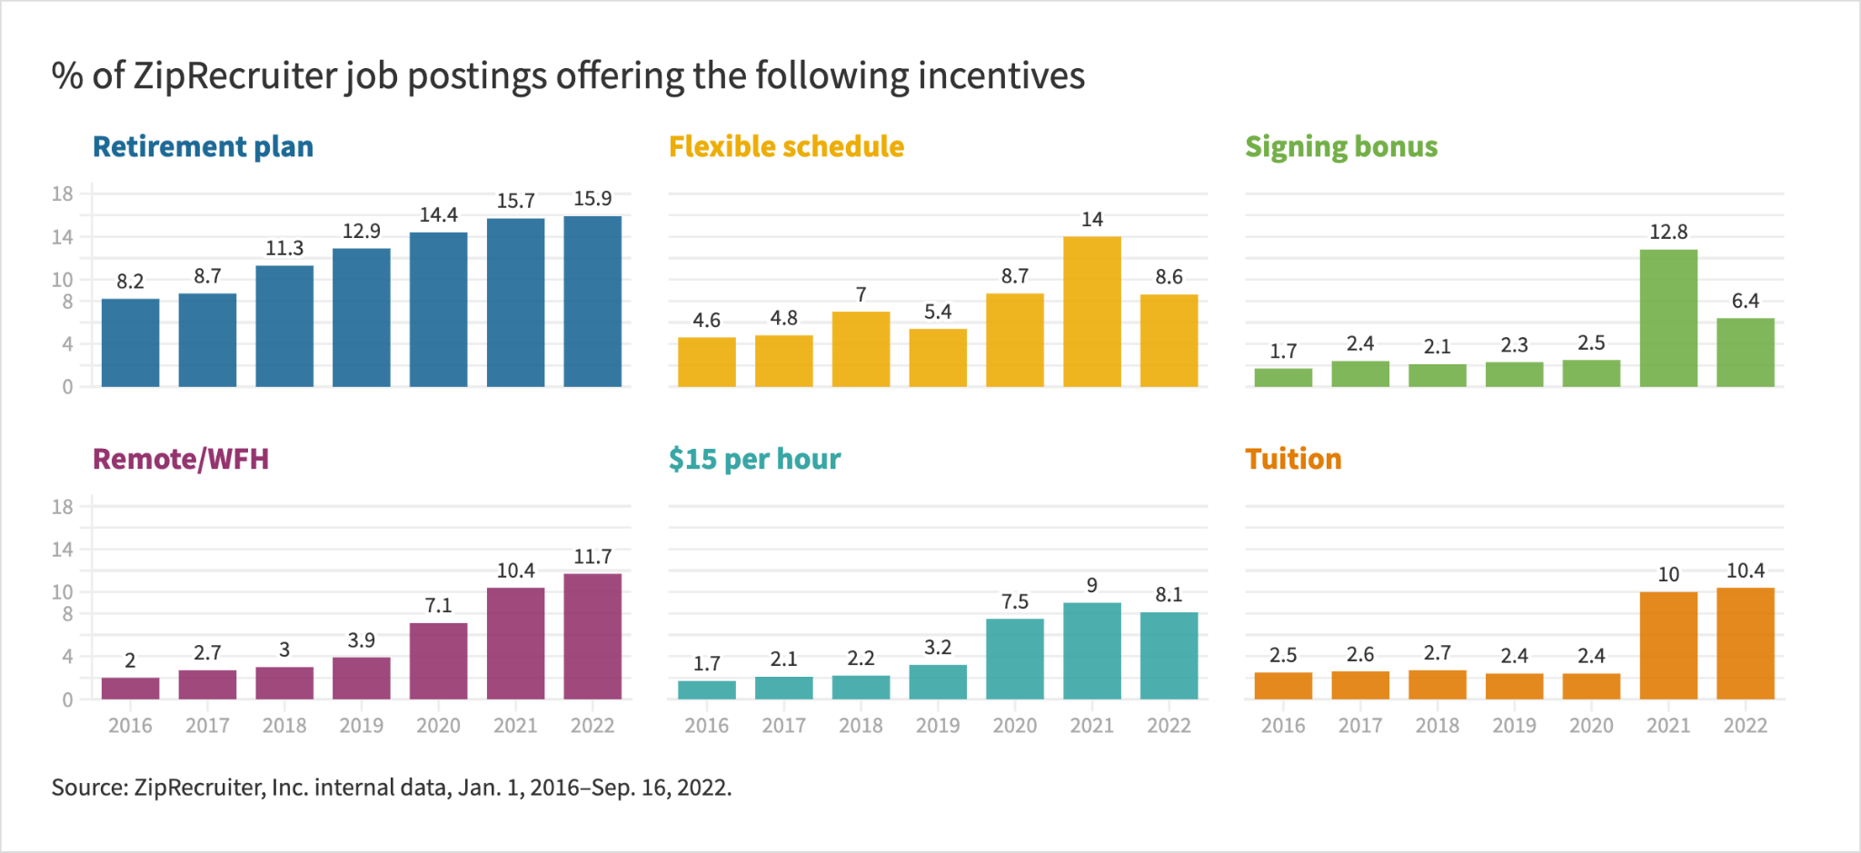
By and large, jobs have gotten better and more flexible.

Slide 5
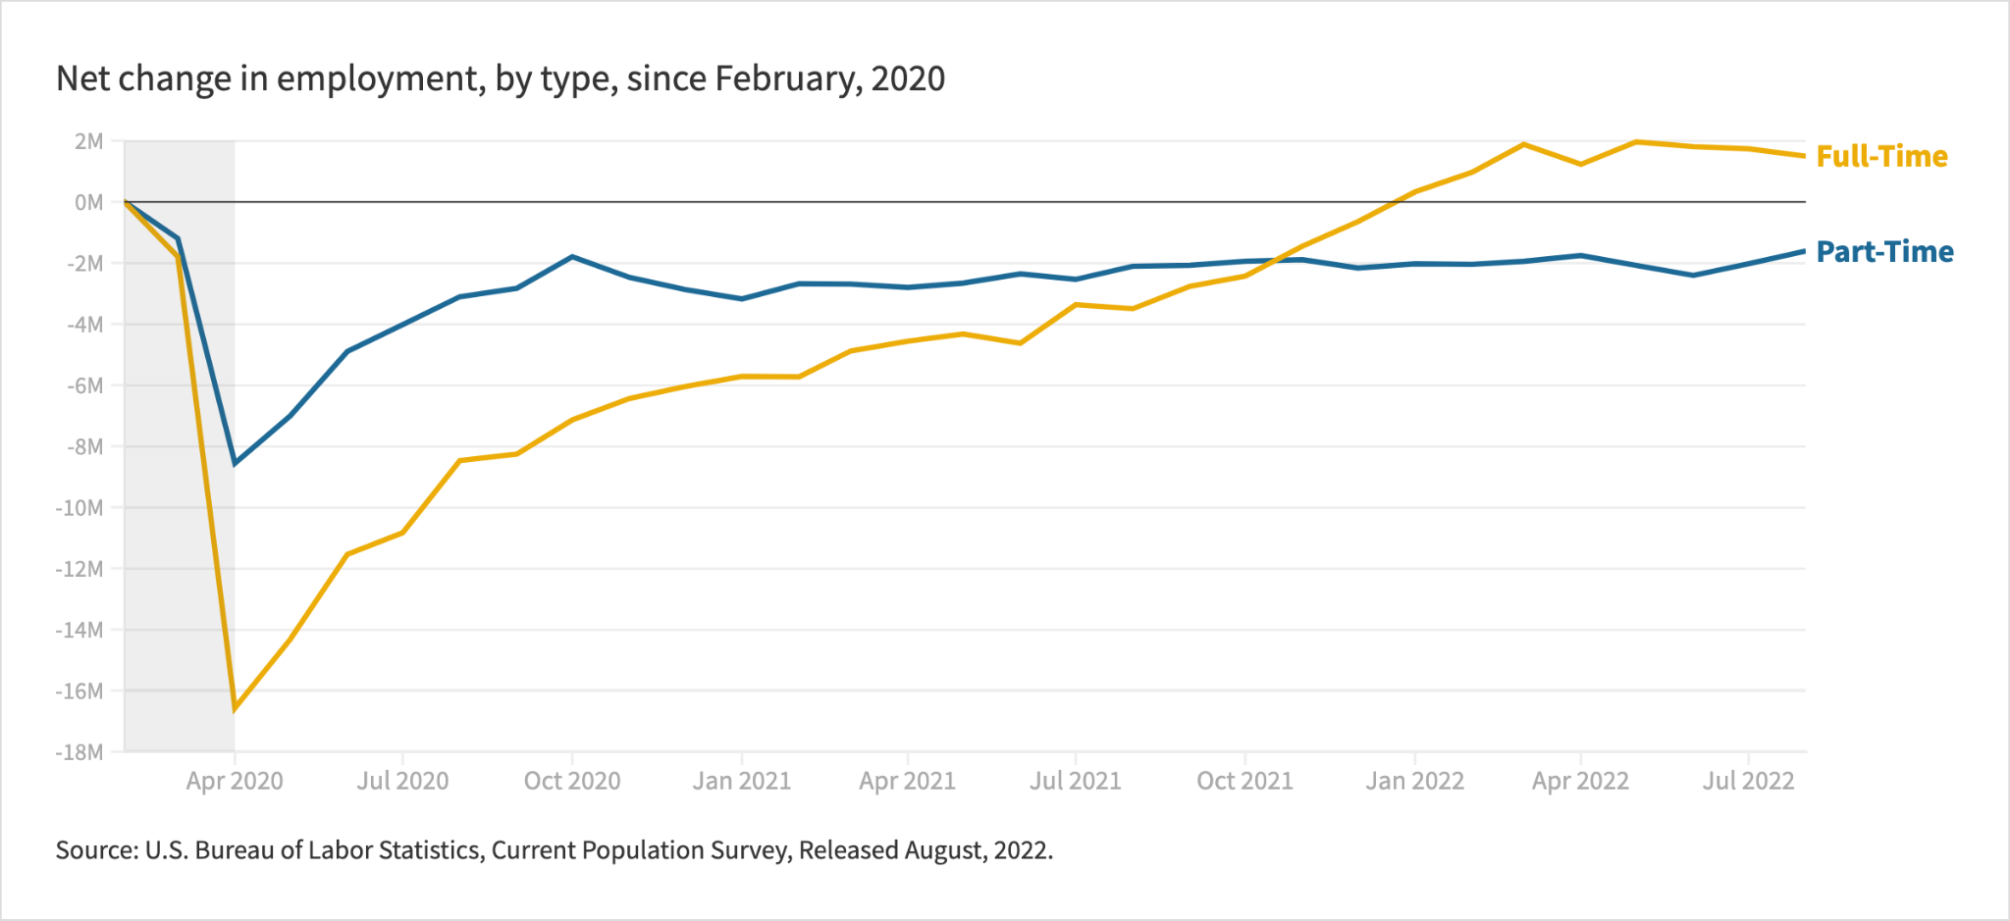
Many workers have been able to trade up.

Slide 6
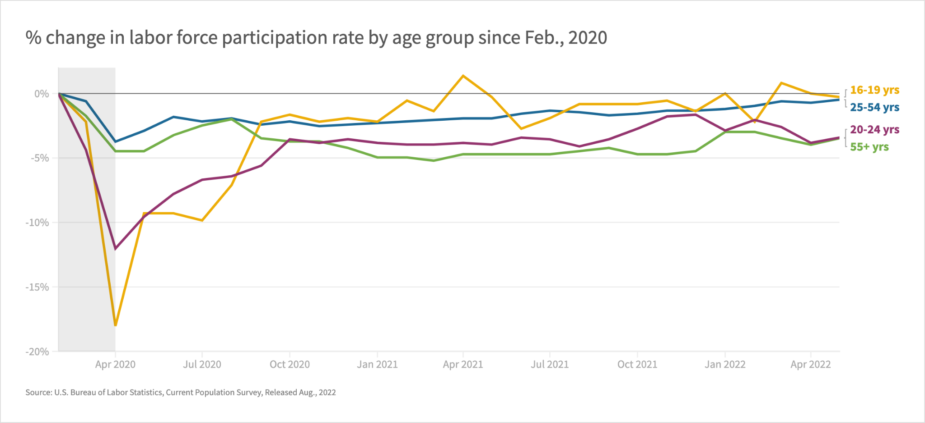
But older workers are missing out.

Slide 7
Overall, a great recovery
+ 2.0 ppt | Employment rate for black men
+ 1.8 ppt | Labor force participation rate for workers with disabilities
+ 1.1 ppt | Teen labor force participation rate
-46% | The child poverty rate
Feb. 2020 – Aug. 2022
Feb. 2020 – Aug. 2022
Feb. 2020 – Aug. 2022
2021 – 2022

Slide 8
…against the backdrop of a Senior-cession
- 2.4 ppt | Labor force participation rate for workers aged 65 and older
- 1.8 ppt | Employment rate for black women aged 65 and older
+1.2 ppt | Poverty rate for Americans aged 65 and older

Slide 9
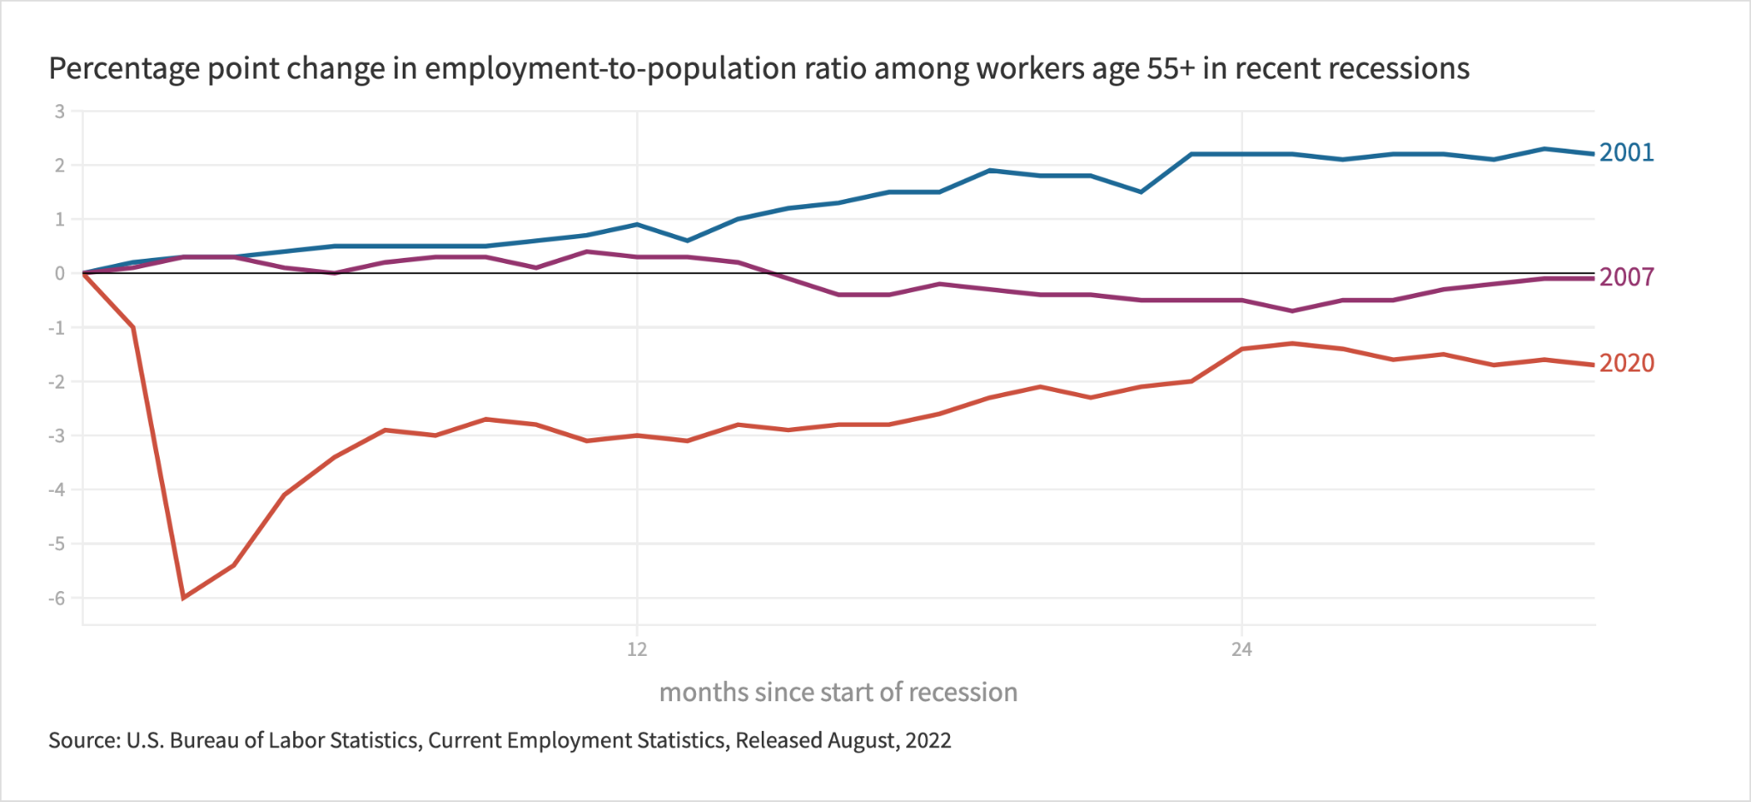
This time is different; older workers are further behind.

Slide 10
Why have seniors been left behind?

Slide 11
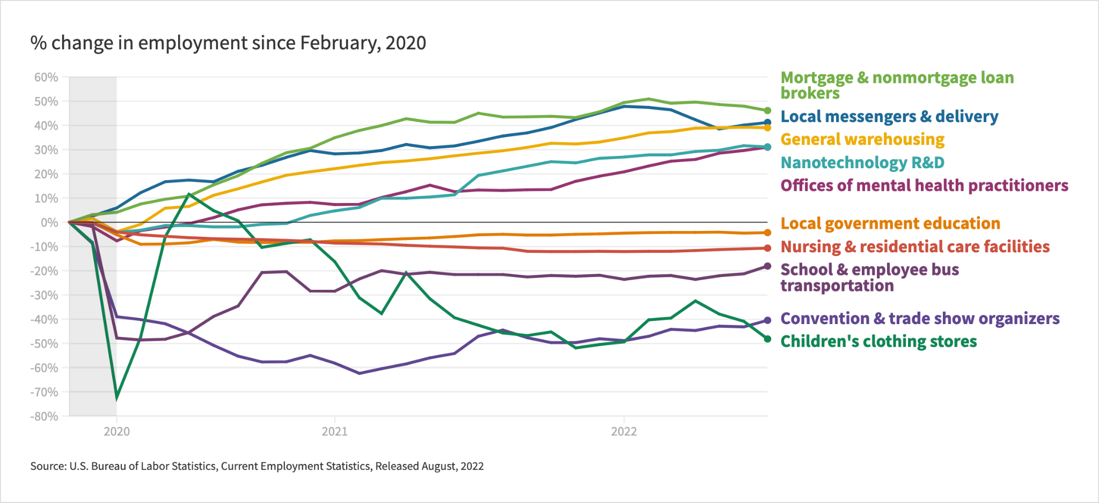
Jobs have returned in different places, however

Slide 12
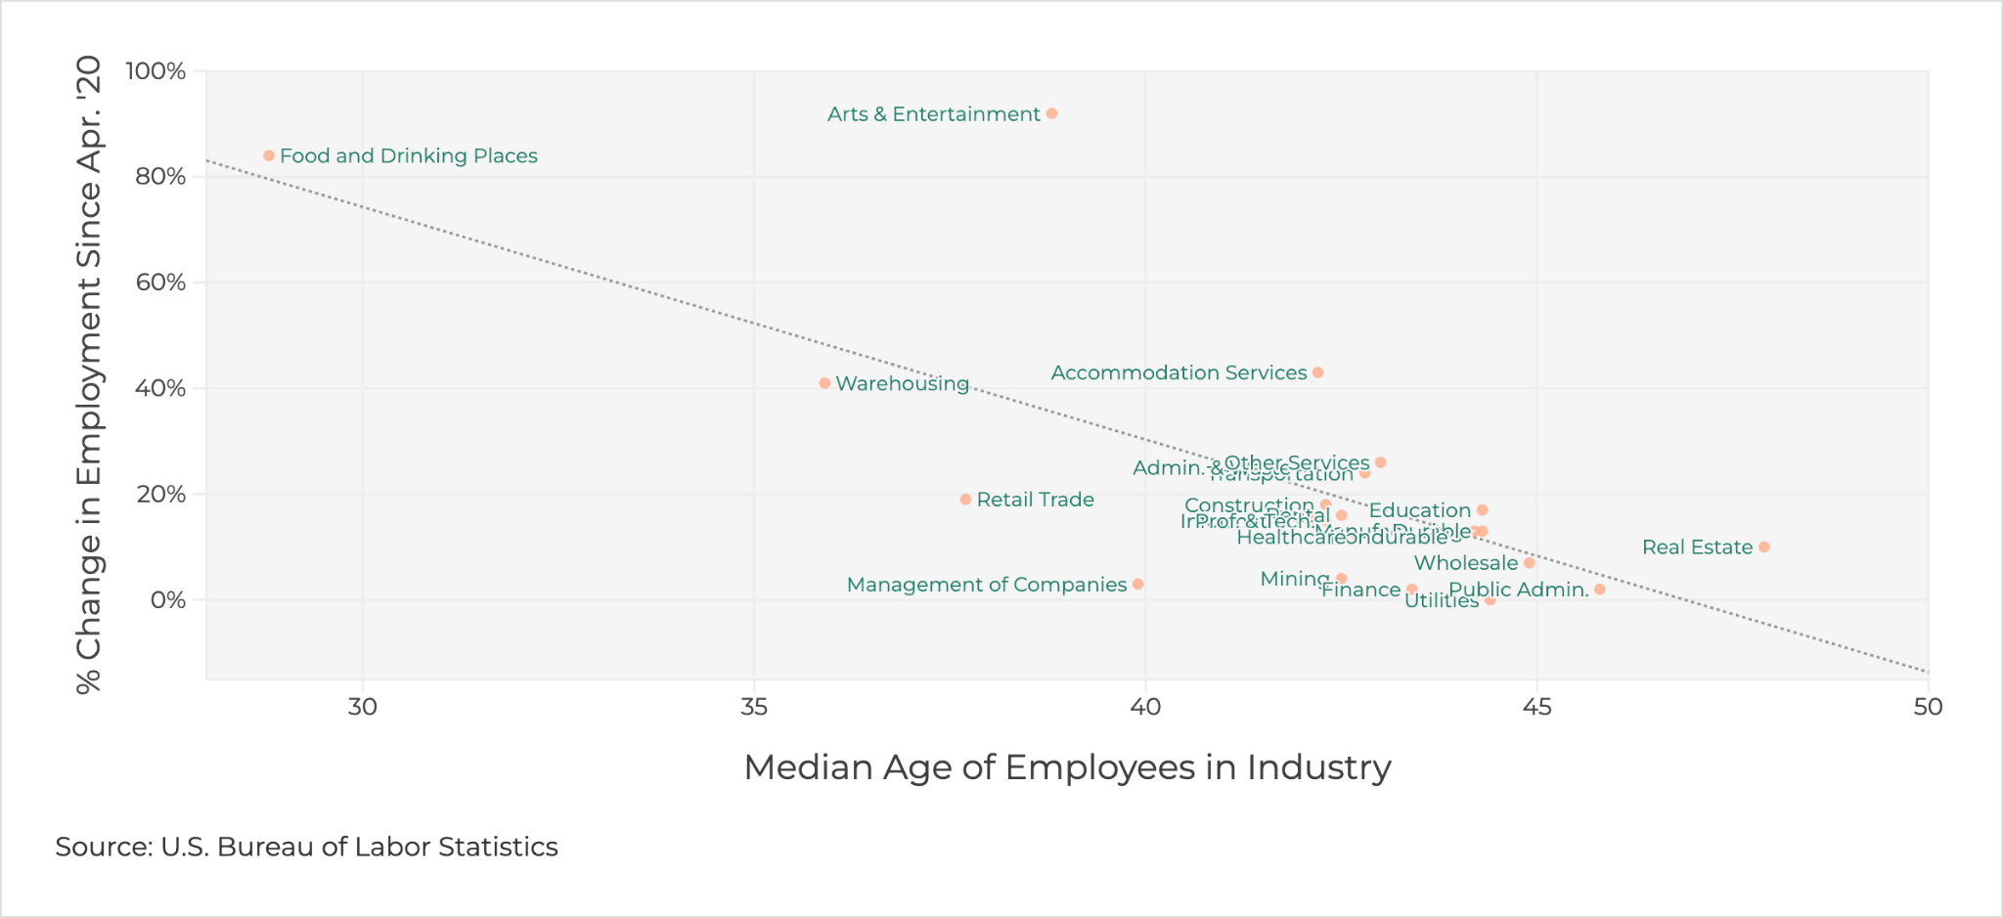
…with the youngest industries leading the jobs recovery.

Slide 13
Reemployment rates for displaced workers aged 65+ who had been working for their employers for >3 years have fallen 15 ppt since the pandemic

Slide 14
Older workers face steeper barriers to reentry
Age discriminiation
A digital divide
A crisis of confidence

Slide 15
Why should we be worried?

Slide 16
Many seniors cannot afford the luxury of a premature retirement
Women are 80% more likely to live in poverty after age 65
50% of seniors rely on social security for the majority of their income, with women receiving less on average
Women live 6 years longer on average, so they are more likely to outlive their spouses and savings
Women age 65+ are the predominant providers of informal care in their communities

Slide 17
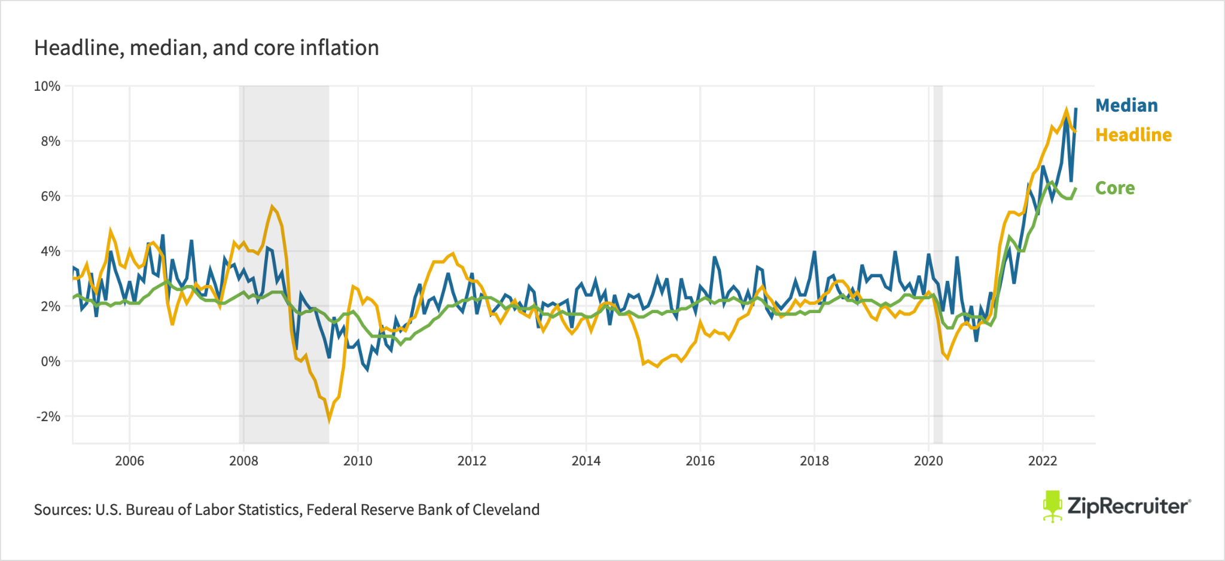
…especially in a time of red-hot inflation.

Slide 18
What can we do?

Slide 19
A plan of action to address the unprecedented Senior-cession
FEDERAL & STATE PROGRAMS
Review priorities and needs—a bigger problem calls for better solutions
COMMUNITY ORGANIZATIONS
Establish/expand Job Club programs
COMMUNITY ORGANIZATIONS
Replicate/expand successful senior upskilling programs
Outreach, advising, support, job placement, continuing education, assistive technology
PRIVATE SECTOR
AARP Employer Pledge program & Age-Friendly Institute certification
Older worker recruitment, retraining, job-sharing, job redesign, job transfer, & phased retirement programs
PUBLIC-PRIVATE PARTNERSHIPS
Create best-in-class job boards for older workers

