Slide 1

Finding data on older workers
Photo by Flickr user Scott Lewis
Paul Overberg
Wall Street Journal
Living Longer: A New Age of Aging
National Press Foundation
Sept. 21, 2022

Slide 2
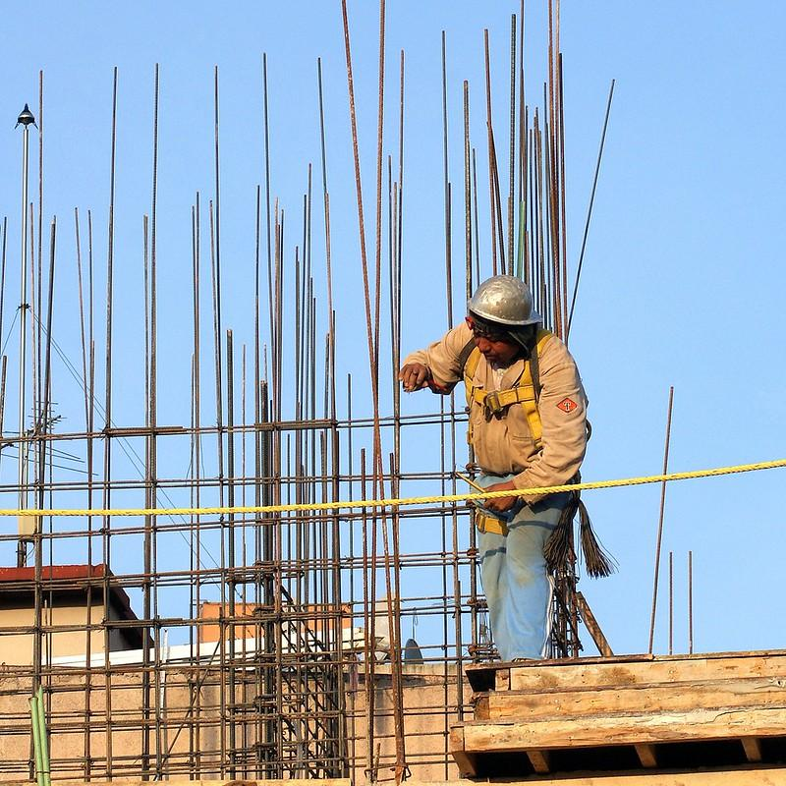
Quick overview
Context, broad trends
Monthly basics (BLS)
Detailed demographics (Census Bureau)
Deeper reading and research
Photo by Flickr user Carl Campbell
Notes:
2

Slide 3
Working-age population (16+)
Not in labor force
Civilian labor force
Employed(workers)
Notes:
Employment-population ratio = Employed/working-age population
Labor force participation rate = Employed/civilian labor force
3

Slide 4
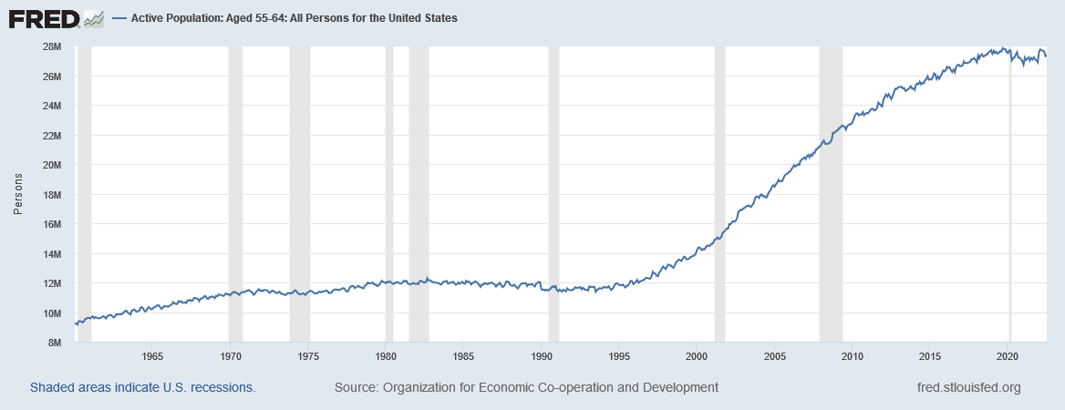
Working-age population
Surge of potential older workers has ended
Demographics underlies economics
Notes:
Organization for Economic Co-operation and Development, Active Population: Aged 55-64: All Persons for the United States [LFAC55TTUSM647S], retrieved from FRED, Federal Reserve Bank of St. Louis; https://fred.stlouisfed.org/series/LFAC55TTUSM647S, August 29, 2022.
4

Slide 5
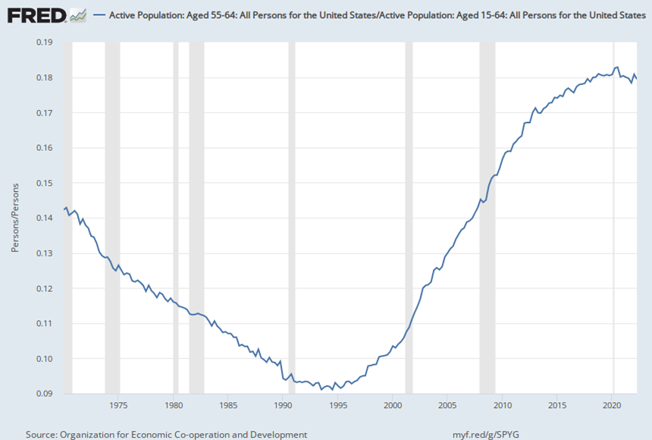
Working-age population
Boomers boosted older workers’ share
But what comes next?
Notes:
Dividing the number of potential older workers (population ages 55 to 64) by (most of) the working-age population (ages 16 to 64) shows that older workers have boosted their profile significantly as the baby boom has aged into this group and been followed by the smaller age groups of Gen X and now Gen Z.
Working-age population: Source: Organization for Economic Co-operation and Development, Working Age Population: Aged 15-64: All Persons for the United States [LFWA64TTUSM647S], retrieved from FRED, Federal Reserve Bank of St. Louis; https://fred.stlouisfed.org/series/LFWA64TTUSM647S, August 29, 2022.
5

Slide 6
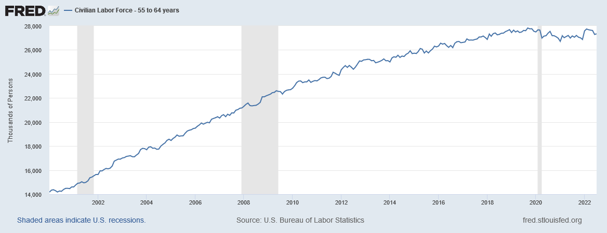
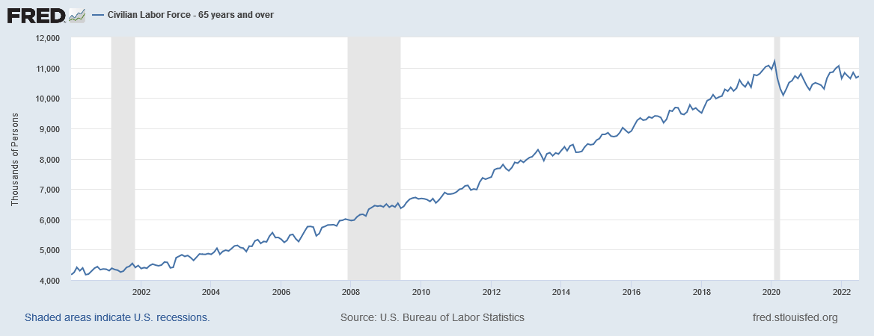
Workers, 55 to 64 and 65+
Notes:
U.S. Bureau of Labor Statistics, Civilian Labor Force - 55 to 64 years [TOTLL5564], retrieved from FRED, Federal Reserve Bank of St. Louis; https://fred.stlouisfed.org/series/TOTLL5564, August 29, 2022.
U.S. Bureau of Labor Statistics, Civilian Labor Force - 65 years and over [TOTLL65O], retrieved from FRED, Federal Reserve Bank of St. Louis; https://fred.stlouisfed.org/series/TOTLL65O, August 29, 2022.
6

Slide 7
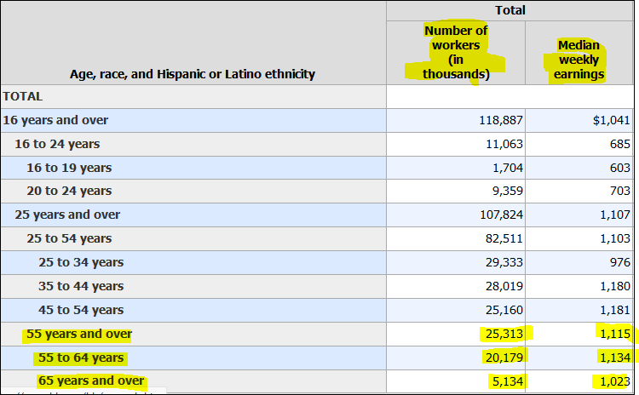
Monthly basics from BLS
Workers 55 to 64 & 65+ and median earnings
Also broken down by sex
Age 55+: Race/Hispanic breakdown
Notes:
https://www.bls.gov/news.release/wkyeng.t03.htm
7

Slide 8
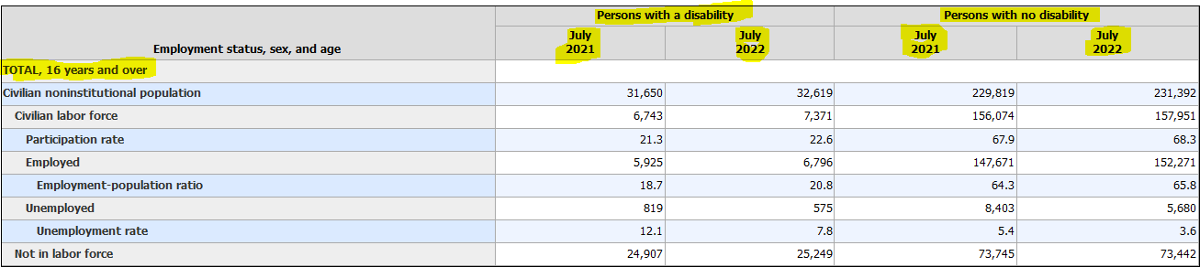
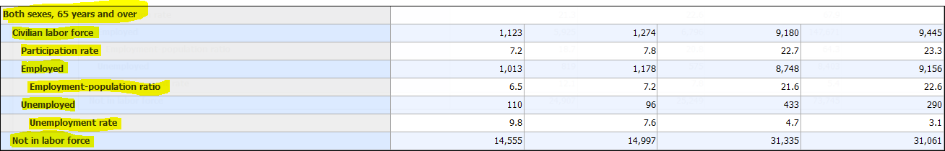
Monthly basics from BLS
Table A-6, monthly “Employment Situation”
Broken down by sex, disability status
Notes:
https://www.bls.gov/news.release/empsit.t06.htm
8

Slide 9
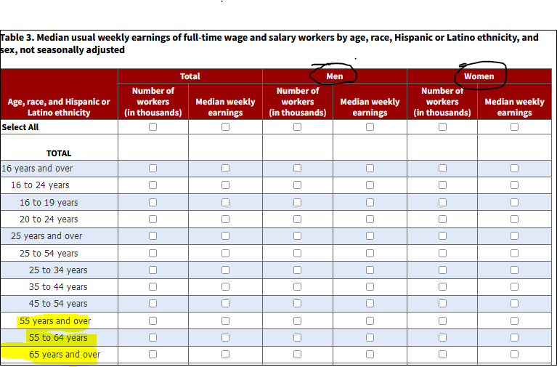
Monthly basics from BLS
Customize and download 10 years of data
Notes:
https://www.bls.gov/webapps/legacy/cpswktab3.htm
9

Slide 10
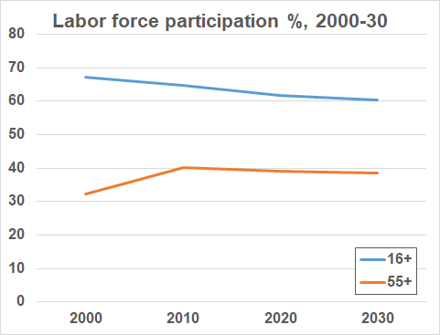
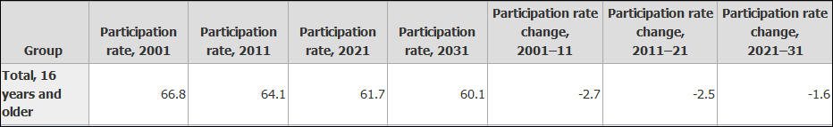
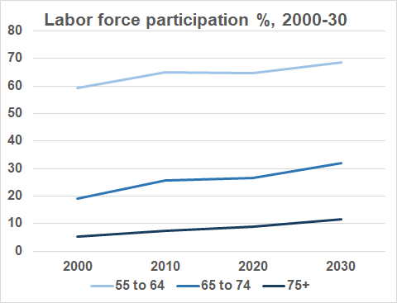
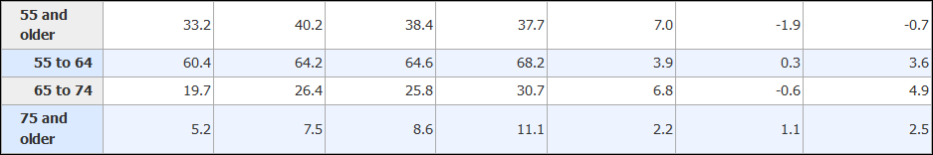
BLS employment projections
See the trend?
Notes:
Employment, 2000-20 and projections to 2030: https://www.bls.gov/emp/tables/civilian-labor-force-participation-rate.htm
10

Slide 11
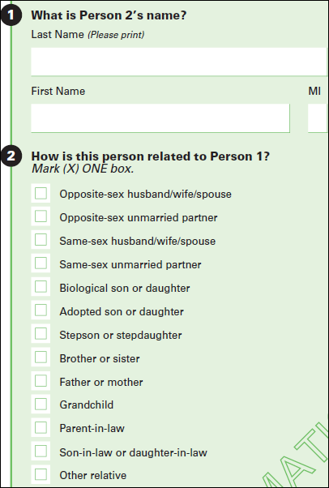
American Community Survey
2 million households/year
Demographic, economic, housing and social data
Available for states, cities, counties, neighborhoods, etc.
Updated annually
Notes:
Start here: https://www.census.gov/programs-surveys/acs
11

Slide 12
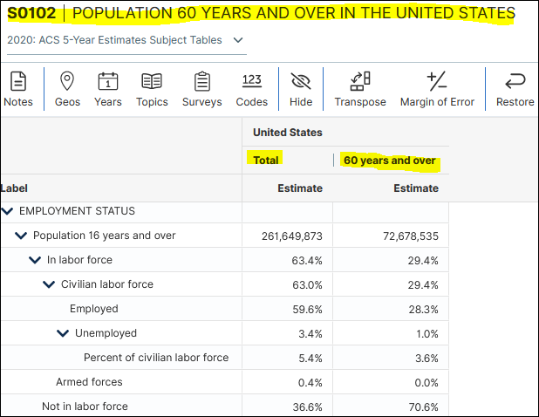
ACS: Overview of older people
Two data reports collect dozens of statistics
People 60+ (73M)
People 65+ (54M)
Includes earnings, employment status, disability status
Notes:
Population 60 and over: https://data.census.gov/cedsci/table?q=s0102&tid=ACSST5Y2020.S0102
Population 65 and over: https://data.census.gov/cedsci/table?q=s0102&tid=ACSST5Y2020.S0103
For any area larger than 65,000 people, single-year updates are available:
Population 60 and over: https://data.census.gov/cedsci/table?q=s0102&tid=ACSST1Y2021.S0102
Population 65 and over: https://data.census.gov/cedsci/table?q=s0102&tid=ACSST1Y2021.S0103
12

Slide 13
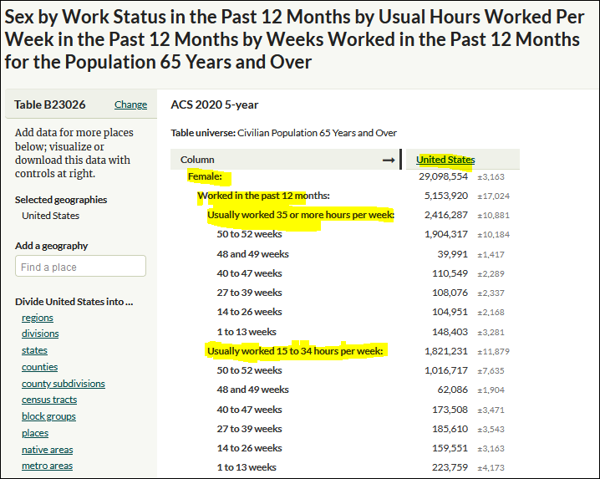
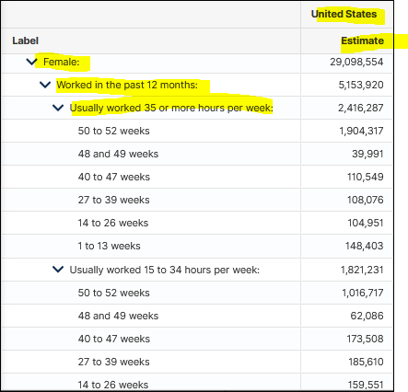
Details on older workers
Employment breakdown by weeks & hours worked
Notes:
B23026: SEX BY WORK STATUS IN THE PAST 12 MONTHS BY USUAL HOURS WORKED PER WEEK IN THE PAST 12 MONTHS
BY WEEKS WORKED IN THE PAST 12 MONTHS FOR THE POPULATION 65 YEARS AND OLDER
https://data.census.gov/cedsci/table?q=B23026
Same table on CensusReporter.org: https://censusreporter.org/tables/B23026/
13

Slide 14
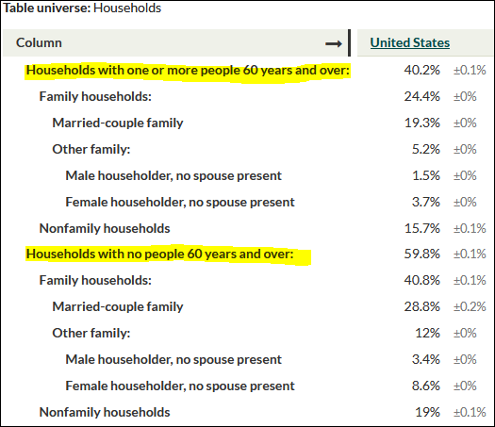
Details on their households
Composition of households with someone who is 60+ or 65+
Notes:
B11006: HOUSEHOLDS BY PRESENCE OF PEOPLE 60 YEARS AND OVER BY HOUSEHOLD TYPE
https://data.census.gov/cedsci/table?q=b11006
B11007: HOUSEHOLDS BY PRESENCE OF PEOPLE 60 YEARS AND OVER BY HOUSEHOLD TYPE
https://data.census.gov/cedsci/table?q=b11007
14

Slide 15
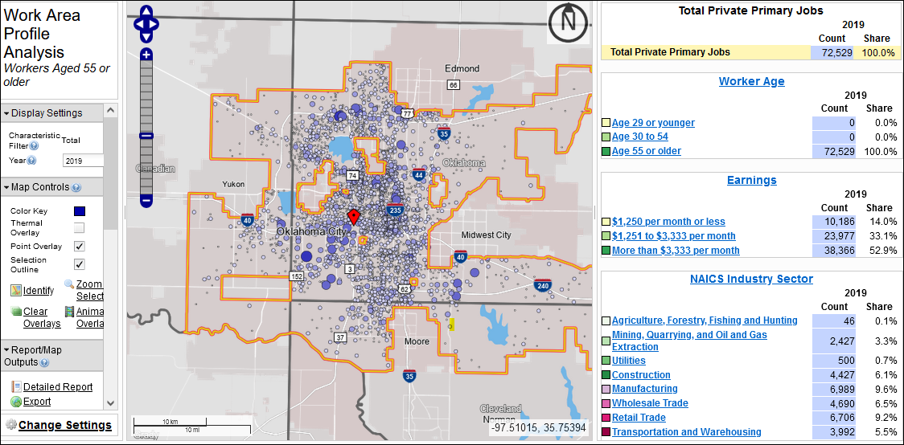
LEHD: On the Map
Based on enhanced UI data
Workers 55+: Earnings, industry, etc.
Notes:
Longitudinal Employer-Household Dynamics: https://lehd.ces.census.gov
On the Map: https://onthemap.ces.census.gov
15

Slide 16
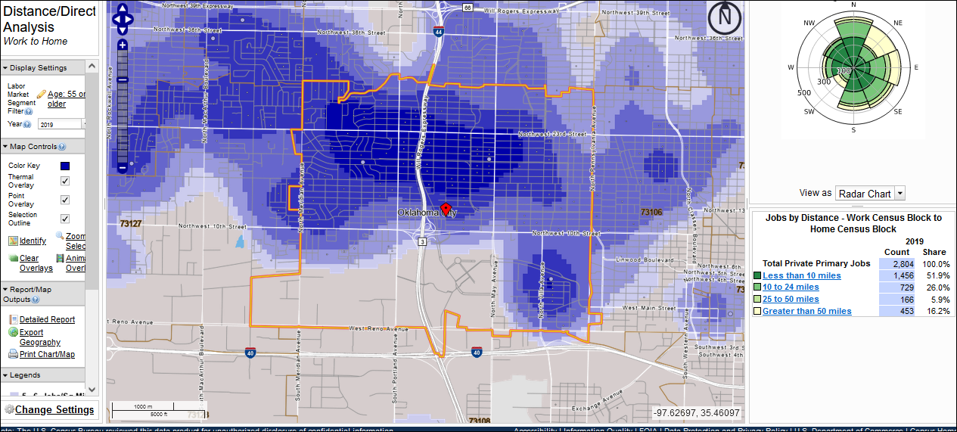
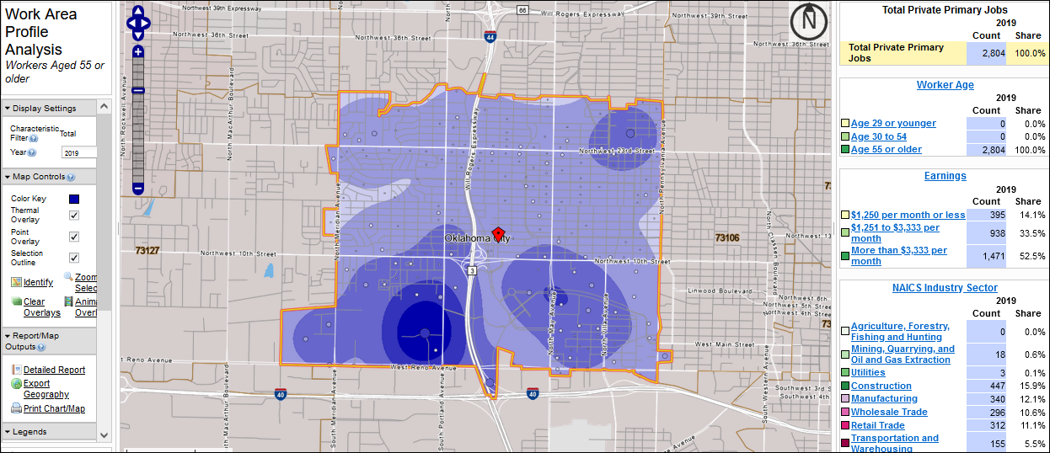
LEHD: On the Map
Analyze metro, city, ZIP, custom area
Also: Commuting patterns
Notes:
Longitudinal Employer-Household Dynamics: https://lehd.ces.census.gov
On the Map: https://onthemap.ces.census.gov
16

Slide 17
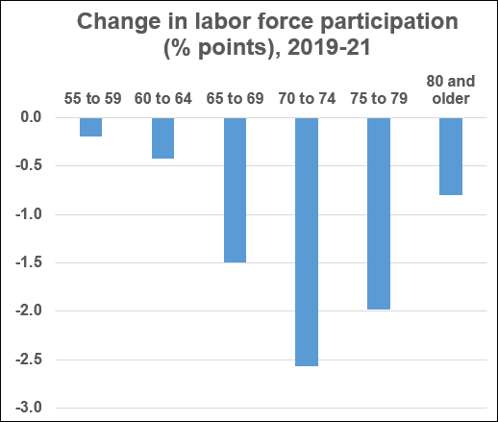
Digging deeper: microdata
DIY tables
Immigrant vs. native-born?
Government vs. private sector?
HS diploma vs college degree?
Notes:
IPUMS/University of Minnesota: https://usa.ipums.org/usa
17

Slide 18

New National Academies report
Notes:
National Academies report: https://www.nationalacademies.org/our-work/understanding-the-aging-workforce-and-employment-at-older-ages
Webinar: https://www.nationalacademies.org/event/07-21-2022/understanding-the-aging-workforce-and-employment-at-older-ages-report-discussion-webinar
18

Slide 19
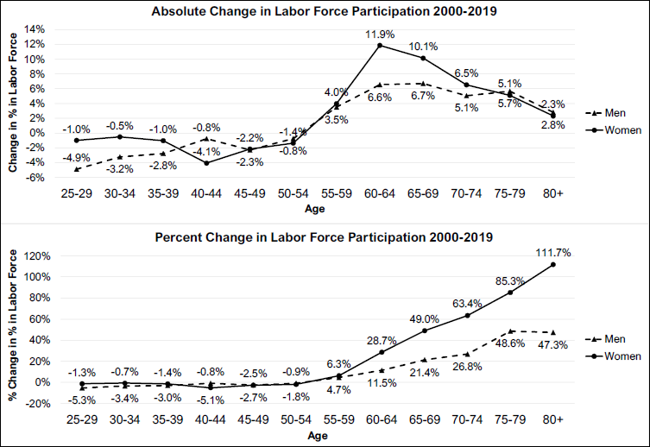
National Academy of Sciences
Notes:
National Academies report: https://www.nationalacademies.org/our-work/understanding-the-aging-workforce-and-employment-at-older-ages
Webinar: https://www.nationalacademies.org/event/07-21-2022/understanding-the-aging-workforce-and-employment-at-older-ages-report-discussion-webinar
19

Slide 20
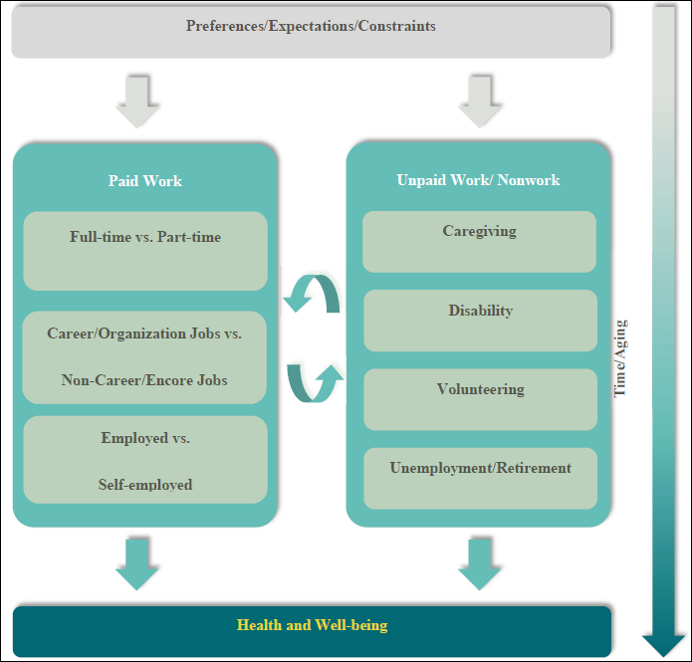
National Academy of Sciences
Many recursive pathways during “retirement”
Agenda for research
More study needed: caregiving, less-advantaged
Notes:
National Academies report: https://www.nationalacademies.org/our-work/understanding-the-aging-workforce-and-employment-at-older-ages
Webinar: https://www.nationalacademies.org/event/07-21-2022/understanding-the-aging-workforce-and-employment-at-older-ages-report-discussion-webinar
20

Slide 21

Health and Retirement Study
Begun early 1990s
Americans 50+
Enroll/follow
In-depth biennial interviews
Notes:
Health and Retirement Study: https://hrs.isr.umich.edu/about
Data book: https://hrs.isr.umich.edu/about/data-book
Bibliography: https://hrs.isr.umich.edu/publications
21

Slide 22
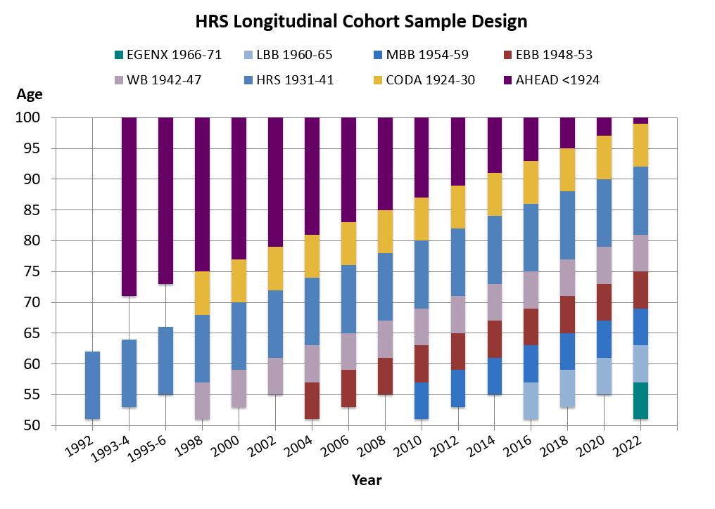
Health and Retirement Study
Original participants enrolled 1992-96
1998: Added cohorts 1924-30, 1942-47
Boomers added 2004, 2010 and 2016
Early Gen X added 2022
Complex design, data
Start with databook, list of publications
Notes:
Health and Retirement Study: https://hrs.isr.umich.edu/about
Data book: https://hrs.isr.umich.edu/about/data-book
Bibliography: https://hrs.isr.umich.edu/publications
22

Slide 23
Questions?
poverberg2@gmail.com
@poverberg
Notes:
23

