Slide 1
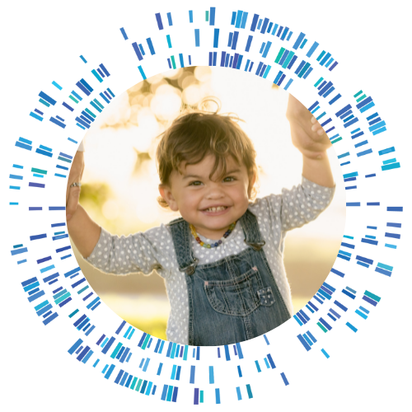
Detecting Rare Disease Early: The Role of Rapid Newborn Genetic Screening
Charlotte Hobbs, MD, PhD
Vice-President, Chief Research and Clinical Management Officer

Slide 2




Progress

Slide 3
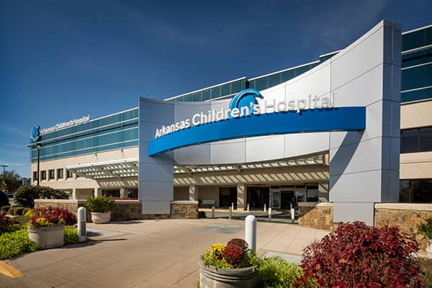
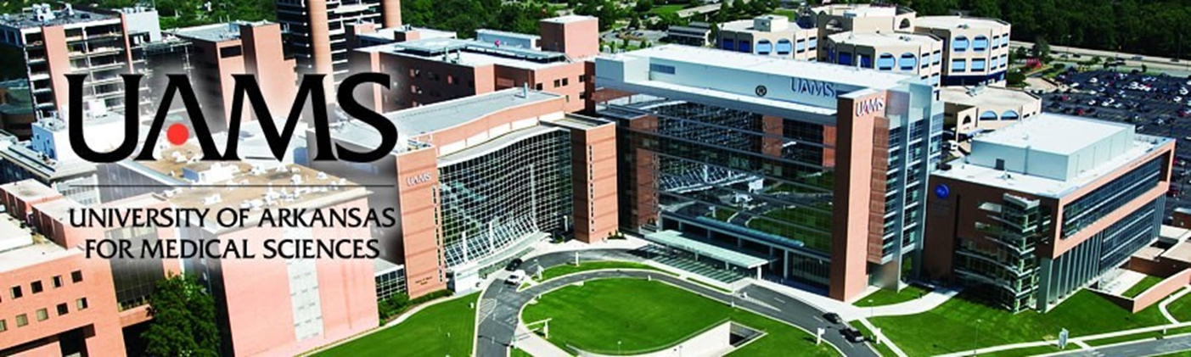
Two and a Half Decades as Neonatal Hospitalist

Slide 4
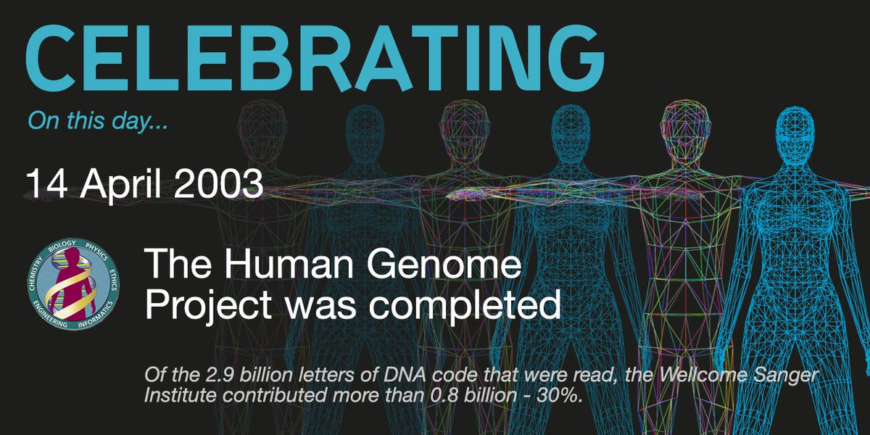

Slide 5
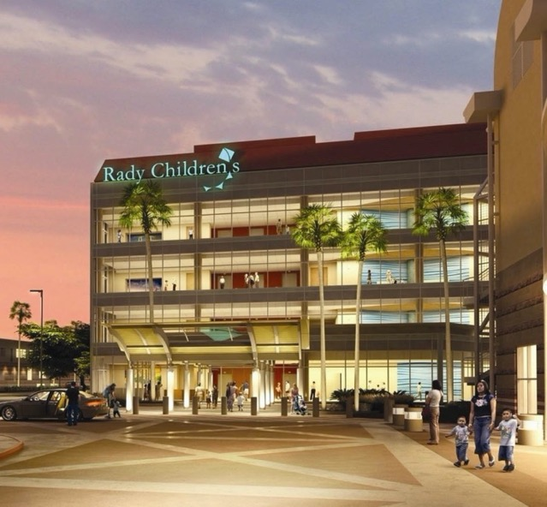
Rady Children’s Institute for Genomic Medicine
Non-profit research organization embedded within Rady Children’s Hospital-San Diego focused on improving lives through Rapid Precision Medicine
Pioneered a medical revolution to end the diagnostic odyssey for neonatal and pediatric rare disease
Trailblazers in end-to-end clinical whole genome sequencing, interpretation and analysis with a proprietary pipeline optimized for newborn screening
Successfully demonstrated proven economic and clinical utility capturing public, private and payor attention
Now we’re moving to end the therapeutic odyssey with a disruptive new approach to newborn screening
Honest broker who understands the clinical landscape and has expertise in moving things rapidly from feasibility to standard of care

Slide 6

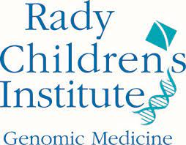

Who We Are: RCIGM by the numbers
#1
281,469
#6
Largest West Coast Children’s Hospital
Children Cared for in FY21
NIH-Funded Ranking in FY20**
81
>6,000
3
Hospital Partner Sites
Genomes Sequenced
Avg Days to Rare Disease Diagnosis*
$2.5M
40%
32%
Cost Savings Generated
Average Diagnostic Rate
Change in Medical Care
*Median # of days to delivery of provisional positive results
**University of California San Diego Department of Pediatrics

Slide 7
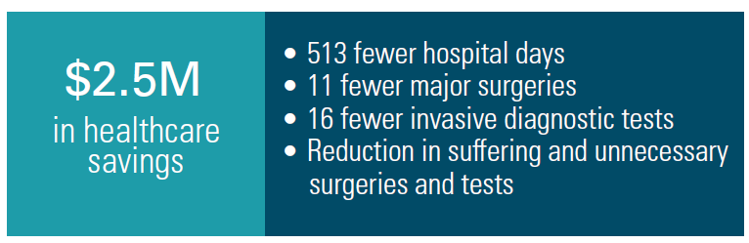
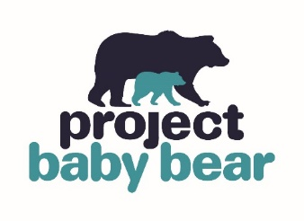
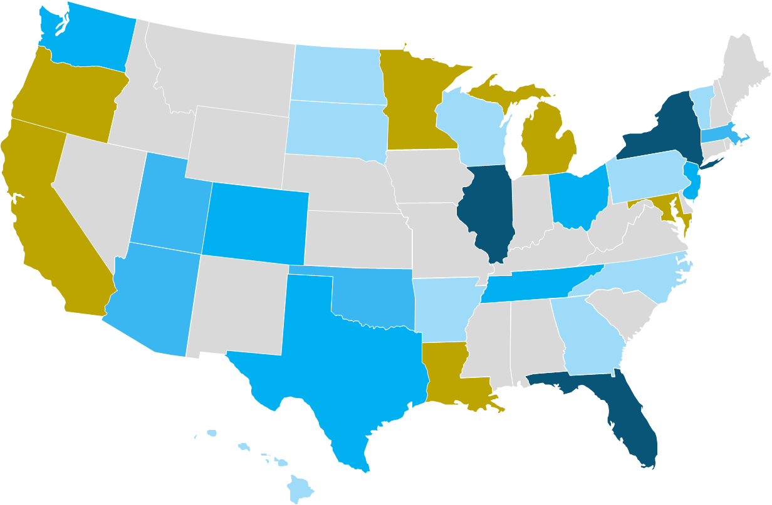





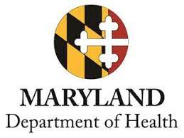











Our Experience: Clinical Partners, Proven Economic & Clinical Utility, Payer Coverage
RCIGM rWGS Partner Network
81 sites across 27 states
Proven Economic & Clinical Utility
rWGS Coverage
1 Site
2-3 Sites
10+ Sites
4-10 Sites
Medicaid Coverage
Notes:
Missing OR and MD in table

Slide 8
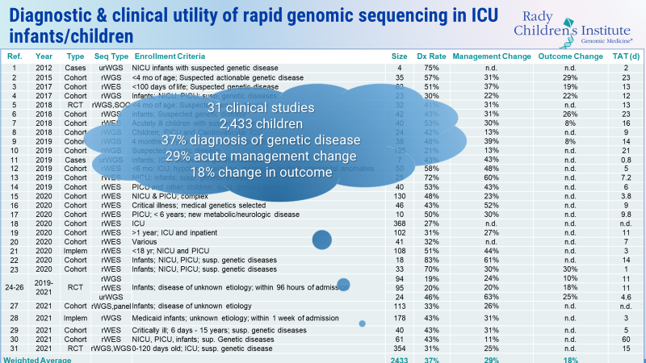

Slide 9
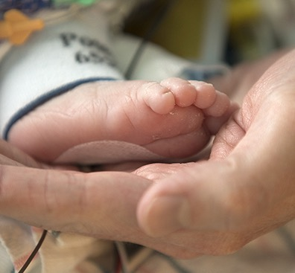

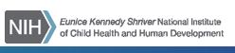
Why Now: The Burden of Genetic Disease is Still Unclear
RCIGM & UCSD received an NIH grant (SOMI) to study how much infant mortality was caused by genetic disease in 2015-2020
Post-Mortem
WGS performed post-mortem on 45 patients who died as infants
Genetic Disease
31% were found to have a genetic disease that was not diagnosed prior to death
Effective Treatment
57% of these genetic diseases have an effective treatment
Infants are dying of undiagnosed genetic disease
NBS-by-WGS will help us find these patients earlier and save lives

Slide 10
2022: An Inflection Point in Pediatric Genomic Medicine
Time to diagnosis by rWGS (hours)
7,200 MIM genetic diseases
Known genetic diseases
Cost
of WGS
7,000
6,000
5,000
4,000
3,000
2,000
$100 genome within sight

Slide 11
Closing the Gap and Accelerating Benefits
There are ~500 actionable genetic conditions affecting newborns that could be screened by WGS for which treatments or treatment candidates in clinical trials currently exist.
1960’s
1
NBS-by-WGS = a way to leapfrog the gap and accelerate the benefits of NBS
2021
35
2022
~500
2030
NBS-by-WGS becomes Standard of Care
Without disruptive progress we will continue to see:​
Unnecessary death or irreparable damage​
Long painful diagnostic and therapeutic odysseys​
High healthcare costs​
Missed opportunities for diagnosis and treatment

Slide 12
NBS-by-WGS: What is it?
NBS-by-WGS is a learning healthcare delivery system that will scale newborn screening by whole genome sequencing to 1 million newborns for up to 1,000 genetic diseases over the next 5 years.
NBS-by-WGS builds upon our current capabilities in rapid diagnostic whole genome sequencing
The network of children’s hospitals we have built
Our reputation for pediatric genomic medicine innovation
The lessons we have learned about navigating the chasm between innovation and market uptake of genomic medicine
NBS-by-WGS is not just a test. It is a learning healthcare delivery system.
1
Education and Engagement
2
Testing and Confirmation
3
Translation into Precision Medicine and Outcomes
4
Acceleration of genetic disease therapy development & access

Slide 13







An RCIGM-led consortium will enable the future of NBS-by-WGS
A perfect storm is accelerating access to precision medicine …
... and NBS-by-WGS will disrupt the current paradigm.
Increasing numbers of effective and approved gene therapies
Revolutionizing and shortening the diagnostic journey
NBS
-by-
WGS
Intervening to change the course of a life from birth
Increasing projections of orphan drug development efforts
Force multiplying the process of slowly adding screening conditions
Decreasing whole genome sequencing (WGS) costs and turnaround times
Generating genomic data that empowers innovation and answers to rare diseases

Slide 14
BeginNGS: Shifting the Paradigm Together
RCIGM-led Consortium
Collectively, the consortium will address important challenges related to:
Appropriately Consenting Families
Equitable Access to Testing and Care
Ensuring Diverse Participation
Patient & Family Engagement & Support
Public Dialogue and Education
Privacy & Security
Clinical Actionability
Longitudinal Outcome Tracking
Bioethics Experts
Newborn
MDs
GCs
Health Systems
Advocacy Groups
Non-profit & Research Orgs
Government (State & Federal)
Life Sciences
Public & Private Payors
Diagnostics & Labs

Slide 15
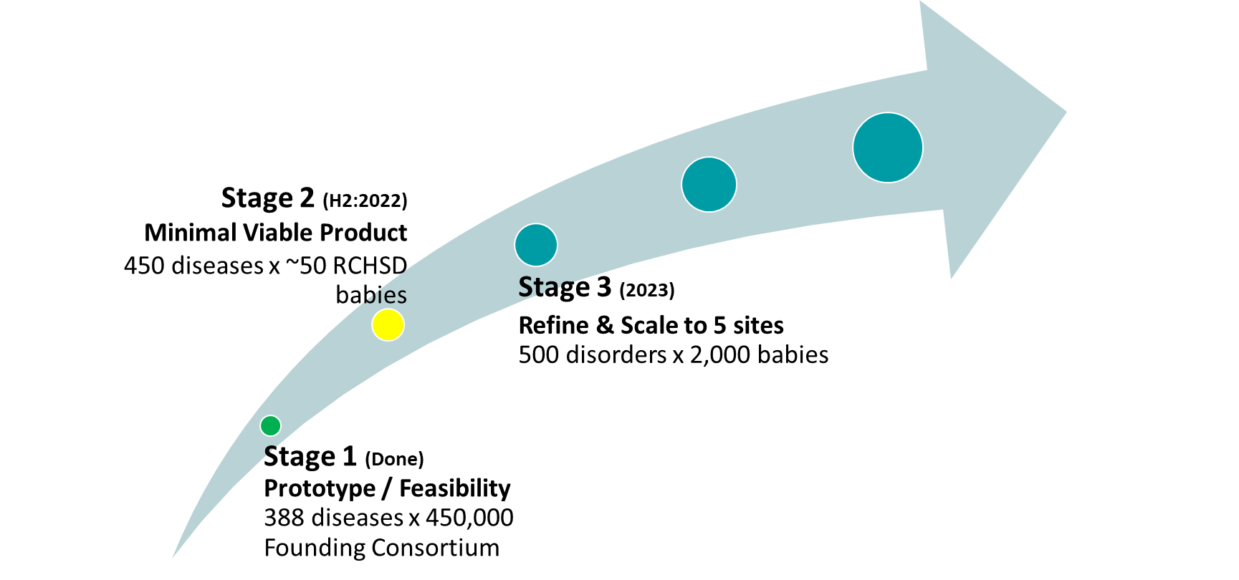
Staged Development, Clear Milestones
Stage 4 (2024)
Prospective measurement of
Clinical Utility & Cost Effectiveness
600 diseases x 20,000 babies
Stage 6 (2027)
Emerging Standard of Care
~1,000 diseases x 3.7M babies
140M global newborns
Stage 5 (2025 – 2026)
Early Commercialization
750 diseases x 200,000 babies
Consortium Announced

Slide 16

After the Diagnosis is Made
GTRx: Genome to Treatment
A RCIGM-developed virtual automated system for immediate acute management guidance and clinical management of genetic disorders

Slide 17
The Story of Fitz
https://vimeo.com/radygenomics/fitz

Slide 18
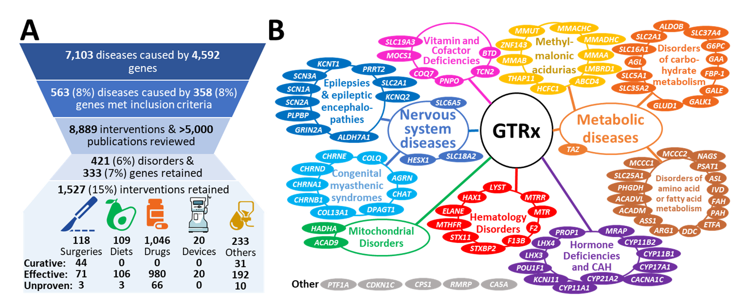
Genome-to-Treatment

Slide 19
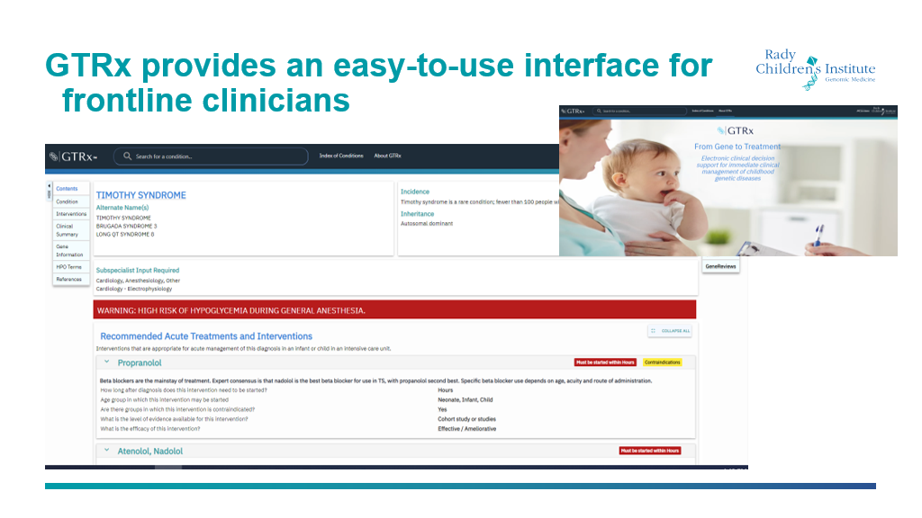

GTRx – From Gene to Treatment

Slide 20

Joining Us in Ending the Diagnostic Odyssey

Slide 21
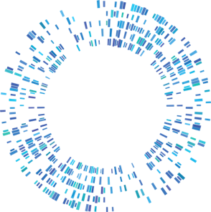
Help us make baby steps toward ending the diagnostic odyssey
Interested in joining as a Clinical Partner Site?
Contact us:
Charlotte Hobbs VP, Chief Research & Clinical Management Officer chobbs@rchsd.org |  | Russell Nofsinger Sr. Dir., Business Development rnofsinger@rchsd.org
https://Begin-NGS.org/
Stacey Seeloff
Dir., Strategic Alliances
sseeloff@rchsd.org
Sara Caylor
Manager, Strategic Programs
scaylor@rchsd.org

Slide 22
Babies and Families are Waiting
Four RCIGM cases where a diagnosis was provided by diagnostic rWGS and how different the age at diagnosis could have been with NBS-by-WGS
 | Case 1 | Case 2 | Case 3 | Case 4
Disease | Factor 13A deficiency | Early infantile epileptic encephalopathy 7 | Ornithine carbamoyltransferase deficiency
Age at diagnosis by rWGS | 42 days | 21.5 years | 166 days | 2 years 3 months
Presentation | Hemiparesis, intracranial hemorrhage | Malnutrition; Cerebral palsy; Seizures; Intellectual disability; Cerebral atrophy; Thoracolumbar scoliosis | Decreased liver function; projectile vomiting, seizures | Decreased liver function; Developmental regression
Age at diagnosis by NBS-by-WGS | 3-5 days | Therapy with selected antiepileptic drugs would have controlled seizures and reduced intellectual disability | Targeted therapy would have prevented disease
Outcome if had received BabySave | Targeted therapy would have either prevented disease manifestations or reduced them | Targeted herapy would have controlled seizures and reduced intellectual disability | Targeted therapy would have prevented disease

Slide 23
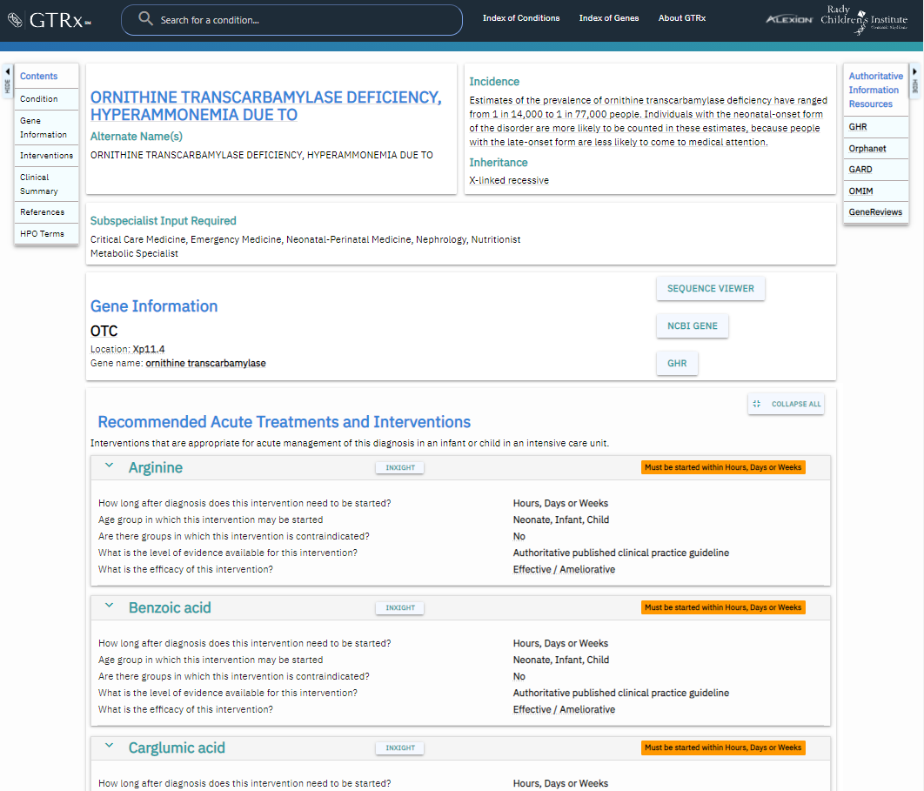
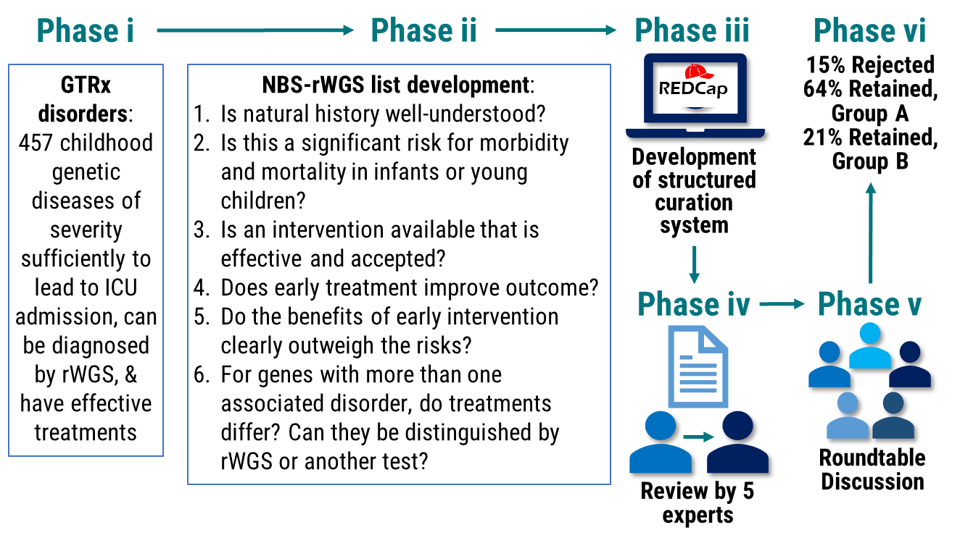
Selecting Disorders for NBS-by-WGS

Slide 24
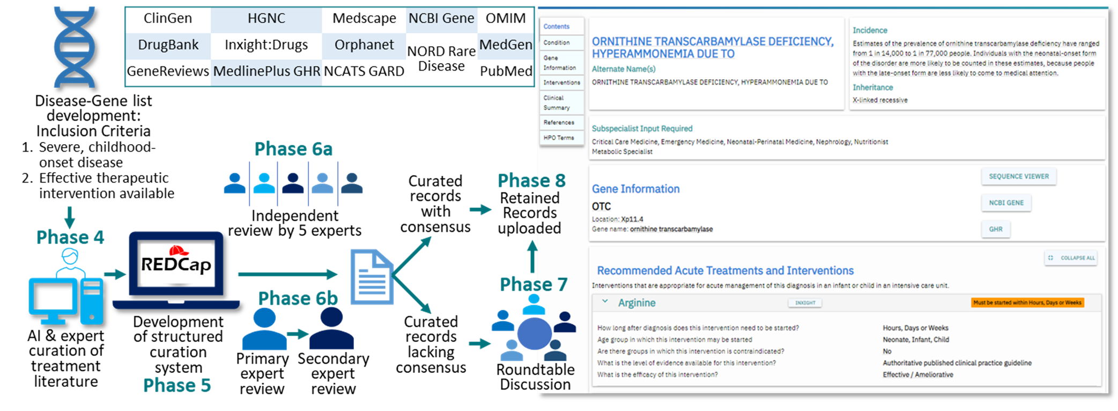
Development of a virtual, acute management guidance system: Genome-to-Treatment (GTRx)

Slide 25
Acknowledgments A Deo lumen, ab amicis auxilum
Executive Team
Stephen Kingsmore, MD, DSc
Wendy Benson
Charlotte Hobbs, MD, PhD
David Dimmock, MD
Donald Kearns, MD
Sue Cox
Jill Strickland
Jean Ford Keane
Leadership
Sylvia Breeding
Yan Ding, MD, MS
Kasia Ellsworth, PhD, FACMG
Lucia Guidugli, PhD, FACMG
Rao Madhavrao, PhD, MS
Russell Nofsinger, PhD
Julie Reinke
Lisa Salz, MS, LCGC
Mari Tokita, MD, FACMG
Clinical Genome Center
Julian Alcantar
Zaira Bezares
Bianca Covarrubias
Alma Johnson
Jennie Le
Luca Van Der Kraan
Catherine Yamada
Clinical Analysis & Interpretation
Kiely James, PhD
Monia Hammer, PhD, MS
Alaina Heinen, MS
Daniel Helbling, MS
Kirstin Kelly, MS
Viridiana Murillo, MSGDA
Eric Ontiveros, PhD
Deepali Shinde, PhD
David Wang, PhD
Nicole Kim
Kelly Watkins, MS, LCGC
Clinicians / Researchers
Matthew Bainbridge, PhD
Jeanne Carroll, MD
Tina Chambers, PhD
Jennifer Friedman, MD
Joseph Gleeson, MD, PhD
Rebecca Mardach, MD
Jonathan Sebat, PhD
Nathaly Sweeney, MD
Robert Wechsler-Reya, PhD
Kristin Wigby, MD
Mary Willis, MD, PhD
Erica Sanford, MD
Kathy Bouic
Linda Luo
Dominic Braun
Lauren Olsen
Soofia Khan
P. Vijayaraghavan
Clinical Trial Team
Jerica Lenberg, MS, LCGC
Information Technology & Bioinformatics
Dan Averbuj
Serge Batalov
Eric Blincow
Josh Braun
Bryant Cao
Carlos Diaz
Christian Hansen
Shraddha Jagdale
Hugh Kwon
Danny Oh
Daniken Orendain
Albert Oriol
Marketing & Communications
Leng Caloh
Ben Metcalf
Strategic Partnerships
Maddie Arenchild
Cheyenne Camp
Sara Caylor, RN, BSN
Erica Haviland
Karin Fuentes-Fajardo
Bianca Joya
Jessica Merritt
Bruce Windhoffer
Administration
Ruby Harris
Stacey Huynh
Mari Leal
Amanda Mabe
Abigail Pham
Tiffany Thompson
Nicole Vollrath
Kim Weiss
Collaboration with: Rady Children’s Hospital-San Diego・UC San Diego Health・National Institutes of Health – NICHD, NHGRI, NIDDK, NCATS・ Illumina, Inc.・Alexion/AstraZeneca・Takeda・Genomenon・L7 Informatics・Fabric Genomics ・TileDB Inc.・ The Liguori Family・ John Motter & Effie Simanikas・Ernest & Evelyn Rady
Notes:
Current as of 1/11/2022

Slide 26
