Slide 1
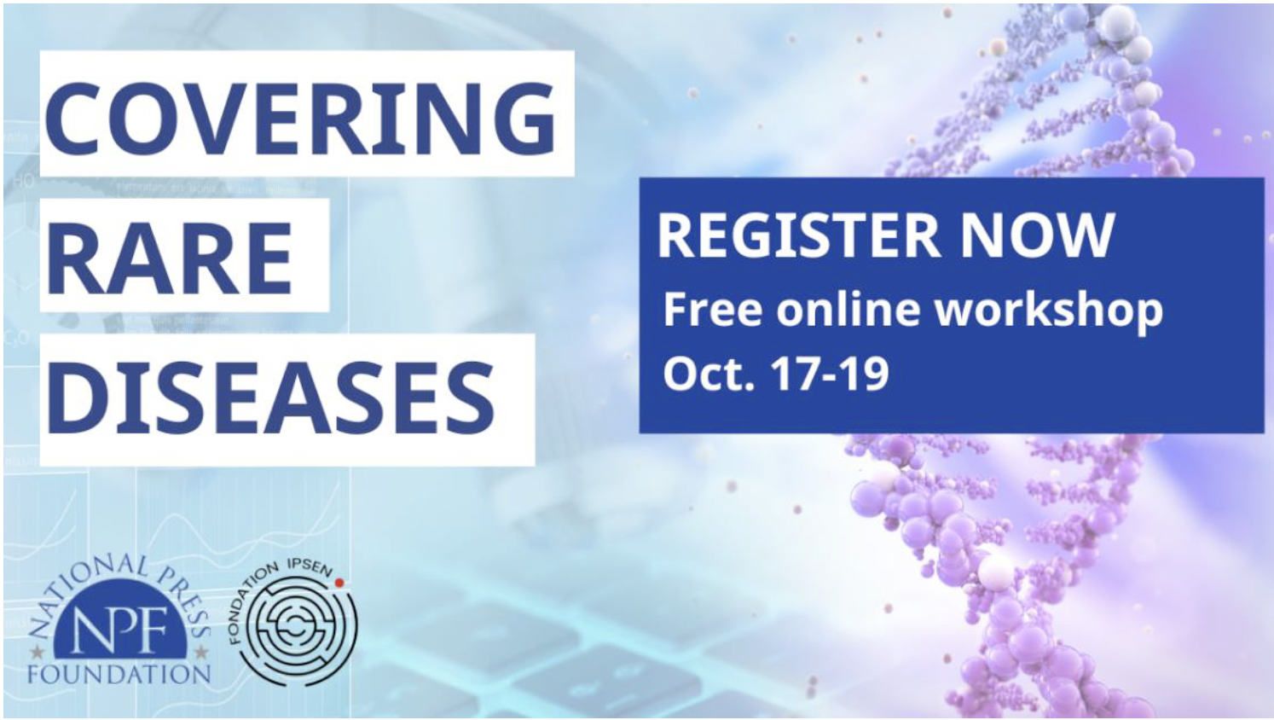
Prof Zané Lombard
Division of Human Genetics
University of the Witwatersrand & National Health Laboratory Service, South Africa

Slide 2
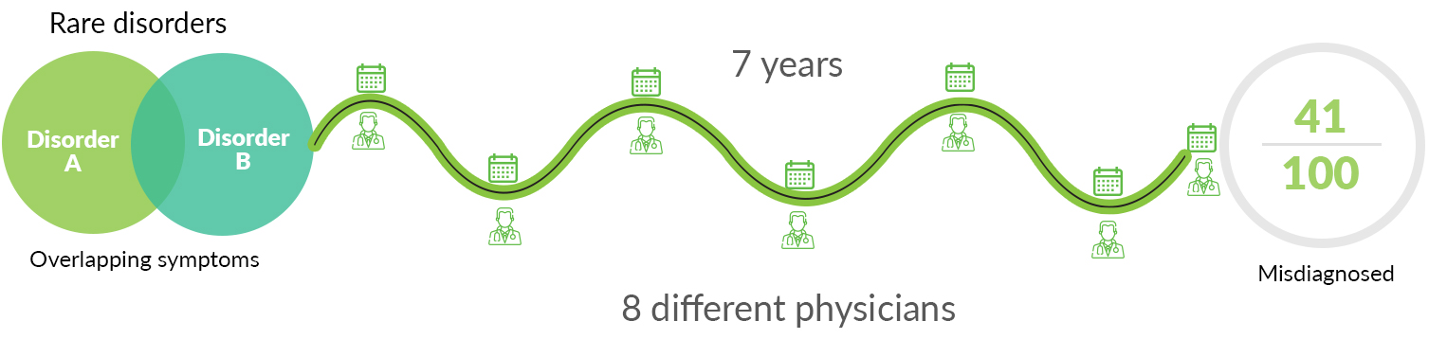
Diagnosing Rare Disease

Slide 3
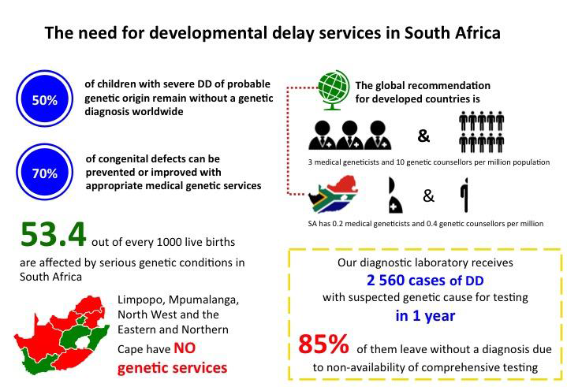
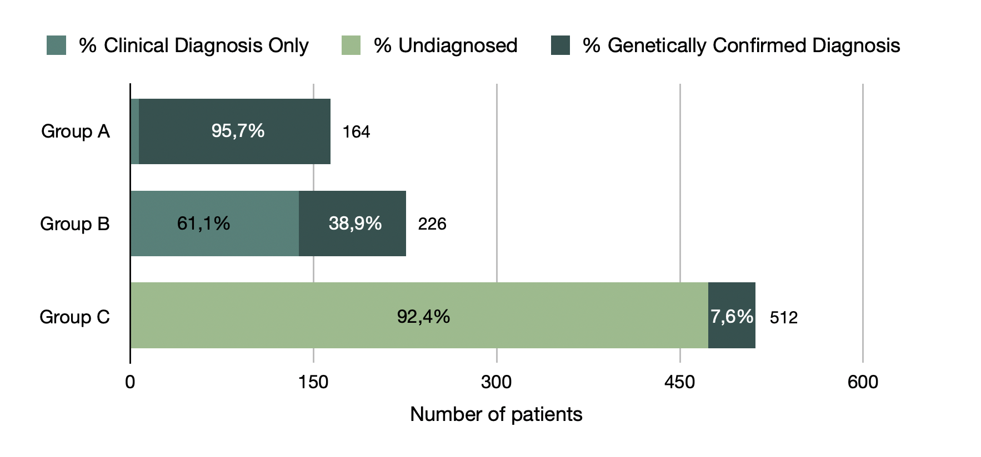
The Need for Rare Disease Services in Africa
92% remain undiagnosed
Notes:
Considerable burden LMIC, and Genetic aetiology of DD in Africa is poorly understood.
Paucity of service and testing

Slide 4
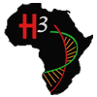
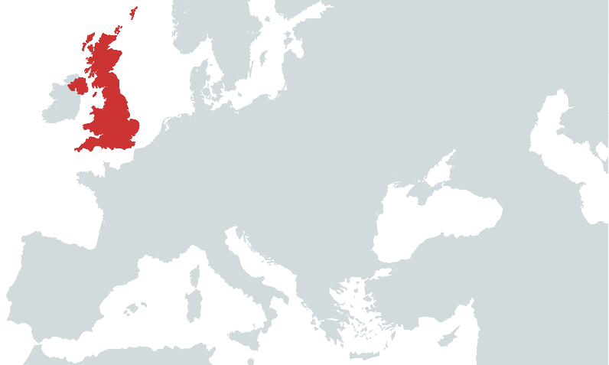
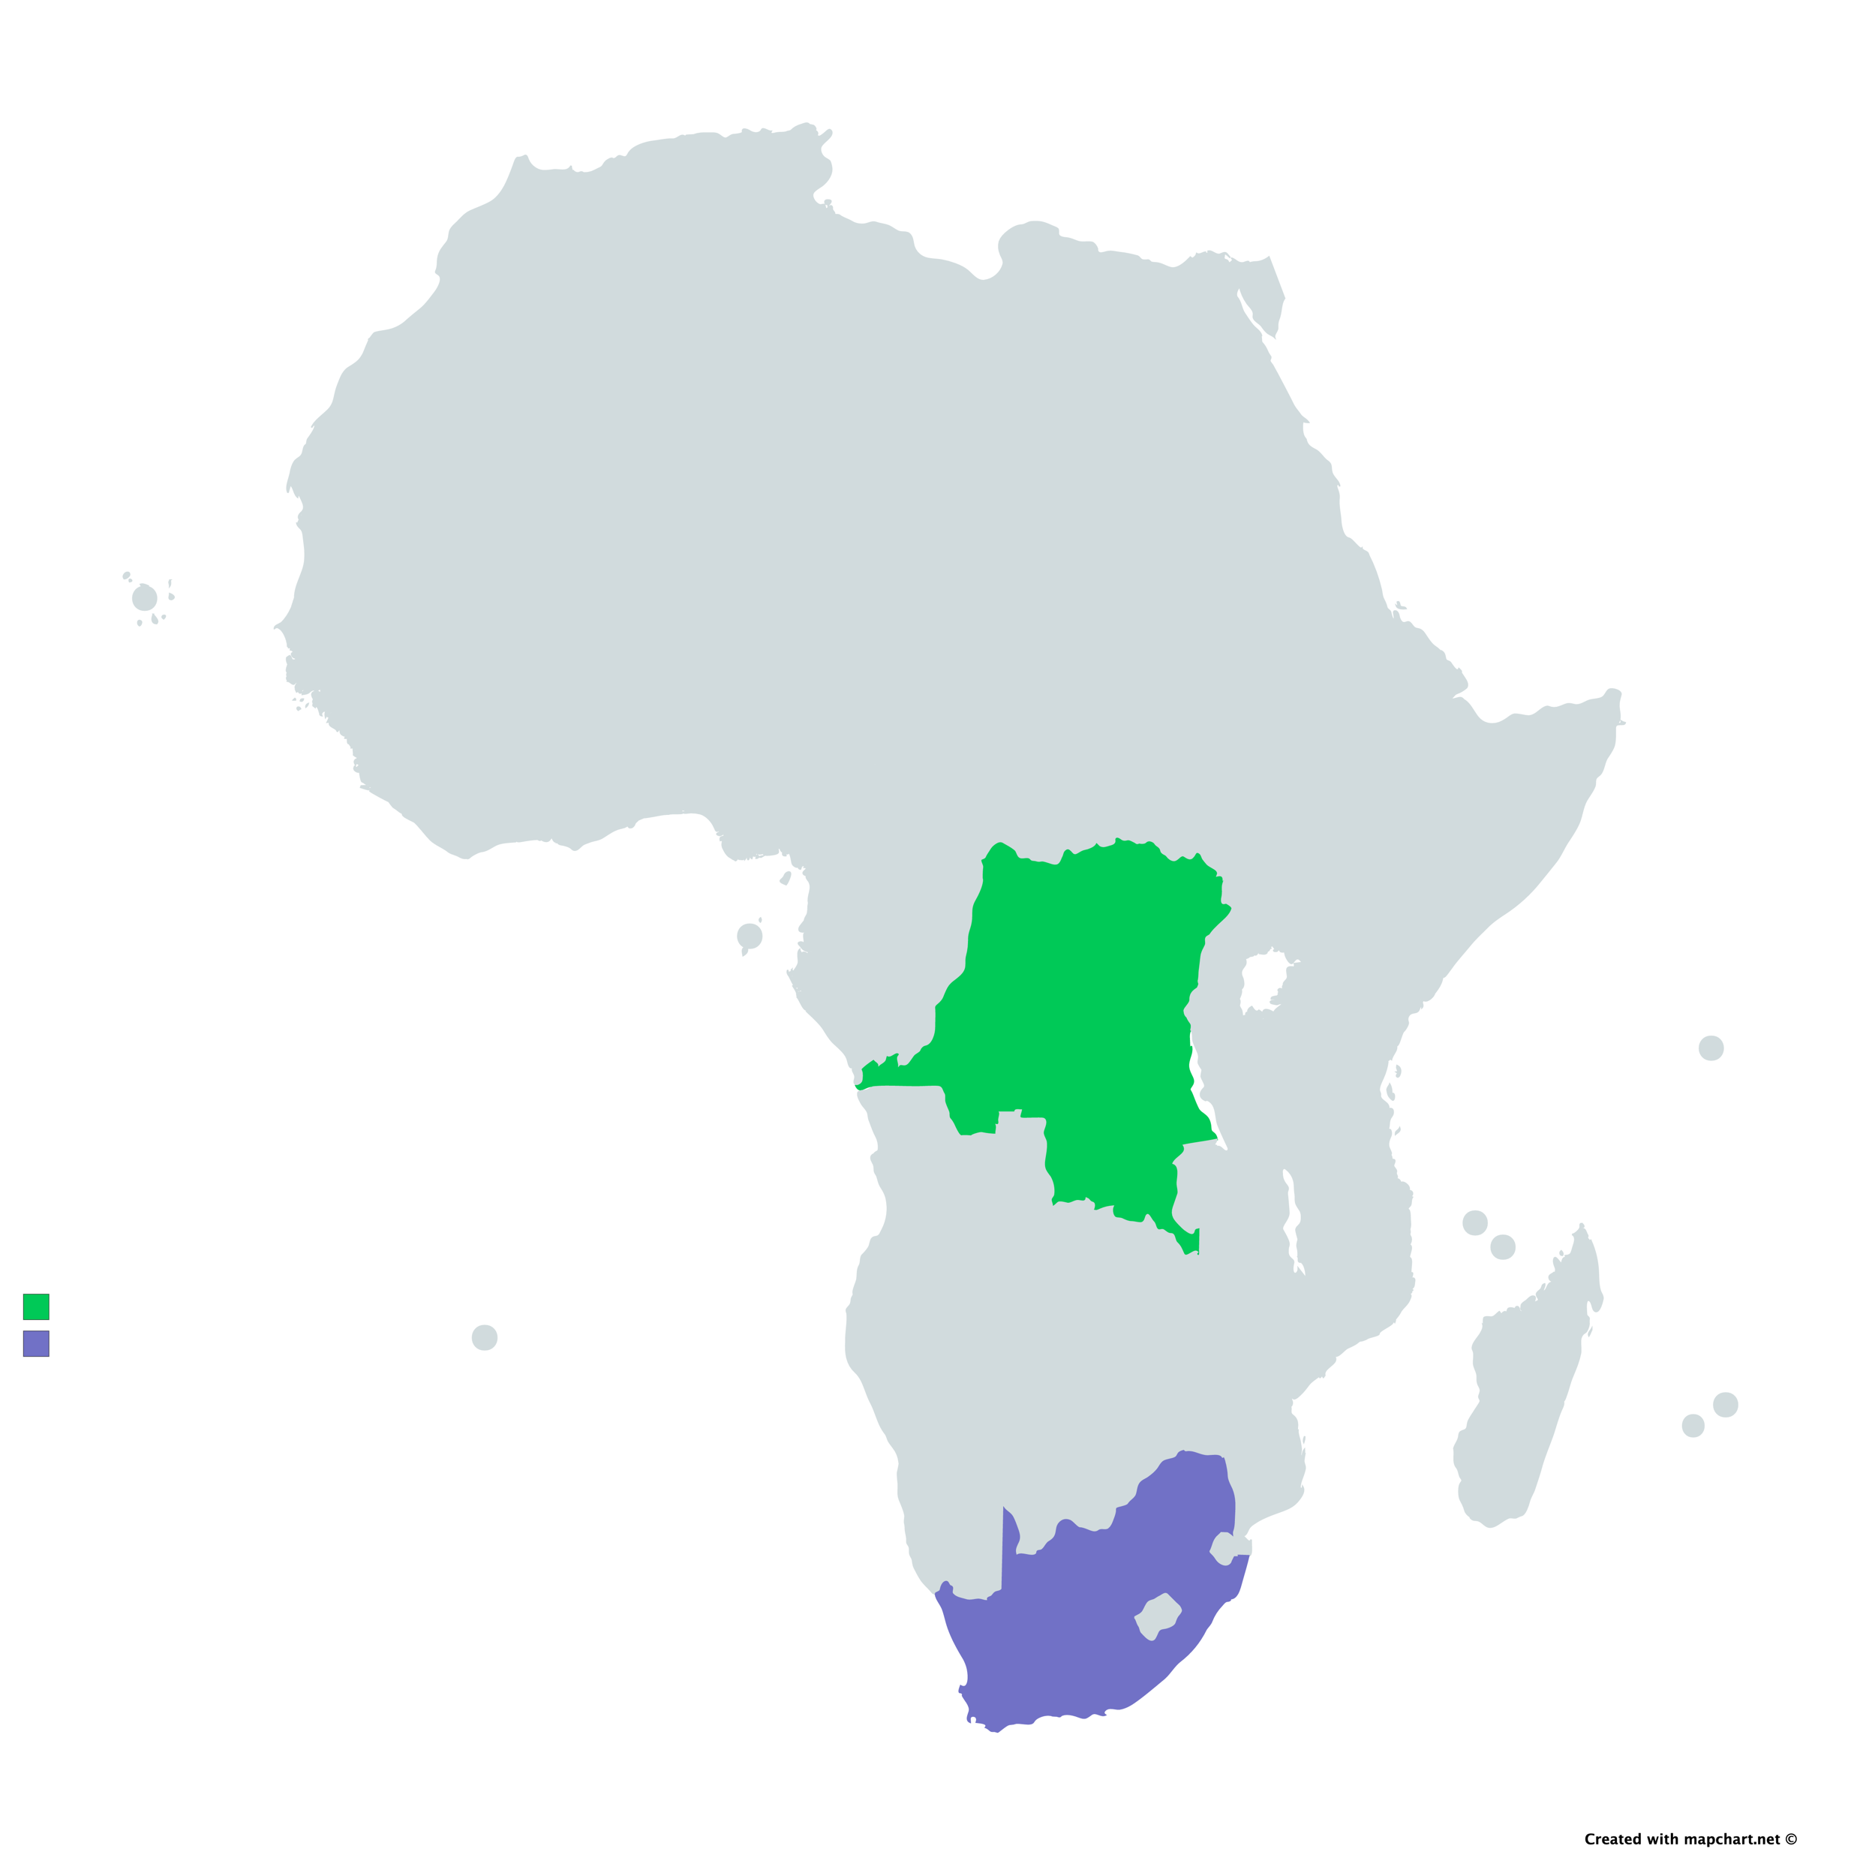
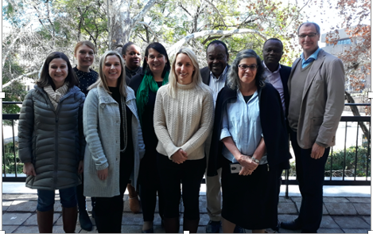
DDD-AFRICA
Deciphering Developmental Disorders in Africa
Clinical Phenotyping
Recruiting 500 patient-parent trios
Whole Exome Sequencing
480 high-depth WES generated
Bioinformatics
Designing a local bioinformatics pipeline for WES analysis
Training
Training postgraduate students in genomics & bioinformatics
Community Engagement
Consider mental health of parents of children with DD
Establish African dysmorphology expertise
Assessing preferences for feedback of individual genetic findings
Assess SNV, CNV, mosaicism & de novo mutation in an African context
Leadership training & mentorship
Standardizing phenotyping methods
WES of 1500 participants
Infrastructure needed for local WES
Is exome sequencing a practical first-line investigation for developmental disorders in a resource constraint environment (LMIC)?
Study Rationale:
Map genetic causes of rare disease in Africans
Catalyse improved diagnostic services

Slide 5
Benefit of Rare Disease Research in Africa
Benefit of genomic medicine in a resource constrained environment.
Benefit to patient care in the long-term.
Discovery opportunities.
Job creation and local skill development.

Slide 6
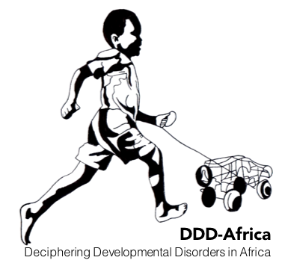
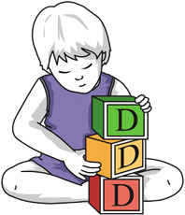


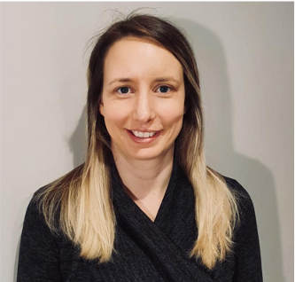
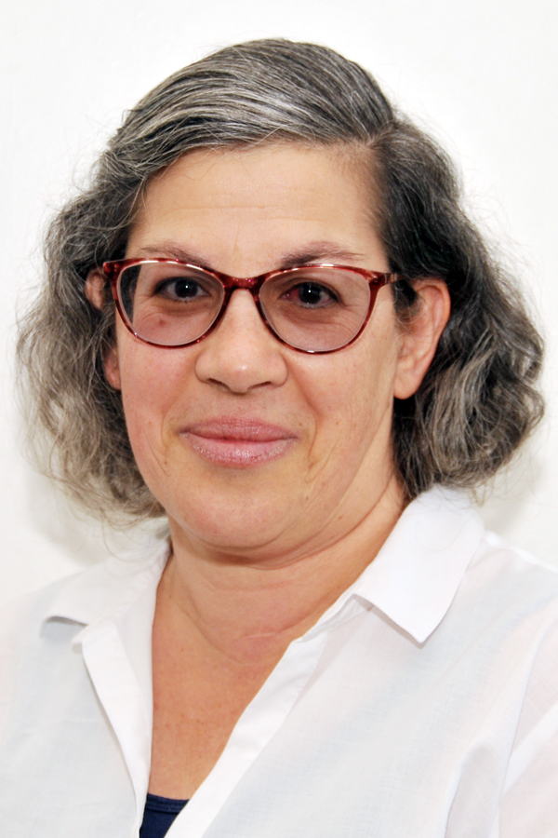
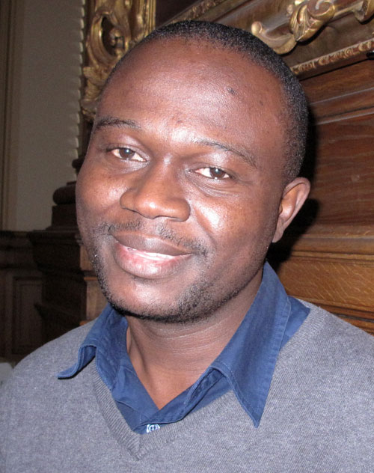
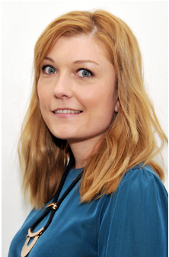
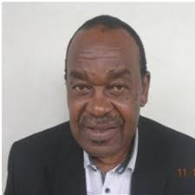

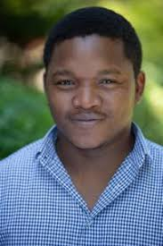
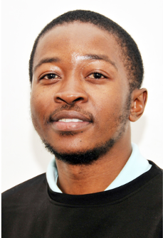
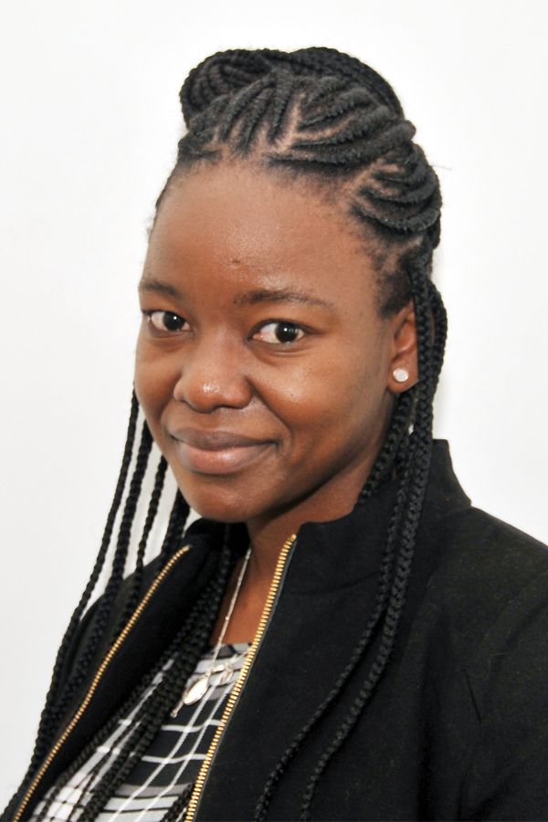

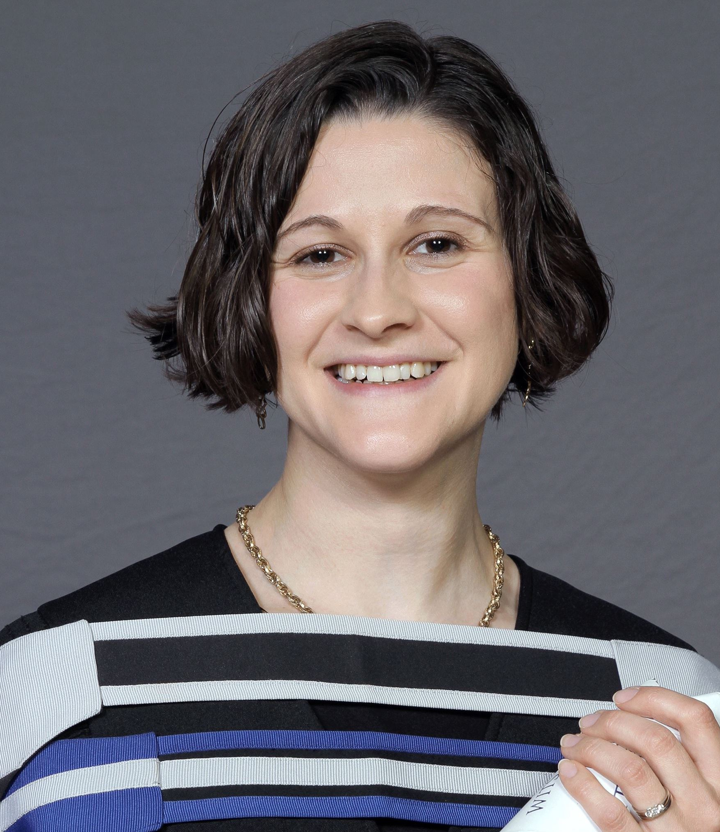
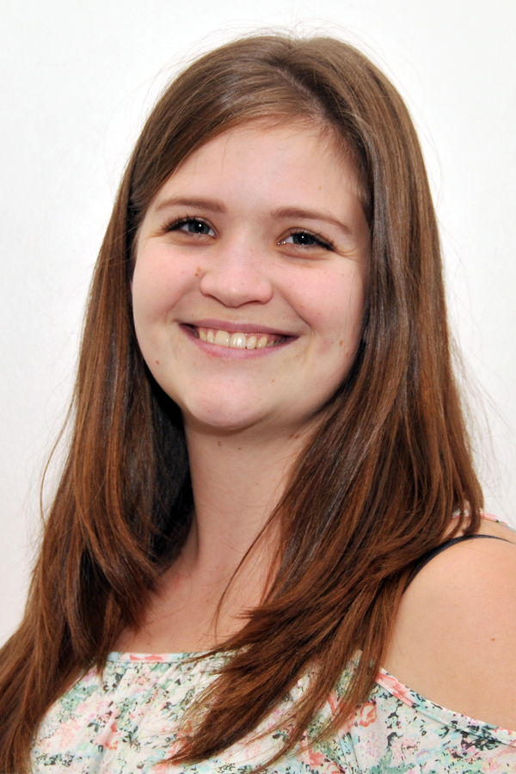
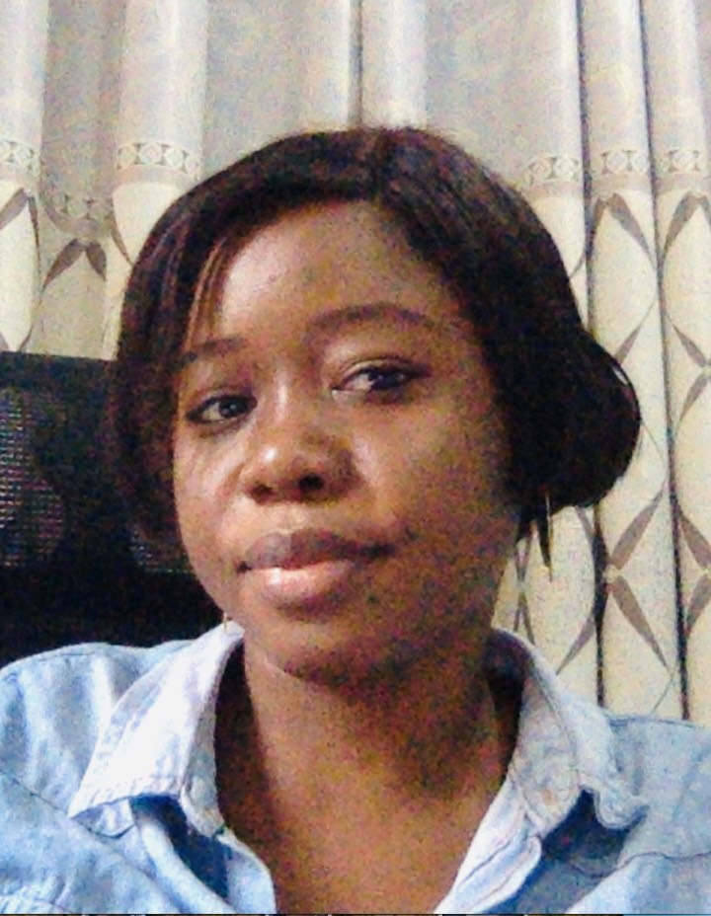
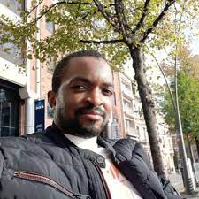
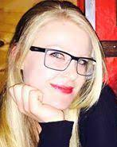
Acknowledgements
Funding: H3Africa NIMH/NIH: U01MH115483. NHLS Research Trust, NRF-SA
Partners: Wellcome Sanger Institute & DDD-UK; H3ABioNet; SBIMB
Institutions: University of the Witwatersrand; National Health Laboratory Service; Wits Health Consortium; National Institute of Biomedical Research (INRB); University of Kinshasa
DDD-Africa research & administration team

