Slide 1

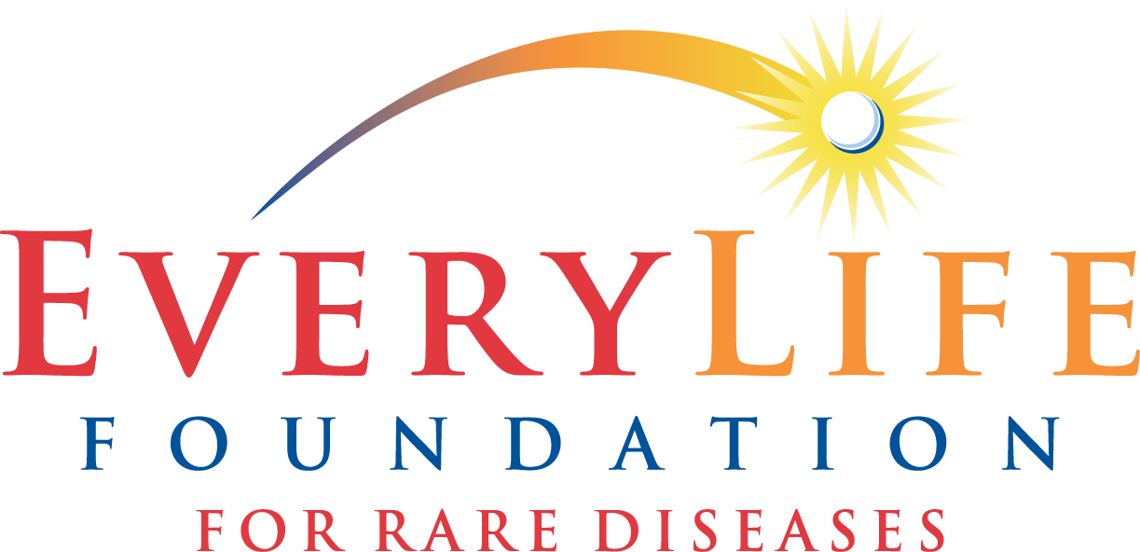

Annie Kennedy Chief of Policy, Advocacy,
Patient Engagement

Slide 2

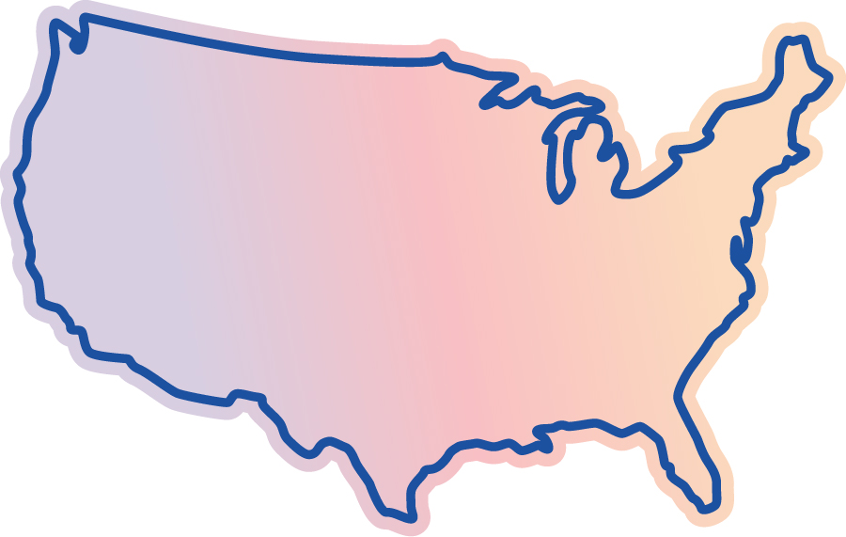
Rare Disease – A Public Health Crisis Requiring Policy Solutions Reflecting our Unmet Need & Urgency
7,000+
More than
50%
rare diseases
Pediatric Onset
~30
~$1T
million affected
Fewer than
5%
2019 Economic Impact of rare disease
60%
FDA Approved Therapies
Costs incurred directly by families & society

Slide 3



Eliminate the diagnostic odyssey for rare disease patients Close the innovation gap for the 95% of rare disease communities who have no FDA approved treatment Facilitate timely access to approved therapies
Our Policy Priorities

Slide 4
Eliminate the diagnostic odyssey for rare disease patients

Slide 5


Newborn Screening Matters – Facts About NBS
has a condition that
can be detected
through screening.
~ 1 in 300
newborns
Screening tests every newborn for genetic, metabolic, hormonal, and functional conditions that are not otherwise apparent at birth.
Screening reaches each of the 4 million newborns in the U.S. every year.
Newborn screening facilitates timely delivery of life-saving treatments, and other therapies that improve quality of life.

Slide 6
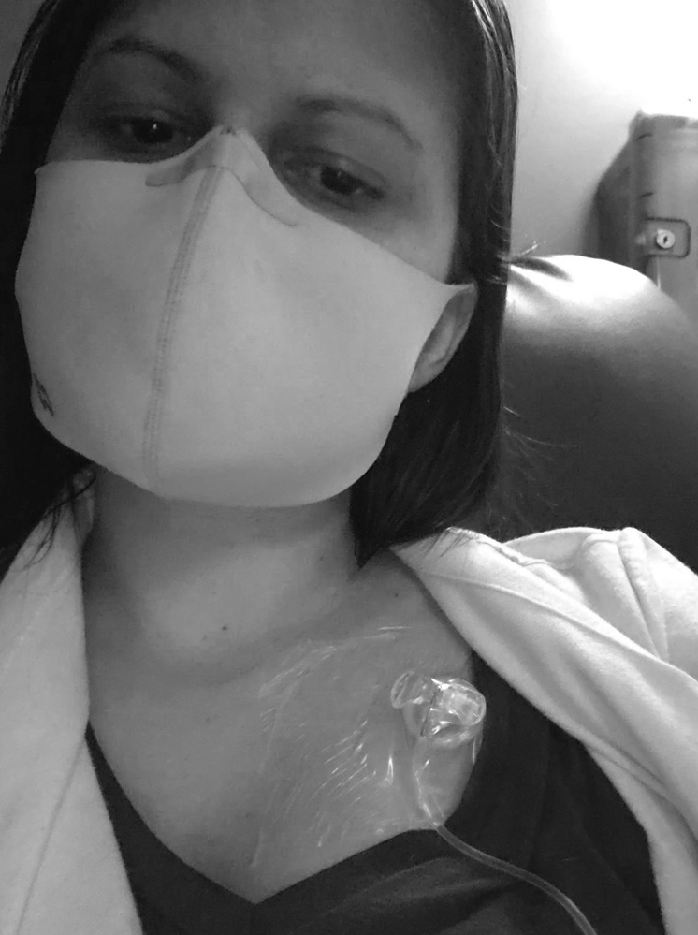


Study Results: RD Impact Survey Captures Medical Burden, Long Diagnostic Odyssey
16.5
10.2
16.9
YEARS
YEARS
Average number of specialists seen since first RD symptom
Since first RD symptom
(mean)
Years since RD diagnosis (mean)
6.3
YEARS
Navigating without RD diagnosis (mean)
Based on final analysis sample of 1,360 completed responses

Slide 7

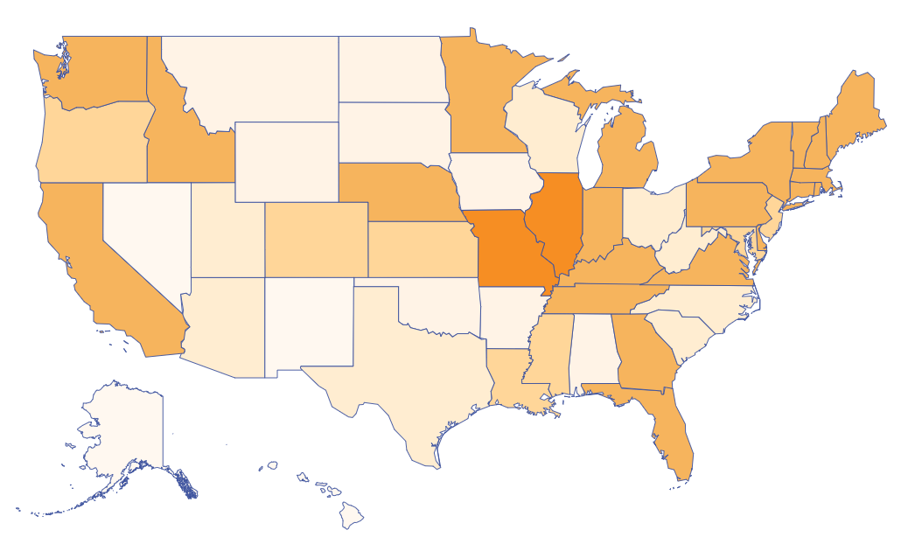
Variability of access to newborn screening
Programs vary widely by state, leading to disparate health outcomes.
Some states screen for fewer than
31 diseases.
Other states screen for more than
60 diseases.
We must do better.

Slide 8
So what are the real life consequences of this system?

Slide 9
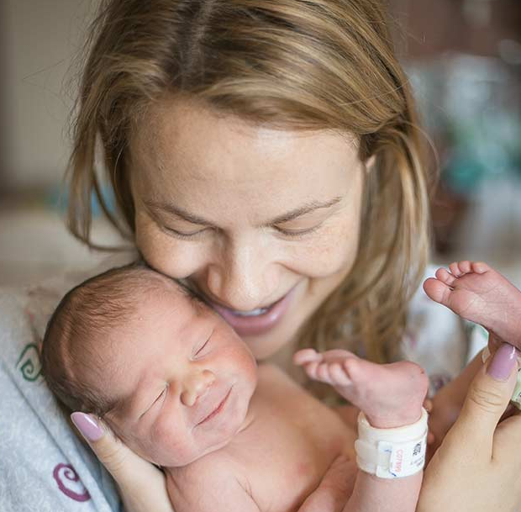
Meet christina & ada

Slide 10
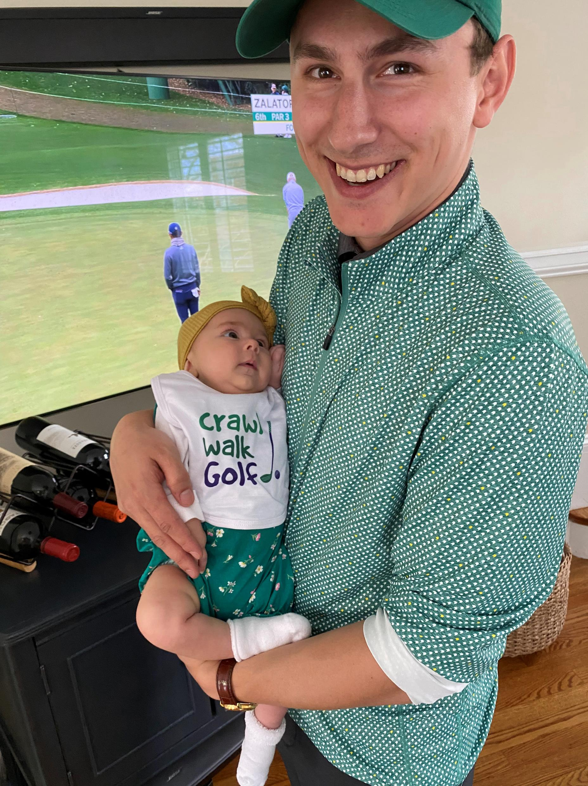
Meet John & Kate

Slide 11
EVERYLIFE - Building a system that matches the pace of therapy innovation
✓
NBS & Diagnostic Policy highlights:
✓
State RUSP Alignment Legislation
Federal Legislation (NBSSLA Reauth, Access to Genetic Services Act, Telehealth, and more)
Newborn Screening Modernization efforts
Assessing the Economic Impact of the Diagnostic Odyssey Partnering on innovation opportunities to include WGS
✓
✓
✓
✓
Notes:
We’ve spent a great deal of time today discussing the many achievements of newborn screening, as well as its limitations, including the policy and operational barriers that could inadvertently hinder our ability to deliver disease-modifying treatments and potential cures to affected babies and young children in a timely fashion
So, what are we doing about it?
Industry (sponsors) are working hand-in-hand with patient organizations to build evidence, not only through funding of pilot studies but in generating evidence to show the clinical utility of the treatments we are developing
We also recognize our role in addressing the urgent need for recommendations as to how public health NBS can move towards a model that can accommodate rapid therapeutic development and approval

Slide 12
Close the innovation gap for the 95% of rare disease communities who have no FDA approved treatment

Slide 13
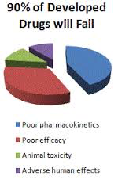
The Reality of Rare Disease Clinical Trials
Limited number of available patients
Heterogeneity of patient population
Nascent clinical care standards
Imperfect (or nonexistent) natural history comparator
Lack of appropriate outcome measures, endpoints & surrogate biomarkers
Disease urgency and unmet need calls into question whether placebos and clinical outcome measures are most ethical
What is meaningful to patients is not always what is – or what can be - measured
In rare disease, doing nothing = doing harm

Slide 14
EVERYLIFE - Building a system that matches the pace of therapy innovation
✓
Regulatory Policy highlights:
Developing & enhancing regulatory approval pathways (including the Accelerated Approval Pathway)
Federal Legislation (User Fees, STAT Act, and many more)
Patient Focused Drug Development PFDD Roundtable Series & The Guide for Patient Involvement in Rare Disease Therapy Development
AA Assessment Study (results coming soon!)
✓
✓
✓
✓
Notes:
We’ve spent a great deal of time today discussing the many achievements of newborn screening, as well as its limitations, including the policy and operational barriers that could inadvertently hinder our ability to deliver disease-modifying treatments and potential cures to affected babies and young children in a timely fashion
So, what are we doing about it?
Industry (sponsors) are working hand-in-hand with patient organizations to build evidence, not only through funding of pilot studies but in generating evidence to show the clinical utility of the treatments we are developing
We also recognize our role in addressing the urgent need for recommendations as to how public health NBS can move towards a model that can accommodate rapid therapeutic development and approval

Slide 15
Facilitate timely access to approved therapies

Slide 16
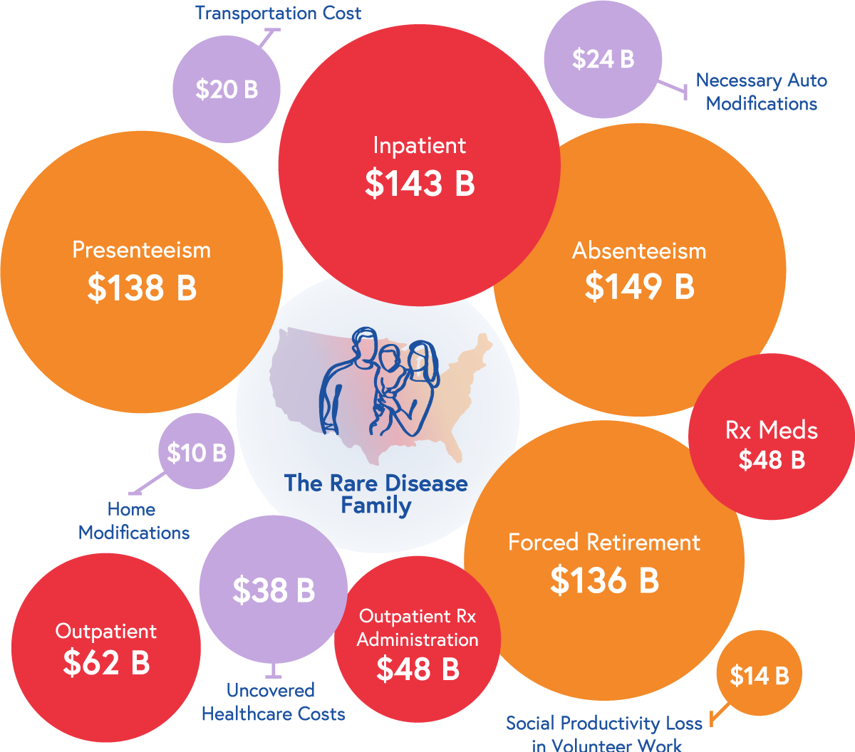
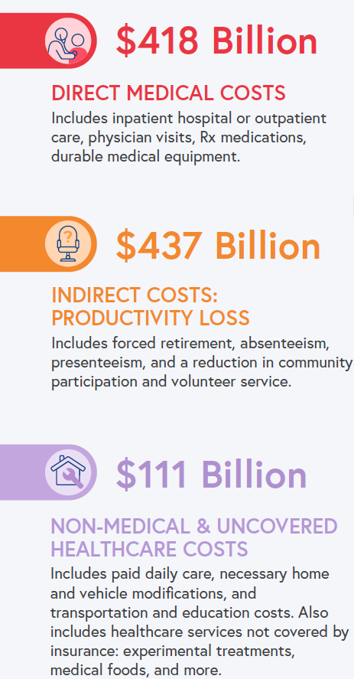
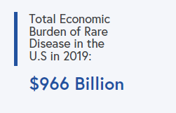
Public Health Urgency of Rare Disease 60% of Costs Shouldered Directly by Employers & Families
Estimated prevalence of 379 RDs
15.5 million
Conservative Estimate of Economic Burden Based on 379 of 7,000 RDs
Notes:
in-direct and Non-medical costs (costs absorbed directly by families) in 2019 accounted for nearly 60% of the overall cost
Of the direct costs which comprised the remaining 40%, the most significant costs drivers were inpatient costs and outpatient care
RX Medications and outpatient RX administration were only about 10% of the overall economic burden and less than what was spent on inpatient care

Slide 17
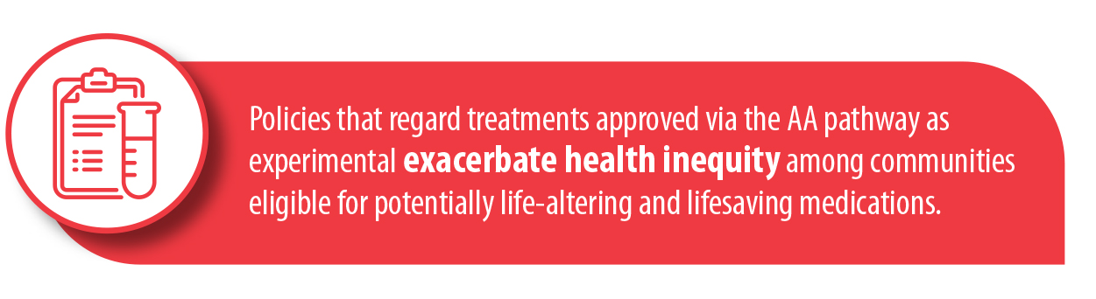
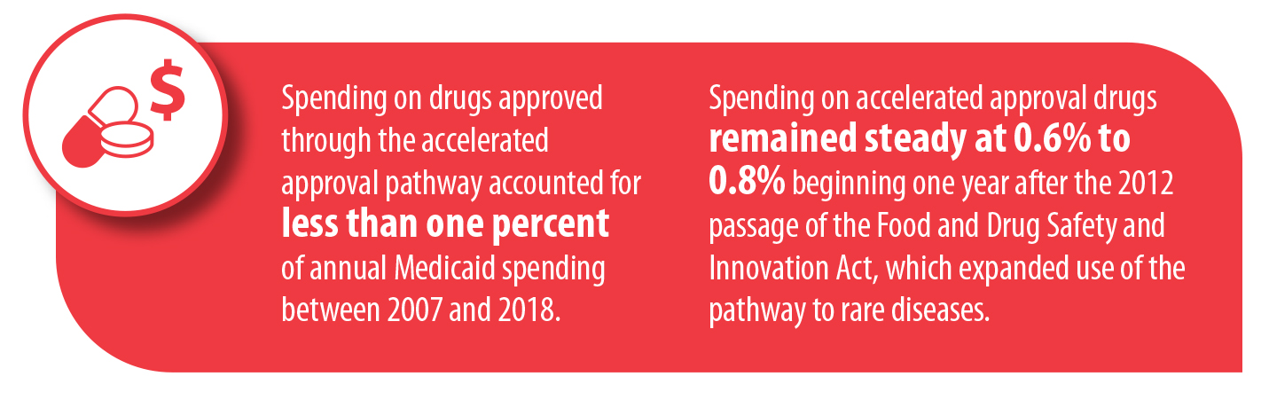
EVERYLIFE – facilitating Evidence - based policy discussion

Slide 18


Slide 19
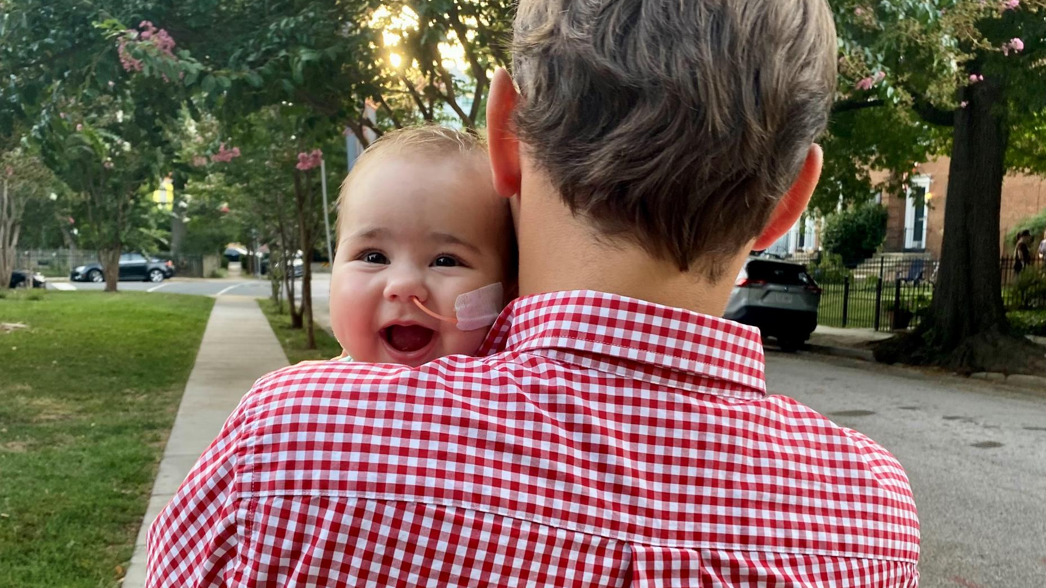

Slide 20
EVERYLIFE - Building a system that matches the pace of therapy innovation
✓
Access & Value Policy highlights:
✓
Evidence generation
Federal & State Legislation Engagement with Regulators, HTAs, Payers, Providers
✓
✓
Notes:
We’ve spent a great deal of time today discussing the many achievements of newborn screening, as well as its limitations, including the policy and operational barriers that could inadvertently hinder our ability to deliver disease-modifying treatments and potential cures to affected babies and young children in a timely fashion
So, what are we doing about it?
Industry (sponsors) are working hand-in-hand with patient organizations to build evidence, not only through funding of pilot studies but in generating evidence to show the clinical utility of the treatments we are developing
We also recognize our role in addressing the urgent need for recommendations as to how public health NBS can move towards a model that can accommodate rapid therapeutic development and approval

Slide 21
Please Keep In Touch
Sign-up for our newsletter, action alerts, and event invitations at www.rareadvocates.org
Follow us on Social Media
Facebook & Twitter: @EveryLifeOrg and @RareAdvocates
Instagram: Rare_Advocates
LinkedIn: EveryLife Foundation
Annie Kennedy, Chief of Policy, Advocacy, & Patient Engagement: akennedy@everylifefoundation.org
Morgan Roth, Chief of Communications Strategy:
mroth@everylifefoundation.org

