Slide 1

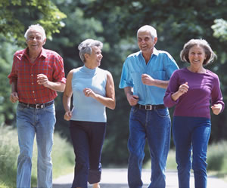
Intersectionality and Aging: How Older Workers Cope With Multiple Challenges
Karon L. Phillips, Ph.D., MPH, CHES
September 20, 2022

Slide 2




Trust for America’s Health
Independent, non-partisan, public health and prevention focus
Advancing evidence-based policy and advocacy with an equity focus
Improving the health of every community
Making disease prevention a national priority
Notes:
For those of you who are new to this series, Trust for America’s Health, or TFAH, is a policy, research and advocacy non-profit dedicated to optimal health and well-being for every individual and community. Our AFPHS training series is part of our initiative to elevate healthy aging as a core public health function and is designed to increase the capacity and expertise of the public health and aging services community on the public health roles in healthy aging. This year, our AFPHS trainings are focused on the social determinants of health, and we are pleased today to welcome representatives from three state health departments who will share information about the development of their data systems on older adults and how they are being or can be used to address social determinants of health.

Slide 3
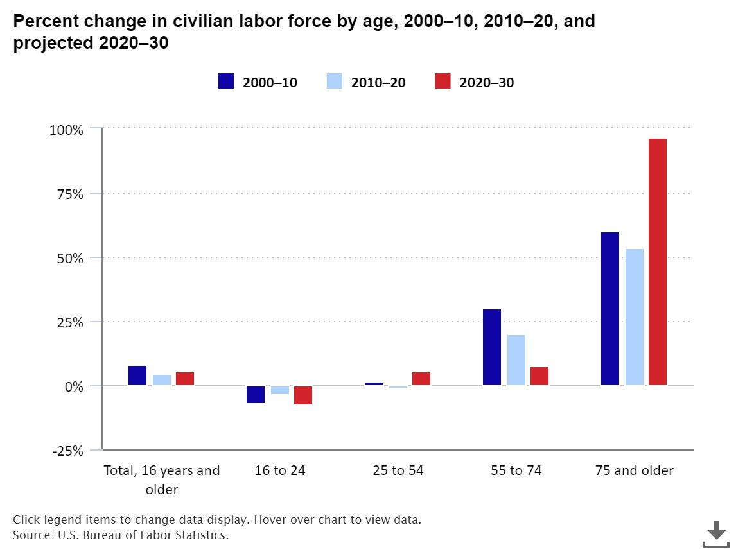
Older Workers
Notes:
https://www.bls.gov/opub/ted/2021/number-of-people-75-and-older-in-the-labor-force-is-expected-to-grow-96-5-percent-by-2030.htm#:~:text=The%20labor%20force%20participation%20rate,to%2049.6%20percent%20in%202030.
The labor force is expected to increase by 8.9 million, or 5.5 percent, from 2020 to 2030. The labor force of people ages 16 to 24 is projected to shrink by 7.5 percent from 2020 to 2030. Among people age 75 years and older, the labor force is expected to grow by 96.5 percent over the next decade.

Slide 4
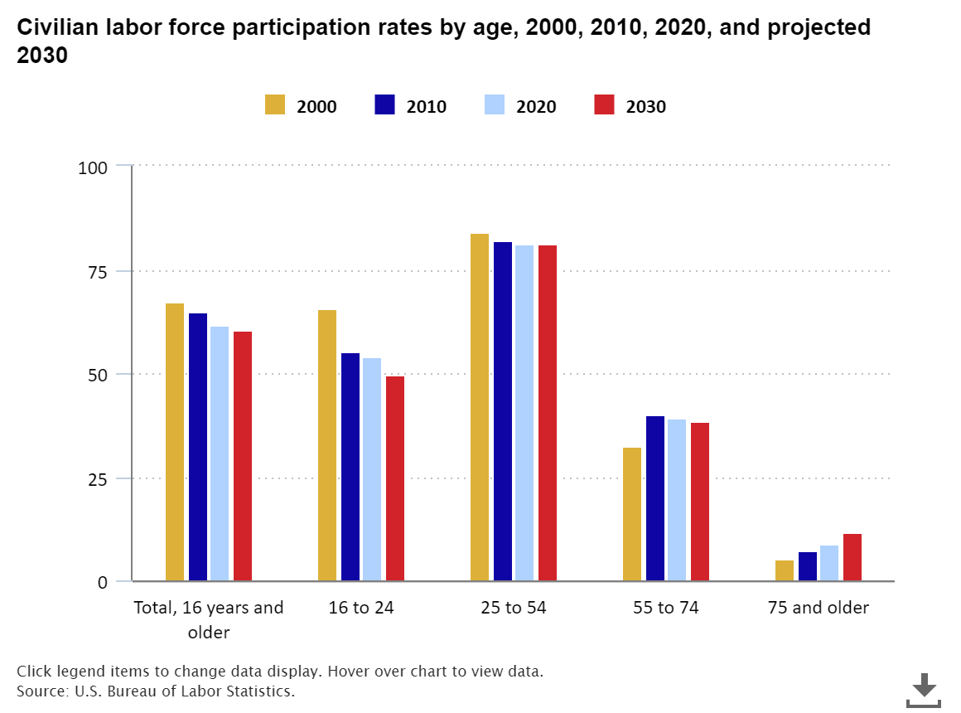

Slide 5
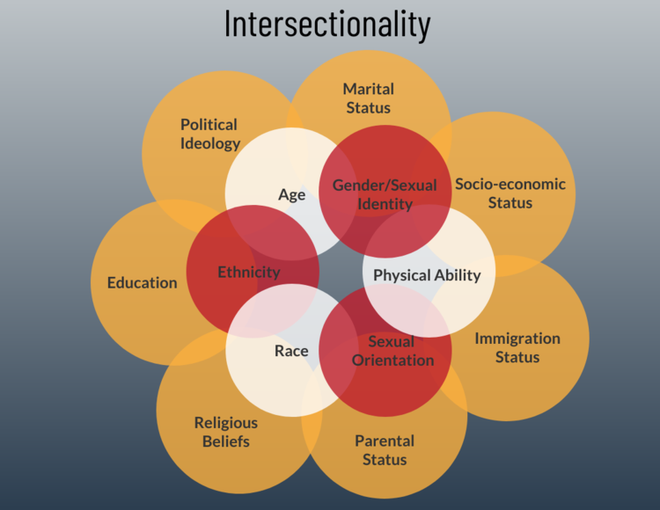
Notes:
Intersectionality: “interactions and multiplying effects of inequalities within individuals”
The chart highlights just how complicated this concept is.
When we think about older adults, and specifically older workers

Slide 6
Unpacking Ageism
Ageism
Sexism
Ableism
Racism
Notes:
You cannot discuss ageism without also considering the concepts of sexism, ableism, and racism.
“Ageism is prejudice against our future selves.” – author Ashton Applewhite
Ageism can also cause people to put their own limitations up – “I can’t keep up with this….” mentality

Slide 7
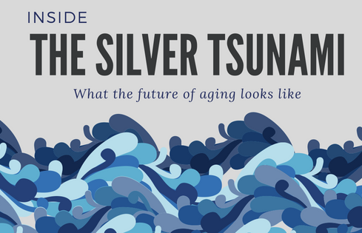

Notes:
Here is the thing –
Ageism results from the images and messages we receive throughout our life.
Starting at an early age…
It’s the jokes we hear our parents tell, the characters we see on TV
The things advertisers and magazines tell us about aging
They all train us to see older people a certain way and thereby treat them a certain way.
These seemingly minor incidents get under our skin and impact not only how we think about others, it impacts how we think about ourselves.
The metaphor of the Silver Tsunami is particularly problematic.
What happens in a tsunami?
Run for the hills and everybody dies.

Slide 8
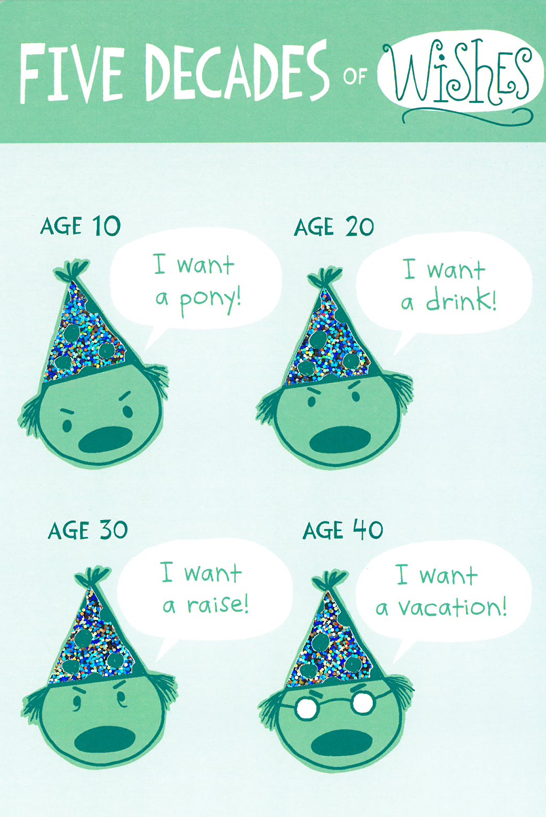
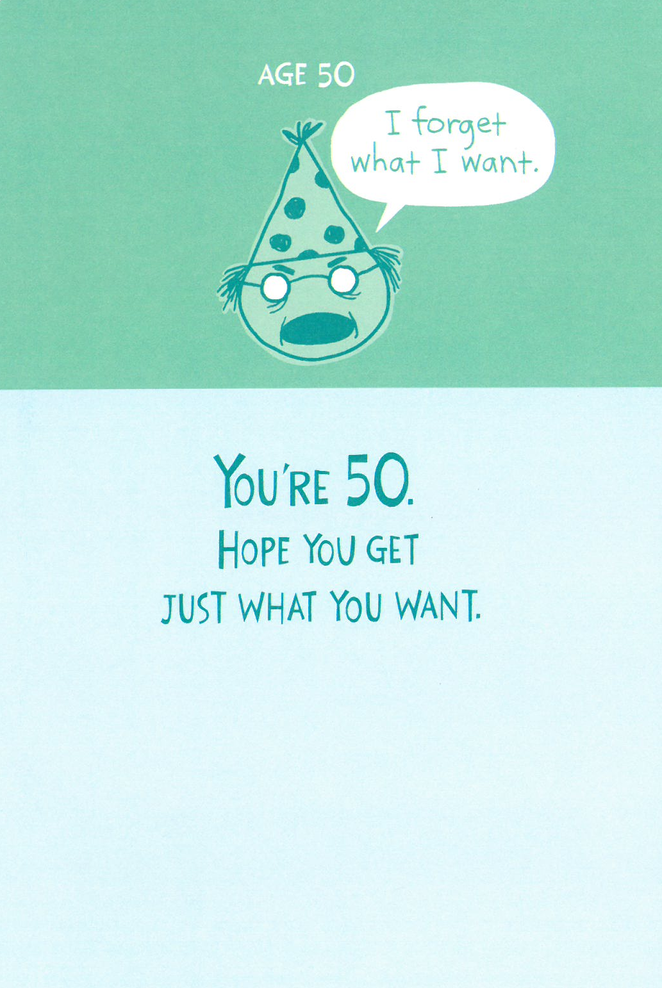
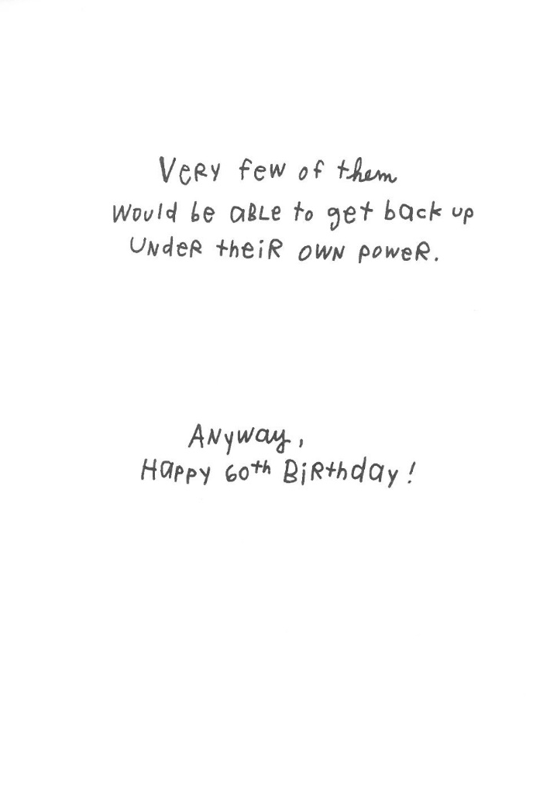
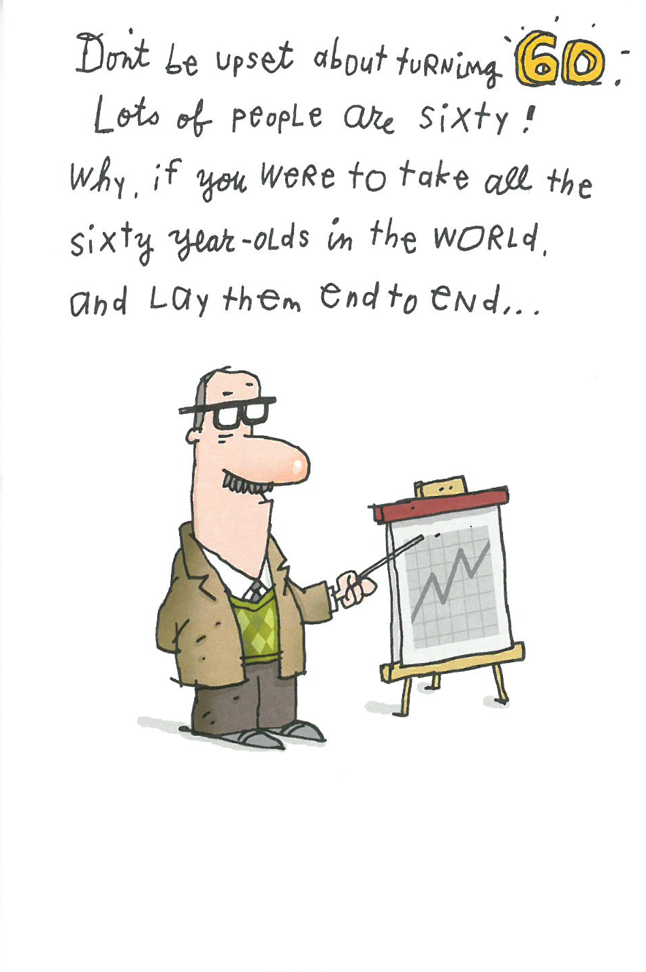

Slide 9
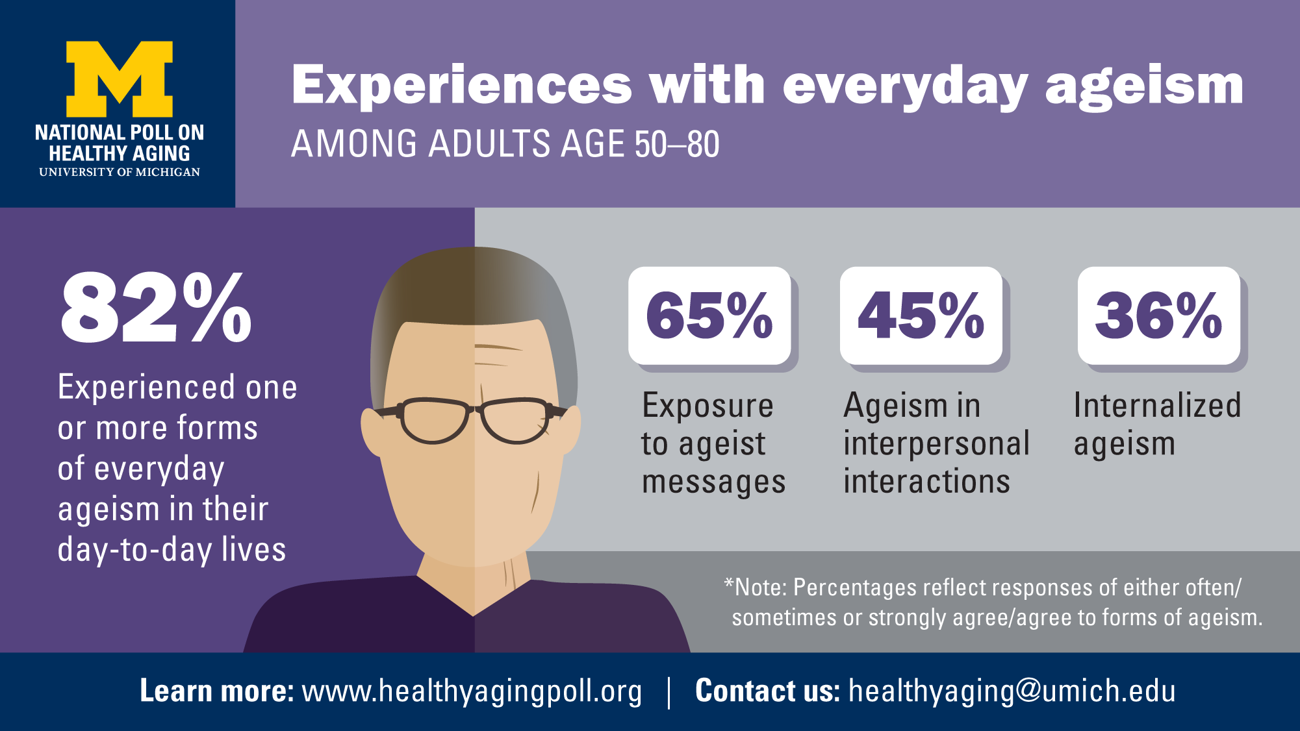
Notes:
You are not alone…a recent poll from the University of Michigan Center on Healthy Aging showed that 82% of adults age 50-80 experience one or more forms of ageism in their day to day lives.
Ageist messages
Interpersonal interactions
Internalized ageism

Slide 10
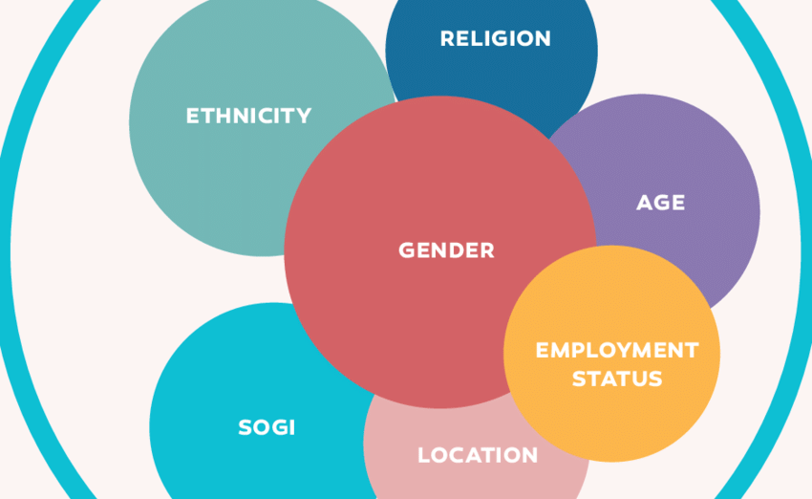

Changing Landscape of the Job Market
Matching skills with opportunities
Cumulative disadvantage

Slide 11
Five Things to Write About
Strategies for addressing ageism
Innovative partnerships that provide opportunities for older adults
What is means to be 65 today
Contributions across the generations
Healthy aging
Notes:
Strategies for addressing ageism
No longer use the term “elderly,” think about how we communicate about life after 65
Innovative partnerships that provide opportunities for older adults
Intergeneration opportunities that provide engagement for older and younger generations (ex. AARP’s Experience Corps)
What is means to be 65 today
The “image” of older adults is still very stereotypical – retired, “slower pace”, plays bingo. This is not what accurately depicts baby boomers, and when gen x gets older they will be different
Contributions across the generations
Each generation has influenced the workplace

Slide 12
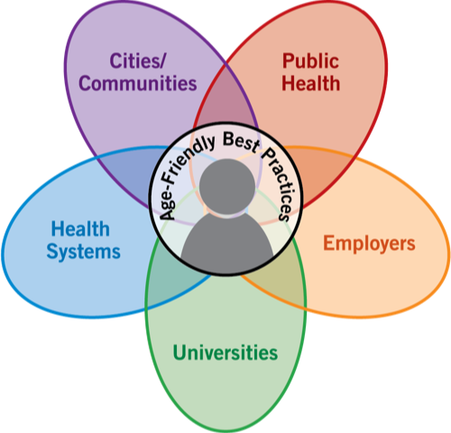
Age-Friendly Ecosystem
Notes:
Aligning sectors and activities; crosswalk frameworks
Assessments and planning based on data
Identify gaps in programs and services
Seamless older adult care

Slide 13
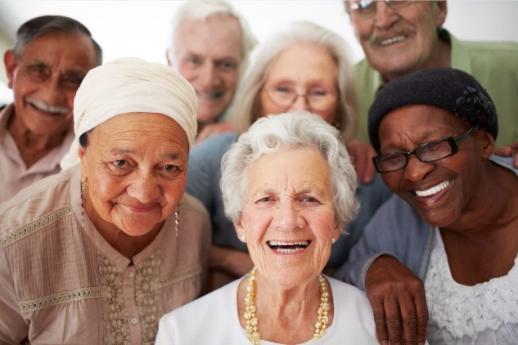

THANK YOU!
Trust for America’s Health
kphillips@tfah.org
www.afphs.org
www.tfah.org

