Slide 1

The Pathway from Rare Gene Discovery to Drug Development
Michael T. Collins, MD
Skeletal Disorders and Mineral Homeostasis Section,
National Institute of Dental and Craniofacial Research
National Institutes of Health

Slide 2
The Pathway from Rare Gene Discovery to Treatment
Michael T. Collins, MD
Skeletal Disorders and Mineral Homeostasis Section,
National Institute of Dental and Craniofacial Research
National Institutes of Health

Slide 3
Disclosures: The SDMHS receives support from:
Amgen – to treat fibrous dysplasia/McCune-Albright syndrome
BridgeBio – to treat autosomal dominant hypocalcemia type 1

Slide 4
Outline
Rare disease drug landscape
Skeletal disorders and mineral homeostasis section
3 Case studies in rare disease drug development
  Tumor-induced osteomalacia – infigratinib
  Autosomal dominant hypocalcemia type 1 – encaleret
  Fibrous dysplasia/McCune-Albright syndrome – TBD

Slide 5
Rare Disease Treatment Landscape
Definition:
  US: <200,000 people (1/1,630); EU: <5/10,000 (1/2,000); Japan: < 50,000 (1/2,500); Global average: 1/2,500
Number of rare diseases: 5,000 – 9,603 (citations vary)
Prevalence: Current best estimate: 6.2% (US: 20 M; EU: 47M)
Cost:
Ferreira, Amer J Med Genet, 2018
IQVIA Institute, 2020

Slide 6
Sea change in rare disease study/treatment
Advances in genetic diagnostics
  ↑speed, ↓cost, ↑accuracy
Advances in drug discovery
  From 100,000’s molecules in vitro → trillions of molecules in silico
Advances in animal models
  CRISPR mice
Changes in the economic landscape
  Entry of small biopharma, interest of big pharma, legislative incentives
Advances in patient information and support
  Social media, patient support groups

Slide 7
Pathways to treatment: 3 case studies
Tumor-induced osteomalacia – infigratinib
  Rapid application (repurposing) of a drug in development
Autosomal dominant hypocalcemia type 1 – encaleret
  Protracted application (repurposing) of and existing drug
McCune-Albright syndrome – TBD
  A tough nut to crack!

Slide 8

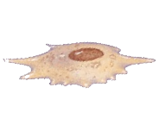
Skeletal Disorders of Mineral Homeostasis Section:
Disorders of PTH and FGF23
PTH
Ca²⁺
PO₄³⁻
bone cells
Ca₁₀(PO₄)₆(OH)₂
FGF23
mineralized tissues
bones & teeth
very few cells
a lot of “matrix”!
the hard stuff
“hydroxyapatite”
(calcium and phosphate)
parathyroid hormone and
fibroblast growth factor 23
regulate Ca & PO, and bone cells

Slide 9
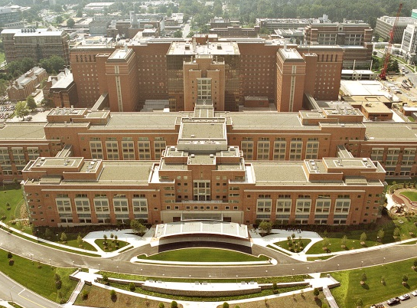
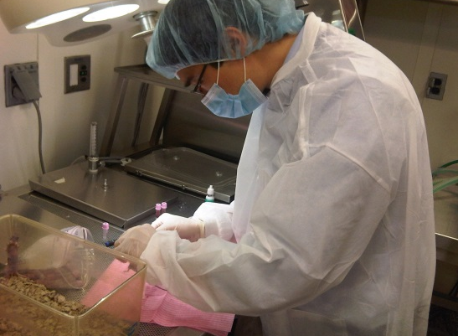
Skeletal Disorders and Mineral Homeostasis Section
- pathophysiology
- models
- preclinical testing
- rare diseases as models
- identify unmet needs
natural history studies
translational studies
clinical trials
- repurposed and novel drugs
- reduce illness and disability
bed-to-bench-to bedside
Notes:
1)This is accomplished through natural history studies (demonstrate later), 2) define the spectrum and natural history of the diseases under investigation, 3) identify unmet needs, 4) establish the standard of care, 5) generate hypotheses for testing in translational studies and clinical trials
1) investigate the underlying pathophysiology, 2) develop in vitro and in vivo models to both probe pathophysiology, but also to perform preclinical testing
All of this leads to studies with repurposed and novel drugs, with the ultimate goal to treat human disease and disability

Slide 10
Skeletal Disorders and Mineral Homeostasis Section
5-10 years
- pathophysiology
- models
- preclinical testing
- rare diseases as models
- identify unmet needs
natural history studies
translational studies
2-5 years
clinical trials
- repurposed and novel drugs
- reduce illness and disability
bed-to-bench-to bedside
5-10 years
Notes:
1)This is accomplished through natural history studies (demonstrate later), 2) define the spectrum and natural history of the diseases under investigation, 3) identify unmet needs, 4) establish the standard of care, 5) generate hypotheses for testing in translational studies and clinical trials
1) investigate the underlying pathophysiology, 2) develop in vitro and in vivo models to both probe pathophysiology, but also to perform preclinical testing
All of this leads to studies with repurposed and novel drugs, with the ultimate goal to treat human disease and disability

Slide 11
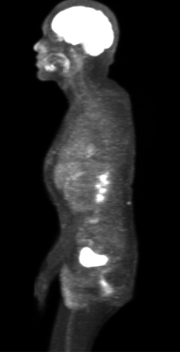
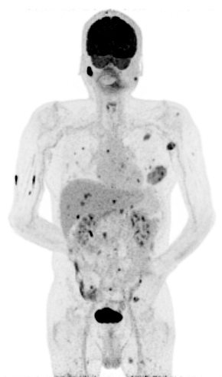
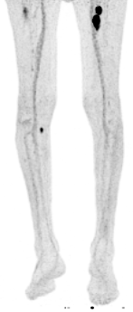
Tumor-induced osteomalacia and infigratinib
TIO is a disease of FGF23 excess
FGF23 lowers blood phosphate
↑↑ FGF23 → ↓ phosphate → weak bones
TIO is caused by small, hard to find tumors
Tumor removal is curative
Some tumors can’t be found or metastasize

Slide 12
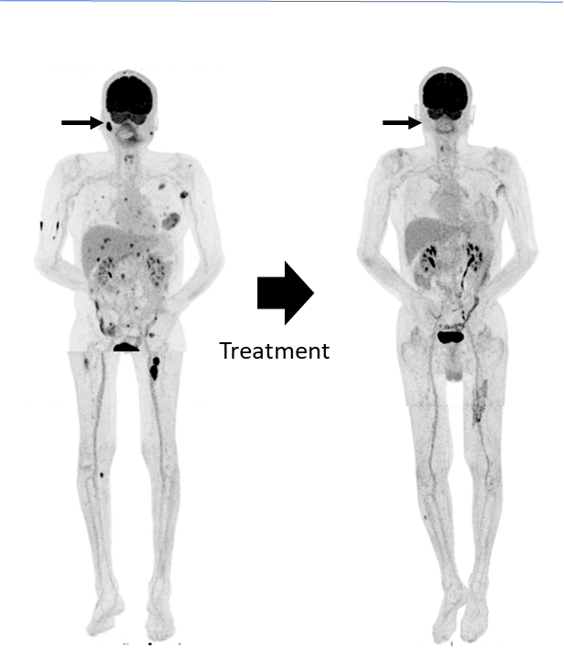
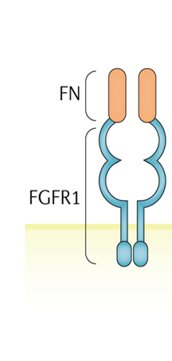
TIO genetic defect identified in 2014
RNA sequencing of tumors found the defect (2014)
“translocation” between two genes
Fibronectin 1 (FN) and fibroblast growth factor 1 (FGFR1)
Possibly transmits FGFR1 signals to the cells
An FGFR blocker may be effective
BGJ 398 (infigratinib)* a “pan” FGFR inhibitor – Novartis
Initiated in 2015
* Approved in 2021 for cholangiocarcinoma

Slide 13
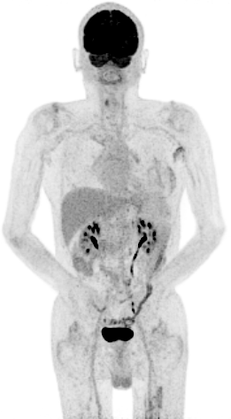
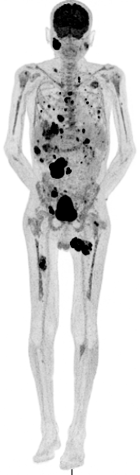
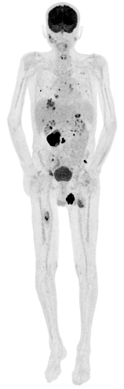
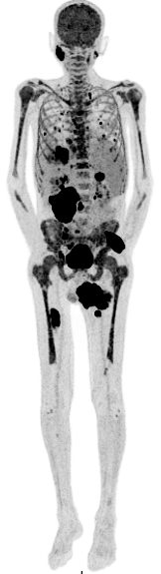
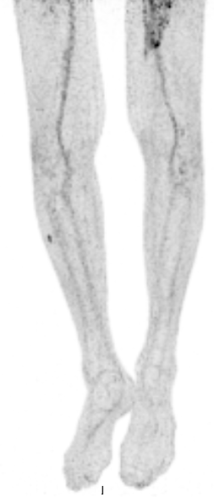
Infigratinib was effective for 5 years
FIRST COURSE OF TREATMENT
DISCONTINUATION
REINITIATION
PROGRESSION
a | Pre-treatment
b | 1 year on drug
c | 28 months off drug
d | 3 months on drug
e | 8 months on drug
Treatment
Stopped due to side effects
Treatment
Intermittent
dose interruptions
due to side
effects
(Hartley, New Eng J Med 2020)
Notes:
His response was really striking.
On FDG/P he had disappearance of tumors shown here pretreatement and 1 year on drug.
This coincided with a dramatic response in FGF23 and remarkably this patient who was chronically hypophosphatemic for decads experienced normalization of blood phosphate

Slide 14
TIO as a rare disease treatment model
TIO was a disease entity for > 50 years
Genetic underpinning identified in 2014 through advanced molecular sequencing techniques (FGFR1)
FGFR inhibitor drugs first appeared in mid 2000’s; first approved 2019
Infigratinib trial in TIO stopped early due to toxicity*
Future:
  More selective inhibitors
  Oligonucleotide therapy
  Tumor-directed delivery
*Hartley, JBMR Plus 2022

Slide 15
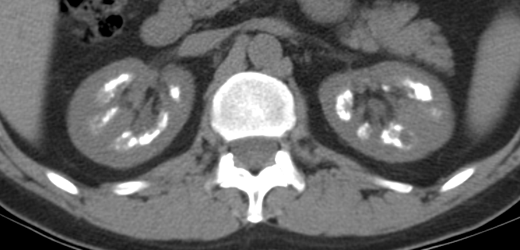
Autosomal dominant hypocalcemia type 1 and encaleret: Mr. B’s story
As a child, cramping, paresthesias, “foggy” thinking
Age 6, evaluated for learning difficulties, found to have low calcium, hypoparathyroidism diagnosed
Family history:
  father checked when son diagnosed, also had ↓ calcium
  2 siblings died in infancy with (?hypocalcemic) seizures
Age 6 onward treated with calcium + vitamin D
Renal calcification (nephrocalcinosis) at 14; hospitalized for hypercalcemia at 20 (overtreatment)
CT scan of kidneys age 51
nephrocalcinosis

Slide 16
Autosomal dominant hypocalcemia type 1
Caused by low levels of parathyroid hormone (PTH)
PTH levels are regulated by the calcium-sensing receptor (CaSR) on the parathyroid gland
ADH1 is caused by a variant (mutation) in the CaSR - 1994
The CaSR is inappropriately “turned on”

Slide 17
ADH1 and calcilytics (antagonists of the CaSR)
The CaSR was discovered in 1993 by Ed Nemeth and Ed Brown
Agonists (calcimimetics) discovered in 1996
Antagonists (calcilytics) reported in 2000
Early 2000’s multiple companies developed calcilytics for osteoporosis
2005 GlaxoSmithKline licensed calcilytics from NPS pharma

Slide 18
Calcilytics for ADH1
2007 NIDCR negotiated a study of ronacaleret in at NIH with GSK
2008 ronacaleret in osteoporosis failed; GSK abandoned ronacaleret
GSK abandoned calcilytics and the NIH study
2011 NPS licenses calcilytics back from GSK – NIH study back on
2014 study of NPS drug in ADH1 conducted at NIH*
2015 Shire acquires NPS – interest in ADH1 waned
2019 Takeda acquires Shire – interest in ADH1 lost
2020 BridgeBio acquires calcilytic encaleret
*Roberts, J Bone Miner Res, 2019

Slide 19
Calcilytics for ADH1
Phase 2 study of encaleret in ADH1 at NIH started in 2020
Phase 2 study completed in 2022
Phase 3 study starting Q4 2022/Q1 2023
normal range
Blood cCa
(mg/dL)
Days
Weeks
Period 2
Period 3

Slide 20
ADH1 as a rare disease treatment model
CaSR gene and ADH1 variant identified in 1993/1994
CaSR drugs (calcilytic) identified in 2000
Phase 2 study delayed until 2020 by:
  Inability of pharma to take risks on “off-label” use of a drug in development
  Acquisitions/mergers – lack of interest/competing interest of drugs
Phase 2 study enabled by:
  New phenomenon of pharma interest in rare diseases
  FDA incentives
  Well-studied rare disease cohort
*Hartley, JBMR Plus 2022

Slide 21
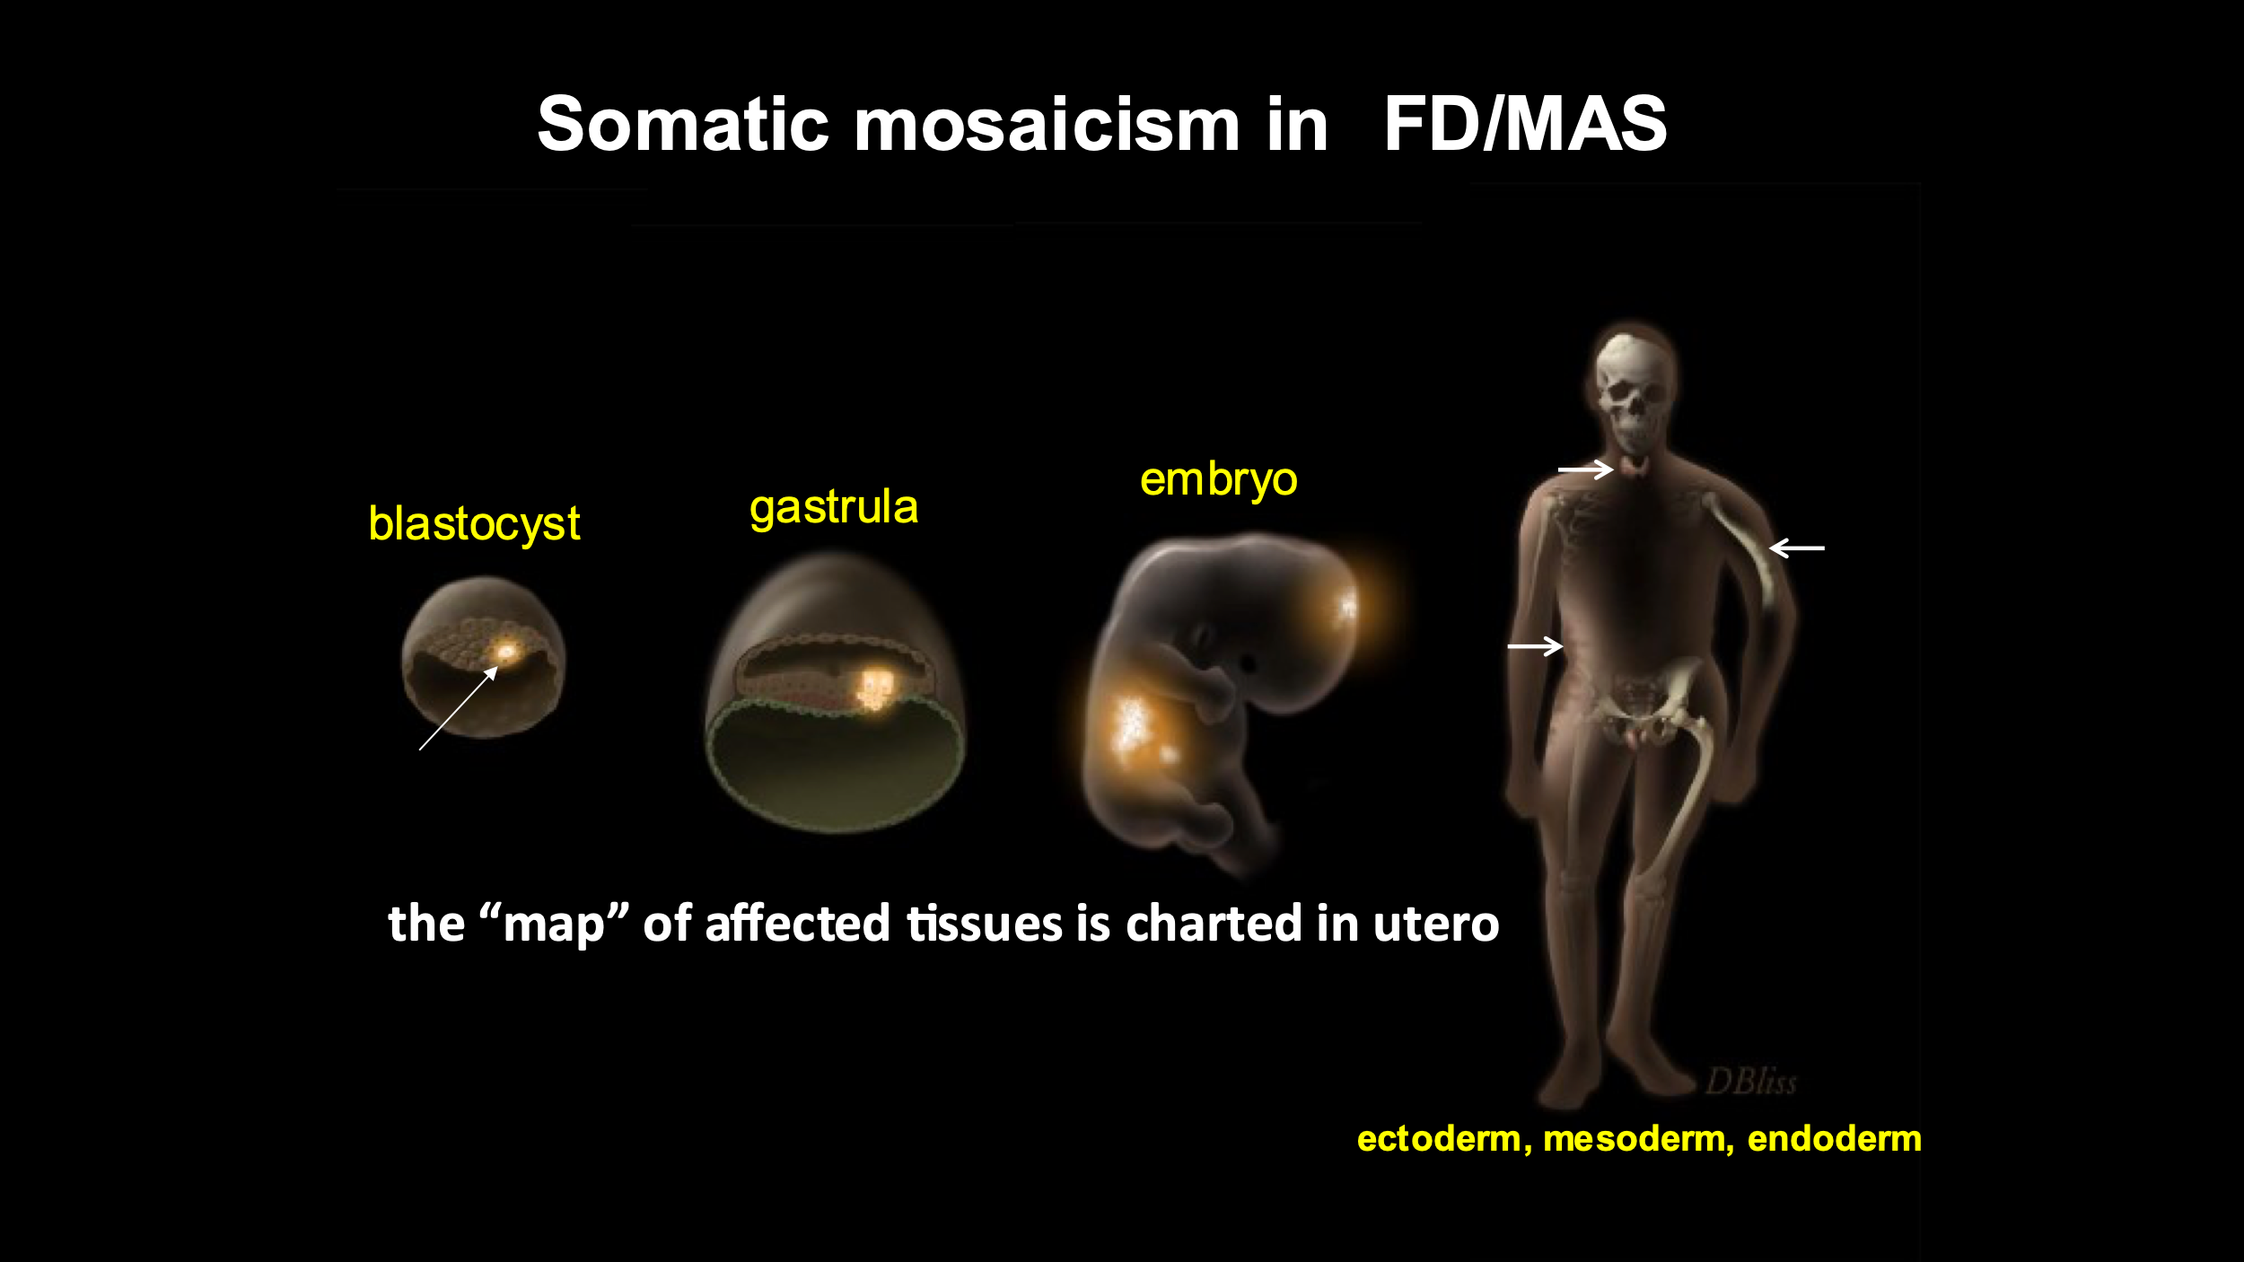
Fibrous dysplasia/McCune-Albright syndrome as a rare disease treatment model
FD/MAS: mosaic disease

Slide 22
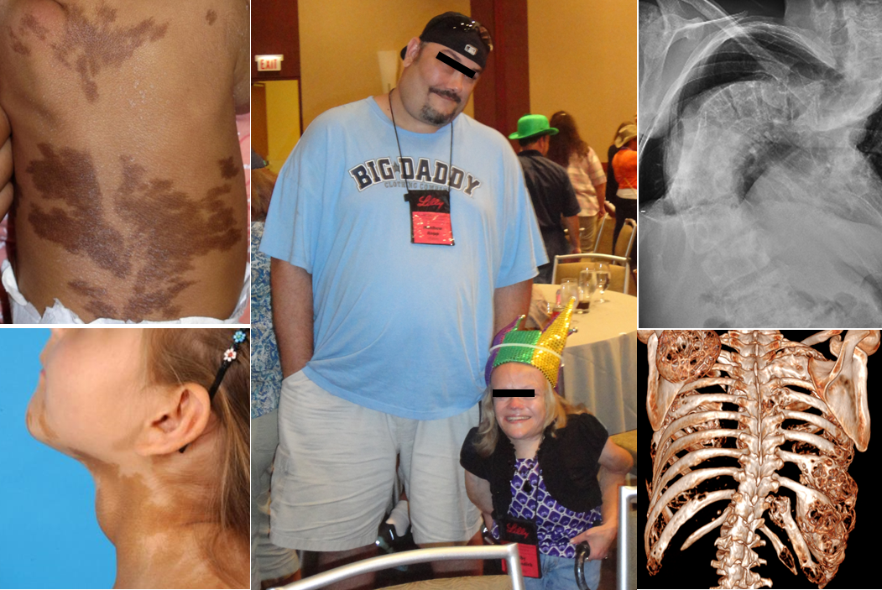
Fibrous dysplasia/McCune-Albright syndrome: complex, broad and debilitating spectrum

Slide 23
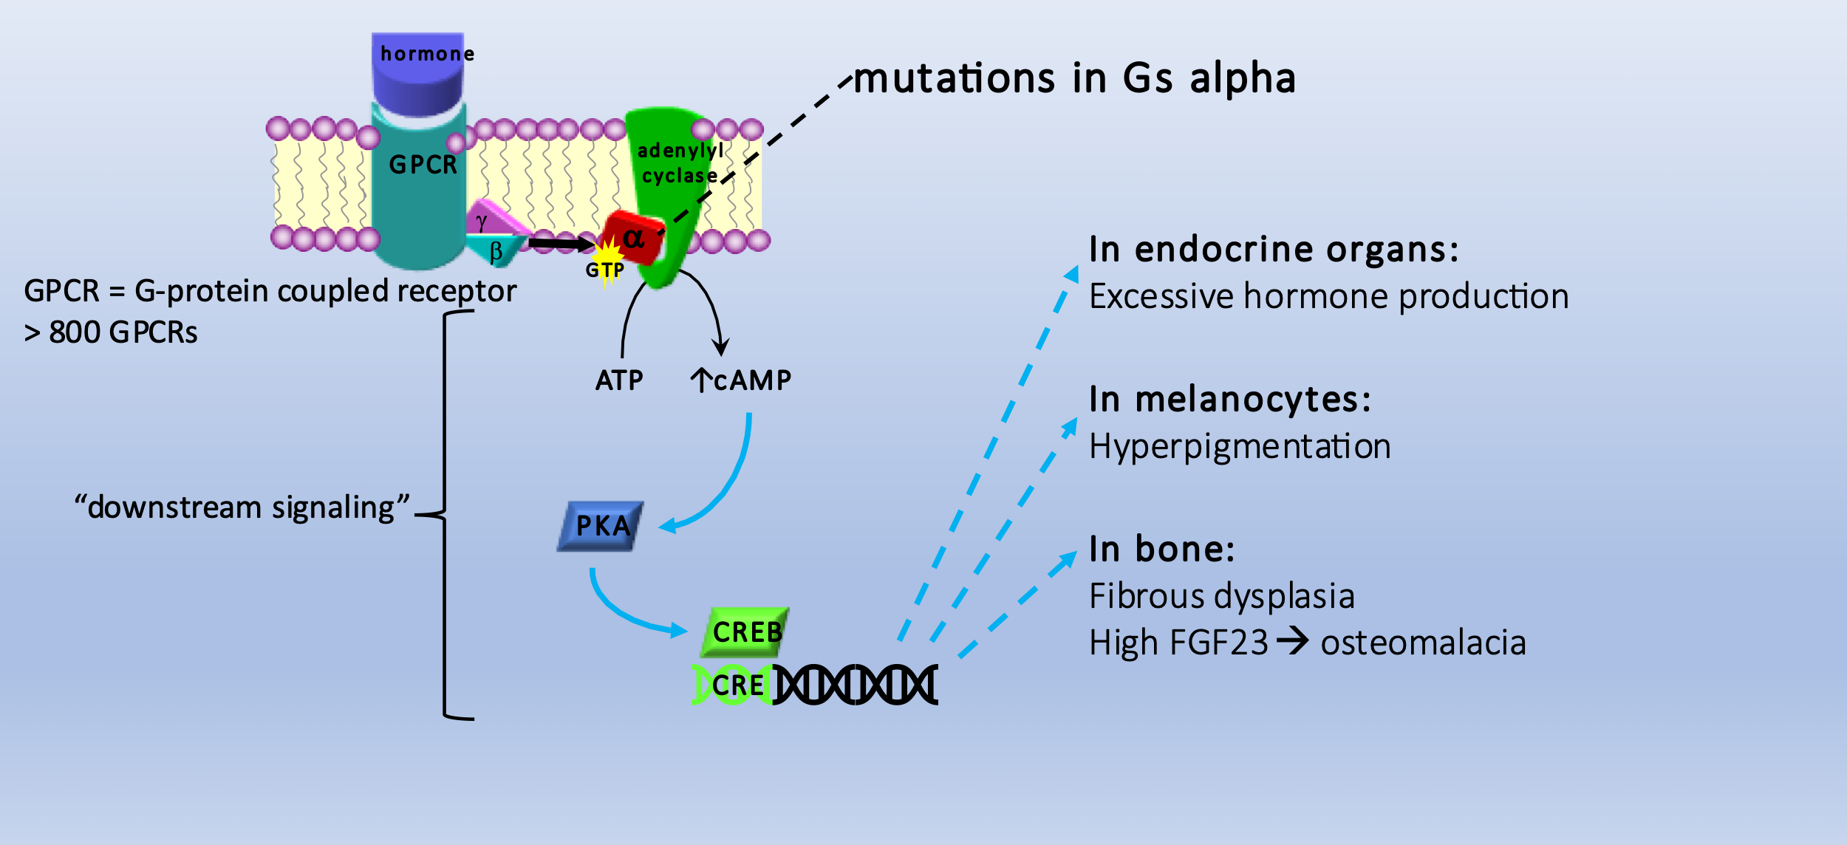
Fibrous dysplasia/McCune-Albright syndrome: dysregulated GPCR signaling

Slide 24
Molecular targeting of the mutation in Gs alpha has proven very difficult
Disease described in the 1930s
50 years before Gs mutations discovered in 1989
Gs mutations as cause of FD/MAS discovered 1991
Drug must be very specific – only mutant Gsα (avoid off-target effects)
Get into mutated cells
SDMHS/NCATS collaboration of almost 10 y failed

Slide 25
Promise for FD/MAS
Oct 2022: small molecule inhibitors of mutant Gs discovered*
Mutant specificity remains to be achieved
“cyclic peptides”
*Dai…Shokat, Cell, 2022

Slide 26
FD/MAS as a rare disease treatment model
Gs alpha gene and FD/MAS variant identified in 1989/1991
Mosaic diseases are harder
G-protein-associated mutants have been very difficult to target
30 years in, we now have promising molecules
Treatment studies will be facilitated by:
  “drug-ready” cohorts: detailed, long-term, patient natural history data
  patient registry
  Existing, validated in vitro and in vivo models

Slide 27
Rare Disease Treatment is Challenging, but barriers are falling
Genetic causes are identified sooner
Drug screening libraries are larger
Nucleotide and gene therapy approaches are improving
Legislative financial incentives and “small” pharma interest
We still need
  Funding for natural history studies and international collaboration
  Creative trial designs and FDAgency flexibility to accommodate small numbers of patients and lack of traditional “control” groups
  Great reporting to inform the public, support the patients, and sway the funders/legislators!

Slide 29
IQVIA Institute, 2020

Slide 30
IQVIA Institute, 2020

