Slide 1
China & Secondary Sanctions:
Lithuania & Beyond
Bryce C. Barros
China Affairs Analyst
Alliance for Securing Democracy at the
German Marshall Fund of the United States
October 20, 2022

Slide 2
Overview
Goal of U.S. Sanctions Regime
U.S. Sanctions Regime
EU Sanctions Regime
Recent U.S. Commerce Actions Against China
China’s Sanctions Regulations
China’s Actions Against Lithuania
Were China’s Sanctions Effective?
EU’s Response

Slide 3
U.S. Sanctions Regime
What are the policy goals of U.S. Sanctions?
Nonproliferation/Counterproliferation
Prevent dual-use technology
Counterterrorism
Combating human rights abuses
Deter individuals and entities from undermining democratic processes or institutions
Prevent military technology development

Slide 4



U.S. Sanctions Regime
Policy Development & Implementing Entities
U.S. Department of the Treasury
Office of Terrorism and Financial Intelligence (TFI)
Terrorist Financing and Financial Crimes (TFFC)
Office of Intelligence & Analysis (OIA)
Financial Crime Enforcement Network (FinCEN)
Office of Foreign Assets Control (OFAC)
Treasury Executive Office of Asset Forfeiture (TEAOAF)
U.S. Department of State
Office of Economic Sanctions Policy and Implementation (TFS/SPI)
U.S. Department of Commerce
Bureau of Industry and Security (BIS)

Slide 5

Recent U.S. Commerce Actions Against China
Commerce BIS targets China’s ability to purchase and manufacture high-end chips
Advanced military systems
Speed and accuracy of military decision making, planning, and logistics
Autonomous military systems
Human rights abuses
Added 31 entities to Unverified List
Restricts export controls on chips
Imposes new controls on chip manufacturing items
Restricts U.S. persons from “support”

Slide 6

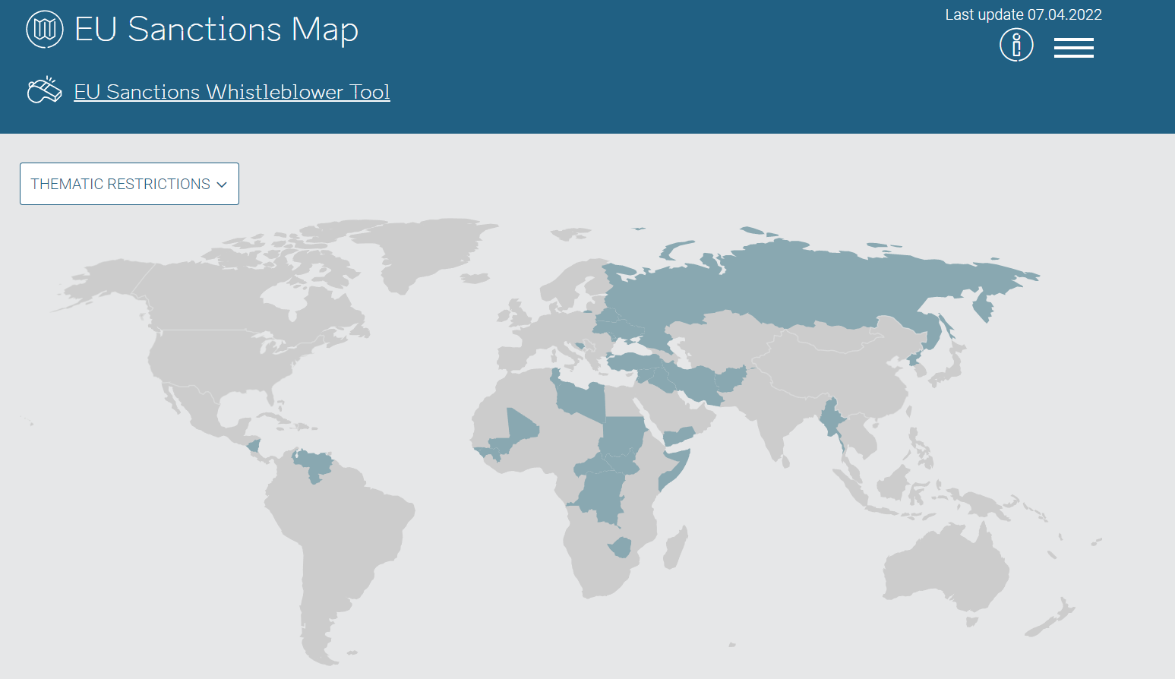
E.U. Sanctions Regime
A part of the E.U.’s Common Foreign & Security Policy
Intended to “bring about a change in policy or activity by targeting non-E.U. countries, as well as entities and individuals, responsible for the malign behaviour”
Types of Sanctions
Arms embargoes
Restrictions on admission (travel bans)
Asset freezes
Other economic measures like restrictions on imports/exports
Policy and Implementing Entities
High Representative of the Union for Foreign Affairs and Security Policy
European Commission (E.U. Executive Branch)
Applicable usually within E.U. member states-only

Slide 7
China’s Sanctions Regulations
Three Regulations
Provisions of the Unreliable Entity List
Rules on Counteracting Extra-Territorial Application of Foreign Legislation and Other Measures
Anti-Foreign Sanctions Law
Used to punish individuals, entities, or governments going against China’s geopolitical interests
China often resorts to economic coercion instead

Slide 8
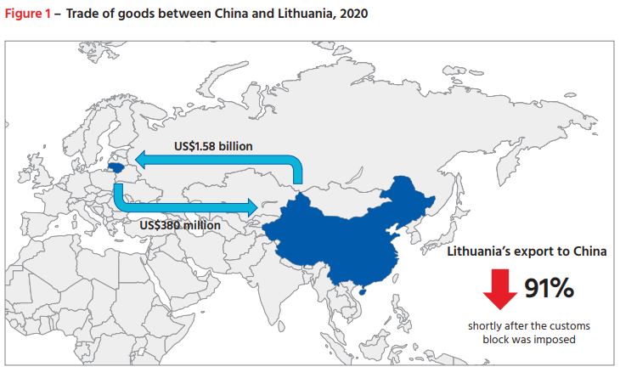
China’s Actions Against Lithuania
July 2021 - Downgraded diplomatic relations
December 2021 - Imposed customs block on Lithuanian exports
At least 130 companies could not send products to China
De facto secondary sanctions against EU-registered companies
Especially with sourced components from Lithuania

Slide 9
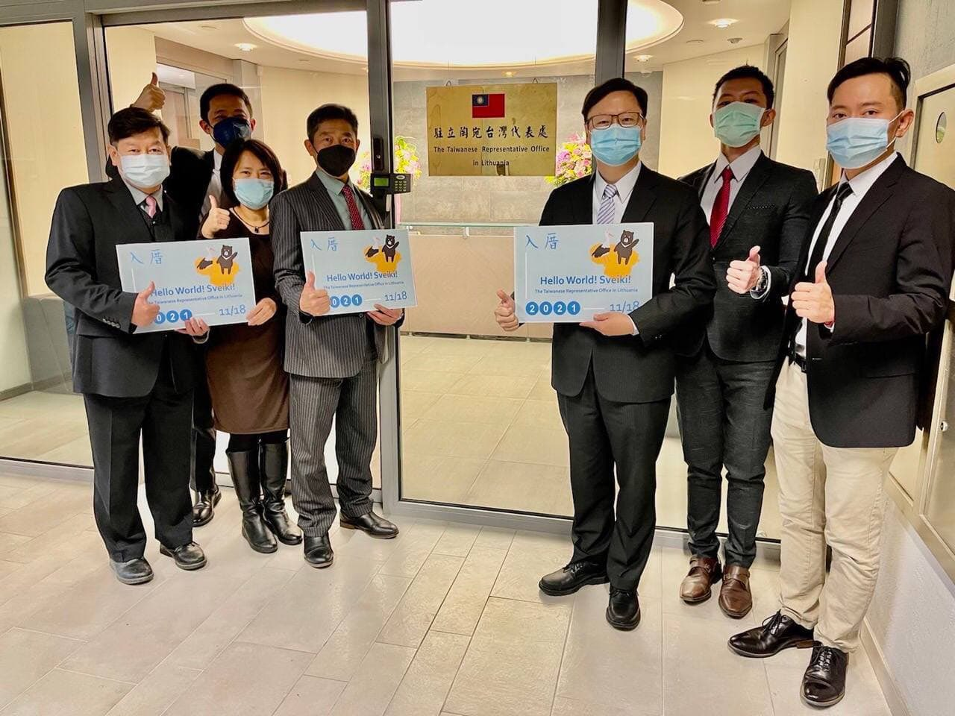
Were China’s Sanctions Effective?
Short Answer - No.
Taiwan-Lithuania relations deepened
Taiwan launched US$1 billion credit program for investment in strategic areas
Backed by Taiwan’s National Development Fund and the Bank of Taiwan
Economic ties with the rest of the Indo-Pacific deepend
Lithuanian exports to the region four times exceed the volume to China in first half of 2021
CC: https://twitter.com/TW_in_LT/status/1461246975366598657/photo/1

Slide 10
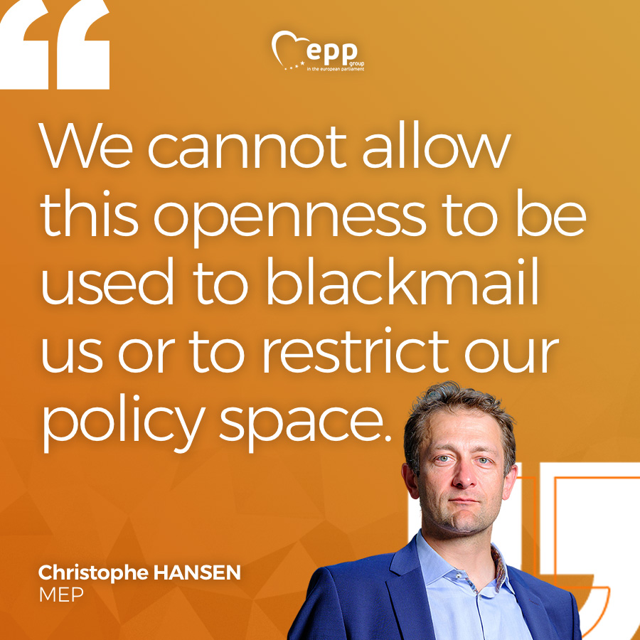
EU’s Response
Anti-Coercion Instrument
Builds on EU’s “Open Strategic Autonomy” ambitions
Defines economic coercion as pressure against the Union or a Member State to induce policy change
Includes countermeasures like:
Suspension of tariff concessions
Import/export restrictions
Banking, insurance, and capital market restrictions
CC: https://twitter.com/EPPGroup/status/1580589767661858816/photo/1

Slide 11
Questions?

Slide 12
Contact Information:
Bryce C. Barros
bbarros@gmfus.org

