Slide 1

using government data sources to understand older worker trends

Slide 2

Overview
A brief review of key government surveys
Using available data tools
Finding data and research led ideas for articles or investigation

Slide 3
Government surveys

Slide 4
U.s. Government surveys with employment data
Current Population Survey (CPS)
Current Employment Statistics (CES)
American Community Survey (ACS)
Job Opening and Labor Turnover Survey (JOLTS)
Survey of Income and Program Participation (SIPP)
Longitudinal Surveys (1979 and 1997)
American Time Use Survey
Employee Tenure
Employment Situation of Veterans

Slide 5
Current population Survey (CPS) - monthly
Administered by the Census Bureau using a probability selected sample of about 60,000 households. One person generally responds for all eligible members of the household.
Conducted during the calendar week that includes the 19th of the month.
Households from all 50 states and the District of Columbia are in the survey for 4 consecutive months, out for 8, and then return for another 4 months before leaving the sample permanently (not technically a panel survey but some analysts use it in that way by matching records).
Respondents must be 15 years of age or over and not in the Armed Forces or institutions. BLS publishes labor force data only for people aged 16 and over
Monthly Data Dictionary available here: https://www.census.gov/data/datasets/time-series/demo/cps/cps-basic.html and links to related tools: https://www.bls.gov/cps/

Slide 6
CPS Annual Social and economic supplement
The Annual Social and Economic Supplement (ASEC) is a supplemental survey to the CPS of more than 75,000 households.
Contains detailed questions covering social and economic characteristics of each person who is a household member as of the interview date.
Contains questions related to income received during the previous calendar year and some additional employment variables.

Slide 7
Large U.S. Census surveys
American Community Survey (ACS): The American Community Survey (ACS) is a large ongoing survey. Information from the ACS help determine how more than $675 billion in federal and state funds are distributed each year. Employment data is annual rather than monthly but can sometimes provide more details about jobs and occupations, educational attainment, veterans, and sources of income.
Survey of Income and Program Participation (SIPP): A nationally representative longitudinal (panel) survey that provides comprehensive information on the dynamics of income, employment, household composition, and government program participation. Data on economic well-being, family dynamics, education, wealth, health insurance, child care, and food security.

Slide 8

Using some available data tools

Slide 9
Current population survey
Data Tools: Based on drop-down options for different data components.
Series Reports: Based on the input of one or more series ID numbers.
BLS CPS data experts

Slide 10
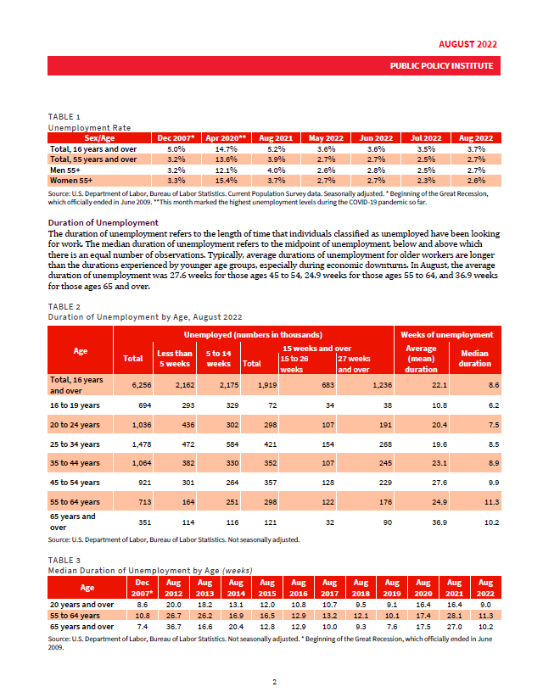
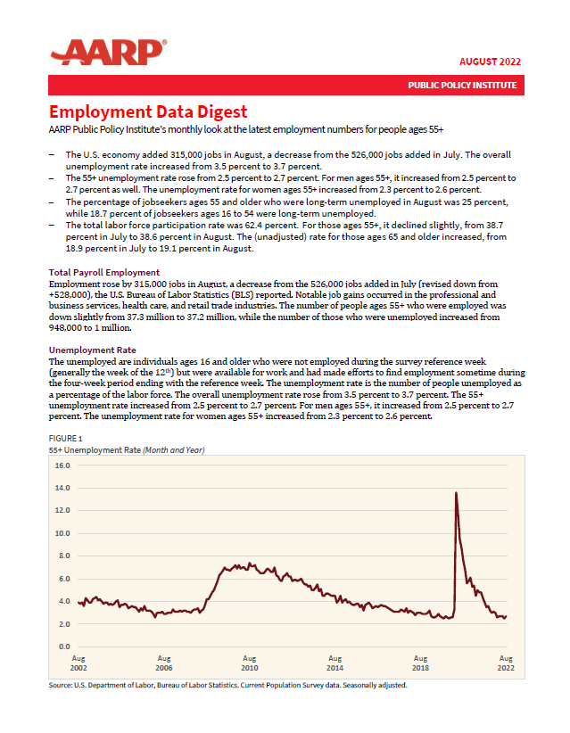
Current population survey
AARP/PPI Employment Data Digest: Brings together CPS data on 55+ employment each month.

Slide 11
ACTIVITY:
Testing the BLS data tools and series reports (LFPR by age and sex)
https://www.bls.gov

Slide 12
What did you find?
 | Feb 2020 | Aug 2022 | Difference Aug22-Feb20 | Divided by Feb20 | Multiplied by 100 | Or as a Percentage
Men 25-54 | 89.2 | 88.6 | -0.6 | -0.00673 | -0.67265 | -0.7%
Men 55 and older | 46.6 | 44.3 | -2.3 | -0.04936 | -4.93562 | -4.9%
Women 25-54 | 76.9 | 77.2 | 0.3 | 0.003901 | 0.390117 | 0.4%
Women 55 and older | 35.0 | 33.5 | -1.5 | -0.04286 | -4.28571 | -4.3%

Slide 13
Local data
The Local Area Unemployment Statistics (LAUS): This program produces monthly and annual employment, unemployment, and labor force data for Census regions and divisions, States, counties, metropolitan areas, and many cities, by place of residence. https://www.bls.gov/lau/
State LMIs: Labor market information websites for each state. Find by search or for a list go to https://www.bls.gov/bls/ofolist.htm. State LMIs usually list an economist or data expert for help and expertise on state labor market data.

Slide 14
Other data portals
IPUMS: IPUMS provides census and survey data from around the world. IPUMS is often used to conduct comparative research and merge information across data types.
Federal Reserve Economic Data (FRED): Online database consisting of hundreds of thousands of economic data time series from national, international, public, and private sources. Combines data with tools to interact with, display, and disseminate data.

Slide 15
ACTIVITY:
Testing Data on FRED (https://fred.stlouisfed.org/)
Find a category
Pick a subcategory
Pick your data points
Add to a graph

Slide 16

Research and Data led articles

Slide 17
Analysis & deep dives of government data
Articles by BLS Economists
The Economics Daily
Monthly Labor Review
Beyond the Numbers
Spotlight on Statistics
Reports
Census - America Counts: https://www.census.gov/library/stories.html

Slide 18
Other research sources: The FED
Federal Reserve Survey of Household Economics and Decision-making (SHED): Survey measures the economic well-being of U.S. households and identifies potential risks to their finances. Covers a range of topics of including credit access and behaviors, savings, retirement, economic fragility, and education and student loans.
Federal Reserve Banks: Boston, New York, Philadelphia, Cleveland, Richmond, Atlanta, Chicago, St. Louis, Minneapolis, Kansas City, Dallas, and San Francisco. Conduct research, analysis, economic modeling and forecasting. Online speeches and events.

Slide 19
Other research sources: INternational
The Organisation for Economic Co-operation and Development (OECD): International organization made up of 38 member countries. The OECD is a good source of international comparisons data. The OECD council works with governments, policy makers and citizens around the world to develop data and policy recommendations for a range of social, economic and environmental issues. AARP has worked with the OECD on international research related to older workers.
ILOSTAT: An initiative of the International Labour Organisation (ILO), ILOSTAT is a global reference for international labor statistics.

Slide 20
research sources that use Government data
National Bureau of Economic Research (NBER): Conducts and disseminates nonpartisan economic research. Working papers are not peer-reviewed but often very current.
Pew Research Center: Demographic changes
The Brookings Institution: Low-income worker data, the Retirement Security Project
Schwartz Center for Economic Policy Analysis (SCEPA): Located at the New School for Social Research. Papers on retirement security, older worker trends
Urban Institute: Based on existing data, the Dynamic Simulation of Income Model (DYNASIM) projects the size and characteristics (financial, health, and disability status) of the US population for the next 75 years.

Slide 21
Release calendars
BLS release calendar
FRED release calendar
MarketWatch release calendar

Slide 22
Discussion and wrap-up
Where do you go to find data on jobs and older workers?
What resources or tools do you find especially user-friendly and accessible?
How do you connect the numbers with real people and their lived experience?
What are some older worker or other labor market trends that you are currently tracking? Do you also notice any countertrends?

Slide 23
Contact information
Jen Schramm, MPhil, GPHR, SHRM-SCP
AARP Public Policy Institute | Senior Policy Advisor, Labor Market Issues
601 E Street NW, Washington, DC 20049
Tel: 202-434-2428 | Email: jschramm@aarp.org

