Slide 1



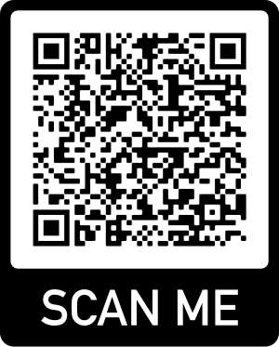
Introduction to the carbon markets
Tuesday, 26 July 2022
contactus@climateimpactx.com • climateimpactx.com
1
1

Slide 2


CLIMATE IMPACT X
A global carbon marketplace and exchange, CIX is accelerating impact by increasing access to quality carbon credits worldwide.
CIX will help scale the voluntary carbon market with transparency, integrity and trust.
Jointly established by:

Slide 3









What is a carbon credit?
A carbon credit represents one tonne of reduced or avoided CO₂ emissions from a verified climate action project.
+ CO₂
– CO₂
Carbon credits provide vital income for climate projects, not just funding.
1. Business activities result in GHG emissions, and some of these emissions are harder to abate.
2. Companies can compensate these hard-to-abate emissions by buying carbon offsets from projects that remove GHG from the atmosphere or avoid more GHG emissions.
3. Offsets are retired to demonstrate that the amount of GHG emissions have been accounted for.

Slide 4





The lifecycle of a carbon credit
Assess feasibility
Project Development
Validation/
Verification
Trade credits
Finance projects
Lifecycle of carbon credits

Slide 5

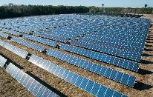
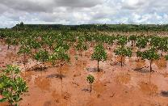
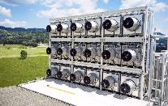
Types of carbon credits
Avoidance / Reduction
Removal / Sequestration
 | Avoided nature loss | Technology-based reduction | Nature-based sequestration | Technology-based removal
Description | Limit the loss of natural ecosystems (e.g. forests and peatlands) which currently sequester large amounts of carbon. | Reduce emissions from current sources, which do not have financial or regulator incentive to decarbonise. | Use nature to sequester more carbon in the atmosphere. | Remove CO2 through use of modern technologies, and store or use it through secure methods.
Examples | Avoided deforestation Avoided peatland and coastal degradation | Renewable energy Energy efficiency Fuel switching Waste management | Afforestation and reforestation Peat and coastal (mangrove) restoration | Direct Air Capture and Storage (DACCS) Bio-Energy with Carbon Capture and Storage (BECCS)
Current availability | High | High | Low | Very Low
Image sources: Global Engineering

Slide 6
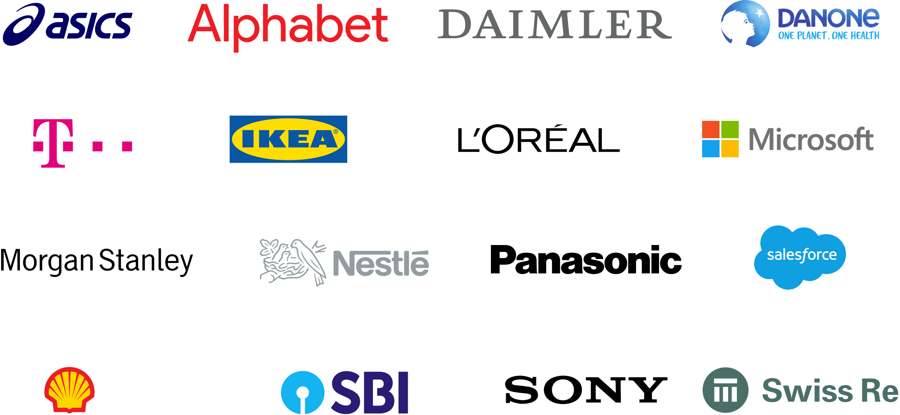
Voluntary carbon markets are growing
Commitments by 1800+ global corporate are driving demand for quality carbon credits
Voluntary Carbon Market 2004-2021
in MtCO₂
10x growth is expected by 2030
Voluntary market demand scenarios (GtCO₂e per year)
2050
< 7.0-13.0 Gt
2030
Up to 100x
~1.1 Gt
~ 10x
2020
0.1 Gt
36% of the S&P 500 buy carbon credits
Major sectors include tech companies, Oil & Gas, FMCG & consumer goods, airlines and increasingly FIs
Source: Ecosystem Marketplace, McKinsey/WEF, Capital Monitor, Shell/BCG

Slide 7
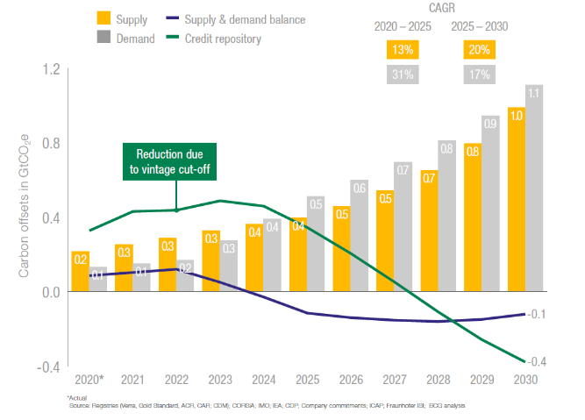
But the worldwide market is still tight for high-quality credits
Greater supply of affordable credits from high-quality projects is needed
Outlook of the voluntary carbon market
“Linked” scenario by BCG/Shell
1-1.3 Gt
Estimated demand by 2030
Sources: BCG/Shell, BNEF and Trove Research

Slide 8






Convergence of the compliance and voluntary carbon markets
Compliance Markets
Enable countries and companies to fulfil obligations under the Paris Accord
For countries, current obligations are driven through the Kyoto Protocol (e.g. Clean Development Mechanism)
For companies, obligations arise through emission trading schemes or national carbon taxes some that allow use of offsets.
Voluntary Markets
Function in parallel to compliance markets and do not fulfil a legal obligation.
Demand for voluntary carbon credits driven by growing voluntary climate action, pledges and stakeholder pressure.
Companies first reduce emissions as much as possible
Companies neutralize the non-abated remainder of their emissions by purchasing voluntary carbon credits
Example markets
Example standards
EU ETS
California ETS
Australia ETS
Korea ETS
Image sources: Global Engineering

Slide 9

Voluntary carbon credits and the Singapore carbon tax
TODAY
Voluntary Market
2024 ONWARDS
Compliance Market
Singapore Carbon Tax
Singapore recently announced a 5x increase in its carbon tax to
S$25/t in 2024
S$50 - 80/t by 2030
International carbon credits will be able to offset up to 5% of the taxable emissions.
Price of carbon tax
is lower than
Price of high-quality carbon credits
Price of carbon tax
is higher than
Price of high-quality carbon credits
After cutting GHG emissions, corporates choose to pay carbon taxes for unabated emissions. Any offsets procured are through the voluntary market.
After cutting GHG emissions, corporates offset up to X% of the unabated and taxable emissions via the compliance market.

Slide 10
How corporates should use voluntary carbon credits
To neutralise and compensate emissions on the path to Net-Zero
Emissions
1
Measure emissions and set a target to achieve ‘Net-Zero’ emissions on a science-aligned pathway (SBTi).
2
Take action to prevent and reduce emissions in your value chain (e.g. through new technology and improved business processes).
2020
2030
2040
2050
3
Use high-quality carbon credits to neutralise residual, hard-to-abate emissions (= Net-Zero)
4
THE HIGH AMBITION PATHWAY
Demonstrate leadership by using carbon credits to compensate for emissions on the pathway to ‘Net-Zero’
Corporates may face a number of concerns around quality and procurement of the right credits for their high-ambition needs

Slide 11
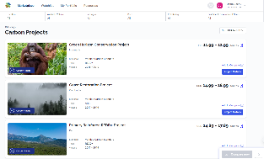
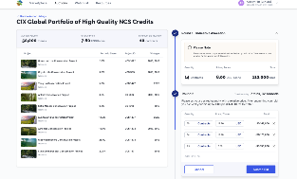
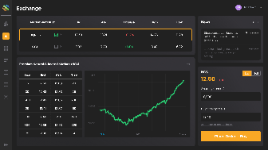
CIX is bringing several platforms to meet different buyer and supplier needs
We build trust in existing quality credits, bring new credit types to market and help scale the next wave of impactful solutions
Now Live!
Q3 2022
Auction in:
Project Marketplace
Browse, compare and buy carbon credits directly from a curated selection of risk-rated projects, with transparent data on SDG impacts and performance.
PRIMARY TARGETS
Corporates
Auctions
Discover the fair market value of newly-issued carbon credits through flexible auctions designed by CIX. Also ideal for sector-based portfolios and large government tenders.
PRIMARY TARGETS
Financial investors
Commodity traders
Corporates
Exchange
Trade high-quality standardised carbon credit contracts that are aligned with leading global standards, with transparent price signals and real-time market data.
PRIMARY TARGETS
Financial investors
Commodity traders
Register for our Q3 2022 auction here!

Slide 12


CIX Commitments to Trust
PRE-TRADE
BUYING, SELLING AND TRADING
POST-TRADE
Trust in
CIX Products
Trust in
CIX Execution
Trust in
CIX Product Use
Trust in
CIX Oversight
CIX curates a wide variety of carbon credits that meet high quality standards
CIX builds exchange-grade systems and operates easy-to-use platforms
CIX is building a community of high integrity buyers and suppliers that advocate for the responsible use of carbon credits
CIX works with an ecosystem of partners to provide transparent data on carbon project risk and performance
Additionality
Credible Baselines
Performance
Leakage
Community Impact
Price Discovery
Inventory Management
Market Risk
Counterparty Risk
Community
Double Counting
Risk Management

Slide 13
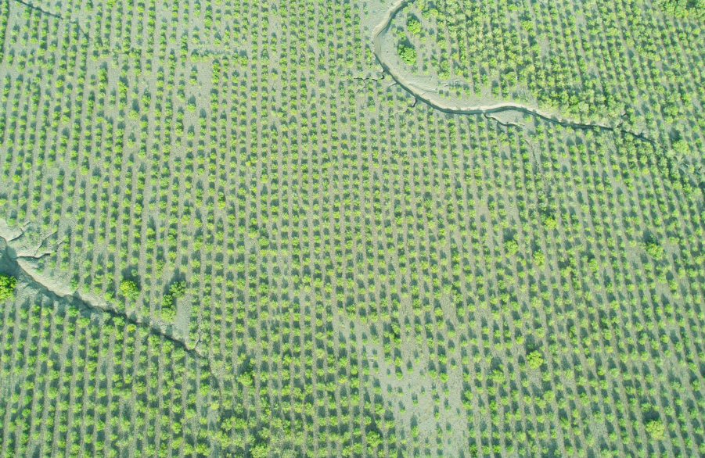
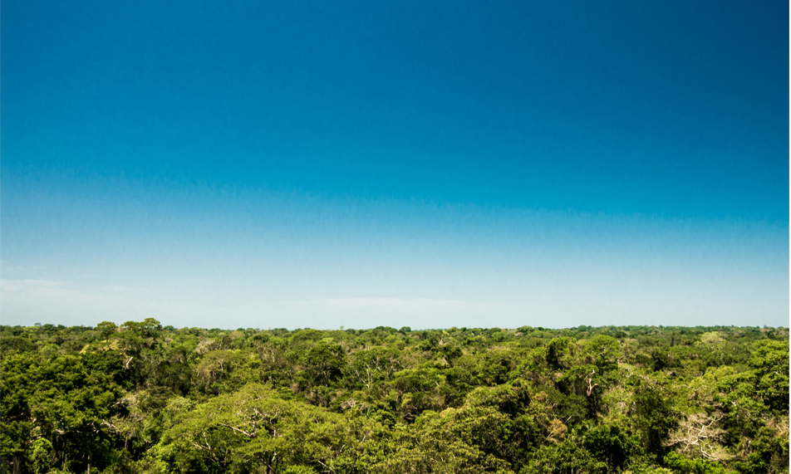
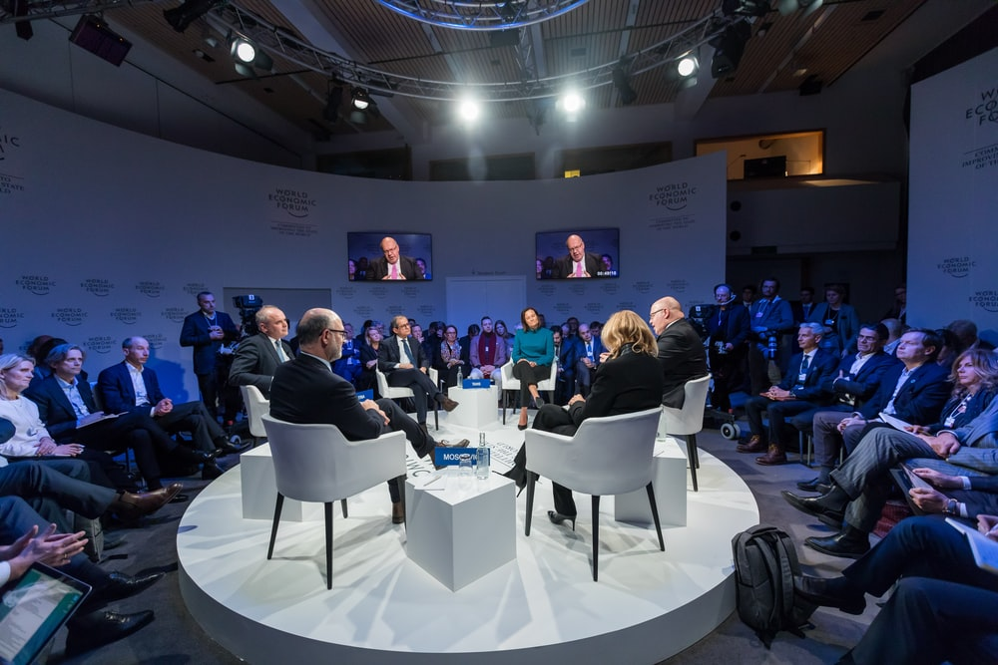

Be part of our CIX Community
Meet project developers
Events | Insights | Opinions
on the Voluntary Carbon Market
Delta Blue Carbon, Pakistan. Courtesy: Respira
Tambopata National Park, Peru. Courtesy: Ecoterria
Events and Networking
Scan to join our community

Slide 14
Thank you

Slide 15
Disclaimer
The information contained in this presentation is strictly confidential (“Confidential Information”) and is provided by Climate Impact X Pte. Ltd. (the “Company”) to you solely for general information purposes only. The information in this presentation is being provided to a limited number of persons who may be interested in any potential transaction, collaboration, and/or partnership involving the Company and/or the subject matter of this presentation (“Subject Matter”). Neither this presentation nor any part thereof may be (i) used or relied upon by any other party for any other purpose; or (ii) copied, duplicated or otherwise reproduced, redistributed or disseminated, directly or indirectly, in any form or by any means whether in Singapore or elsewhere to any other person.
In preparing this presentation, the Company and its Representatives may have relied upon and assumed, without independent verification, the accuracy and completeness of all information available from public sources and certain confidential information made available to the Company and its Representatives. The Confidential Information is provided as at the date of this presentation and is subject to change without notice, its accuracy is not guaranteed, has not been independently verified and it may not contain all material information concerning the Subject Matter. The Confidential Information is a summary only and does not purport to be exhaustive or contain all of the information that is relevant to the Subject Matter. This presentation does not take into account any specific investment or other objectives, financial situation or other particular needs of you or any particular person. Further, nothing in this presentation should be construed as constituting legal, business, regulatory or any other professional advice. Neither the Company nor any of its related corporations or any of their respective directors, officers, employees, consultants, advisors, agents or other representatives (collectively, “Representatives”) makes any representation or warranty, expressed or implied, with respect to the accuracy or completeness of any information contained herein and undertakes any duty to update such information.
The launch of Climate Impact X, and its joint operation by DBS, SGX, Standard Chartered and Temasek, is subject to all required regulatory approvals/consents being obtained. This presentation and its contents have not been reviewed by any regulatory authority and any definitive transaction, collaboration or other partnership involving the Subject Matter may be subject to regulatory approval and other conditions. You are entirely responsible for performing your own investigation, due diligence, review and evaluation of the Confidential Information, and in no event shall the Company or any of its Representatives have any liability whatsoever to you in connection with the Confidential Information, your use thereof, or otherwise in connection with this presentation.
The information set out in this presentation is not intended to form the basis of any contract. Nothing contained in this presentation shall compel or oblige you to enter into any discussions, negotiations or the transaction(s) contemplated by this presentation with the Company and nothing contained herein constitutes an offer or other invitation whatsoever by or on behalf of the Company. You further acknowledge and accept that the Company reserves the right, in its sole discretion, to suspend, modify or terminate at any time any discussions or negotiations with you.
To the maximum extent permitted by all applicable laws, regulations and rules, the Company and its Representatives shall not be liable for any damages or losses (whether direct or indirectly and including any special, incidental, consequential or other losses of any kind), in tort, contract or otherwise (including but not limited to loss of income or profits), arising out of or in connection with any acceptance of or reliance on this presentation or any part thereof by you.
This disclaimer extends to any statements, opinions or conclusions contained in, or any omissions from, this presentation or in respect of written or oral communications transmitted or otherwise made available to you.

