Slide 1
Trade, labour and Human Rights - at odds or reconcilable
Harpreet Kaur, PhD
Business and Human Rights Specialist
UNDP Asia-Pacific Regional Centre
harpreet.kaur@undp.org
Notes:
Cover Option 2

Slide 2
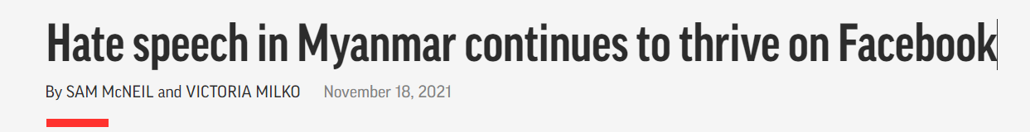
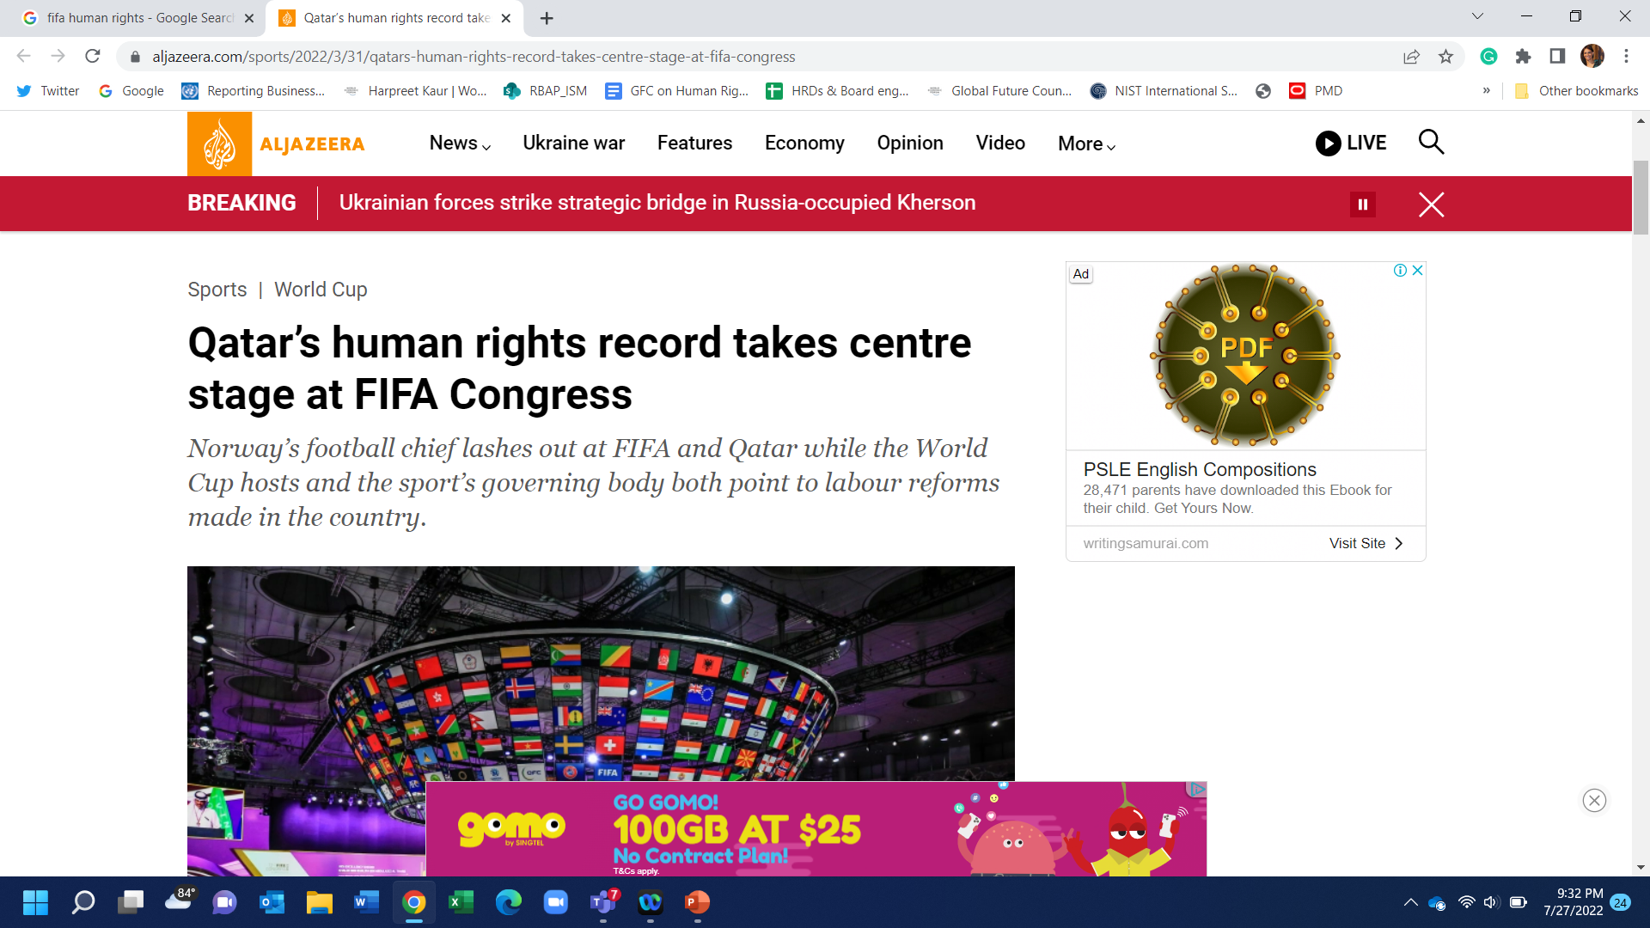
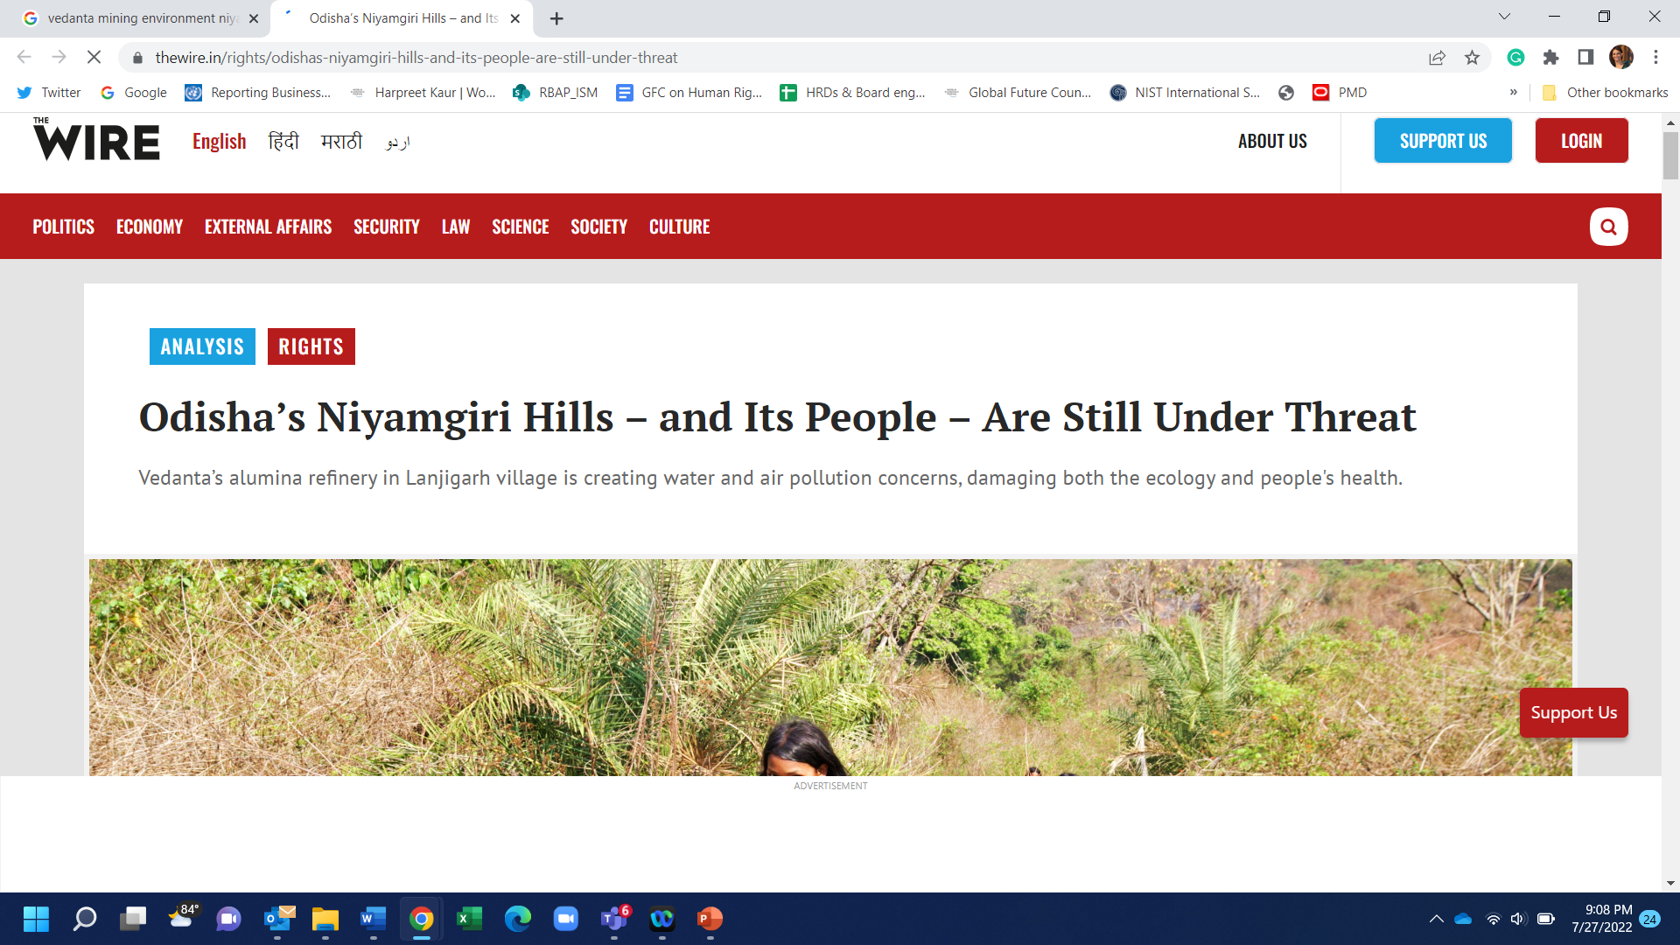
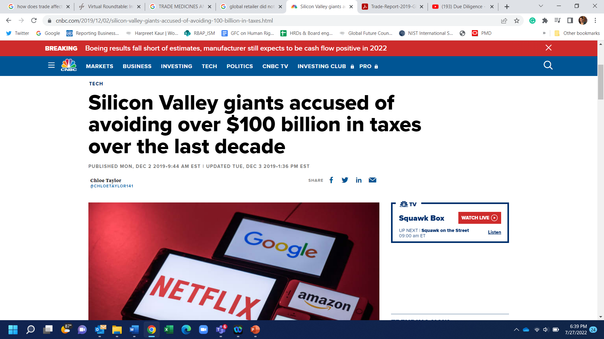
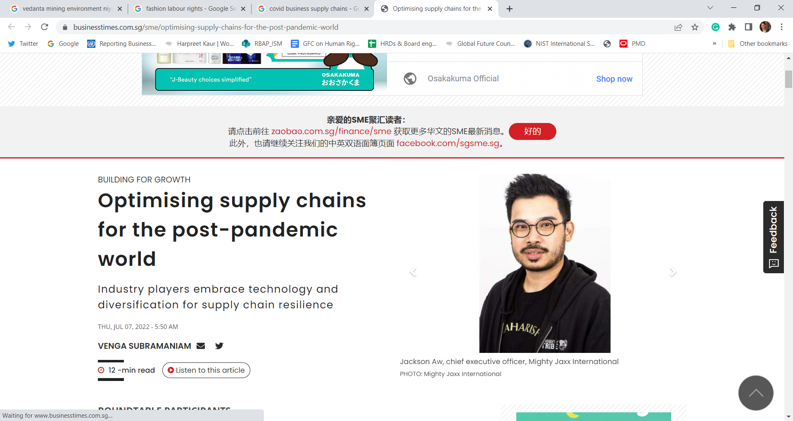
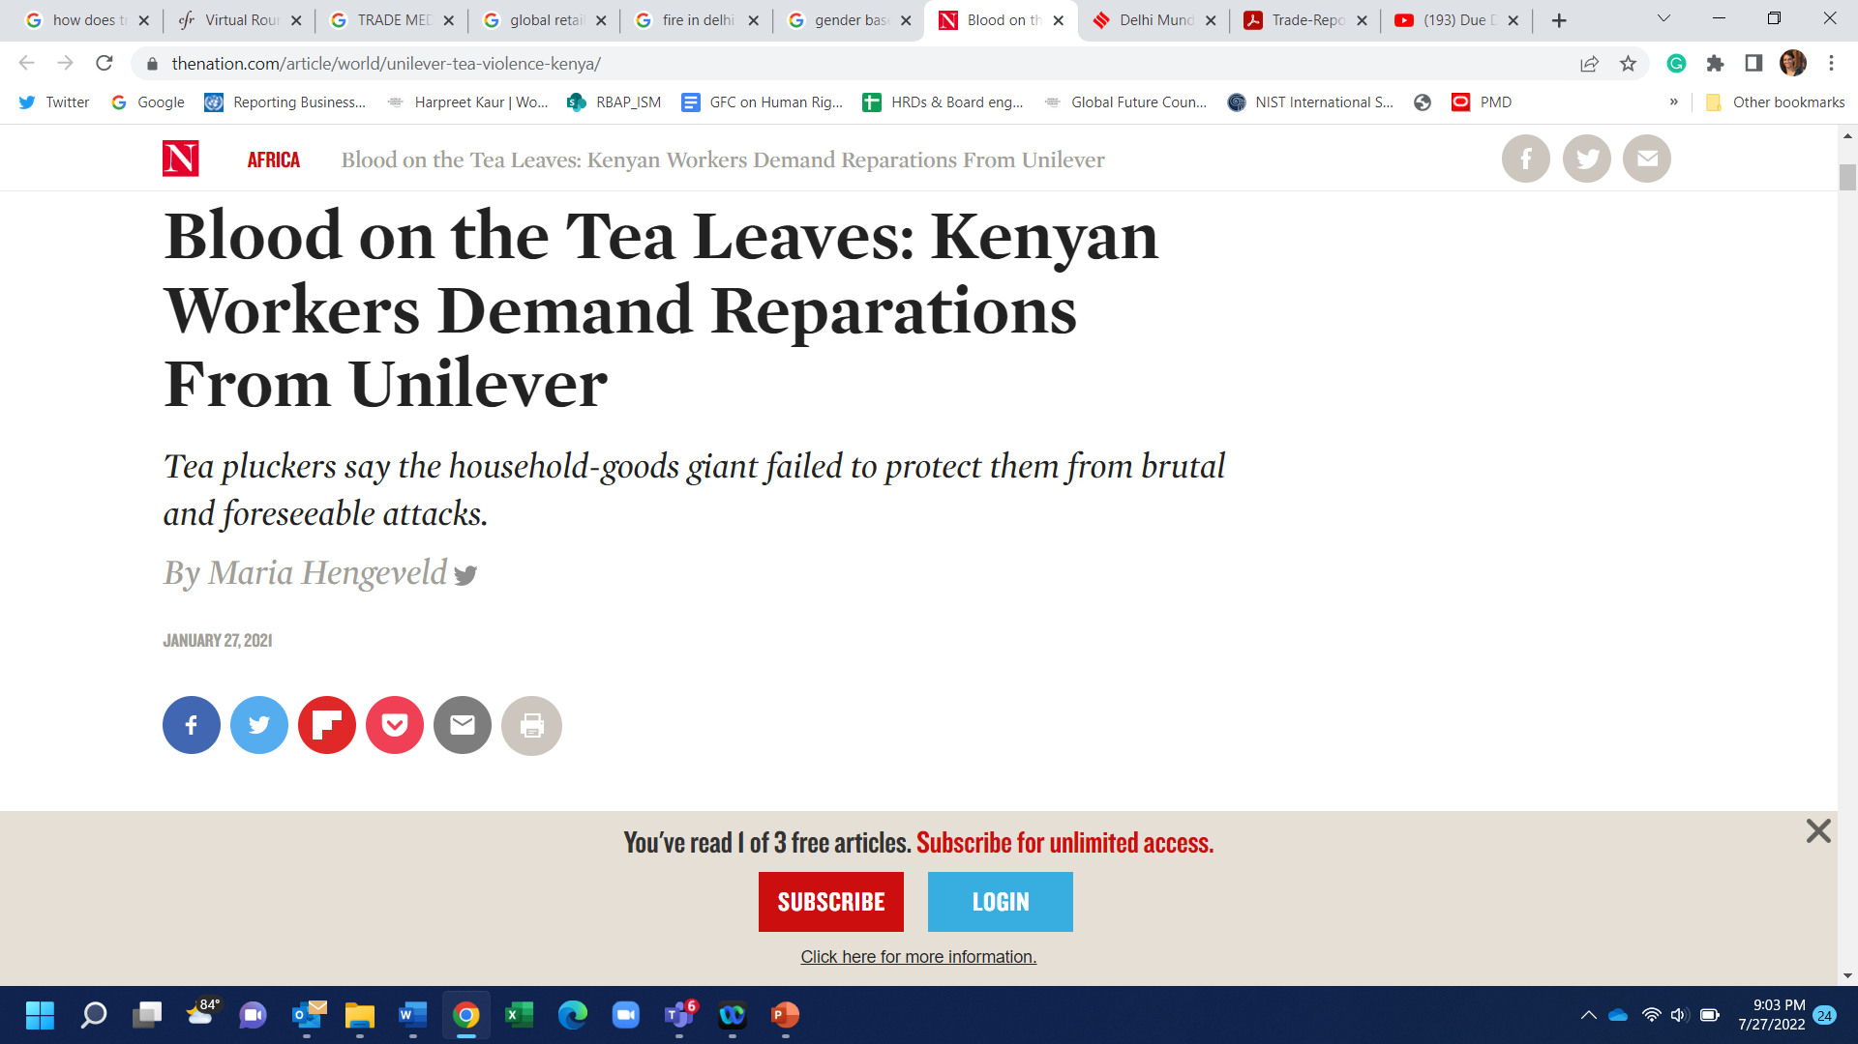
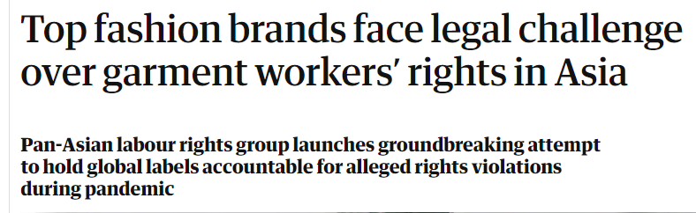
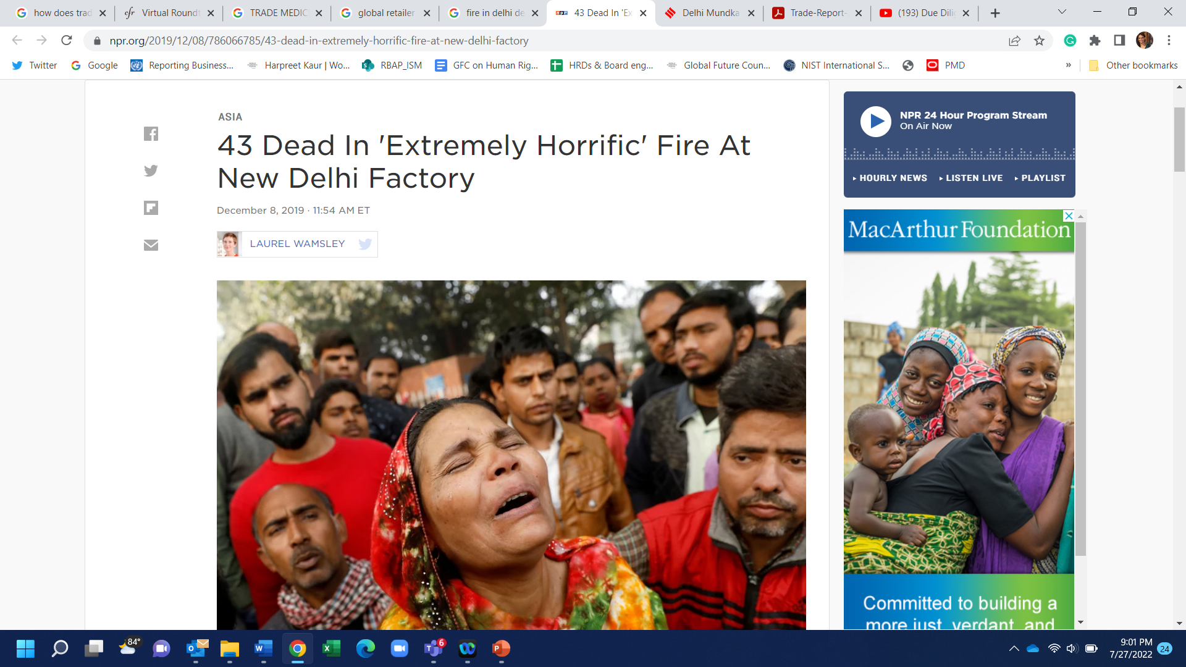
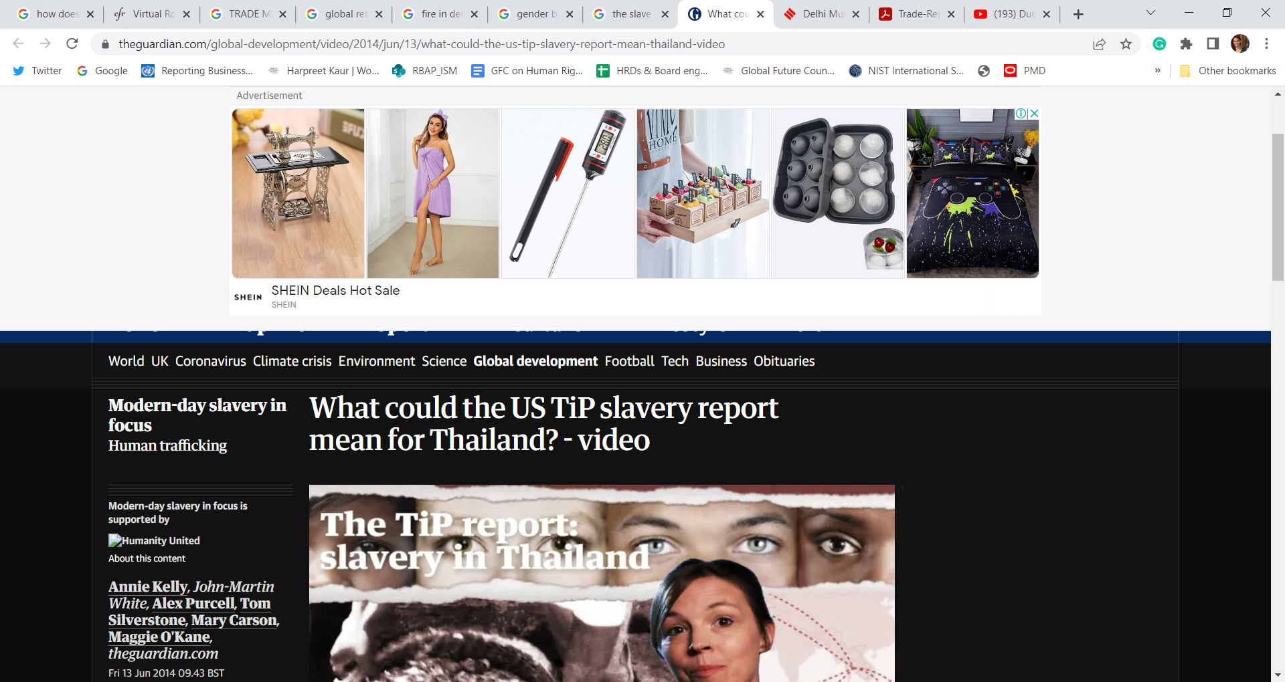

Slide 3

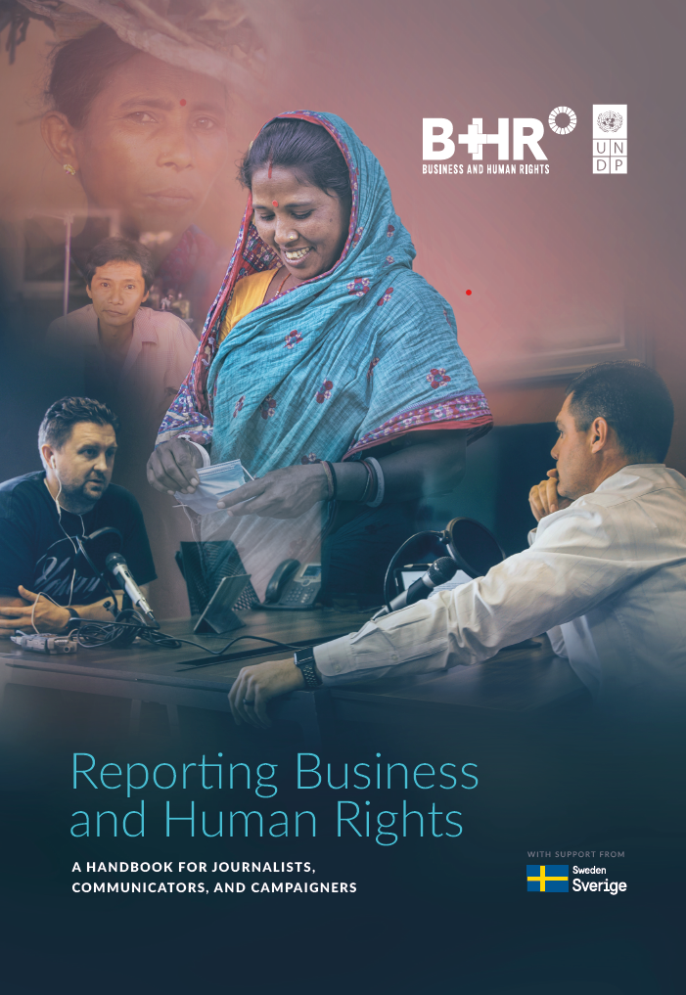
Understanding business and human rights, its themes and topic
Looks at the practicalities of reporting business and human rights stories: from finding ideas and spotting stories through to the process of research and carrying out interviews
Looks at how you can tell business and human rights stories, and ‘sell’ them to your audience and editors
Whilst some media law is discussed, it is as general introductory information only and should not be construed as or relied upon as legal advice
DOWNLOAD HERE: https://www.undp.org/publications/reporting-business-and-human-rights-handbook-journalists-communicators-and-campaigners

Slide 4
CONTENT
Trade and Human Rights - the contours of the relationship
Human Rights: Introduction
Corporate Accountability or Business and Human Rights
United Nations Guiding Principles on Business and Human Rights
Trade Agreements
CSR versus BHR

Slide 5
Trade and Human Rights
The contours of the relationship

Slide 6
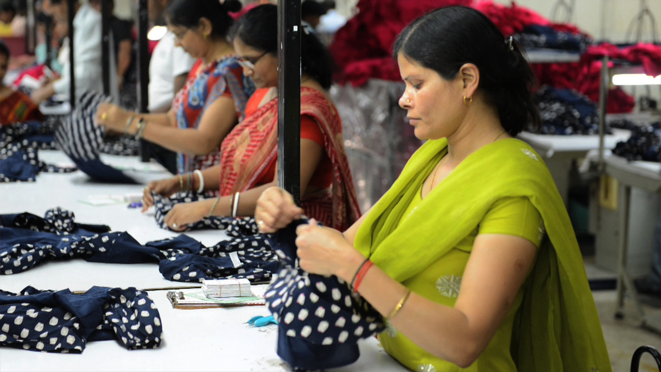
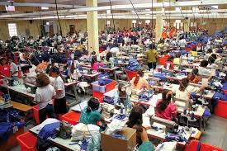
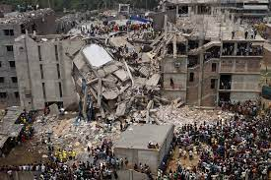
The story of Savar, Gazipur & Maquiladoras

Slide 7
TRADE IMPACT HUMAN RIGHTS
Positively:
Trade can result in higher GDPs thus overall growth and development
Trade can provide decent jobs and incomes for workers and their families;
Businesses supported through trade can support freedom of expression through information and communication technology
Companies can advance development by creating new roads and water supplies to poor communities;
Companies may support access to health by making new medicines available and accessible
Negatively:
Trade can promote weaker regulations, lower wages, weaker unions and inferior environmental standards
It may promote forced labour or child labour or gender inequality
It may disclose users’ personal data thereby violating their right to privacy.
They may displace communities from their lands without their consent;
Trade and investment treaties may promote the commercial interests of the multinational pharmaceutical industry over the needs of people in developing countries.

Slide 8
Unfair wages and abusive or excessive working hours
Workplace discrimination
Forced and bonded labour
Indigenous Peoples’ rights
Women’s rights
Disabled persons’ rights
Participation and consultation
Health and safety violations
Pollution and toxic or hazardous chemicals
Land use and property rights abuses
Inclusivity and participation issues
Community impacts
Privacy rights abuses
Gender-based discrimination
Sexual harassment
Product testing concerns
Advertisement, marketing and intellectual property
Unlawful or harmful use of product
Misuse of government authority
Misuse of private security forces
Youth and child labour
LGBTI rights
Notes:
Businesses can impact on all internationally recognized human rights

Slide 9





HUMAN RIGHTS
Inherent
Indivisible & Interdependent
Equality & Non-discrimination
Universal
Inalienable
Notes:
Human rights are rights we have simply because we exist as human beings - they are not granted by any state. The Universal Declaration of Human Rights (UDHR), adopted by the UN General Assembly in 1948, was the first legal document to set out the fundamental human rights to be universally protected. The UDHR, which 72 in 2021, continues to be the foundation of all international human rights law.
These universal rights are inherent to us all, regardless of nationality, sex, national or ethnic origin, color, religion, language, or any other status. They range from the most fundamental - the right to life - to those that make life worth living, such as the rights to food, education, work, health, and liberty.
Human rights are inalienable. They should not be taken away, except in specific situations and according to due process. For example, the right to liberty may be restricted if a person is found guilty of a crime by a court of law.
All human rights are indivisible and interdependent. This means that one set of rights cannot be enjoyed fully without the other. For example, making progress in civil and political rights makes it easier to exercise economic, social and cultural rights. Similarly, violating economic, social and cultural rights can negatively affect many other rights.
Article 1 of the UDHR states: "All human beings are born free and equal in dignity and rights." Freedom from discrimination, set out in Article 2, is what ensures this equality.
Non-discrimination cuts across all international human rights law. This principle is present in all major human rights treaties.

Slide 10
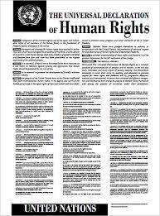

INTERNATIONAL BILL OF RIGHTS
The International Covenant for Civil and Political Rights
The International Covenant for Economic, Social and Cultural Rights
Notes:
While the Universal Declaration of Human Rights is considered the cornerstone of international human rights, these rights are codified in the International Covenant on Civil and Political Rights and the International Covenant on Economic, Social and Cultural Rights
Collectively, all three documents are known as the International Bill of Human Rights.

Slide 11
LABOUR RIGHTS
Labour rights are enshrined in the Declaration on Fundamental Principles and Rights at Work, which has four categories of principles and rights:
Freedom of association and the right to collective bargaining
The elimination of forced labour
The abolition of child labour
The elimination of discrimination in respect to employment and occupation
These rights are also covered in the International Labour Organization’s eight core conventions.

Slide 12
HUMAN RIGHTS & BUSINESS

Slide 13
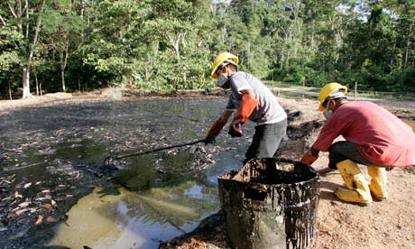
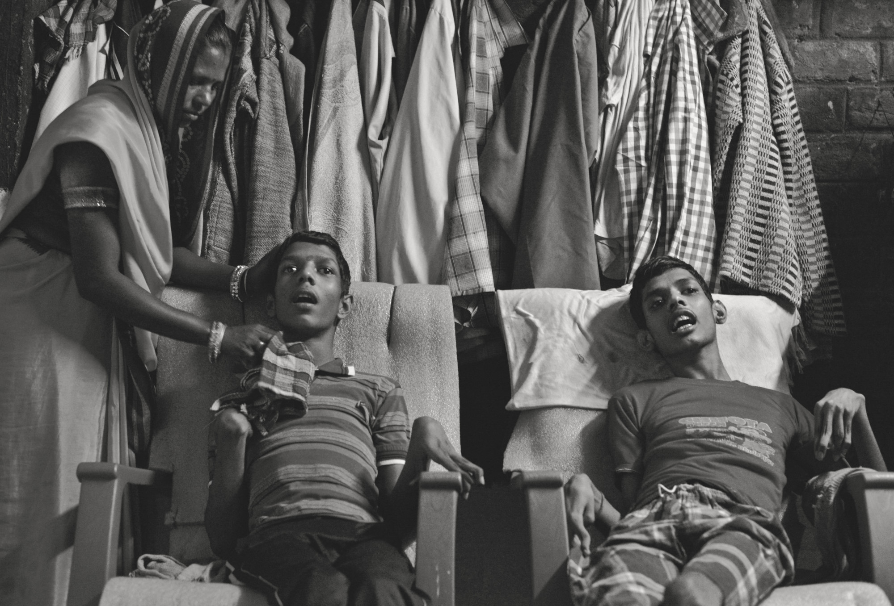
Business and Human Rights Issues
after the World War II
Expansion of transnational corporations.
Chevron (formerly Texaco): from 1964 to 1992, unleashed “toxic Chernobyl” by leaving over 600 unlined oil pits in the Amazon and dumping over 68 billion liters of toxic production water into rivers.
Between 1989 and 2002, eight union leaders from Coca-Cola bottling plants in Colombia killed after protesting the company's labour practices.
Bhopal disaster: On Dec. 3, 1984, a chemical leak from a Union Carbide pesticide plant in gassed thousands of people to death and left more than 150,000 disabled or dying.

Slide 14
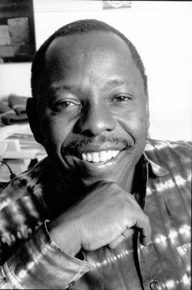

WATERSHED MOMENTS
‘Ogoni Nine’ were executed by a brutal military regime in Nigeria in response to their activism against oil extraction by Shell in Ogoniland. Most prominent was Ken Saro-Wiwa (10 October 1941 – 10 November 1995).
‘Sweatshop Labour’: Nike, Gap, Disney and other brands accused of using sweatshop labour.
On the Life and Legacy of Ken Saro Wiwa - The View from an Ally
https://voices.ihrb.org/episodes/on-the-life-and-legacy-of-ken-saro-wiwa-iii

Slide 15

WHY SHOULD/DO BUSINESS CARE
Operational risk: can lead to community grievances, project delays or cancellations, and a loss of licence to operate.
Legal risk: businesses may incur liabilities through long, drawn out, lawsuits, and are increasingly liable before domestic courts in European jurisdictions. Even when not found liable, this may eventually create a negative image…
Reputational risk: a company’s involvement in human rights violations is often accompanied by negative media coverage, which can lead to media boycotts, loss of brand value, and difficulty in attracting talent.

Slide 16





Game changers
Increased Awareness of need for Sustainable Business practices and Standards to achieve them
Peer Learning and healthy competition within and among subregions
Knowing and showing campaigns through Social Media and investigative journalism
Growing pressure from consumers and investors
New and upcoming requirements from Trade Partners
Notes:
Public concern over human rights abuses in global supply chains has increased drastically
Companies in multiple sectors are also concerned with impact of their operations on human rights

Slide 17
RESPONSE TO CORPORATE ABUSE
Sullivan Principles
OECD Guidelines for Multinational Enterprises
Initial codes of conduct of companies
Multi-stakeholder Initiatives: Kimberly process (certification of diamonds), Ethical Trading Initiative (labour practices, etc)
MacBride Principles
ILO Declaration on Multinational Enterprises
UN Global Compact
UN GUIDING PRINCIPLES ON BUSINESS AND HUMAN RIGHTS
Prof Ruggie appointed as UN Special Representative on Business and Human Rights
UN Code of Conduct for Transnational Corporations – abandoned
Rise of CSR: do-goodery, philanthropy, charity
EU corporate Sustainability Reporting Directive
1970s
1980s
1990s
2000
2005
2011
2022
Notes:
Public concern over human rights abuses in global supply chains has increased drastically
Companies in multiple sectors are also concerned with impact of their operations on human rights
The Sullivan and MacBride Principles are among the first voluntary guidelines focused on specific issues in specific territories: South Africa and apartheid, and Northern Ireland and religious tension.
Both described a role for business in addressing human rights abuses. These early efforts lead to the development of other standards by multilateral organizations.

Slide 18
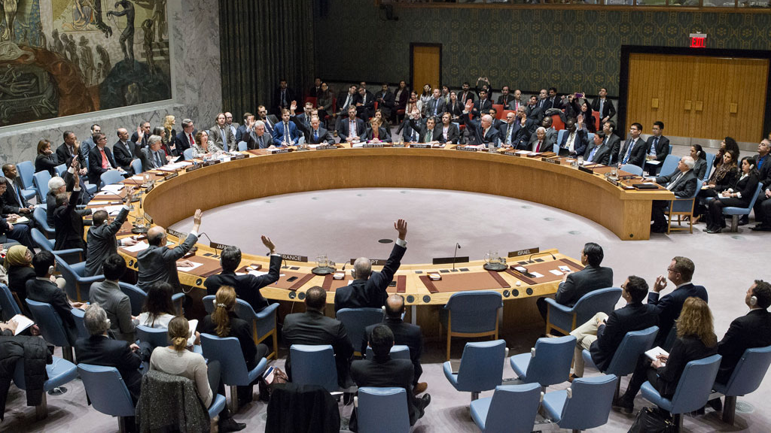
In 2011, the UN Human Rights Council unanimously adopted
the UN Guiding Principles on Business and Human Rights

Slide 19
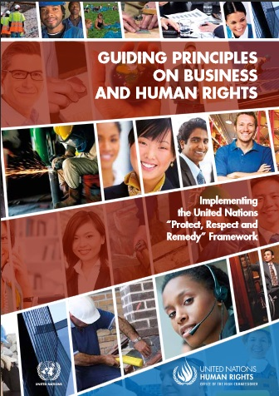
What is it made up of?
31 principles under 3 pillars AKA the “Protect, respect and remedy” Framework
What is its purpose?
Clarify the duties and responsibilities of States and businesses to protect and respect human rights in the context of business activities and ensure access to effective remediation for individuals and groups affected by the activities.
For whom was it written?
States
Businesses

Slide 20
WHAT HUMAN RIGHTS ARE PROTECTED
Universal Declaración of Human Rights (1948)
ILO Declaration on Fundamental Principles and Rights at Work(1998)
International Covenant on Civil and Political Rights (1966)
International Covenant on Economic, Social & Cultural Rights (1966)
Forced labour
Freedom of Association
Non-Discrimination
Child labour

Slide 21


UN GUIDING PRINCIPLES ON
BUSINESS AND HUMAN RIGHTS
https://www.youtube.com/watch?v=eQjIEA0xLCc

Slide 22
UN GUIDING PRINCIPLES ON BUSINESS AND HUMAN RIGHTS
1: STATE
2: BUSINESS
3: STATE &BIZ
PILLAR
PROTECT
RESPECT
REMEDY
NEED
ROLE
Protect against human rights abuses by actors, including business
Respect human rights throughout the value chain
Ensure access to remedies in the case of human rights abuses
ACTION
Policies
Legislation
Regulation
Developing corp. policy
Acting with due diligence
Addressing adverse impacts
Judicial remedies
Non-judicial remedies
UNGP: 1 - 10
UNGP: 11 - 24
UNGP: 25 - 31
Notes:
States have the legal obligation to respect, protect and fulfil the human rights set out in the international human rights conventions they ratify. The obligation of States to respect human rights means that they must refrain from interfering with or curtailing the enjoyment of human rights. Their obligation to protect human rights requires them to protect individuals and groups against human rights abuses by third parties, including by business enterprises. Their obligation to fulfil human rights means that States must take positive action to facilitate the enjoyment of basic human rights.
Businesses on the other hand, generally have no obligations under human rights treaties to respect or protect human rights. However, businesses, just like other non-State actors such as illegally armed groups, can affect the enjoyment of human rights.
Under the Pillar 2 of the UNGPs, businesses have a responsibility to respect human rights.

Slide 23
THE STATE DUTY TO PROTECT
1: STATE
2: BUSINESS
3: STATE &BIZ
PILLAR
PROTECT
RESPECT
REMEDY
NEED
ROLE
Protect against human rights abuses by actors, including business
Respect human rights throughout the value chain
Ensure access to remedies in the case of human rights abuses
ACTION
Policies
Legislation
Regulation
Developing corp. policy
Acting with due diligence
Addressing adverse impacts
Judicial remedies
Non-judicial remedies
UNGP: 1 - 10
UNGP: 11 - 24
UNGP: 25 - 31

Slide 24

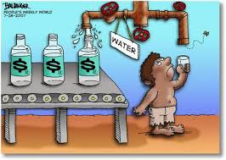
Contd…
State duty to protect is applicable within their territory/or jurisdiction: States should take appropriate steps to prevent, investigate, punish and redress abuses by corporations [Principle 1]
States should also set out expectations that companies “domiciled in their territory and/or jurisdiction respect human rights throughout their operations” [ Principle 2]
States should take additional steps to ensure that State-owned enterprises do not violate human rights [Principle 4]
State should exercise adequate oversight when they outsource or privatize services having a bearing on human rights [Principle 5]
States should maintain adequate domestic policy space to meet their human rights obligations when pursuing business-related policy objectives with other States or business enterprises, for instance through investment treaties or contracts [Principle 9]

Slide 25
Contd…
The UN Working Group on Business and Human Rights have consistently advocated creating innovative trade policies and bringing together trade and investment actors to set principles for creating trade and investment frameworks that support business respect for human rights and the environment.
Resulting in a new generation of domestic laws, such as the French Duty of Vigilance Law, the German Supply Chain Act and the latest EU Corporate Sustainability Due Diligence Directive – which seeks to hold corporations accountable if they abuse rights.

Slide 26
Trend towards mandatory due diligence legislation
From reporting legislation:
EU Non-Financial Reporting Directive
UK Modern Slavery Act
Australia Modern Slavery Act
California Supply Chain Transparency Act
To mandatory due diligence legislation:
France’s Duty of Vigilance Law (2017)
Netherlands’ Child Labour Due Diligence Law (2019)
EU Conflict Minerals Regulation (2017)
(Upcoming) EU mandatory human rights due diligence regulation
What does this mean?
Appropriate corporate governance arrangements
Robust I
nternal controls and reporting systems
Effective stakeholder engagement
Independent external assurance
KPIs
Disclosure on policies and processes
Non-financial disclosure
Risk management (for example through contractual obligations)
Allocation of resources
Notes:
Can someone from PSCI team help?

Slide 27
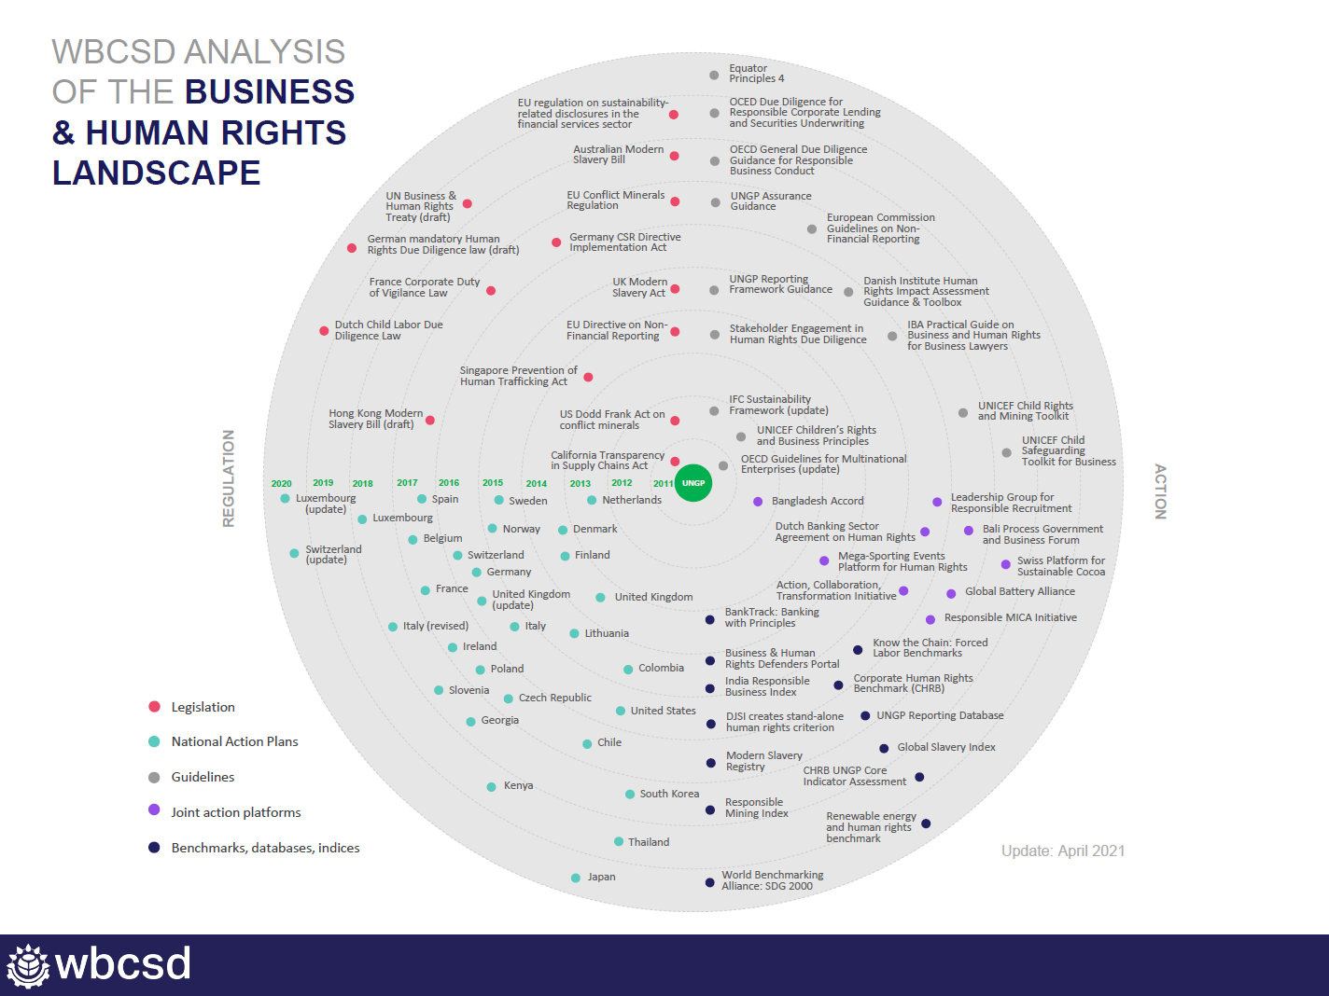

Slide 28
TRADE AGREEMENTS THAT SUPPORT MORE RESPONSIBLE BUSINESS
November 2021: The trade deal signed between Indonesia and the EFTA states (Iceland, Liechtenstein, Norway and Switzerland) on palm oil.
EU’s trade deal with Mercosur bloc, agreed in principle, yet to enter into force: to benefit tariff reductions, traders of chicken eggs will have to demonstrate their products meet animal welfare standards.
Morocco-Nigeria Bilateral Agreement – investors seeking to benefit from the Treaty to conduct a social impact assessment of their activities. In addition, Treaty includes a mechanism to hold investors under civil law, if their acts or decisions leads to damage.
US-Mexico-Canada Agreement (USMCA): Pact’s terms include a powerful company specific labour enforcement system, the Rapid Response Mechanism, whichhc can be harnessed by independent Unions in Mexicio to fight for worker’s rights – unique as it allows workers to organize.
Notes:
The deal offers low tariffs on iimportsof Indonesian palm oil but only on the condition hat importers can prove that their product meets sustainability criteria.; flawed model – RSPO, still better
Mercosure is brazil, Argentina, Uruguay and Paraguay
USMCA_ this is because the deal includes both legal innovations In labour rights enforcement alongside commitments to undertake structural domestic reforms creating new rights and institutions to guranette them

Slide 29

NATIONAL ACTION PLANS ON BUSINESS AND HUMAN RIGHTS
NATIONAL ACTION PLANS ON BUSINESS AND HUMAN RIGHTS
Definition of NAP
An evolving policy strategy to protect against adverse human rights impacts by business enterprises
The Process of NAPs
Coordinated and coherent government leadership
Multi-stakeholder and transparent consultation
A process of continuous monitoring of implementation
The Content of NAPs
Compatible with the UNGPs
Context specific based on baseline assessment
Smart mix of mandatory and voluntary measures
Working Group portal:
http://www.ohchr.org/EN/Issues/Business/Pages/NationalActionPlans.aspx

Slide 30
1: STATE
2: BUSINESS
3: STATE &BIZ
PILLAR
PROTECT
RESPECT
REMEDY
NEED
ROLE
Protect against human rights abuses by actors, including business
Respect human rights throughout the value chain
Ensure access to remedies in the case of human rights abuses
ACTION
Policies
Legislation
Regulation
Developing corp. policy
Acting with due diligence
Addressing adverse impacts
Judicial remedies
Non-judicial remedies
UNGP: 1 - 10
UNGP: 11 - 24
UNGP: 25 - 31

Slide 31

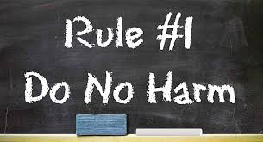
THE CORPORATE RESPONSBILITY TO RESPECT
Avoid infringing on human rights
Address adverse human rights impacts
+

Slide 32
EXPECTATIONS FROM BUSINESSES
Corporations may create human rights impact in different ways – they may cause, contribute to or be directly linked to such risks [Principle 13].
Businesses are expected to declare a Policy Commitment to respect human rights [Principle 15(a) → 16]
Businesses are expected to conduct Human Rights Due Diligence [Principle 15 (b) → 17-21]
Businesses are expected to put in place processes to enable Remediation of any adverse human rights impacts [Principle 15 (c ) →22]

Slide 33
HUMAN RIGHTS DUE DILIGENCE PROCESS
Policy commitment to Human Rights
Identifying and Assessing Impacts
STAKEHOLDER ENGAGEMENT
AND
ACCESS TO REMEDY
Communicating and Reporting
Integration and acting upon Findings
Tracking and Monitoring
Process of Continuous Improvement

Slide 34
HRDD: POINTS TO REMEMBER
The target of HRDD should be risks to the rights-holders (rather than businesses).
HRDD is an ongoing process.
Both actual and potential impacts should be considered.
Due diligence needs to include listening to the most vulnerable groups across the entire value chain – especially groups such as workers in suppliers and contractors.
Should cover adverse human rights impacts that the business may cause or contribute to through its own activities, or those that can be linked to its business relationships.
The nature and extent of HRDD will vary as per the size, sector and operating context of the corporation. There are some issues in human rights that are more likely to be infringed depending on the industry and local situation where operations are located.
Businesses conducting due diligence should prioritize areas where the risk of adverse human rights impacts is the largest.
Notes:
Conduct HRDD, develop a Human Rights Policy and, provide Remedy to victims of abuses where required

Slide 35
1: STATE
2: BUSINESS
3: STATE &BIZ
PILLAR
PROTECT
RESPECT
REMEDY
NEED
ROLE
Protect against human rights abuses by actors, including business
Respect human rights throughout the value chain
Ensure access to remedies in the case of human rights abuses
ACTION
Policies
Legislation
Regulation
Developing corp. policy
Acting with due diligence
Addressing adverse impacts
Judicial remedies
Non-judicial remedies
UNGP: 1 - 10
UNGP: 11 - 24
UNGP: 25 - 31

Slide 36
ACCESS TO EFFECTIVE REMEDY
State-based judicial mechanism [Principle 26]
State-based non-judicial mechanism [Principle 27]
Non State-based grievance mechanism [Principle 28-31]
Rights without effective remedies do not mean much in practice.
As part of their duty to protect against business related human rights abuse, States must take appropriate steps to ensure , through judicial, administrative, legislative or other appropriate means, that when such abuses occur within their territory and/or jurisdiction, those affected have access to effective remedy”, [Principle 25].
Also companies should establish or participate in effective operational level grievance mechanisms to address adverse impacts [Principle 29].
Industry groups should also establish grievance mechanisms. Grievance mechanisms must be 1) legitimate; 2) accessible; 3) predictable; 4) equitable and; 5) transparent
RIGHT HOLDERS SHOULD BE CENTRAL TO REMEDY

Slide 37
CSR v/s BHR
Corporate Social Responsibility | Business and Human Rights
CSR is based on voluntarism and expectations of responsibilities arising from the role of corporations as members of society. | BHR is grounded in a core set of human rights norms.
CSR is based on self-guided decision-making and voluntary measures rather than state sponsored regulation. | BHR is focused more narrowly on holding corporations accountable for harms caused or contributed to by their own activities, or directly linked to its operations, products or services by its business relationships.
CSR is sometimes referred to as “charity” or “corporate philanthropy.” | BHR emphasizes the role of the State, but also the independent and complementary role of business.
CSR may consider social justice issues but without a human rights lens. | BHR focuses on access to remedy for victims of human rights abuses linked to business conduct.

Slide 38
An infection has broken out in a neighboring country. The factory manager raises voluntary contributions among staff to provide food and PPE.
The infection crossed borders. Cramped dormitories for migrant workers may help spread the virus. The factory builds temporary housing facilities.
Children from a community near the factory are not being educated. With other companies, the factory decides to help build a school for the children.
Children who swim in the local waterway get sick from the factory’s smoke/discharge. The factory provides free medical access and facilities to the children and their parents.
Vacancies are advertised in a language to favor one ethnic group. After newspapers report, the company advertises in local ethnic and other languages.

Slide 39

Sustainable Development Goals and
United Nations Guiding Principles

Slide 40
SDGs & UNGPs
Sustainable Development Agenda (Agenda 2030)Means of implementation and the Global Partnership, paragraph 67, the outcome-document states:
"Private business activity, investment and innovation are major drivers of productivity, inclusive economic growth and job creation. We acknowledge the diversity of the private sector, ranging from micro-enterprises to cooperatives to multinationals. We call upon all businesses to apply their creativity and innovation to solving sustainable development challenges. We will foster a dynamic and well functioning business sector, while protecting labour rights and environmental and health standards in accordance with relevant international standards and agreements and other ongoing initiatives in this regard, such as the Guiding Principles on Business and Human Rights17 and the labour standards of the International Labour Organization, the Convention on the Rights of the Child 18 and key multilateral environmental agreements, for parties to those agreements”.

Slide 41




When business conduct robust environmental impact assessments and monitor their operations and supply chains for violations of environmental laws, they substantially reduce the number of deaths and illnesses from hazardous chemicals and air, water and soil pollution and contamination (SDG 3.9).
Business can develop and enforce anti-discrimination policies in furtherance of gender equality (SDG 5.1), while ensuring women’s full and effective participation in economic life through empowerment programmes (SDG 5.5).
When business provide for living wages they promote sustained, inclusive and sustainable economic growth for all (SDG 8.5), thought he impact may be the greatest for the poorest.
By investing more in monitoring, auditing, and complaints systems throughout their supply chains, businesses can contribute to ending forced labour in all forms (SDG 8.7).
Private sector respect for human rights and the use of due diligence processes to measure adverse impacts ensure that fundamental freedoms are safeguarded for all (SDG 16.10).

Slide 42
Name: Dr Harpreet Kaur
Position: Business and Human Rights Specialist, UNDP Asia Pacific
Email: Harpreet.kaur@undp.org
Twitter: @hkaur0304
Notes:
Back slide

