Slide 1

Trauma reporting
Haven Orecchio-Egresitz
Notes:
Hi everyone.
I’m Haven Orecchio and I’m Insider’s senior criminal justice reporter.
I’ve been asked today to speak a bit about trauma reporting, and in my work covering policing, crime, courts, and cults I report on a lot of trauma.
Throughout my career, a good chunk of my job has been knocking on people’s front door, or calling them up, and asking them to tell me about the absolute worst day, week, or months of their lives, in vivid detail.
And there’s a real balance there, right? Presumably, none of us do these kinds of interviews simply to exploit someone’s trauma for our own benefit, but rather because these are people who have a unique perspective that is just impossible to ignore when doing a comprehensive piece on a certain topic. They represent the WHO when were trying to get people to care about some massive systemic injustice or broken system.
And so when it comes to telling stories about these big picture atrocities - war, police misconduct, sexual abuse in holywood, whatever, it’s invaluable to hinge them on the experiences of real people.
As I’m sure you have all found in your own work, for people to feel moved enough on an issue to take a stance or to feel passion, it’s almost essential that the get to know some of the people who have been harmed.
And it’s our job, as reporters, to introduce them.
So I guess I’ll talk a bit about some things I’ve found helpful when trying to find and interview those who’ve gone through terrible tragedy, and to do it in a way where we can walk away without feeling sort of icky about it.
AND PLEASE just raise your hand with questions throughout this. It’s super informal and conversational. This slideshow is not all-encompassing, of course, so I’m happy to address things on the fly as well.

Slide 2
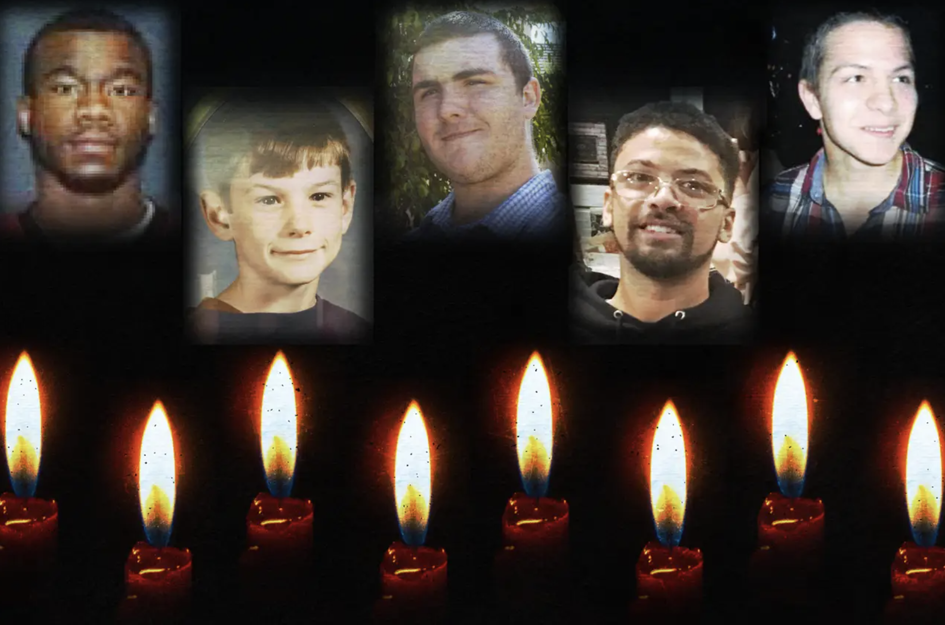
Survivor’s Guilt:
Moms Called 911 to Get Help for Their Kids.
Police Killed Them.
Notes:
Today I’m going to focus on a series that I started working on in the summer of 2020, when it seemed like the whole world began paying attention to criminal justice reform efforts and police shootings - topics that I’ve covered pretty much my whole career, with an underwhelming amount of interest from readers.
This elevated interest from the public, of course, was in response, in part, to the killings of George Floyd and Breonna Taylor.
There was a stretch of weeks around that time, when I was really focused on looking into police shooting news and records from around the US, and I was especially interested in getting in touch with the civilians who called 911 and brought the officers to the scenes in the first place.
I knew that there was likely a lot of regret around making the phone calls, and unlike police who usually have trauma care available to them after these shootings, these civilians don’t. So I was generally interested in hearing not only why the people made those calls, but how their lives have changed after the fact.
In doing research, though, I realized that many of the callers weren’t just store clerks - like in George Floyd, for example - but actually it was moms, and brothers, and grandmas who ended up summoning their loved one’s killers. And obviously in those cases, any guilt around the call was increased 100-fold.
In the end, I ended up profiling moms around the country- from really diverse socio-economic, racial, and political backgrounds - who all lived through remarkably similar trauma and aftermath.
Their sons had long-lived with psychological diagnoses - schizophrenia in a lot of cases - and they just wanted to get them into treatment.
In most places, the way to get your adult child committed to treatment if they are over 18 and unwilling to cooperate is to have law enforcement, and later a judge, deem them a danger to themselves or the community. To do that, families tend to call 911 when their loved one is in crisis.
Many of these moms didn’t really fear their child when they placed the call, but they thought it was their only available pathway to treatment. They were exhausted and scared for their sons’ safety. They just needed help.
But none of them ever made it to treatment, because when police showed up, and the person was in crisis and therefore unable to comply with commands, they were killed.
The moms, years or decades later, are still reeling with grief and guilt, and many of them were unable to really rebuild their lives.
I used these individual stories of the moms give people a way into a bigger issue - a broken mental healthcare system in the US.
I wrote a main bar, explaining the system, it’s gaps, and what ends up happening- this is where a lot of my experts were featured and some law enforcement. And also published five profiles on the moms, with details about their lives before, during, and after they made the calls.
People really want a black and white story - a victim and a villian, and there are plenty of police shootings where there might be both a victim and a villian.
But in my series, the behavioral healthcare system was really the the villain.
And so it was more about all of the roadblocks these women faced BEFORE 911 was ever called - and the actions of police just demonstrated how badly people suffer when all those other steps fail to get people the help they need fail along the way.
I also tried to include a solutions journalism element, by talking to experts, psychologists, and others who are working to fix the issues that lead to these deaths. That was in the main bar, as well as some of the profiles.
The series ultimately won the NY Press Club award in National Crime reporting, but more importantly, it got a lot of attention on a broken-systems story, which I’ve always personally sort of struggled to get eyes on.
So now that I’ve talked at length about the series, I’ll just talk about one of the moms I profiled and explain my steps to getting the series done – also again feel free to jump in with questions or comments whenever.

Slide 3
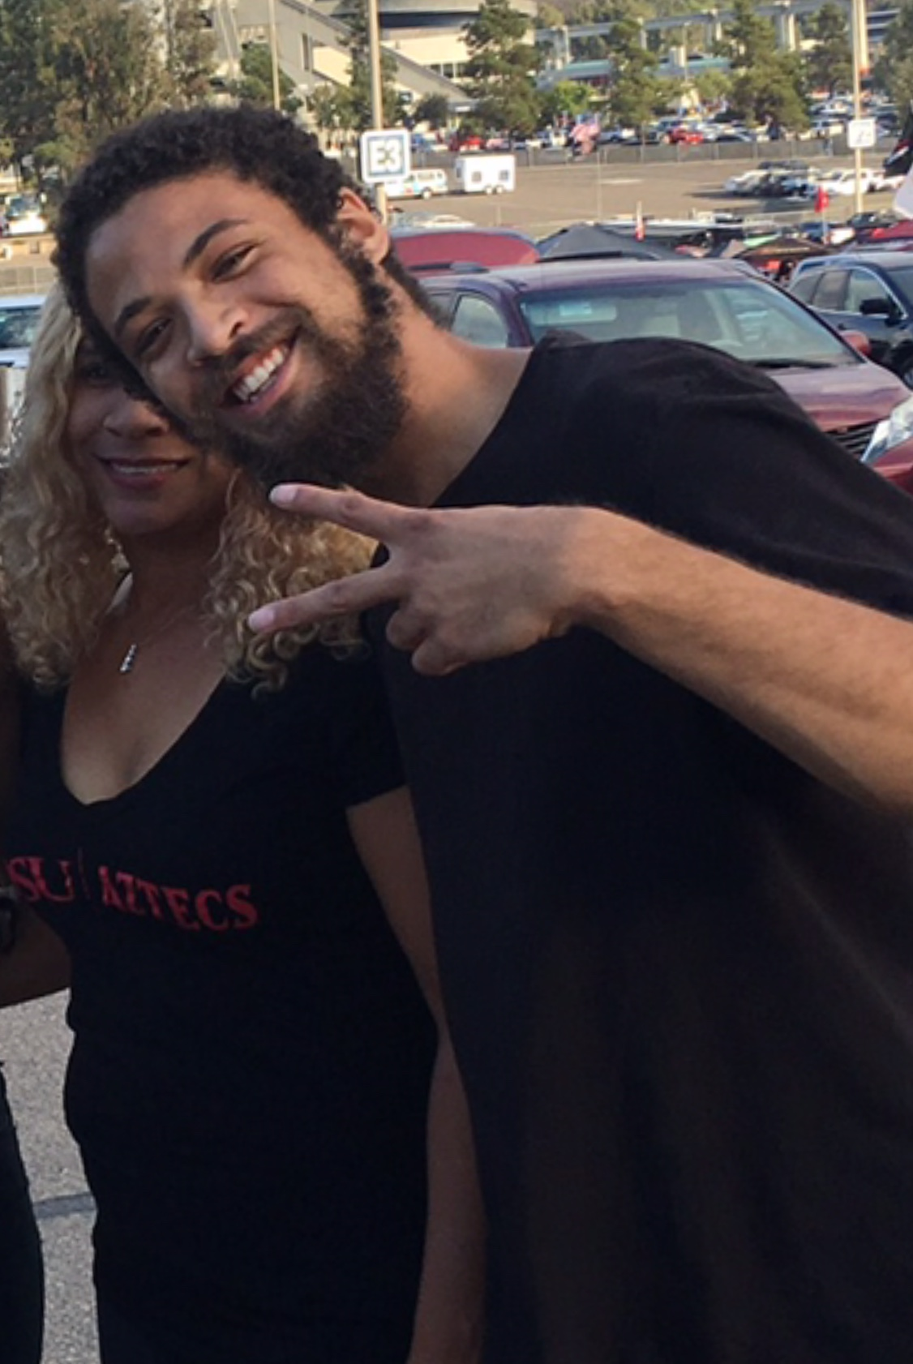
Taun Hall took steps to prevent her son’s killing. It still happened.
Taun Hall was raising a tall, Black son with schizophrenia in a wealthy, white neighborhood.
She long-feared what could happen to her son Miles if he went into crisis and encountered police.
She took classes with NAMI and was frequently in contact with the police department’s mental-health officer - hoping to prevent the kind of tragedy she feared.
Still, during an episode of psychosis, police responded to the Halls’ neighborhood and shot Miles dead.
The mental health officer was on scene, but it was too late.
Notes:
I’m going to talk about the Hall family. I don’t want to say that this is my favorite of the profiles, but to me it was definitely the most powerful. Taun Hall was raising her two kids in a a sort-of upper class neighborhood. The parents are educated and pretty wealthy, and their neighbors were too. When her son Miles started showing signs of mental illness in high school, she immediately began imagining the worst case scenario - if police showed up to her bougie, predominantly white neighborhood and saw her tall, Black son running around yelling in a way they might have perceived as a threat. She worried he’d end up dead. So to sort of get ahead of this, she started talking to experts - she took a workshop with NAMI, the national Association of Mental Illness, on how to adapt to parenting a child who goes though episodes of psychosis. The trainer actually recommended she reach out to the local police department and get to know the officers. So she did. She was put in touch with a woman who worked as the mental health officer for the department and they got to know each other. As his diagnosis was made - it was schizoaffective disorder - she learned more tactics to work with him and she stayed in touch with the department. It was really difficult for her, as it is for a lot of parents in this situation. There were periods where Miles was on a good medication and he was working towards his goals and then there were other times where he was not doing well.
After he graduated high school, his symptoms got worse. He was ranting a lot. There were times where he believed he was jesus and became quite obsessive about gardening.
Around this time, he started knocking on neighbors doors and this REALLY worried Tuan, right. She was really afraid of how a negative interaction with a neighbor could end.
So she called her source again at the department, told her what she was worried and was told that he wasn’t committing a crime so they really couldn’t do anything.
In California at the time, to get her adult son involuntarily committed, a pathway was through having police come three times to make reports showing he’s a danger to himself or others. Those reports can then be presented to a judge and a judge could rule to commit him against his will.
Taun successfully got him into a shorter treatment on one instance, for example, because he went into a neighbors pool and had a knife on him. He wasn’t using it or waving, but Taun used that as an example of how he was dangerous and somehow that worked to get him briefly hospitalized at least and it also counted toward one of the three strikes.
So about three months after that episode, though, police charged him for the incident— which Taun didnt think would happen, obviously. It threw Hall into a spiral. He was convinced he was going to jail. And his symptoms were at their worst.
Taun called police again to let them know he’s in full-blown psychosis and they said officers were aware. THE NEXT DAY, he has an episode and was experiencing delusions and used a gardening tool to smash a glass door at the family home - something he’d never done before. The family called 911 to report it. This was the third strike and likely would have led to commitment.
Unfortunately, the mental health officer was not the first on scene. Three other officers showed up and were yelling commands at Miles when he was in the street. He didn’t comply and was going toward the officers, his mom thinks to try and get around them, but two officers opened fire and he was shot and killed in the street. His mom was there.
The mental health officer never fired, and Taun thinks that if they waited to engage with him until she arrived, he might still be alive.
After the shooting, that officer told her - this is a quote -
"She said, 'Your family did everything right. You were trying to get him help, and you guys did everything right,'" Hall told me. "Well, if we did everything right, how is our son dead?"
I was particularly moved by the Halls’ story because it showed that even if you do everything right, if a system is broken you are still at risk.

Slide 4







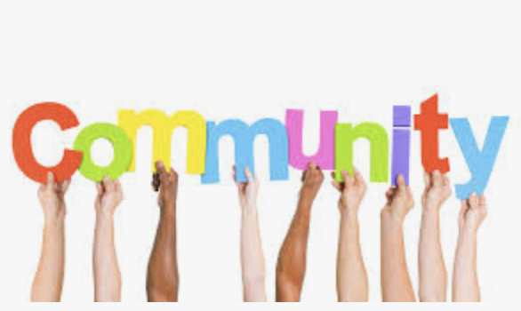


Where do I start?
Notes:
So now ill talk about how i go about finding people for this kind of work.
Whenever I start a project like this, that are about such a large national topic, but also pretty niche when it comes to sourcing, it feels a little overwhelming.
Like I have an idea, but now what? It means nothing unless you have the right voices.
So in these cases, my first calls are usually to advocacy and support groups, in this case in the area of police violence. Some of these were familiar sources on by beat, and some were just sort of cold calls to organizations or facebook and social media-based support groups around the country.
I simply called them up, introduced myself, explained my story idea, and asked if they had anyone in mind who fit in this group. Some of them didn’t, and said they’d keep an eye out, but others knew right away who I should speak to.
For the most part, the organizations weren’t really sure who called 911 in a lot of the cases, but they did know families of people who were killed while they were in crisis. It was a good starting place, and usually pretty easy to find out who placed the 911 call - either by talking to the family or reading local news stories about the incident.
Newspapers were my other starting point. I googled a bunch of variations of keywords to look up news stories around police killings, 911, mental health, crisis, etc. I wasn’t just looking for recent cases. This is obviously an issue that is talked a lot about now, but in decades past police weren’t under quite as close of a critical lens so I knew there were a lot of stories from years ago that had never come to light. And I really wanted to include those moms too, because I was genuinely interested in what lingering impact remained for these women all these years later.
So I made a list of maybe a few dozen possible families that I could start to speak to, linking the original stories about the killings in the document so I had something to look at if they picked up the phone.

Slide 5
Take a breath, and make the call.
Nothing beats a face-to-face.
Be authentic: Don’t overdo the sympathy.
Don’t overpromise.
Make it clear, it’s not a one-and-done interview.
Building trust takes time.
Notes:
Listen. In an ideal world, I would ONLY do these sort of difficult interviews of vulnerable people in person. Some of my best stories covering crime in local news were sitting with grieving mothers the day after their kid was killed and listening to stories from their childhood as they pulled out boxes of old photos for the memorial. Being able to include details about where in a sentence a mom choked up because she came across a photo of her son when he was seven and dressed like superman, is really powerful in storytelling and also just building trust with that source.
Standing in a backyard with a Wampanoag mom, as she picked up a handful of tobacco and threw it into a bonfire - a traditional ritual of mourning in her community - you can’t get that imagery, those smells even, in a phone call or Facebook message.
That being said, this particular series was done in peak-covid and we were still under a work travel ban - so I had to do all of the interviews by phone or zoom. It made it harder, but not impossible to build the trust you need to tell good stories.
–
It’s daunting to say the least to make first contact. There are a lot of unknowns. You might not get the right person on the phone. If you do, they might call you the scum of the earth - and you might feel like you are in that moment.
BUT I always remind myself that we’re doing something important. We’re trying to give people a voice. And in a lot of cases, people really want you to know who they are or who their loved one was— more than just that they were victim of some wrongdoing.
So if you’re authentic, and upfront with the project you’re trying to accomplish, people might welcome you with open arms right away. And you better have your notebook ready.
Other times, it’s not as easy. You’re asking people to talk about really difficult stuff, stories that affect them mentally and emotionally. So it could take time - maybe a few phone calls or coffee meetups - to make them feel comfortable opening up with you.
If and when they do agree, you want to be as transparent as possible about the process between the interview and the story being published. I like to tell them whether or not it’ll be a quick few-day turnaround or it it’s something coming out months from then, I also like to let them know I’m interviewing a ton of people, and every person’s story will be important to the main story on police shootings or trauma-etc, but not every individual story will be featured- so they don’t get their hopes up when the story publishes and they’re not mentioned - you dont want them to feel like you’re just another person who didn’t think they were important enough in the end..
There are a few things I personally don’t do, but everybody is different so you may decide you want to.
I don’t tell them that they might “feel better” to get the story out, because I have no idea they will- they might actually feel awful when they see it in print.
I don’t tell them their story could change a policy, because I really don’t know that and it most likely won’t, on its own, change anything.
BUT I do also like to tell them that when it comes to their experience as a survivor they are in control of that part of the story. I will get documents or interviews and police reports elsewhere, and report them, but they are free to tell me how much or how little they can about what they personally lived through.
Depending on the story, and their hesitancy to participate, I might let them know that they can go on background at different times to give me context that they might not want reported or maybe they can’t for SURE confirm, but believe is the case.. Then we’ll have conversations about that background information later - if it seems important to the story - to see there’s a way to get it on the record from them or someone else.
If there’s going to be a fact-checking process - which you know i hope there is, it might also be worth letting them know that, as well. They should know that you or someone else will likely be calling back about specific allegations and it’s not because you don’t believe them, it’s just because you need to make sure that there wasn’t a miscommunication somewhere and that you’re dedicated to accuracy.
And one last thing on this before I move on. Be cautious with your sympathy. You might sincerely feel terrible for your sources. Their story might actually move you to tears. But not all your sources want to feel like a victim - it could even make it harder for them to work with you.
Everyone is totally different how they approach this, and that’s good because authenticity is important ESPECIALLY to trauma victims, but I usually say something like, “I’m sorry to be asking you to speak about something so difficult.” or “i’m sorry you had to experience this” once or twice during the talk, at points when that’s what I’m thinking, but I try and limit it.
We’re not bullet proof either obviously. I have choked up in interviews - plenty of times - but i try my best to keep it discreet. It’s unavoidable. Maybe I’ll have a sip of water at that time, or I’ll ask the source if they’d like to take a break (only if they themselves seem pretty emotional at that time)
What I won’t ever do though is explain how I’m feeling to them, or worse let them know that their trauma somehow reminds me of something in my own life. I get that’s how people try and relate or connect to their source, but I really don’t ever want to be part of a story. I want to remain a witness and listener. And I don’t want them to feel responsible for my emotions in any way.

Slide 6
Know when to walk away
These are not public figures.
We’re asking a lot from them.
Be patiently persistent, when they seem like they have a story they want to tell.
Also try and gauge when it’s time to look elsewhere.
Notes:
Ultimately, I included five moms in my “survivor’s guilt” series. It was a lot less than the number of people I reached out to - but I like to cast a large net in these cases because I know I won’t hear back from everyone.
It was a mix of gentle persistence to get some moms to commit to the process, and also knowing when to cut the string on others who I could tell were wishy-washy about being involved.
When I need facts out of a public official or public figure, I’m aggressive and I push. I’ll leave repeated voicemails, visit their homes sometimes, call their grandma. Whatever. Especially if they’re the only gatekeeper to a story I need to tell.
But trauma victims are a different kind of source. We’re asking a lot of them to bear their soul to us, and the public.
So if you get the sense that someone is not game to go through the whole process with you, or that their memory of the events are so hazy that you can’t get an accurate picture (which is a totally normal reaction to trauma) you might need to make a decision, thank them for their time and walk-away.
That might be hard to do when you feel like you’ve gotten to know them already, but in the end you don’t want to publish something that you or they are going to regret if you can help it.
Don’t feel like it was a waste of time, because doing these hard interviews over and over just help you get better at them.

Slide 7
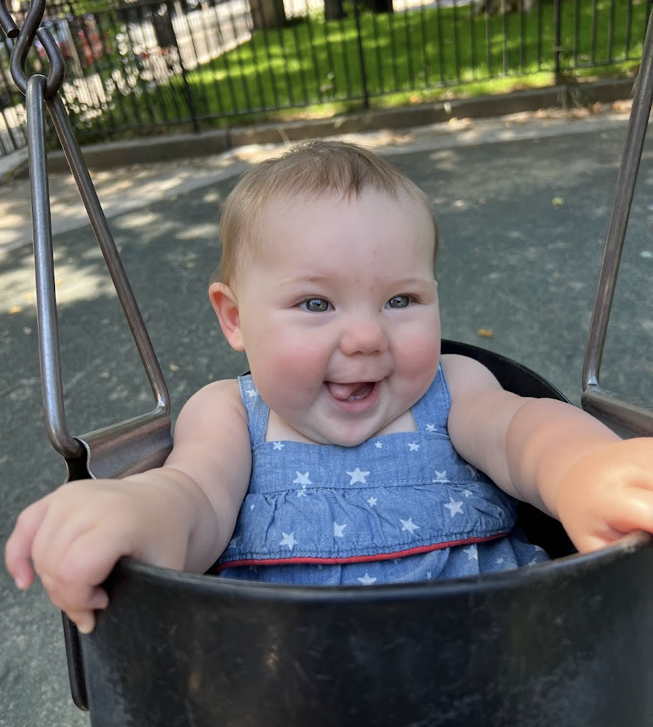
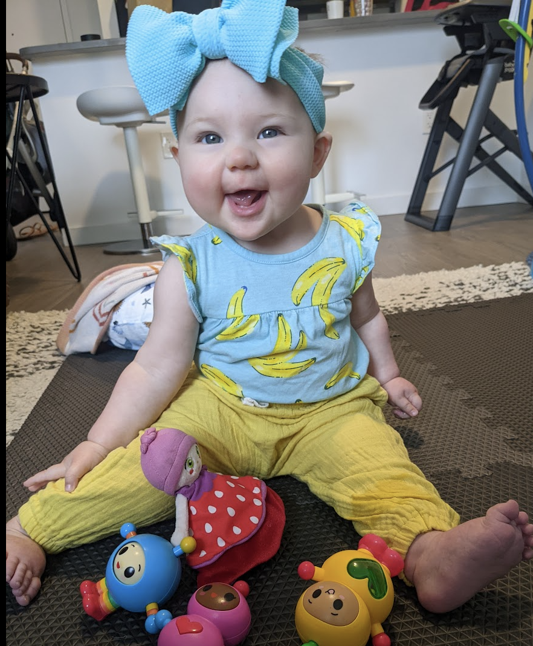
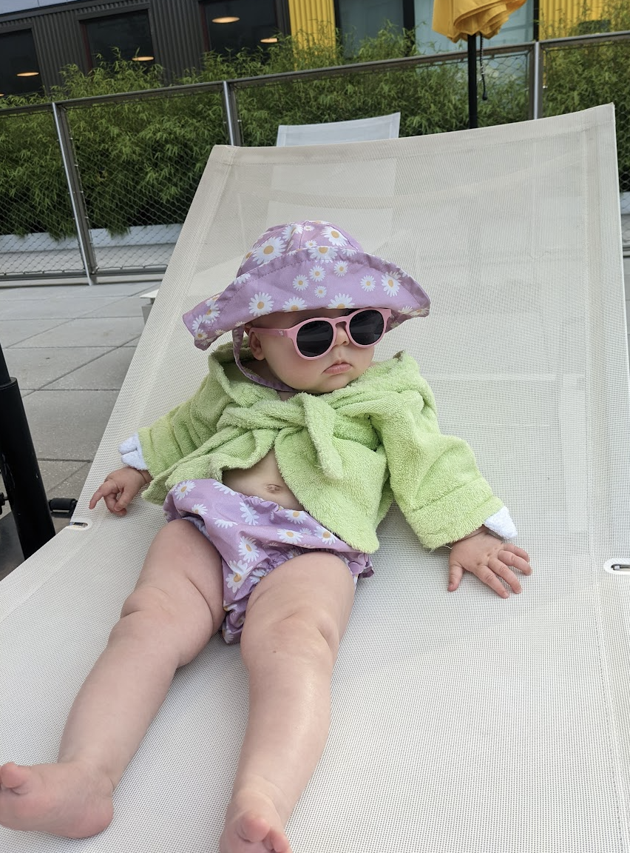
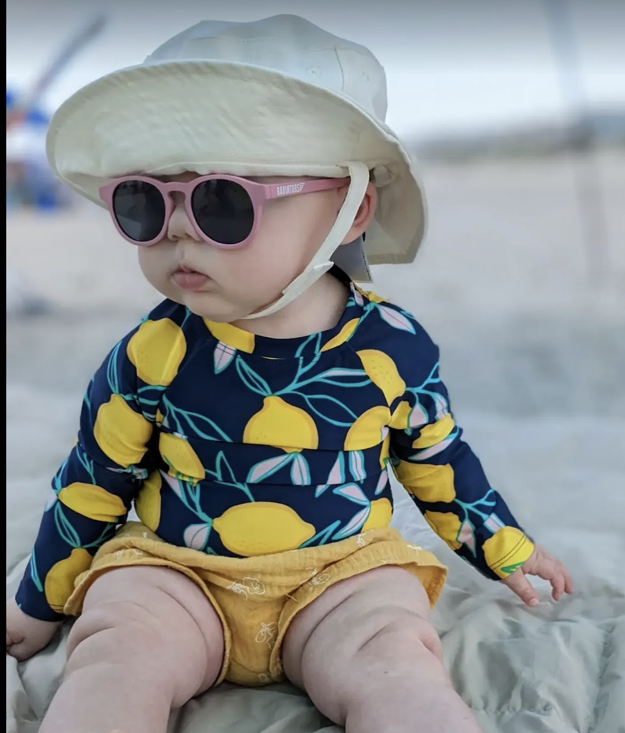
Take care of yourself
Our work can affect us.
Maybe not right in the moment, or tomorrow, but it may hit you out of nowhere.
Be aware of how you’re feeling and find moments to step away from the work and do something you enjoy.
Keep your editors in the loop.
Notes:
I’m probably not the best person to preach self-care, because it’s not something I’m super great at- but here are some photos of my daughter, Simone, who at 8-months-old is WAY better than I’ll ever be at living her best life.
I became a reporter in traditional legacy newspapers, and very much absorbed those “work hard, be tough” vibes - and still tend to go a really long time covering really rough stuff without stepping back and thinking “ok, how is this affecting my mood, my non-work relationships and behavior, and ultimately my journalism.”
I think being aware of how your work can impact you is important for not only your own wellbeing, but also for your journalism.you can become hardened and jaded in this industry, and when you do it might actually make it harder for you to identify good stories right in front of your face- because that started happening to me to be honest
I think it’s important if your work is really hurting you mentally or emotionally, to talk about it with your editors. See what can be done to readjust.
A good friend of mine (we actually became close friends from covering the Boston Marathon Bombing together) had a rough run of going from mass-shooting to mass-shooting scene over a few year period and was diagnosed with PTSD. She found in the end she could only continue as a journalist if she stepped away from crime reporting - which she loved and had always done - and did really well. I think the decision was a tough one, but she a healthy one.
For me, when the work I’m doing is especially heavy, I try to sneak in an afternoon walk in the park or go to a new spot in the city i haven’t been, or schedule a weekend outing that takes my mind of my work. We are wildlife conservancy members so we go to zoos and aquariums a lot,
But self-care looks different for everyone and can be as little as treating yourself to a fancy no-phone coffee break.
I personally don’t think scrolling social media is self-care in any way, but sometimes that’s all i have time for and at least im not reading homicide affadavits to i might do that too.
I’ve included some links and resources from other journalists that address this much better than me.

Slide 8
Resources
The DART Center
Guide to trauma-informed reporting
A list of self-care and mental health tips
Some more tips on things to avoid when interviewing vulnerable sources
A Poynter listicle on getting sources to open up
Notes:
So that’s the end of my slides on this particular series, but I’m happy to talk about anything else - I spent a bit of time on the ukrainian border early in the war covering the refugee crisis and that was more trauma reporting on the fly - so if anyone wants to talk about that feel free to reach out.
But outside of that, I put together some resources that go deeper on this topic.
Many of them are from The Dart Center out of Columbia, which specializes in trauma and reporting. They lead really helpful seminars, as well, which I recommend you all sign-up for if you can. Sometimes they host newsroom-wide or small group trainings, and I’ve participated in a few of them - that’s actually where a few of my practices came from – others I just developed through the work, as you all do too I’m sure.

Slide 9
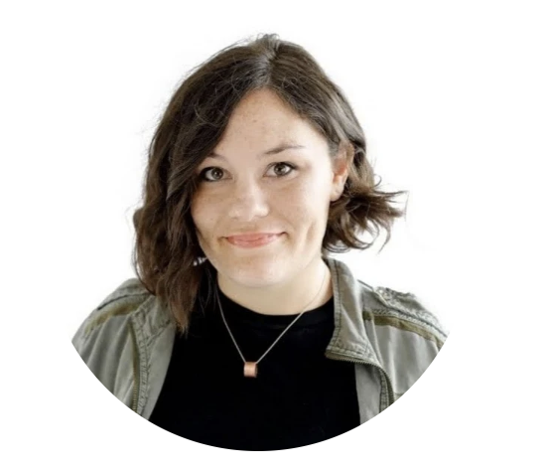



Call me, tweet me, if you wanna reach me.
845-304-4037
@InsiderHaven
horecchio@insider.com horecchio@gmail.com
Notes:
Thank you for listening to me ramble about my work- and bearing with my awful slideshow and public speaking skills.
I’m always happy to grab a coffee in person, zoom, or the phone just to talk about anything and everything.
I love reporting and reporters, and it’s always fun to hear what everyone is working on.
Happy Hunting!

