Slide 1

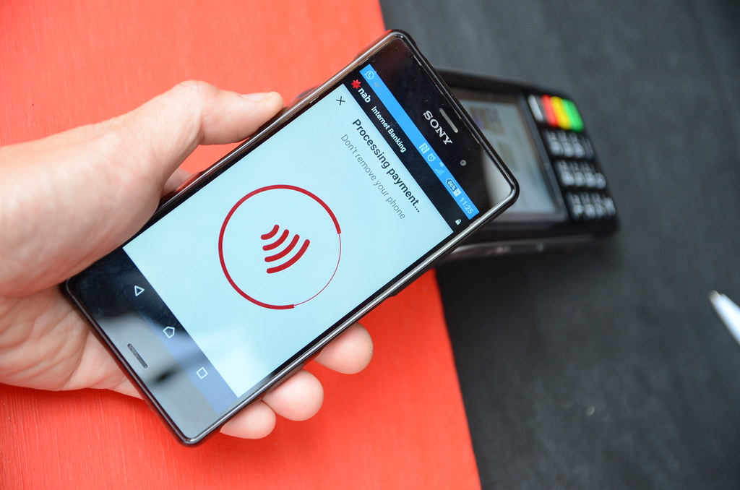

Retail Banking
Over $110 Trillion assets under management in Retail Banking worldwide
Celent Research

Slide 2



Retail Banking Transformations
Big data
Leveraging Cloud Computing
AI
Business Continuity
Leveraging Cloud Computing
Targeted Campaigns/Offers
Long-Term Growth
n
Regulatory Compliance
Personalized Service
Customer Acquisition
Risk Modeling
Leveraging Cloud Computing
Increasing Wallet Share
Predictive Analytics
Virtual Banking
Millennials/Gen Z Preferences
Short-Term Survival
Leveraging Cloud Computing
Client Solvency
Customer Loyalty
Social
Insights
New Products/ Services
Omni-Channel Banking
Reducing Costs
Customer Retention
Maintaining Liquidity
Banker
Productivity
Fraud Prevention
Process Automation
Data Privacy
Notes:
This slide shows banks are weighed down with both industry and regulatory pressures.
The weight of all these market demands is presenting a conundrum for today’s banking organizations. Banking organizations cant ignore either of these areas, but need to strive for some balance to provide achieve long-term growth and success.

Slide 3
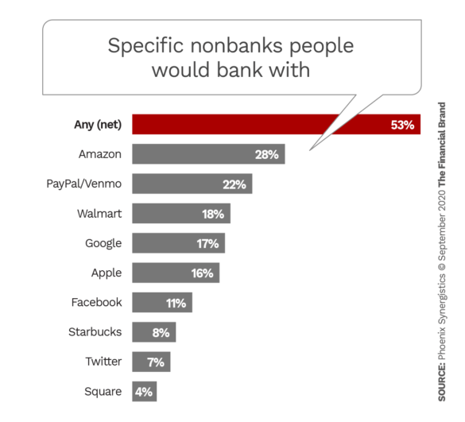
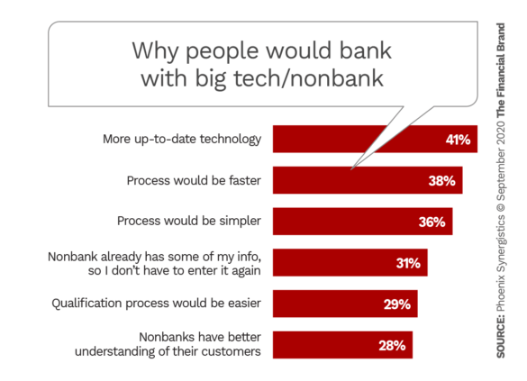
The Shift by Consumers deepens
Technology companies as banks are generally attractive, especially to younger generations
And the reasons why directly point to the issues that Covid has highlighted and banks grapple with in general
Notes:
This slide highlights the fact that there are many non-traditional banks/financial institutions entering the banking space and that consumers are increasingly showing a willingness to work with those non-traditional banking firms.
Net-net, retail banks are not just competing with other banks but now also with non-traditional financial institutions.

Slide 4
Digital Currencies
Digital currency is a type of currency available in digital form. It exhibits properties similar to physical currencies, but can allow for instantaneous transactions and borderless transfer-of-ownership. Examples include virtual currencies, cryptocurrencies, and central bank digital currency. These currencies may be used to buy physical goods and services, but may also be restricted to certain communities such as for use inside an online game.
Notes:
QuickStarter has created an outline to help you get started on your presentation. Some slides include information here in the notes to provide additional topics for you to research.

Slide 5
Related topics to research
Blockchain
Cryptocurrency exchange
Ripple
Cashless society
DigiCash
Litecoin
Cryptocurrency wallet
Bitcoin Cash
What’s next?

Slide 6
Topics of interests
Types of Digital Currencies
Law & Regulations
Adoption by Governments
Adoption by Financial Actors
Technologies
Sentiments and Drivers

Slide 7
International Trade & Trade Finance Digitization
International Trade
International trade is the exchange of capital, goods, and services across international borders or territories. In most countries, such trade represents a significant share of gross domestic product. While international trade has existed throughout history, its economic, social, and political importance has been on the rise in recent centuries.
Trade Finance Digitization
Digitizing Trade Finance seeks to address the significant gap in global trade financing by working with the public and private sectors to identify and develop technologies and associated technology standards that facilitate connections between digital islands, trade finance inclusion for small and medium-sized enterprises (SMEs) and trade tech for emerging market economies (EMEs).
Notes:
QuickStarter has created an outline to help you get started on your presentation. Some slides include information here in the notes to provide additional topics for you to research.

Slide 8
Related topics to research
International trade law
International business
Exchange Rate & Settlements
Trade Finance Automation & Digitization
Trade Finance Networks
Blockchain

Slide 9
Topics of Interests
International Trade Law
Supply Chain Disruptions and Resolutions
Trade Finance Automation & Digitization
Trade Finance Networks
Technologies – Blockchain, AI/ML, Web 3.0, 5G, IoT

