Slide 1
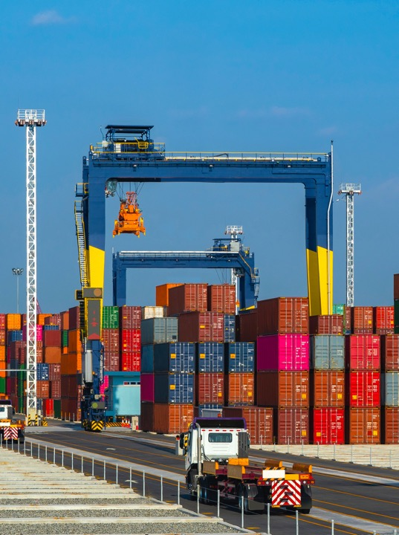
Supply Chain Challenges in Pandemic Times
Carlos Kuriyama
Senior Analyst, Policy Support Unit, APEC Secretariat
International Trade Training – National Press Foundation
27 July 2022 - Singapore

Slide 2
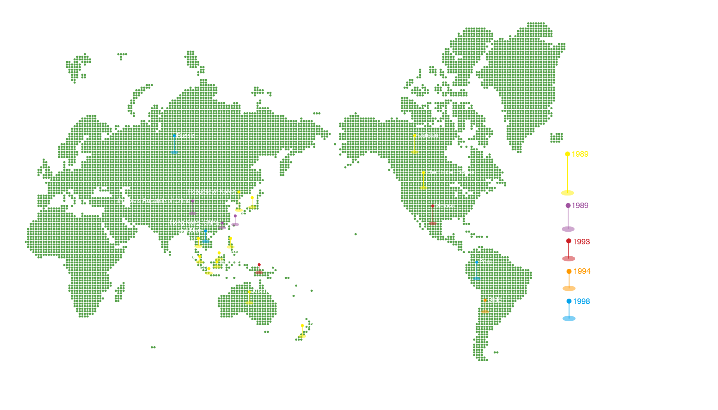
The 21 APEC Member Economies
Copyright © 2022 APEC Secretariat

Slide 3
The APEC Mission
Build sustainable, secure economic growth
Support economic and technical cooperation
Improve living standards
Promote trade and investment

Slide 4
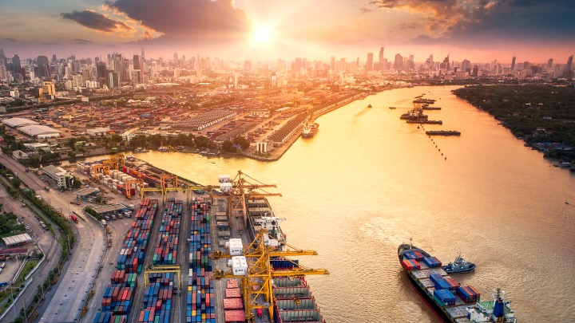
APEC has led to
greater, easier trade
Trade in the region
increase 7-folds in the last 25 years.
Average tariff rates went down,
from 17% to less than 6%
Trade cost went down 5%,
which in a 5-year period has save businesses
as much as USD60 billion.

Slide 5




COVID-19 severely impacted global supply chains at the start of the pandemic
However, supply chains have not fully recovered yet
International Trade The APEC region saw a 6.3% decrease in exports and a 5.5% decrease in imports in 2020
Global Manufacturing
Closure of businesses
and factories caused merchandise exports to
fall in 2020
Electronics
Vulnerabilities of the electronics industry were laid stark because of its lean production methods
Responses
Supply chain disruptions have impeded COVID-19 response and mitigation measures, e.g. food and medicines
Lockdowns, social distancing and restrictions affecting labour and supplies affected global value chains.
Several products not longer being produced or exported at the same pace
Building more resilience into global supply chains is needed.

Slide 6
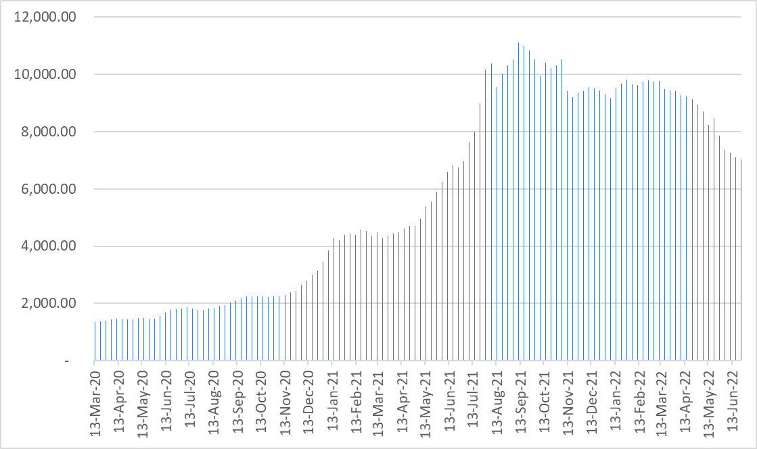
Difficulties in supply chain logistics: soaring shipping costs
Freightos FBX Global Container Index (USD per 40 TEU container)
Cargo capacity has not been restored to pre-pandemic levels yet
Freight market rates for a 40-ft long container went up from USD 1,343 in March 2020 to USD 7,032 in end-June 2022
Source: Freightos. https://fbx.freightos.com/

Slide 7
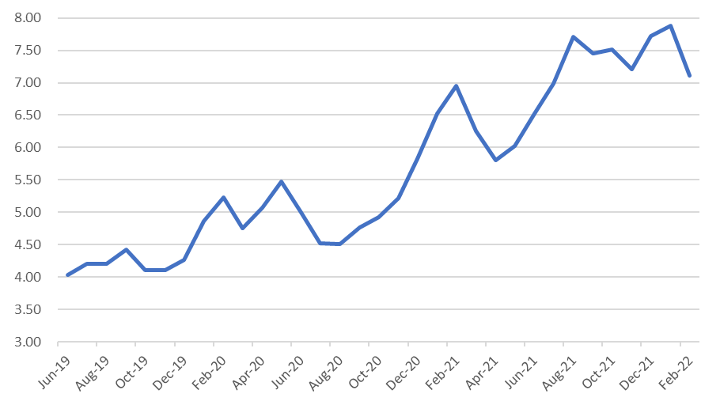
Difficulties in supply chain logistics: connectivity issue
Global average delays for late vessel arrivals (# of days)
Global average delays for vessel arrivals are higher now than at the beginning of the pandemic. 4.75 days in March 2020 and 6.17 days in June 2022

Slide 8
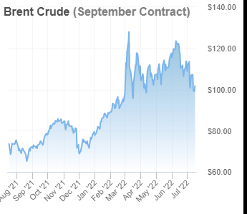
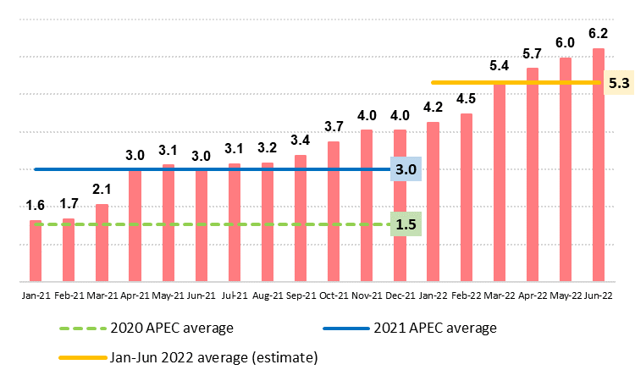
Difficulties in supply chain logistics: inflation
Production and transportation costs affected by higher inflation
Year-on-year inflation is going up despite increases in interest rates
Demand is recovering faster than supply, war in Ukraine affecting commodity prices and quantitative easing increased the amount of money in the market
Oil prices are going up as demand is recovering from COVID-19 pandemic and war in Ukraine is reducing supply

Slide 9
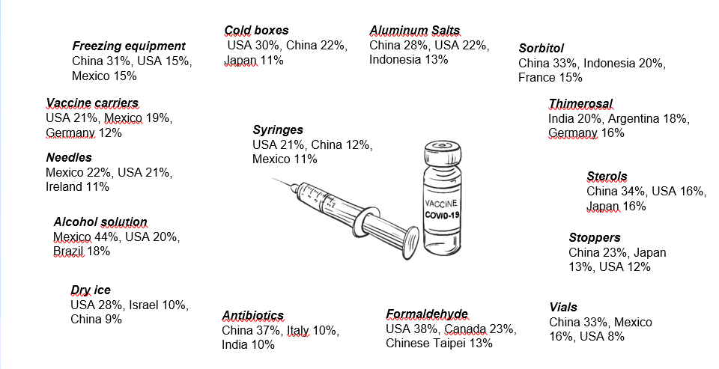
Difficulties in supply chain logistics: vaccine supply chain is complex.
International cooperation and trade facilitation are very important
Main sources of APEC imports of supplies and equipment necessary for production, distribution and administration of vaccines, 2019 (Share in APEC imports)
Source: ITC Trade Map. APEC PSU Calculations. Image from Shutterstock

Slide 10
Supply chain efficiency vs resilience
Resilience: strong enough to withstand shocks and changes
Agility: able to recover from shocks
Flexibility: strong enough to withstand shocks and changes
Redundancy: able to build adequate surplus capacity
Key characteristics of a resilient supply chain:
Trade-off: Resilience is costly. Long-term resilience vs. short-term profits.
Copyright © 2022 APEC Secretariat

Slide 11
Modifications to supply chains for better resiliency
Re-shoring and near-shoring
Moving closer to markets or headquarters for easier management.
More regional supply chains for easier management.
Just-in-case inventory management
Building redundancies (i.e. holding. precautionary stocks) or by diversifying suppliers
Additional stock gives extra time to plan their recovery when hit by disruptions.
Improving visibility
More supply chain visibility to anticipate shifts in market and react with flexibility
Better supply chain visibility is expected to result in 20 - 25% cost savings and overall improved levels of service.

Slide 12
Important role for regional cooperation
Promote digitalisation and supply chain visibility
Develop a predictable, consistent and transparent regulatory environment to put firms at ease to adjust.
Improve trade facilitation
Redouble structural reform efforts
Particularly in relation to managing the flows of essential goods such as food and medical products.
Digital platforms to assist in on-line and real-time monitoring and transparency.
Enhance regional cooperation on trade, connectivity and economic openness
Maintain commitments to open trade policies and avoid discriminatory, trade-restrictive measures.

