Slide 1
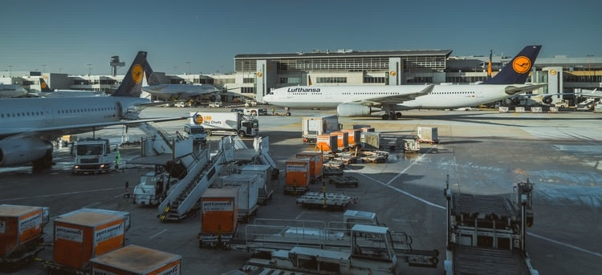

Carbon footprint of e-commerce shipping options
Lynette CHEAH, Engineering Systems, Singapore University of Technology and Design
National Press Foundation Fellows, 26 July 2022
Notes:
Short description of presentation:
In the bid to stay competitive, online shopping platforms often offer a variety of shipping options to meet the preferences of consumers. While faster delivery might be desirable for consumers, this may be detrimental to the environment. This study aims to conduct a comparative carbon footprint assessment of shipping options available in Taobao, a highly popular Chinese online shopping website. We evaluate the case of cross-border e-commerce, where goods are ordered from China to Singapore as the shipment destination. Thereafter, a shipping choice preference survey is conducted to evaluate the impact of carbon labelling on consumers’ shipping preferences. Out of 188 survey respondents, slightly more than half (55%) were found to be willing to compromise the speed of delivery for a less carbon-intensive alternative. Given this finding, the study advocates for carbon labelling to be introduced for e-commerce shipping options.

Slide 2

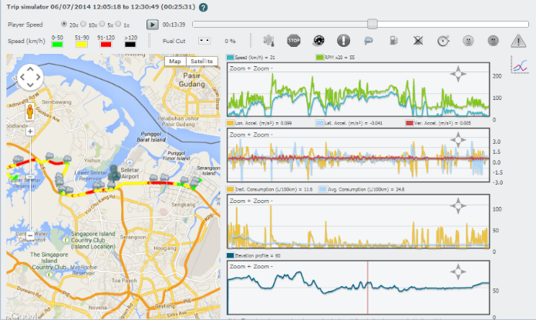
Sustainable Urban Mobility Lab
  Data-driven models and solutions to promote sustainable passenger and freight transport in cities
Key capabilities
  Transport modelling and simulation
  Sustainability assessment of products and systems
Recent projects:
  Life cycle carbon emissions from commercial trucks
  Crowdshipping using public transport
  Data-driven assessment of urban vibrancy
https://mobility.sutd.edu.sg
Notes:
The Sustainable Urban Mobility Lab is interested in assessing and reducing the environmental impacts of transportation in cities.
It has been active in examining both passenger and freight transport, considering how people and goods are moved around cities.
Key capabilities include data analysis, modelling and transport simulation, with the intention to inform policy decision-making.
The next few slides will describe a few recent projects undertaken by the lab.

Slide 3
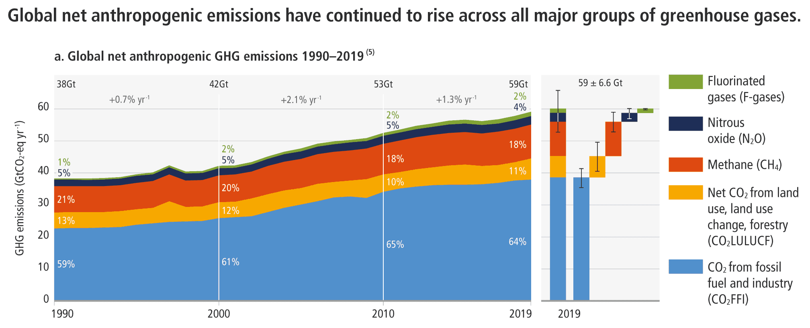
Source:
IPCC, 2022
Notes:
https://www.ipcc.ch/report/ar6/wg3/

Slide 4
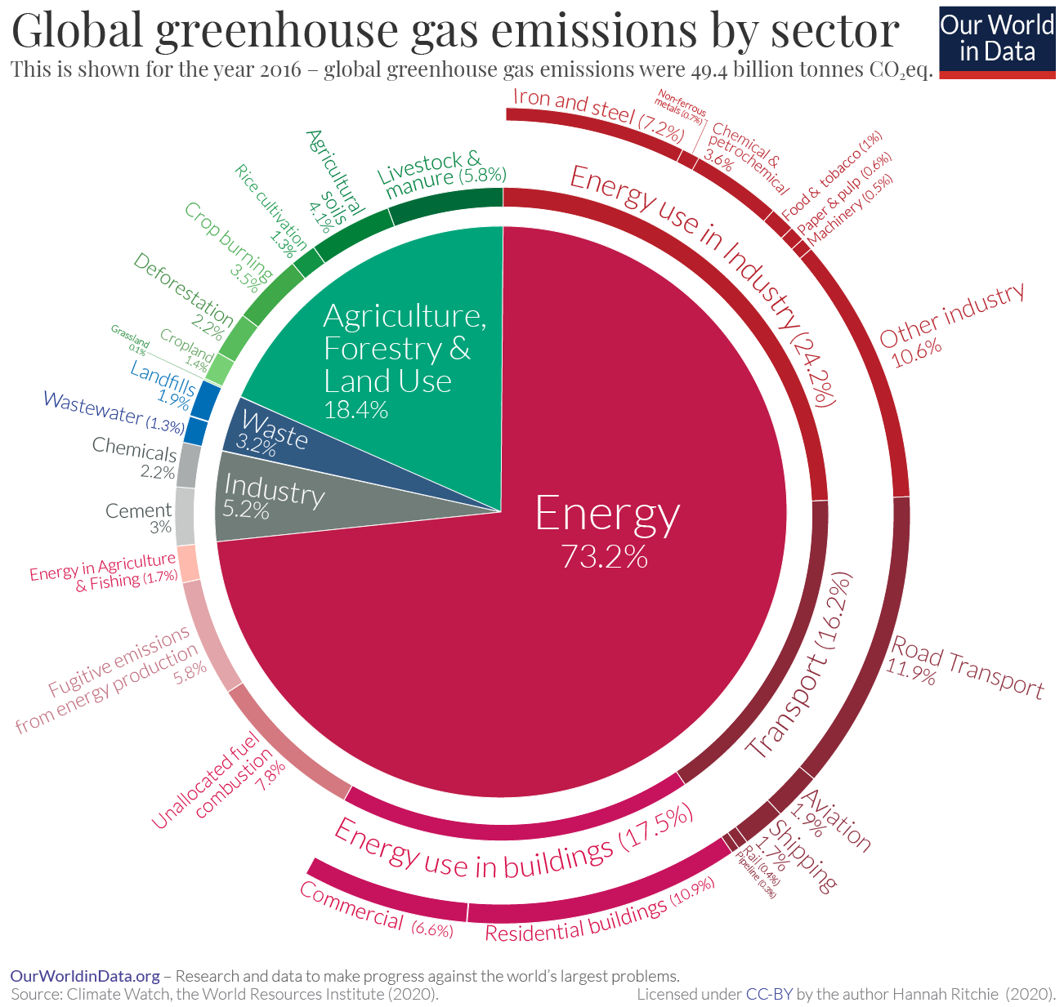
Notes:
https://ourworldindata.org/ghg-emissions-by-sector

Slide 5
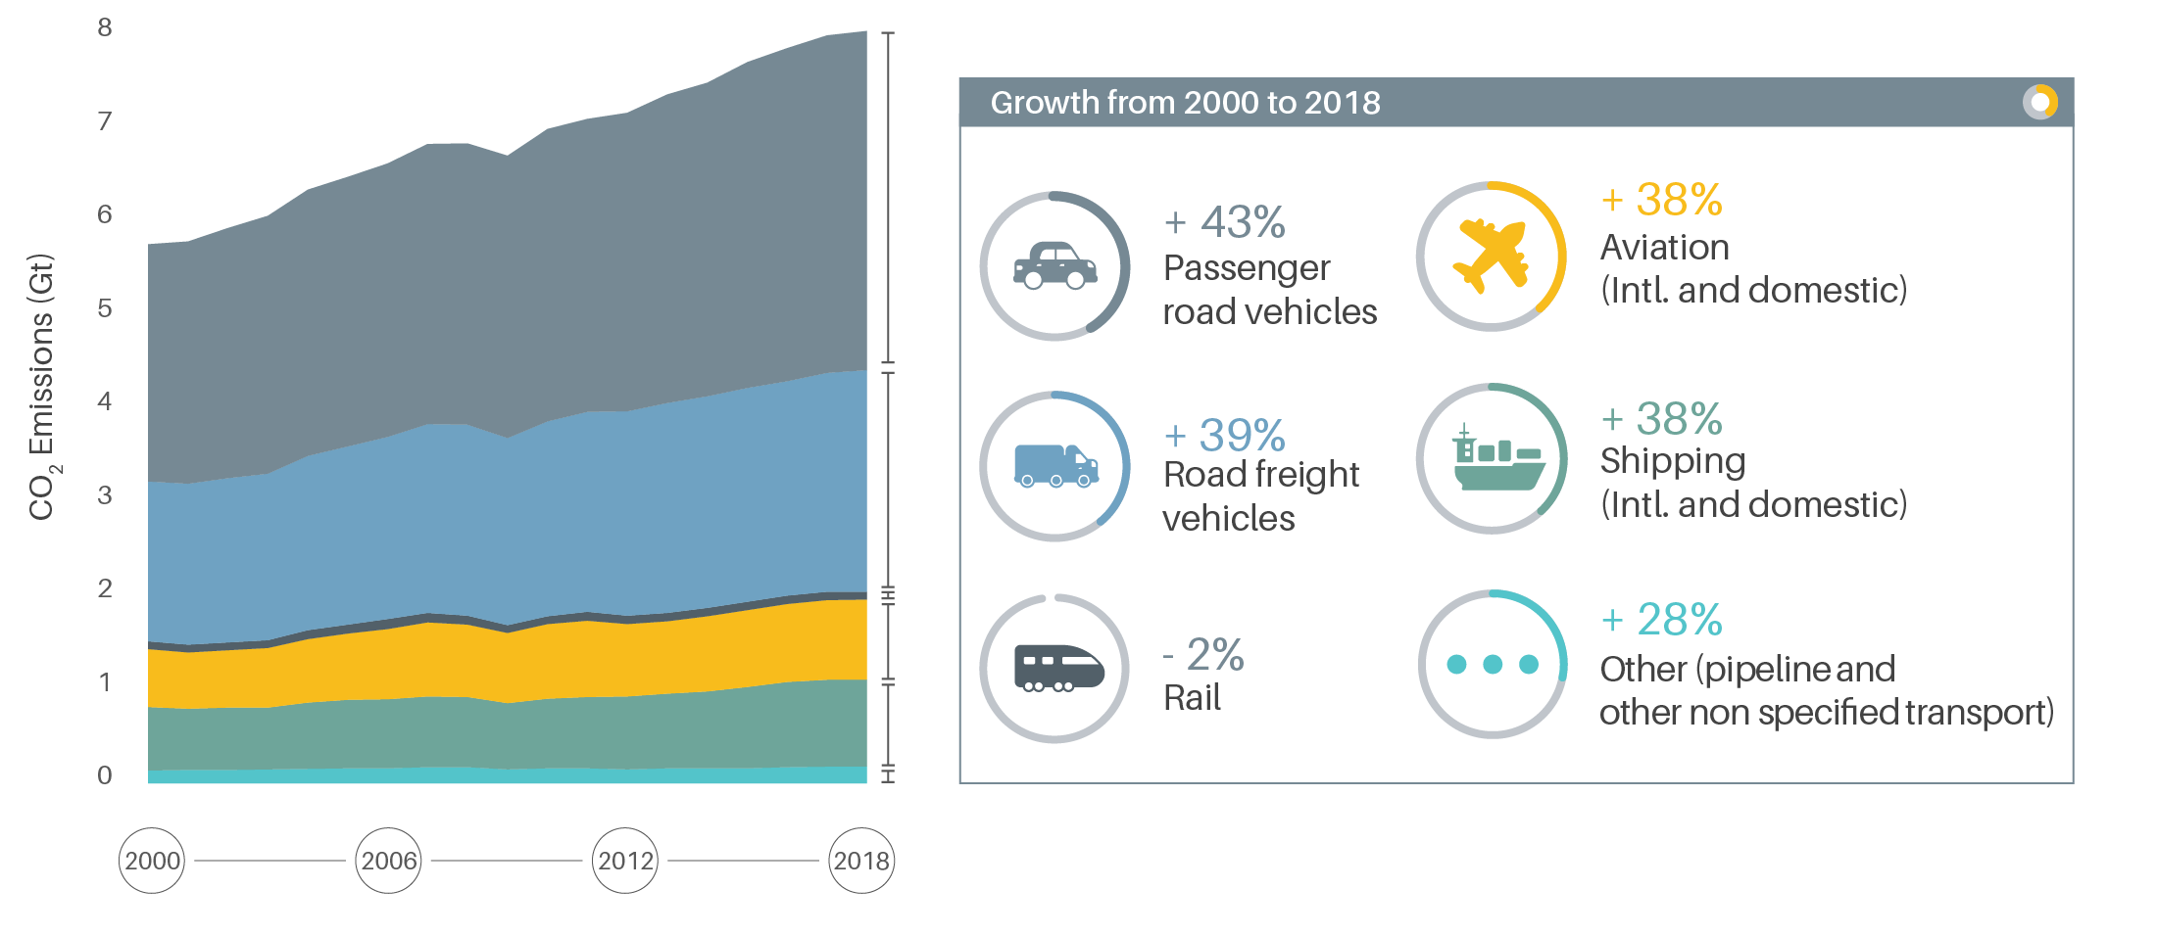
Road transport is a main contributor
Source:
SLOCAT, 2022
Notes:
https://tcc-gsr.com/global-overview/global-transport-and-climate-change/

Slide 6
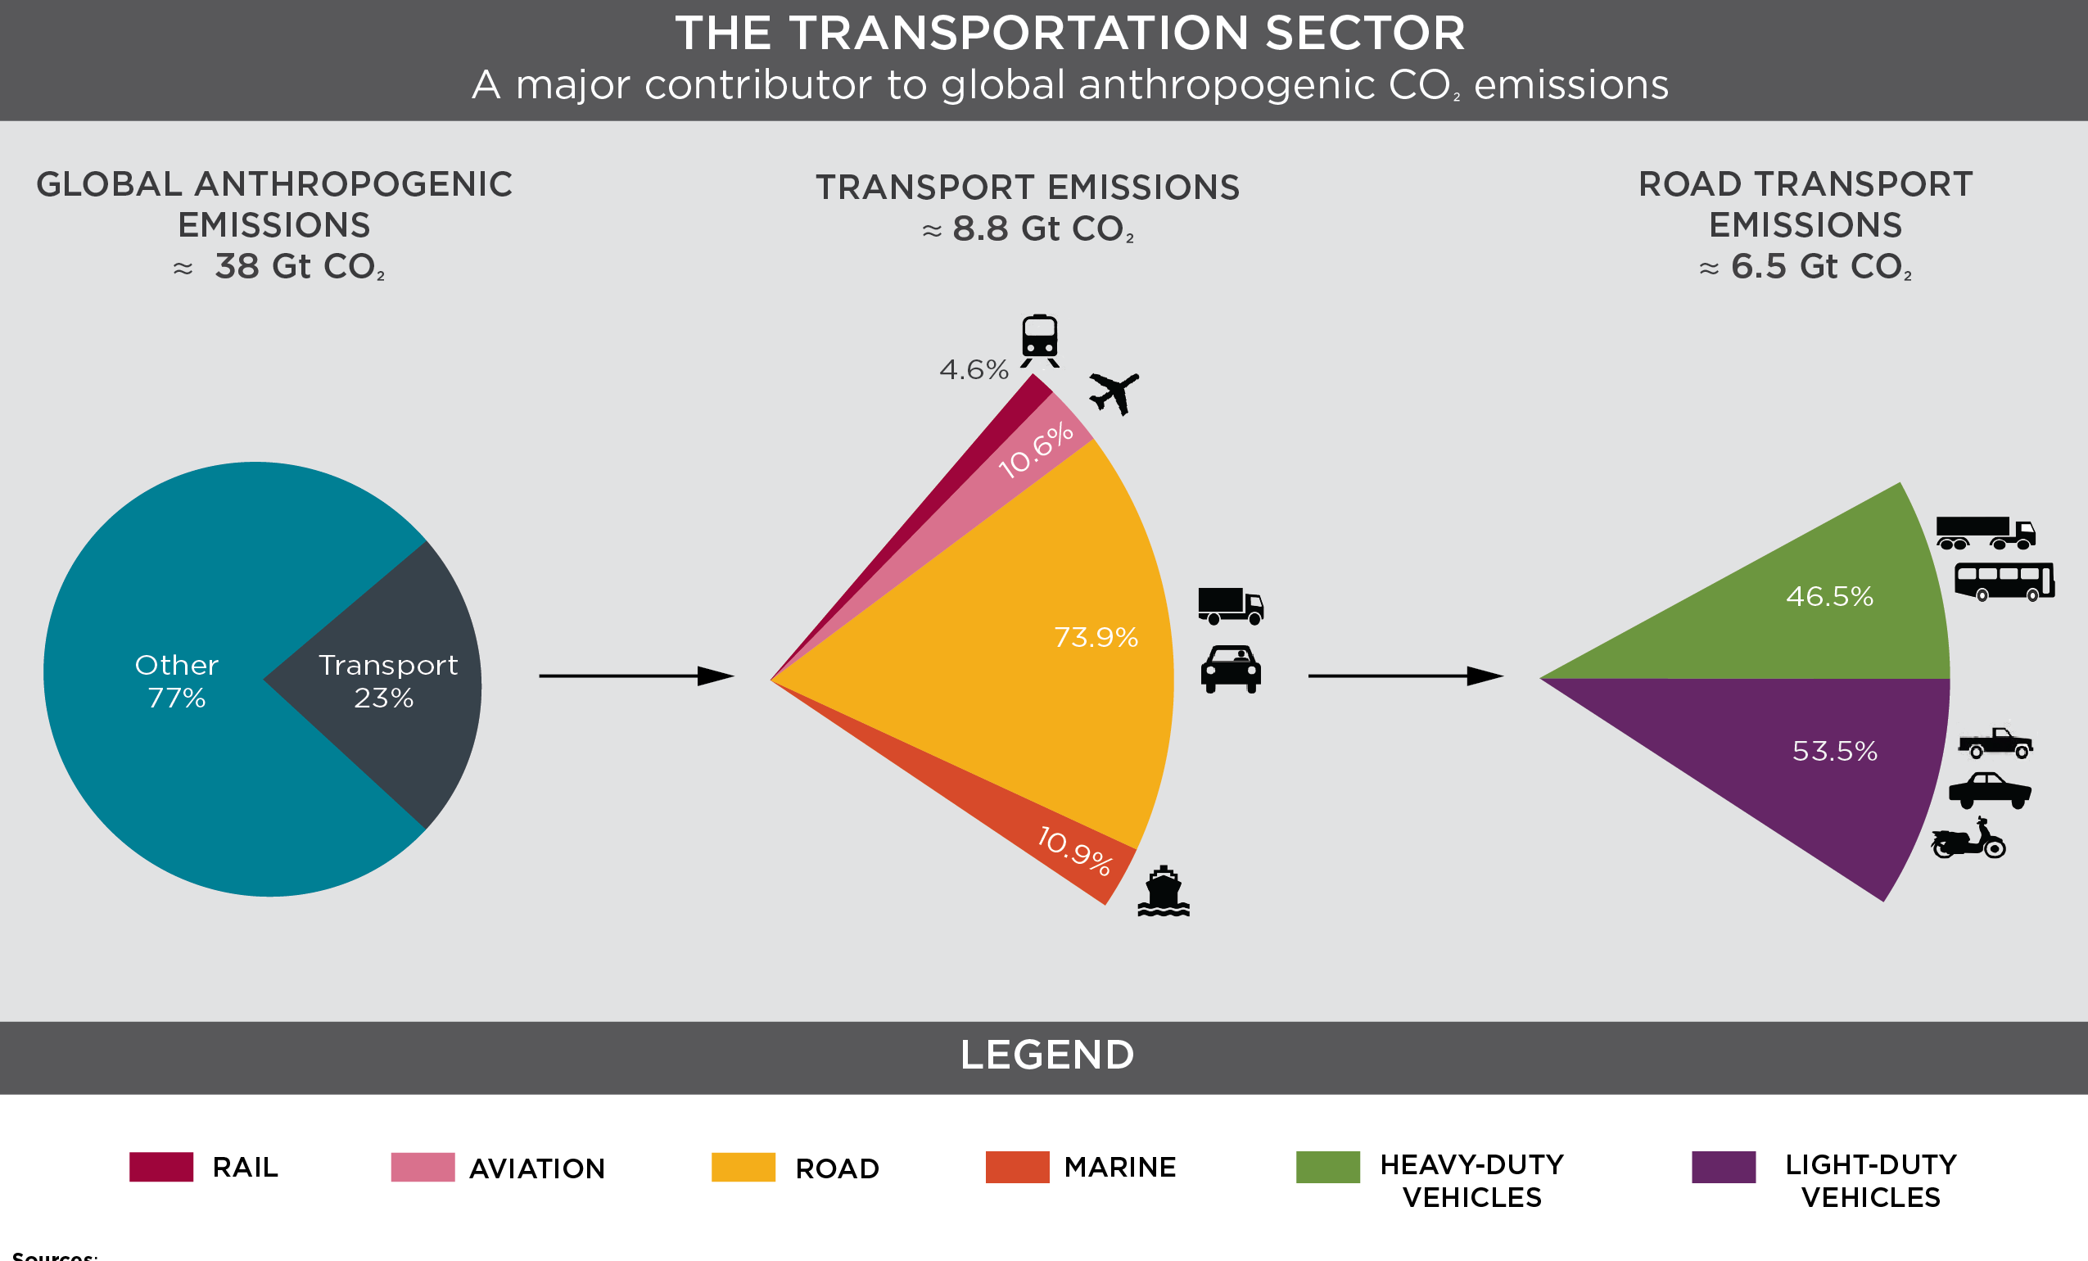
Source:
ICCT, 2014

Slide 7
Urban freight trends
Population and freight transport demand growth
Competing land uses in dense cities
Increasing e-commerce, emergence of freight-on-demand services
Inefficiencies in goods deliveries - Empty return trips, failed deliveries, idling, congestion
Shortage of drivers – impetus for autonomous vehicles
Fragmented logistics industry

Slide 8
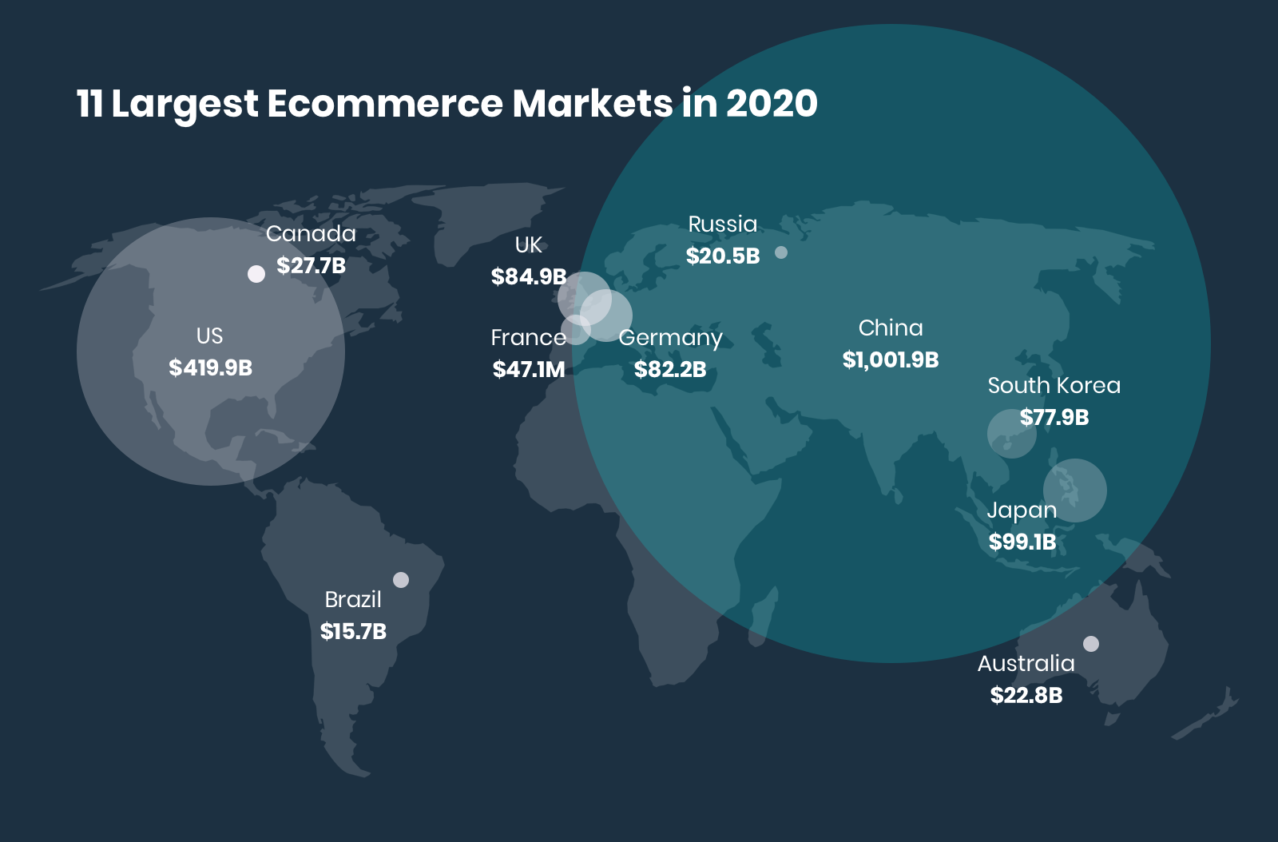
Global e-commerce market
E-commerce in China accounts for more than 50 percent of worldwide retail sales on the internet.
China's expansion of e-commerce is happening at a rate faster than anywhere else in the world.
Source: Statista via Orendorff, 2021

Slide 9
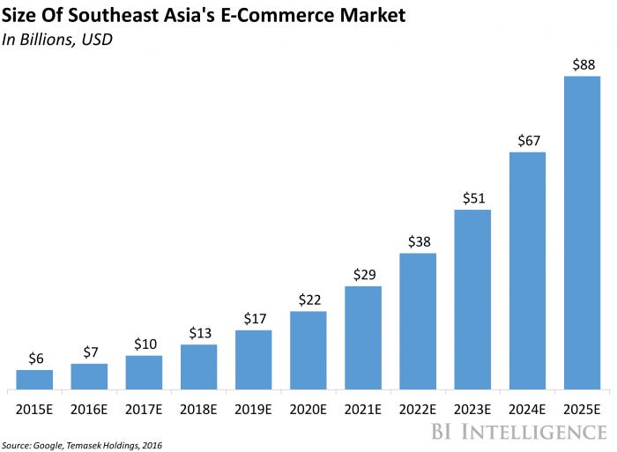
Drivers of ecommerce in Asia-Pacific:
Growth in internet connectivity and penetration
Social commerce providing online market places
Lack of physical retail infrastructure
Emergence of growing middle class
Notes:
SEAsia – Singapore, Malaysia, Thailand, Indonesia, Philippines,

Slide 10
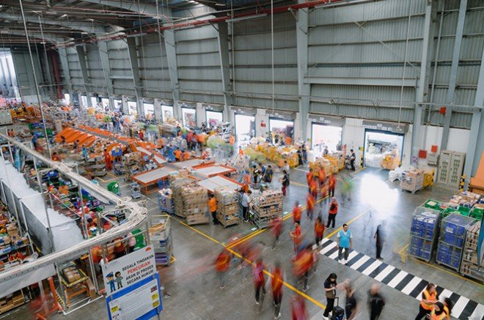
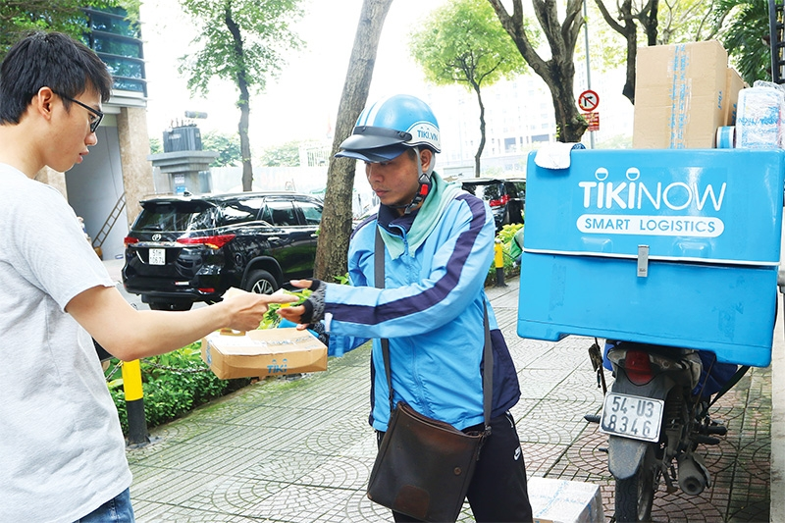
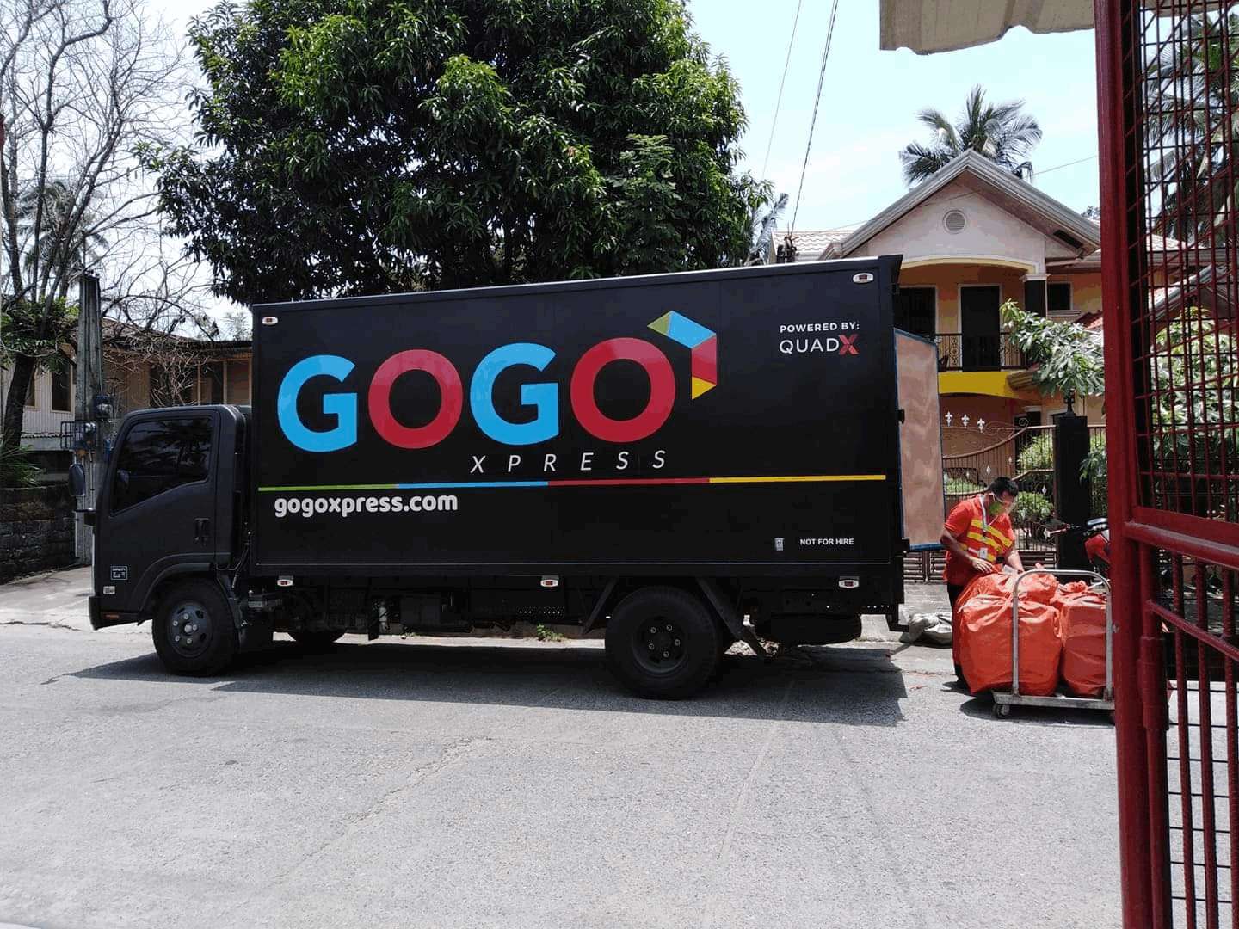
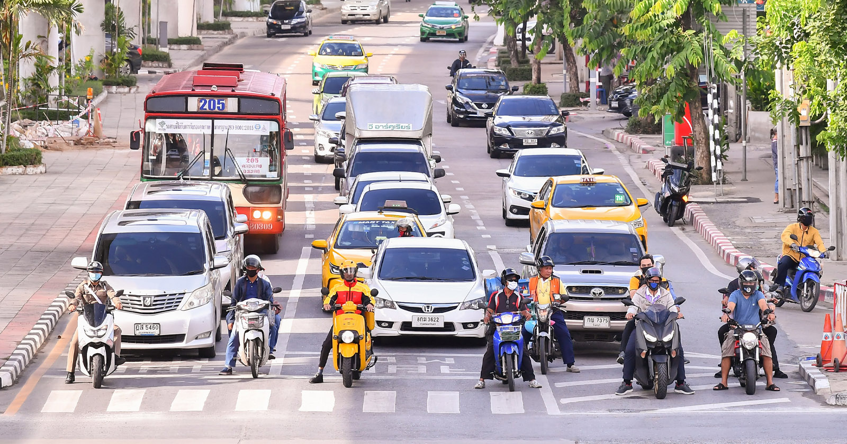
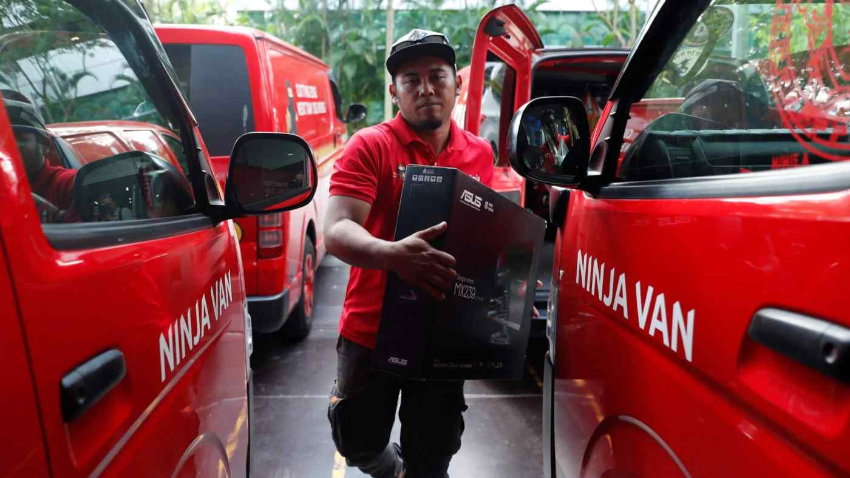
Lazada Indonesia’s warehouse
(SCMP, 2021)
Cash on delivery in Vietnam
(Le Tian, 2020)
Delivery service in the Philippines (GoGo Xpress, 2020)
Electric delivery bike among traffic in Thailand (DHL, 2020)
Unloading cargo in Singapore (Reuters, 2020)
Notes:
https://www.scmp.com/presented/business/topics/china-conference-hong-kong/article/3135007/ecommerce-logistics
https://vir.com.vn/last-mile-delivery-services-battle-over-market-share-79777.html
https://thesmartlocal.com/philippines/courier-services/

Slide 11
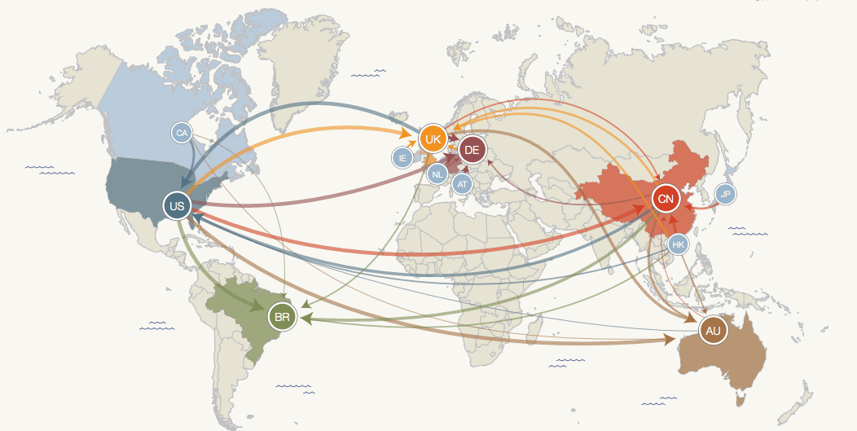
Cross-border e-commerce
Cross-border or International e-commerce is the business of selling products online to buyers in foreign countries (vs. within the domestic market)
Accounts for ~20% of global e-commerce spending, and rising fast!
Source: PayPal, 2014
Notes:
https://www.paypalobjects.com/webstatic/mktg/2014design/paypalcorporate/PayPal_ModernSpiceRoutes_Report_Final.pdf
Higher in some markets, in Singapore, 55% of ecommerce sales are for cross-border purchases

Slide 12
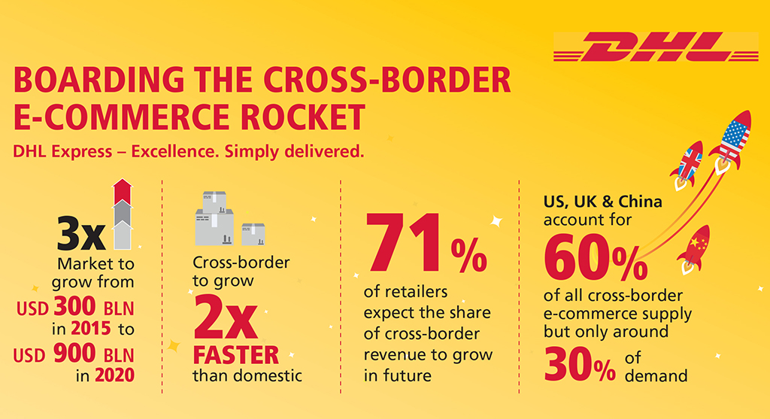
Rise in cross-border e-commerce
Why so popular?
Cheaper prices
Access to products not easily available in domestic market

Slide 13
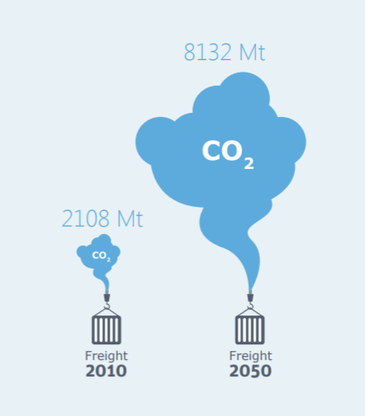
International freight emissions
International freight transport over longer hauling distances generates considerable carbon emissions.
Carbon emissions from global freight transport are expected to grow 4x by 2050. [1]
More complex supply chains, less efficient [2], more carbon-intensive [3]
Source: ITF, 2015
Notes:
https://www.itf-oecd.org/sites/default/files/docs/cop-pdf-06.pdf

Slide 14
Studies on shipping preference
A majority of consumers expect free shipping [4]
Cost, speed and order value matter to consumers. [5-7]
Cost is the most important factor influencing shipping choice [8-9]
Consumers trade-off between speed and cost [10-11]
Not all consumers, however, need fast shipping - 47% of online shoppers polled chose faster shipping when available, despite not having an immediate need for the items [12]
Notes:
4. https://nrf.com/media-center/press-releases/nrf-study-says-more-online-shoppers-want-free-shipping

Slide 15
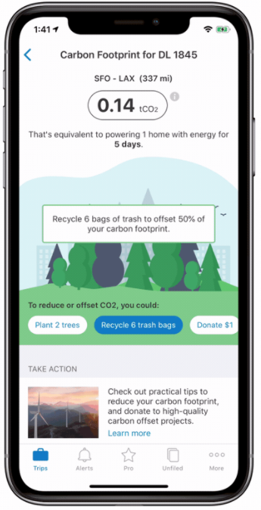
Can carbon labelling help?
Eco-conscious consumers were found to be strongly influenced by the labelling of sustainability information in products. [12]
For example, if carbon labelling were to be made available on travel booking websites, potential annual savings of 79 metric tonnes of CO₂e was reported [13]
One study investigated eco-labels on shipping options: 64% of the 215 millennials surveyed indicated a willingness to wait for an order with greener shipping, while only 25% of them indicated willingness to pay for greener shipping [14]
Source: TripIt, 2021
Notes:
https://news.sap.com/2020/01/tripit-update-flight-carbon-footprint/

Slide 16
This research
Questions
  What is the carbon footprint of various cross-border e-commerce shipping options?
  Will carbon labelling have an influence over consumers’ shipping preferences?
Approach
  Assess the carbon emissions of shipping options on Taobao, a popular e-commerce platform
  Examine the case of cross-border online shopping transactions placed in Singapore
  Stated preference survey to understand how consumers will respond to carbon labelling
Notes:
Highly contextual
Since this project concluded last year, we have continued projects studying public acceptance of AVs, in particular among groups who may need more assistance during their journeys, e.g. parents with children, elderly, disabled, etc. We’ve also tried using other means of soliciting views, in particular using chatbot surveys and chat groups as different forms of engagement that might be more accessible.

Slide 17
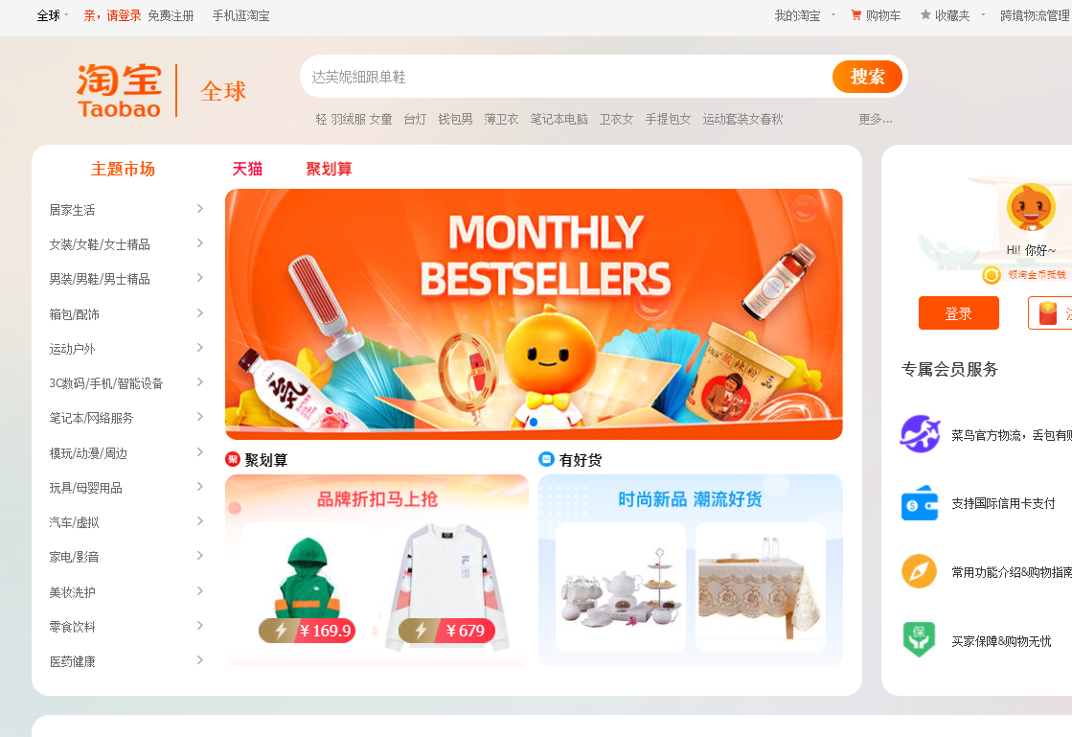
Taobao, an e-commerce platform
Specializes in the B2C and C2C retailing where the merchants are based in China
Dominant in the Asian e-commerce marketplace. Ranked as one of the top 10 e-commerce sites in the world [15]
As a subsidiary of Alibaba, Taobao operates in over 200 countries, has more than a billion products listed [16]

Slide 18
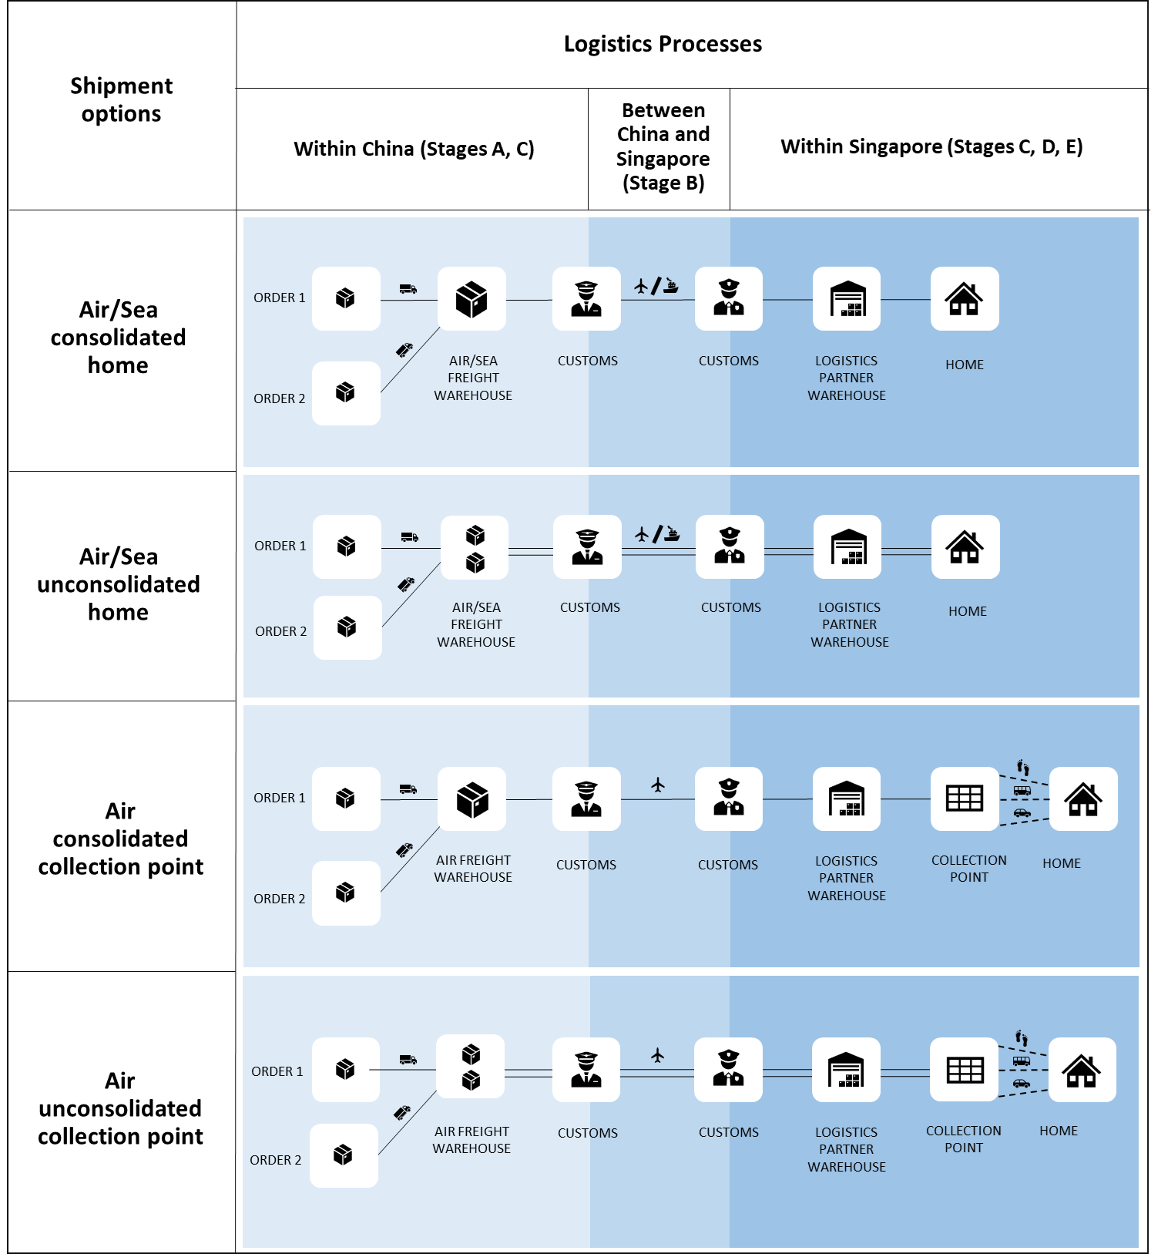
Shipping options offered and stages considered
For multiple orders, consolidated delivery or not
A. Truck transport within China
B. Cross-border transport - sea or air freight
C. Warehouse operations
D. Last-mile delivery van transport within Singapore
E. Consumer’s passenger trip to a collection point, if any – walk, public transport, private car

Slide 19
Shipping activity emissions
(kg CO₂e emissions)_{mode} = (kg CO₂e emission/tonne-km)_{mode} x (km) x (tonnes)
Sources: UK BEIS, 2019 and MEWR, 2015
Notes:
(kg CO₂e emissions)m by transport mode = kg CO₂e emission per tonne-km by transport mode x distance travelled in km x shipment weight in tonnes

Slide 20
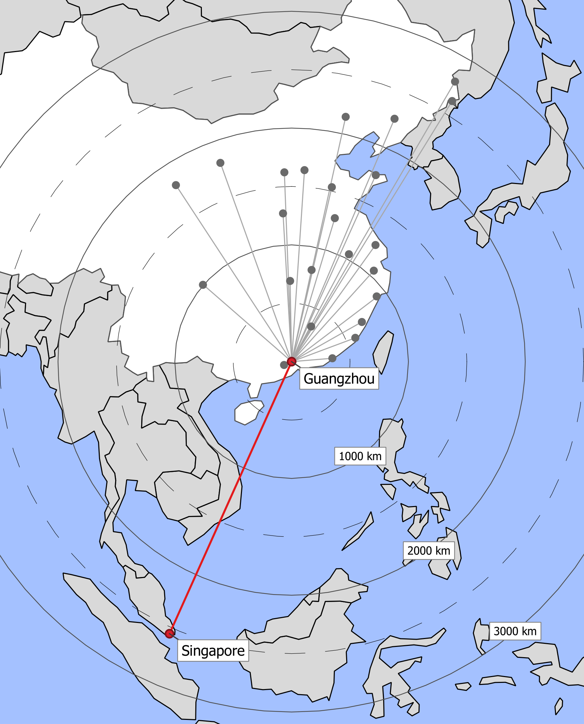
Assumptions
Two orders (from different sellers) in one transaction
Consolidated deliveries require +1 day
Parcel sizes are small and light - <42x37x61 cm (16x14x24 in), 1 kg (2.2 lb)
Main departure Chinese city is the port city of Guangzhou
Warehouse emission factor is 0.026 kg CO₂e/parcel-day [17]
Delivery failure rates for the first three attempts are 5.9%, 26.2%, and 47.1%

Slide 21
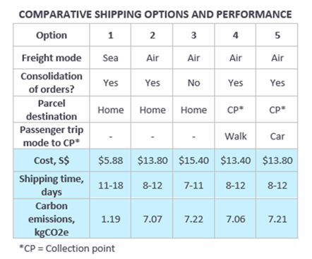
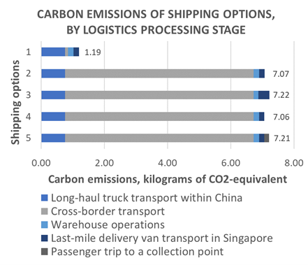
Result 1: comparison of shipping options
Notes:
In general, shipment consolidation, slower freight transport mode (sea vs. air), and cleaner passenger transport mode (walk vs. car) can reduce emissions.
“sea-consolidated-home” shipment option is the least impactful option. It is also the slowest and the cheapest.
If consumers do not have an immediate need for the items purchased, they can reduce carbon emissions associated with the delivery by at least 81% by opting for sea instead of air freight

Slide 22




Shipping choice experiment
Objective is to investigate consumer’s willingness to (i) wait for their orders and (ii) pay more for a less carbon-intensive option.
For simplicity, will look at single order transaction, to be delivered to consumer’s home.
Order value
Low ($30), High ($400)
Carbon label
No, Yes
Delivery time
Slower, Faster
Shipping cost
Lower, Higher

Slide 23
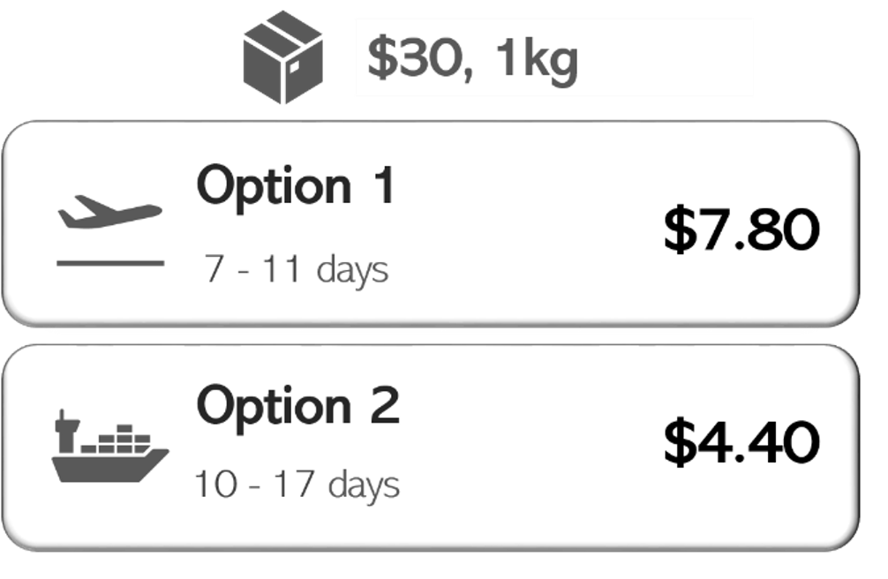
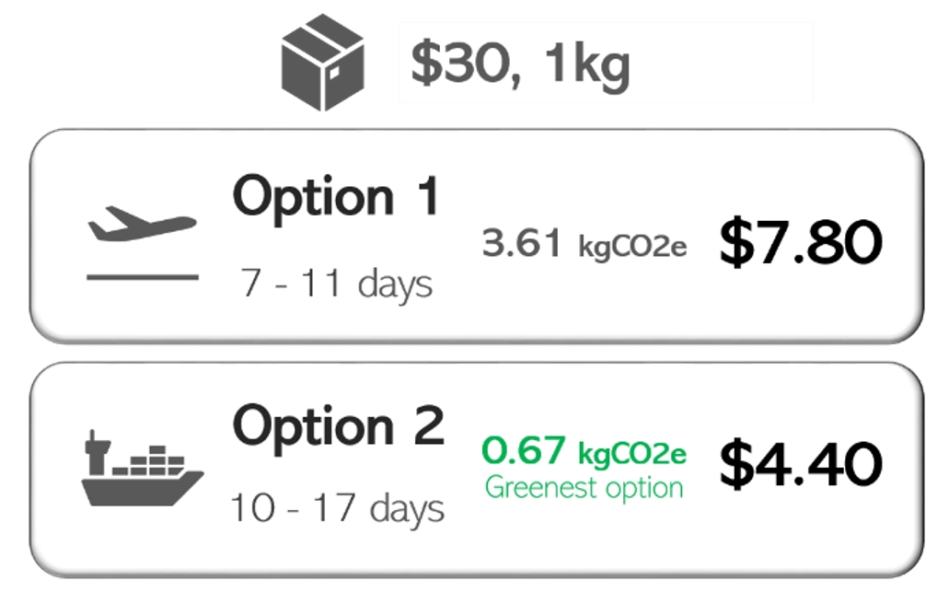
Examples of options presented
Scenario 7
Scenario 8

Slide 24
Full factorial design of scenarios
Scenarios | Order value | Carbon label | Trade-off between cost and speed
1 | High | No (X) | Slower option is cheaper
2 | High | Yes (O) | Slower option is cheaper
3 | High | No (X) | Faster option is cheaper
4 | High | Yes (O) | Faster option is cheaper
5 | High | No (X) | Both have the same price
6 | High | Yes (O) | Both have the same price
7 | Low | No (X) | Slower option is cheaper
8 | Low | Yes (O) | Slower option is cheaper
9 | Low | No (X) | Faster option is cheaper
10 | Low | Yes (O) | Faster option is cheaper
11 | Low | No (X) | Both have the same price
12 | Low | Yes (O) | Both have the same price

Slide 25
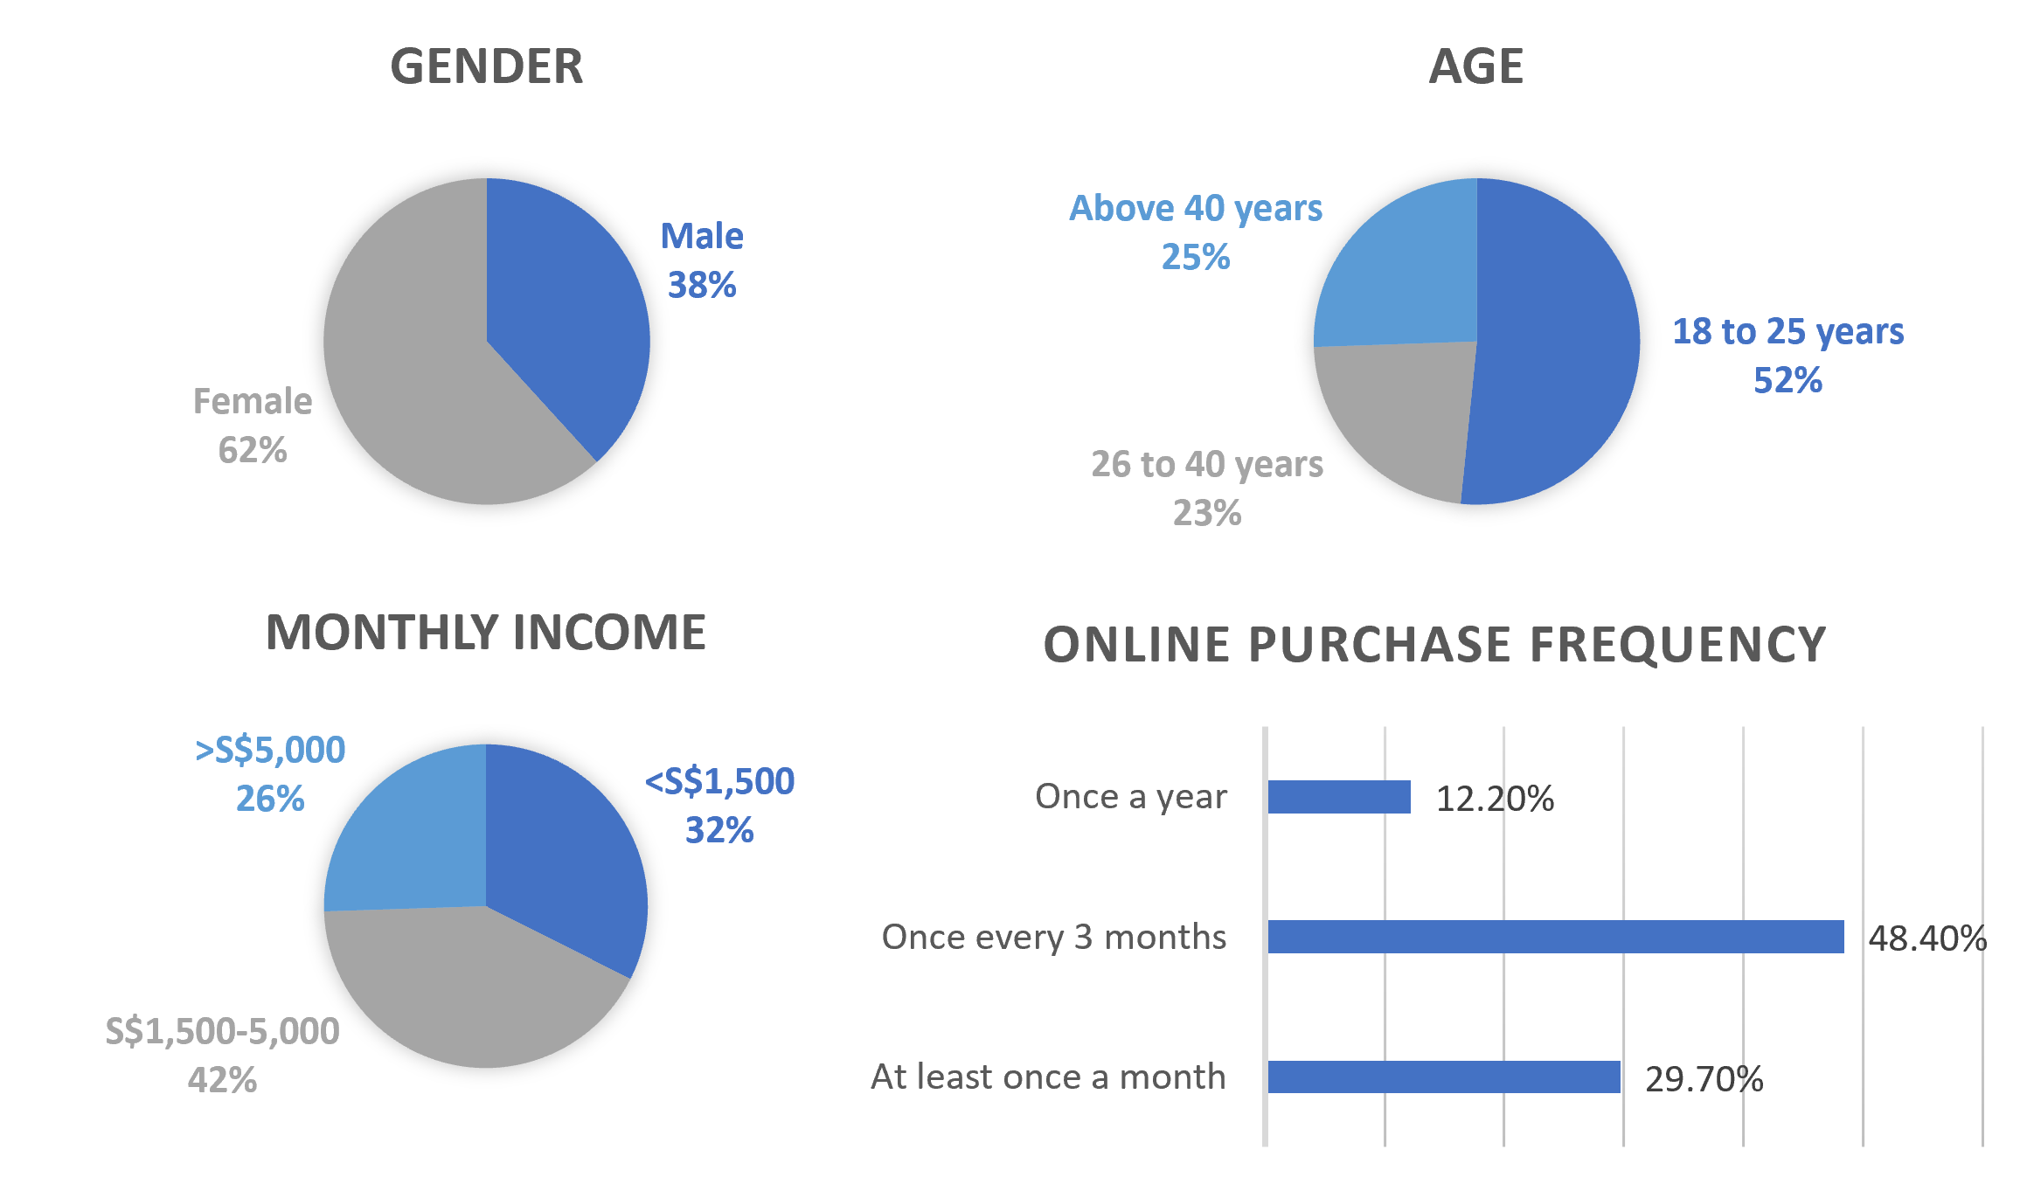
Survey respondents
Online survey among adult Singapore residents with prior experience making cross-border e-commerce purchases
June-July 2020
188 valid responses
Notes:
Market survey of online shoppers in SG – 57% female, 52% between 18 to 34 years

Slide 26
Result 2: Survey outcome
Notes:
Majority were cost-sensitive, as expected. Cost mattered to type P and U, and this remains true for both high- and low-value orders.
More will prefer faster shipping for higher order values.

Slide 27
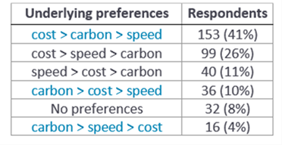
Discovered consumer preferences
Out of 188 respondents, 55% were willing to compromise the speed of delivery for the greener alternative.
A quarter of these respondents were willing to pay more for the greener alternative.

Slide 28
Takeaways
Emissions can vary considerably for different cross-border shipping options. Slower shipments cost and emit less.
These emissions are most sensitive to the choice of sea or air freight.
Slightly over half of surveyed shoppers in Singapore were willing to wait for greener shipping if carbon labels were presented, suggesting potential to influence shipping decisions.
Reference:
Cheah, L., Q. Huang, 2021. Comparative Carbon Footprint Assessment of Cross-border E-commerce Shipping Options. Transportation Research Record. doi: 10.1177/03611981211037249.
Notes:
https://doi.org/10.1177/03611981211037249

Slide 29
Individual choices
Virtual meetings
Take public transport
Carpool
Bike, walk
Share a vehicle
Smaller vehicle
Hybrid car
Electric car
Live in a compact town
Buy local
Don’t choose fast delivery
Deliver to parcel lockers
Travel off-peak

Slide 30


Thank You
Lynette Cheah
lynette@sutd.edu.sg
https://mobility.sutd.edu.sg

Slide 31
Future work
Scale up survey to better understand demographic and socioeconomic characteristics that influence shipping preferences
Supply-side analysis to understand impacts of slower deliveries
E-commerce platforms receptiveness to carbon labels

Slide 32
References
ITF, 2015
Jeroschewski, 2015
Nakamichi et al., 2016
US NRF, 2019
Koukova et al., 2012
Zhang et al., 2005
iPrice, 2019
Unni et al., 2015
Al Karim, 2013
Nguyen et al., 2019
Gawor and Hoberg, 2019
Autry et al., 2012
Ma, 2017
Schindler et al., 2005
Dotcom Distribution, 2016
O’Rourke and Ringer, 2016
Amenta and Sanguinetti, 2020
Brunetti et al., 2018
SimilarWeb, 2019
Brennan, 2016
Weideli, 2013

