Slide 1
China’s Long Term Growth
Presentation for The National Press Foundation
Hinrich Foundation Singapore July 26 2022
Bert Hofman
National University Singapore

Slide 2
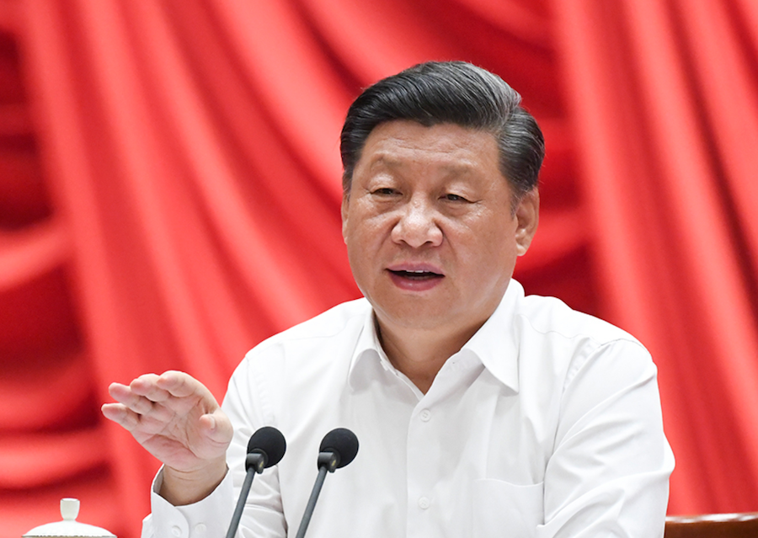
Ambitions for the New Era
“To build China into a great modern socialist country that is prosperous, strong, democratic, culturally advanced, harmonious, and beautiful by the middle of the century”
Xi Jinping, 19th Party Congress, November 2017
“It’s completely possible for China to reach a high-income country standard at the end of the 14th five-year plan in 2025 and to double total economic size, or per capita income, by 2035.”
Xi Jinping, November 4, 2020

Slide 3
A New Development Concept For A New Era
New Development Philosophy
Innovative, coordinated, green, open, and shared development
Belt and Road
Dual Circulation
Common Prosperity
Ecological civilization
More reliance on domestic demand
Expanding domestic (critical) supply chains
Indigenous Innovation
Reform and Opening Up
Supply-side Reforms
Establish reasonable distribution system
Adjust excessive incomes
Prohibit illicit income
More Equal Public Services
Source: Outline of the 14th Five Year Plan, various policy speeches

Slide 4
China’s GDP per worker only one-fourth of the US
Source: World Development Indicators, Authors’ calculations

Slide 5
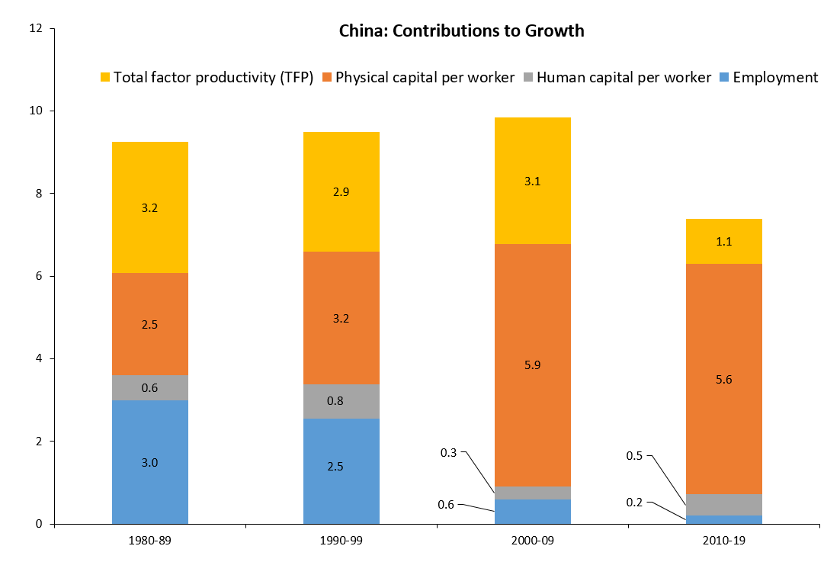
How Did China Grow?
Source: Brandt et al (2022): China’s Productivity Slowdown and Future Growth Potential.
Note: TFP is a measure of overall productivity in the economy
Notes:
Large demographic dividend in the 1980s and 1990s
Reforms paid off in large contribution of TFP to growth
In the past decade, the demographic dividend disappeared.
TFP growth was only modest
This is a worldwide phenomenon, not just China.
Irrespective, growth relied increasingly on capital accumulation, or investment.
China’s future growth will have to be differnet from the past.

Slide 6
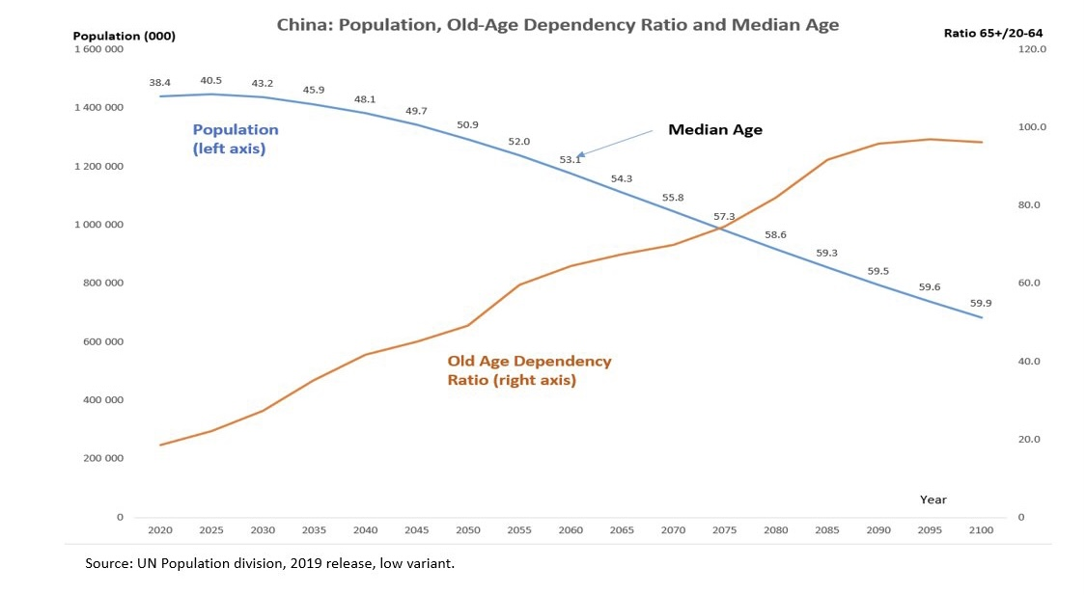
Demographics headwind ahead
Notes:
Decline in overall population to less than 700 million by 2100
Median age from 38 years now to 59 by the end of the century.

Slide 7
Human Capital Seems on Track for Higher Income
Source: Penn World Tables 10.0 and Authors’ Calculation

Slide 8
More capital per output needed, though business investment remains efficient
Source: Herd (2020).

Slide 9
Catching up fast in Research and Development
Source: World Development Indicators
Notes:
Spending in R&D has rapidly risen, now comparable with the EU.

Slide 10
How Fast Can China Grow?
Source: Authors’ calculation

Slide 11
Examples of growth enhancing reforms
Extend retirement age to 65 for men and women
Abolish the household registration system
Lower entry barriers in services sector
Reduce negative list for private investment
Increase dividends from SOEs to the budget
Increase efficiency of bankruptcy system
Reform the intergovernmental fiscal system
Establish private pillar in pension system
Improve the government innovation system
Improve the rural education system
Improve the rural land system

Slide 12
China will catch up with the US, unless structural reforms lag
Source: Authors Calculations and OECD Long term Projections update 2021. Note: US growth rate is actual growth for 2021, 2.4 percent 2022-30 and 1.4 percent thereafter

Slide 13
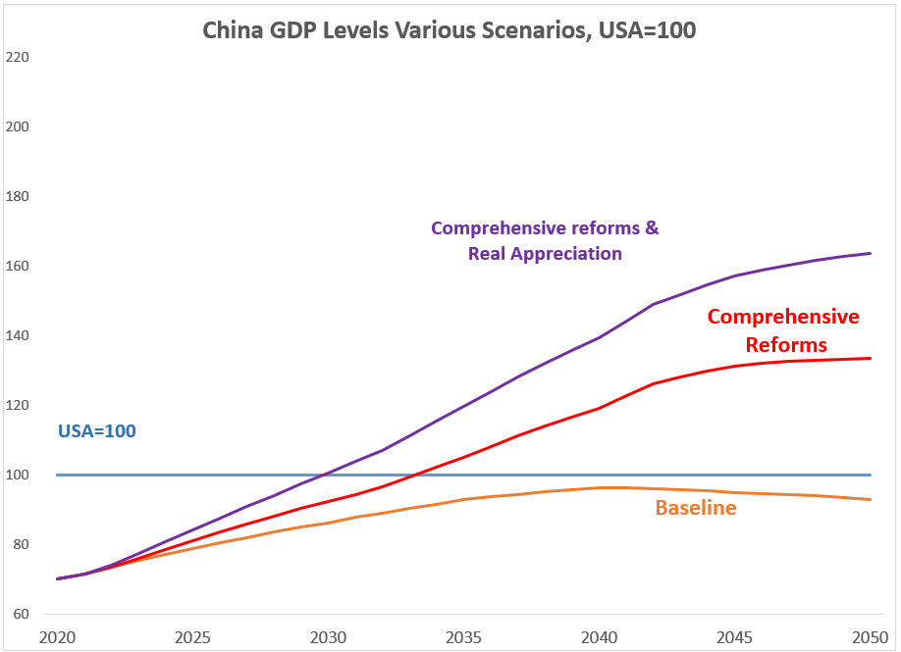
With a US Growth Acceleration, China needs Comprehensive Reforms to Catch Up
Source: Authors Calculations and OECD Long term Projections update 2021. Note: US growth rate is actual growth for 2021, and 2.4 percent thereafter.

Slide 14
A Debt Crisis Will Set China Back
Source: Authors Calculations and OECD Long term Projections update 2021. Note: US growth rate is actual growth for 2021, 2.4 percent 2022-30 and 1.4 percent thereafter

Slide 15
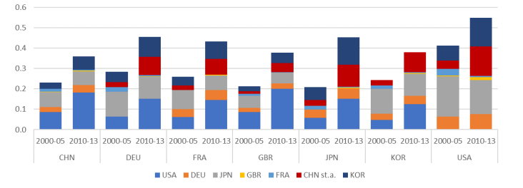
The price of decoupling
Productivity Spill-overs Over Time
Source: Diego A. Cerdeiro et al, 2021, Sizing Up the Effects of Technological Decoupling, IMF WP/21/69, Washington DC.
Note: The figure shows the implied contribution from the knowledge spillovers of the different technological leaders to the annual labor productivity growth in the country on the x-axis. Chinese R&D numbers are rescaled to match the average patenting productivity using the discounted stock as reference.
Notes:
From IMF. Estimate of the loss in productivity GROWTH due to Decoupling. Costly for China, especially if all major partners were ot join. Would result in lower growth, but not just in China!

Slide 16
Decoupling seems manageable, but is unpredictable
Source: Authors’ calculation. Decoupling based on Diego A. Cerdeiro et al, 2021 estimate of spillover effects on labour productivity

