Slide 1
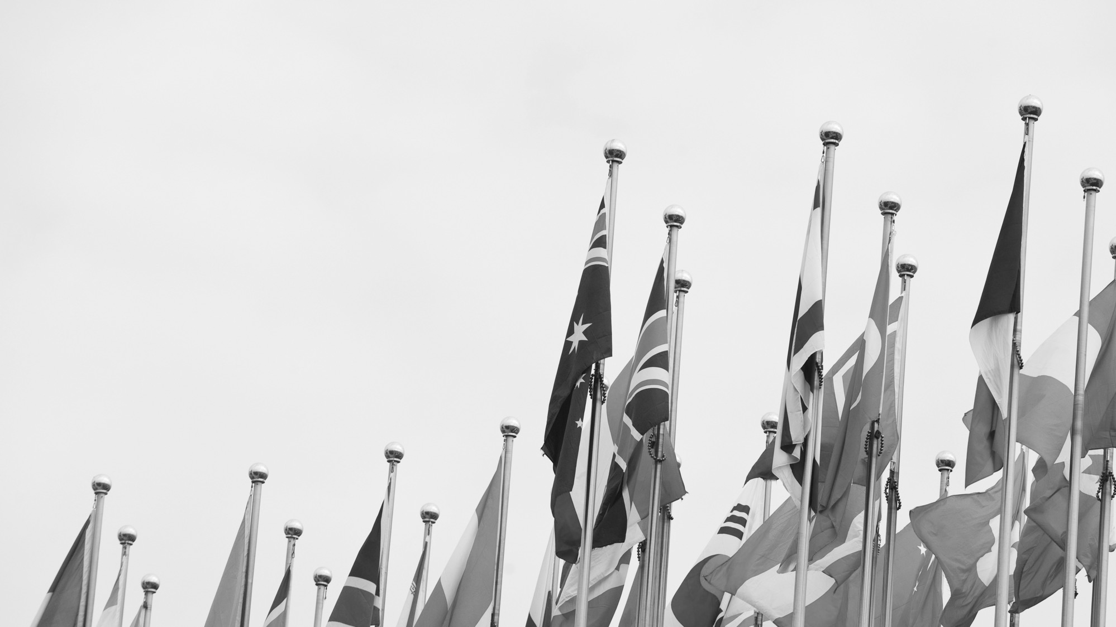

Global Trade at an Inflection Point
Stephen Olson, Senior Research Fellow
July 2022

Slide 2
A very crowded global trade horizon
WTO MC, IPEF, trade fallout from pandemic/Ukraine, US-China, etc… All important, but…
Let’s start our conversation from a different perspective… take a step back, view the global trade horizon through a much broader lens.
At times like this, we can miss the forest because attention is focused on individual trees
What does the bigger picture look like?
  We are at an inflection point of historical proportions
Questions: Where we are today, how did we get here, and where are we headed?

Slide 3
Birth of the modern trade system
Picking the pieces up after WWII
  Shaped by the lessons of disastrous previous 30 years: WWI, Great Depression, WWII
  Desire for a new world order
Free trade is the centerpiece
  Protectionism exacerbated the Great Depression.
  GATT and the birth of the rules-based trade system
  Sense of common mission, we’re all in this together, high levels of trust
Early years
  Methodical, highly successful reduction in trade barriers
  As tariffs reduced, trade agenda turns towards more complex issues

Slide 4
Globalization and “free trade” take off
1980s: Hyper-globalization
  Globalization viewed almost as a scientific fact
  Technocratic economists run the world
Common set of assumptions harden like concrete
  Trade and investment barriers were anachronistic & would be steadily reduced
  The global economy would progressively become more integrated
  Forces of globalization moved in only one direction: towards deeper, more intense globalization.
Government policy choices reflect these beliefs: FTAs/Uruguay Round
  symbiotic relationship between government & business.

Slide 5
Cracks start to appear in the consensus
Pro-free trade, pro-globalization consensus starts to break down.
Rising questions about the trade-offs of globalization
  Globalization benefits MNCs and banks, but disadvantages average worker?
  China shock
  Systemic shocks: pandemic and war in Ukraine
Trade governance falls apart
  Predatory practices proliferate/trade rulebook can’t keep up
Rising geopolitical tensions driving trade fragmentation: democracy vs. autocracy
Compare mindset/assumptions of today vs. the founding of rules-based trade system

Slide 6
Where are we headed?
Post WWII vision continues to slip away
More fragmented system
  Built on common values/geopolitical outlook rather than economic efficiency
  Eco-systems rather than FTAs
New world for business
  Global strategies now more complex
Tenuous path for developing countries
  Export led development path still open?
  Forced to choose?

