Slide 1
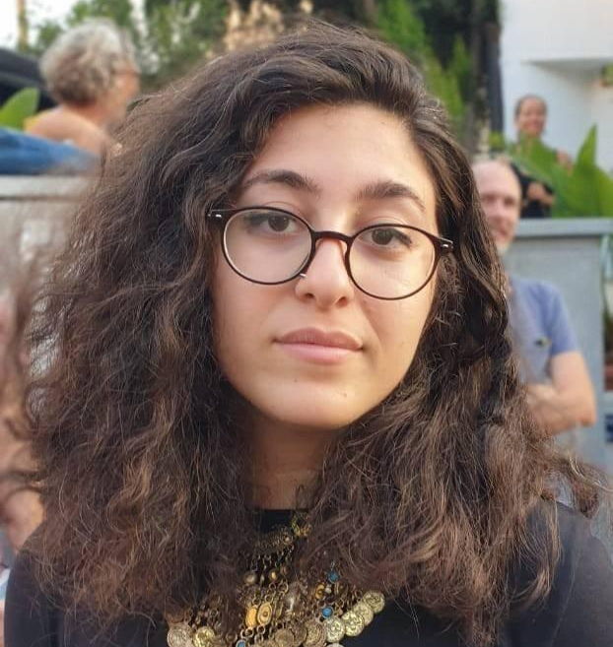
How misinformation works
Azza El Masri
@aemasri
National Press Foundation
March 2022

Slide 2
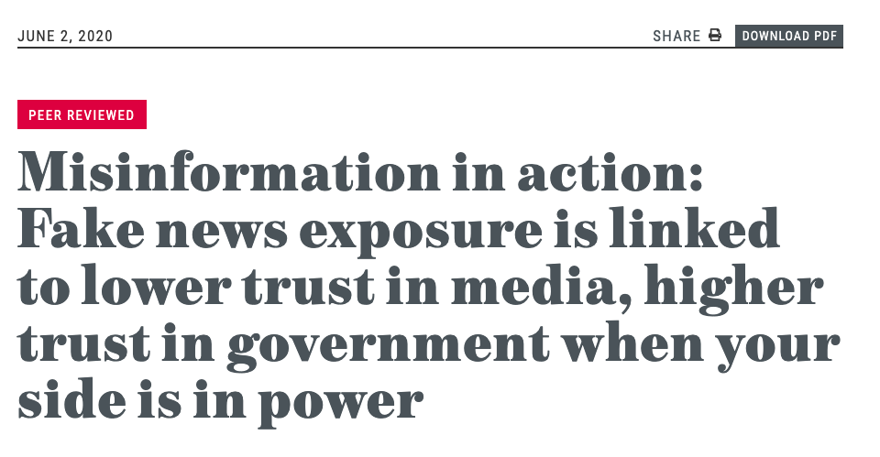
Source: https://misinforeview.hks.harvard.edu/article/misinformation-in-action-fake-news-exposure-is-linked-to-lower-trust-in-media-higher-trust-in-government-when-your-side-is-in-power/

Slide 3
Intent to harm
Misinformation
Disinformation
false content, but the person sharing doesn’t realize that it is false or misleading
content that is intentionally false and designed to cause harm.
Falseness
Notes:
The sharing of misinformation is driven by socio-psychological factors. Online, people perform their identities. They want to feel connected to their ‘‘tribe,” whether that means members of the same political party, parents who don’t vaccinate their children, activists concerned about climate change, or those who belong to a certain religion, race or ethnic group. Disinformation is motivated by three factors: to make money; to have political influence, either foreign or domestic; or to cause trouble for the sake of it.

Slide 4
But what ecosystem sustains these varied forms of misleading information?

Slide 5
CORE ASSUMPTIONS
Individuals will consume news to keep track of their political officials and of world events, and seek out sources of information that affirm their worldviews, and imbue them with credibility.
Elites profit from and ascertain control over identity-confirming discourse
Media outlets and journalists run the risk of punishment if they deviate from this discourse
Notes:
three core assumptions.
Individuals will consume news to keep track of their political officials and of world events, and seek out sources of information that affirm their worldviews, and imbue them with credibility.
Elites ascertain control over their constituents by making sure that media outlets are giving them ample coverage of their identity-confirming discourse
Media outlets and journalists, particularly partisan ones, are incentivized to keep broadcasting identity-confirming discourse or run the risk of punishment.

Slide 6
How misinformation spreads
MEDIA
FOREIGN INTERESTS
PUBLIC
SOCIAL MEDIA
POLITICIANS
PARTISAN GROUPS
Notes:
So I spent a few years thinking about a model for networked propaganda that would be applicable to my local context, and even possibly other Global South countries. This model is based on my work at Meedan and years researching and observing the evolving Lebanese media landscape, the explosion of social media use and the continuously changing power dynamics in the country and the region. It may look confusing here, but I will break this model down in the following slides.

Slide 7
Deliver favorable coverage of identity-confirming politicians;
Attack opponents;
Police deviance from identity confirmation
Deliver identity-confirming news and opinion as a bundle
MEDIA
Seek identity-confirming news & truth
Higher dependency in identity confirming media
PUBLIC
POLITICIANS
The Political Economy of Disinfo
Notes:
Let’s start with the media and the public. The media’s goals and incentives don’t change from the propaganda feedback loop, but the one discrepancy here is the public’s relationship with the media. Trust in media is glaringly low but we still DEPEND on it because of its wide and far-reaching availability and accessibility. It would be wrong to assume that, let’s say independent media outlet Megaphone, is rival to mainstream TV stations LBCI or al Manar because we don’t take into account that almost 30% of the population still doesn’t have access to the internet.

Slide 8
MEDIA
Exert editorial and economic control to ascertain identity-confirming coverage
POLITICIANS
PARTISAN GROUPS
Incentivize their loyal base to amplify support for their narratives
The Political Economy of Disinfo
Notes:
The role politicians play in our case is a lot more explicit: on one hand, they are able to utilize the sectarian clientelistic system to incentivize their loyal base to amplify their support for their “version” of the truth.
On the other hand, the laws passed to regulate print and audiovisual media gives them direct control over the information disseminated. But at the same time, this relationship and dependency on political funding shows us that the media landscape in its iteration today is incredibly fragile and unsustainable. We saw this happening with the shutdown of historical media and newspapers such as Assafir, Future TV, and Al Mostaqbal newspaper.

Slide 9
MEDIA
Cover coordinated behavior as authentic (clickbait stories)
SOCIAL MEDIA
POLITICIANS
Amplify and exaggerate public support of politicians’ narratives
Seek identity-confirming politicians
PARTISAN GROUPS
Incentivize their loyal base to amplify support for their narratives
The Political Economy of Disinfo
Notes:
Partisan groups are then able to coordinate massive campaigns online to exaggerate public support of their politicians’ narratives. We see that on Twitter almost daily, when we look at the trending hashtags and the media cover that behavior online as clickbait stories. And it’s also important to mention their power on WhatsApp, but documenting the flow of disinformation is a lot harder due to it being end-to-end encrypted. I personally saw this play out almost daily in their attempts to discredit the 2019 revolution in its first few months.

Slide 10
MEDIA
Fund information operations to sway public opinion
FOREIGN INTERESTS
Cover coordinated behavior as authentic (clickbait stories)
SOCIAL MEDIA
POLITICIANS
Exert power over politicians
The Political Economy of Disinfo
Notes:
Finally, and most importantly, we can’t deny the power foreign countries have in influencing our political, economic and social realities, either through the control they have over politicians or through the information operations we see on social media platforms that are aimed at misinforming the public. The onus of responsibility here lies on platforms and their inability to protect their users from real-world harm because their content moderation policies fall flat and are so vague that content takedowns usually harm the free speech of independent journalists and people like you and me.

Slide 11
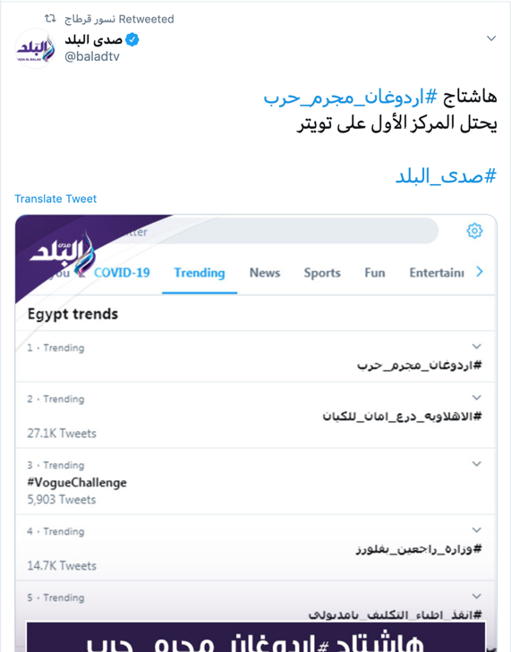
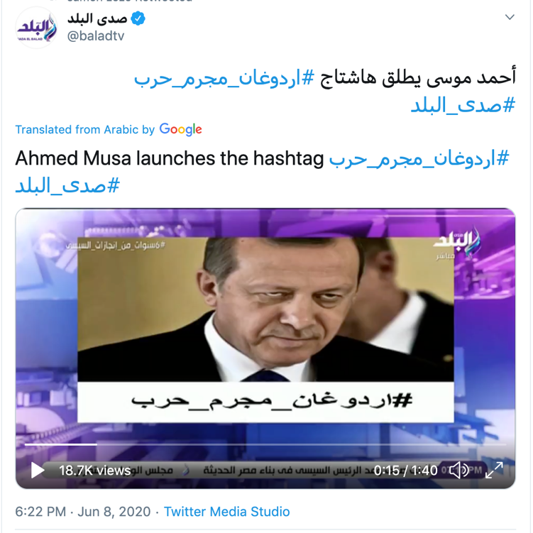
Hashtag laundering
Hashtag laundering is the media coverage of information operations with the aim of increasing engagement on social media and giving the cover of legitimacy and credibility.
Notes:
https://www.latimes.com/world-nation/story/2020-04-08/coronavirus-becomes-new-front-in-middle-east-battle-for-influence
These operations become more dangerous when we see media platforms take responsibility for creating hashtags to give them a legitimate cover. We call this phenomenon hashtag laundering. Remember that the media and social media platforms are tools of power.

Slide 12
Dis/misinformation is an access to information issue

