Slide 1
800,000 Latinos in the U.S. turn 18 every year

Slide 2
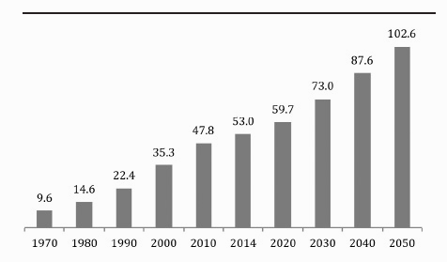
Latino Population (millions)
Latino America 2014

Slide 3
Hispanic/ Latino Population in 2000
35,305,818
 | N | %
Hispanic or Latino: | 35,305,818
Mexican | 20,640,711 | 58.46
Puerto Rican | 3,406,178 | 9.65
Central American | 1,686,937 | 4.78
South American | 1,353,562 | 3.83
Cuban | 1,241,685 | 3.52
2000 Decenial Census

Slide 4
Hispanic/ Latino Population in 2020
59,361,020
 | N | %
Hispanic/ Latino: | 59,361,020
Mexican | 36,537,028 | 61.55
Puerto Rican | 5,699,150 | 9.60
Central American | 5,497,573 | 9.26
South American | 3,819,508 | 6.43
Cuban | 2,332,584 | 3.93
2020 ACS Estimates

Slide 5
Percent foreign born
Calculated using Census

Slide 6
Geography

Slide 7
Most Important Issues 2020
Election Eve Poll 2020

