Slide 1
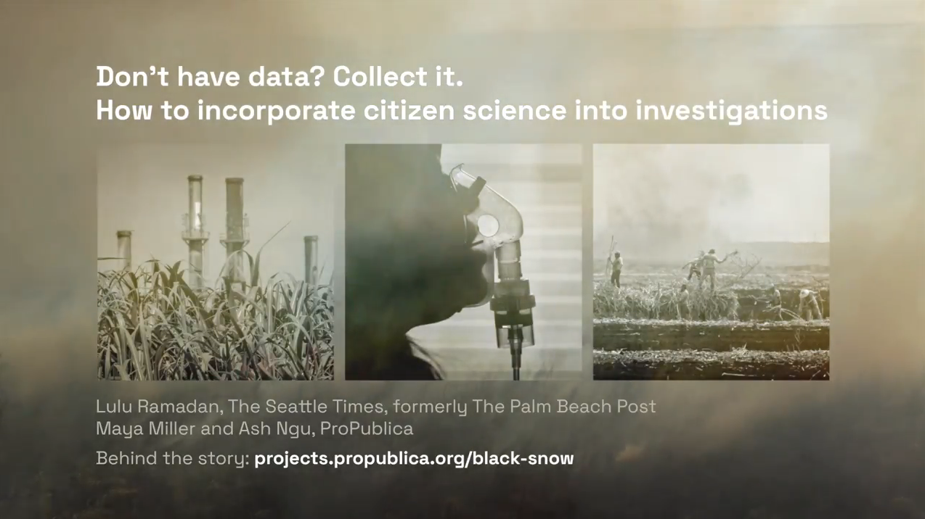

Notes:
Loop video by opening link. Right click on video in GoogleDrive > Loop
https://drive.google.com/file/d/1vqULVkmC-zgWhUqiDmUYZT7nhE43AaWt/view?usp=sharing

Slide 2
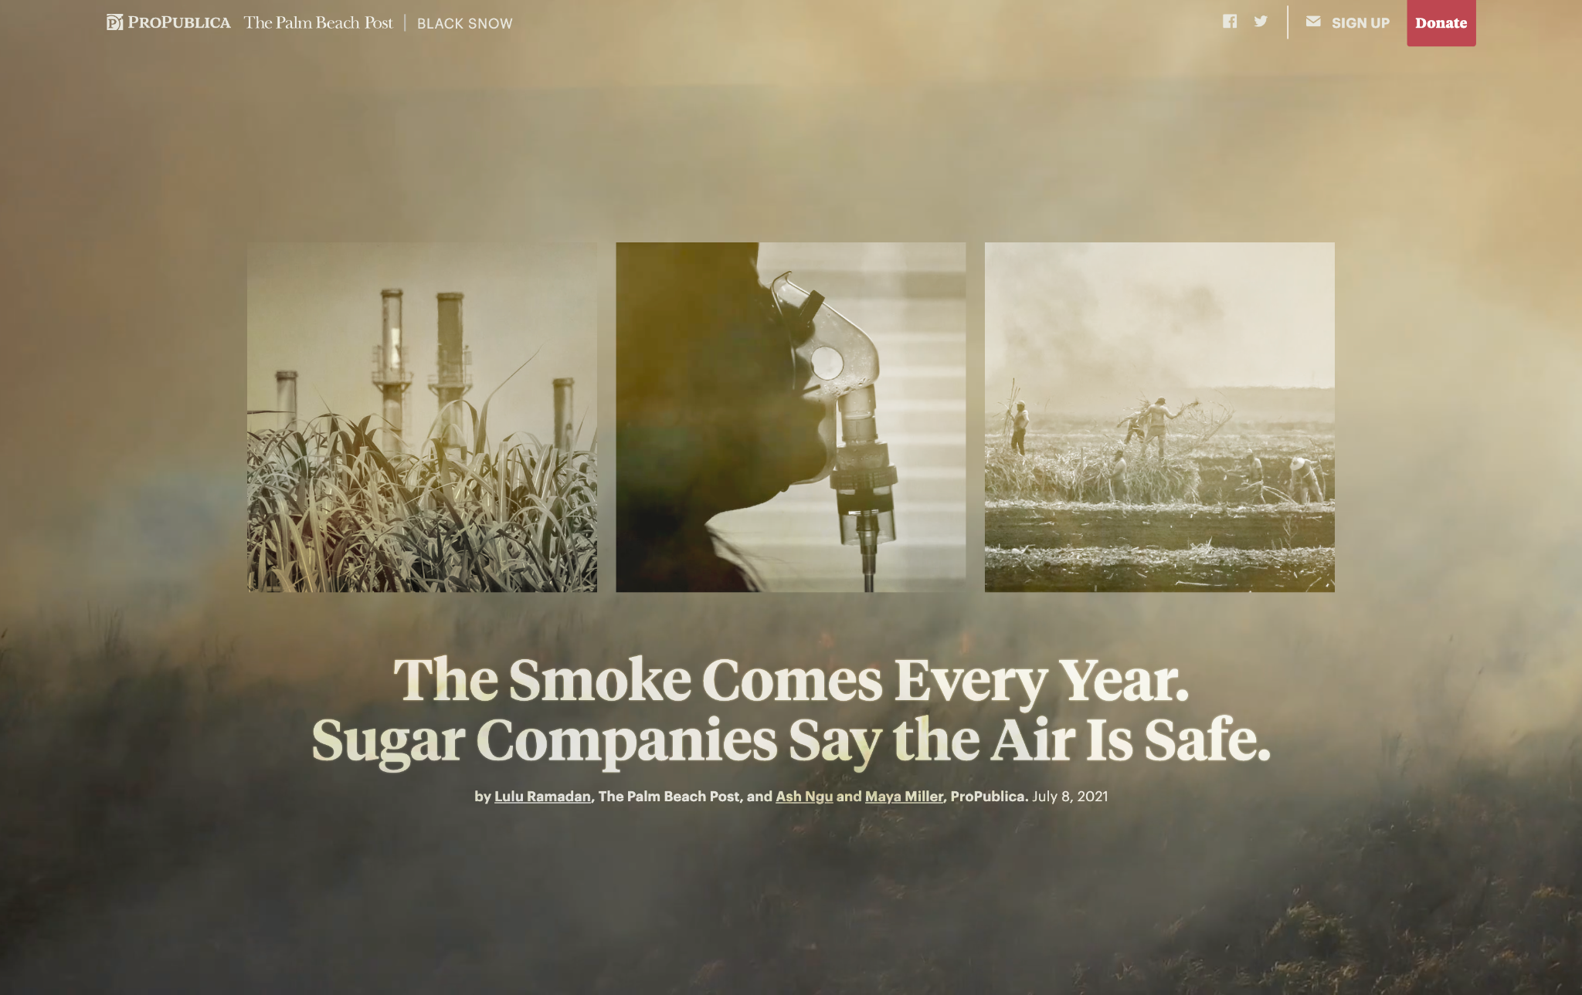
Notes:
Black Snow examined the pollution and health impacts of sugar cane burning in South-Central Florida, where most of the country’s cane sugar comes from. Sugar cane is burned before harvest – it’s the cheapest most effective way to prepare the plant for harvest.

Slide 3
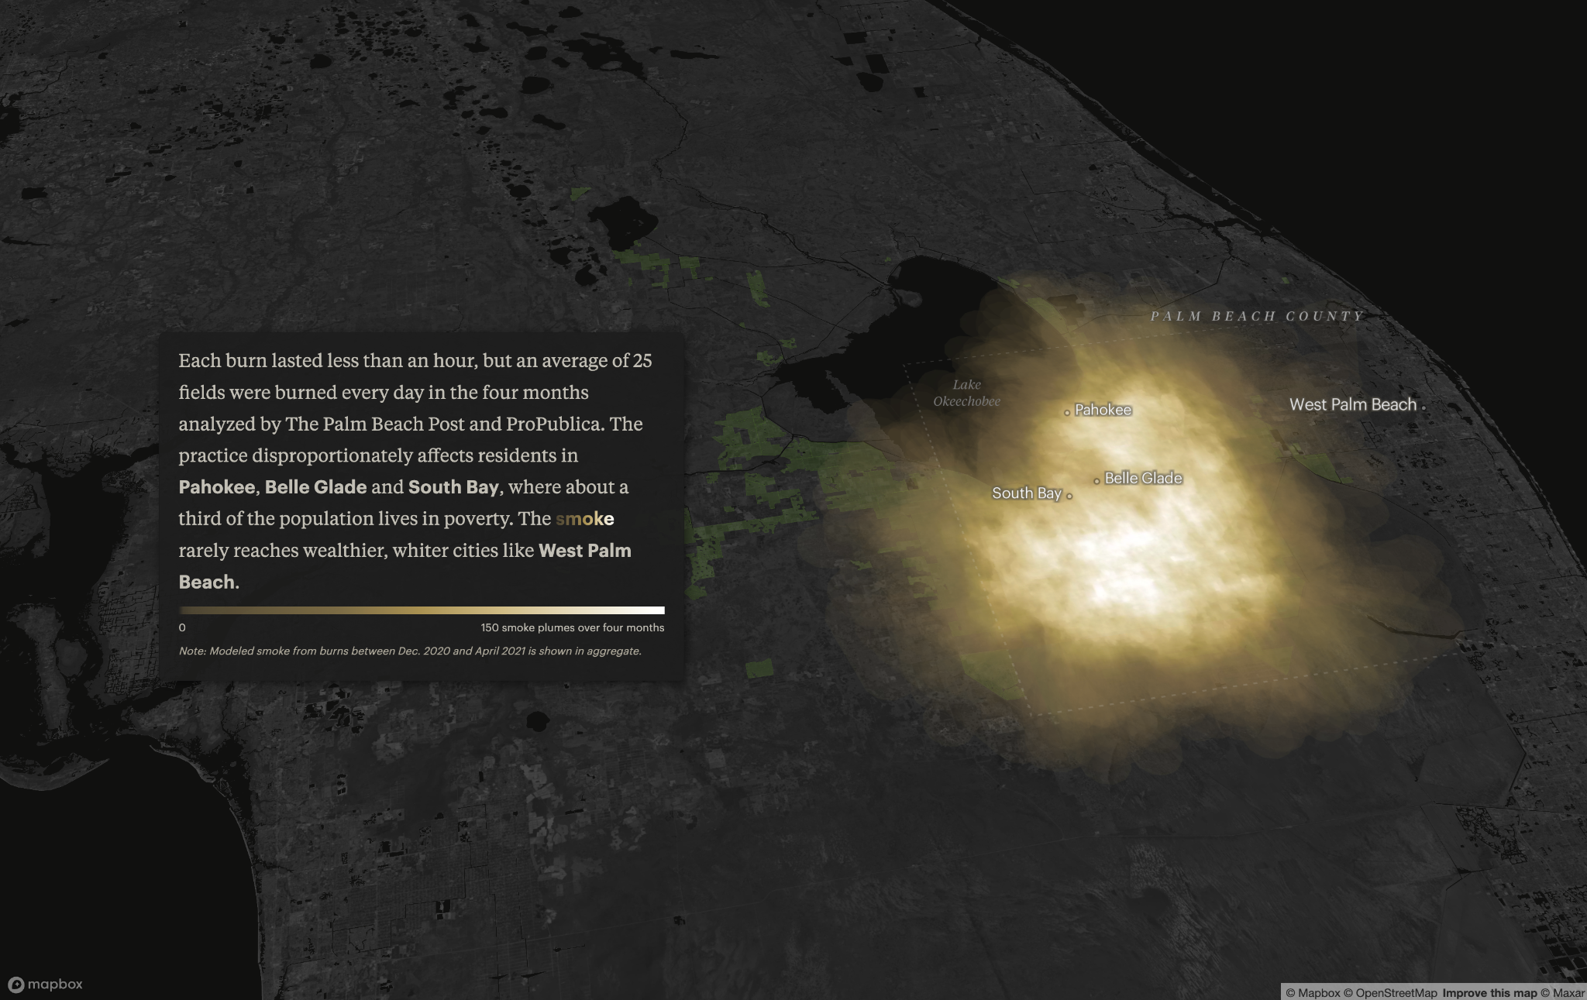
Notes:
We used several data sources (that we’ll dive into in depth in this presentation) to build out this interactive story that takes you into Florida’s heartland and explains where the fires are concentrated and how they mainly affect the poor, low-income communities you see highlighted by the fire map here – and not the wealthier, whiter coastal cities – including Trump’s home just 40 miles east of this area.

Slide 4
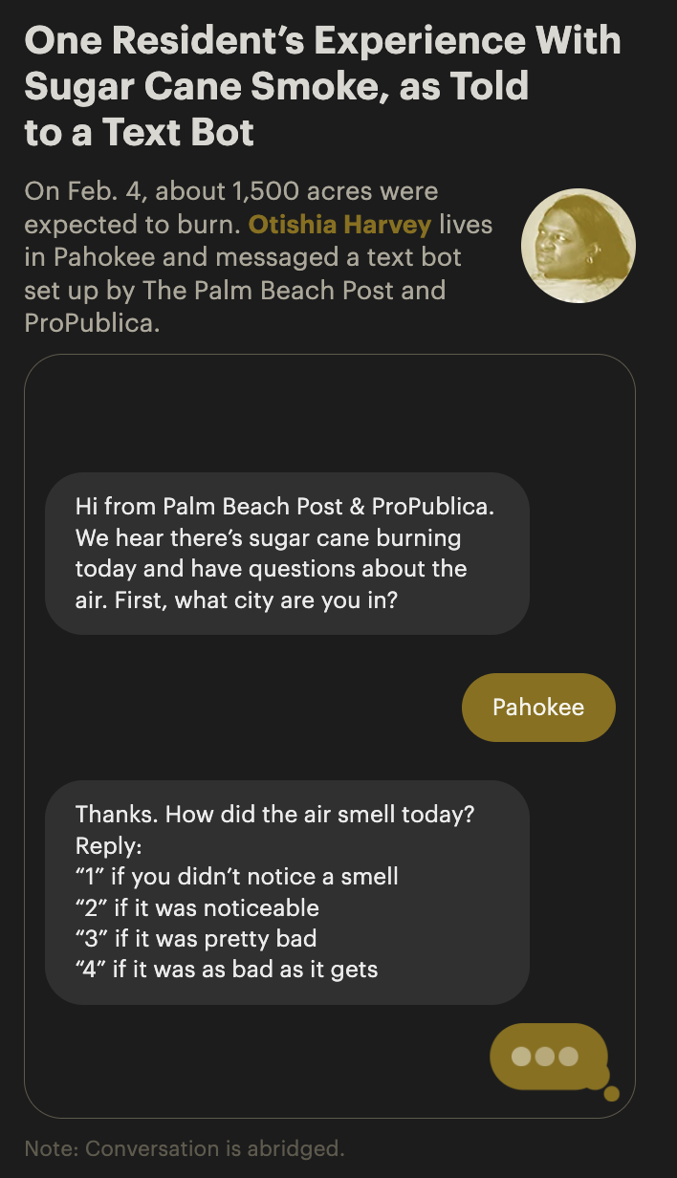
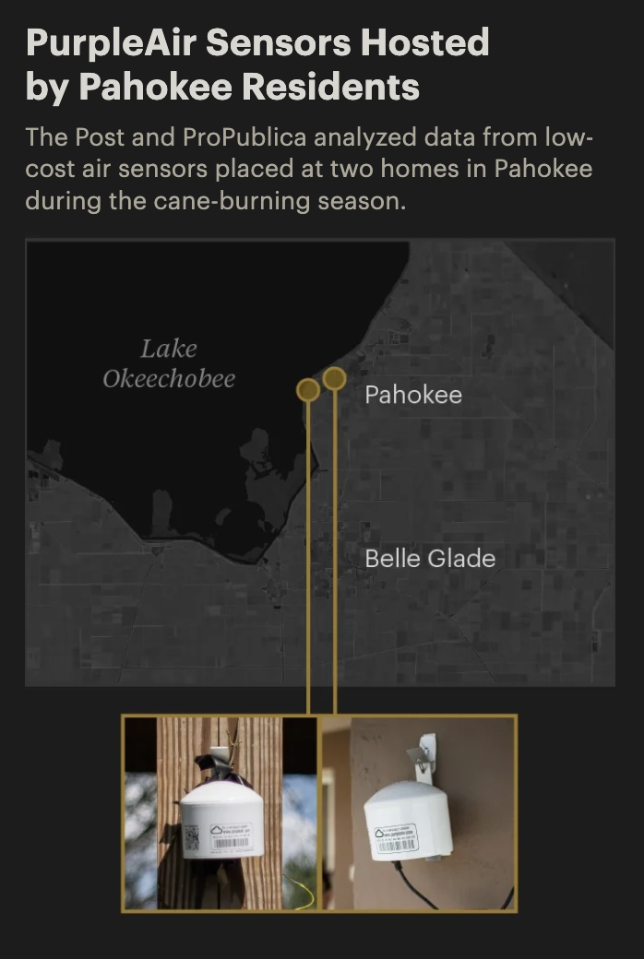
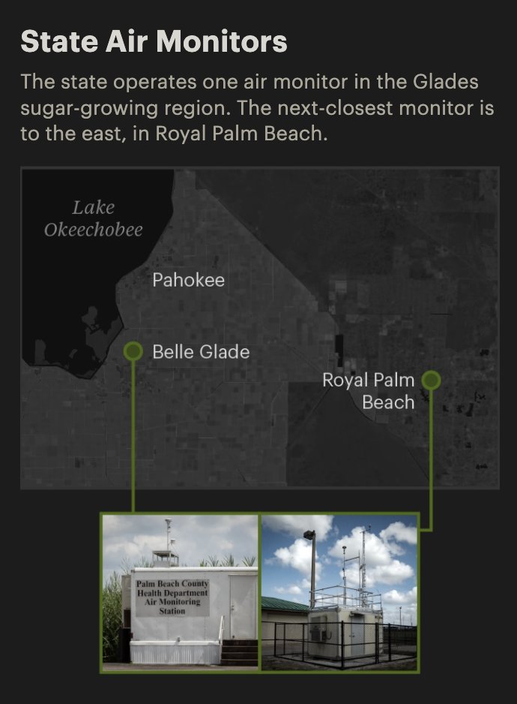
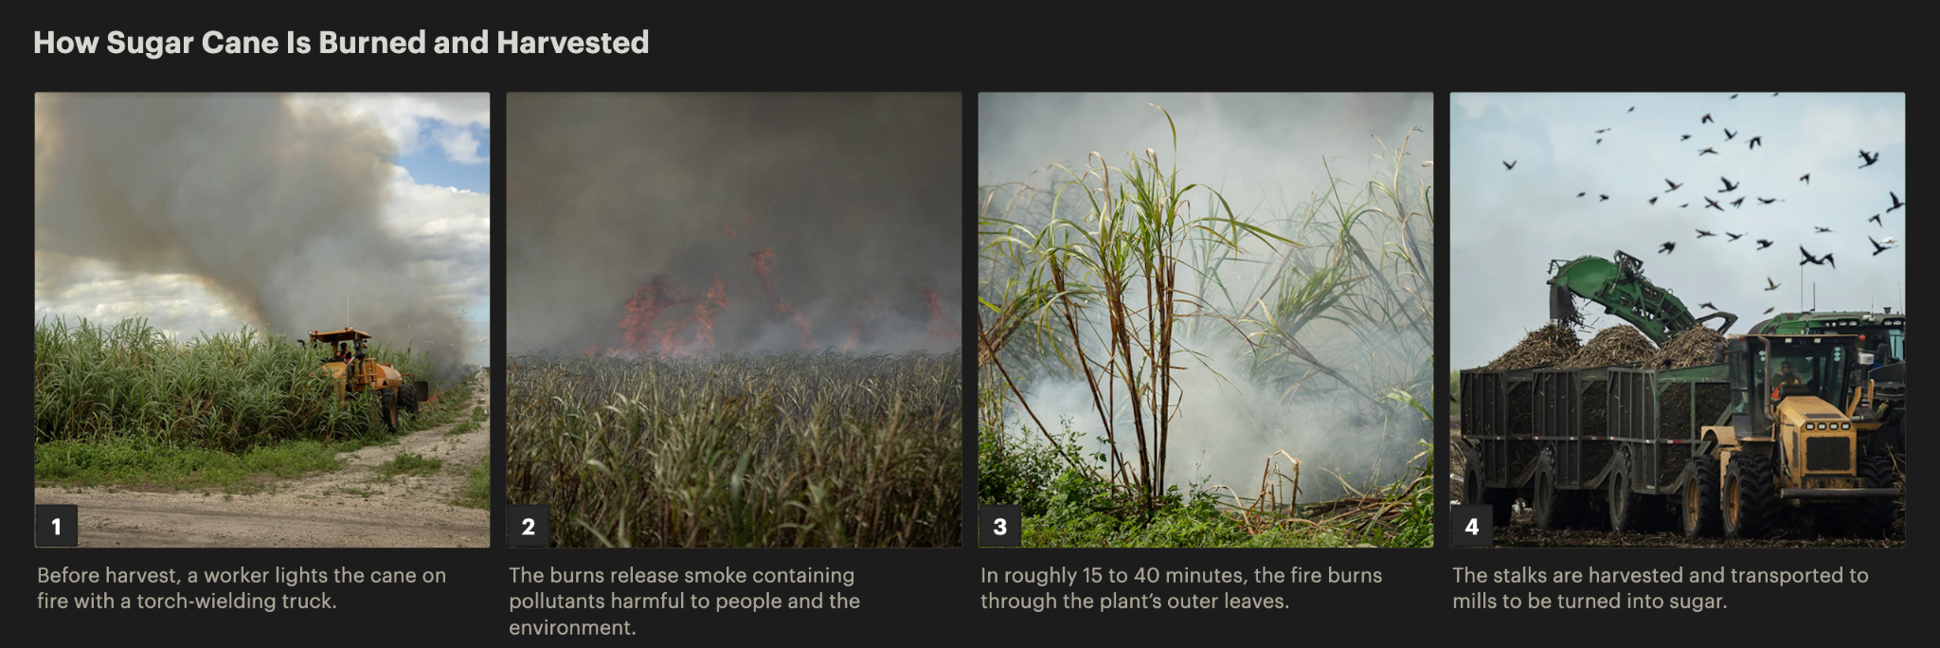
Notes:
When we realized we couldn’t get reliable air quality data from government agencies, we consulted experts and built out a plan to collect it ourselves using low cost air sensors, which were becoming increasingly more popular, even within the EPA, because they are a cost-effective way to fill gaps in air monitoring in huge swaths of the country.
We’ll talk more about the specifics of the tactics we used, but ultimately we found …

Slide 5
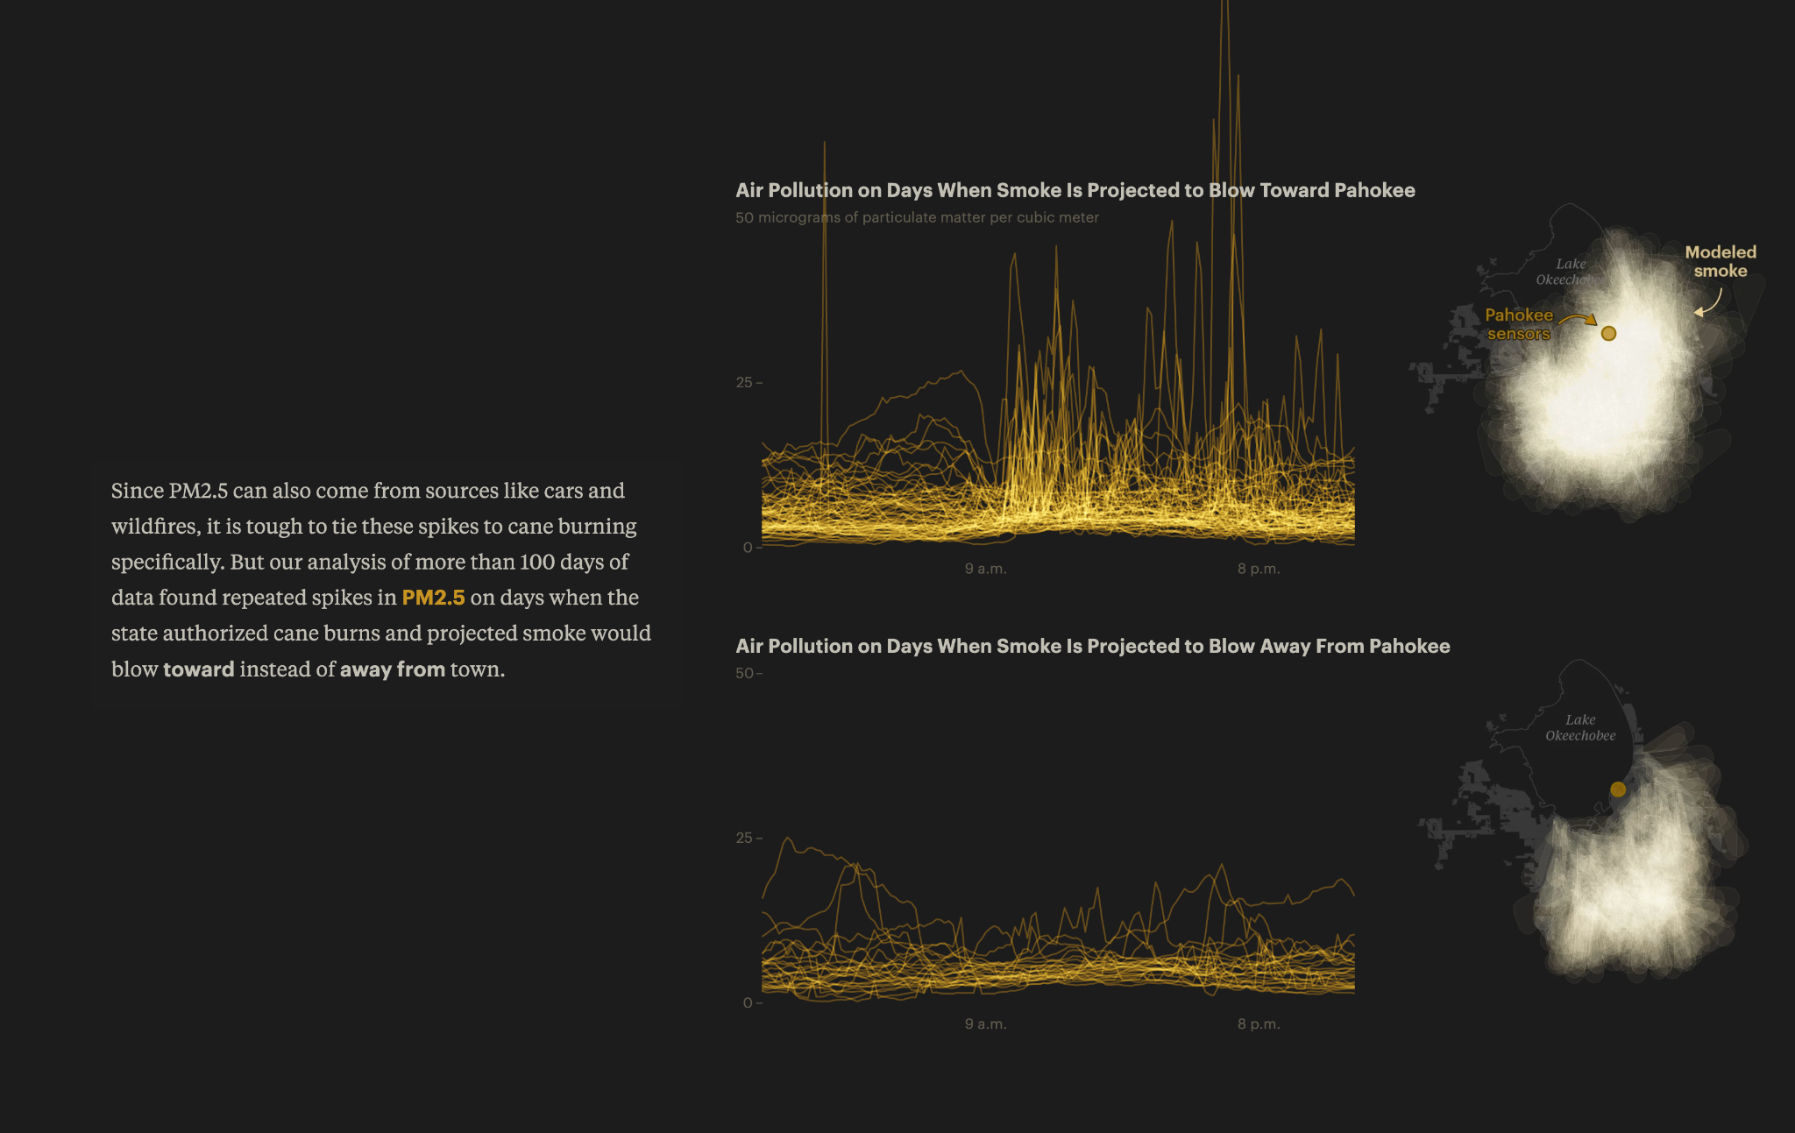
Notes:
Here’s what that looked like over the course of the harvest season.
This is a comparison of toward and away that helped us bolster our ultimate findings that pollution spikes in short bursts during sugar cane burning events.

Slide 6
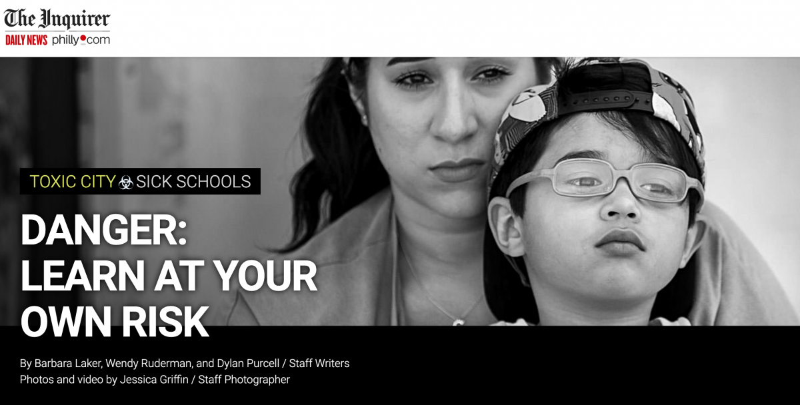
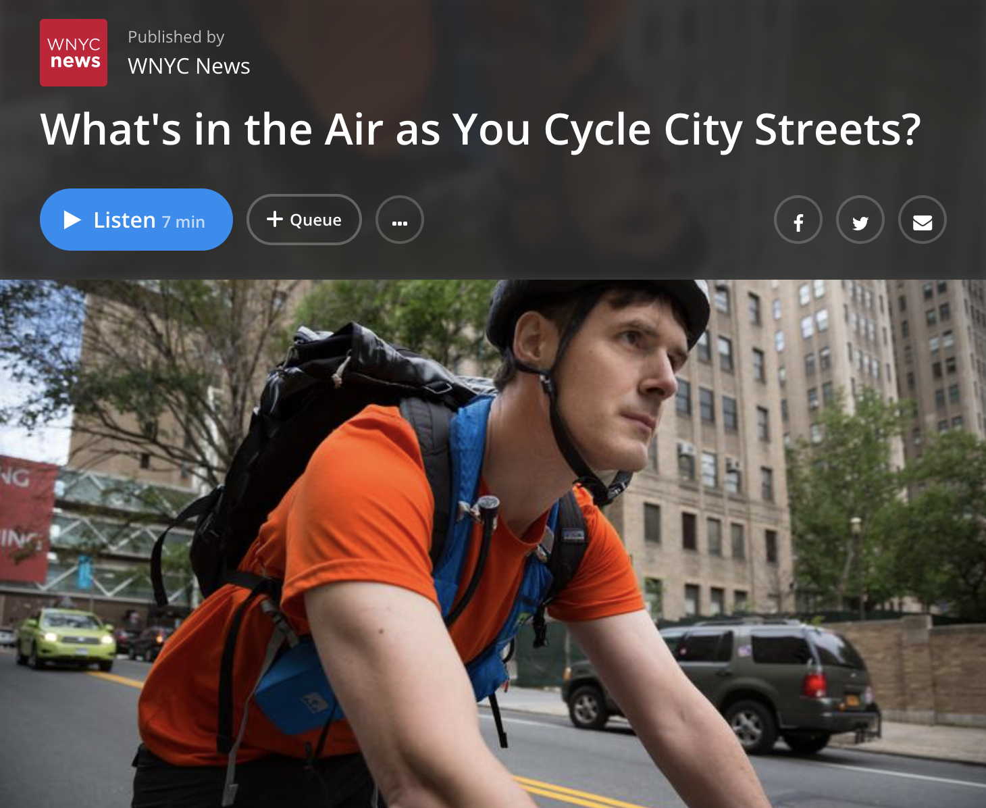
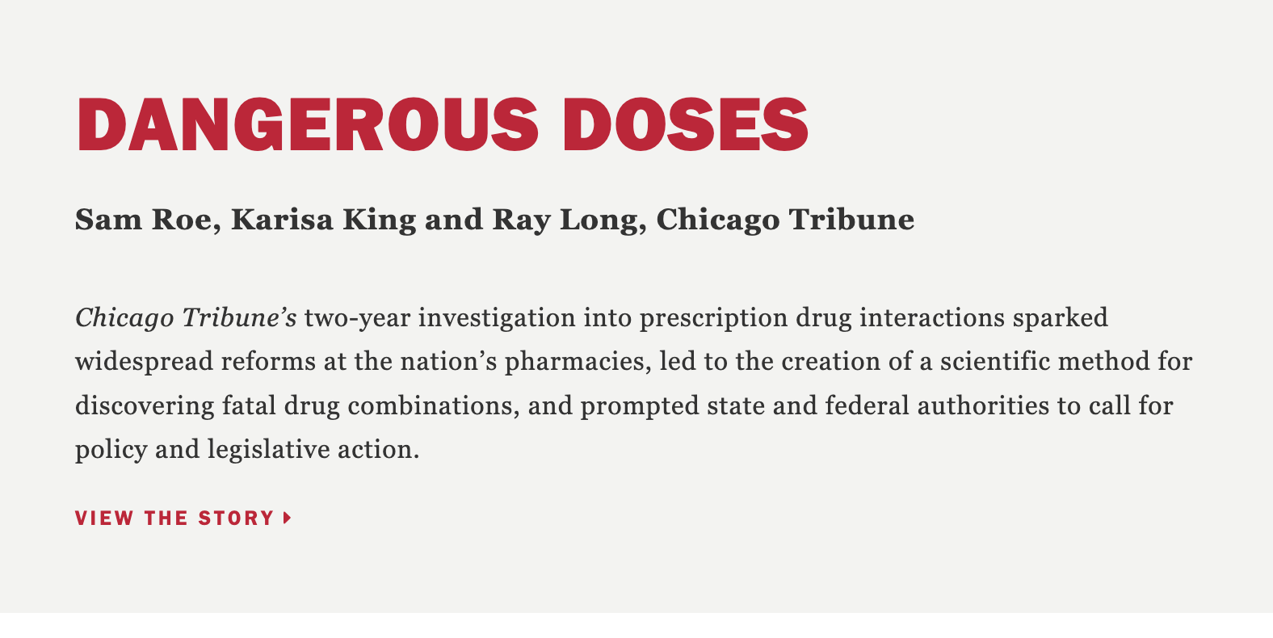
What is citizen science? And how can we use it as journalists?
Notes:
Citizen science is the practice of public participation and collaboration in scientific research to increase scientific knowledge. It’s also known as “amateur science” and it’s perfectly useful for reporting as long as you’re up front about the limitations of being experimental without being a scientist.
Increasingly, we’re seeing journalists get really creative with their empirical approaches to stories. When they see a need for an academic-style analysis, they step in to fill it.
Philly Inquirer’s Toxic City - which included several approaches, collecting soil samples at local parks and playgrounds to test lead levels; collecting water and dust samples are area schools; they learned how the testing worked by going to a local lab and getting a demonstration; they partnered with school employees to collect samples on campuses
Chicago Tribune’s Dangerous Doses - Exposed the perils of drug prescription combinations (an underregulated and occasionally fatal aspect of health care); reporters consulted with pharmaceutical academics on perilous and common prescription drug combos and sought prescriptions in their own names
WNYC’s What’s in the air - WNYC partnered with Columbia University to test air quality in New York City by attaching air quality monitors to bicyclists; the partnership allowed WNYC to solicit volunteers and take on the traditional reporting while a team at Columbia analyzed the data to inform a rolling series with pieces like “Pedaling through Pollution” and “Biking and Breathing”
What did all of these stories have in common? They relied on the help of experts and they were very transparent about the methodology and limitations of the approaches.

Slide 7
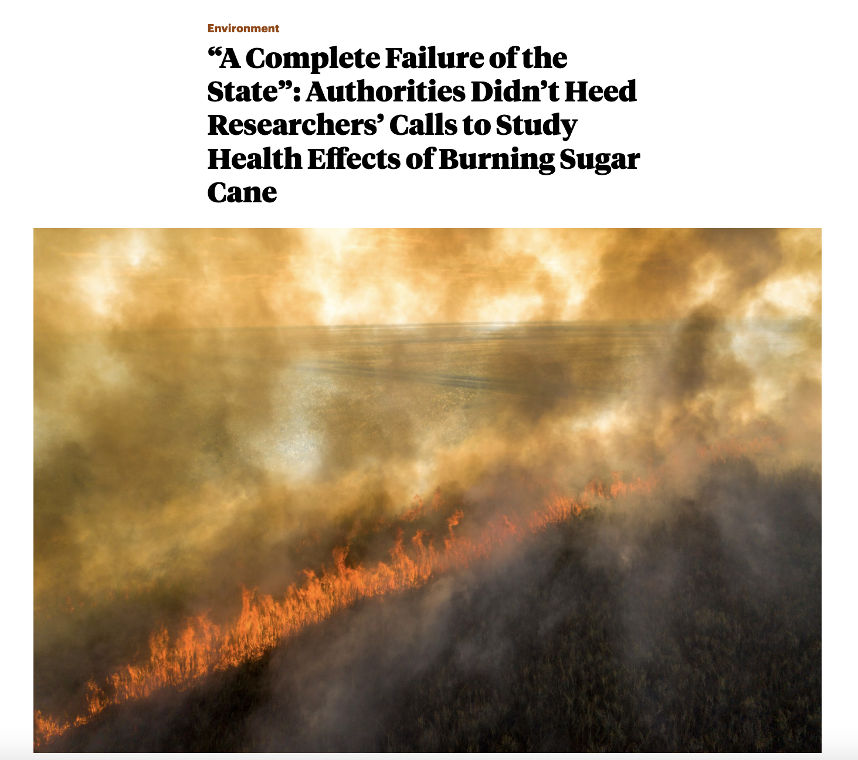
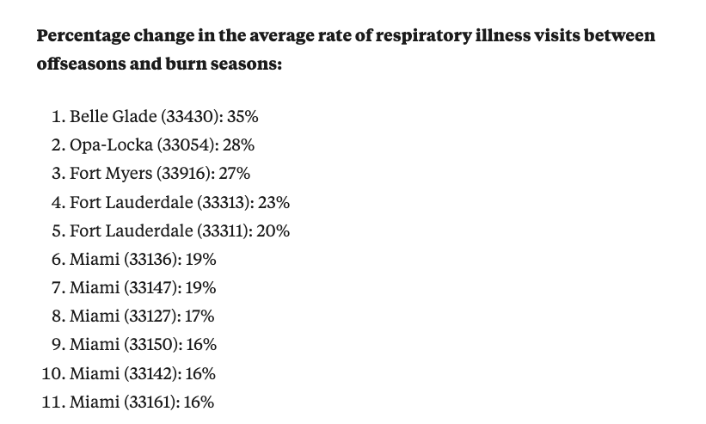
Part 2: Health data analysis
Used state hospitalization and emergency room admission data
Mimicked (at the advice of a panel of experts) academic studies that had tracked the impacts of sugar cane burning in Hawaii, Brazil and Thailand
Used R to narrow the large dataset and identify key illnesses (using ICD-codes identified by academic studies)

Slide 8
2020
2021
April
May
June
July
Aug
Sep
Nov
Dec
Jan
Feb
Mar
April
May
June
July
Foundational reporting; records requests; contacting academics; reading reports; mining for sources; etc.
After identifying the universe of people: Letter writing, follow calls
Consulting experts on PurpleAirs; informal advisory panel
Finding PurpleAir hosts, textbot sign-ups, interviews
Collecting burn + air quality data
Writing, editing, rewriting, re-editing
Analyze data
Mockups
Design and development
Bulletproofing
Share findings
🎉 Publish!
Notes:
So what does that whole process look like? Well … long. As you can see from our timeline, we spent roughly 15 months on the project, from forming the approach, finding community partners and collecting the data for months.
We’re going to take you through the practical tips we learned along the way (both on the reporting and the detailed data side).
Lulu to add in her start & end dates (records requests, putting in LRN proposal)
Added “writing” roughly january to june

Slide 9
Engagement

Slide 10
How to start building an outreach strategy
Community research
American Community Survey
Interviewing & listening to community leaders
Identifying community characteristics
Do I have a prior relationship with these communities?
Am I part of the communities that I’m covering?
Have they been talking about what I’m reporting on? If so, where?
Notes:
Do your homework
Check your own biases and relationships; ask yourself simple questions that will guide the work

Slide 11
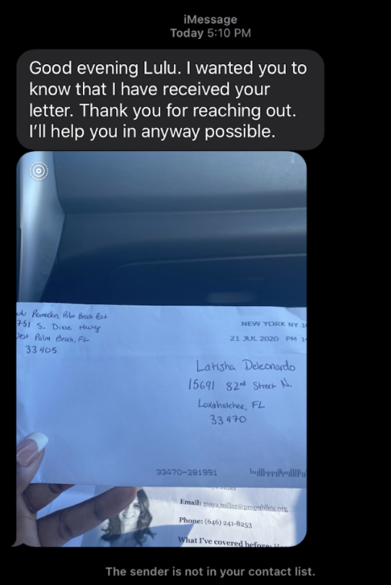
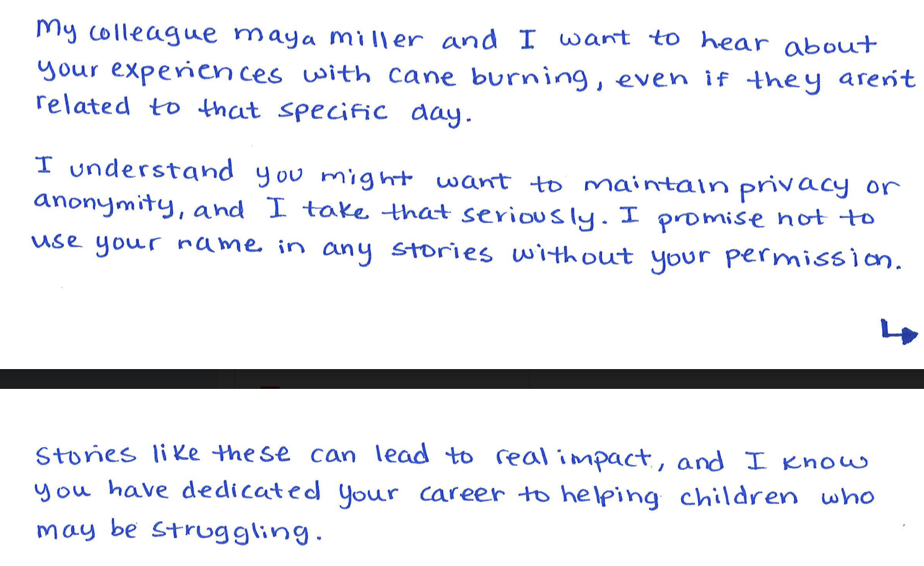
Executing outreach strategy
Letter writing
Follow-up phone calls & texts

Slide 12
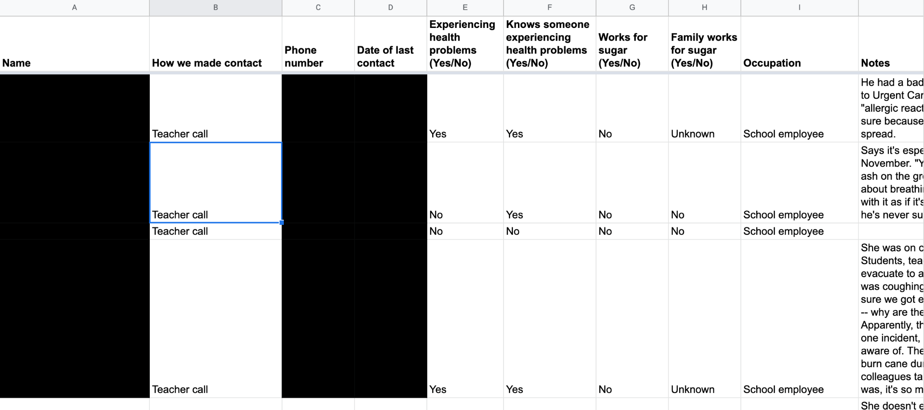
Staying organized

Slide 13
Data collection and analysis
🛠️: PostgreSQL, QGIS, R
Notes:
The task on the data analysis side of the project was to figure out if we could prove a connection between sugar cane burns and air pollution in residential areas of the Glades.

Slide 14
Data challenges
Mismatch in time specificity of air quality measurements (real-time) and timestamps of individual burns (daily)
Burns are short (15 to 40 min) and official air quality measurements are routinely averaged over hour or 24 hour periods
Dispersed burning: dozens of small burns take place over a large area
Notes:
Now at face value, it seems like this should be a straightforward thing to prove. Burning things releases smoke. And in theory that smoke would show up on the sensors as increased levels of particulate matter.
But, sugar cane burning in particular presents a few challenges.
First, we didn’t know exactly when burns took place. The burns were timestamped only to date and a broad window when they might burn. So it would be impossible to say “oh this burn started at 9am, and then at 930 am, we saw elevated levels of particulate matter 2.5 (PM 2.5) in our sensors because of that burn.”
Second, the burns are pretty short. They take roughly 15 to 40 minutes on average. Most regulatory air quality standards are averages over hourly intervals or 24 hour periods. This decreases noise, but also means that actual short term spikes in pollution could get averaged out over these longer time durations. We eventually decided to average our data over 10 minute intervals which experts said was kosher because of the short-term nature of cane burns.
Third, the burns take place over 400,000 acres of land and we only had a couple of sensors deployed. This dispersed quality makes the impact of cane burns harder to track.

Slide 15
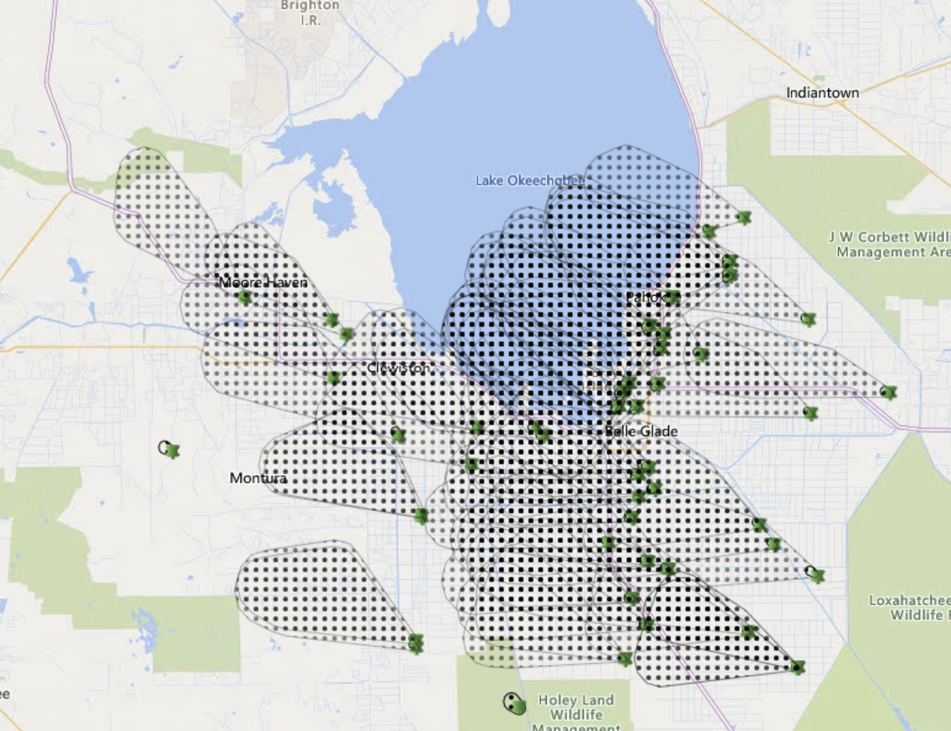
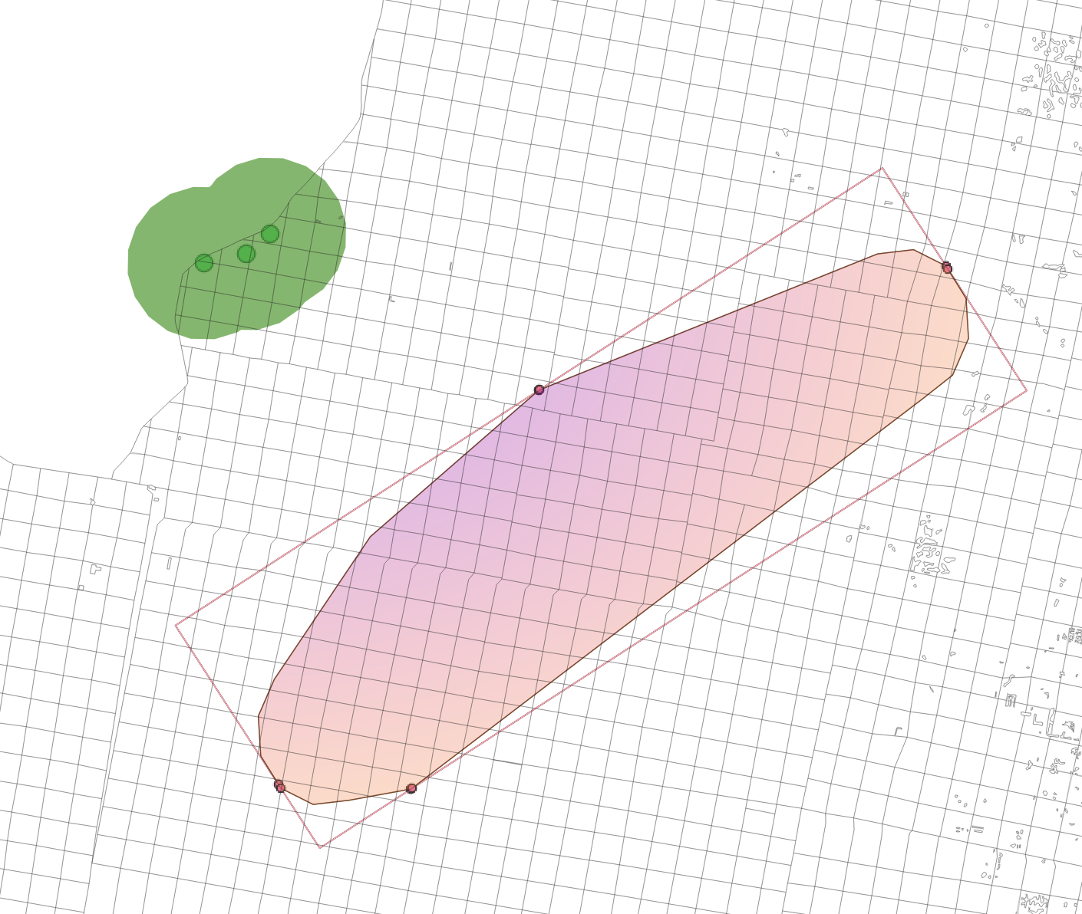
Burn permit and smoke plume data
Scraped from the state on a daily interval
FOIA’ed for the final cut of data
Burn permits: spreadsheet
Burn and smoke plume locations: GeoJSON files
urls = {
"active_oba_areas" => "http://fireinfo.fdacs.gov/MapProxy/REST/9.0/Map/FMIS_MAP_Public/Features/Active%20OBA%20Areas/Query/?Format=JSON",
"active_oba_broadcast_burns" => "http://fireinfo.fdacs.gov/MapProxy/REST/9.0/Map/FMIS_MAP_Public/Features/Active%20OBA%20Broadcast%20Burns/Query/?Format=JSON",
"active_oba_pile_burns" => "http://fireinfo.fdacs.gov/MapProxy/REST/9.0/Map/FMIS_MAP_Public/Features/Active%20OBA%20Pile%20Burns/Query/?Format=JSON",
"active_oba_plumes" => "http://fireinfo.fdacs.gov/MapProxy/REST/9.0/Map/FMIS_MAP_Public/Features/Active%20OBA%20Plumes/Query/?Format=JSON",
"active_oba_ash_plumes" => "http://fireinfo.fdacs.gov/MapProxy/REST/9.0/Map/FMIS_MAP_Public/Features/Active%20OBA%20Ash%20Plumes/Query/?Format=JSON"
}
Notes:
In any event, to do the analysis, we first had to collect data. The state agricultural department issue burn permits and makes projections of how that smoke will travel.
Each dot is a burn location and each cone is a smoke “plume.” That data is posted publicly online on a map that is updated on a daily basis.
We had previously had a hard time getting records from the state, so the idea of relying on them to regularly give us data throughout our collection period was not reasonable.
In order to get the data as soon as it was posted, we actually set up a scraper that pulled down the geoJSON files that populated the online map.
Then at the end of our data collection period, after four months or so, we FOIA’ed for the final “official” cut of data.

Slide 16
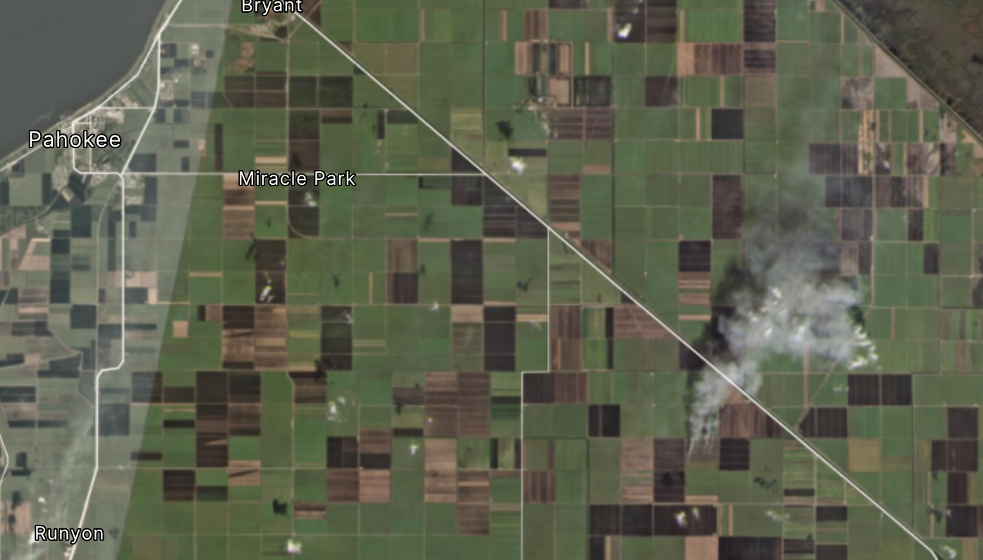


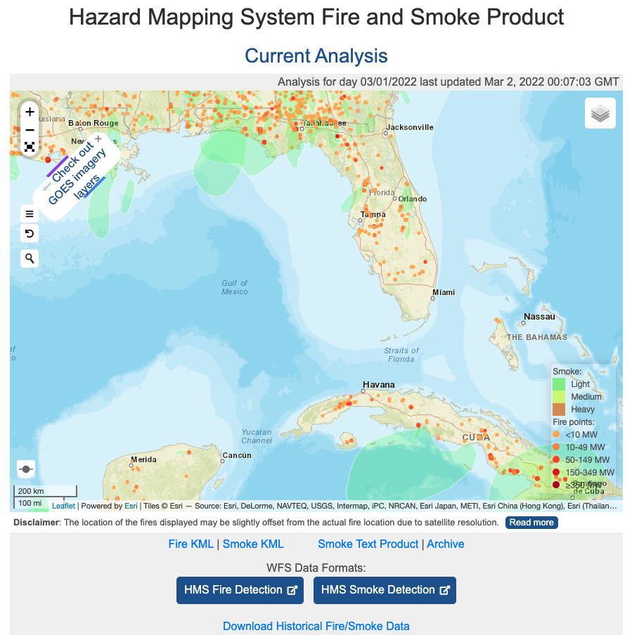
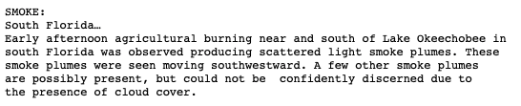

Exploration of alternative datasets
Notes:
In addition to those necessary sets of data we also explored other datasets.
Both NASA and private companies have a bunch of satellite data products. Cane sugar burns are actually visible from space when there’s no cloud cover and an imaging satellite happens to pass over the area during daytime burn hours. In the top left hand corner is one plume that was captured by a PlanetLab satellite.
NASA also has a group of analysts who work on this thing called the “Hazard Mapping System Fire and Smoke Product”-- literally people look at satellite images, circle the smoke plumes, and then publish a text report of what they observe on a daily basis. I was momentarily entranced by these reports and wanted to use them in some way because over and over again, they would point out agricultural fires in the Florida region.
We didn’t end up including these in our analysis or in any visual elements, but it was important research to do, just to make sure we knew the universe of possibilities.

Slide 17
Design and development
🛠 : Mapbox Studio + GL JS, GDAL, D3, HTML, CSS, Javascript, Illustrator, Google Docs + ArchieML
Notes:
Moving onto the design and development phase: We got to a point with our analysis where we felt confident that the data strongly suggested a link between air pollution and cane burning. We had collected data over 100 days of the burn season and we found repeated spikes in PM2.5 on days when cane smoke was projected to blow toward Pahokee. The question became: okay how do visually present what we’ve done over the past months with these sensors and explain those findings to readers.

Slide 18
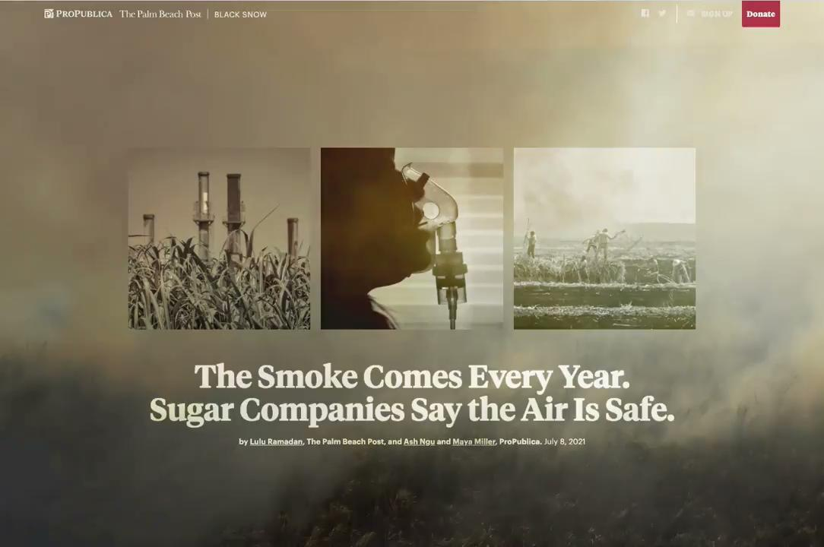
Notes:
Returning to that top visual, this is what the final version looked like. The opening visual has an important job. It acts similarly to a lede in text in that it summarizes and reinforces the topic at hand. So from this collage we see in the background a field vaguely burning, there’s smoke, there’s industrial infrastructure and some kind of crop growing, there’s someone with a respirator, people working in fields. Using this collage + hed, we are able to communicate instantaneously with the reader what this story is about.
But this intro didn’t start out like this

Slide 19
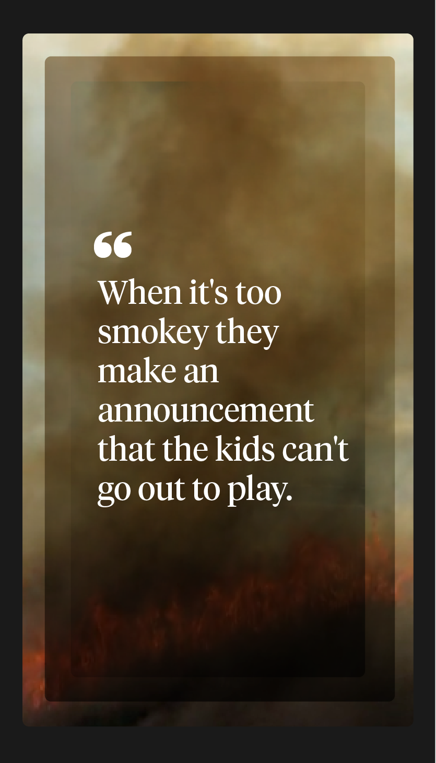
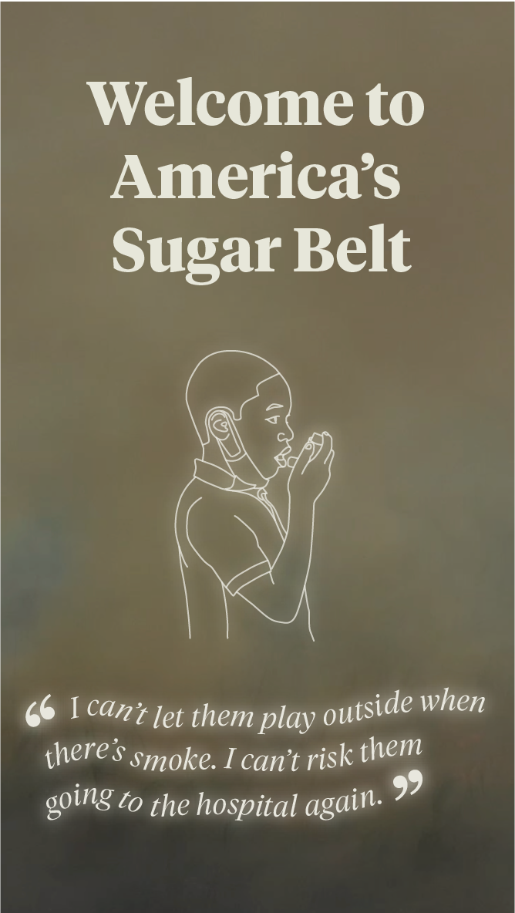
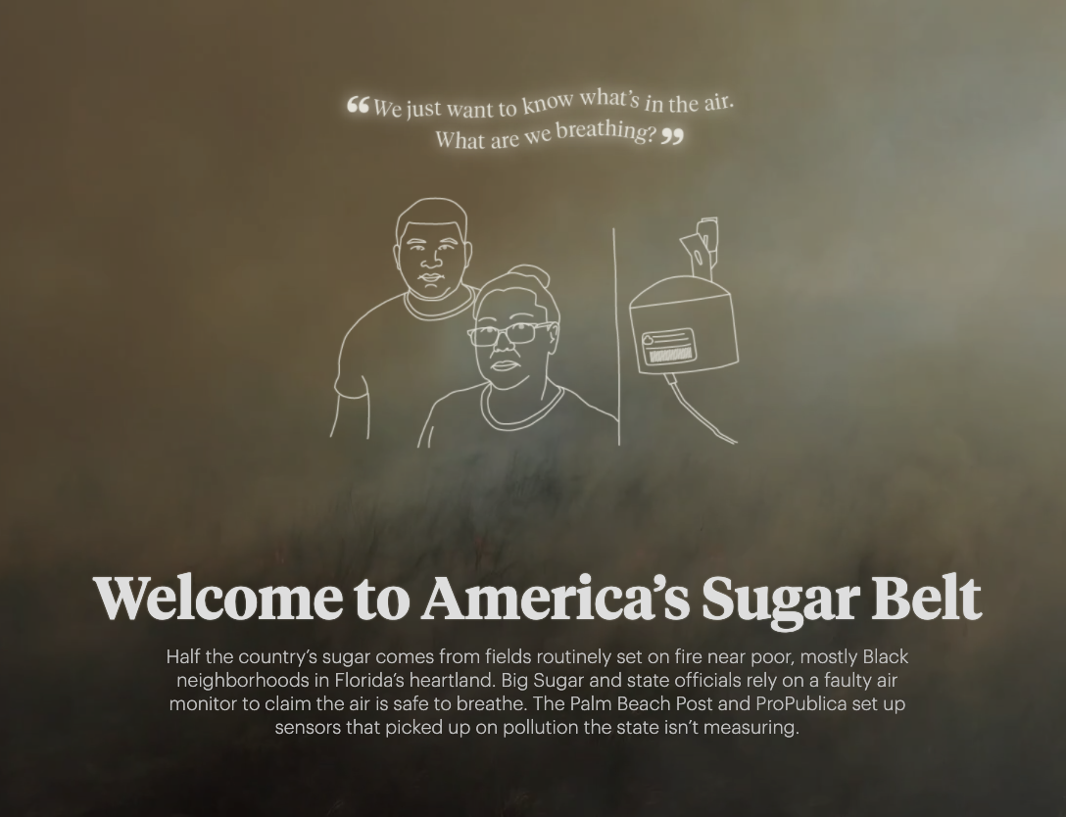
Notes:
I had started with these mockups which put a strong emphasis on the voice of the residents. These used the same drone footage of a cane burn, that our photographers had gotten, but instead that video was combined with quotes and portrait illustrations instead of photos.
We had versions that looped through three sets of quotes and portraits or took you through them one by one as you scrolled. And you can see the hed we were working with at that time was more generic than what we ended up going with. We got pretty far with this combination. But in conversation with our photo/art direction team, we ultimately decided to scrap this in favor of a photo collage. There were a number of reasons, but among them were: a concern of redundancy if we wanted to use the same photos in the rest of the story, as well as a feeling that we were asking readers to take in a lot of text right when they land on the page.

Slide 20
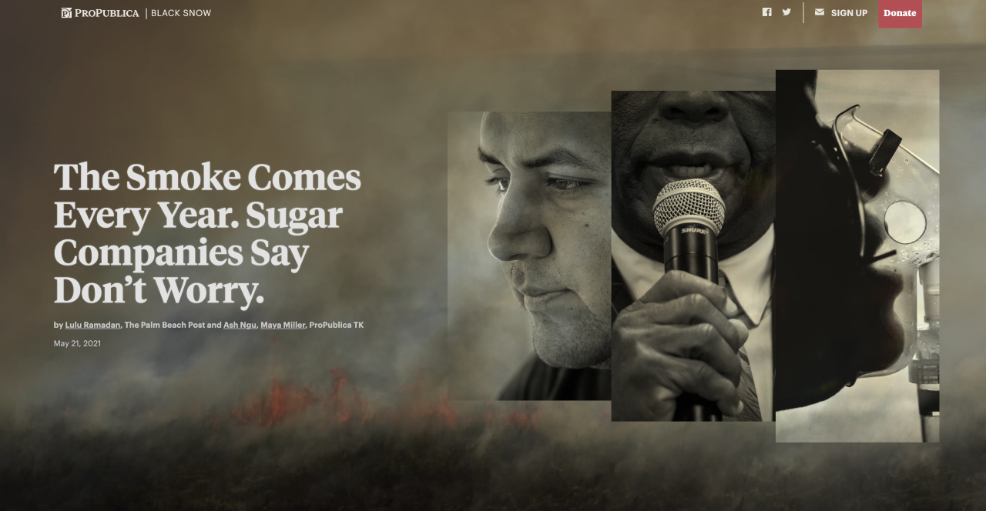
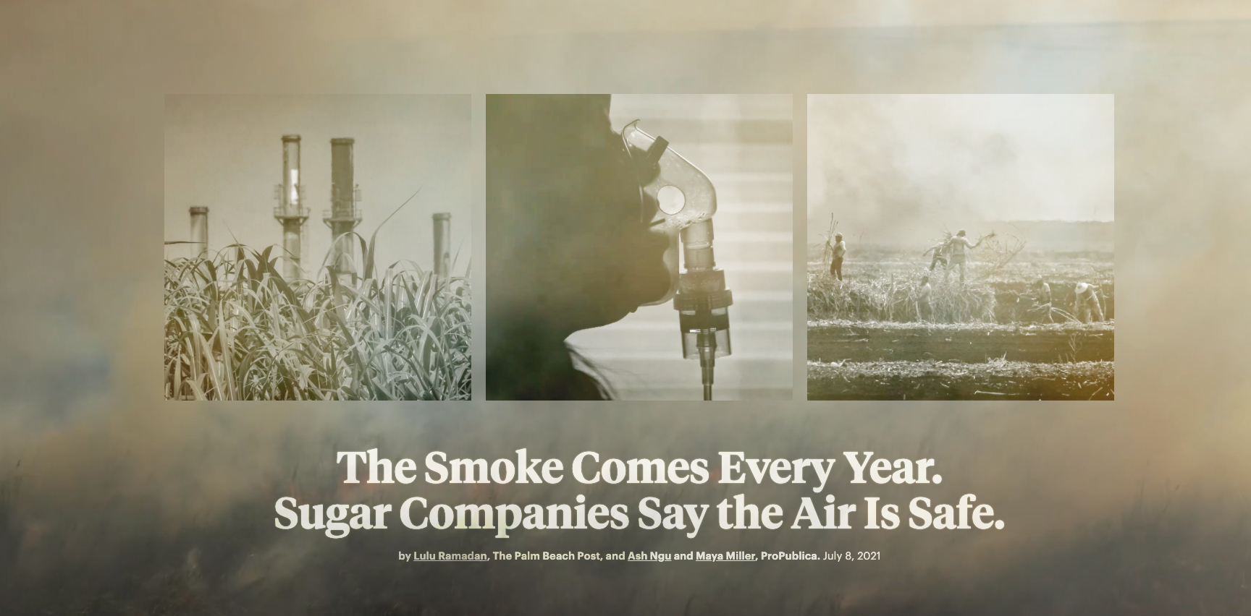
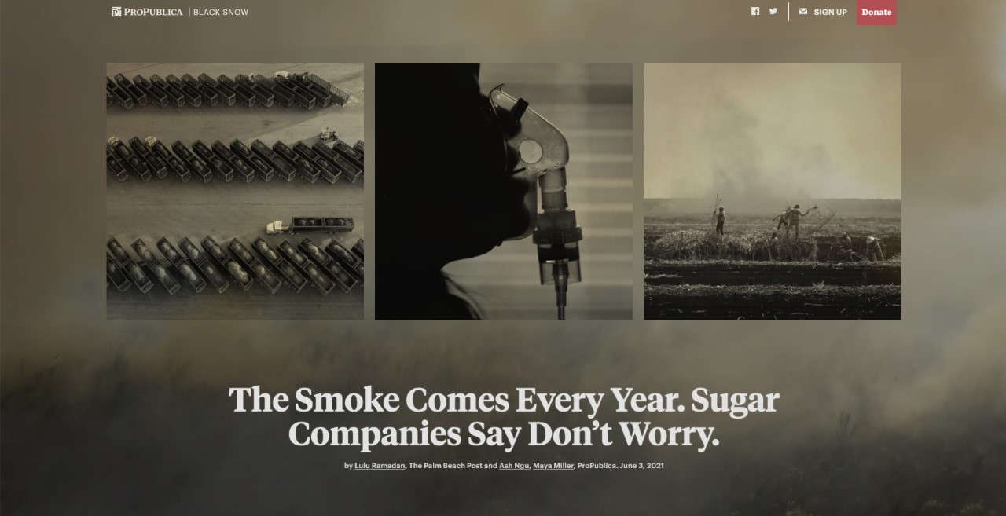
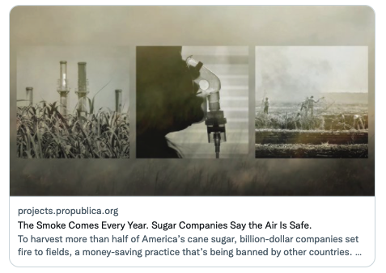
Notes:
The first iterations of photo collaging again placed a lot emphasis on people. We had these three residents, one a sensor host, one a mayor, one another resident.
But we wanted to depict industry more. We had a version with trucks and workers. The trucks felt too generic and far away and the orientations were mismatched top down, versus ground view. So we swapped out that for a photo of cane sugar with industrial stacks in the bkgd which hit the right notes.
You can also see that we tried a different cut of the background video with more flames versus smoke. We had like a 5 minute drone video to cut a ten second clip from. Some cuts had lots of flames, which felt too apocalyptic as the opener. We had other cuts that were more sky than smoke and had lots of panning movement. So we landed on this goldilocks ten second slice where the camera is not moving, there’s smoke passing through with some plants, and more subtle flickers of flame.
And the purpose of this collage was really to hit on what air pollution *feels* like to people. Line charts, data abstractions don’t really accomplish that as well as photo/video.
It was also necessary to collaborate closely with the photographers because we needed a specific shot. We asked for these drone videos to be taken and for there to be moments when the camera was not moving but still recording. This level of involvement in photo direction is part of the gamut of skills that are useful as a graphics editor.

Slide 21
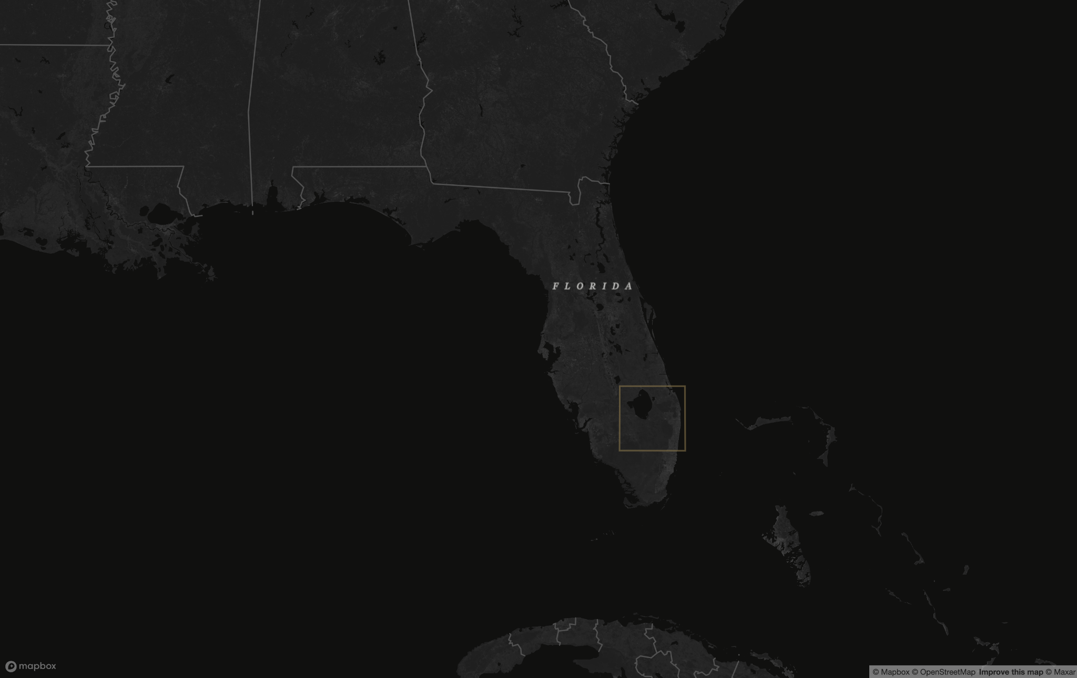
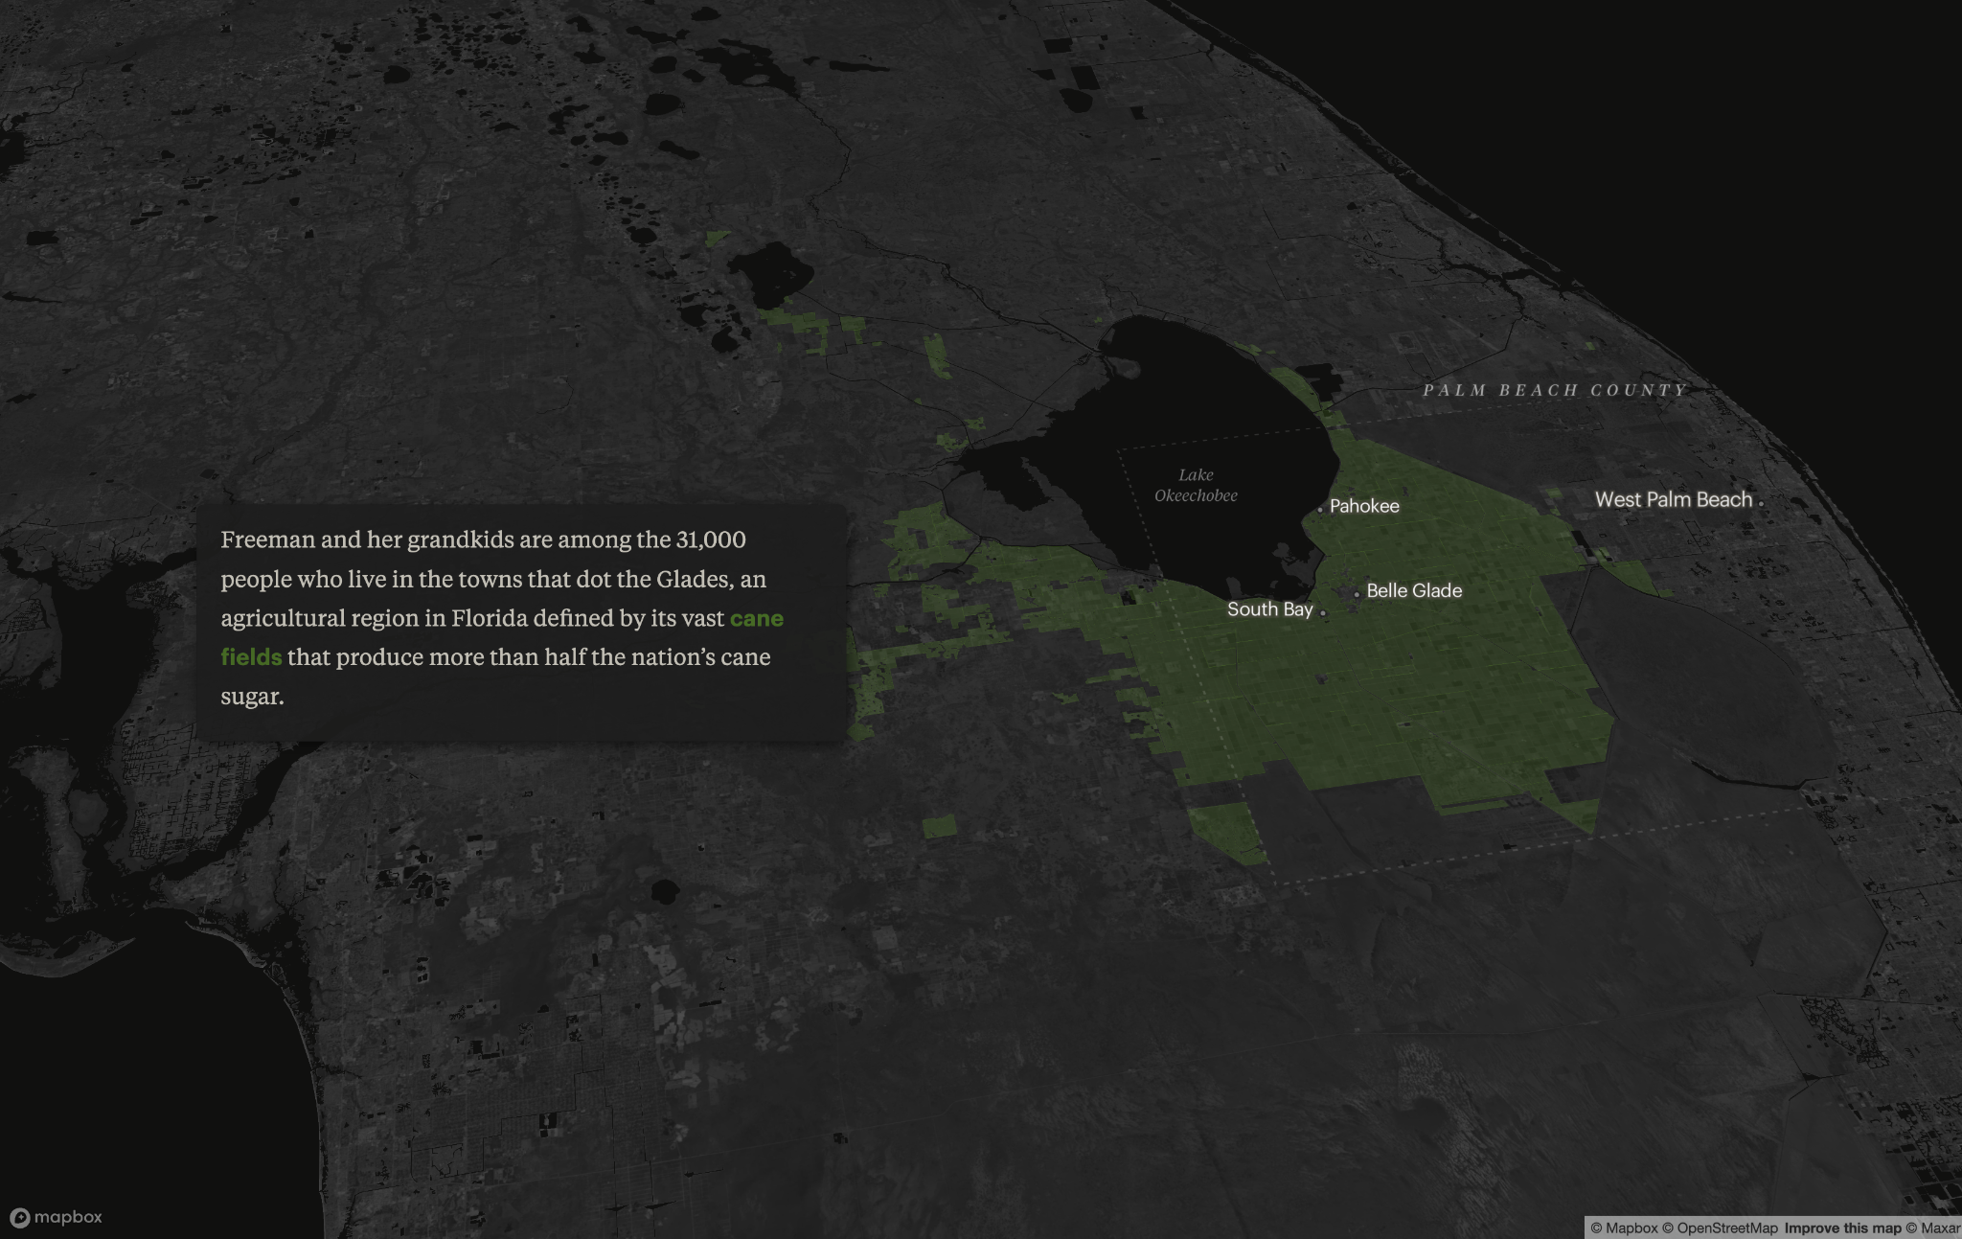
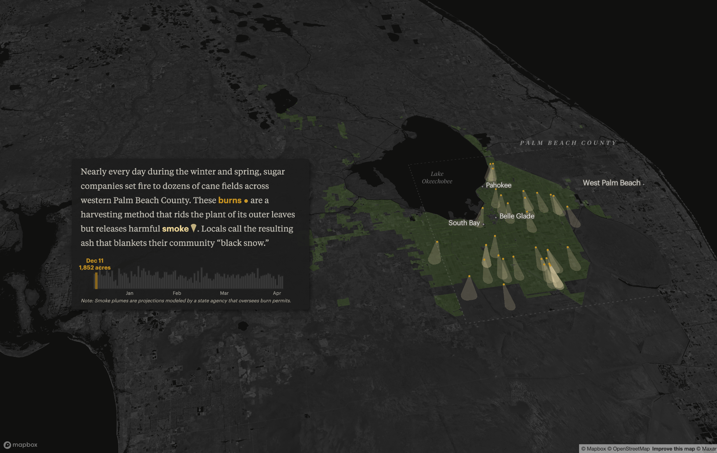
Notes:
Moving onto the map section. This is kind of what filmmakers might call an establishing shot.
Our readership is a combined local one and national one, given the set up of LRN. This scrolly map section sets up the geographic context of the place we’re talking about, starts in Florida and then zooms into the Glades, the rural towns and the big city to the east, the green swath of agricultural fields, and the burns and plumes of smoke that are emitted almost daily for several months each year.

Slide 22
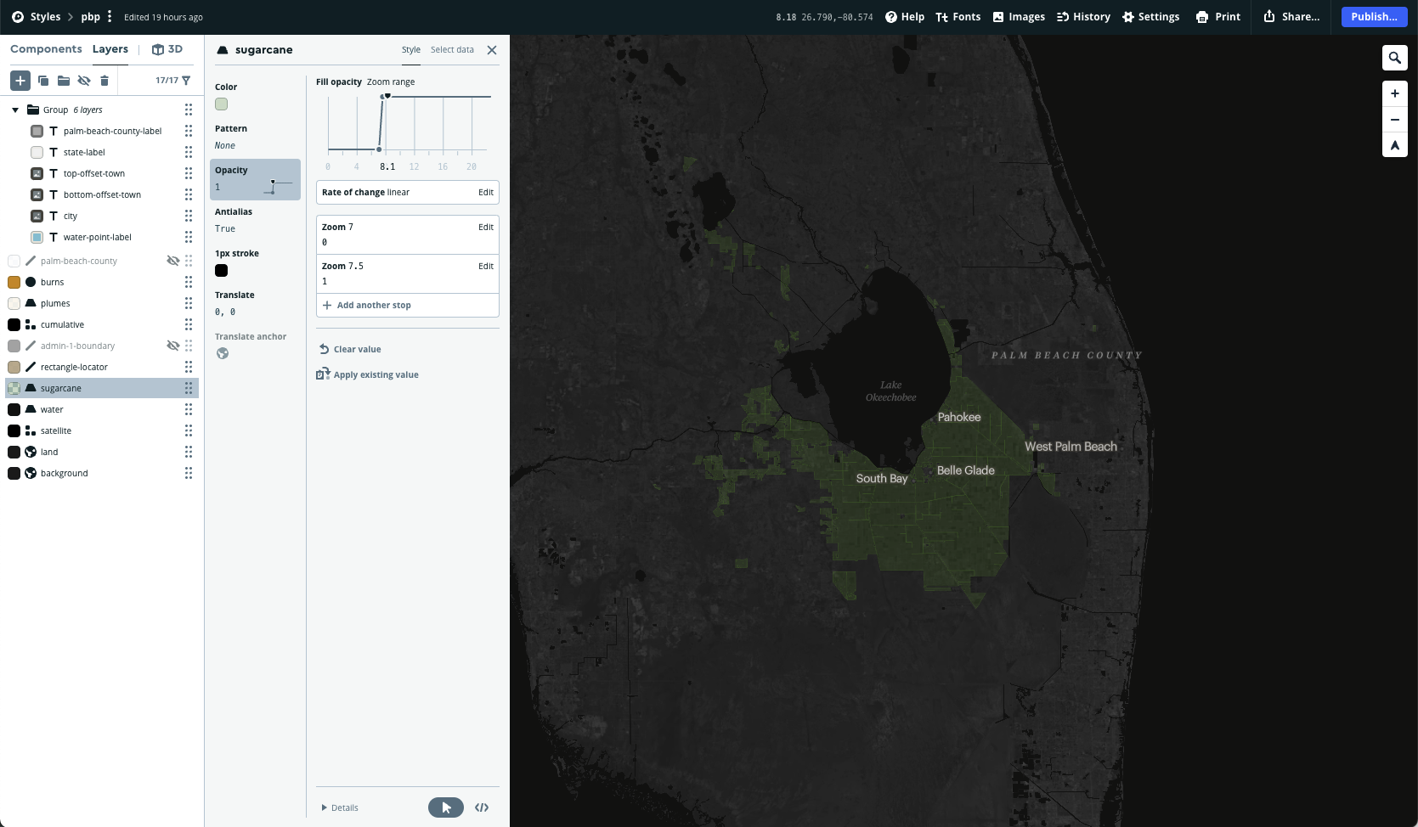
Notes:
Mapbox studio style https://studio.mapbox.com/styles/propublica/ckn54t6e5048517omhc5i8dwa/edit/#6.9/27.454/-81.059
I built the map using Mapbox Studio which I highly recommend. Their web app lets you customize your own interactive maps
Drag and drop in vector and raster data sets
Style layers, based on zoom level
Add labels
Comes with presets that can give you a good starting point

Slide 23
Incorporating data into writing and design
Imagine what you could show using the data you already have and the data you could get
Propose imagined copy to help text reporters and editors blend grafs into visuals
Share in-progress “storyboard” with the broader team and stay in the loop on text drafts
Collaborate with photographers/videographers to specify images that are necessary for visual elements
Iterate from low to high fidelity mockups
Notes:
So to summarize, in order to take visual ideas to execution these are some high-level tips.
Use the data and visual assets that you already have in combination with what you imagine you *could* get. Combine those to create your mock ups especially in the early stages.
Propose imagined copy in your mock ups to help text side understand how the visual elements integrate into the story structure, instead of being plopped in randomly with no connection to the copy before or after.
Share sketches and vice versa, stay up to date on the latest text drafts. Communicate as much as possible around what you’re proposing.
If you need particular angles, photos, portraits, scene shots, specific durations of video, work all those specifics out with your photographer/videographer colleagues
And lastly, this whole process is about iterating with increasing levels of fidelity. Propose something tentative, get feedback, and go back to the drawing board. Eventually your mockups will reach a place where they feel *firm* and feasible at which point you can actually build them IRL.

Slide 24
Bulletproofing data
Run your analysis back by your experts, community collaborators and the subject(s) of your stories
Be transparent! Include your methodology in your requests for comment/interview
Build in data checks – we ran our methodology, analyses and formulas past several parties
Circle back with your sources

Slide 25
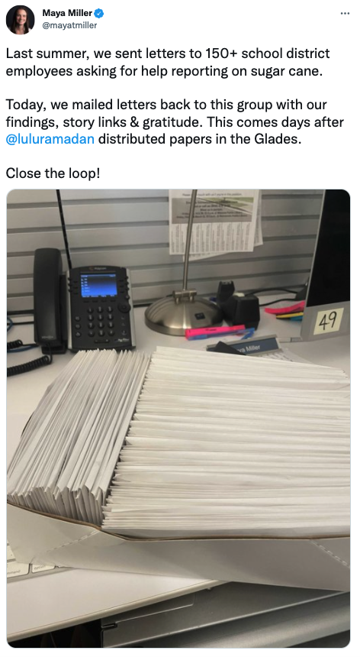

Slide 26
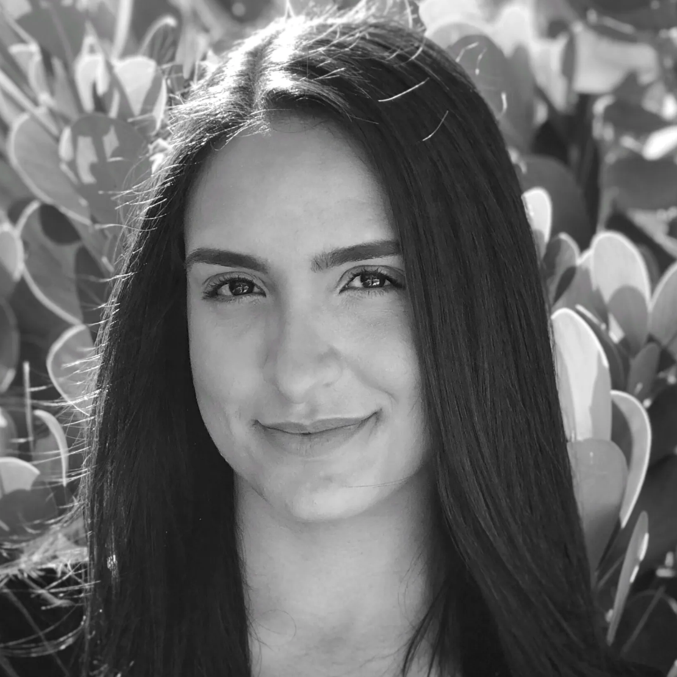
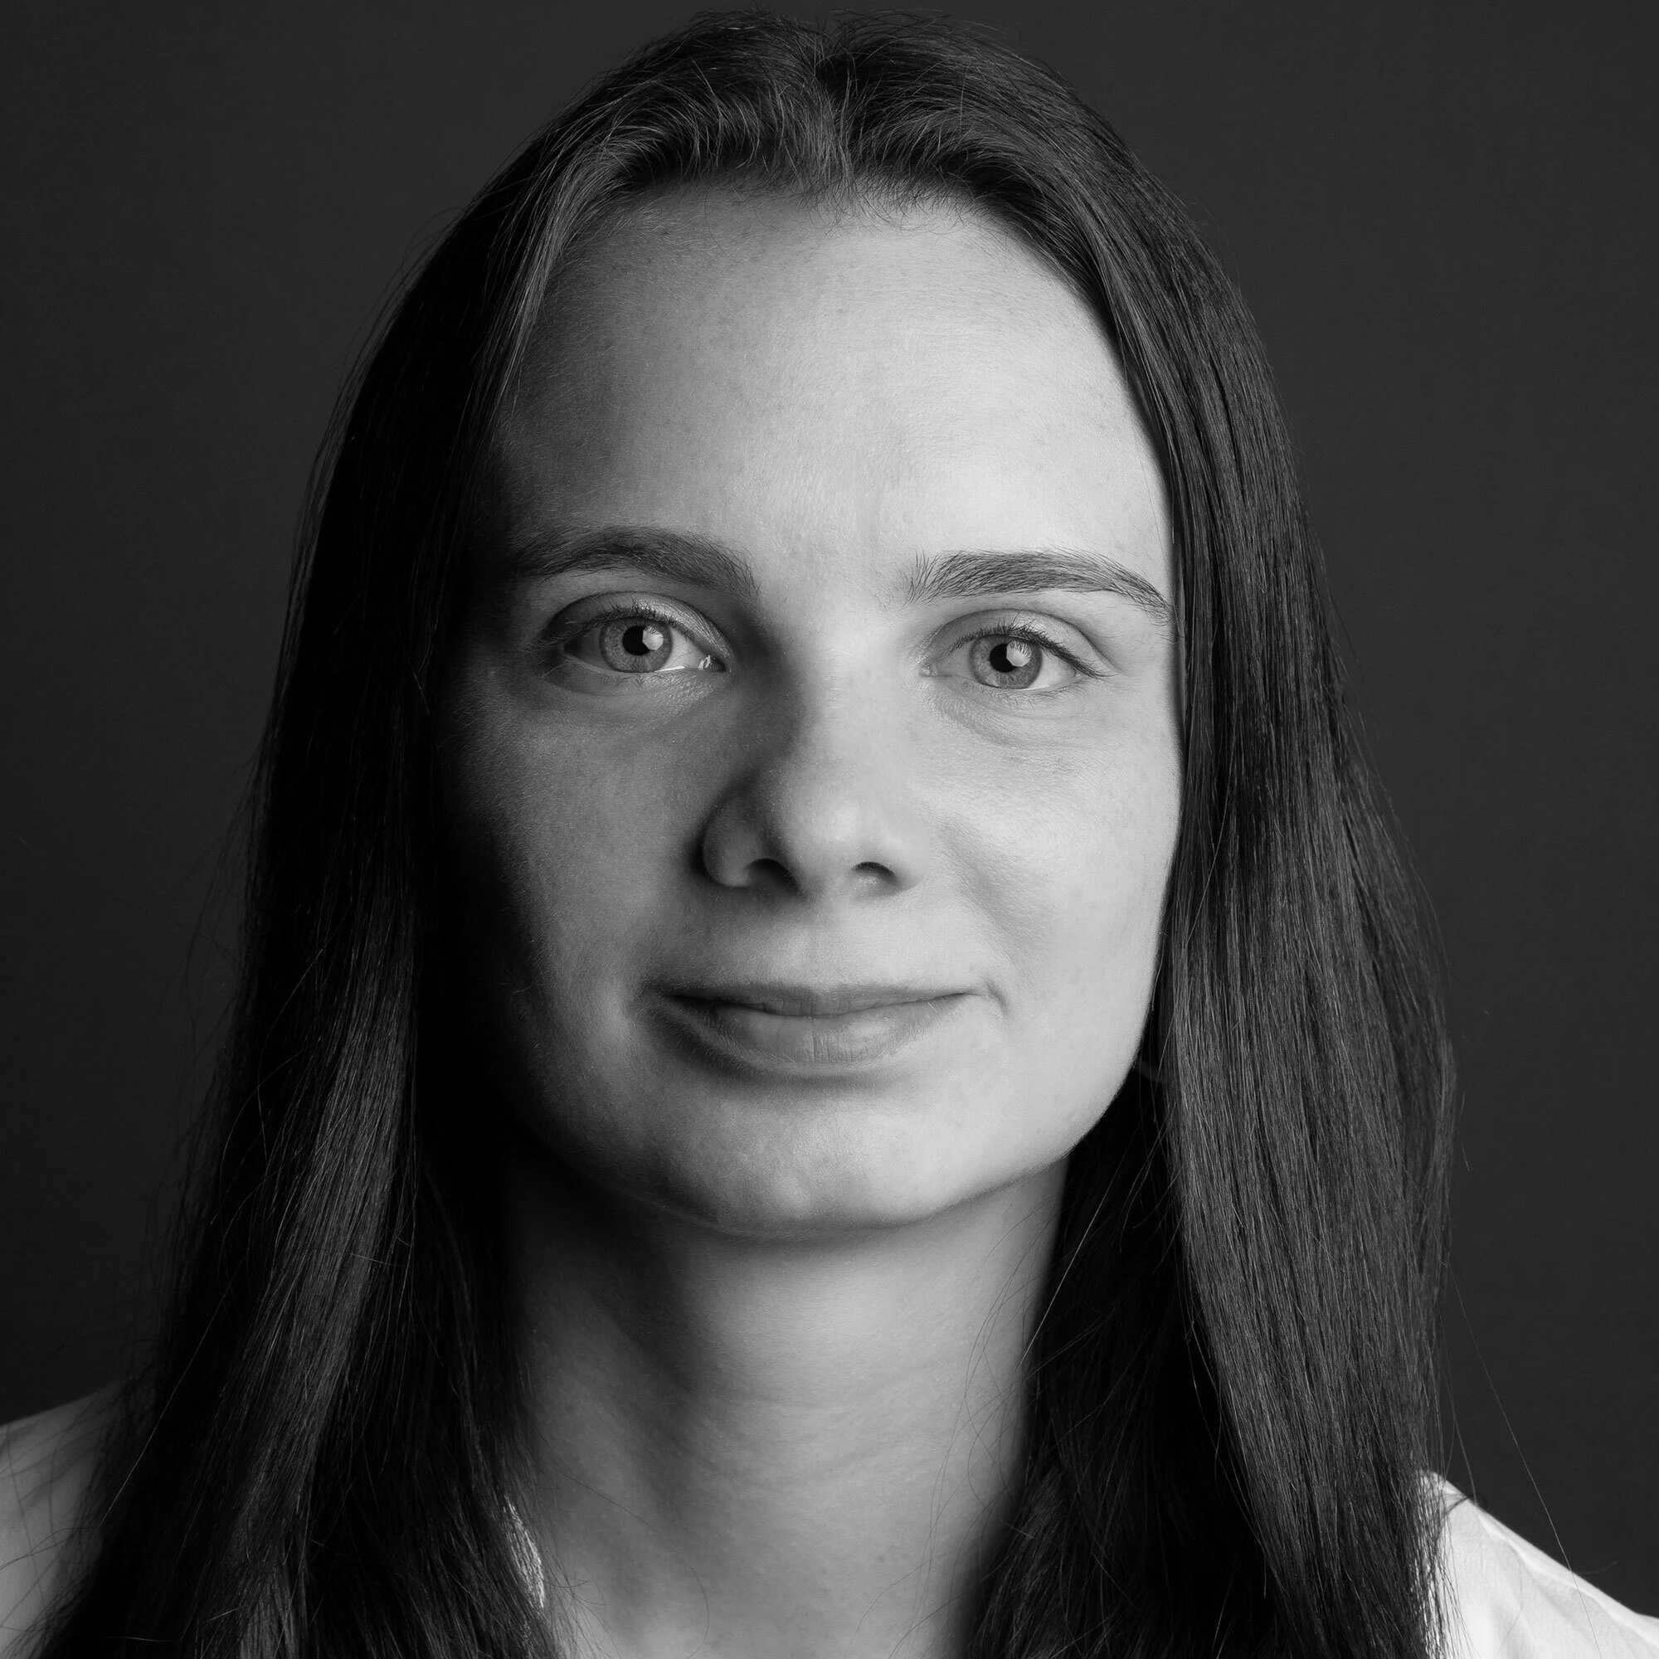
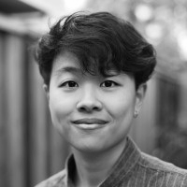
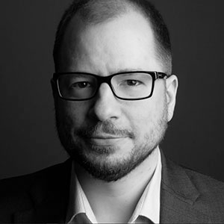
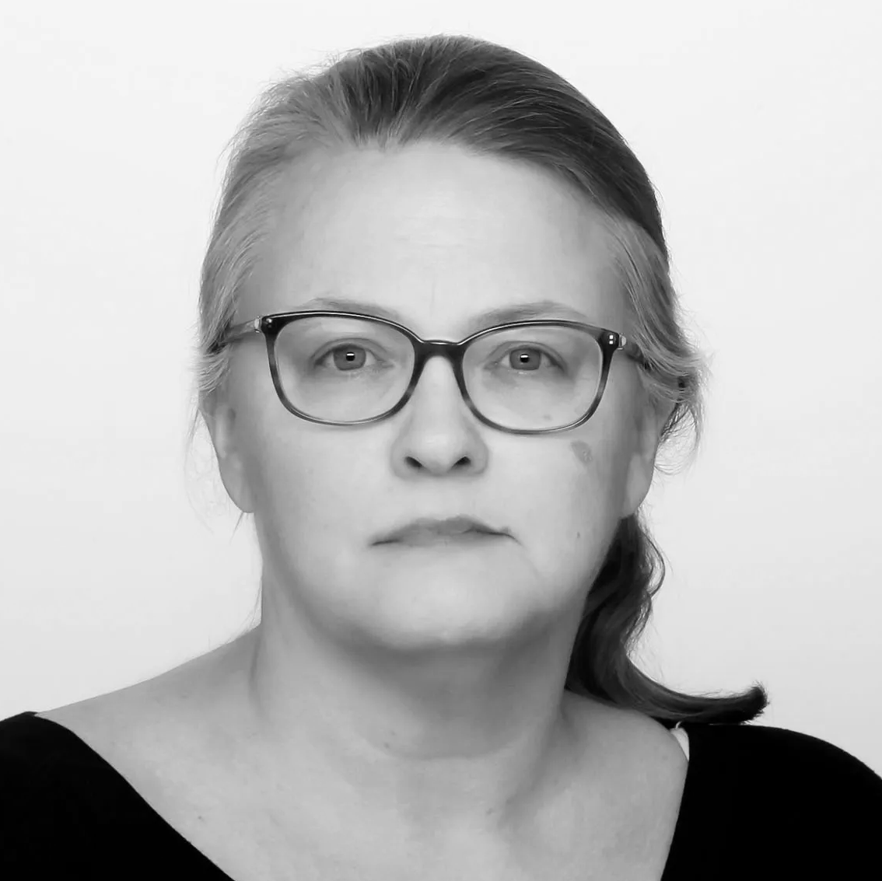
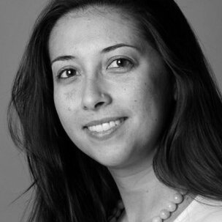
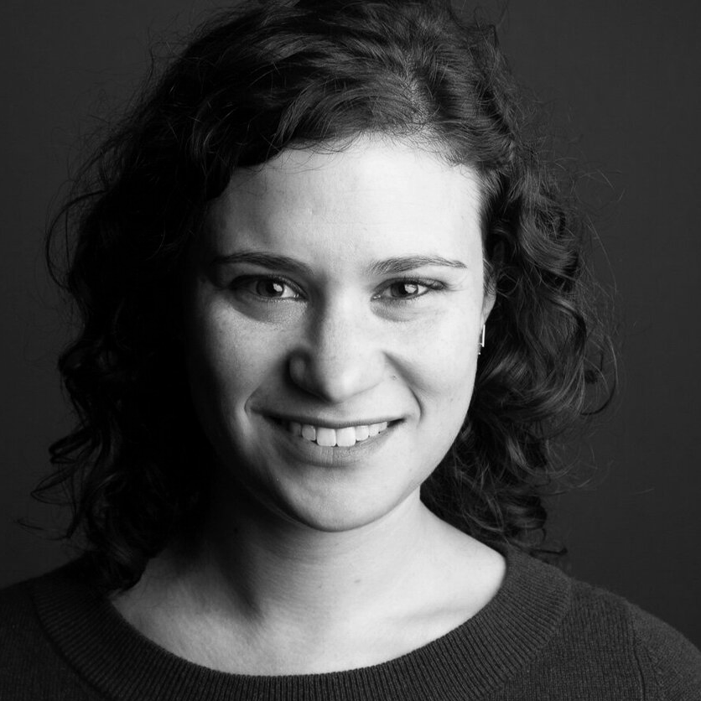
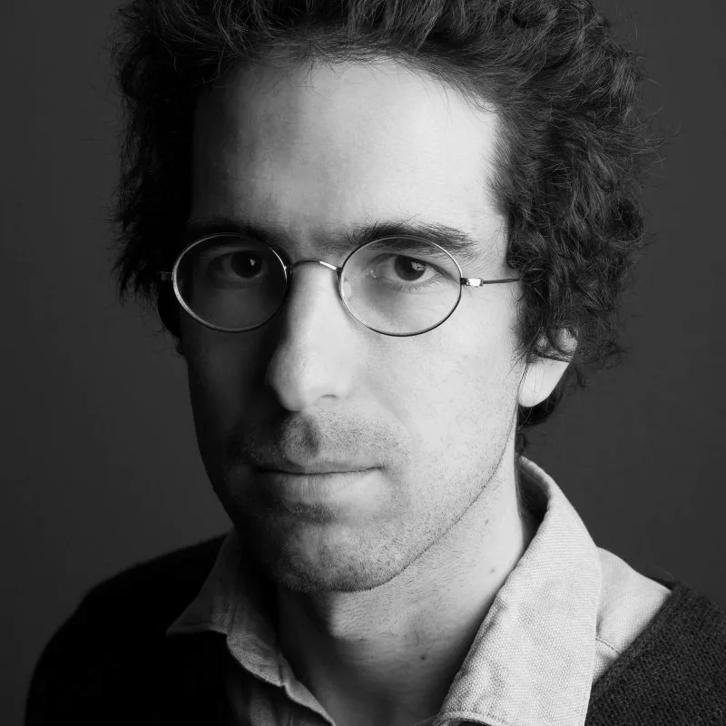
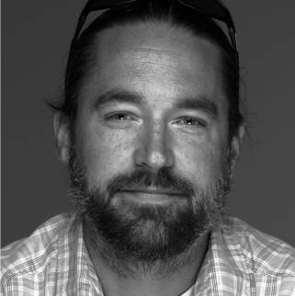
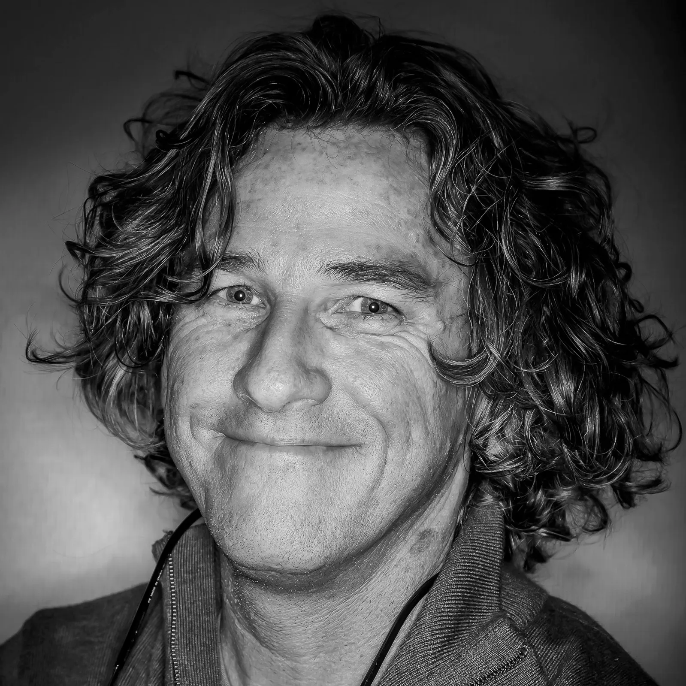
It Takes A Village
Lulu Ramadan
Reporter
Maya Miller
Engagement
Ash Ngu
News Apps
Michael Mishak
Senior Editor
Holly Baltz
Senior Editor
Erin Smith
Engagement
Ariana Tobin
Engagement Editor
Al Shaw
Deputy News Apps Editor
Thomas Cordy
Photography
Greg Lovett
Videography
Additional contributions by Sally Beauvais, Jan Byun, Adriana Gallardo, Maryam Jameel,
Ryan Little, Beena Raghavendran, Kengo Tsutsumi, Andrea Wise, and Lisa Larson-Walker

Slide 27
Questions?
lramadan@seattletimes.com

