Slide 1
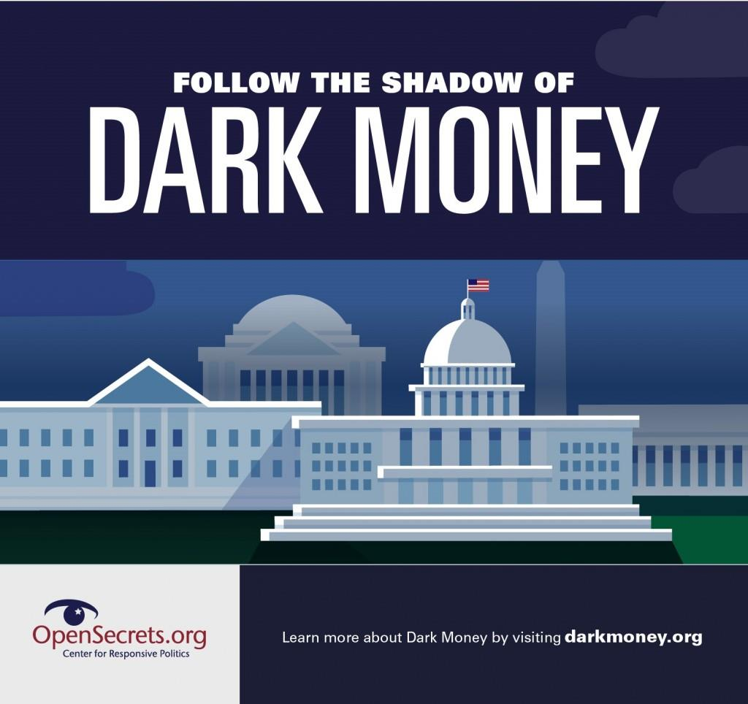

Dark Money
Anna Massoglia
OpenSecrets
anna@crp.org
@annalecta

Slide 2
Dark Money Facts
Dark money: spending meant to influence political outcomes where the donor is not disclosed & the source of the money is unknown.
Dark money groups have spent over $1 billion — mainly on television, online ads and mailers — to influence elections in the decade since the 2010 Citizens United v. FEC Supreme Court ruling that fueled politically active nonprofits.

Slide 3
Types of Dark Money
Politically active 501(c) nonprofits are allowed varying levels of politicking
501(c)(3) groups are banned from political activities, but allowed some GOTV activity.
501(c)(4) groups may engage in political activities but it cannot be their primary purpose.
The IRS never defined “primary” or how a percentage should be calculated.
De facto rule: 49.9% of overall expenditures
Other 501(c) organizations that may engage in political activities with the same general limits as 501(c)(4) organizations
Limited Liability Companies (LLC) or “shell” companies
Non-entities
Fiscal sponsorship
Digital spenders

Slide 4
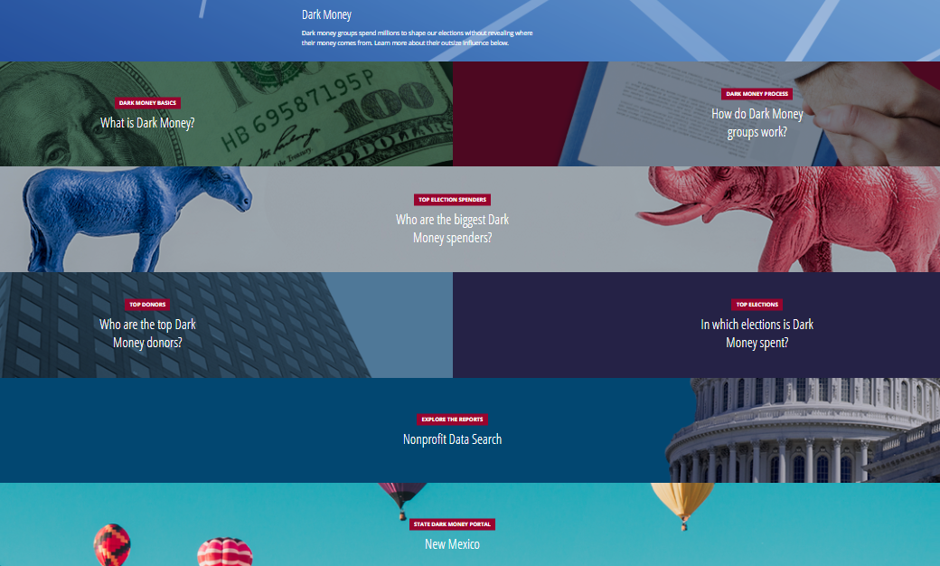
DarkMoney.org

Slide 5
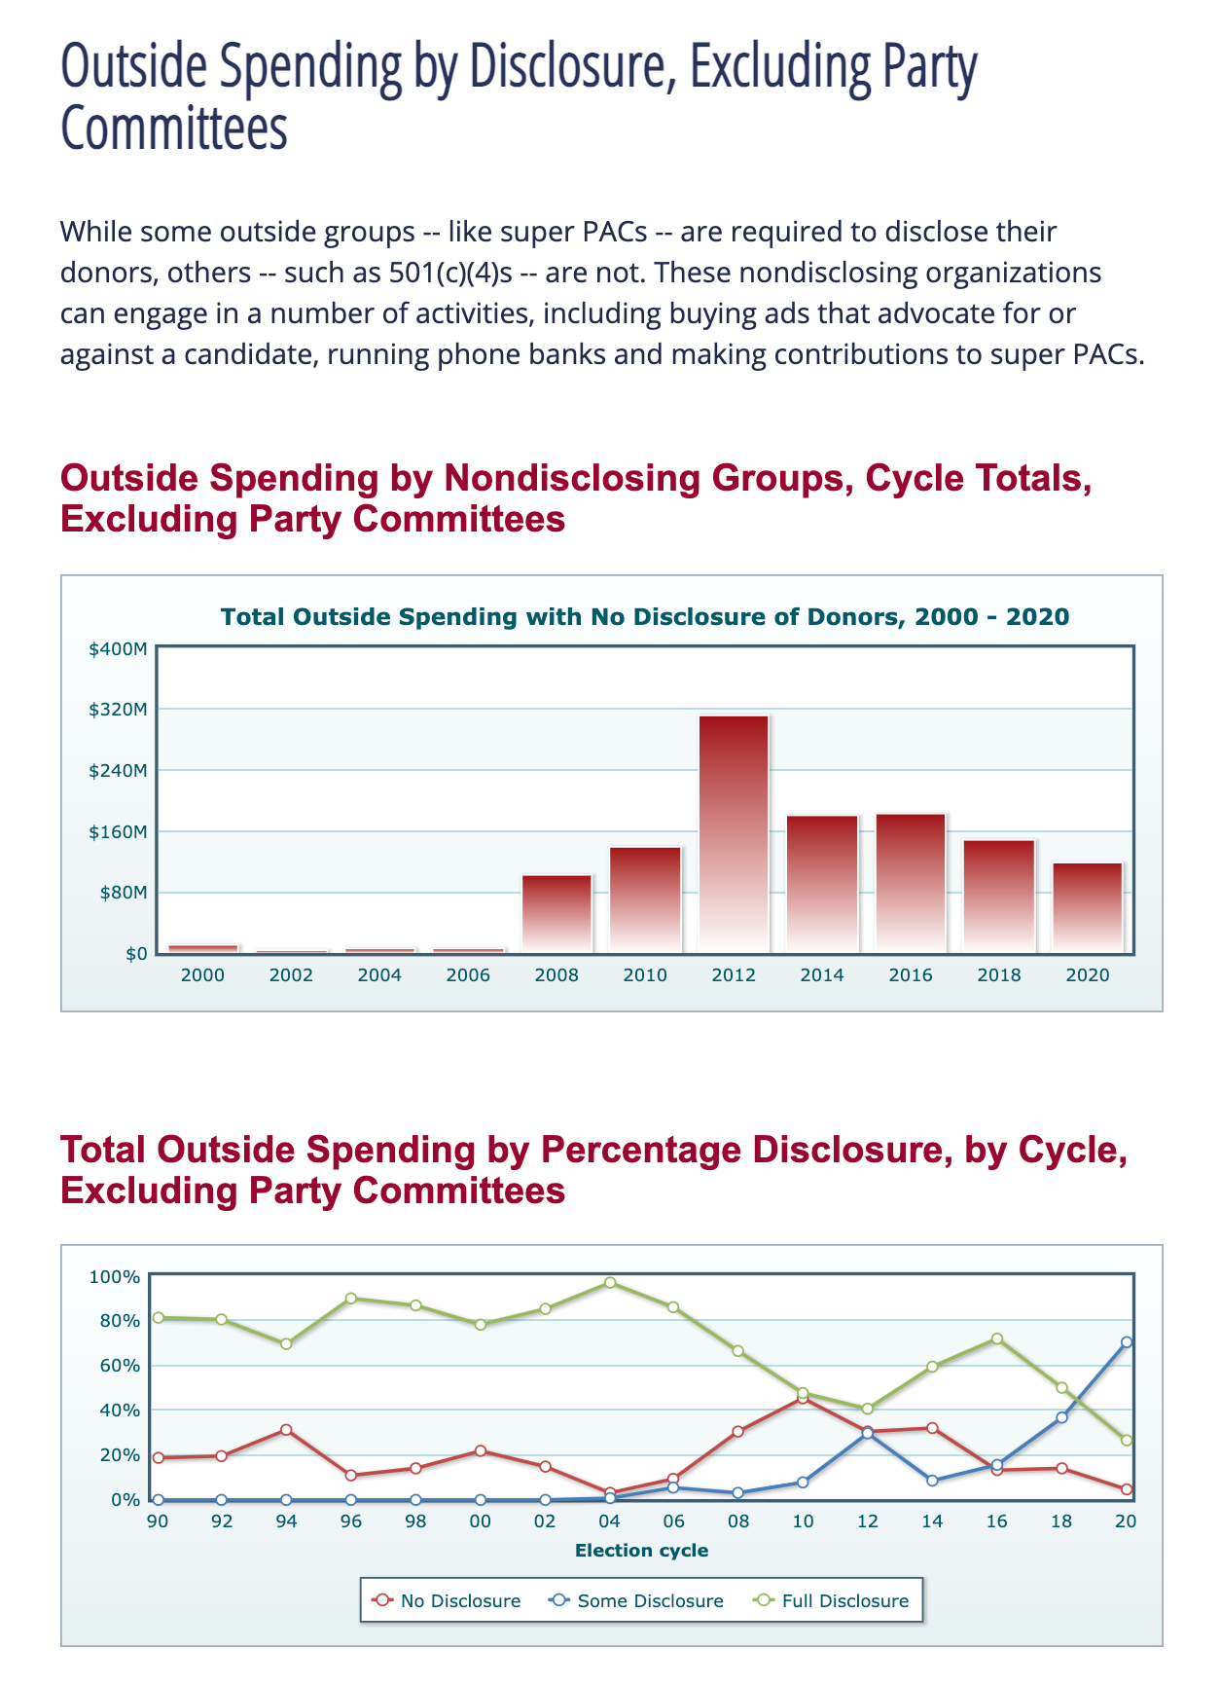
Dark Money Sources: FEC Data

Slide 6
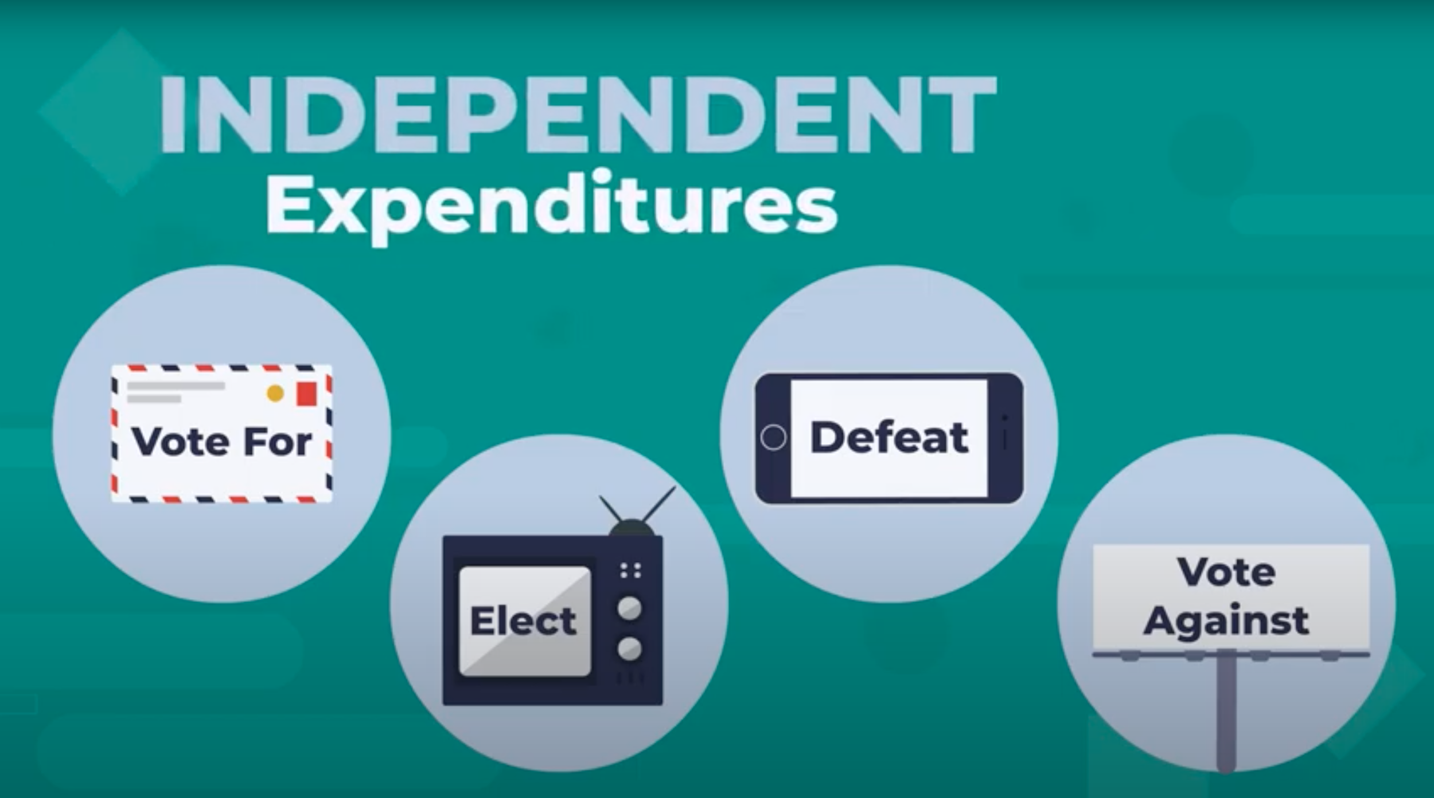

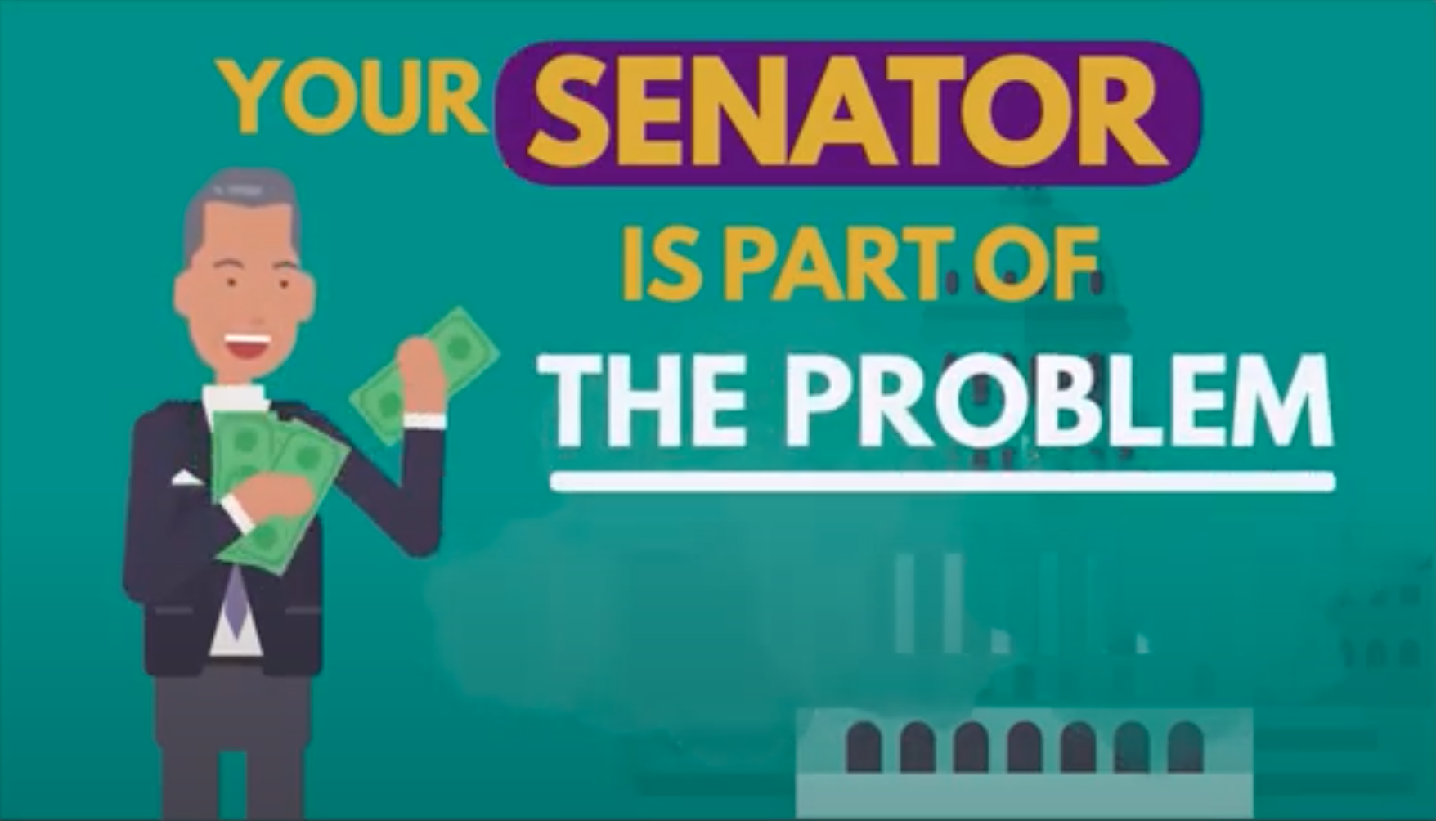
FEC Disclosure Loopholes
Electioneering Communications
“Issue Ads”
Independent
Expenditures
“Express Advocacy”
Magic Words
OPENSECRETS VIDEO
EXPLAINER: crp.org/vecie

Slide 7
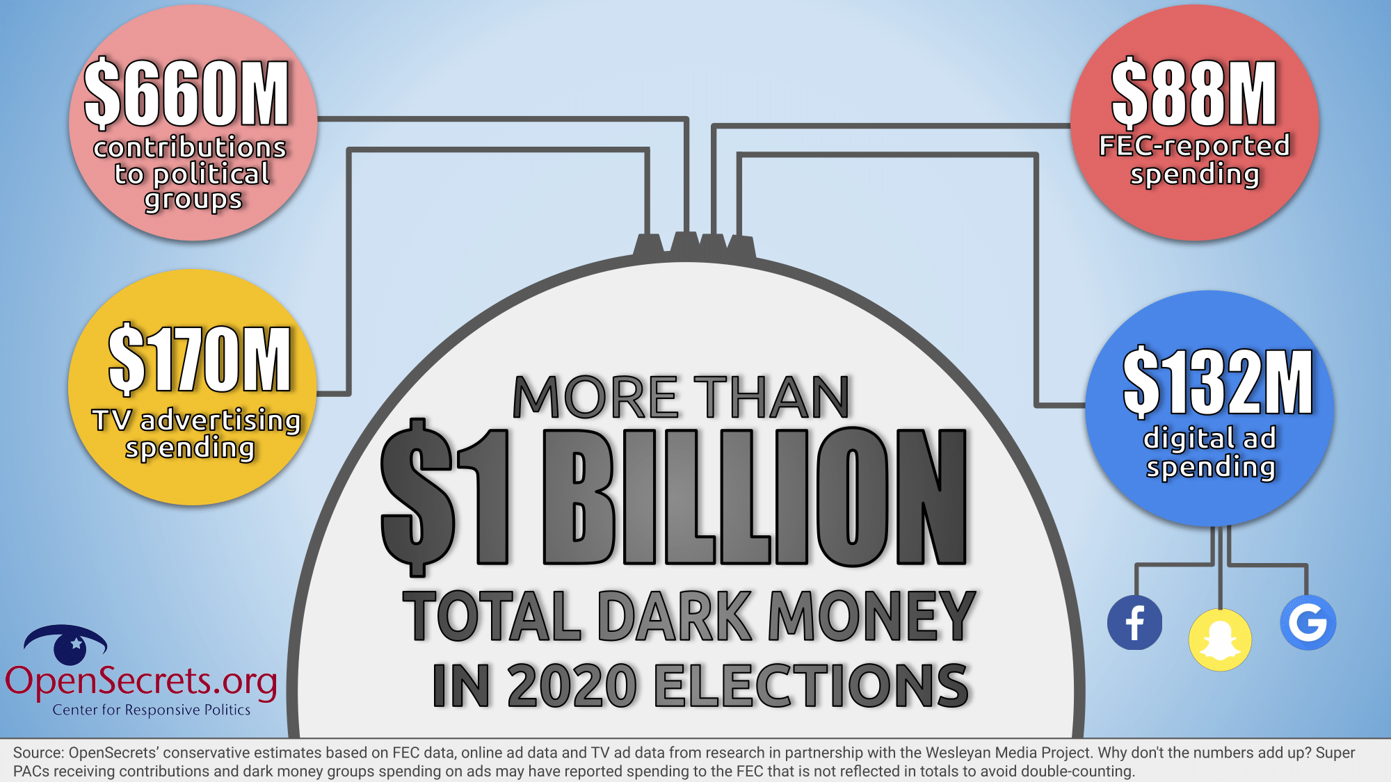
2020 Dark Money

Slide 8
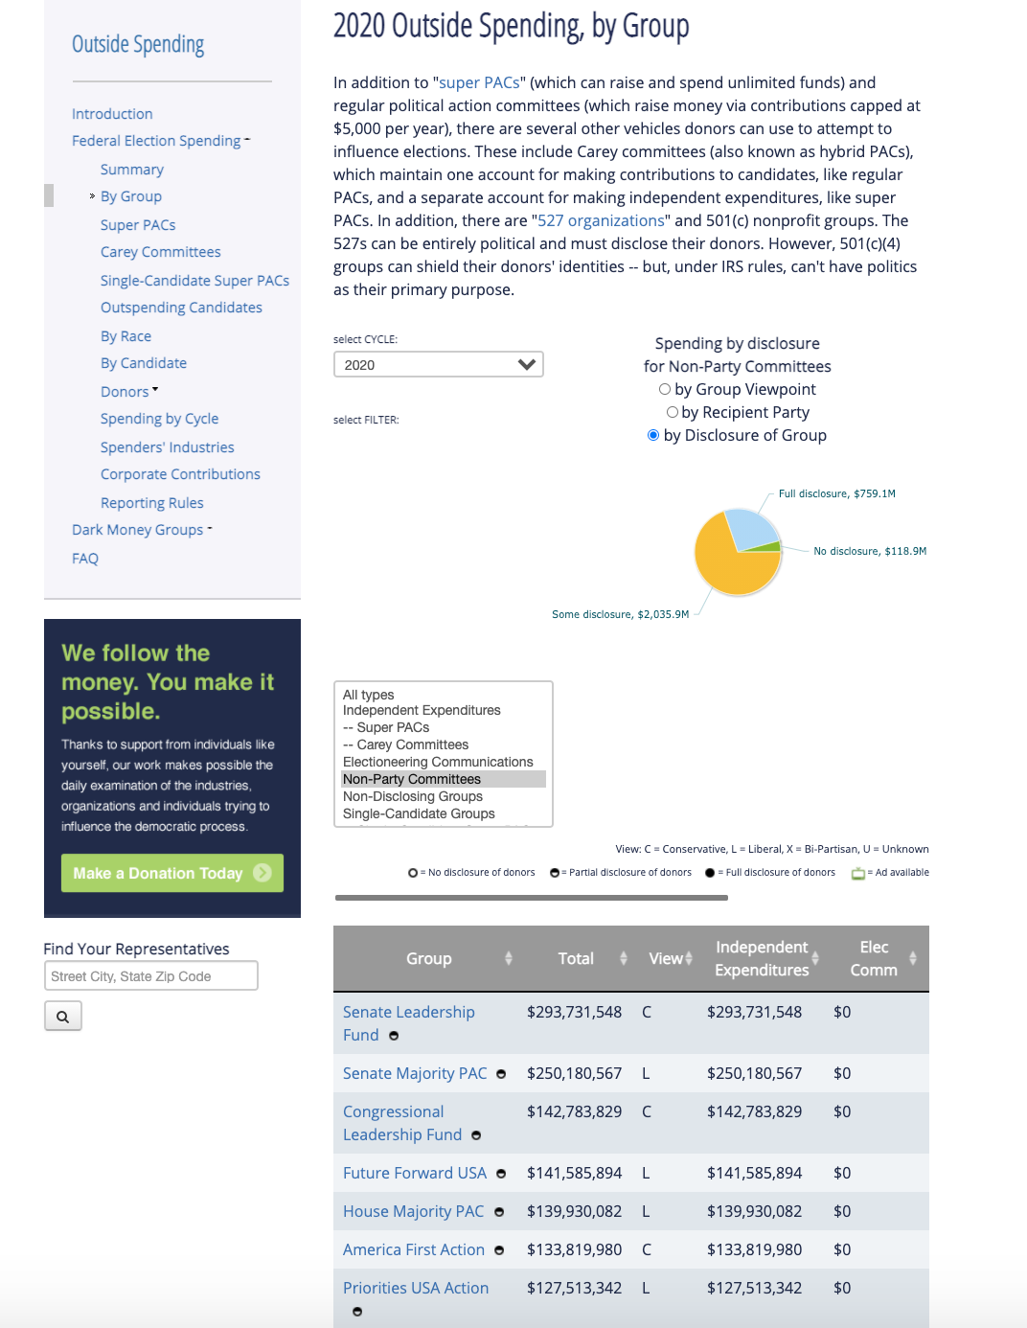
Dark Money Sources: FEC Data

Slide 9
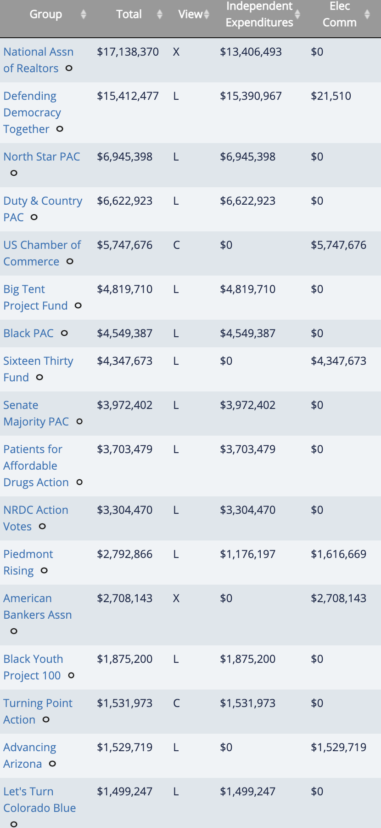
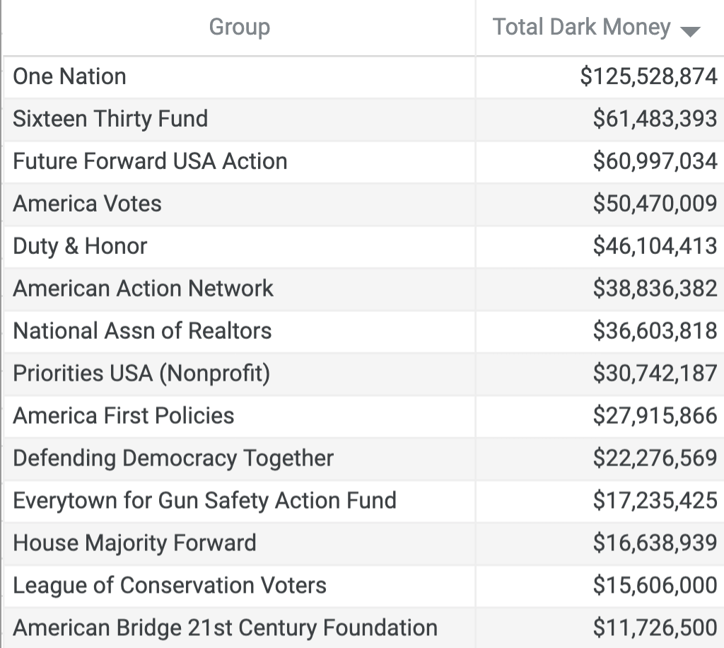
FEC-reported Spending vs. Total Dark Money

Slide 10
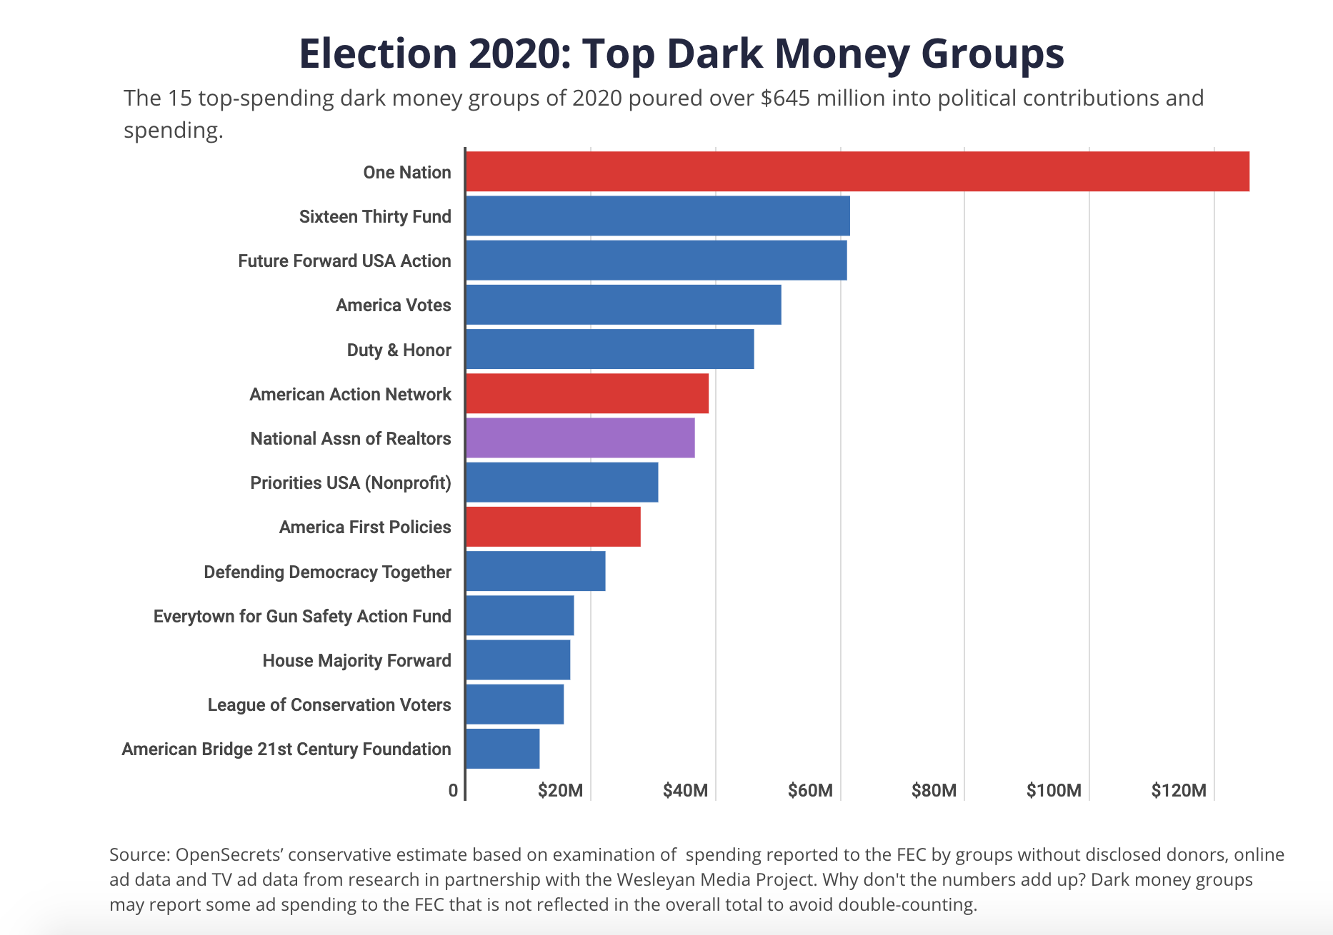
2020 Dark Money

Slide 11
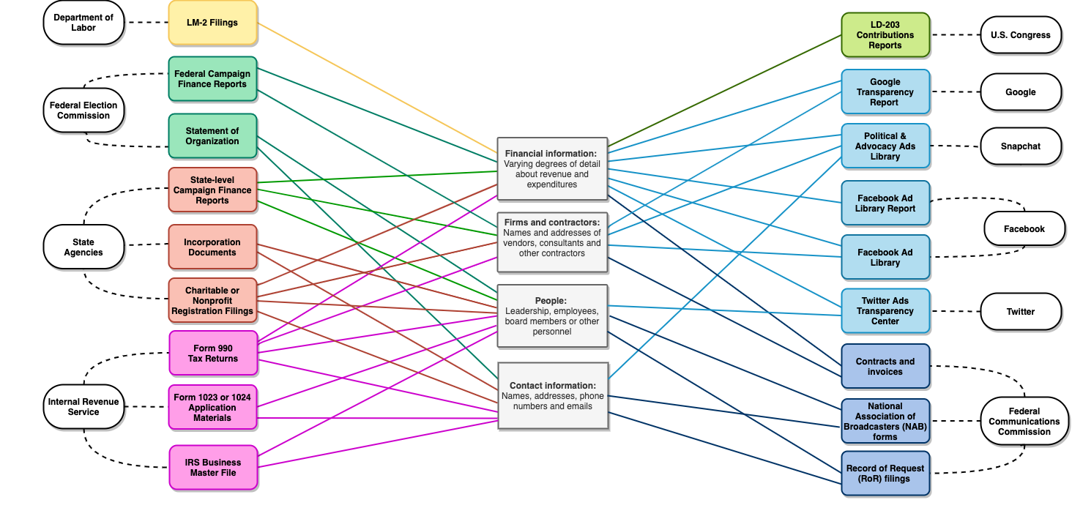
Dark Money Sources

Slide 12
Dark Money Sources: IRS Records
Annual Form 990 tax returns
5-10 ½ months after an organization’s fiscal year
Tax-Exempt Status Application Materials
Form 1024
Form 1023
Form 8976 Notice
Notify the IRS within 60 days of when the organization is formed
Not considered application materials

Slide 13
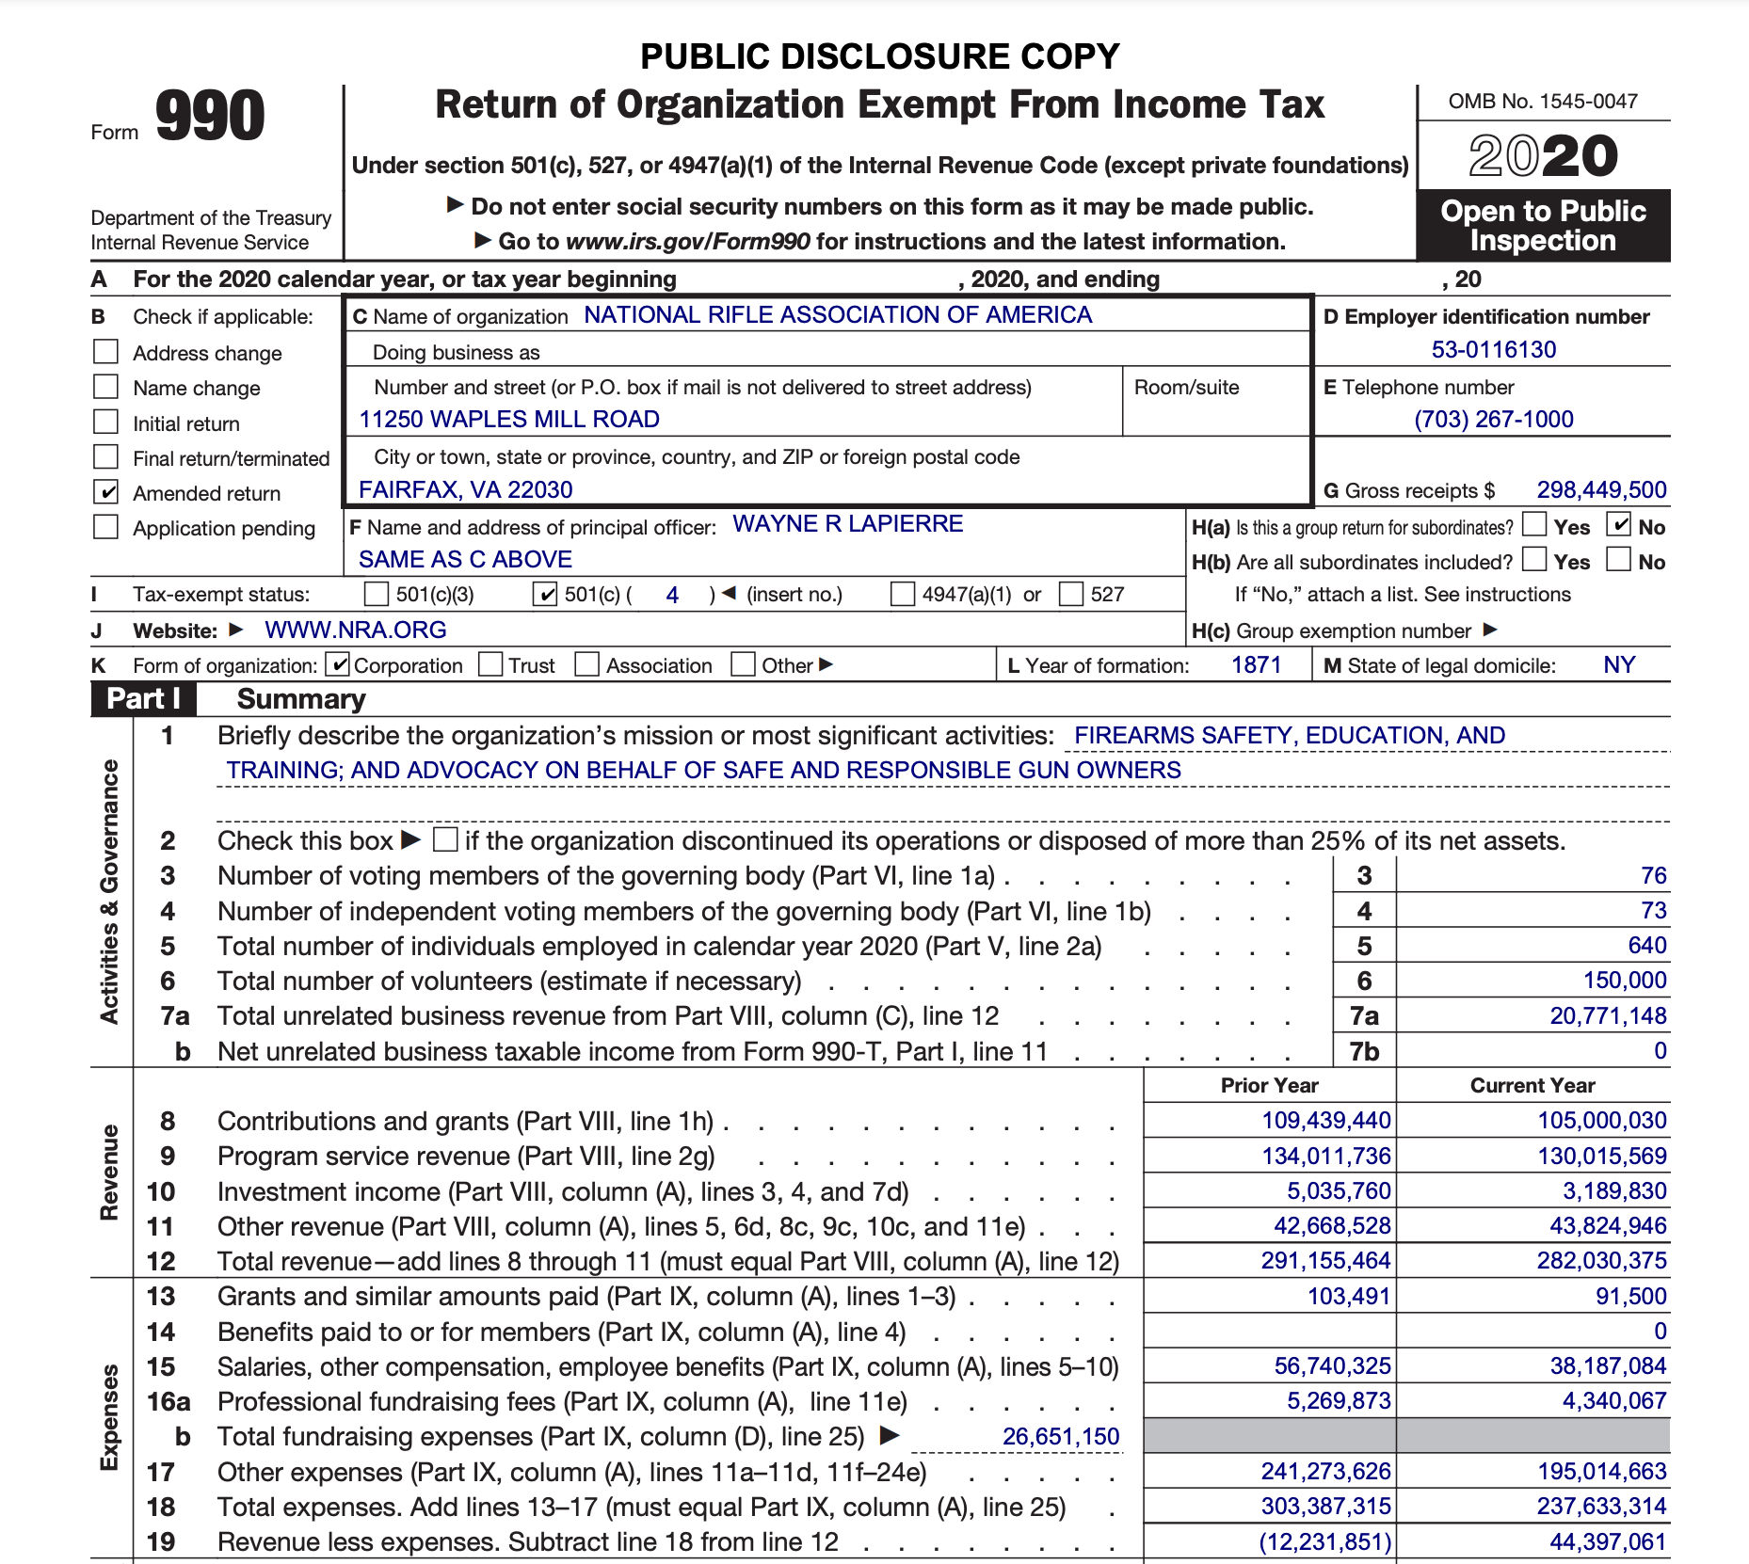
Dark Money Sources: IRS Records

Slide 14
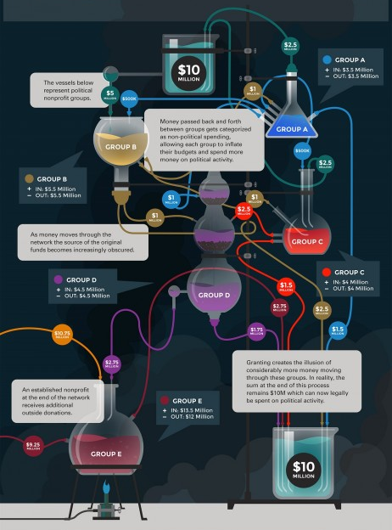
Dark Money Alchemy
Dark money groups may avoid reporting too much political spending is by making large grants to like-minded group.
These grants are considered part of the organization’s primary purpose expenditures, even if the grant recipient spends a portion of the money on political activities.
The recipient organization’s overall budget grows larger, allowing it to spend more money on political activity.

Slide 15
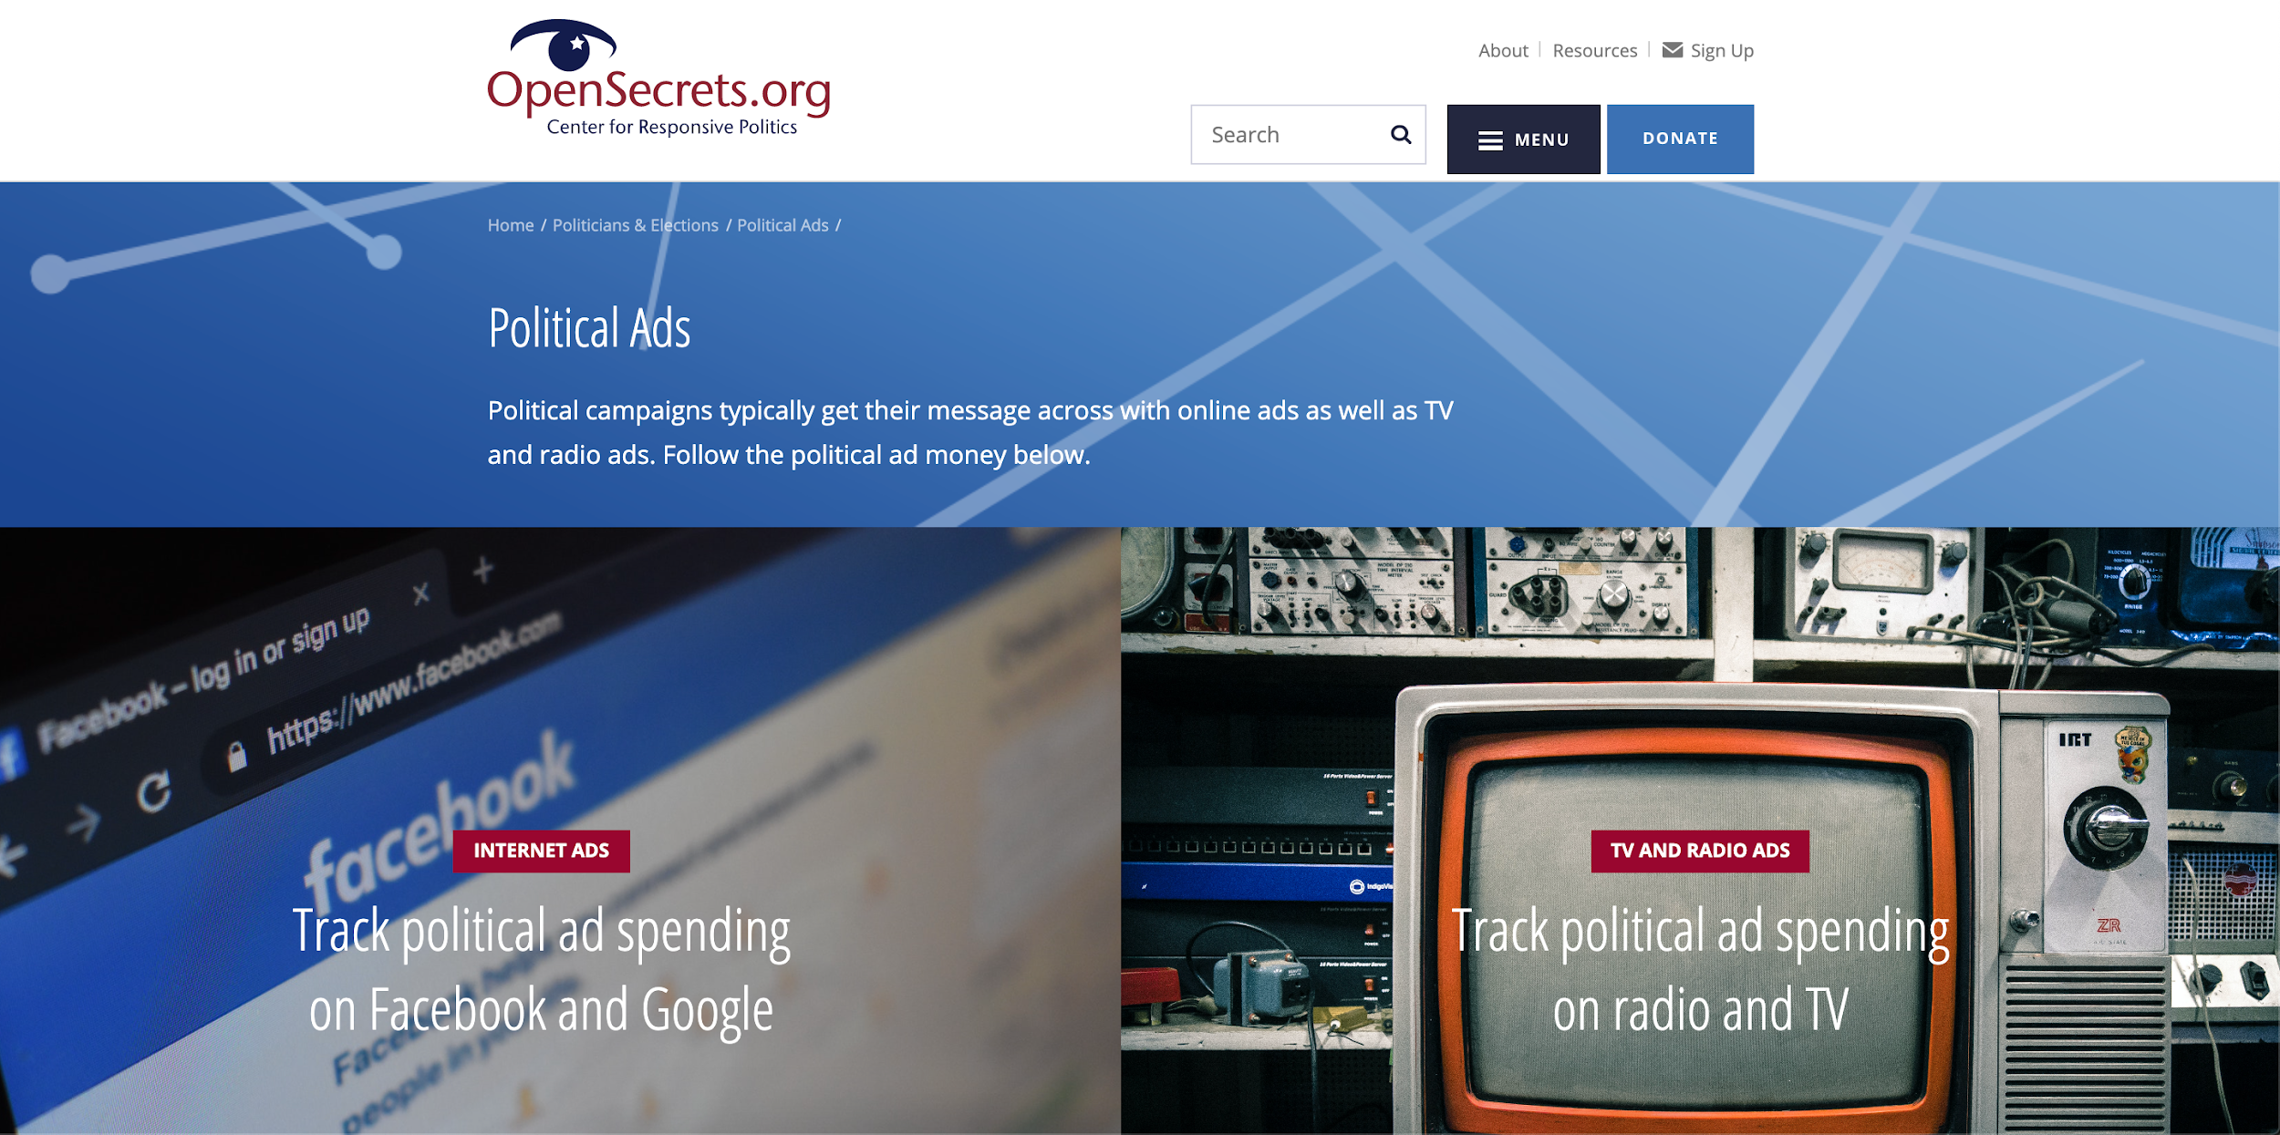
Political Ads

Slide 16
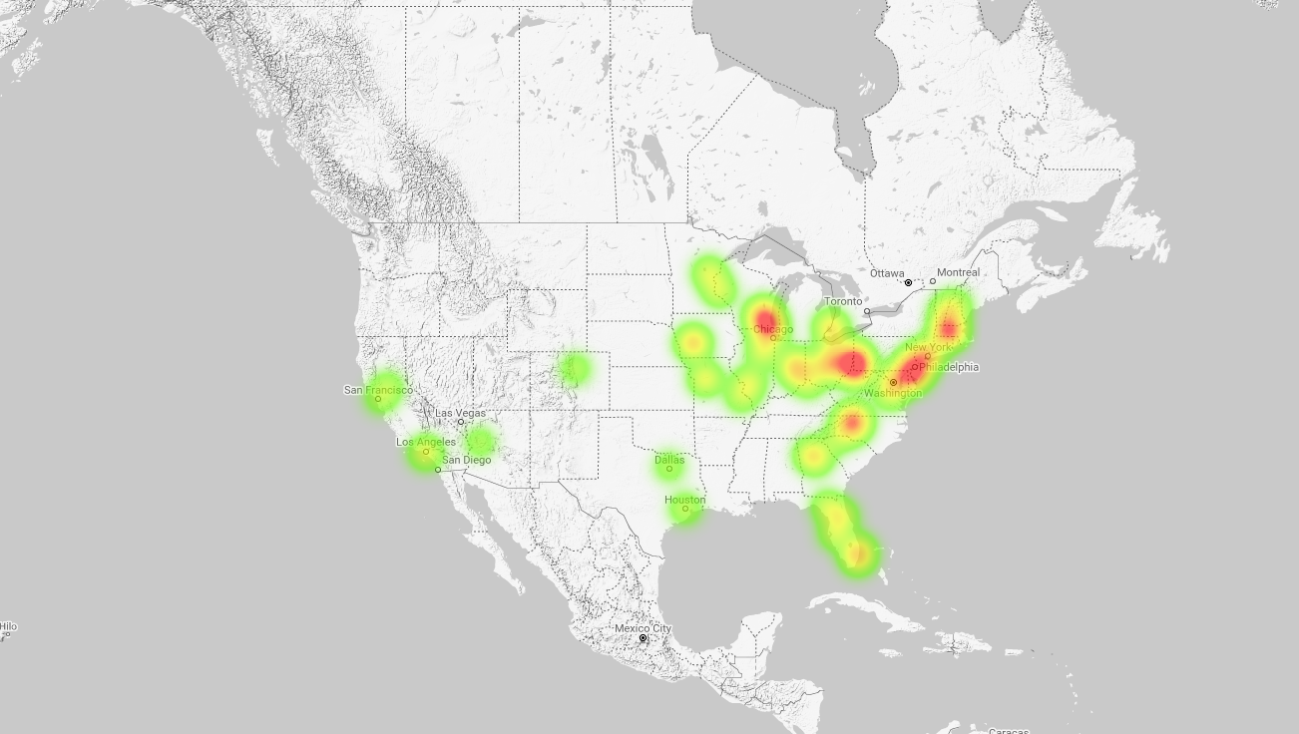
FCC Political Ad Files
FCC political file:
Stations files of airtime purchases
Most radio, TV, satellite & cable
AdData.org (currently paused)
Text from over 5.9 million documents
Extracted, parsed and updated daily
Contracts, invoices, and other filings
“Issue” ad spending not reported to the FEC
Real-time advertising spending by “dark money” groups

Slide 17
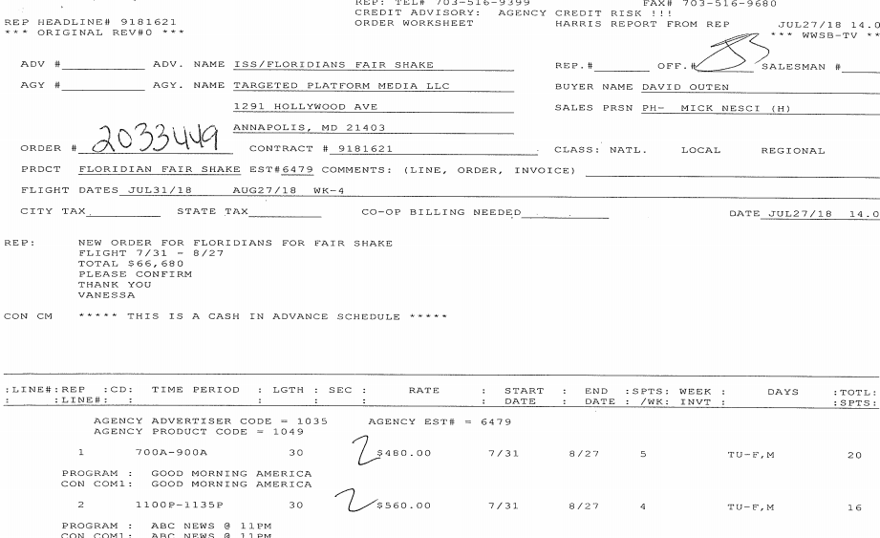
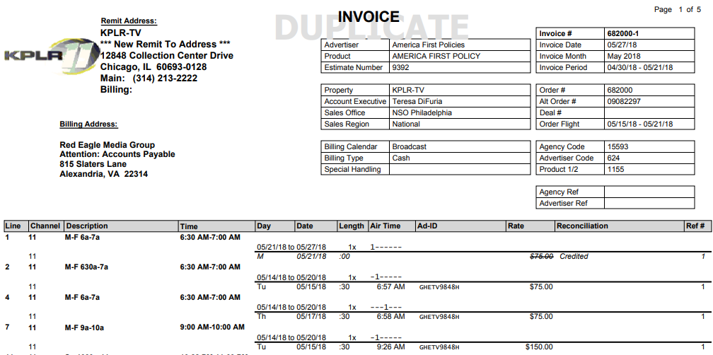
FCC Political Ad Data

Slide 18
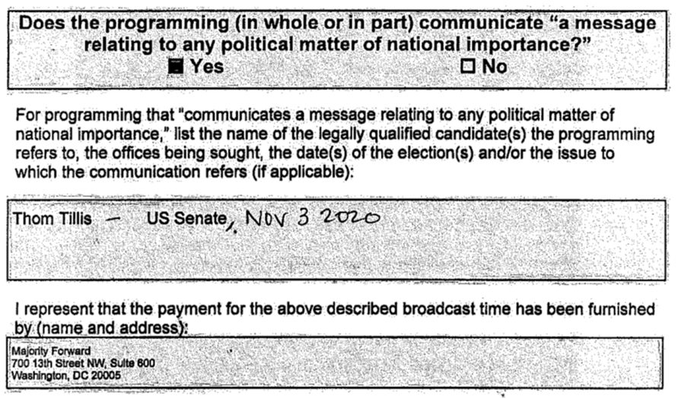
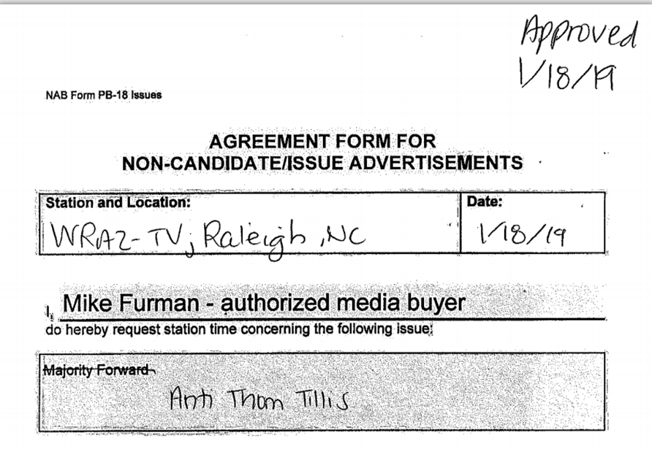
FCC Political Ad Data: NAB Filings

Slide 19
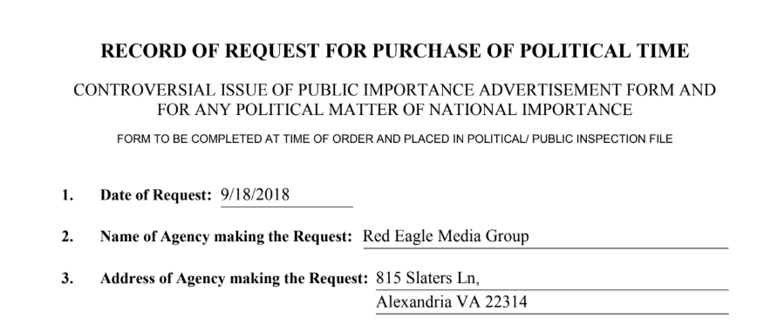
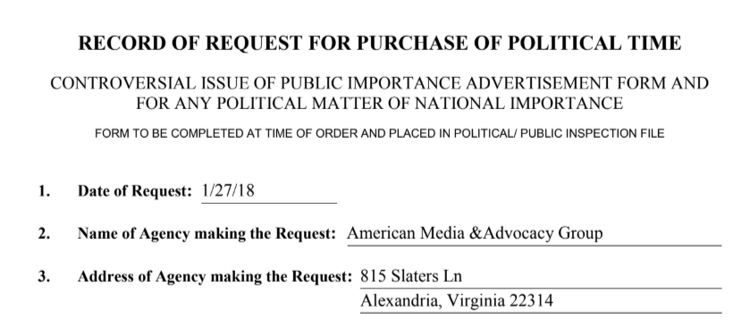
FCC Political Ad Data: Shell Buyers

Slide 20
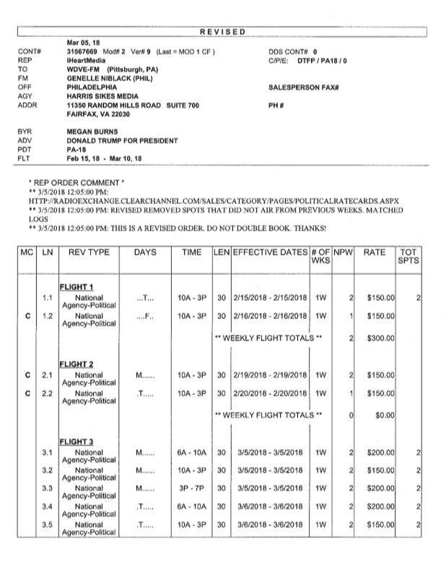
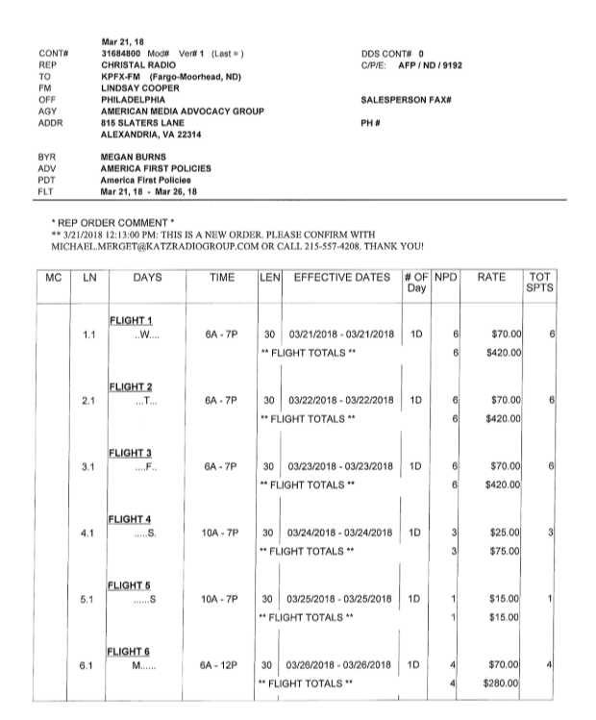
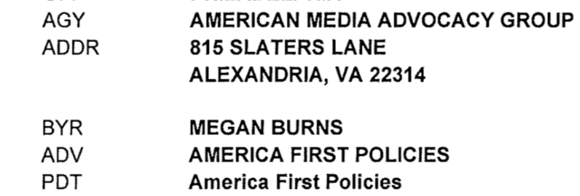
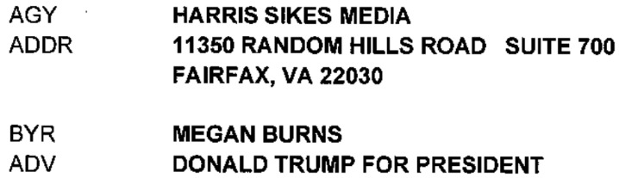
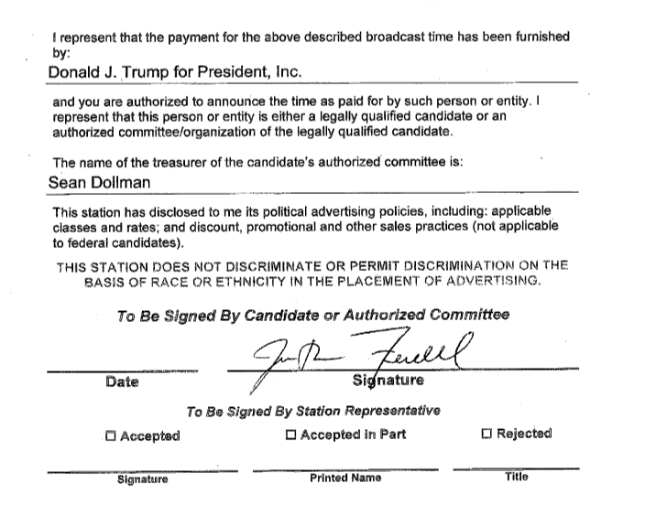
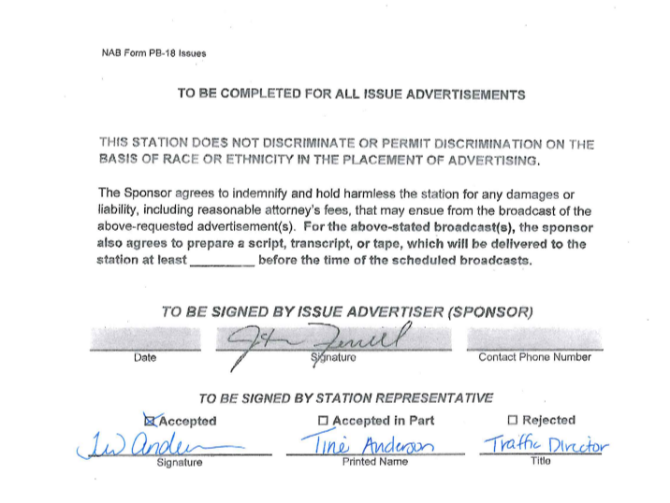
FCC Political Ad Data: Shell Buyers

Slide 21
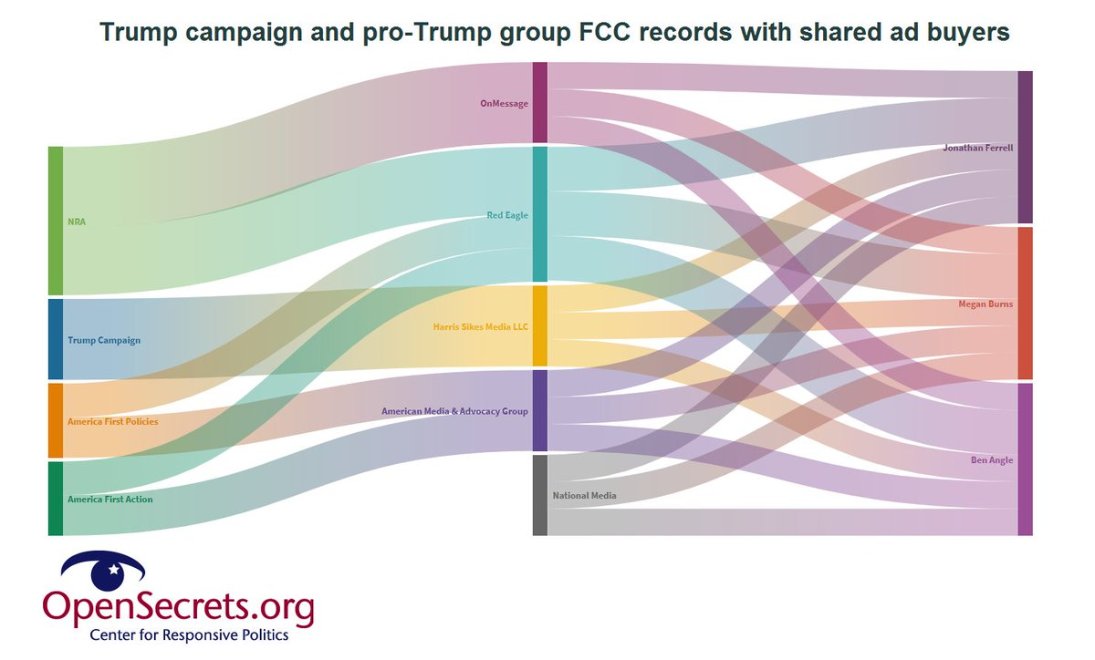
FCC Political Ad Data: Shell Buyers

Slide 22
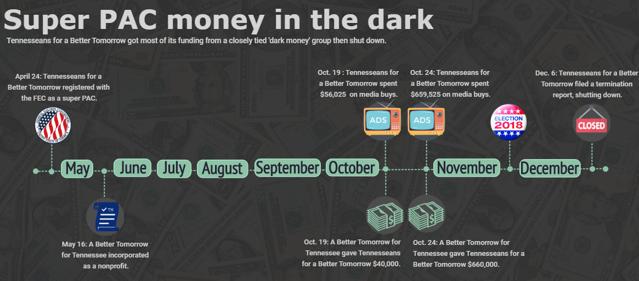
FCC Political Ad Data: Case Study

Slide 23
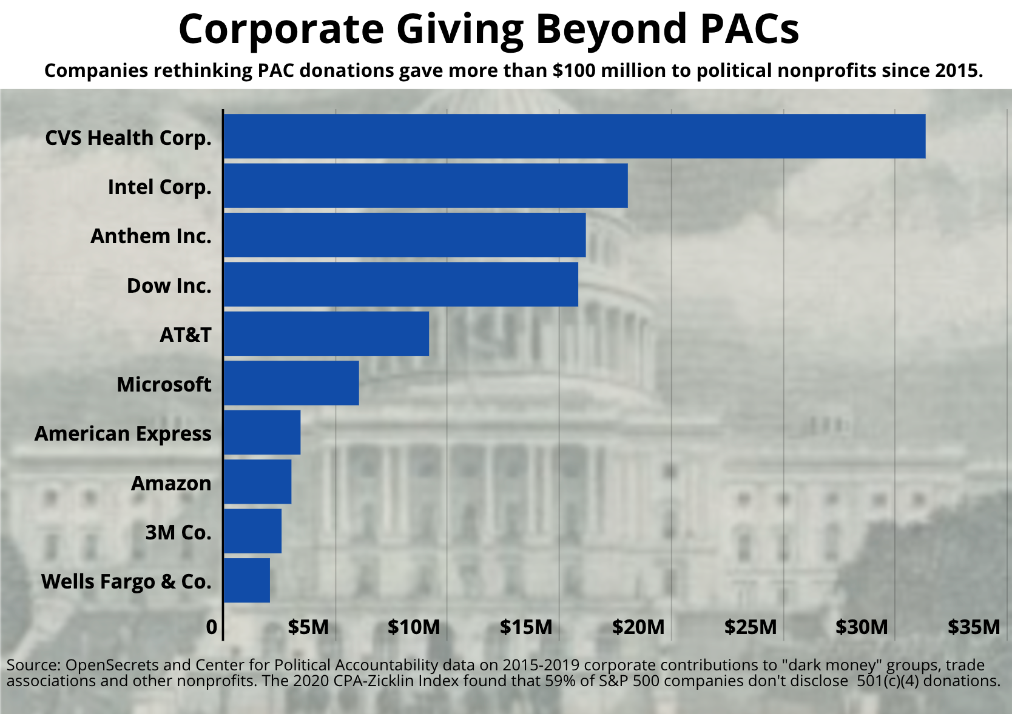

Slide 24
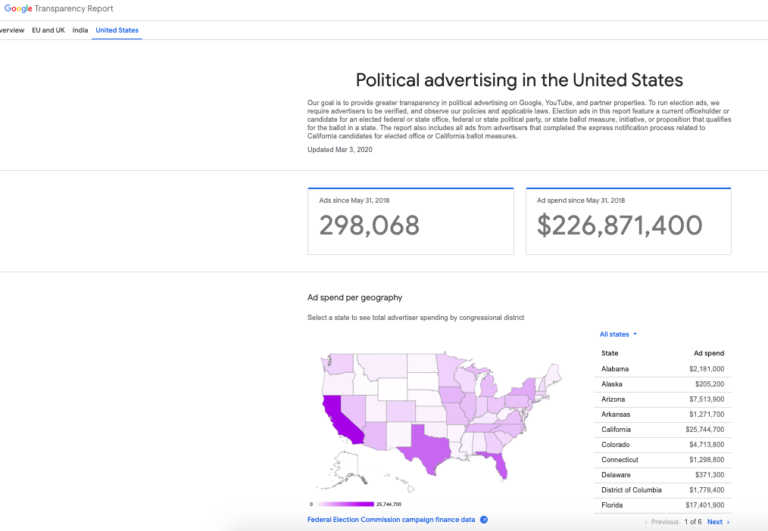
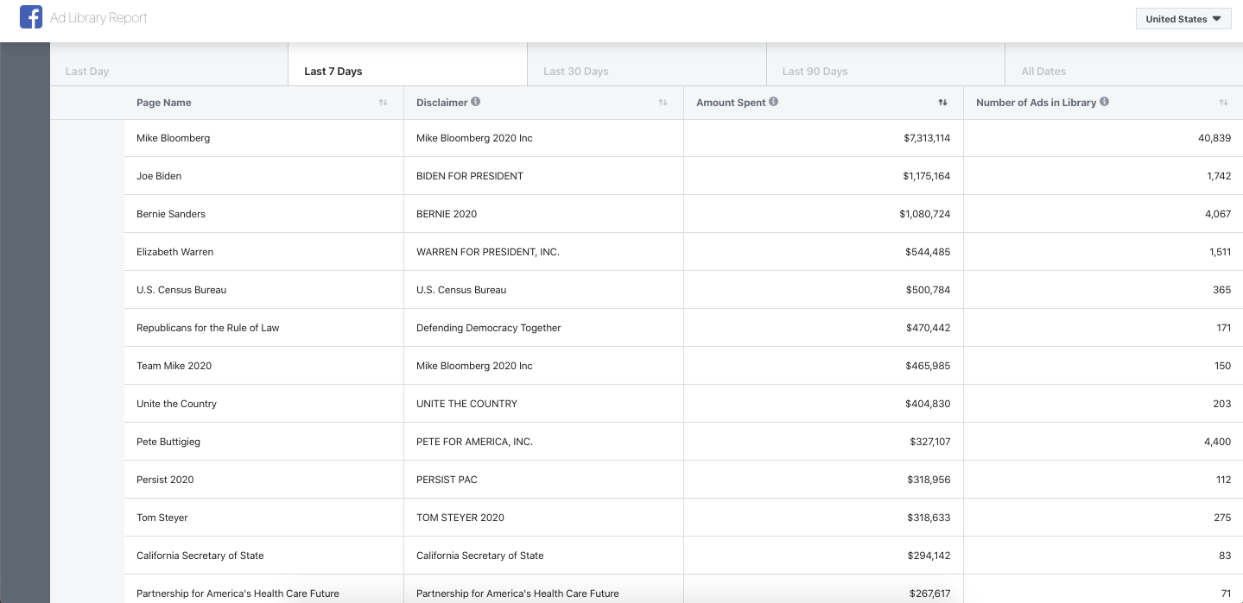
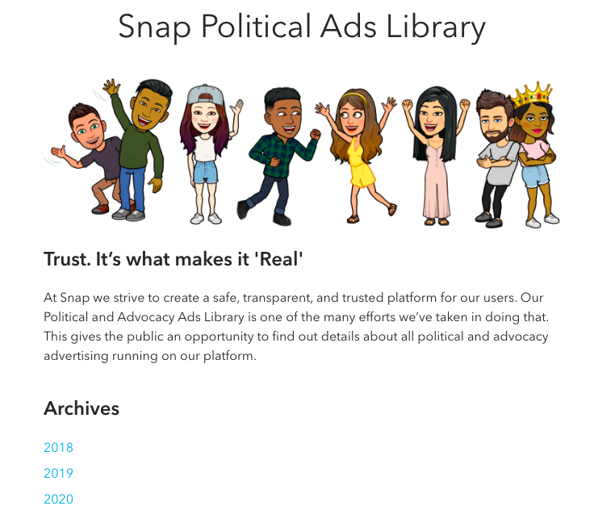
Digital Ad Data

Slide 25
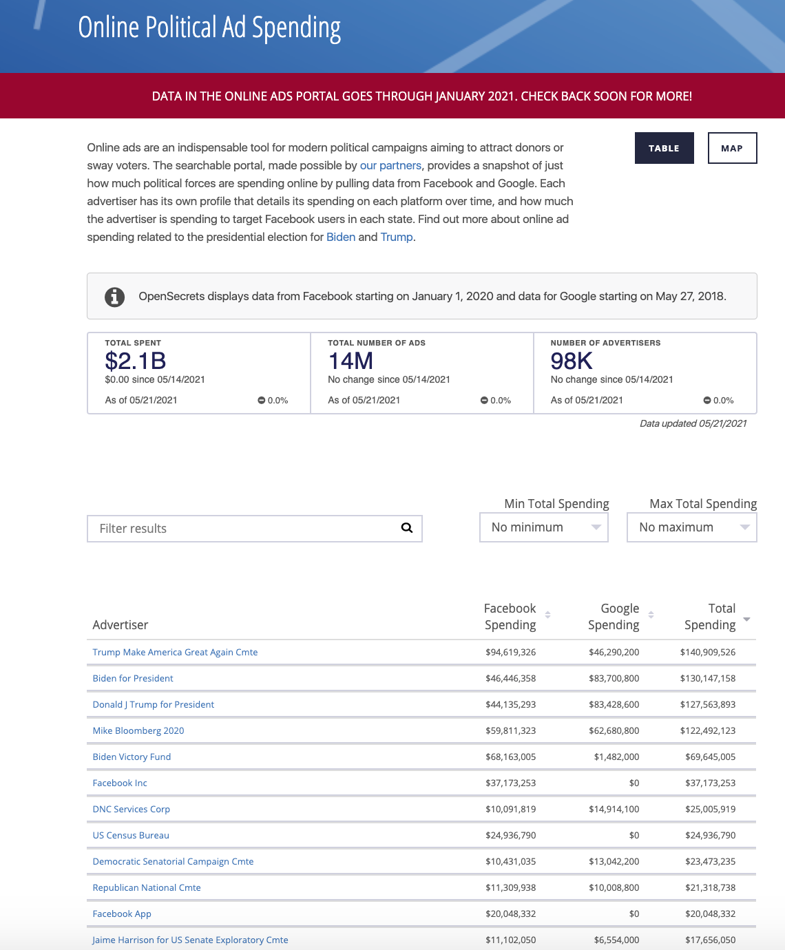

Digital Ad Data: AdData.org

Slide 26
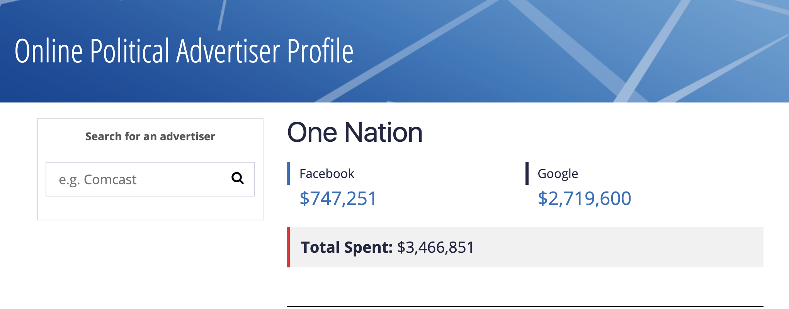
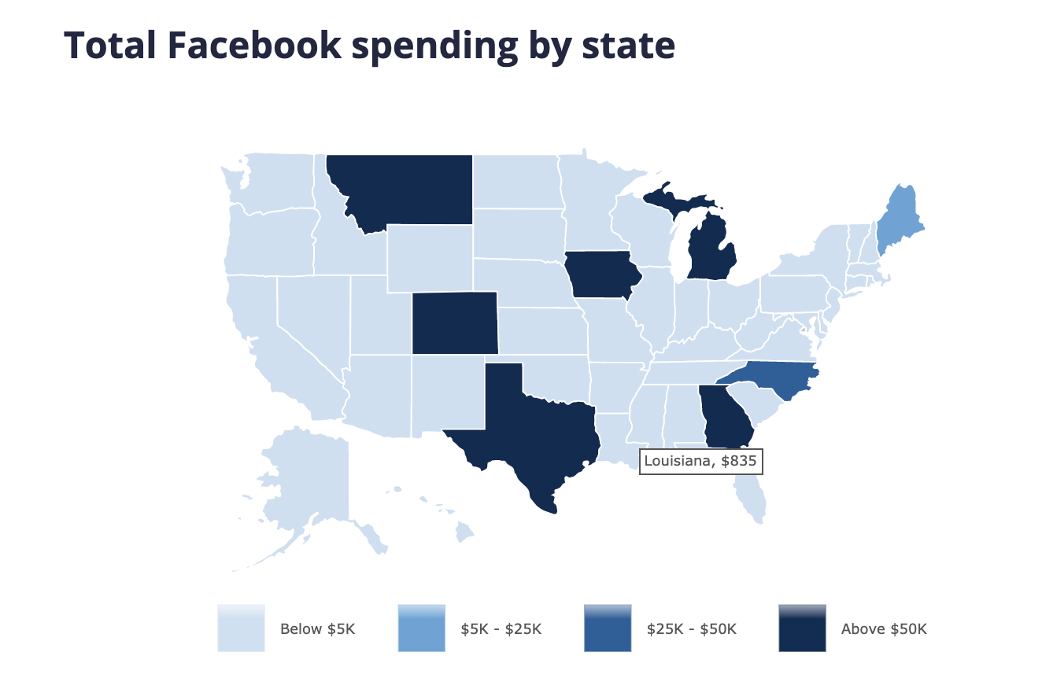
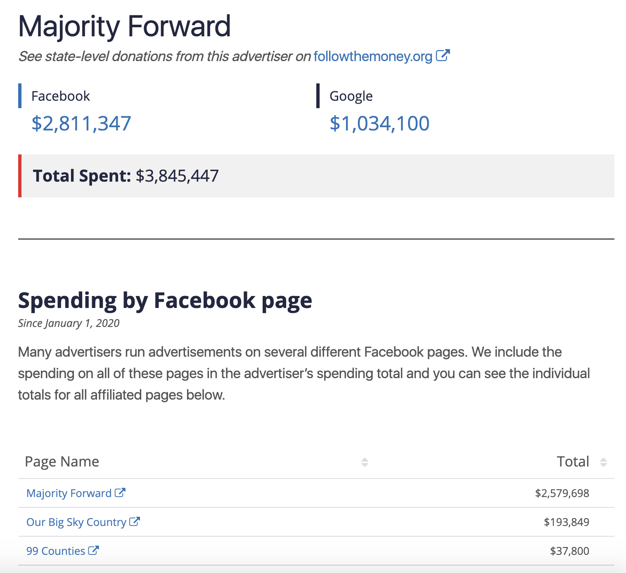
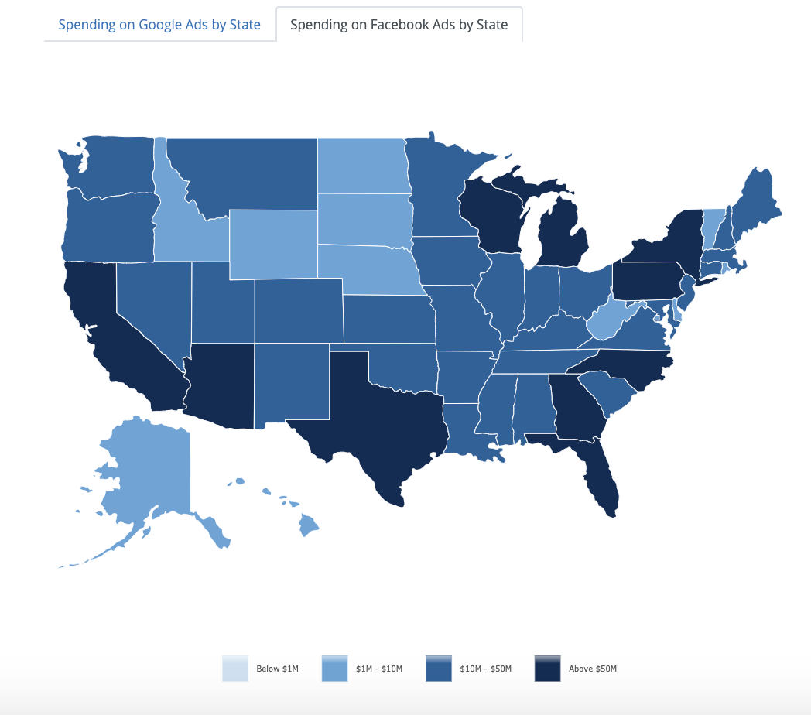
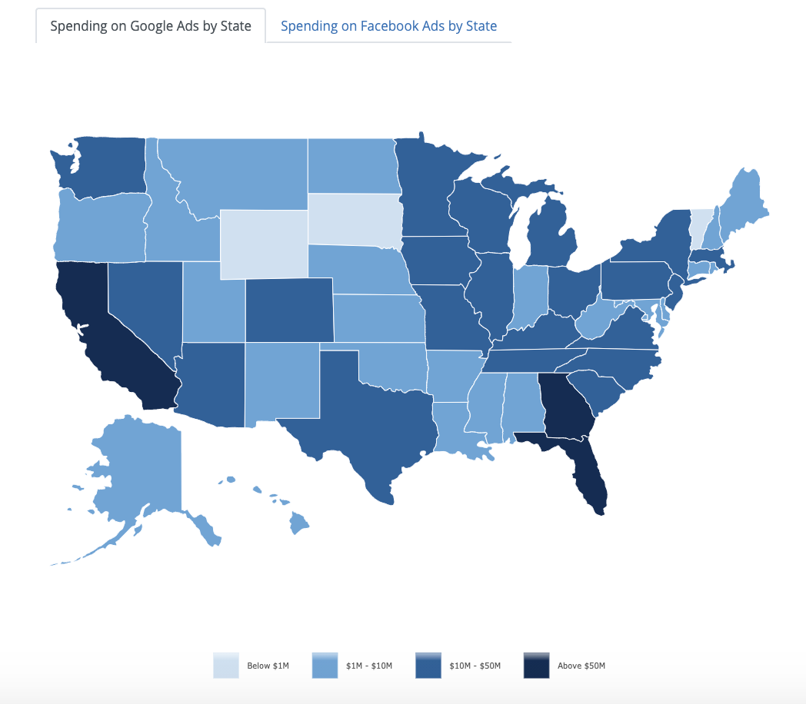
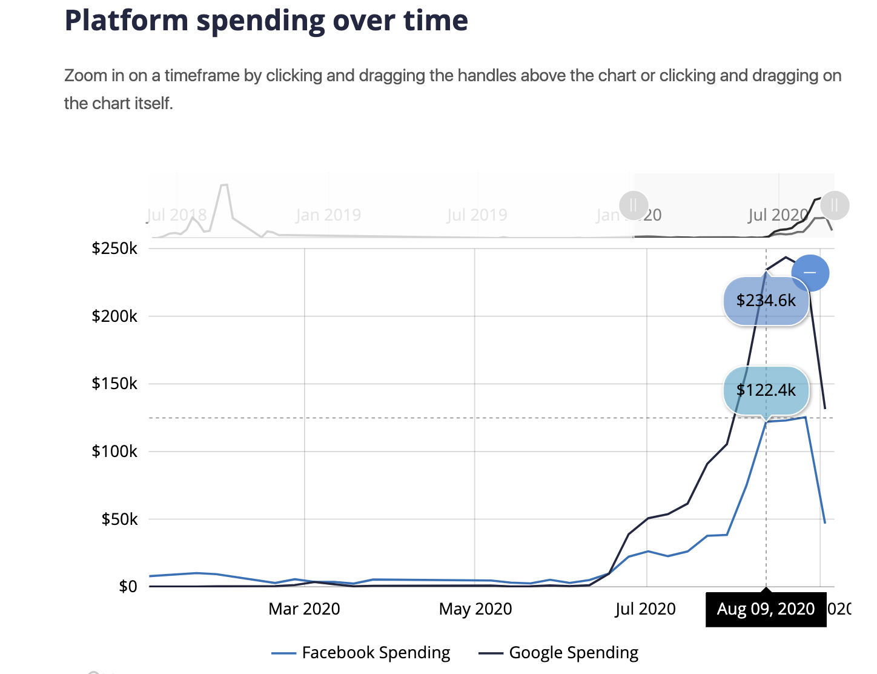
Digital Ad Data: AdData.org

Slide 27
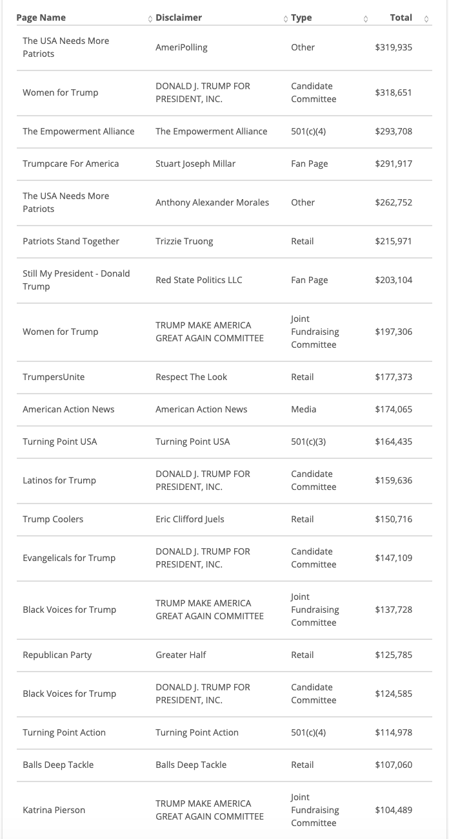
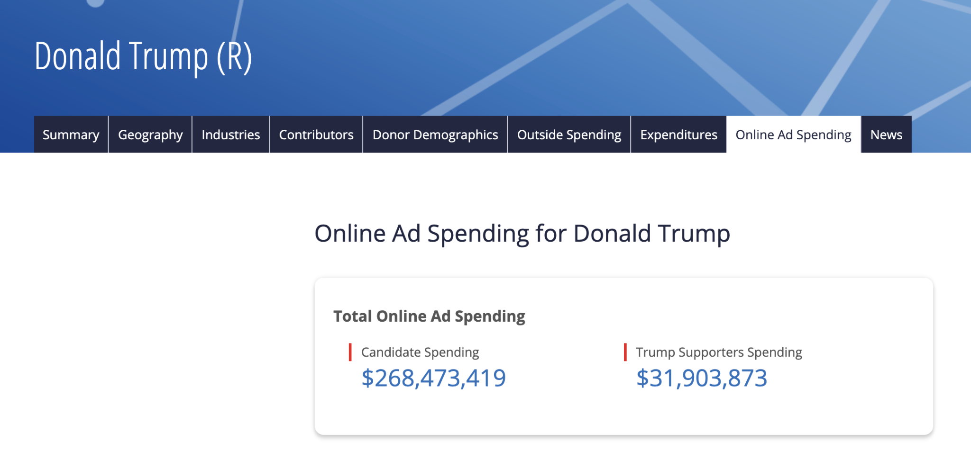
Digital Ad Data

Slide 28
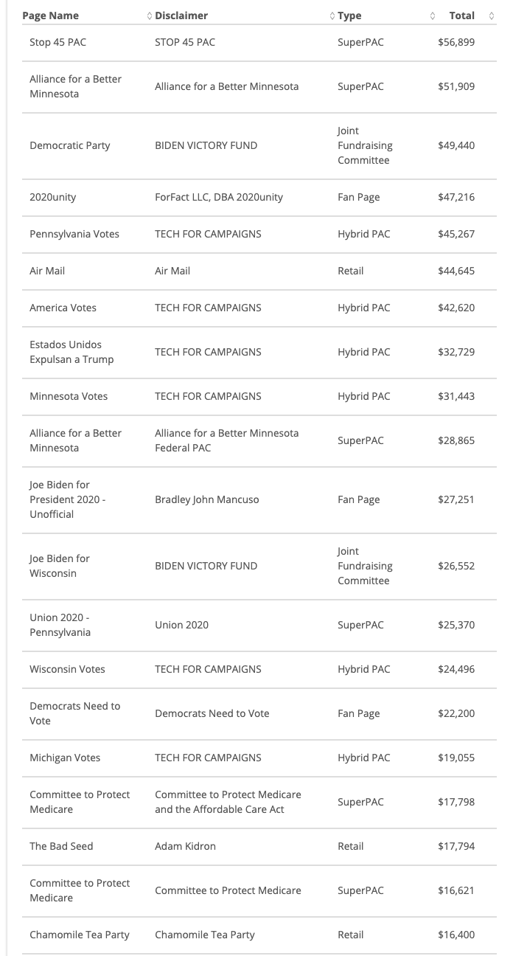
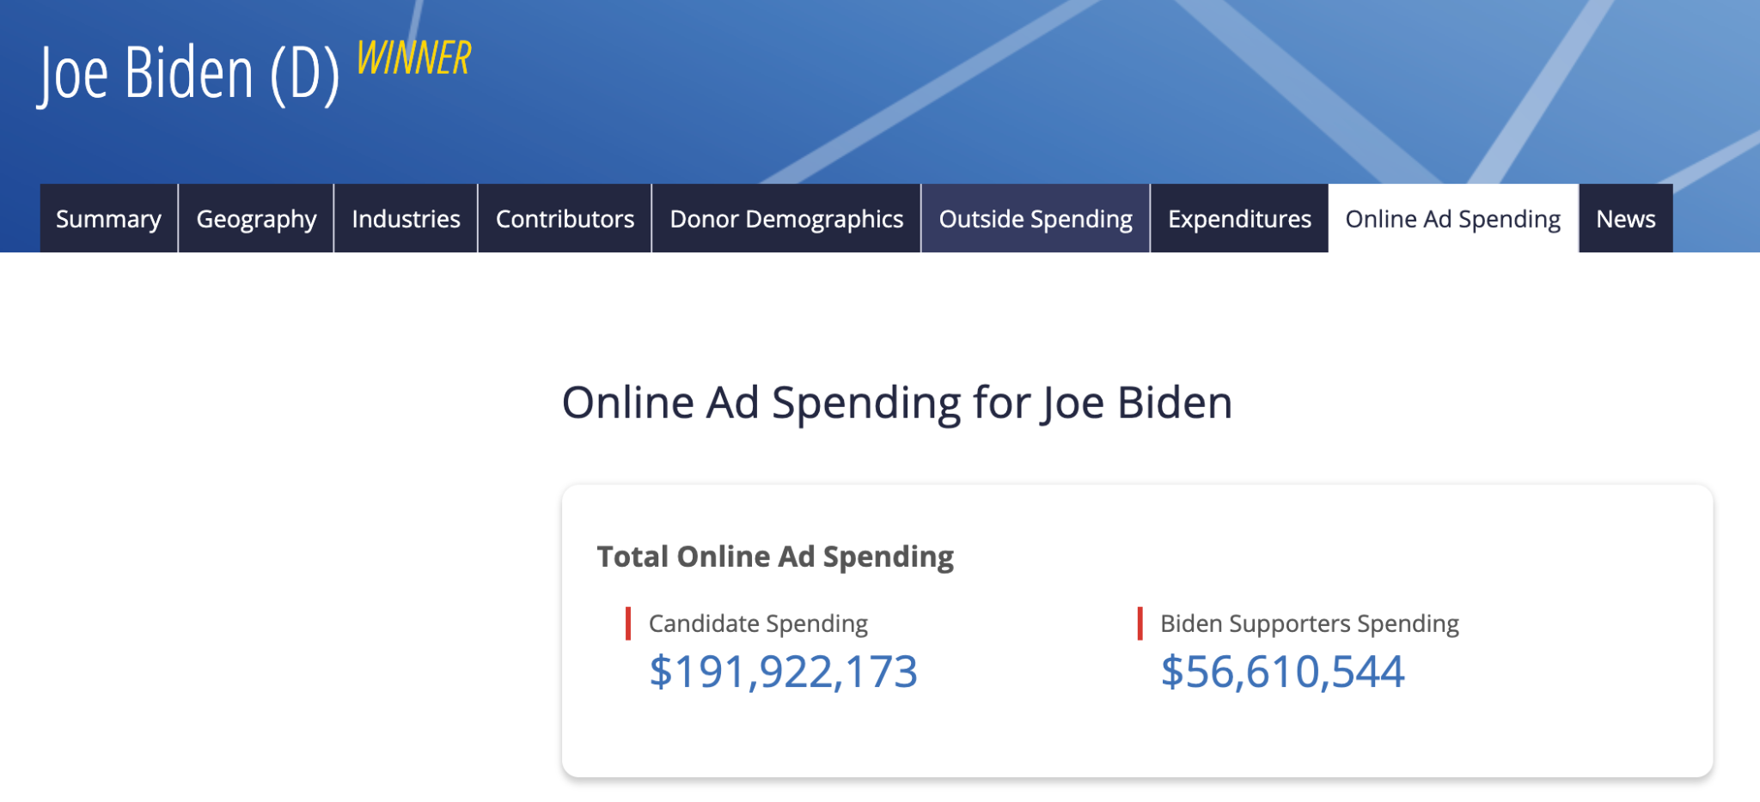
Digital Ad Data

Slide 29
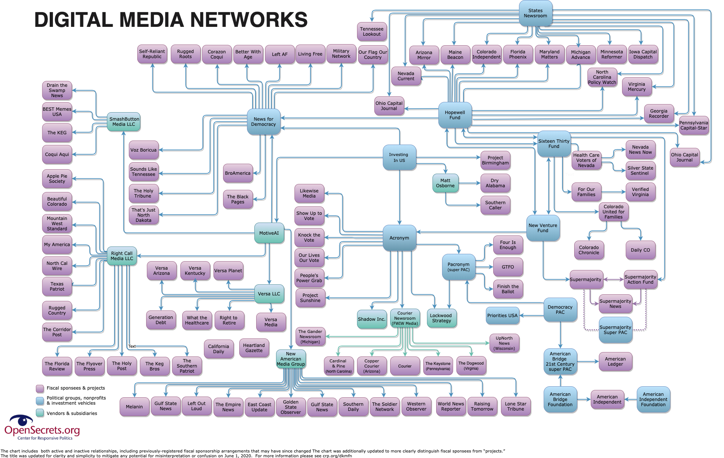
Digital Ad Data

