Slide 1
Model-Legislation in your state house
Michael Squires
ProPublica
Twitter: @mgsquires
michael.squires@propublica.org
(602) 206-2785
Kristian Hernandez
Stateline
Twitter: @kristianreports
khernandez@pewtrusts.org
(915) 999-8252
Pratheek Rebala
Center for Public Integrity
Twitter: @pratheekrebala
prebala@publicintegrity.org
(202) 910-8668

Slide 2
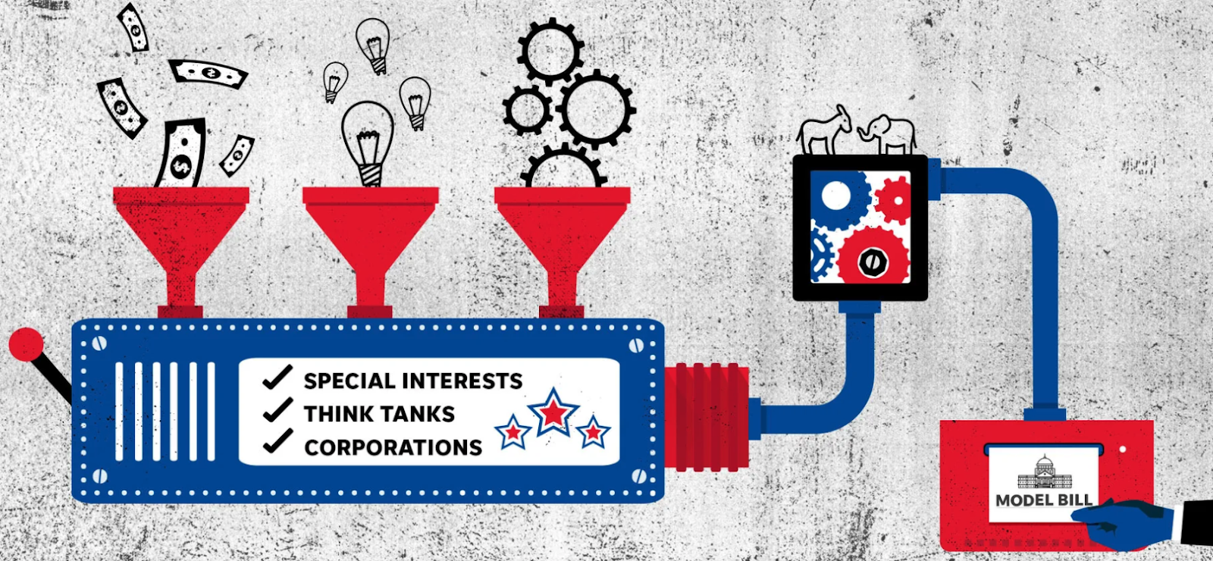
Understanding influence
Why do Legislatures do what they do?
Whose problems are they concerned with?
Watch yourself when you say “everybody knows”?
Notes:
BACKGROUND ON THE PROJECT B/C IT ILLUSTRATES HOW WE THINK ABOUT MODEL LEGISLATION
UNDERSTANDING INFLUENCE - One of the primary goals I had covering Legislatures. Voters elect representatives. Whose agenda do those representatives pursue? PUT SIMPLY IT’S TO UNDERSTAND WHY DO LEGISLATURES DO WHAT THEY DO?
Arizona lawmakers, according to the last count I saw, had introduced 70 bills to alter elections in some way. I think we know the motivations behind that, but you get the idea. In a state where the cost of living has skyrocketed, that’s in a drought that threatens its very existence, that’s predicted to be among the most disrupted places due to climate changes … why are we talking about these topics?
Who is setting the agenda? And why? Industry; partisan; donors …
“Everybody knows that …”

Slide 3
Model legislation
It’s not new, and it’s not all “bad.”
But it’s one of the least-understood and least-documented documented expressions of influence in statehouses.
“… copycat bills amount to the nation’s largest, unreported special-interest campaign, driving agendas in every statehouse and touching nearly every area of public policy.”
Notes:
Model legislation was a less-understood aspect of influence and agenda.
It’s been around a long time. Trayvon Martin - stand your ground law (ALEC model) the reason police didn’t initially charge George Zimmerman
Others had done work. Data scientist Joe Walsh while at the Center for Data Science and Public Policy had shown how algorithms could identify copied text in bills; the Arizona Center for Investigative Reporting did a 2016 project looking at Arizona lawmakers’ use of model bills.
But after hearing them talk about their approach at an IRE session that year, I thought what was truly needed from an investigative reporting standpoint was to show the whole game. Who was writing them? Why? What did they get out of it? How did lawmakers get these bills? Why were they so eager to carry the water of model bill factories?
These methods executed on a massive scale could dust for fingerprints in legislation around the country. How massive an undertaking that would be, I had no idea at the time.

Slide 4
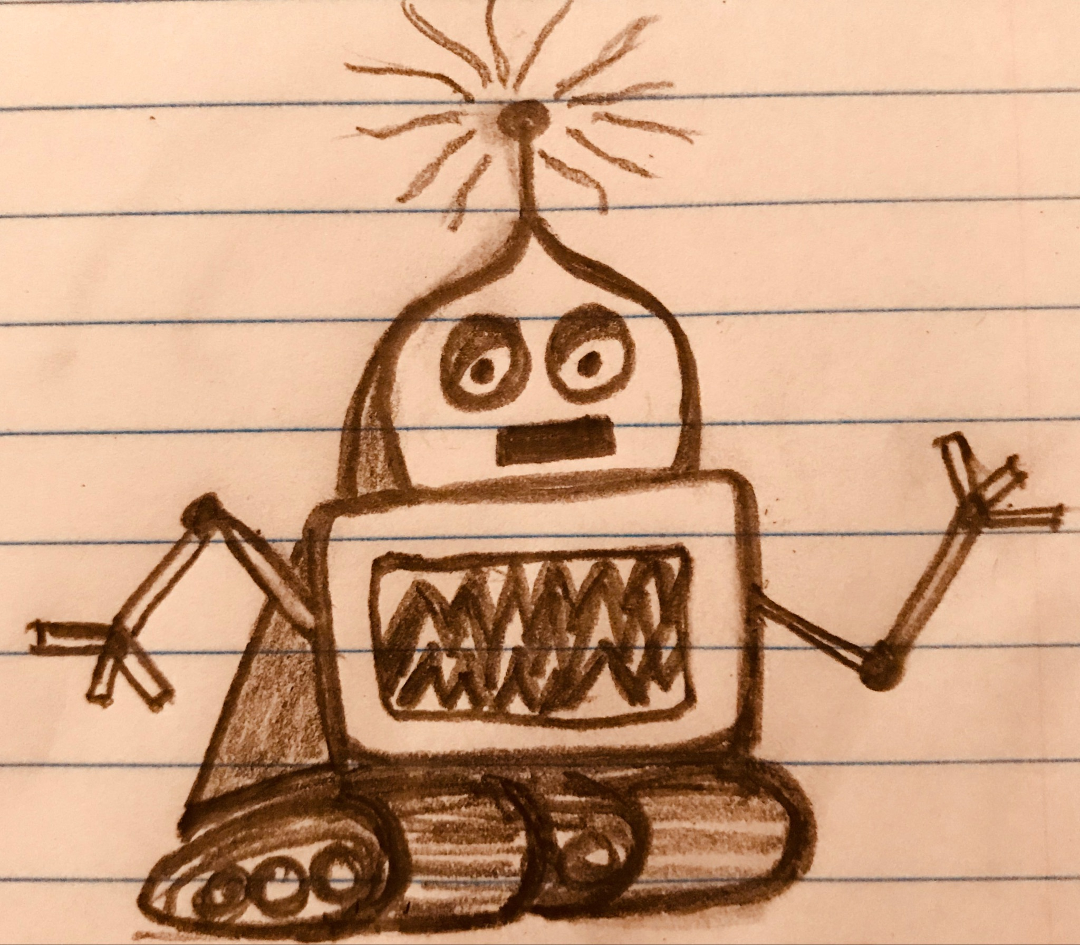
What our “robot” found.
How we went about looking through 1 million bills.
https://www.usatoday.com/story/news/investigations/2019/04/03/how-laws-made-why-we-revealed-politicians-didnt-write-them/3162256002/
What we found. https://www.usatoday.com/pages/interactives/asbestos-sharia-law-model-bills-lobbyists-special-interests-influence-state-laws/
Our robot found a lot of stuff. (Note the bewildered look on its face.)
Notes:
Designing our ALGO; our METHODS. Our FINDINGS.

Slide 5
Data gives you what and where but not why.
Who’s behind them:
ALEC and other industry groups
“Think tanks” and ideologically oriented groups, Goldwater Institute and other State Policy Network members
Public interest law firms, ie Alliance Defending Freedom
What they get out of it:
$ - reduced liability; competitive advantages
Advancing their ideology
Publicity and donations. “Right to Try”
Notes:
What did we find? A lot
In all, these copycat bills amount to the nation’s largest, unreported special-interest campaign, driving agendas in every statehouse and touching nearly every area of public policy.
Who was doing it? Organizations like ALEC, public interest law firms like Alliance Defending Freedom (bathroom bills); single subject groups (Heartbeat bills); “think tanks” like the Goldwater Institute (Check out the State Policy Network for similar institutions in your state)
The data, as is often the case, gives you WHAT/WHERE, but it doesn’t tell you WHY.
THE GROUPS:
FINANCIAL BENEFIT (topics that we wrote about included reduced asbestos liability; used car dealers not being liable for airbags; reduce regulations on them.)
IDEOLOGICAL BENEFIT (think anti-abortion with the so-called Heartbeat Bills that we wrote about; the anti-Sharia Law bills)
DONATIONS: Right to Try. Goldwater. Might be the most successful model of all time. Passes congress. Trump talks about it in the SOTU. This session Goldwater boasted about writing the bill, which has passed, requiring teachers to post online their lesson plans.

Slide 6
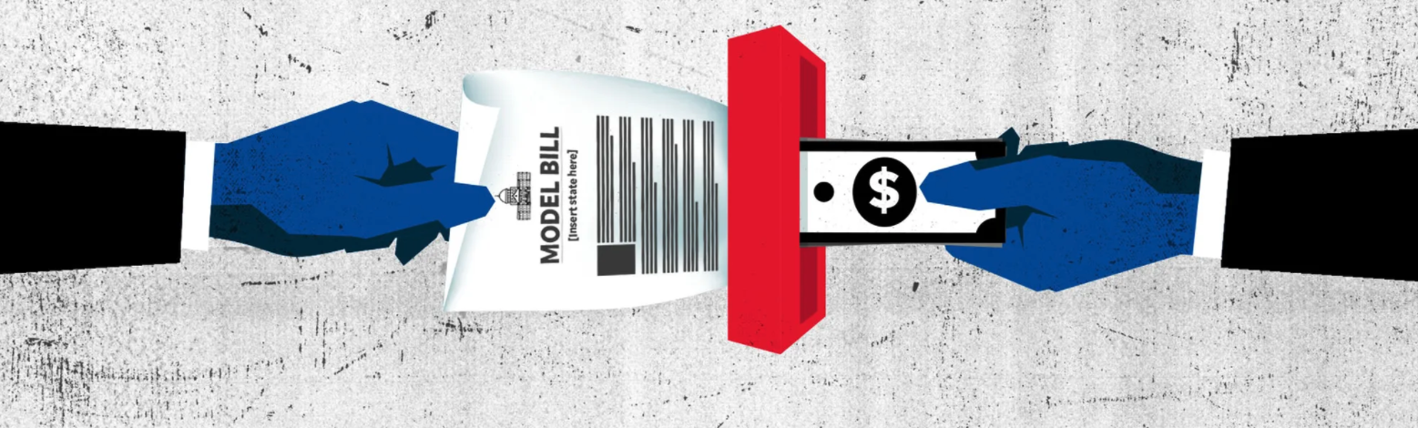
What legislators get
A bill and maybe an expert to testify for it.
Shot at an accomplishment to point to.
Contact with potential donors.
Opportunity to network in the broader political system.
Notes:
LAWMAKERS:
You have a bill to introduce. You want legislation to point to; you don’t have a staff. Here’s something easy. It may come with hearing-ready experts willing to pay their own want to testify for it.
You agree with the ideology behind it.
But they aren’t always aware – Penn lawmaker … 70-plus bills said he didn’t know.

Slide 7
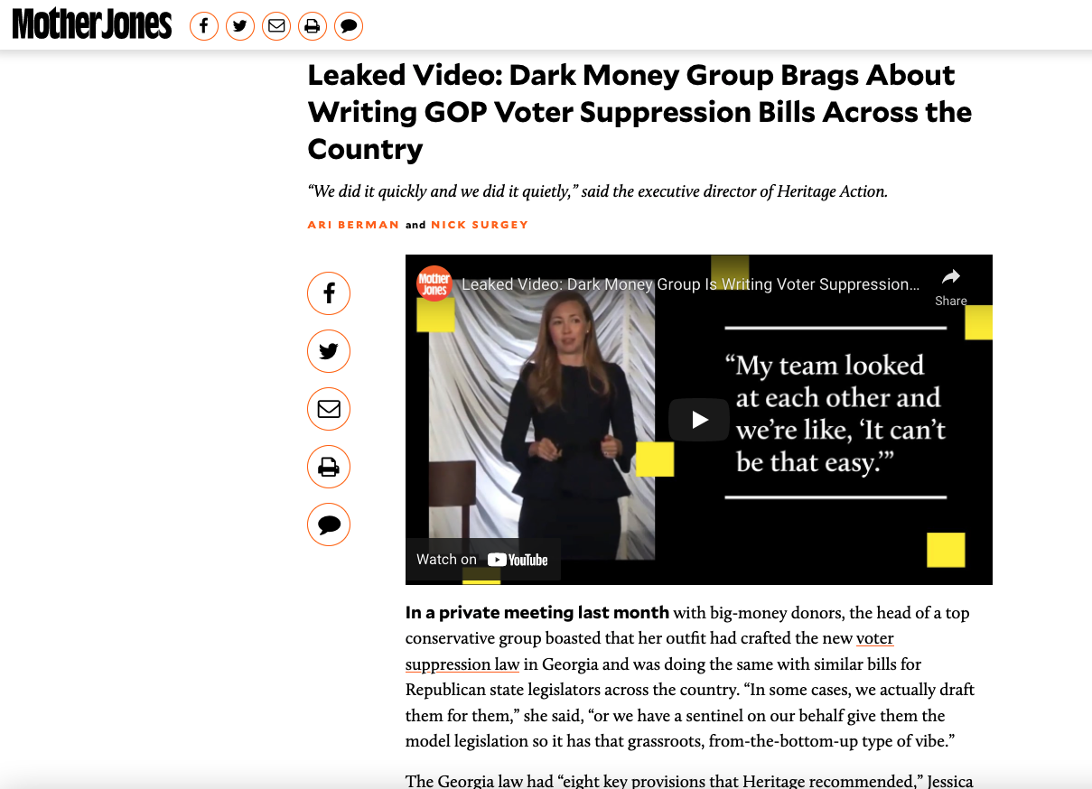
They’re still running the game.
Be suspicious of coincidences.
Find points of origin.
Reveal the motives.
Notes:
Be suspicious of coincidences. If you see the same thing popping up in different places it’s not a coincidence.
Find the point of origin

Slide 8
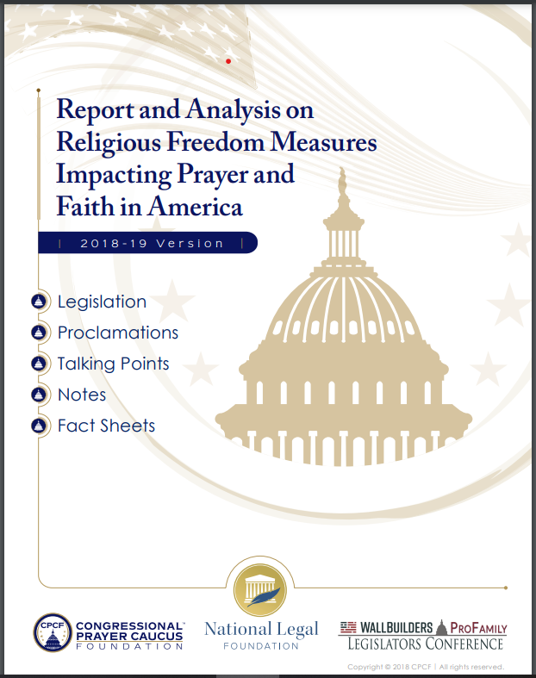
Project Blitz
Religious freedom bills
Project Blitz promoting “Our Country’s Religious Heritage.”
500 bills introduced in 49 states, 60 signed into law, in 10 years.
Adoption Centers
9 states had passed the law
22 states pending legislation
https://drive.google.com/file/d/1_VlpDKavo80GiNNj1RhCe1QE7La51JC7/view?usp=sharing
Notes:
Examples of religious freedom bills, In God We Trust, Religious Freedom Day, Bills allowing prayer in schools and bills that defined marriage as a union between a man and a woman.
National Prayer Caucus founded in 2005 by Rep. Randy Forbes, Republican in Virginia. Room 219
Several conservative and pro-family groups lobbying for these bills could be linked to David Barton of Aledo, Texas, a prominent evangelical and former vice-chairman of the Texas Republican party who has created books and videos promoting the idea that the United States was founded as a Christian nation and must continue as one.

Slide 9
Four Ways to Find Who’s Pulling the Strings
Triangulate by using states that have good data that can help you find similar players/issues in your state -
Iowa, Wisconsin, Massachusetts, Colorado, California
Lobbyists’ swanky dinners etc. In some states these would be indicated in general lobbyist and/or expenditure filings
Iowa, Maryland
Search legislative testimony
Nevada, Maine
Search industry and advocacy groups’ online materials for events, guest lists, bills they are tracking.
https://docs.google.com/document/d/1z5vTo8K-TxjOcITgyxa9gOAmeMWj75HgpBd4j1aAoZc/edit?usp=sharing
Notes:
States where lobbyists register positions on bills
IA - can search for all positions taken on bills by client or lobbyist l
WI - can search by bill or topic or budget subject
MA - can search for lobbyists & positions by bill number or description
CO - can search lobbyist positions by bill number
CA - lists lobbyist positions in lobbyist filings and in bill analyses
(2) Lobbyists’ swanky dinners etc. In some states these would be indicated in general lobbyist and/or expenditure filings. Also:
IA- “function reports”
MD - “event reports”
(3) Nevada allows you to search legislative committee minutes. You can also easily find who testified on certain bills, etc., in the state’s NELIS system.
Maine’s legislative website allows easy access to written forms of committee testimony on bills. Illinois groups witnesses at legislative committee hearings into proponent/opponent/no position. You can find those positions and testimonies for committee hearings here: http://my.ilga.gov/
Best state legislative website for easy access to video of committee testimony: Tennessee.
4) Search national advocacy groups’ online materials for events, guest lists for which state officials attend, such as the Republican Attorneys General Association conferences, the Democratic Governors Association, the National Association of Insurance Commissioners conferences, ALEC meetings, etc. to see how special interests may be courting your officials.

Slide 10
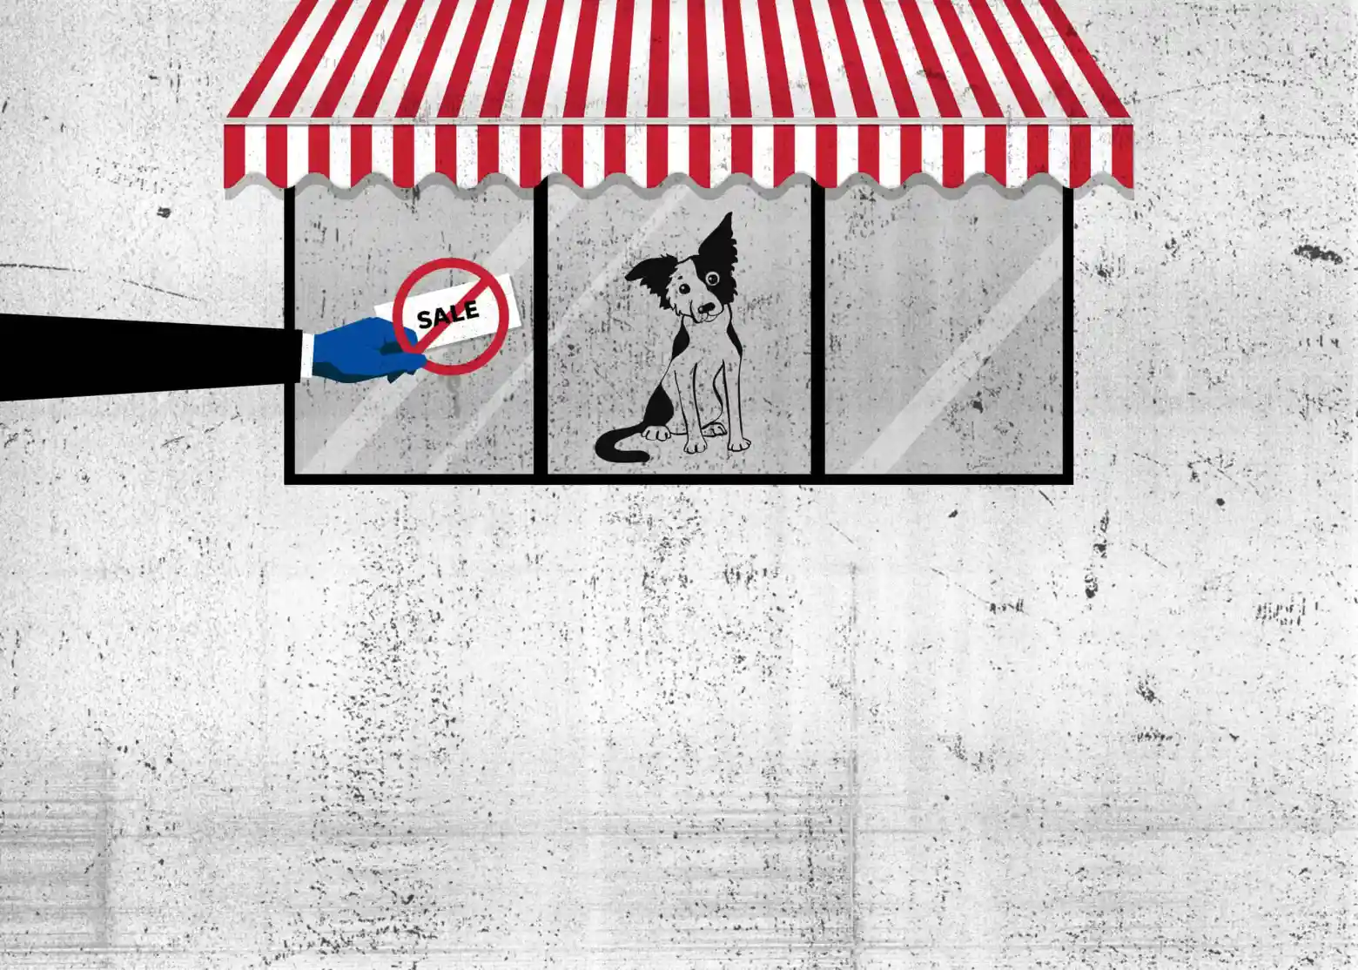
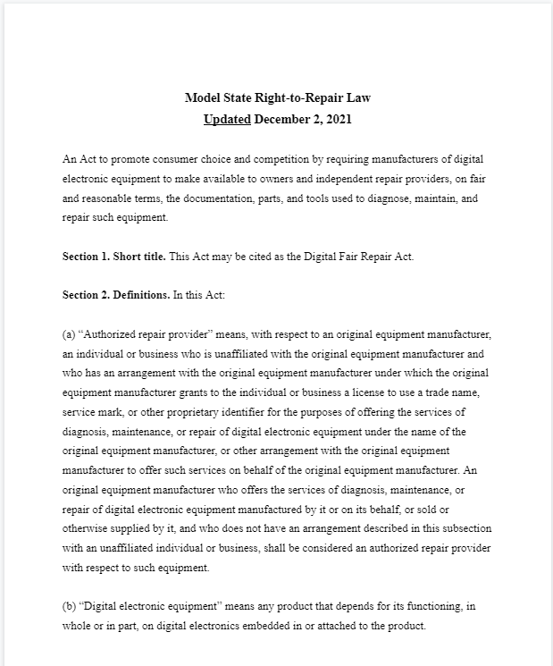
Puppies, Phones and Porn
1.2 million bills across all 50 states and compared their text to identify when two bills in different states have common language.
How does model legislation affect consumers lives
Fair Repair, Puppy Mills, Meat/Milk, Porn
https://model-legislation.apps.publicintegrity.org/bill/highlight?selectedBills=1307109&selectedBills=1541970&sourceId=1185988&matchId
Notes:
Using the model legislation tracker it took a few weeks to put together the capstone story to the project. We wanted to get as many eyes on the story so we went with the most kinda click-batee, bills we found. We also wanted to clearly show normal people, consumers how model legislation is everywhere.
Repair Association, ALEC, Beef/Milk industry
National Catholic Society for Animal Welfare, Petland had a counter bill

Slide 12
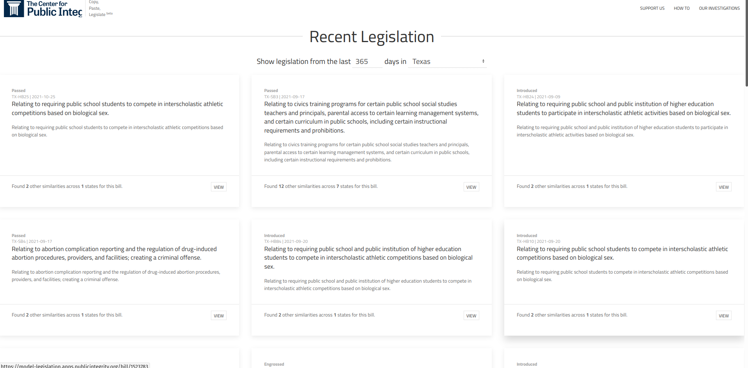
Model Legislation Tracker

Slide 13
Model Legislation Tracker
10+ years of legislation text and metadata (courtesy of Legiscan)
Updated semi-regularly (ideally weekly)
Pair-wise comparison of all pieces of legislation C(n,2)
2.3 Million Documents
1.4 Million Bills
2,644,998,850,000 potential comparisons
Groups similar bills based on “community detection”
Identifies and highlights similar text between each combination of bills for ease of research

Slide 14
Our workflow
Acquire legislation metadata from LegiScan
Scrape every version of every piece of legislation introduced across the country since 2008.
Parsing and cleaning legislation text
Tokenizing, and shingling the text
Identifying potentially matching legislation
Weeding out the bad matches
Identifying “clusters” of bills

Slide 15
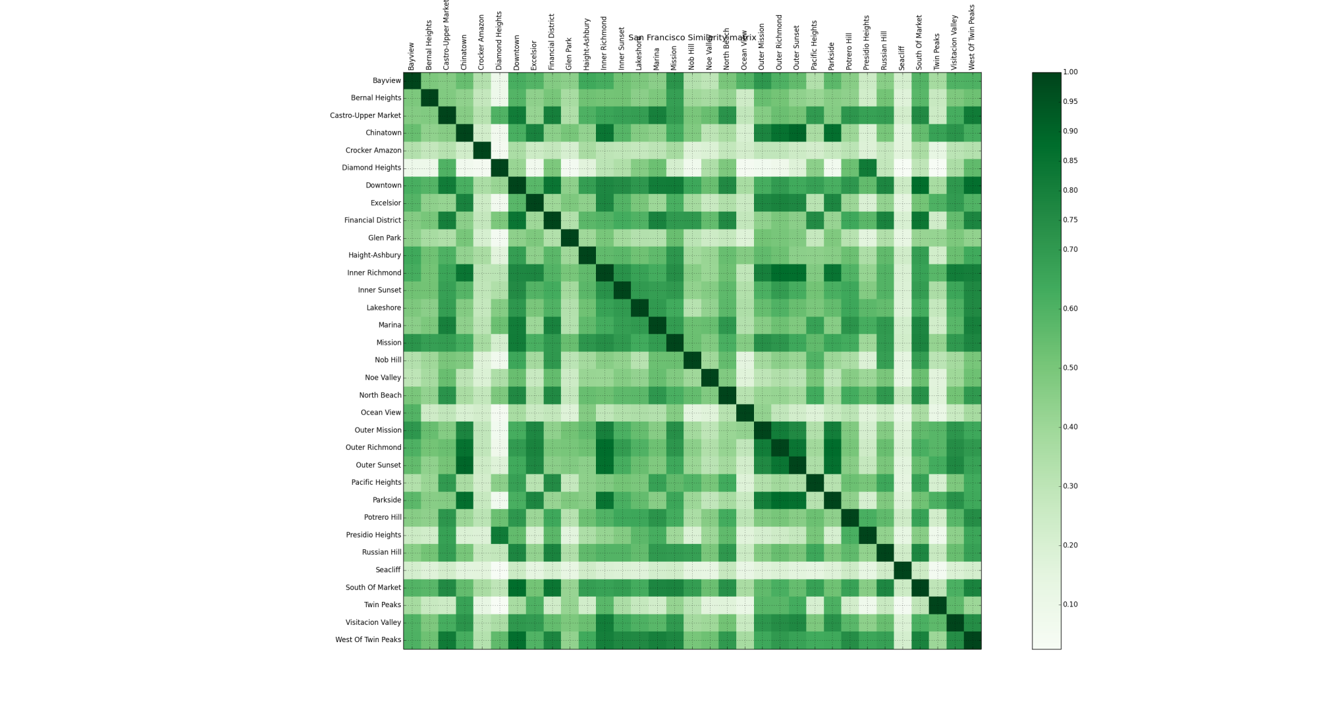
Pairwise Comparison

Slide 16
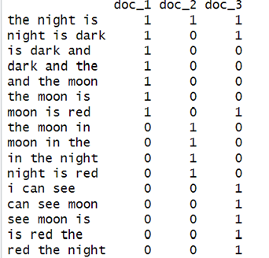
Text Shingling

Slide 17
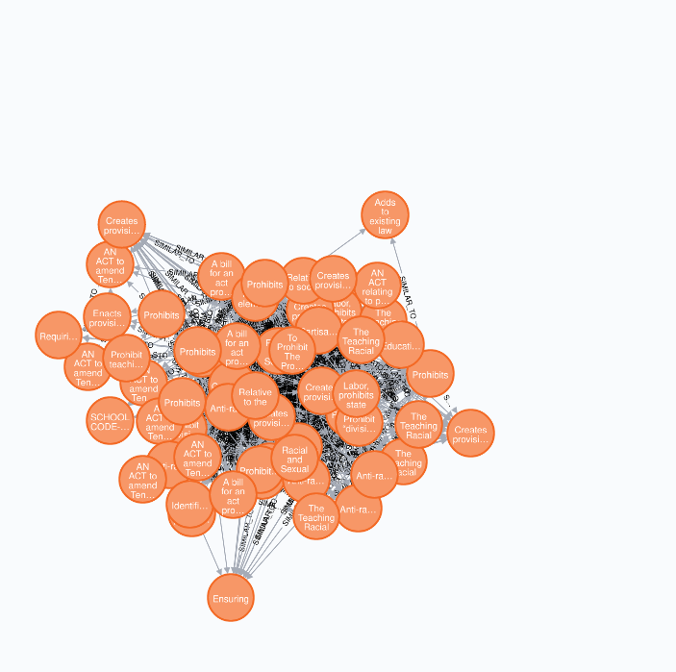
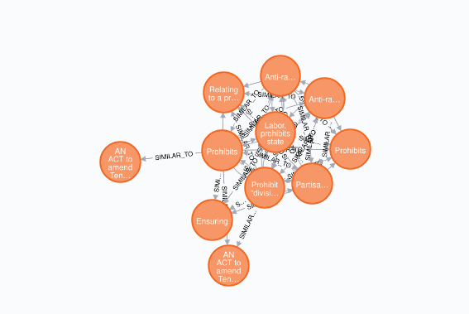
Identifying Clusters & Weeding out the bad matches

Slide 18
Finding “known” model legislation
Some of the bigger groups publicly share their draft model legislation
PrayUSA: https://prayusa.com/downloadable-kits/
ALEC: https://alec.org/model-policy/
Uniform Law Commission: https://www.uniformlaws.org/home
Industry associations often share draft model legislation
Story Recipe:
Look for keywords from these bills on the tool to find if any of them are in your state.
Once you have a single known bill, you can automatically surface every instance of a model bill across the country.
Once you’re able to identify a model bill, use the Legiscan link to identify sponsors and research their campaign contributions, lobbying records etc.

Slide 19
Covering active legislation
Use the “recency” search to identify legislation in your state house as it’s being debated.
Lookup individual bills in session identify provenance of specific language or ideas (both within your state and outside)
Research individual legislators that you are covering to identify if they have introduced model legislation
Lookup your state’s budget bill to see if unpopular language from failed legislation is being reintroduced.

Slide 20
Caveats
Not all model legislation is nefarious
There may be cases where two bills contain identical language but are not model legislation.
We recommend visually inspecting the matching bills to confirm that the shared language is substantive and is related to your topic.

Slide 21
Demo Time

Slide 22
Questions?

