Slide 1

Redistricting Threats and Opportunities
Redistricting:
What Happened?, What’s Next?
Michael C. Li
March 30, 2022
Include Subhead or Date Here

Slide 2
Lay of the Land

Slide 3
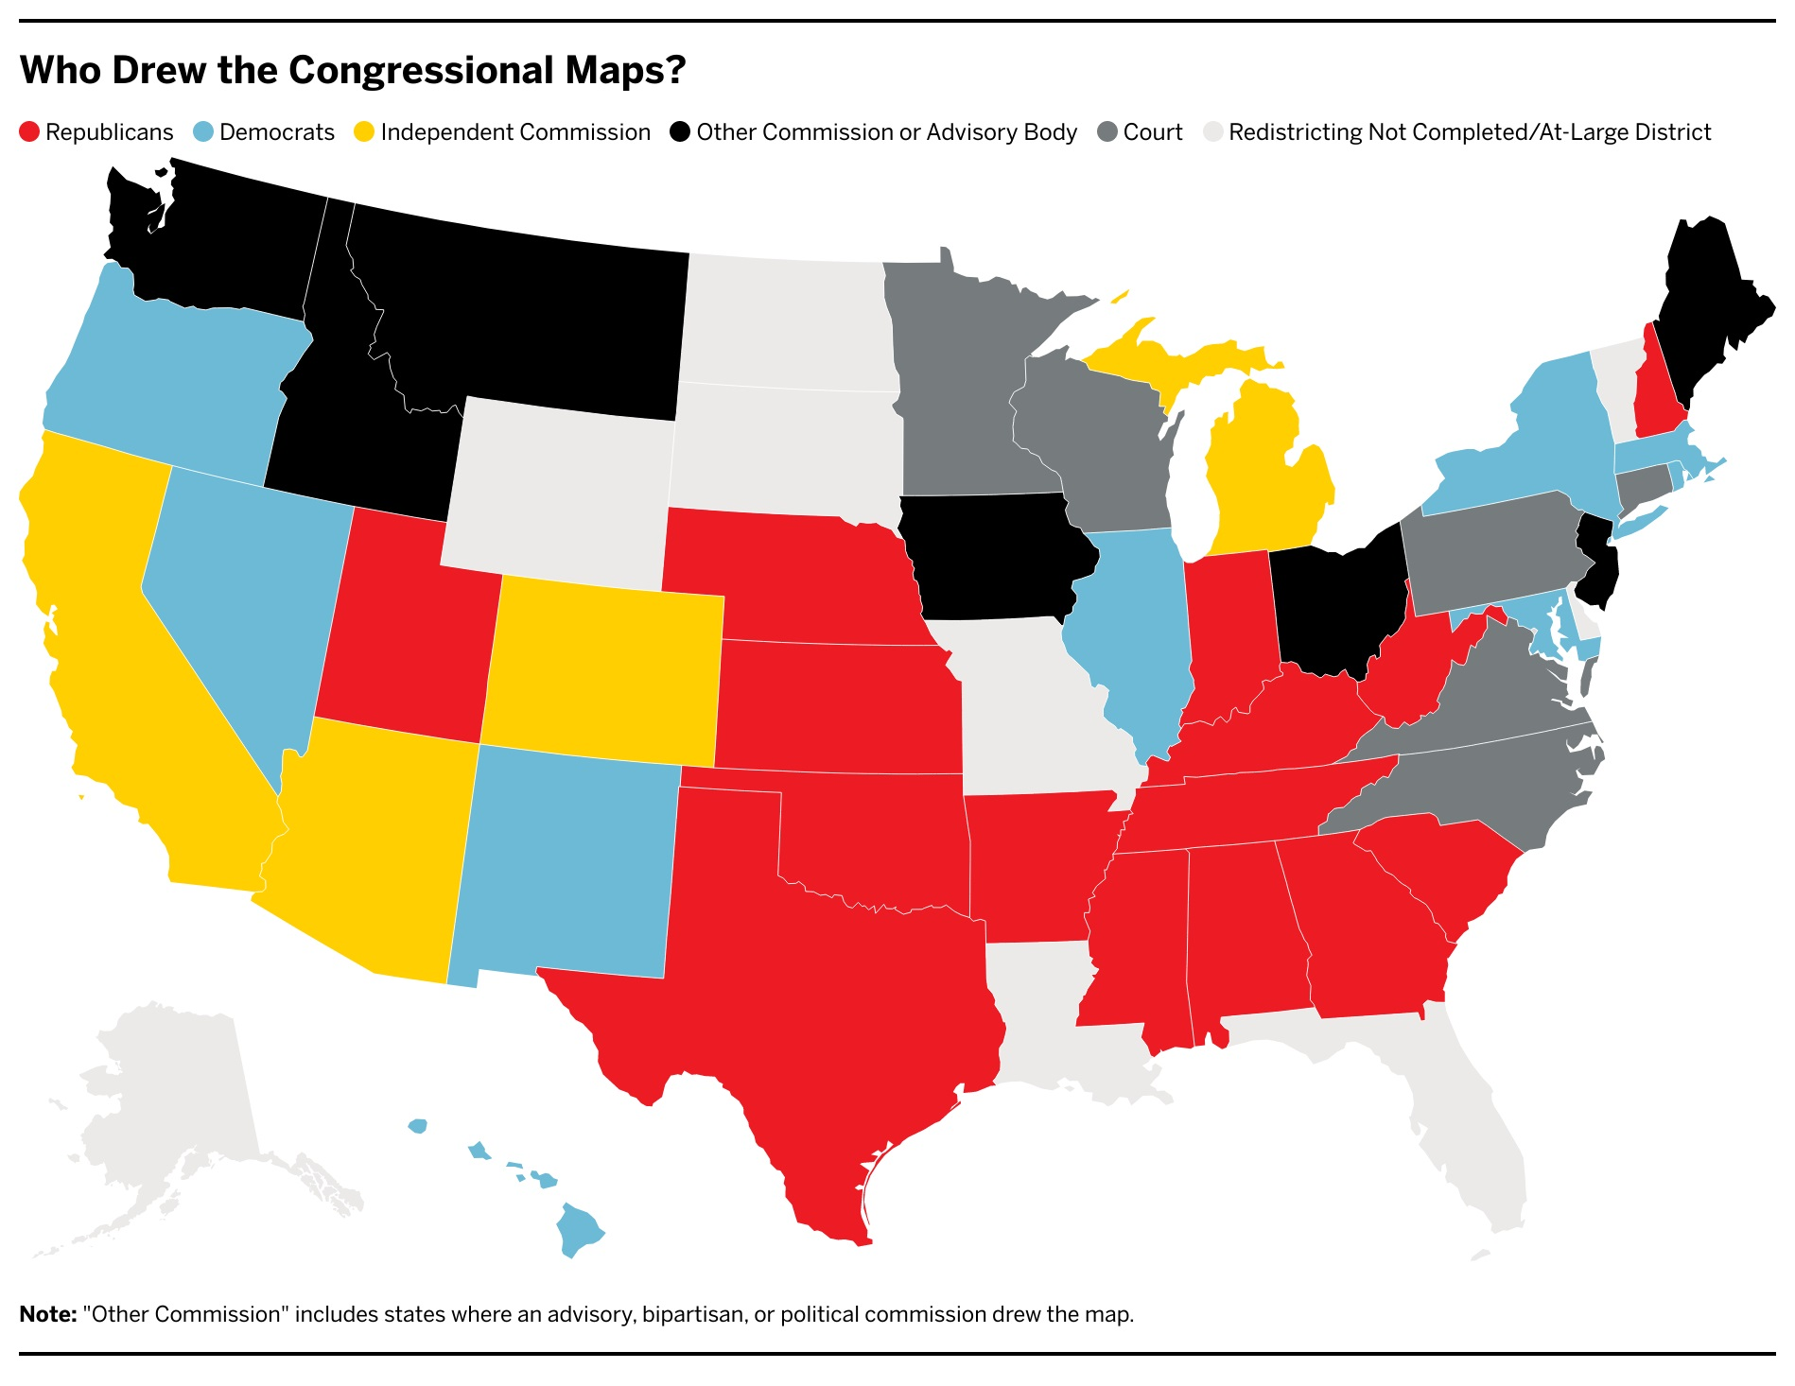
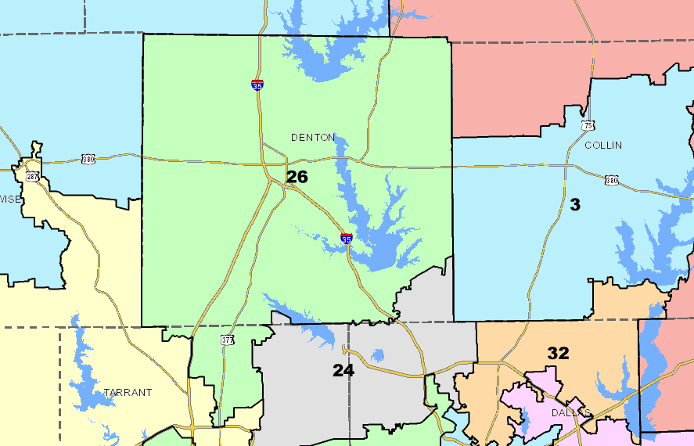
Who Drew This Cycle’s Maps

Slide 4
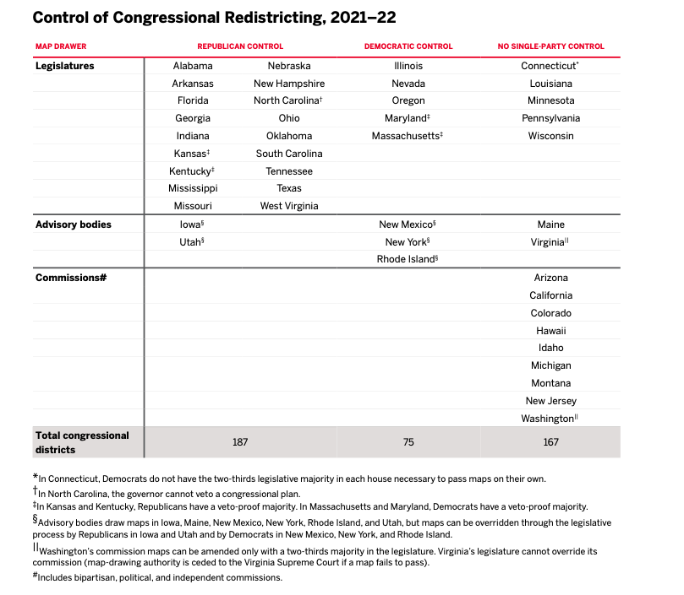
Map Control

Slide 5
How to Think About Gerrymandering

Slide 6
Redistricting Tradeoffs
Maximize seats
Protect seats
Protect incumbents

Slide 7
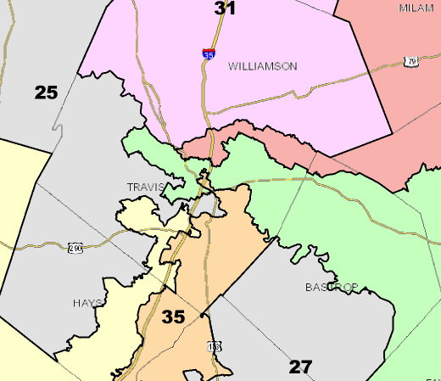
Redistricting Tactics: Cracking
Last decade’s
map divided Austin
among 6 districts to
maximize GOP seats.

Slide 8
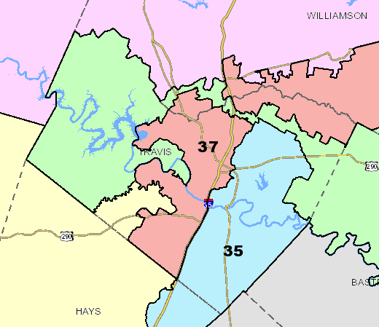
Redistricting Tactics: Packing (“Vote Sink”)
This decade’s
map puts most of
Austin in one
district, thereby
shoring up GOP seats.

Slide 9

Choices Are a Big Tell

Slide 10


Are People Even Playing the Same Game This Cycle?

Slide 11
There Will Be Many Fewer Competitive Seats (Especially in GOP States)

Slide 12
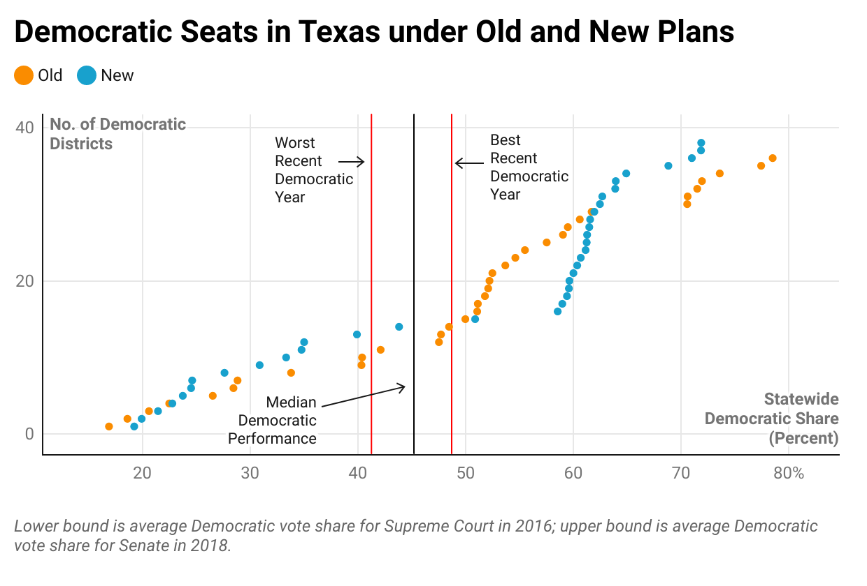
Texas

Slide 13
Competition: Texas

Slide 14
Competition: New York

Slide 15
Competition: Nationwide (as of 3/28)

Slide 16
Communities of Color Are in Map Drawers Sights

Slide 17
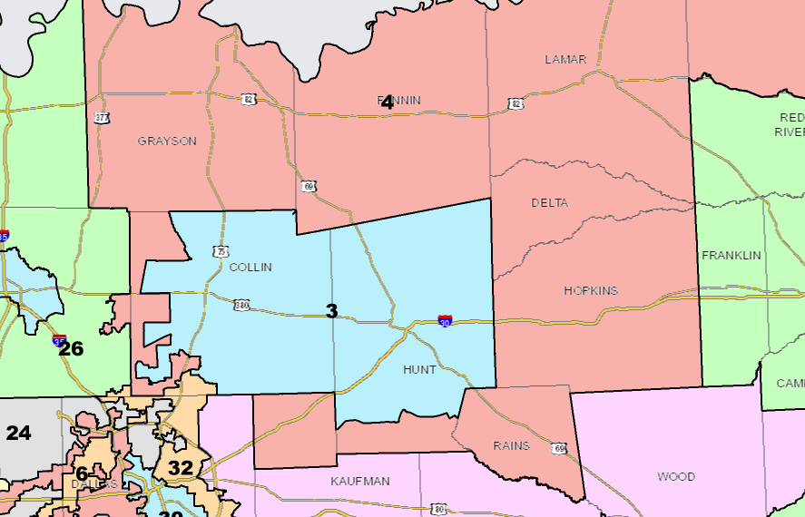
TX-4

Slide 18
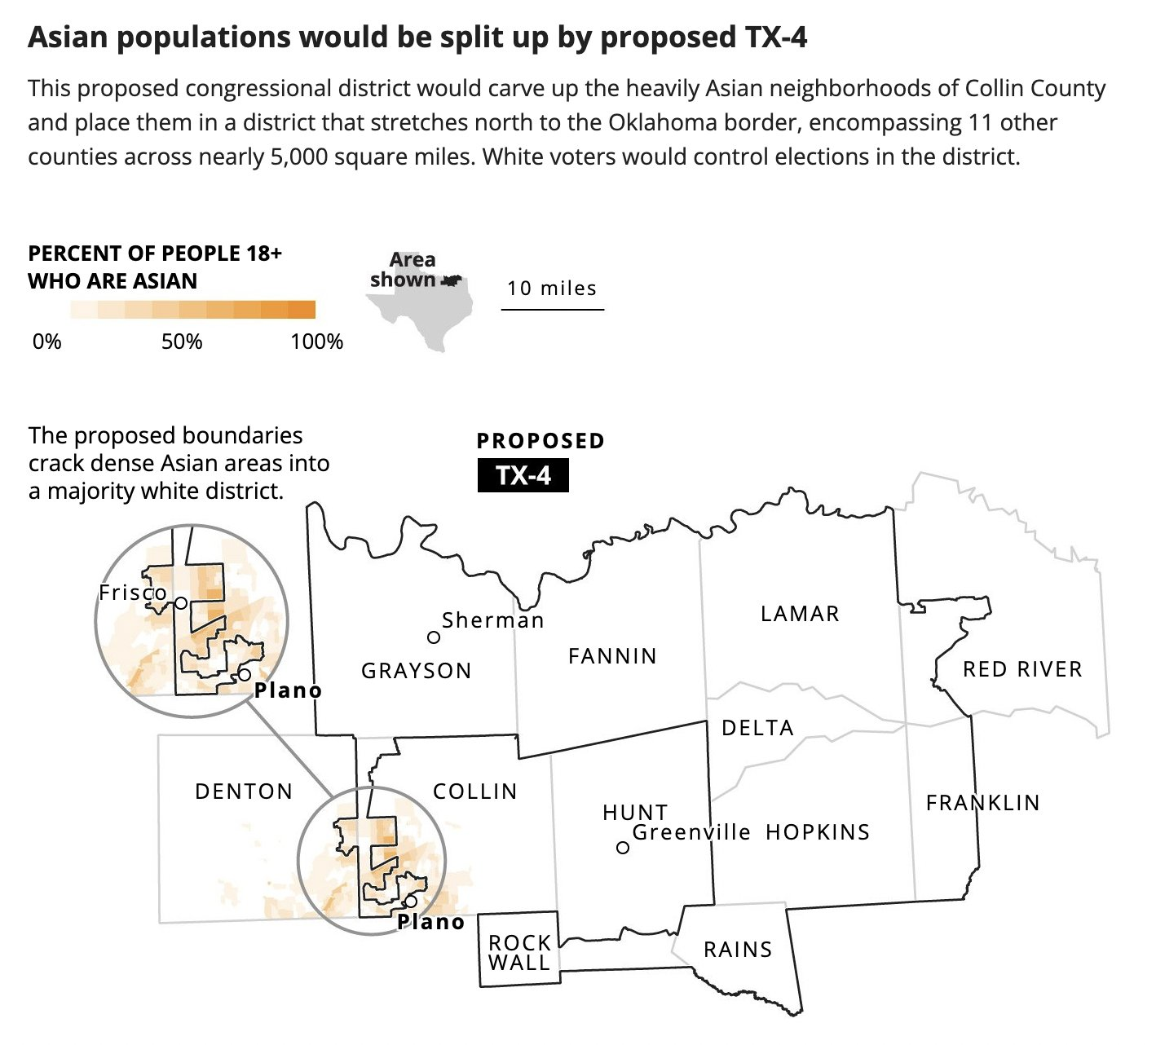
TX-4 (With an Ethnicity Lens)

Slide 19
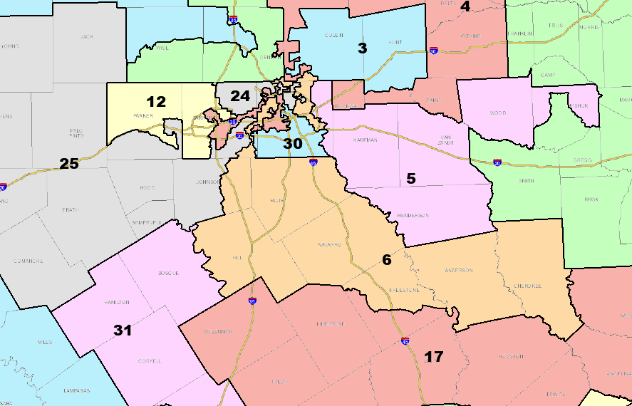
TX-6

Slide 20
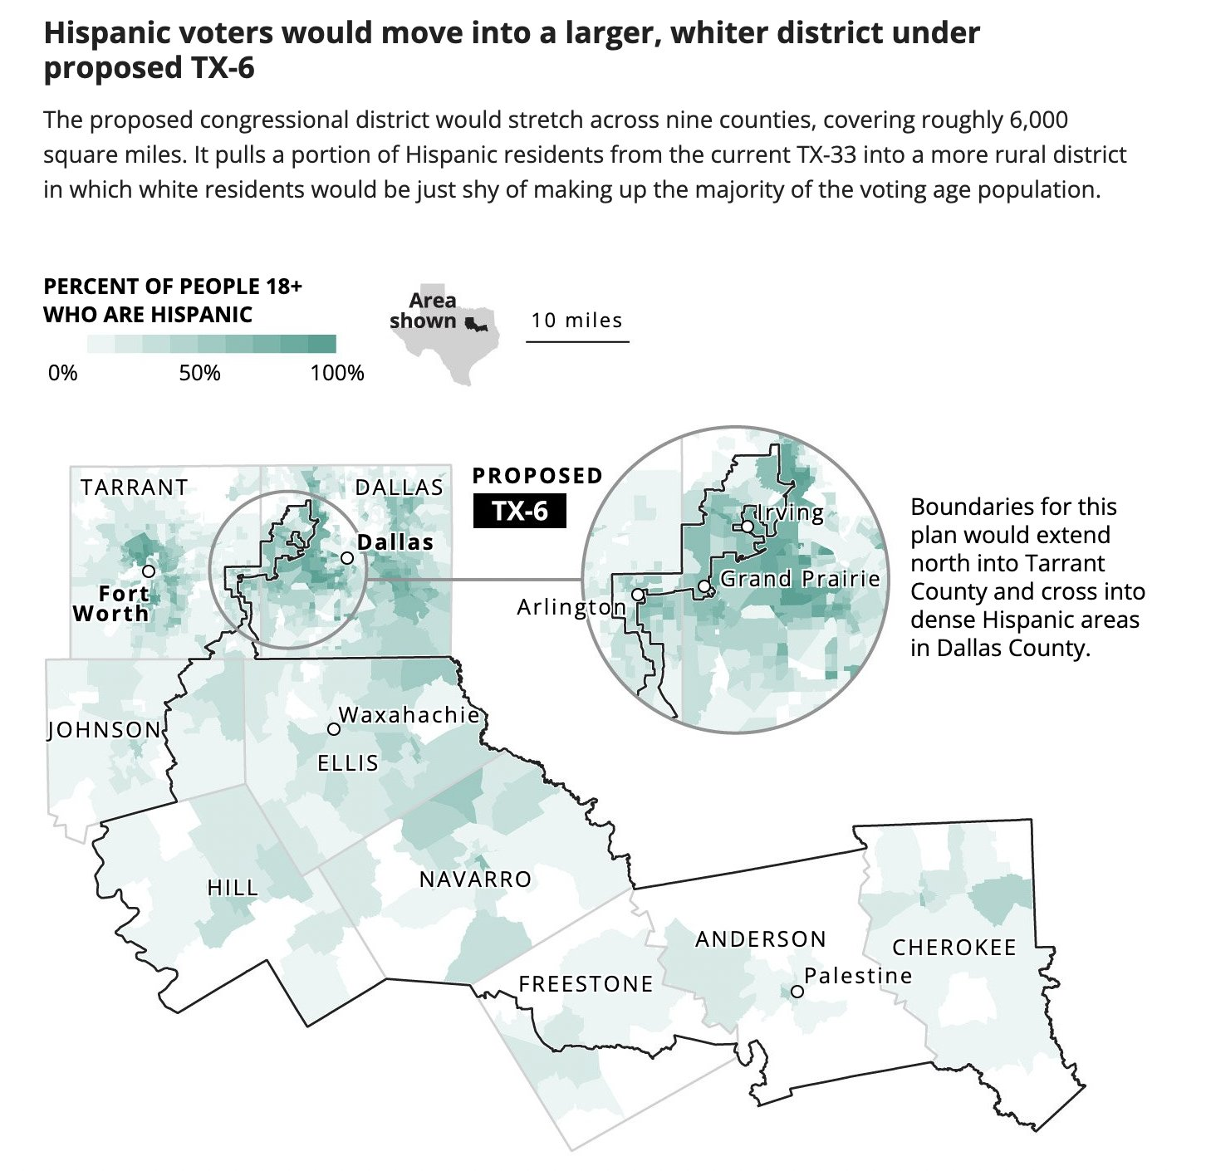
TX-6 (With an Ethnicity Lens)

Slide 21
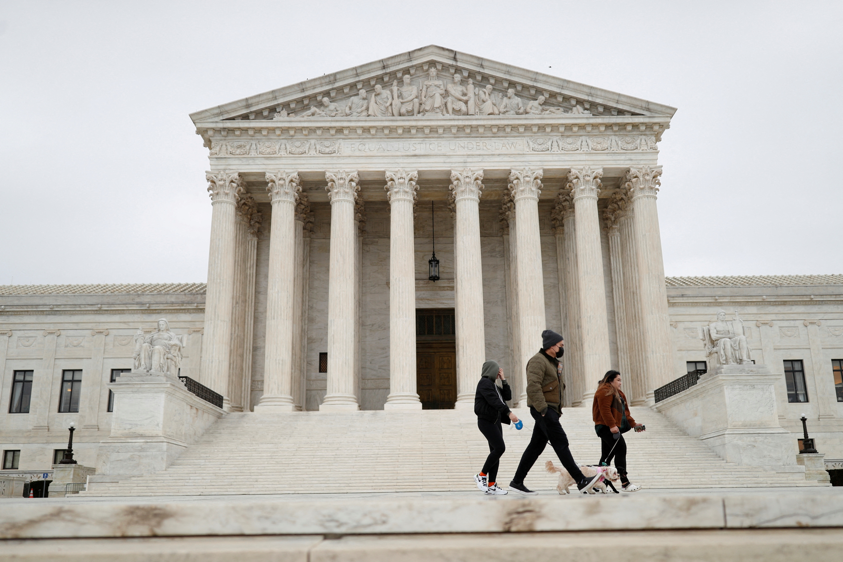
Race vs. Politics: The Rucho Loophole

Slide 22
The Battle for the Suburbs (Especially in the South)

Slide 23
Denton County, Texas Today

Slide 24
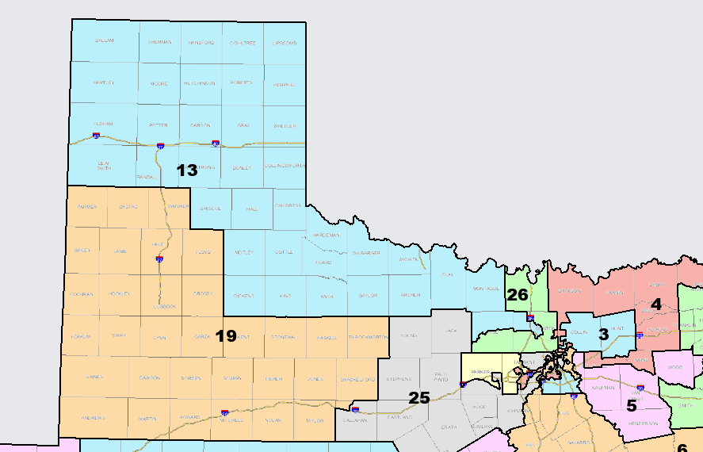
Denton County, Texas as Redistricted

Slide 25
Litigation

Slide 26
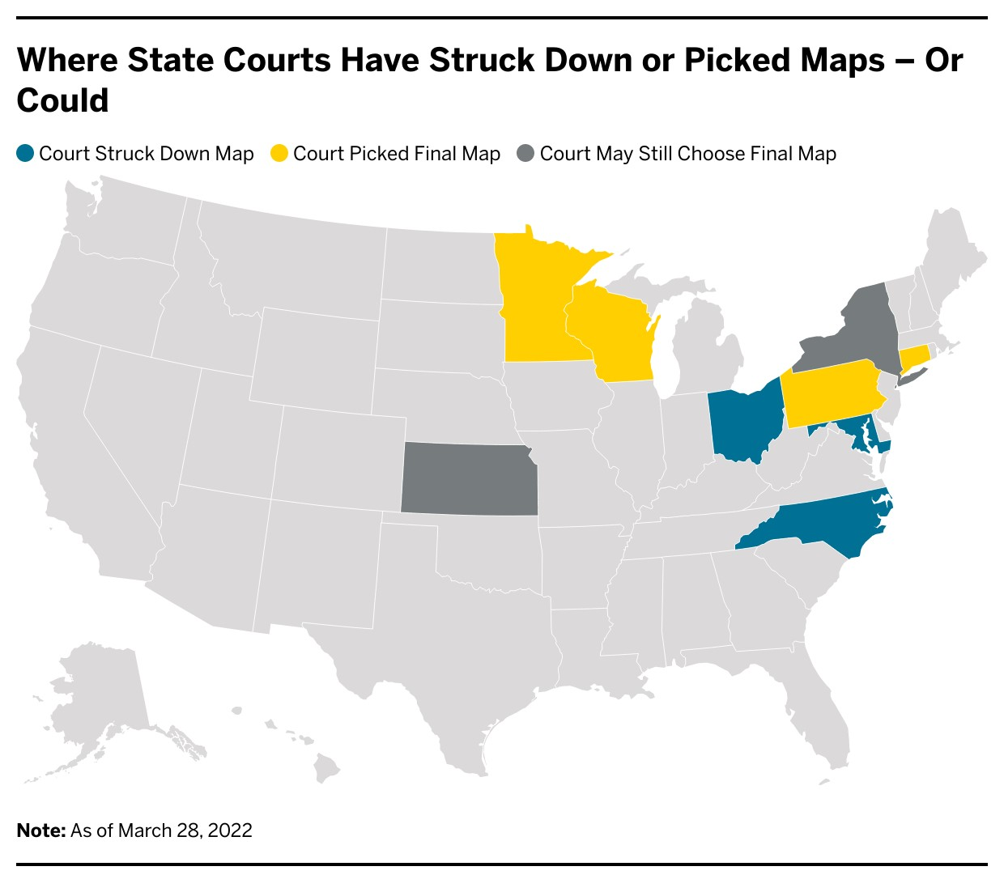
A Growing Role for State Courts

Slide 27
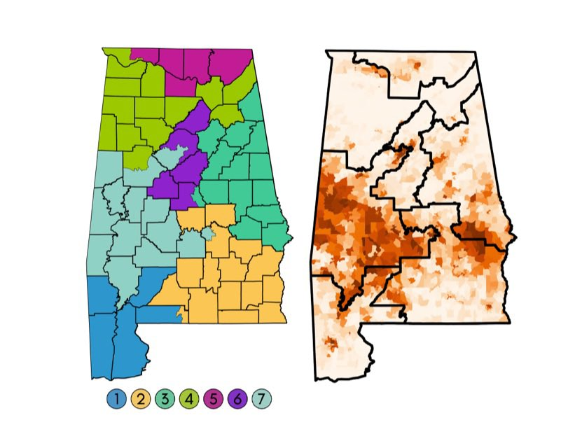
The Coming Battle Over the VRA: Merrill v. Milligan

Slide 28
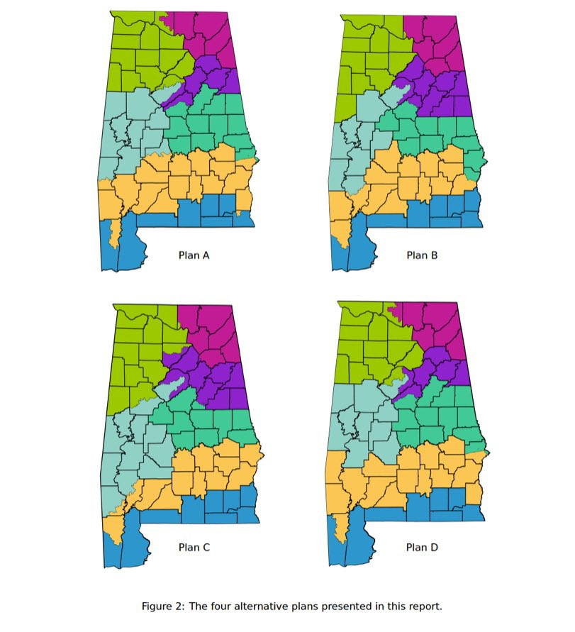
The Coming Battle Over the VRA: Merrill v. Milligan

Slide 29

Lots More to Come

Slide 30
❓
Michael C. Li
michael.li@nyu.edu
Twitter: @mcpli

