Slide 1
Requesting data from the government…
and after
Huo Jingnan
@National Press Foundation
04/22/2022

Slide 2
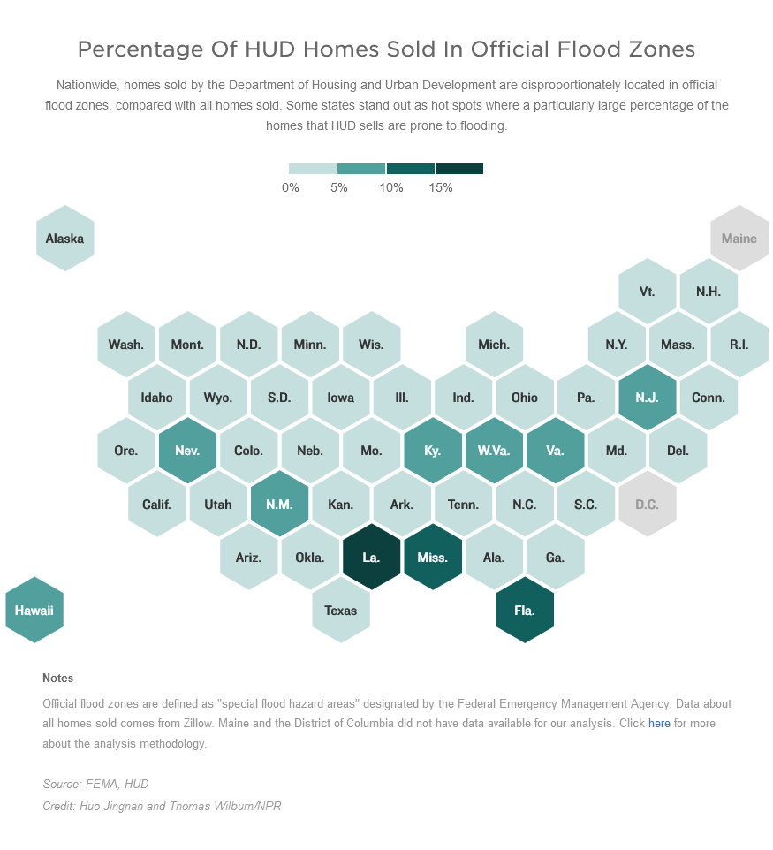
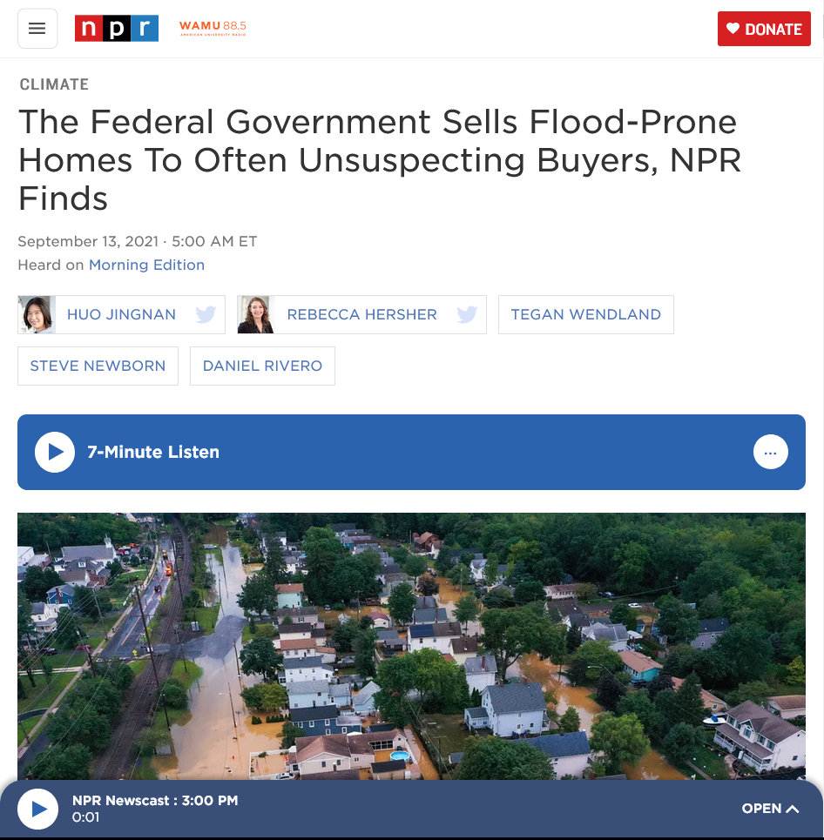


Slide 3
Requesting the data

Slide 4
Who is involved?
You
FOIA officer
Agency analysts
Agency lawyers
Media lawyers
Reporting partners

Slide 5
When to file a request?
ASAP
Try other sources
  Open data
  FOIA logs, reading room
  Agency
  Researchers
  Industry groups
  Scraping

Slide 6
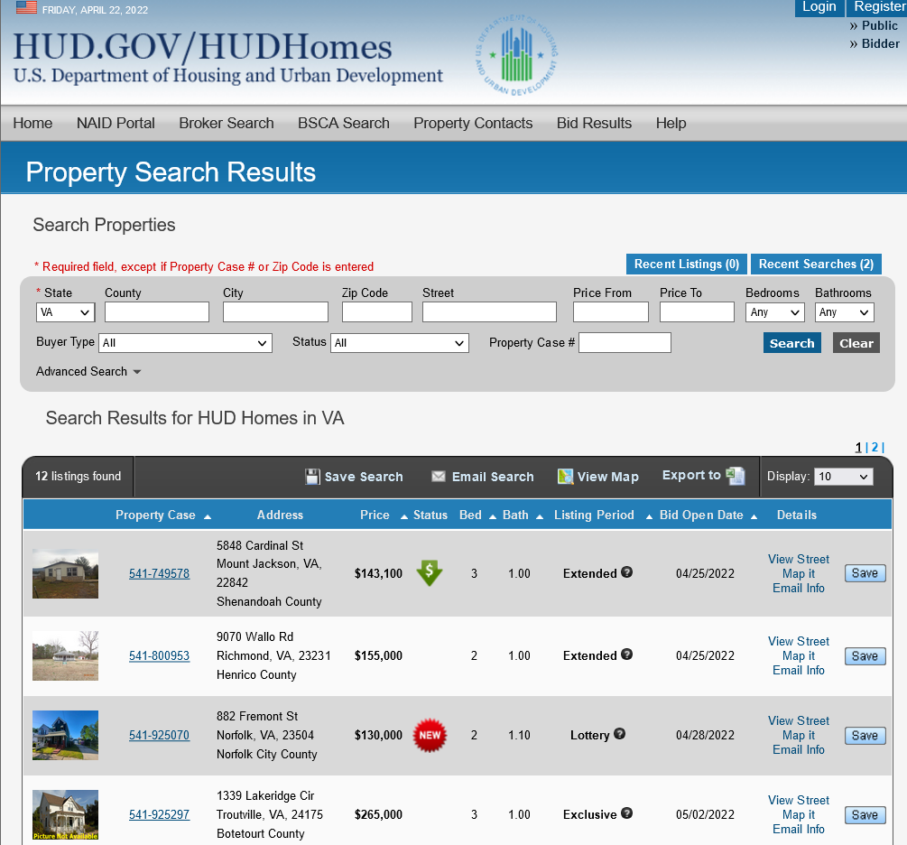
How to put the request together? 1 of 3
· date reconciled,
· zip code,
· state code,
· latitude,
· longitude,
· street name,
· street number,
· listing price,
· sale price
-As well as any other attributes that the SAMS database contains except for names of buyers and sellers.
Identify databases and file structure
Sources
Forms
Inspection/enforcement manuals
Regulations
Studies, reports, audits…CRS, OIG, GAO
Footnotes
Internal employee surveys
“Wishful”
-All the property sales records in the Single Family Acquired Asset Management System (SAMS) from Jan.1st, 2017 to Aug. 6, 2020. Each sales record should contain the following fields or attributes-
· address,
· case number,
· city,
· date acquired,
· date closed,

Slide 7
How to put the request together? 2 of 3
Try to understand the database better
Funding
Motivation
What is the universe? Who/what is excluded?
  Crime statistics and policing
  EEOC and non-binary gender option
  Middle East and North African people in the Census
How is the data collected?
Survey - how were the questions phrased and delivered

Slide 8
How to put the request together? 3 of 3
Ask for spreadsheet format like .csv, .xlsx or .dat
Ask for a data dictionary or similar documentation

Slide 9
Analyzing the data

Slide 10
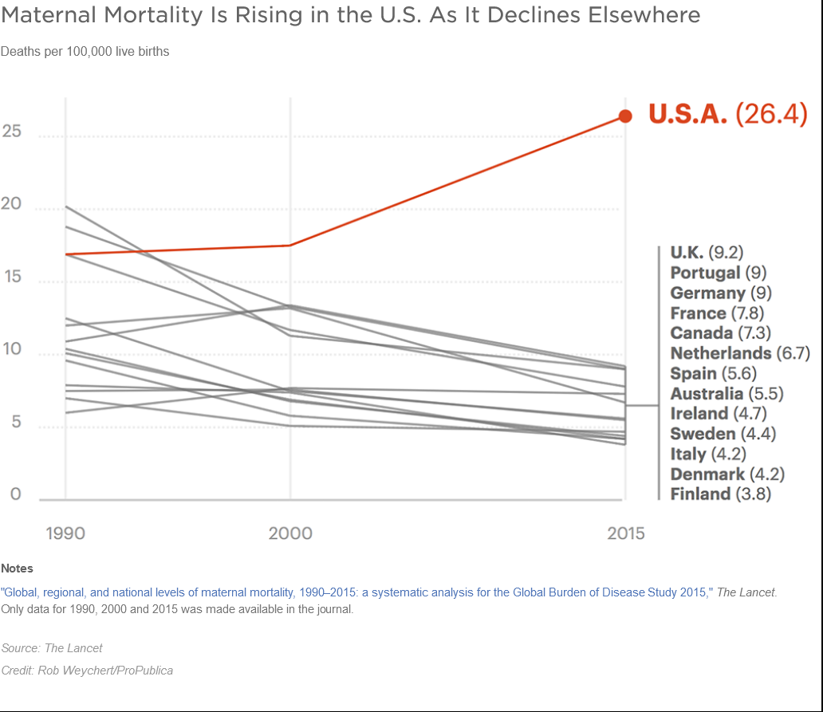

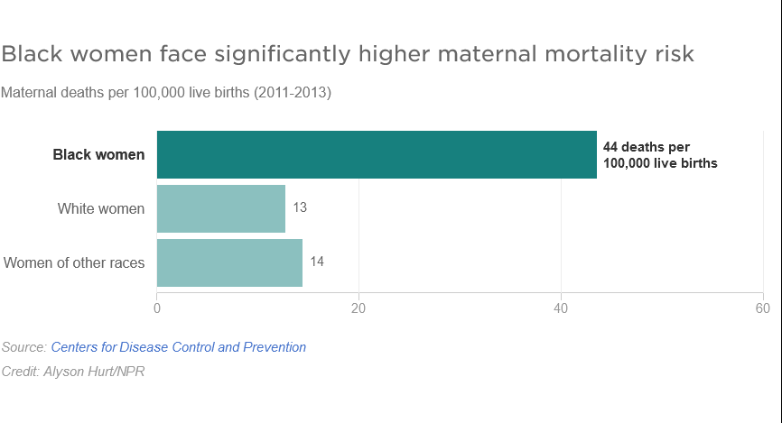
Benchmarks

Slide 11
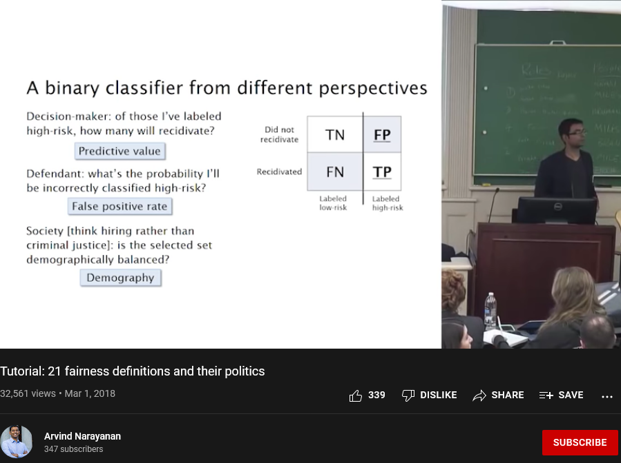
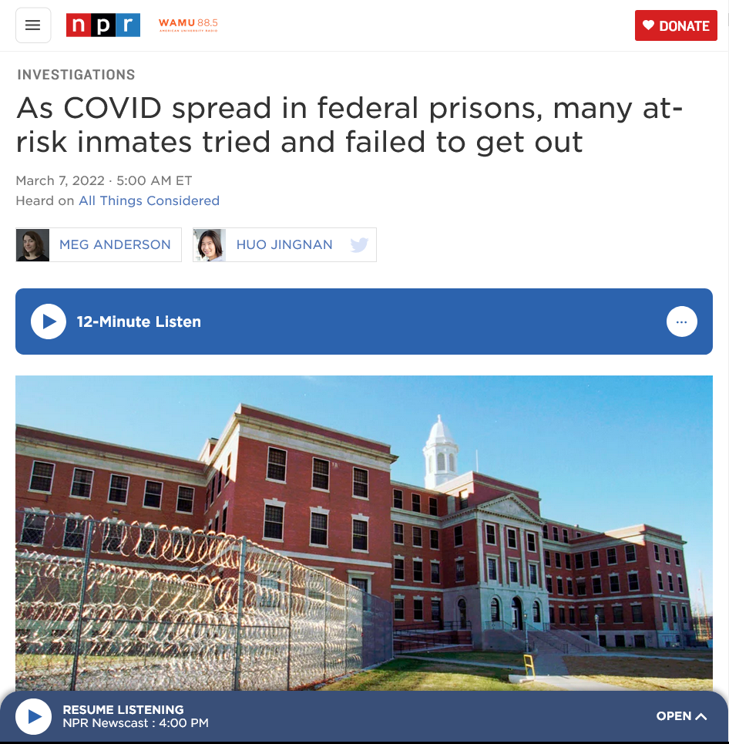
Benchmarks

Slide 12
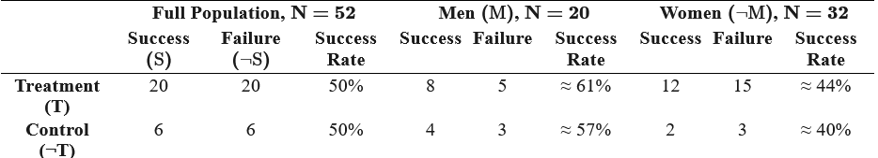
Subgroups
Simpson’s paradox
Finding disparities is only the beginning

Slide 13
General considerations
Does the data answer your research question?
Are you trying to demonstrate correlation or causation…or are you trying to predict something?
Run by more people

Slide 14
Telling the story

Slide 15





Human face
Variety of anecdotes
Visualization

Slide 16
Collaboration best practices
Start collaborating as soon as possible
Check-in frequency
  Collaboration memo
  Data and field reporting in tandem
  “Write in sentences”
Sharing knowledge and experience
Credits
Reflect

