Slide 1
Images and Refugees

Slide 2
QUESTIONS TO PONDER
What role do visual images have in construction of our concept of “the refugee”?
What do photos of refugees tell us about their subject and their audience?
Why are some instances of forced migration covered by the media while others are ignored?
What determines the type of media treatment that refugees receive?
What moves people to respond to visual images of forced migration?
How does terminology impact the way we “see” and understand a displacement crisis?

Slide 3
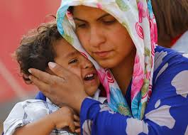

Slide 4
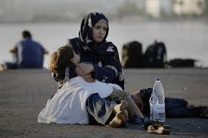

Slide 5
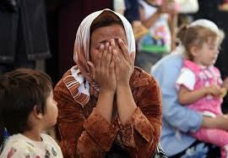

Slide 6
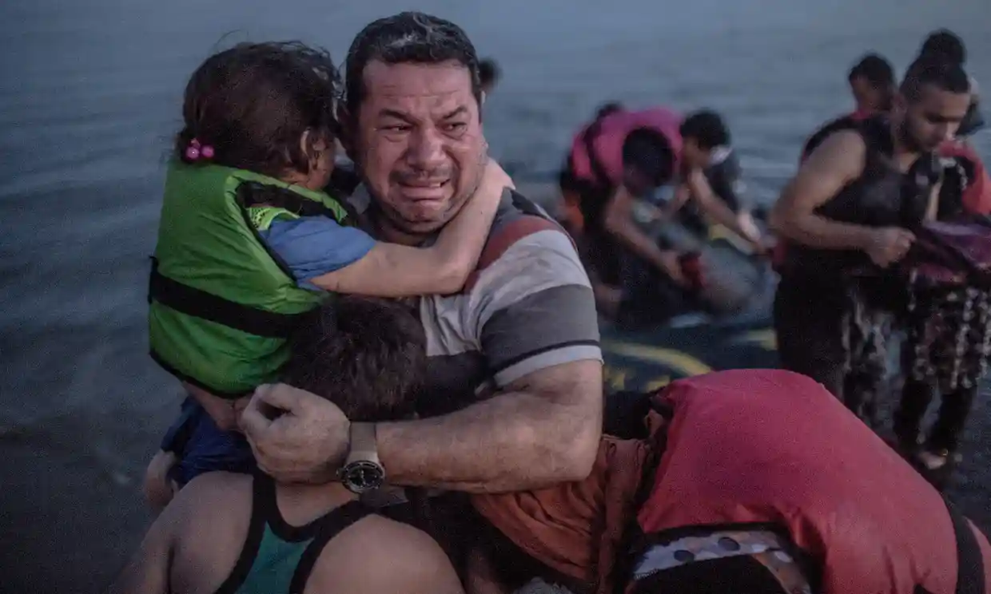

Slide 7
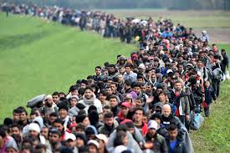

Slide 8
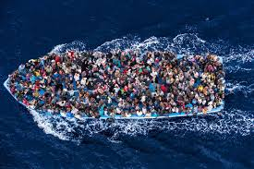

Slide 9
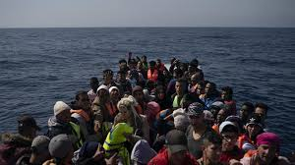

Slide 10
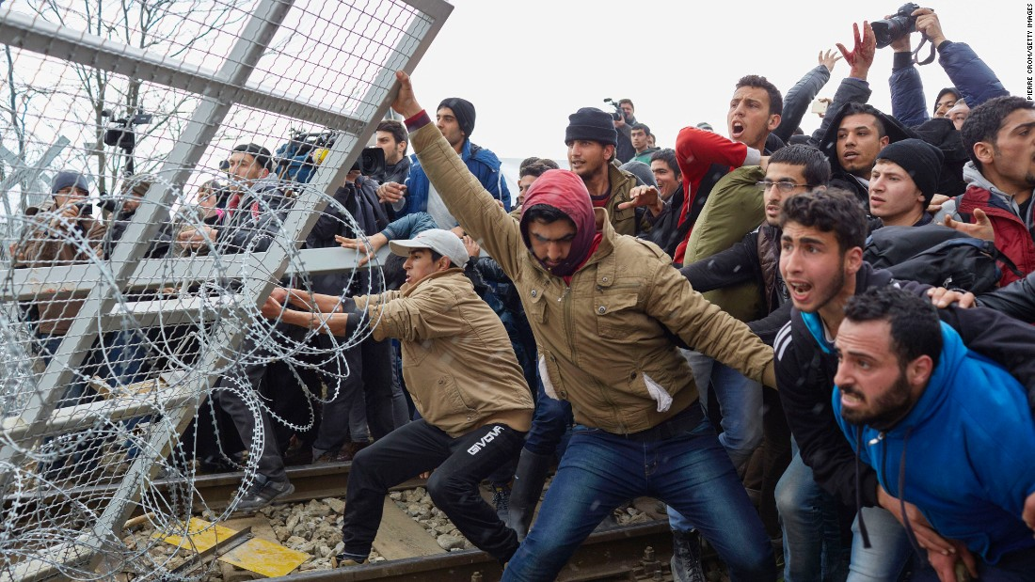

Slide 11
