Slide 1

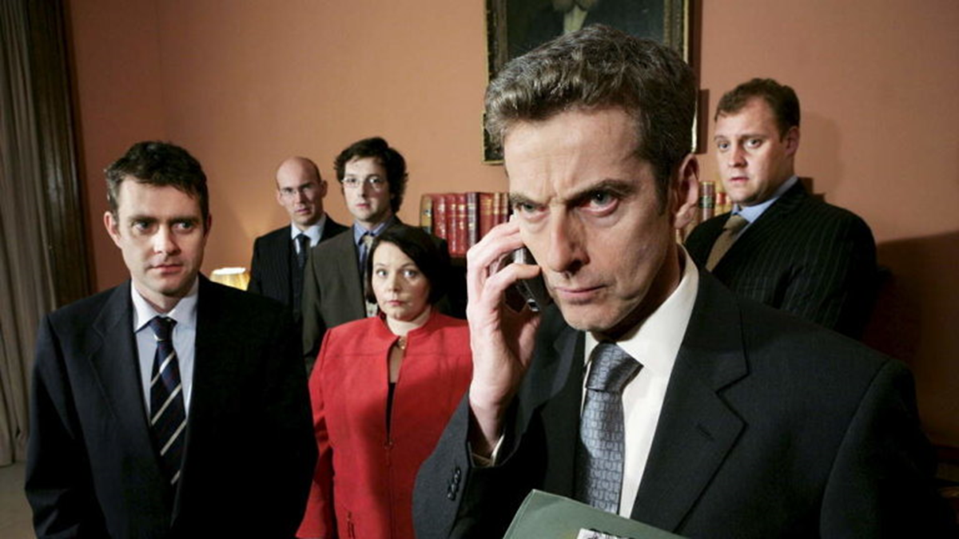
Don't get turned around by political spin
Dr Caroline Fisher
Associate Professor, Communication
Deputy Director, News and Media Research Centre, Faculty of Arts & Design, University of Canberra
Caroline.Fisher@canberra.edu.au

Slide 2
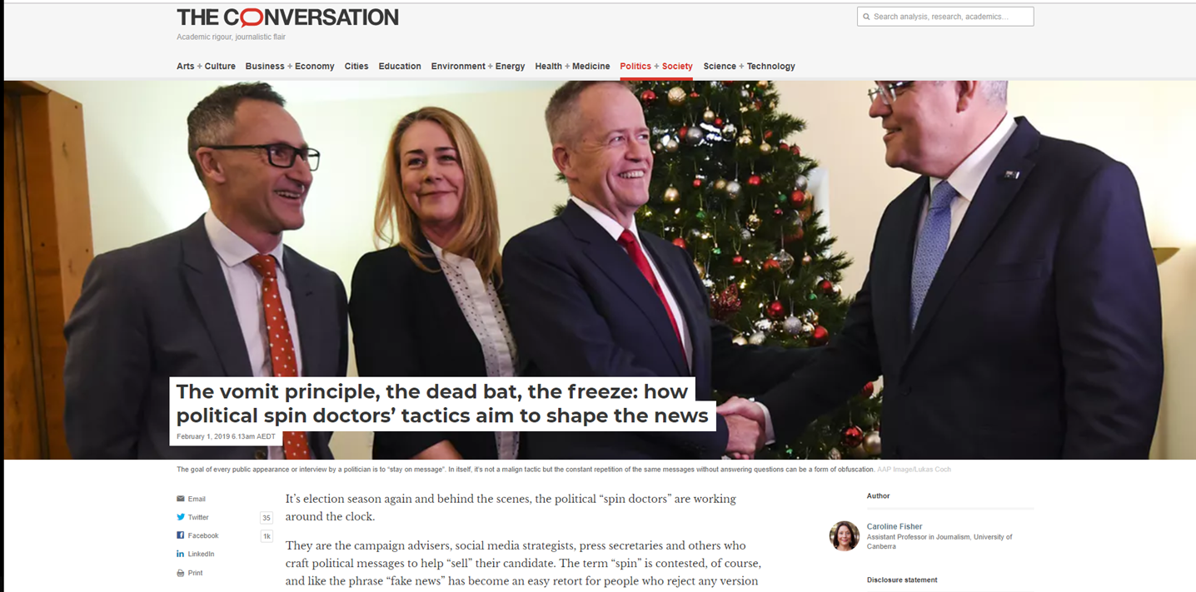
https://theconversation.com/the-vomit-principle-the-dead-bat-the-freeze-how-political-spin-doctors-tactics-aim-to-shape-the-news-106453

Slide 3

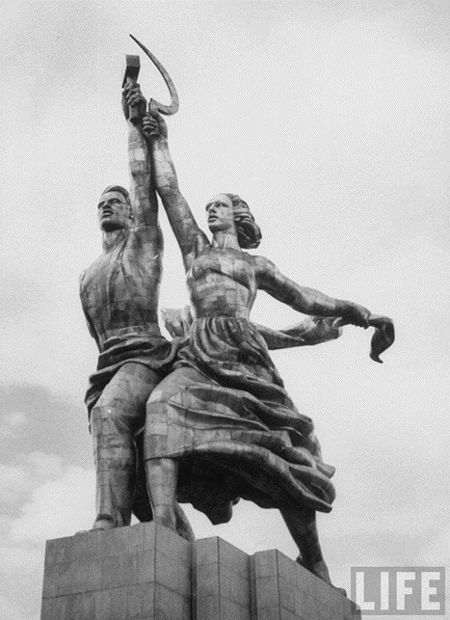
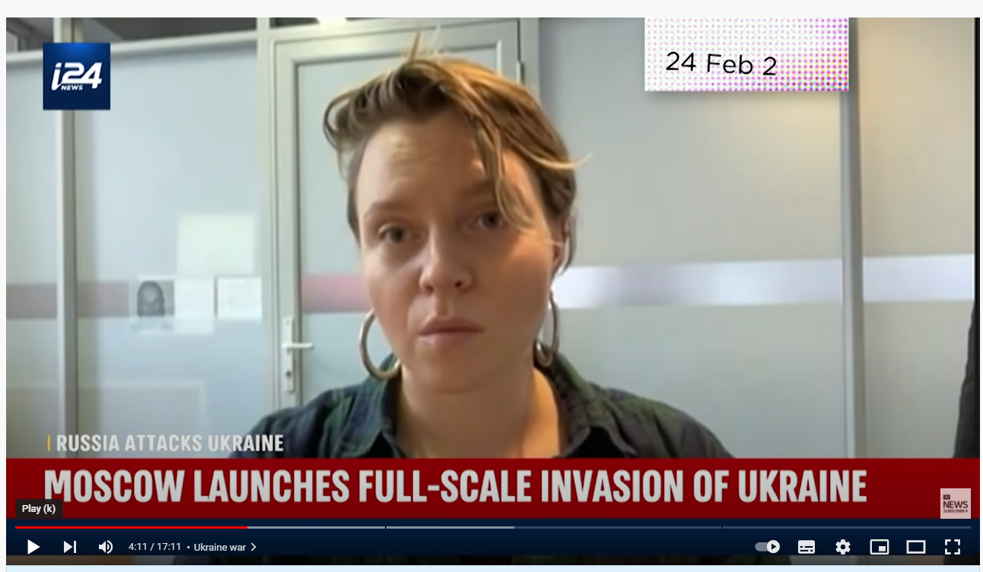
Propaganda
“Propaganda is the deliberate, systematic attempt to shape perceptions, manipulate cognitions, and direct behaviour to achieve a response that furthers the desired intent of the propagandist”.
Jowett & O’Donnell (2006) What is propaganda and how does it differ from Persuasion? In, Propaganda & Persuasion, Thousand Oaks, Sage, Ch. 1, p. 7.
Three elements:
• Rhetoric
• Myth
• Symbolism
Source: Lilleker, D. (2006) Propaganda, in Key Concepts in Political Communication, Sage, pp. 162-165

Slide 4
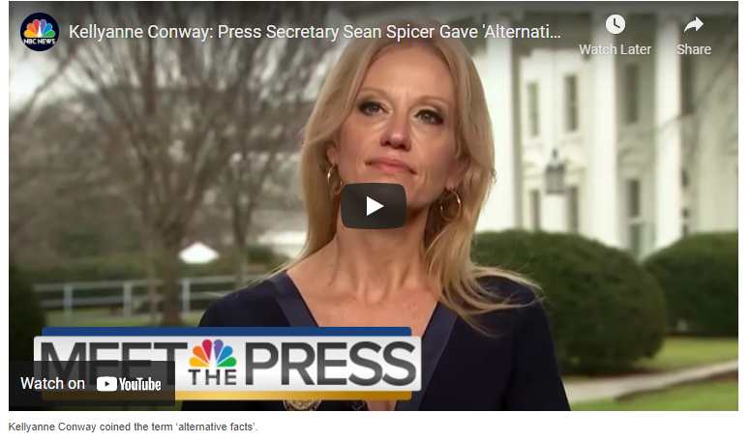
Spin
“Spinning is when a person telling a story emphasises certain facts and links them together in
ways that play to his advantage, while at the same time, downplaying or ignoring inconvenient
facts … The basic story being told is distorted but the facts are not put together so as
to tell a false story which would be a lie”
Mearsheimer, John J. 2013. Why Leaders Lie: The Truth about Lying in International Politics. New York: Oxford University Press. pp 16-17.
“Alternative facts”

Slide 5
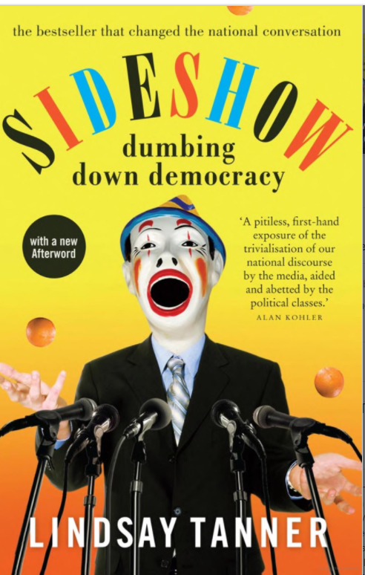
Politician/journalist relations
“What is now universally derided as ‘spin’ is, in fact, a whole range of techniques that have evolved among politicians in response to changing media dynamics. In essence, these techniques, though highly manipulative, are inherently defensive.
The more the media set out to trap politicians in order to generate entertaining content, the more politicians have to resort to dubious artifice to do their jobs.”
Tanner, L. (2011) Sideshow: Dumbing Down Democracy, p. 93.

Slide 6
‘Covert’ spin tactics
The leak
The freeze
The spray
The drip
Staying on message
Pivoting
The vomit principle
Playing a dead bat
The truth, but not the whole truth
Throwing out the bodies/taking out the garbage
Get rid of it now
Fire-breaking
Dead cat bounce strategy
Kite-flying
Keeping out of the media/being a small target
Flying under the radar
Dishing dirt
Dog-whistling
Wedging

Slide 7
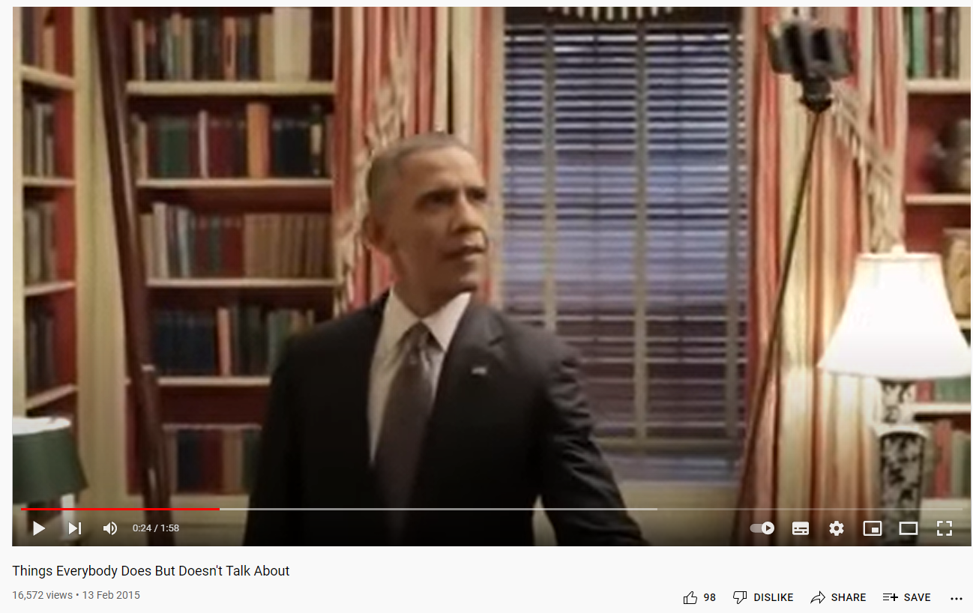
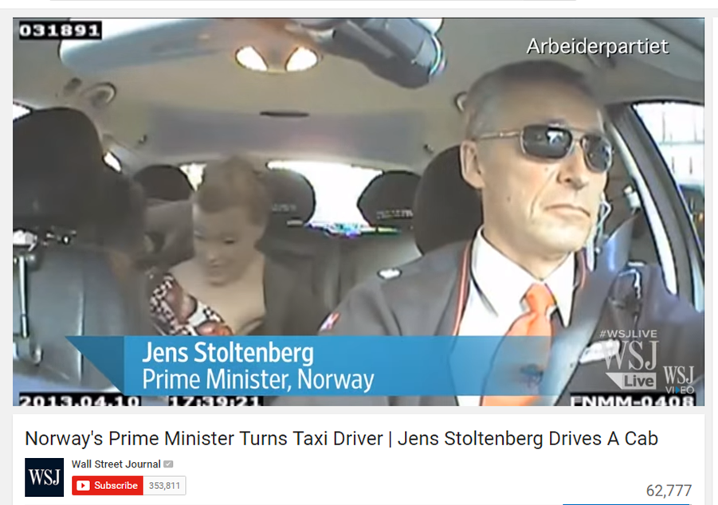
Authenticity
https://www.youtube.com/watch?v=nyfKIy1oZkI
https://www.youtube.com/watch?v=uqsoWbQewIo

Slide 8
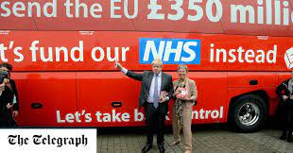
Strategic lying
Intentional lie – the more outrageous the better
Designed to capture the media attention and hold it through rebuttal.
Each rebuttal reinforces the original lie.
Spread through social media
Amplified by the mainstream media
Lies spread faster - harder to scrutinise and debunk.
The repetition of the lie through rebuttal, reinforces the claim in people’s minds.
UK: Brexit campaign
“We send the EU £350 million a week. Let’s fund our NHS instead”
US: Trump
- Election steal
- “Birther” controversy
AUS:
- Mediscare
- Death Tax
- Chinese influence over ALP
Gaber, I., & Fisher, C. (2021). “Strategic lying”: The case of Brexit and the 2019 UK election. The International Journal of Press/Politics, 1940161221994100.
https://theconversation.com/strategic-lies-deliberate-untruths-used-as-a-political-tactic-new-study-159723

Slide 9
References
Clarke, Harold D., David Sanders, Marianne C. Stewart, and Paul Whiteley. 2015. Austerity and Political Choice in Britain. London: Palgrave MacMillan.
Enli, G. (2014). Mediated authenticity. Peter Lang Incorporated.
Fisher, C. (2017). Re-assessing the “Public's Right to Know” The shift from journalism to political PR. Journalism Studies, 18(3), 358-375.
Frankfurt, Harry. 2005. On Bullshit. Princeton: Princeton University Press.
Gaber, I. (2000). Government by spin: an analysis of the process. Media, Culture & Society, 22(4), 507-518.
Gaber, I., & Fisher, C. (2021). “Strategic lying”: The case of Brexit and the 2019 UK election. The International Journal of Press/Politics, 1940161221994100.
Jowett & O’Donnell (2006) What is propaganda and how does it differ from Persuasion? In, Propaganda & Persuasion, Thousand Oaks, Sage, Ch. 1, p. 7
Kellner, D. (2018). Donald Trump and the politics of lying. In Post-Truth, Fake News (pp. 89-100). Springer, Singapore.
Lilleker, D. (2006) Propaganda, in Key Concepts in Political Communication, Sage, pp.162-165
Mearsheimer, John J. 2013. Why Leaders Lie: The Truth about Lying in International Politics. New York: Oxford University Press. pp 16-17.

Slide 10
Thank you for your interest
Q&A

