Slide 1


Slide 2
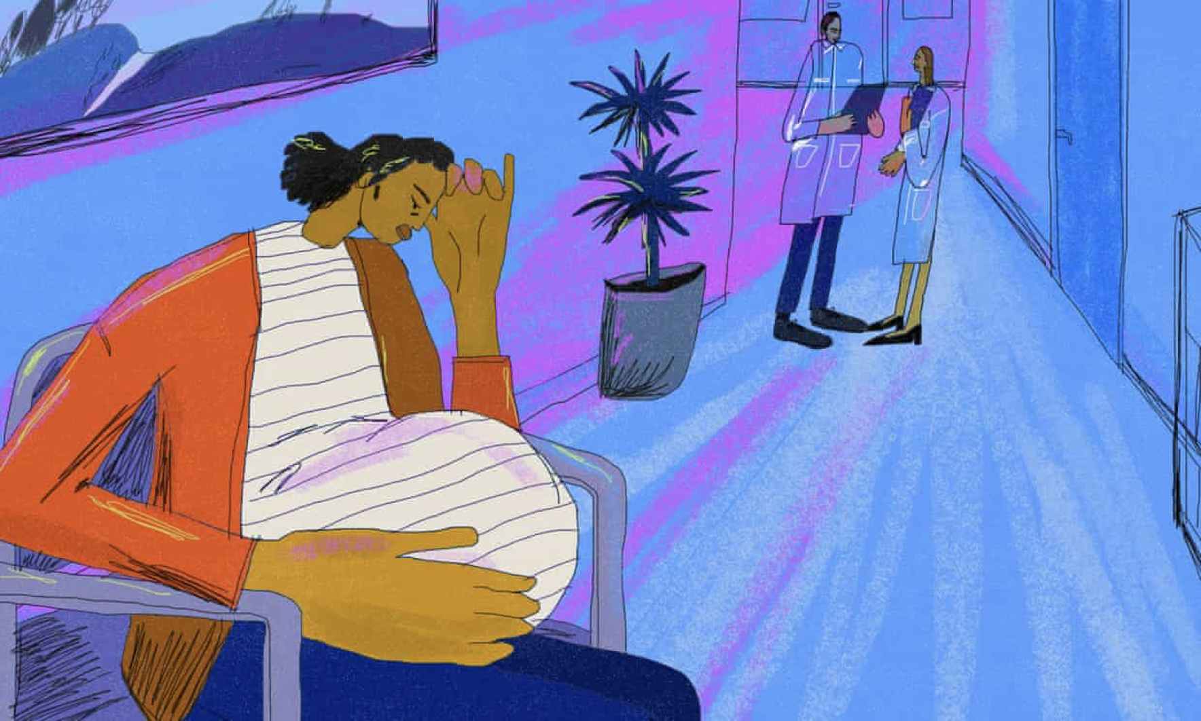
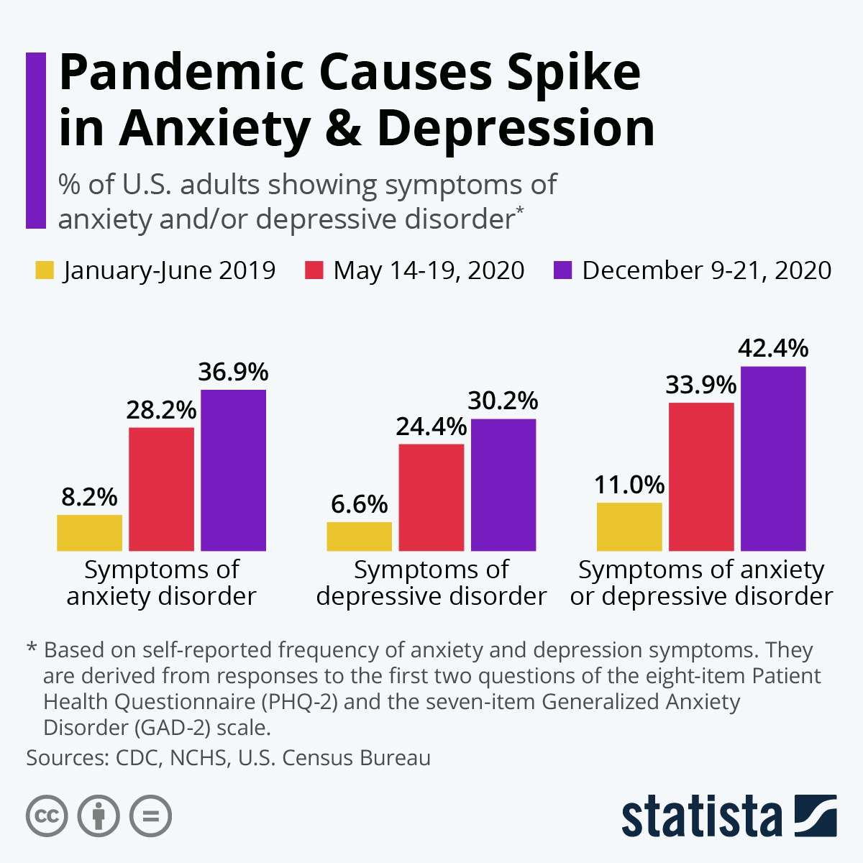

Slide 3
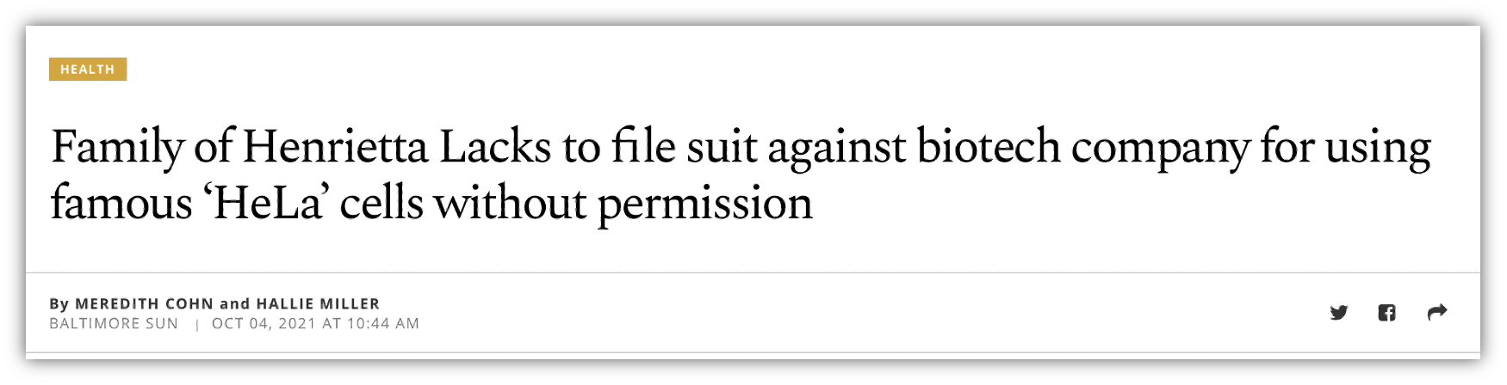

Slide 4
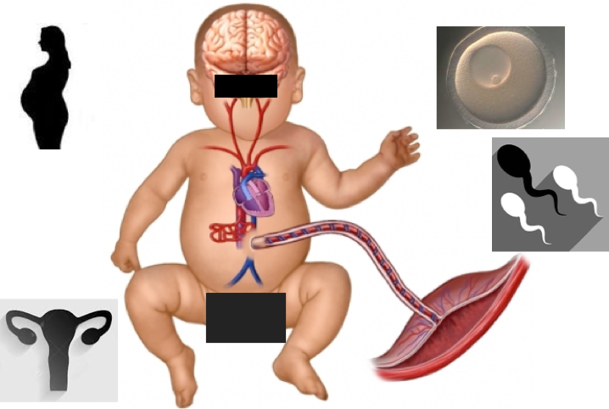

Slide 5
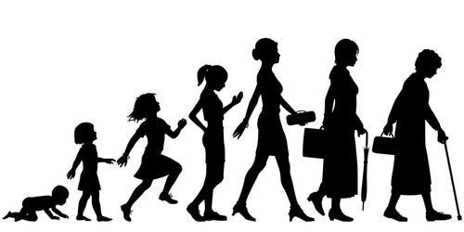
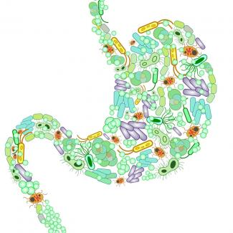

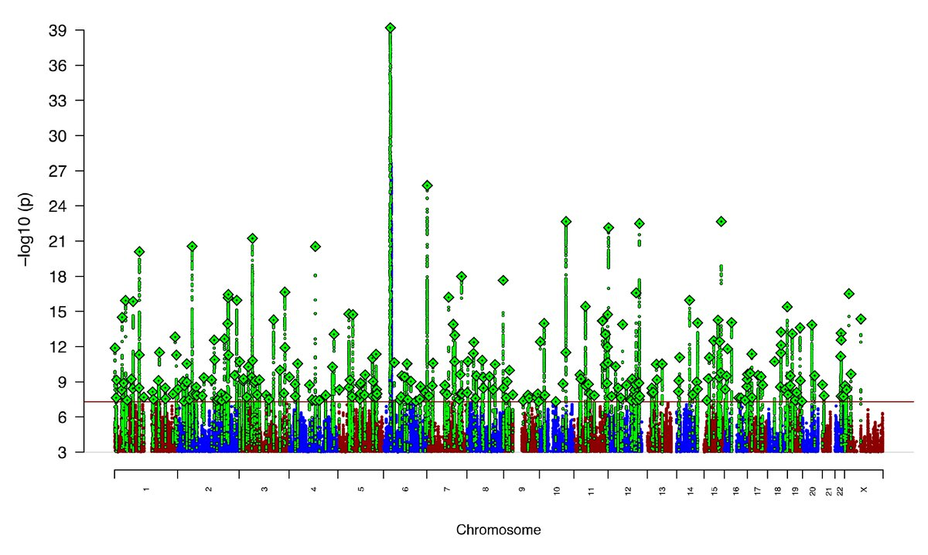
Developmental Timing
Environment
Genetic risk

Slide 6
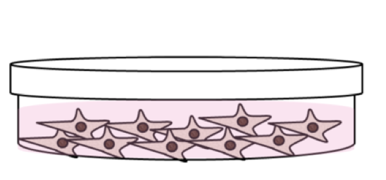

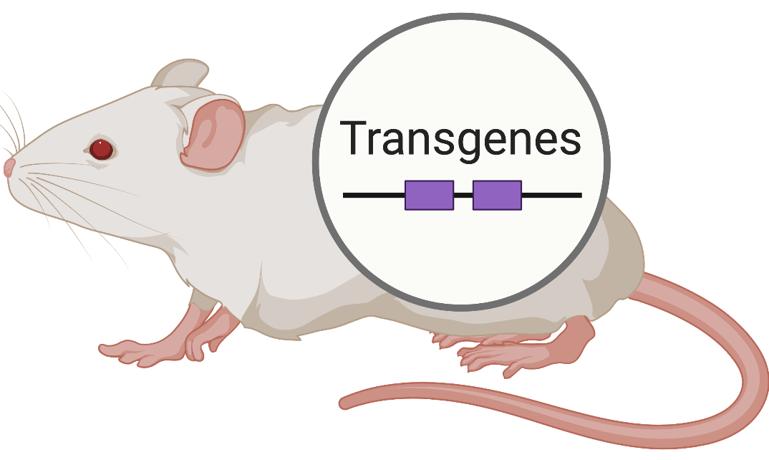
Translational research approach

Slide 7
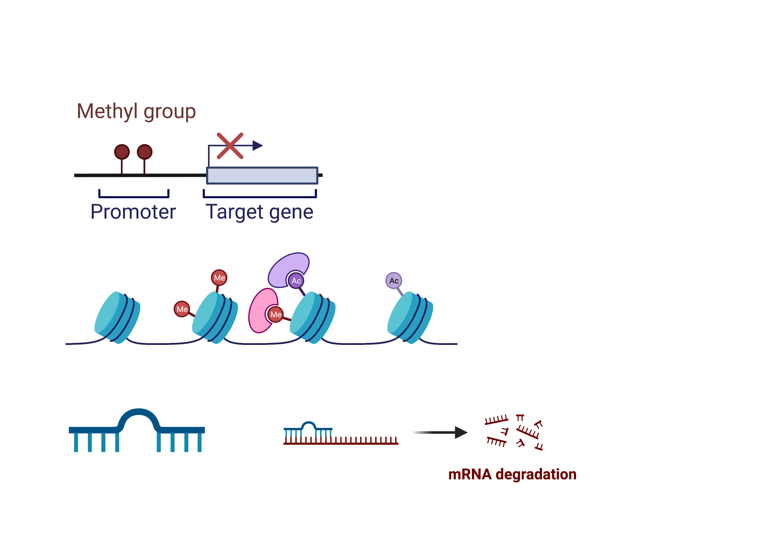
Epigenetics: biochemical modifications that alter how genes are expressed but do not change DNA sequence
DNA methylation
Histone modifications
Small noncoding RNAs

Slide 8
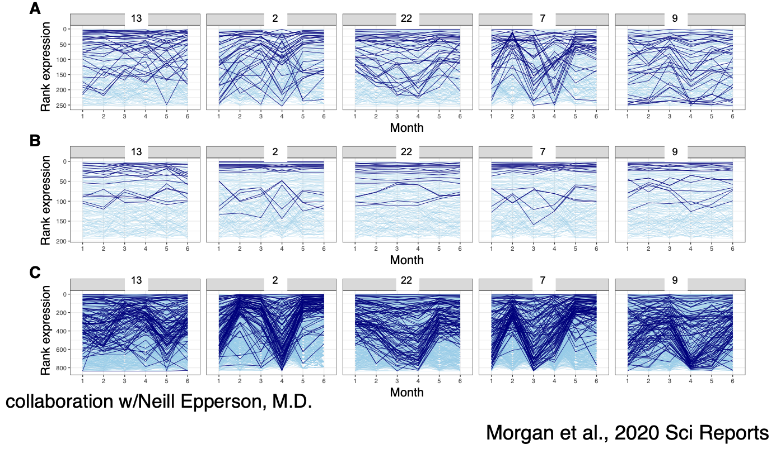

Slide 9
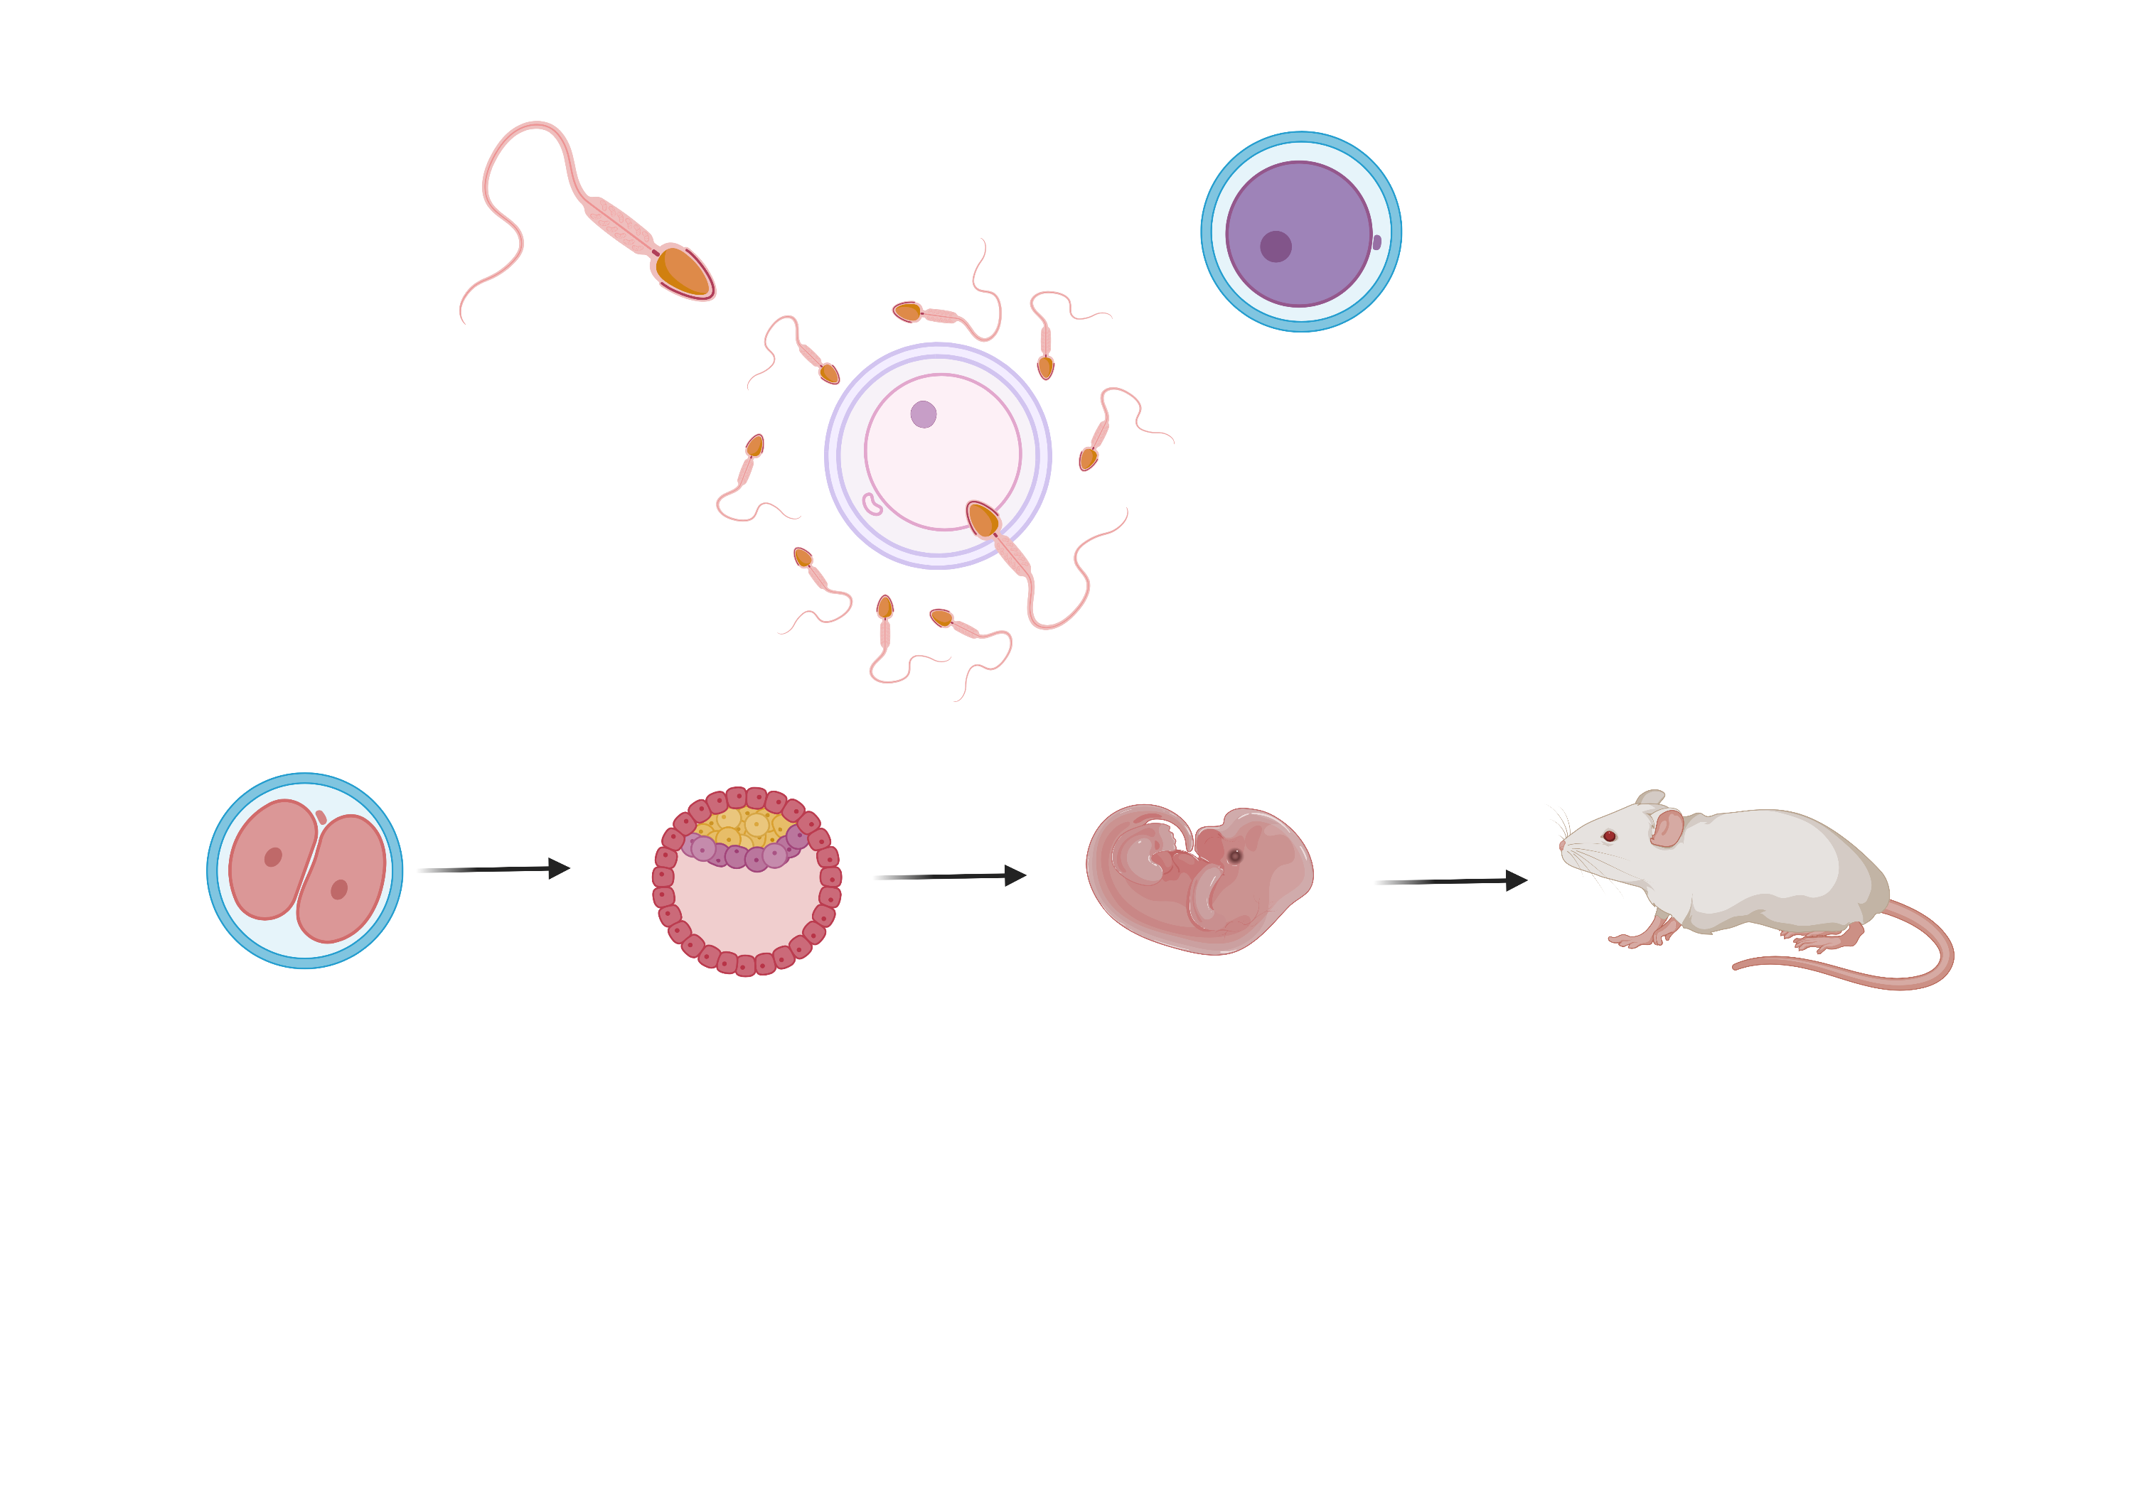
Intergenerational epigenetics?
A
A
A
A

Slide 10
Intergenerational epigenetics?
Intergenerational effects
A
B
C
D

Slide 11
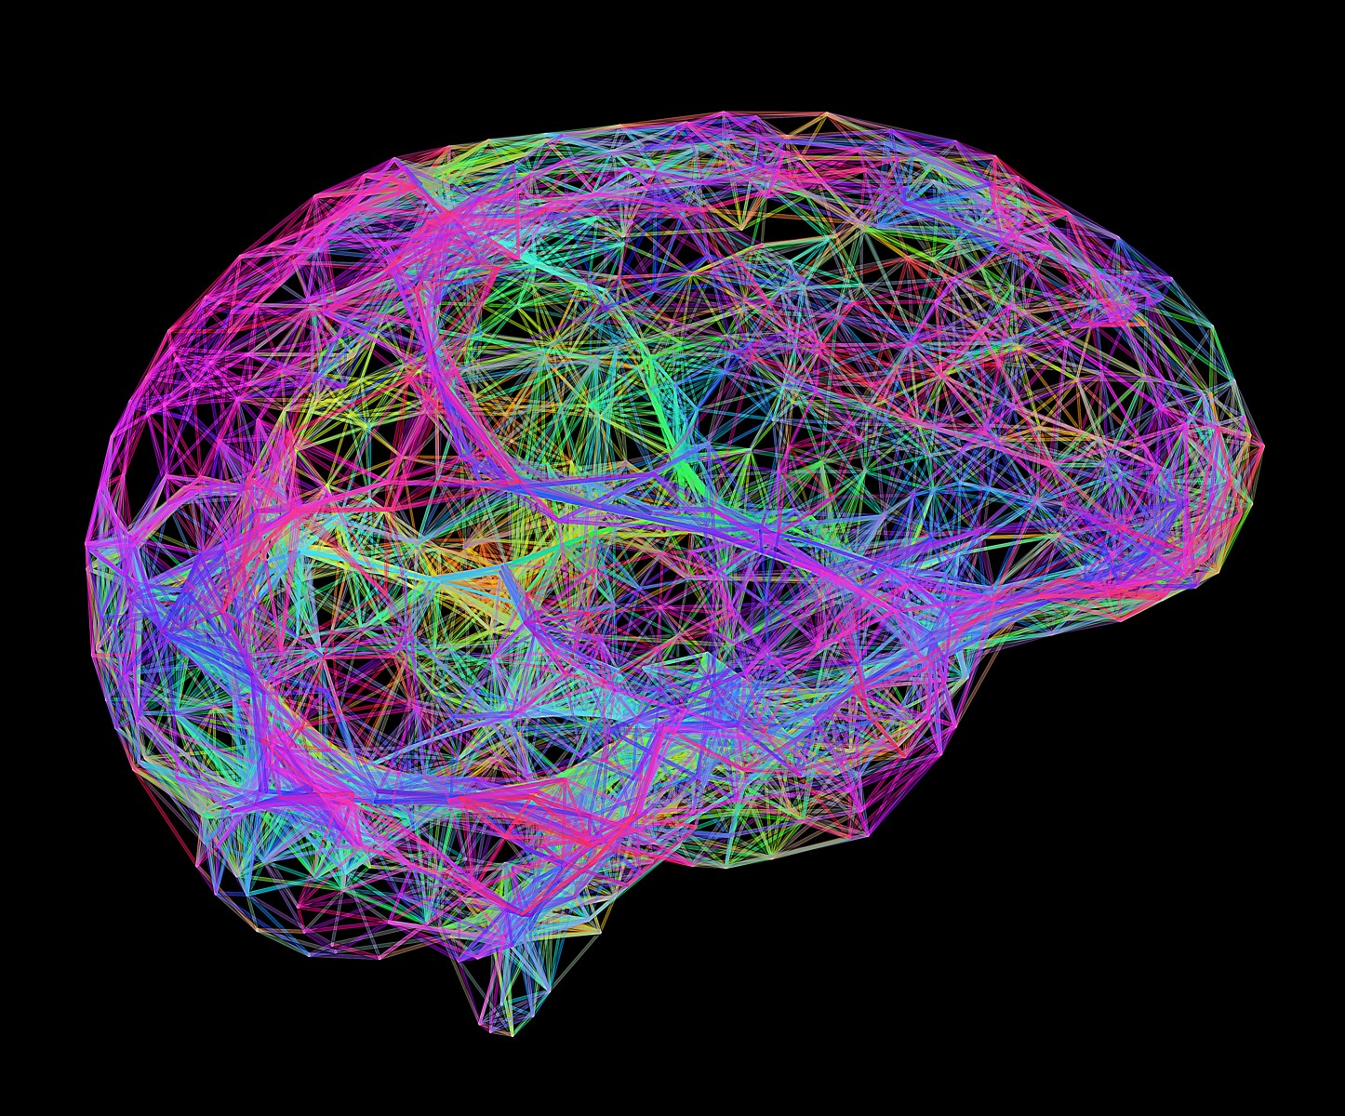

Slide 12
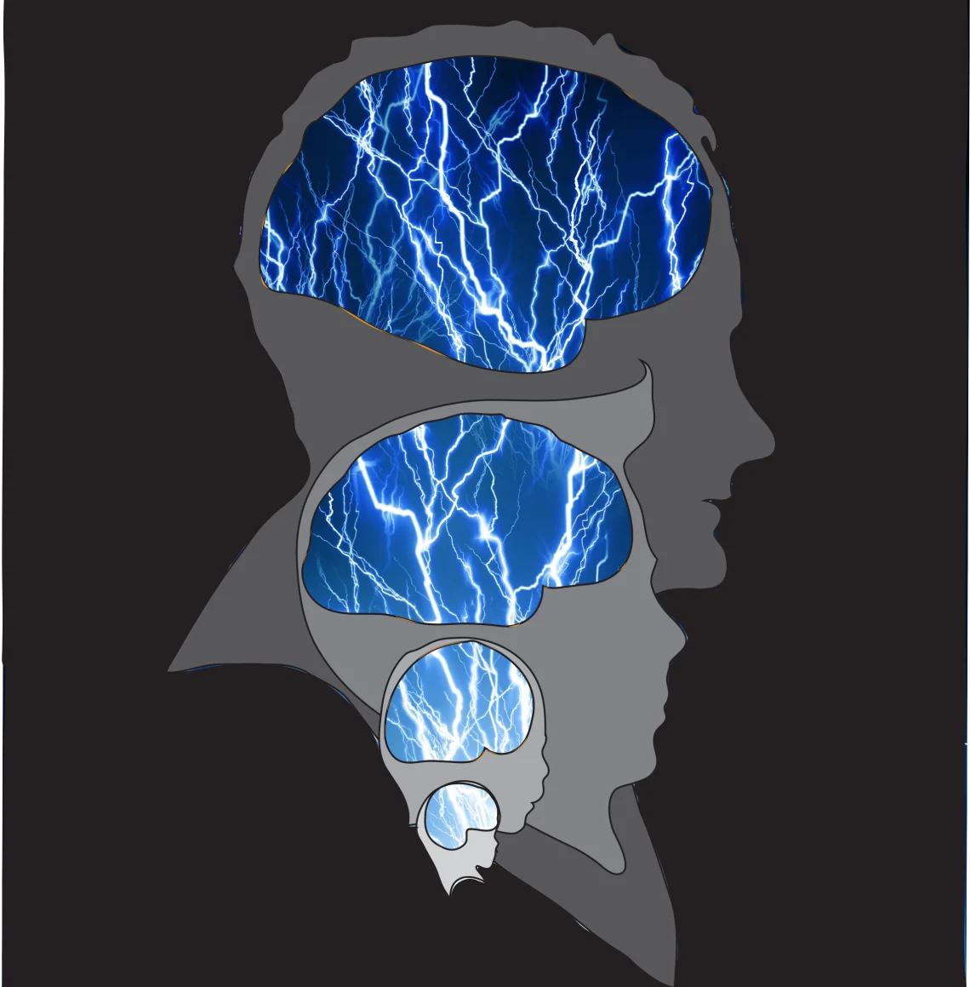
Normative
At risk

Slide 13




Funding and Research Support

