Slide 1
Logistics Under Pressure.
9 February 2022
Phil Levy, Chief Economist

Slide 2
Agenda
Describing the logistics crisis?
  An unusually short, sharp recession
  Unexpected import boom– Blank sailings and blank strings
  So was it a demand boom or a supply crunch?
So why did goods demand go up in a steep recession?
  Incomes
  Preferences
Some story ideas

Slide 3
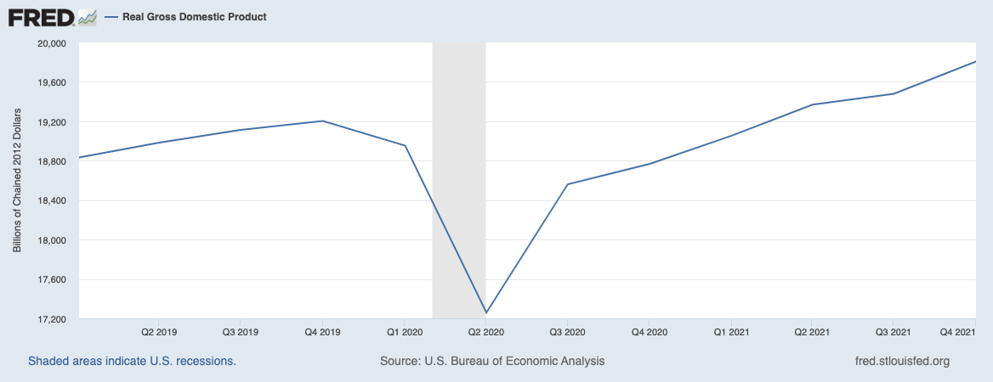
The GDP Impact of the Pandemic
Notes:
https://fred.stlouisfed.org/graph/?g=JcSp
Pre-pandemic level regained by Q2 2021
Excellent data source: St. Louis Fed (FRED)

Slide 4
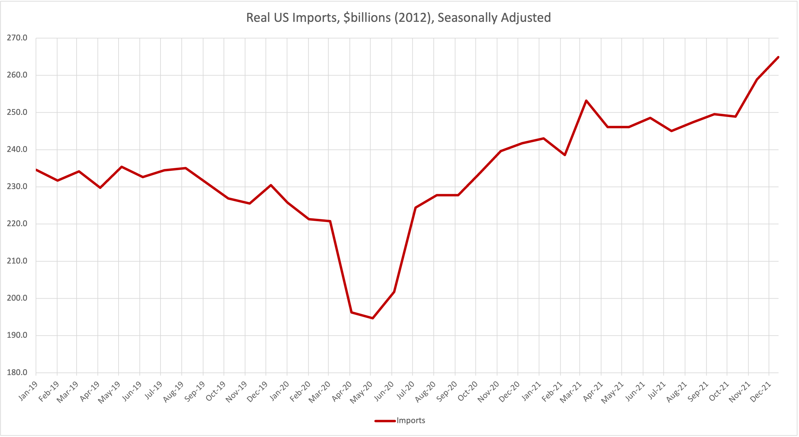
Dip then Boom in U.S. Imports
Notes:
Pre-pandemic level regained by August 2020!!
Answering the question: Supply or Demand?
https://fred.stlouisfed.org/graph/?g=FQMl

Slide 5
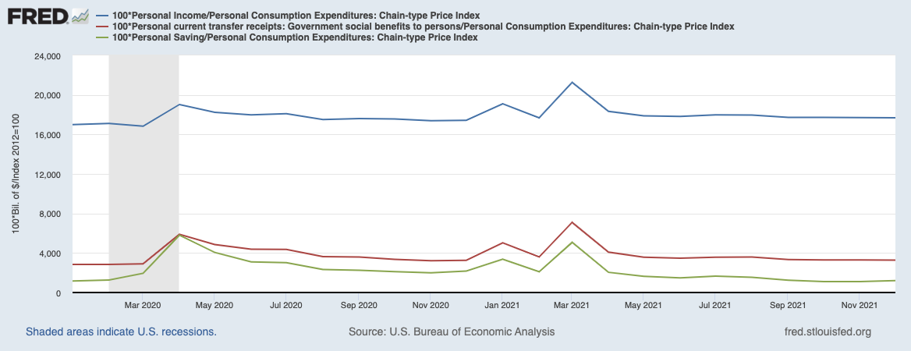
Behind the Shock – Unusual Income Effects (real)
Notes:
Personal Income doesn’t go down, driven by government tranfers. Savings rates went up impressively.
https://fred.stlouisfed.org/graph/?g=LQaF

Slide 6
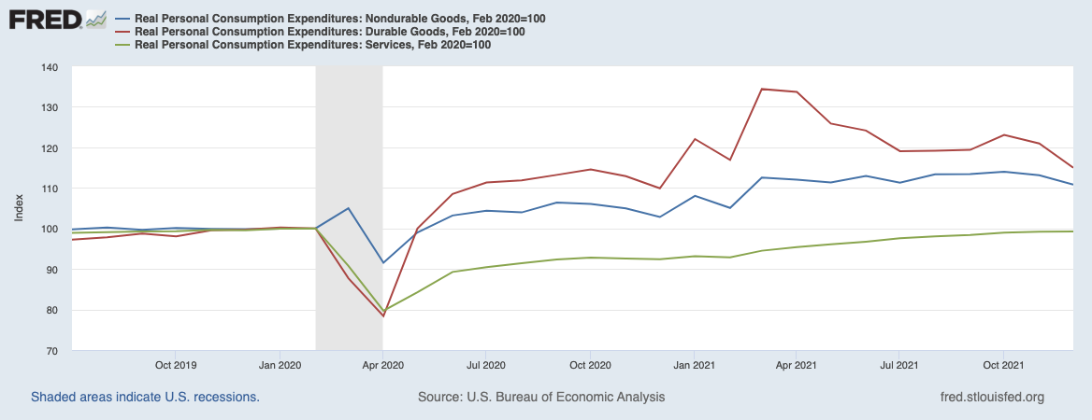
The Goods Boom – Especially Durables
Notes:
Two years of data. Monthly, seasonally adjusted. Note how boring until March 2020
January 2020=100. Note: Services account for 60% of PCE (was 64%), Nondurables about 24% (was 22%), Durables about 16% (was 14%).
https://fred.stlouisfed.org/graph/?g=FLFJ

Slide 7
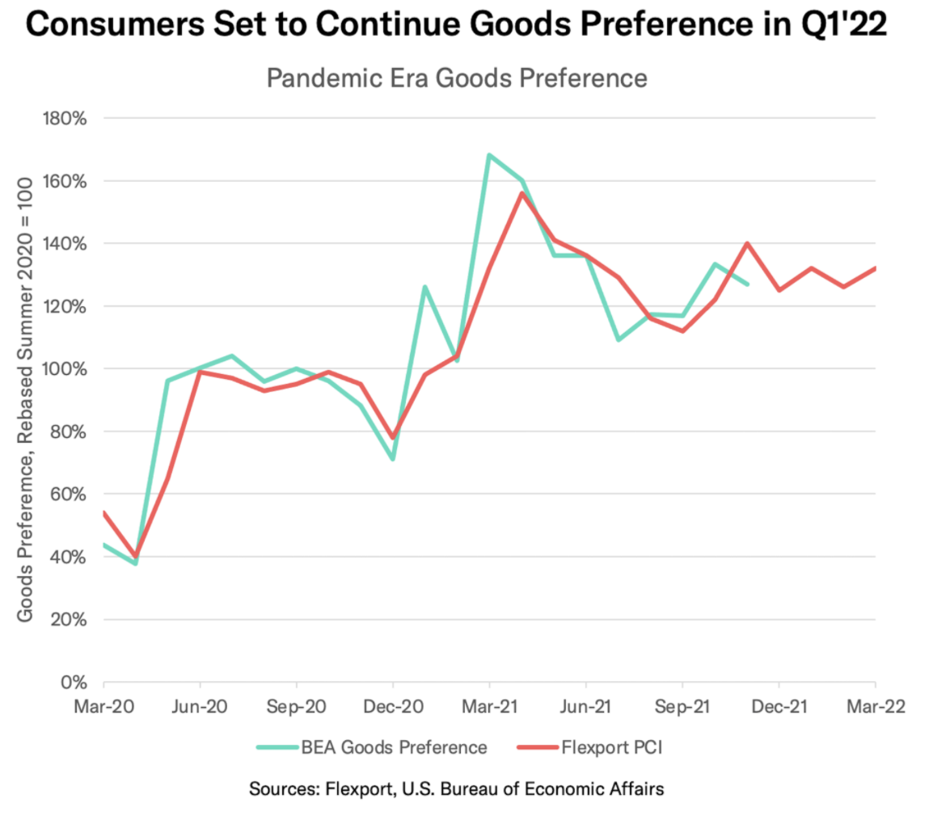
Flexport
Post-Covid Indicator
January Release
Sources: Flexport and US Bureau of Economic Analysis
Notes:
https://www.flexport.com/research/post-covid/
New release out next week. We know PCE fell in December.

Slide 8
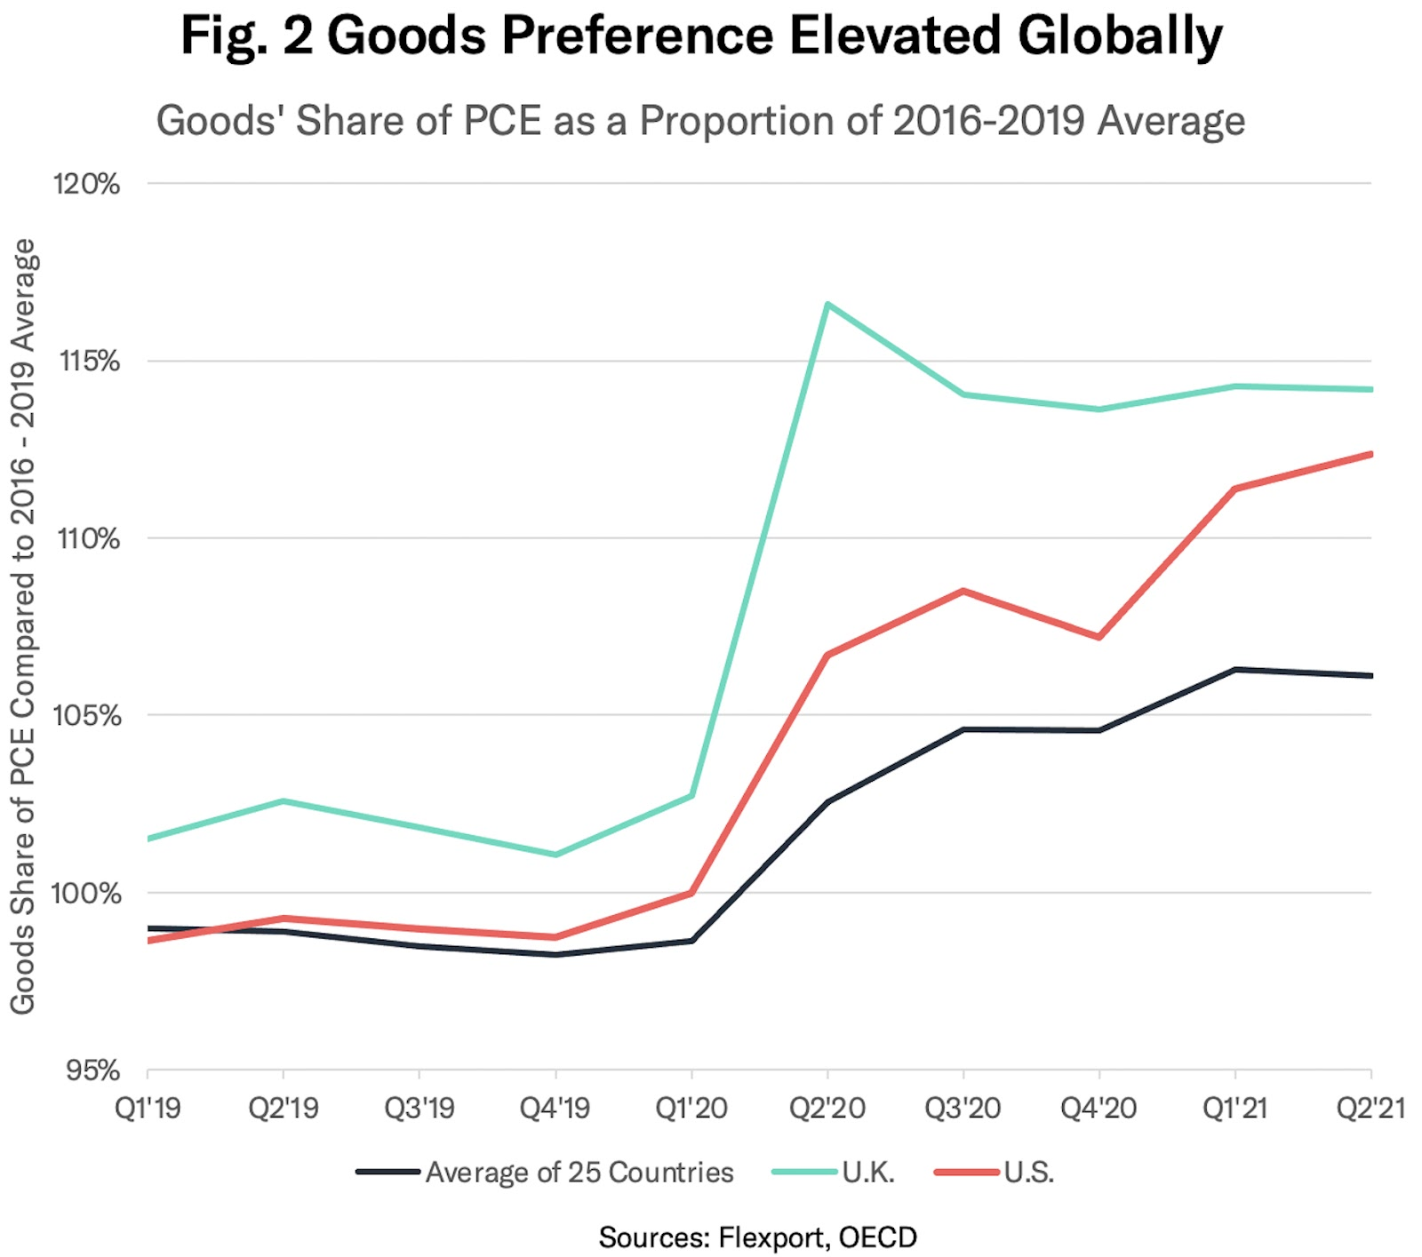
Not a Purely US Phenomenon
Notes:
. Not a monthly release. From a study we did, so a little older.

Slide 9
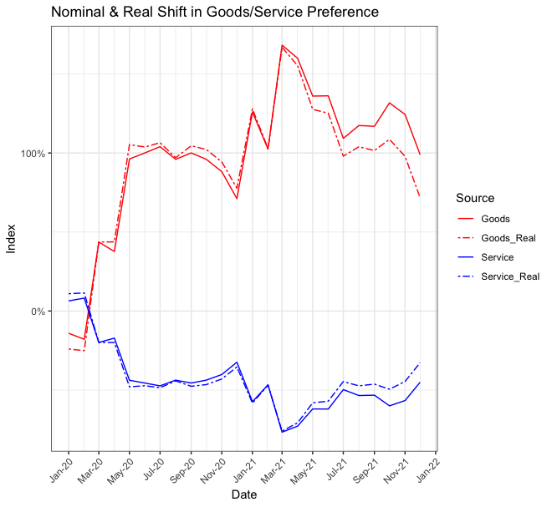
Sneak Preview
Latest PCE
Inflation Matters!
Sources: Flexport and US Bureau of Economic Analysis
Notes:
From a forthcoming Flexport research report.
Flexport calculations based on BEA data, using separate PCE_Goods and PCE_Services deflators

Slide 10
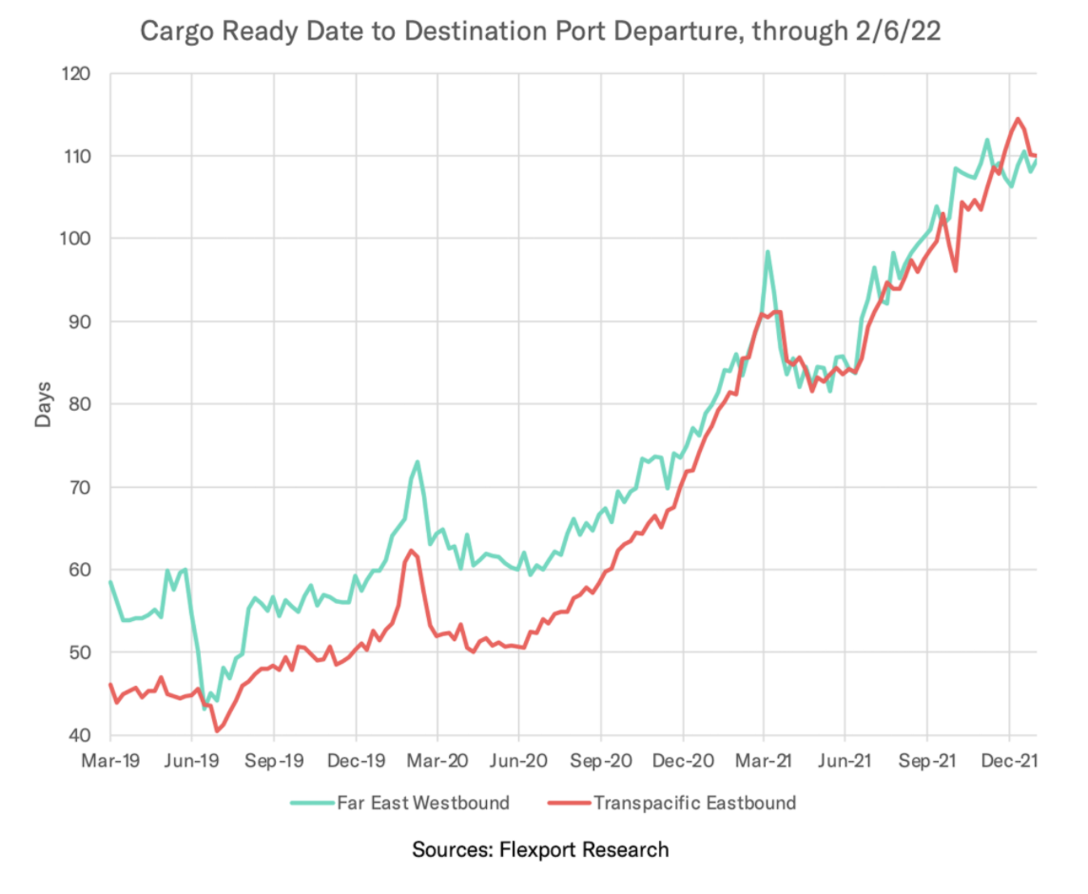
Flexport
Ocean Timeliness Indicator (OTI)
February 7 Release
Source: Flexport
Notes:
https://www.flexport.com/research/ocean-timeliness-indicator/
Updated weekly, on Mondays.
TPEB = Asia to North America. FEWB = Asia to Europe.

Slide 11
Stories to Follow
Consumer Spending Power
  What happens after income support?
Inflation Distortions
  It’s hitting different sectors differently
  Big enough to make a difference
Which Part of the Supply Chain is the Problem?
  It has shifted around during the pandemic
Sourcing Decisions
  Are businesses really moving their supply chains around?

Slide 12
Thank you!
For further information and data, please visit flexport.com/research

