Slide 1
Data Journalism for Accountability
Derek Willis, Merrill College of Journalism

Slide 2
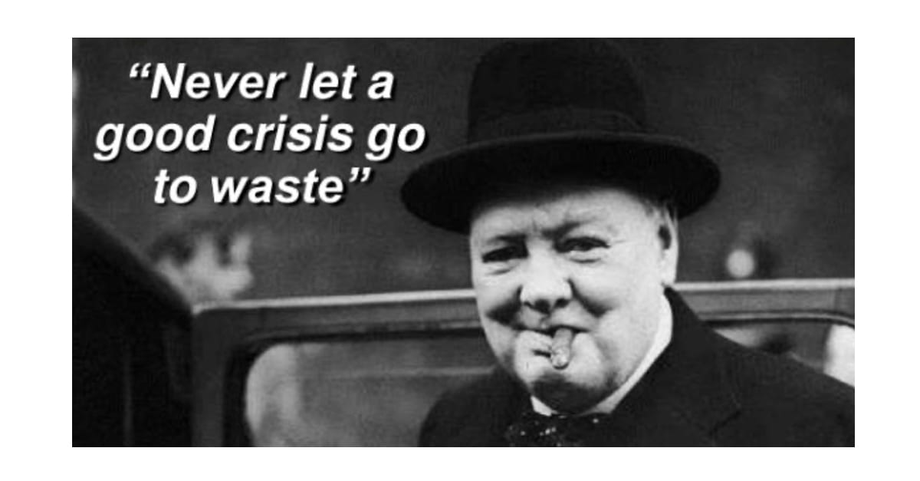
First lesson of contracting

Slide 3
Browsing vs. Searching
SAM.gov: https://sam.gov/reports/awards/static
FPDS: https://www.fpds.gov/fpdsng_cms/index.php/en/
(or, reading answers vs. asking questions)
Notes:
Live demos of SAM.gov COVID report.

Slide 4
Searching vs. Gathering
FPDS search for COVID NIC
Or, why manual repetitive tasks mean you’re doing it wrong

Slide 5
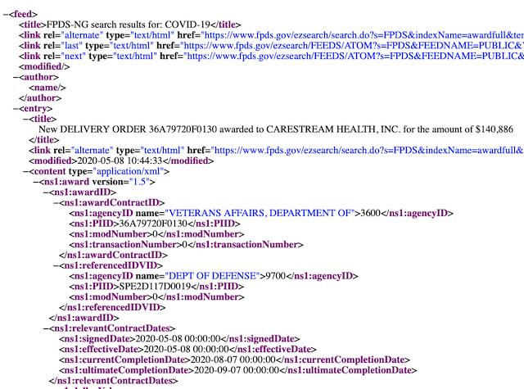
Get the Right Data
Not just the easy data

Slide 6
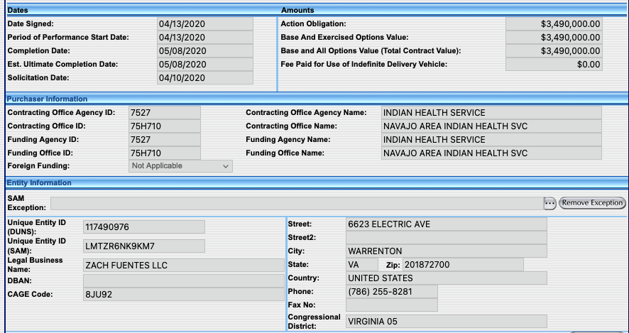
Data Means Definition
The more you use data, the more you learn from it

Slide 7
Design The Data to Answer Questions
https://pp-covid19-contracts.herokuapp.com/covid_contracts
Zach Fuentes
New Contractors
Looks aren’t important right now

Slide 8
Expand Your Questions
Who makes PPE?
Who is VPL?
VPL
Using data for leads & theories

Slide 9
Visible -> Accountable
Terminated Contract Actions
Federal Government Experts
Data can be used to hide things. Better questions make them easier to find.

Slide 10
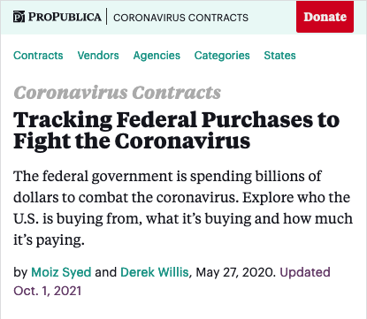
When You Understand, Readers Will
Or, “When should we publish a database?”

Slide 11
How We Built It
A SQL Database (PostgreSQL)
A programming language (Ruby)
A Web application framework (Ruby on Rails)
HTML/CSS/JavaScript
Lots of editing

