Slide 1

Choose to Change (C2C) Overview
October 2021
Notes:
Use only the logo for the lab you need

Slide 2







A Homegrown Solution to Decreasing Youth Violence
2015 Design Competition
Crowdsource
Design
Assess
Partner
Labs and foundations crowdsourced promising solutions to gun violence from every corner of the urban landscape.
Children’s Home & Aid and Youth Advocate Programs developed the C2C program by combining the strengths of each organization.
Subject matter experts selected the ideas with the greatest potential to improve lives at scale. Of almost 200 entries, three winners were recognized.
The Crime Lab and Education Lab partnered with winners to rigorously evaluate and help scale the most cost-efficient and effective programs.
Notes:
Identify, test, scale

Slide 3

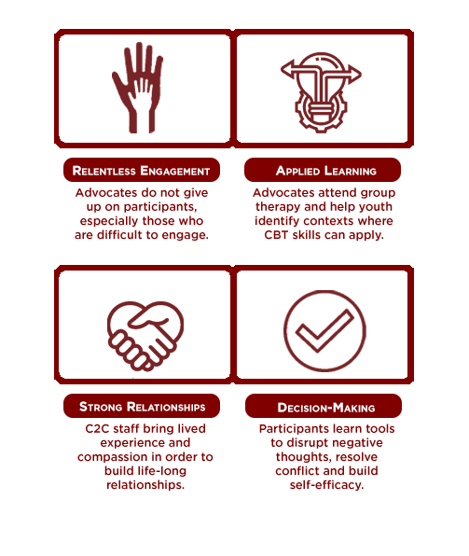

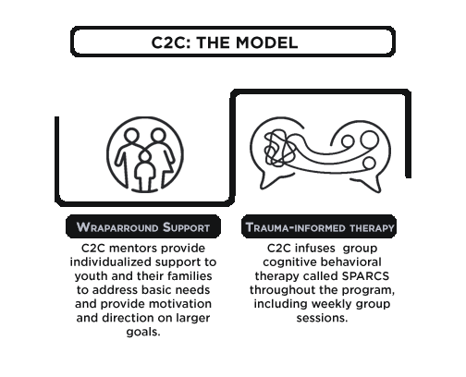

Relentless Engagement:
Advocates do not give up on participants, especially those who are difficult to engage
Choose to Change
The Model
Applied Learning:
Advocates attend group therapy and help youth identify contexts where CBT skills can apply
Decision-Making:
Participants learn tools to disrupt negative thoughts, resolve conflict, and build self-efficacy
Wraparound Support
Trauma-informed Therapy
Strong Relationships:
C2C staff bring lived experience and compassion in order to build life-long relationships

Slide 4
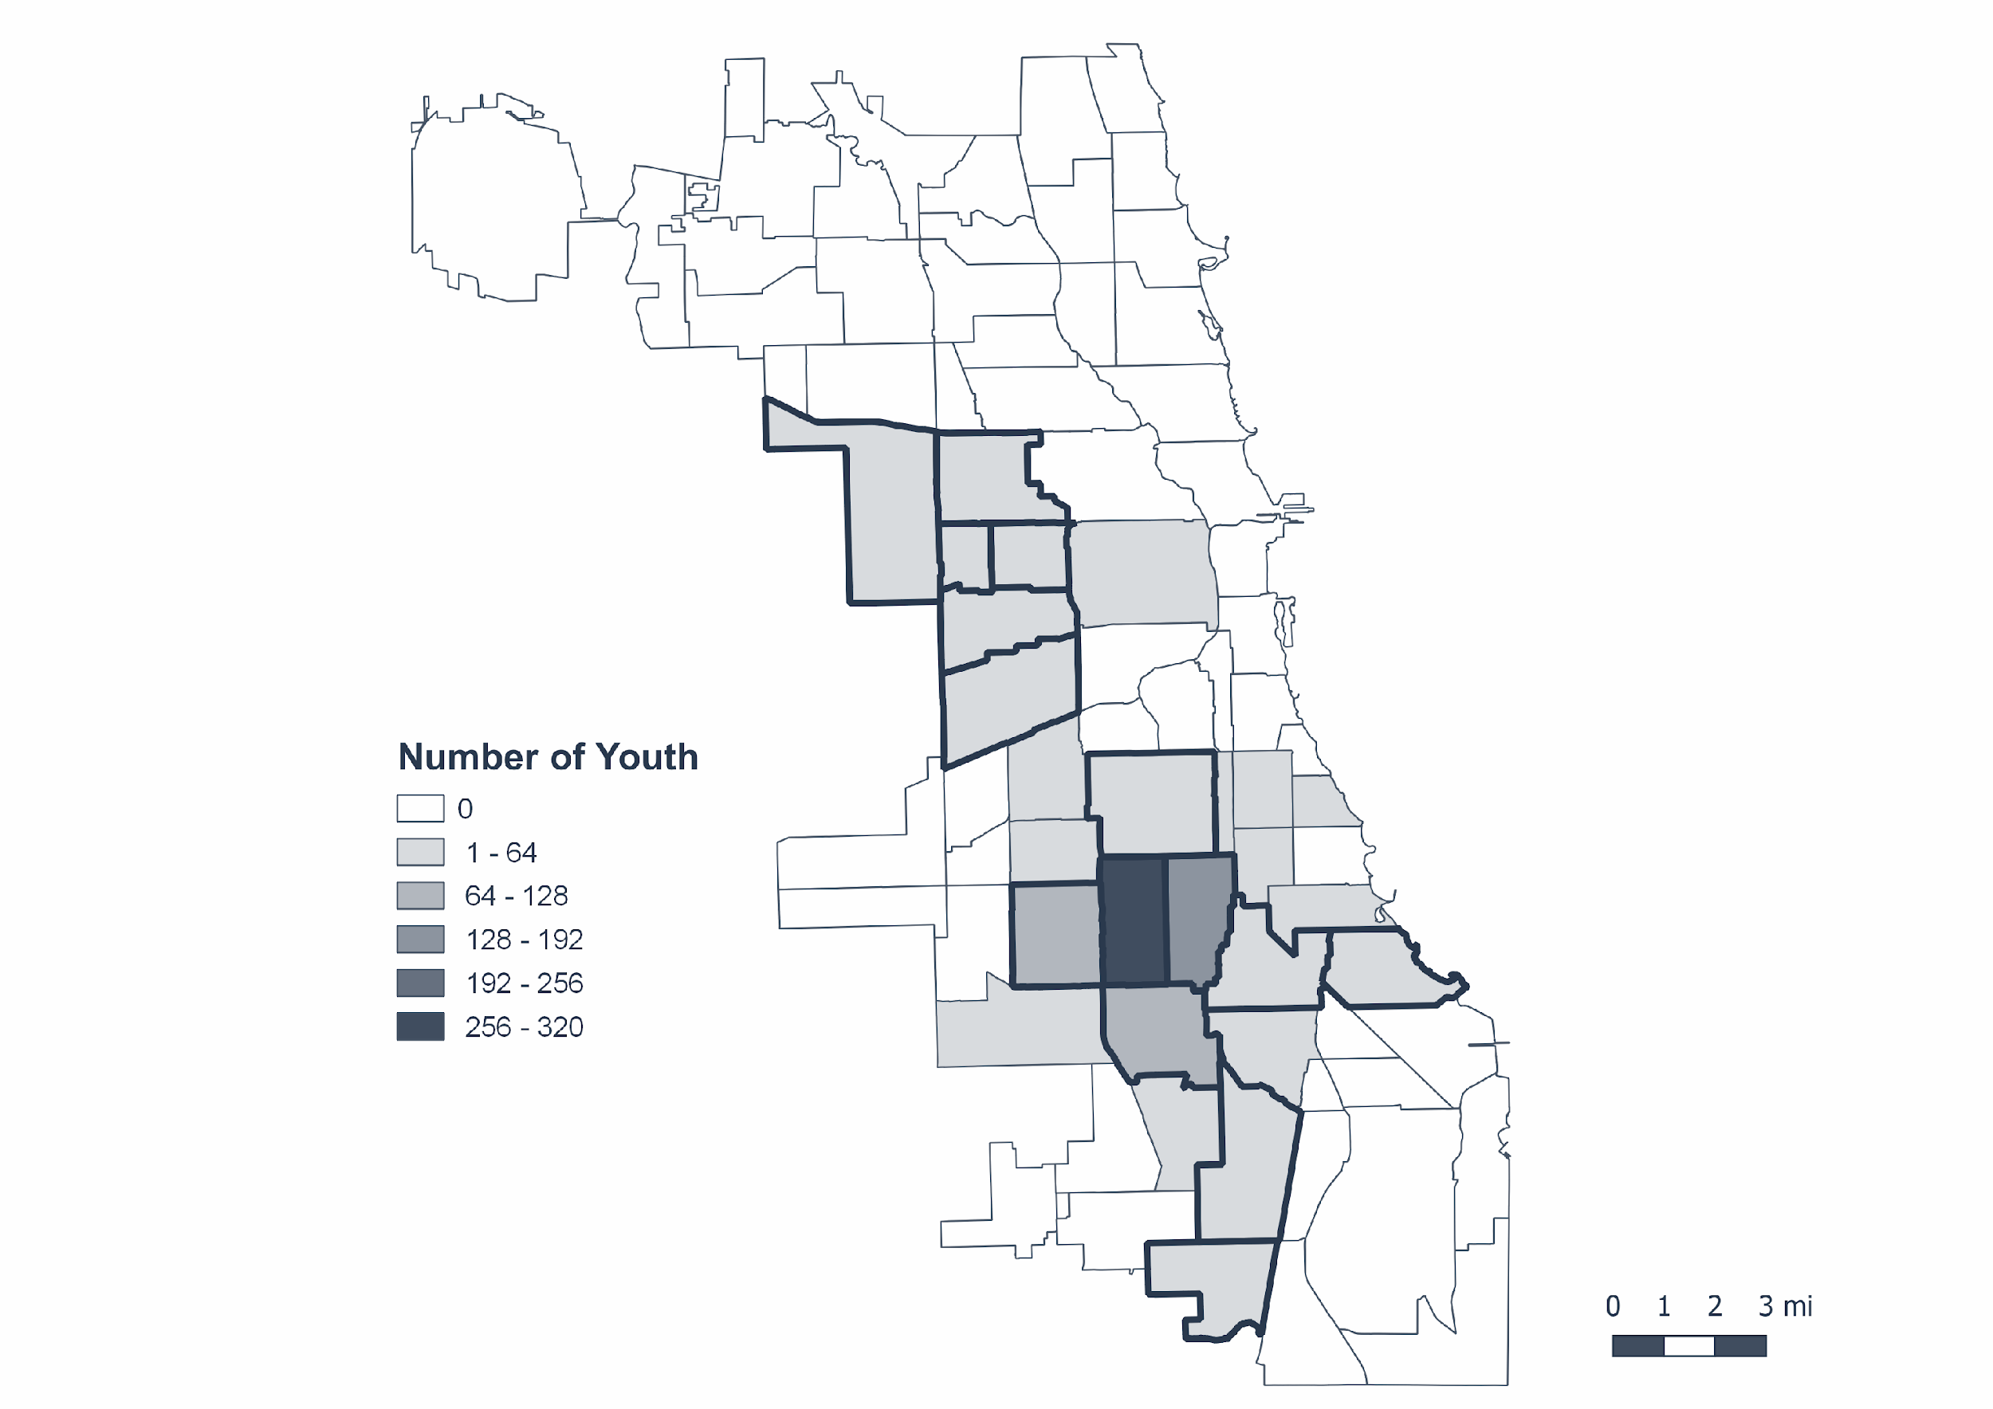







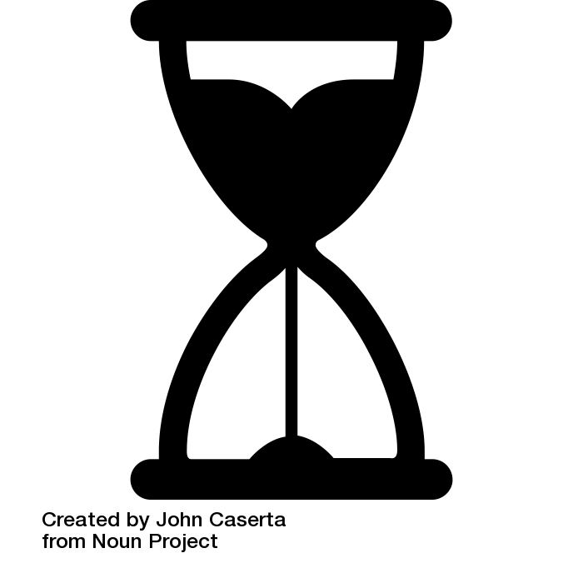
C2C serves youth who are justice-involved or disconnecting from school
C2C Meets the Need – where C2C youth live*
Community Areas with highest levels of violence outlined
21%
37%
24%
95%
homeless or housing unstable
have a prior arrest
have an Individualized Education Plan
Black
30%
22%
41%
16
of school days in prior school year missed
not enrolled in school at some point during the prior school year
are female
average age

Slide 5




On average, C2C participants have experienced high levels of trauma exposure at the start of the program
On average, C2C youth
have experienced
traumatic events*
50%
45%
40%
39%
at least seven
have been told about someone’s killing or injury
have been hurt or injured themselves
have seen or heard someone being badly hurt
have seen someone dead or dying or had watched or heard someone being killed
*Based on Children’s Home and Aid data from a Trauma History Checklist completed by 60% of the C2C participants from the RCT.
Notes:
Some stats of trauma exposure for C2C youth:
56% have been told about someone’s killing or injury
55% youth have seen or heard someone being badly hurt
50% have been hurt or injured themselves
45% have seen someone dead or dying or had watched or heard someone being killed

Slide 6
C2C was evaluated through a randomized controlled trial
YOUTH OFFERED C2C
COMPARISON GROUP
C2C RECEIVES REFERRALS OF YOUTH AGED 13-18 WHO MEET THE CRITERIA:
Disconnecting from school (chronically truant or frequent misconducts),
gang affiliated,
victim of traumatic events,
or has previous contact with juvenile justice system.
REFERRALS ARE RANDOMLY
DIVIDED INTO TWO GROUPS,
SIMILAR TO A LOTTERY
POST-INTERVENTION,
OUTCOMES ARE MEASURED
FOR BOTH GROUPS

Slide 7
C2C keeps youth safe in the immediate and longer term
Justice System Outcomes
During the Program
1.5 Years After
the Program Ends
2.5 Years After
the Program Ends
C2C reduces violent crime arrests
C2C reduces violent crime arrests
C2C reduces the probability of any arrest
-48%
-38%
-33%
*All results shown are the impact of participation in C2C
*This is a summary and subset of all results

Slide 8
C2C increases youth’s attachment to school
Educational Outcomes
6 Months After
the Program Ends
+6%
One full week of school
C2C increases attendance
C2C reduces school misconduct
-33%
*All results shown are the impact of participation in C2C
*This is a summary and subset of all results

Slide 9

The C2C Program leaves a lasting impact
“Influence, intelligence, experience. He’d been there done that, he’d been my age before. But I hadn’t ever been his age, and I’m trying to get there.” – C2C Alum
“I learned how to walk away and not act on everything and make a permanent decision on a temporary situation.” – C2C Alum

