Slide 1

THE RARE DISEASE
DIVERSITY COALITION

Slide 2

About Black Women’s Health Imperative
The Black Women's Health Imperative (BWHI) is the only national non-profit organization dedicated to advancing health equity and social justice for Black women, across the lifespan, through policy, advocacy, education, research, and leadership development. The organization identifies the most pressing health issues that affect the nation's 22 million Black women and girls and invests in the best of the best strategies and organizations that accomplish its goals.

Slide 3
Vision and Mission
OUR VISION
Black women enjoy optimal health and well-being
in a socially just society.
OUR MISSION
To lead the effort to solve the most pressing health issues that affect Black women and girls in the U.S. Through investments in evidence-based strategies, we deliver bold new programs and advocate for health-promoting policies.

Slide 4


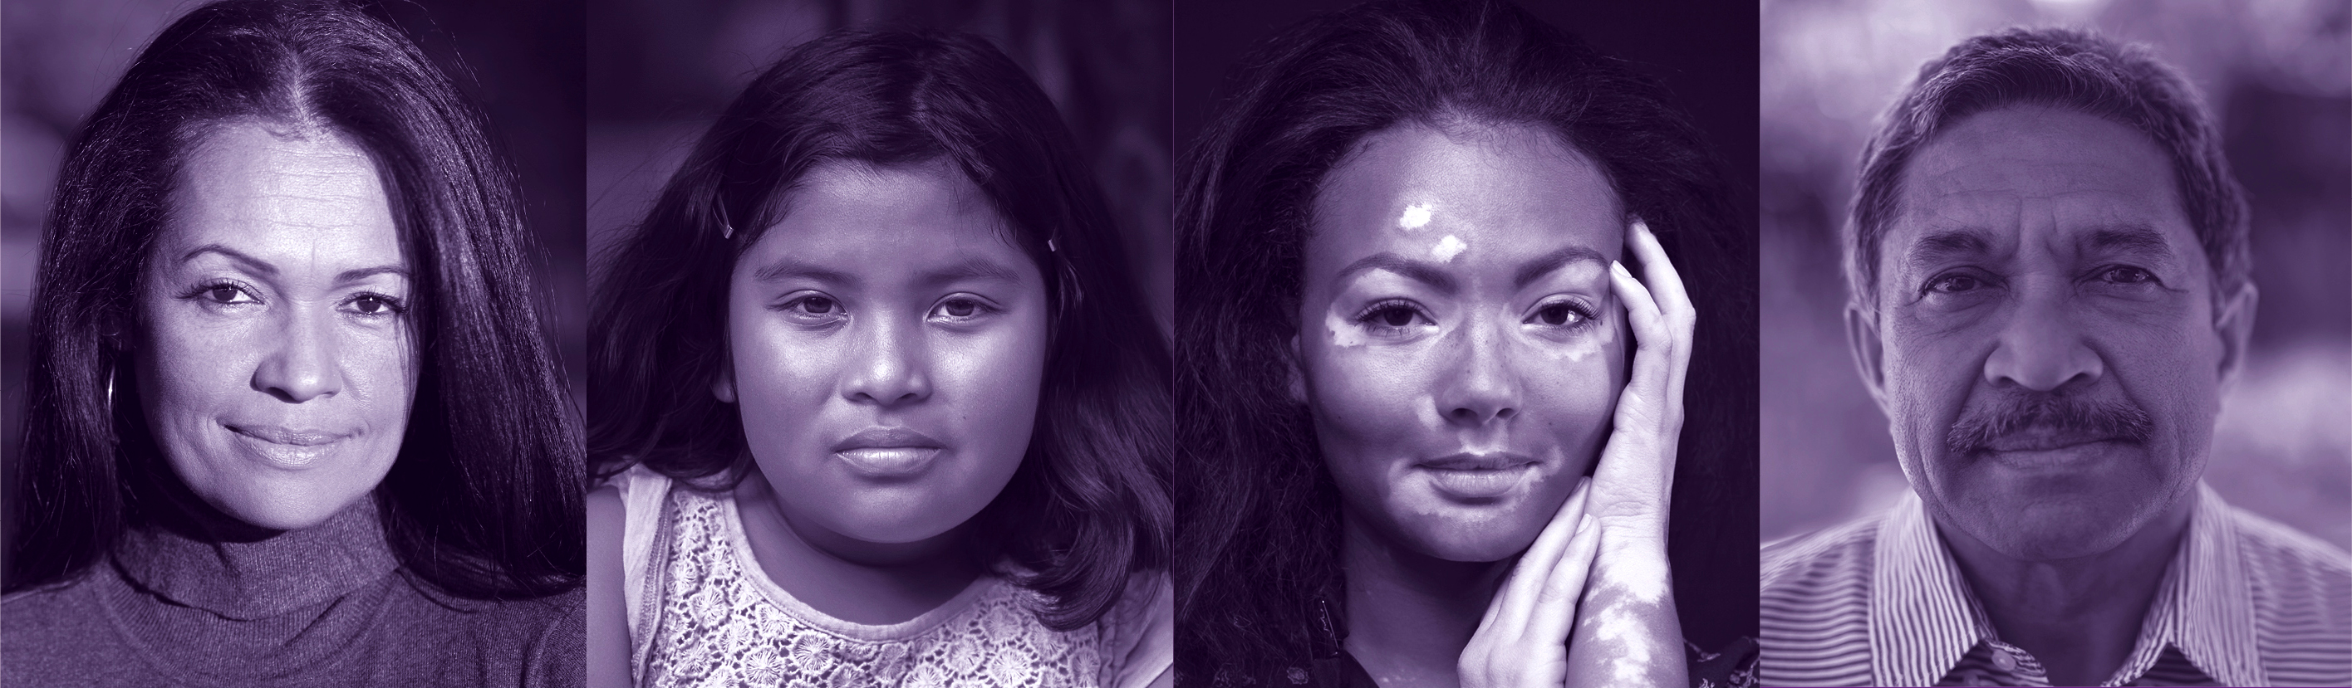

Slide 5
Why Is This Necessary?
African Americans have higher death rates than Whites for 12 of the 15 leadi ng causes of death and almost all rare diseases
Blacks and American Indians have higher age-specific death rates than Whites from birth through the retirement years
Hispanics have higher death rates than whites for diabetes, hypertension, liver cirrhosis & homicide
The non-white population gets sick younger, has more severe illness and dies sooner than Whites
D.Williams, Harvard, 2007

Slide 6
Why Is This Necessary?
There Is No Biologic Or Genetic Determinant For Race

Slide 7
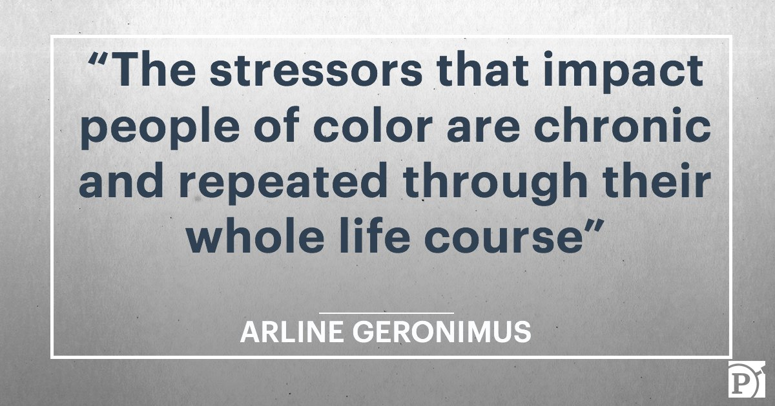
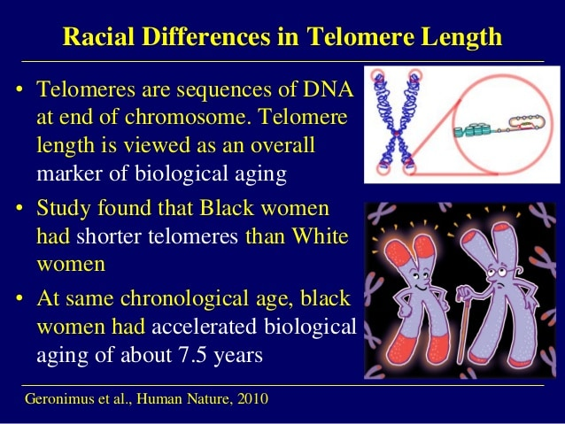
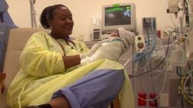
Why Is This Necessary?
What We Know About Disease Expression in People of Color and Low Income People

Slide 8
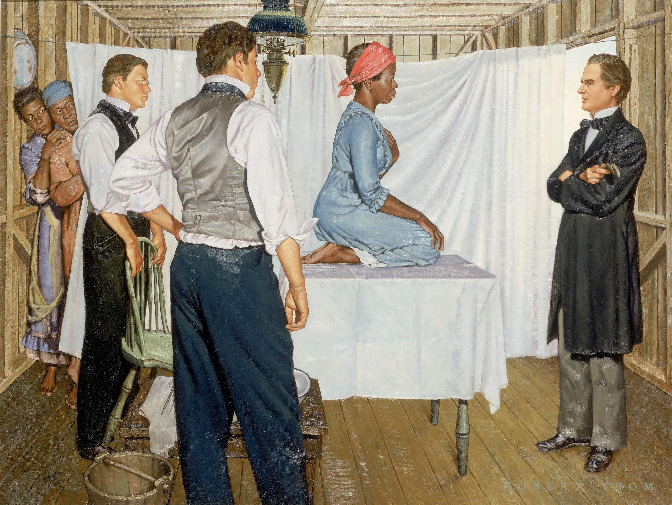
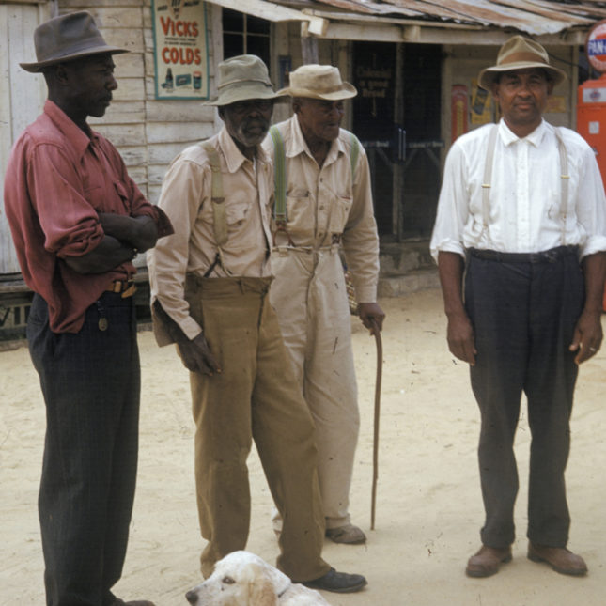
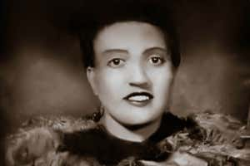
Why Is This Necessary?
Historical Abuse and Mistreatment
Lack of Trust in Medicine and Research is Justified

Slide 9
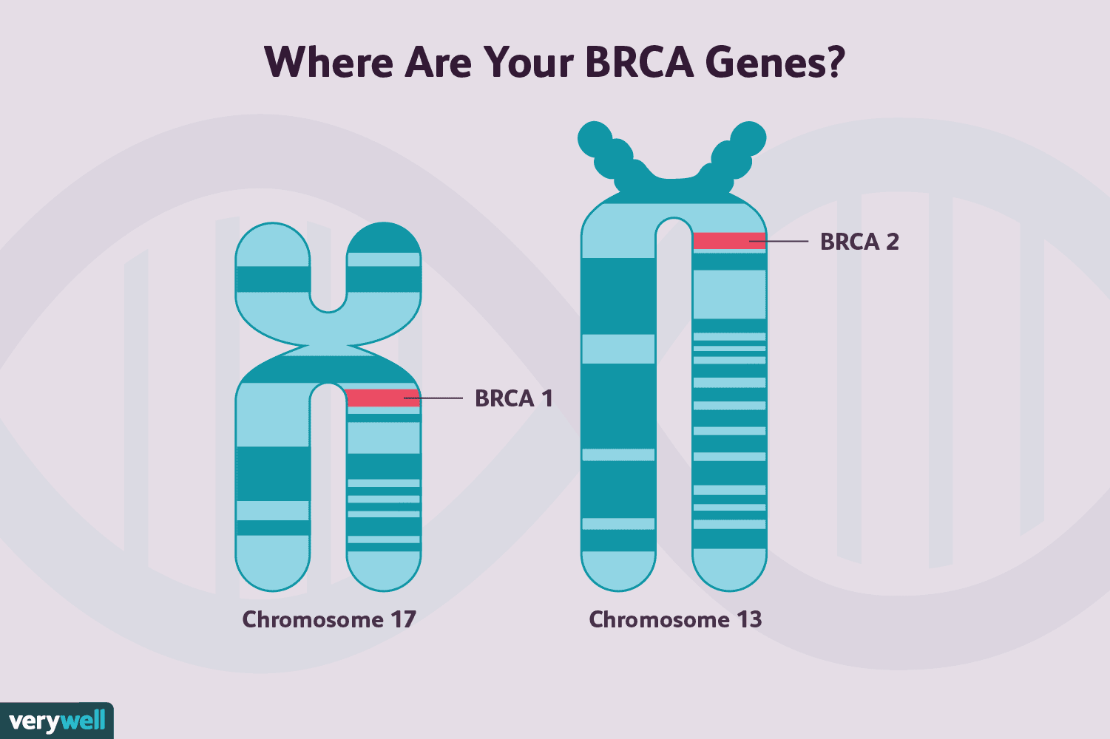
Why Is This Necessary?
Persistent Disparities in Health Outcomes
Present in Rare Diseases as with Other Diseases

Slide 10
Why Is This Necessary?
What Becomes Evidence Depends on Who’s Asking the Questions,
Who They’re Asking and,
Who is Funding the Research
It’s Not Who You Know, But Who Knows You
The % of Black and Hispanic physicians is about 5% and NIH funded researchers is <2%. That has not changed in over 40 years

Slide 12


About Rare Disease Diversity Coalition
Black Women's Health Imperative and Travere launched the Rare Disease Diversity Coalition (RDDC) to address the extraordinary challenges faced by rare disease patients of color. The Coalition brings together rare disease experts, health and diversity advocates, and industry leaders to identify and advocate for evidence-based solutions to alleviate the disproportionate burden of rare diseases on communities of color.

Slide 13
RDDC Steering Committee
By convening key stakeholders with deep knowledge of the medical, industry, regulatory, and cultural challenges facing patients of color with rare disease, the RDDC is poised to achieve action in the years to come.
Anchored by the expertise of the Rare Disease Diversity Coalition Steering Committee and supported by a growing number of sponsors and Coalition members, the RDDC advocates for solutions to alleviate the disproportionate burden of rare diseases on communities of color.
The Coalition is governed by a diverse Steering Committee comprised of:
Influential health experts
Patient advocacy leaders
Health groups comprised of and focused on communities of color
Rare disease organizations
Medical associations

Slide 14



























Rare Disease Diversity Coalition Members

Slide 15
RDDC Working Groups
PATIENT & CAREGIVER
PROVIDER EDUCATION & ENGAGEMENT
Co-Chairs:
Shonta Chambers, Executive Vice President of National Patient Advocate Foundation
Donna Cryer, CEO of the Global Liver Institute
Co-Chairs:
Dr. LaTonya Washington, President of Bluff City Medical Society
Rev. Anthony J. Brownlow, Deputy Chief Operating Officer of Alfred Street Baptist Church
Joaquin Baca, Senior Policy Analyst at the American Medical Association
DELAYS IN DIAGNOSIS & TREATMENT
RESEARCH & CLINICAL TRIALS
GOVERNMENT REGULATION, LEGISLATION & POLICY
Co-Chairs:
Dr. Garfield Clunie, Board of Trustees and Treasurer of the National Medical Association
Christian Rubio, Vice-President of Strategic Advancement at Global Genes
Co-Chairs:
Linda Goler Blount, President & CEO of Black Women's Health Imperative
Dr. Marshall Summar, Director of the Rare Disease Institute at Children’s National Hospital
Co-Chairs:
Tammy Boyd, Chief Policy Officer & Counsel of Black Women's Health Imperative
Julia Jenkins, Executive Director of EveryLife Foundation

Slide 16
Delays in Diagnosis
Family Health History: Develop patient-oriented education media campaign to build awareness of the importance of family.
Genetic Testing: Develop patient education for genetic testing with multi-lingual materials to connect them with genetic counselors.
Increasing Industry commitment : Develop an industry sign-on “pledge” to provide guidance for the healthcare industry on how to develop and deploy culturally sensitive and inclusive patient materials.
Research & Clinical Trials
Research, evaluate, and confirm the composition of the patient data base in rare disease clinical trials.
Increase the number of principal investigators/study coordinators of color by creating a R25 Grant Award and Program for young investigators.
Utilize BearGenes app to provide educational videos as a resource for patients regarding research and clinical trials.
Putting Money Where Our Collective Mouths Are

Slide 17
Government Regulation, Legislation & Policy
Develop clear and concise advocacy messaging for use in both the legislative and executive branch on our policy objectives and proposals.
Schedule an RDDC virtual advocacy day on the Hill targeting 40-60 participants covering over 200 office visits.
Track executive branch regulatory comments and draft and submit comments on behalf of RDDC.
Provider Education
Develop healthcare provider cultural sensitivity/awareness/bias training for providers with CME accreditation.
Create & promote webinar series to increase medical student education/exposure to rare disease.
Produce a pipeline initiative to increase people of color enrollment in medical schools.
Create a communities of color rare disease fellowship program, beginning with 3 part-time fellows in December, 2021

Slide 18
Patient and Caregiver
Conduct an analysis on the needs of rare disease patients and caregivers of color to identify gaps in areas like healthcare access, patient/provider communications, and patient engagement.
Conduct an audit and analysis of the current state and efforts of patient organizations in rare disease to improve patient outreach and communications to develop best practice tools.

Slide 19
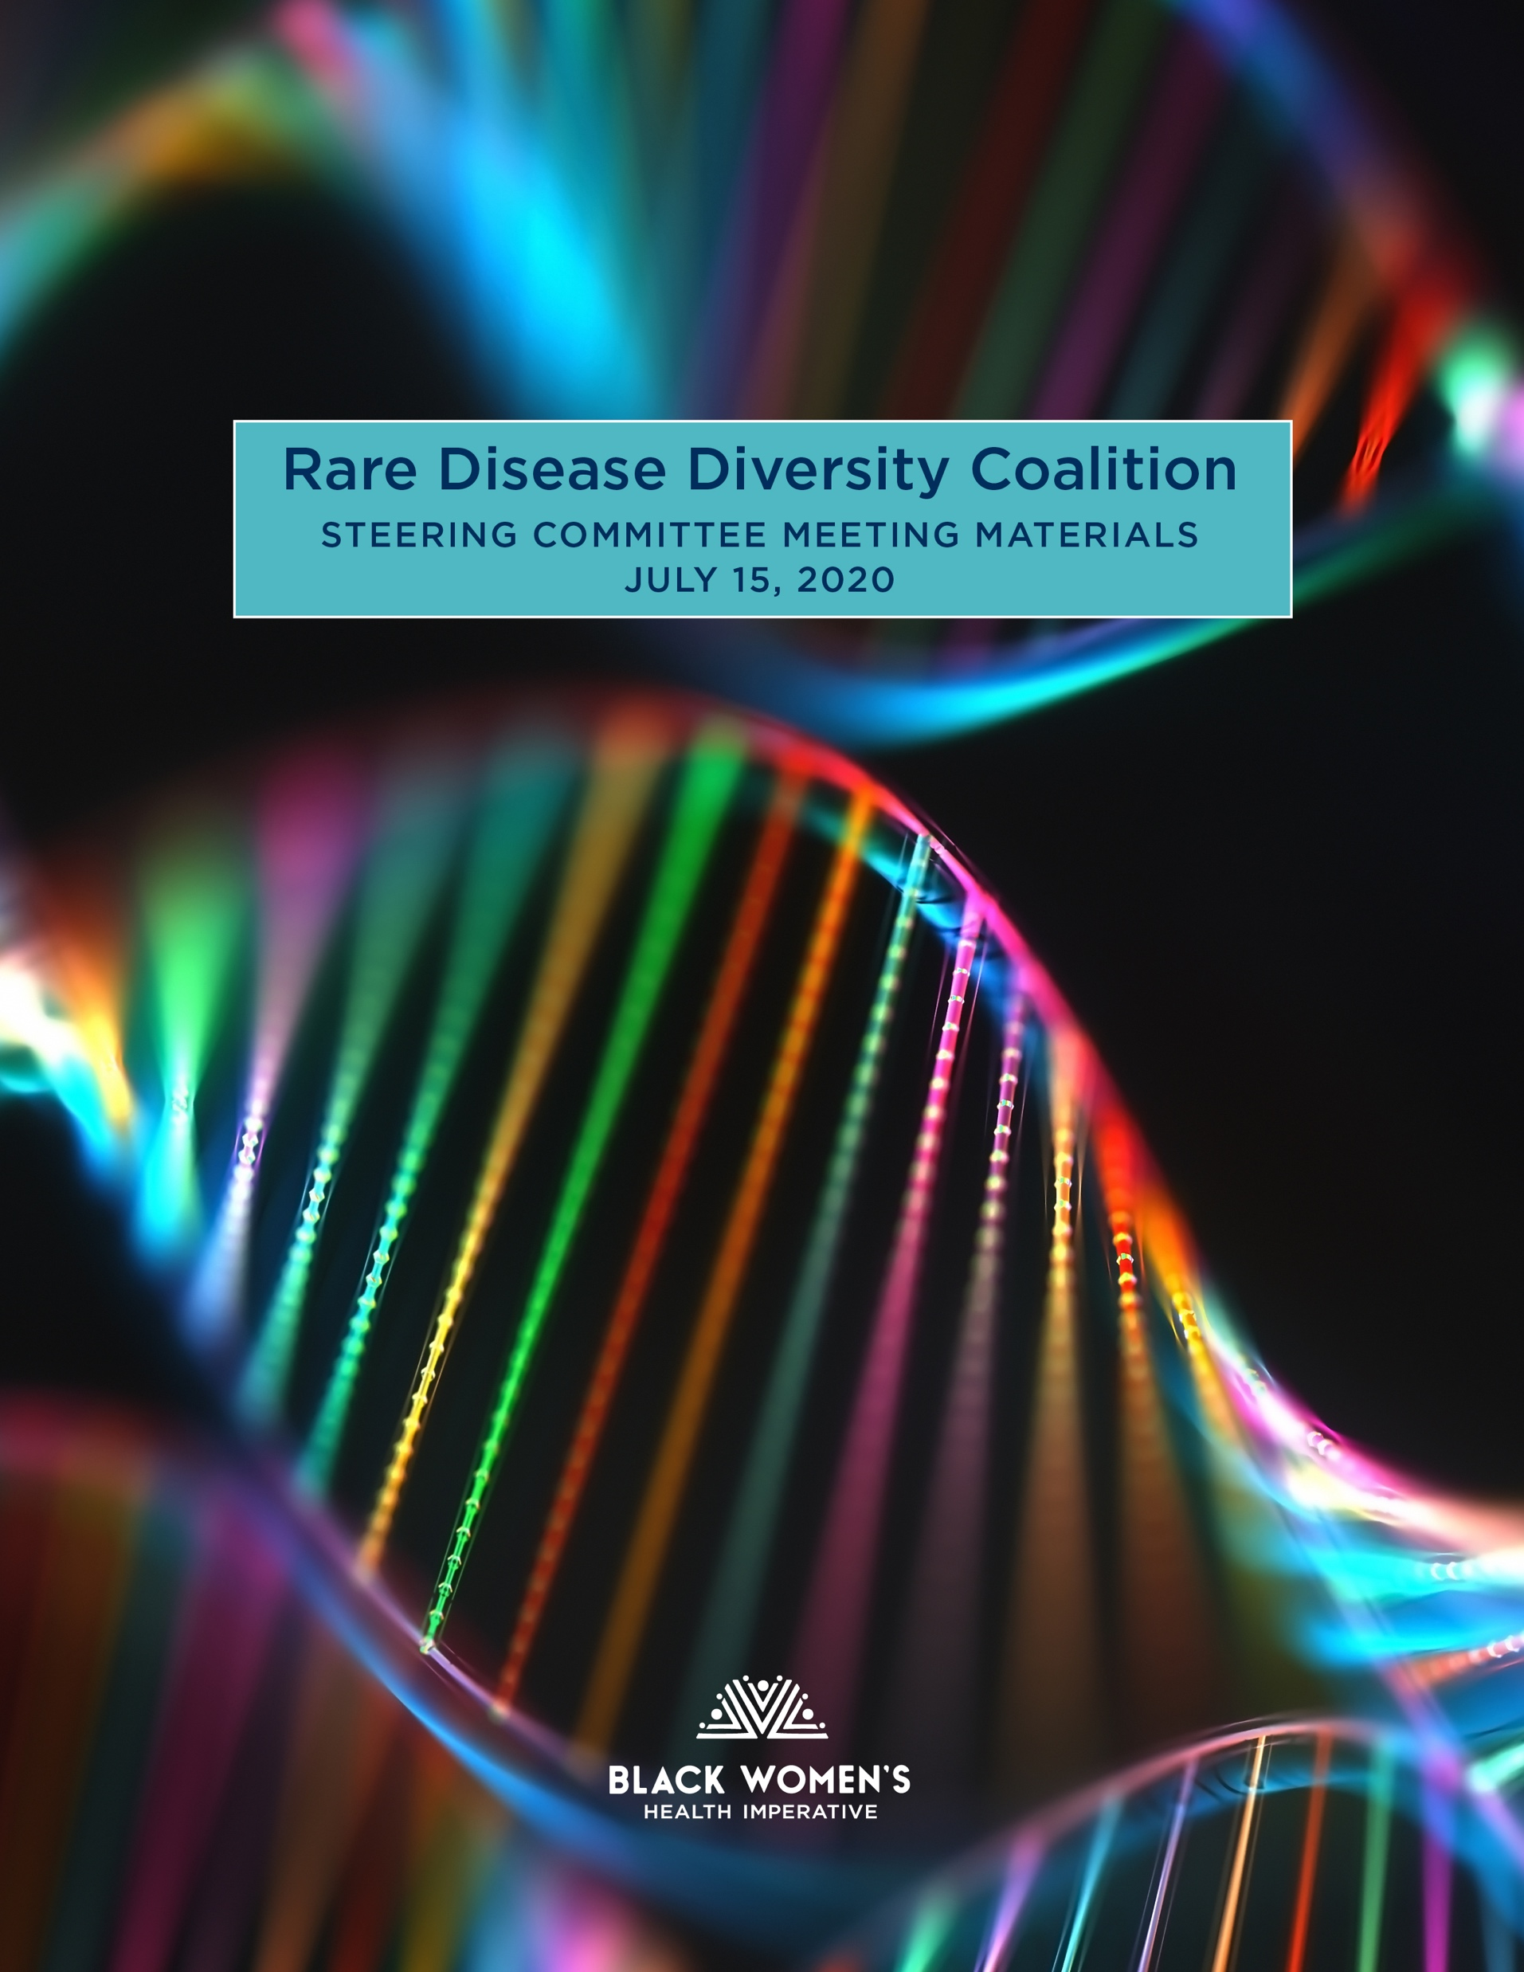
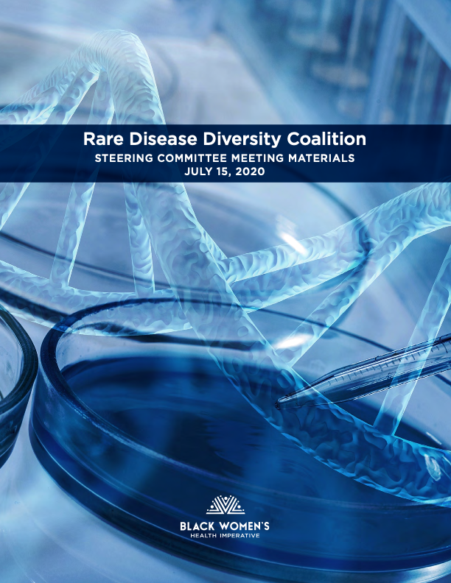



Key RDDC Coalition Meetings
RDDC Meetings 2020
RDDC Meetings 2021

Slide 20
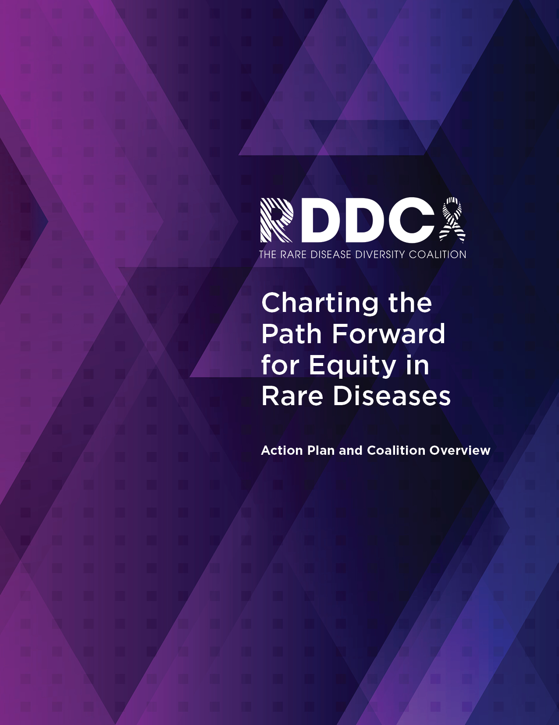
RDDC Action Plan
The RDDC released its 2021 Action Plan entitled
Charting the Path Forward for Equity in Rare Diseases.
The RDDC's Steering Committee undertook a 6-month study to assess the most pressing challenges faced by people of color with rare disease and identify potential solutions.
RDDC identified more than 75 recommendations, 11 were prioritized, that cut across the four key areas of focus
  Correcting delays in diagnosis and treatment
  Improving patient and provider education and engagement
  Improving the state of research and clinical trials
  Advocating for government policy
The 11 recommendations form a preliminary roadmap to guide the Coalition’s 2021 advocacy work. For each recommendation, RDDC has outlined concrete steps to make meaningful progress in 2021.
These specific actionable efforts will directly address many of the social determinants of health with a focused eye toward improving health and reducing longstanding disparities in health care for people of color with rare diseases.

Slide 21
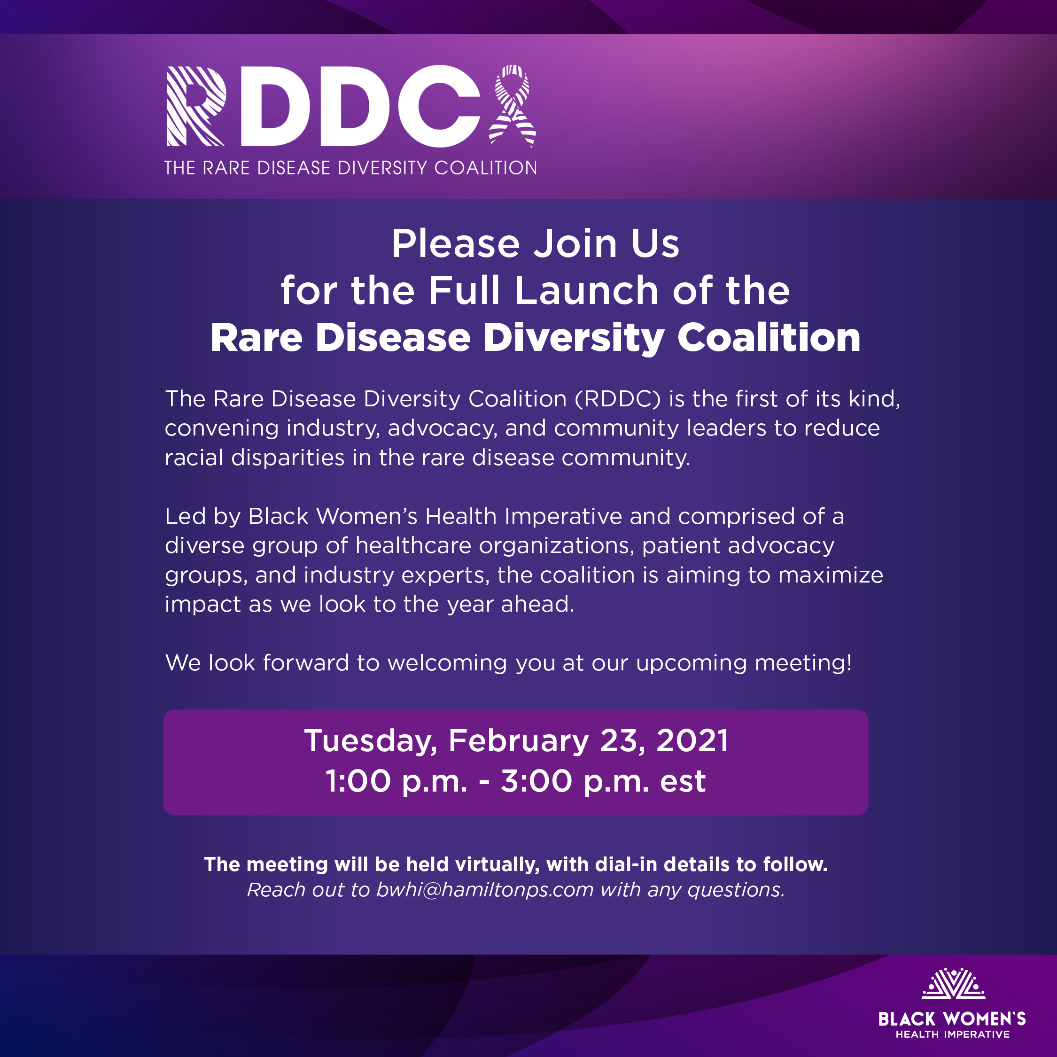
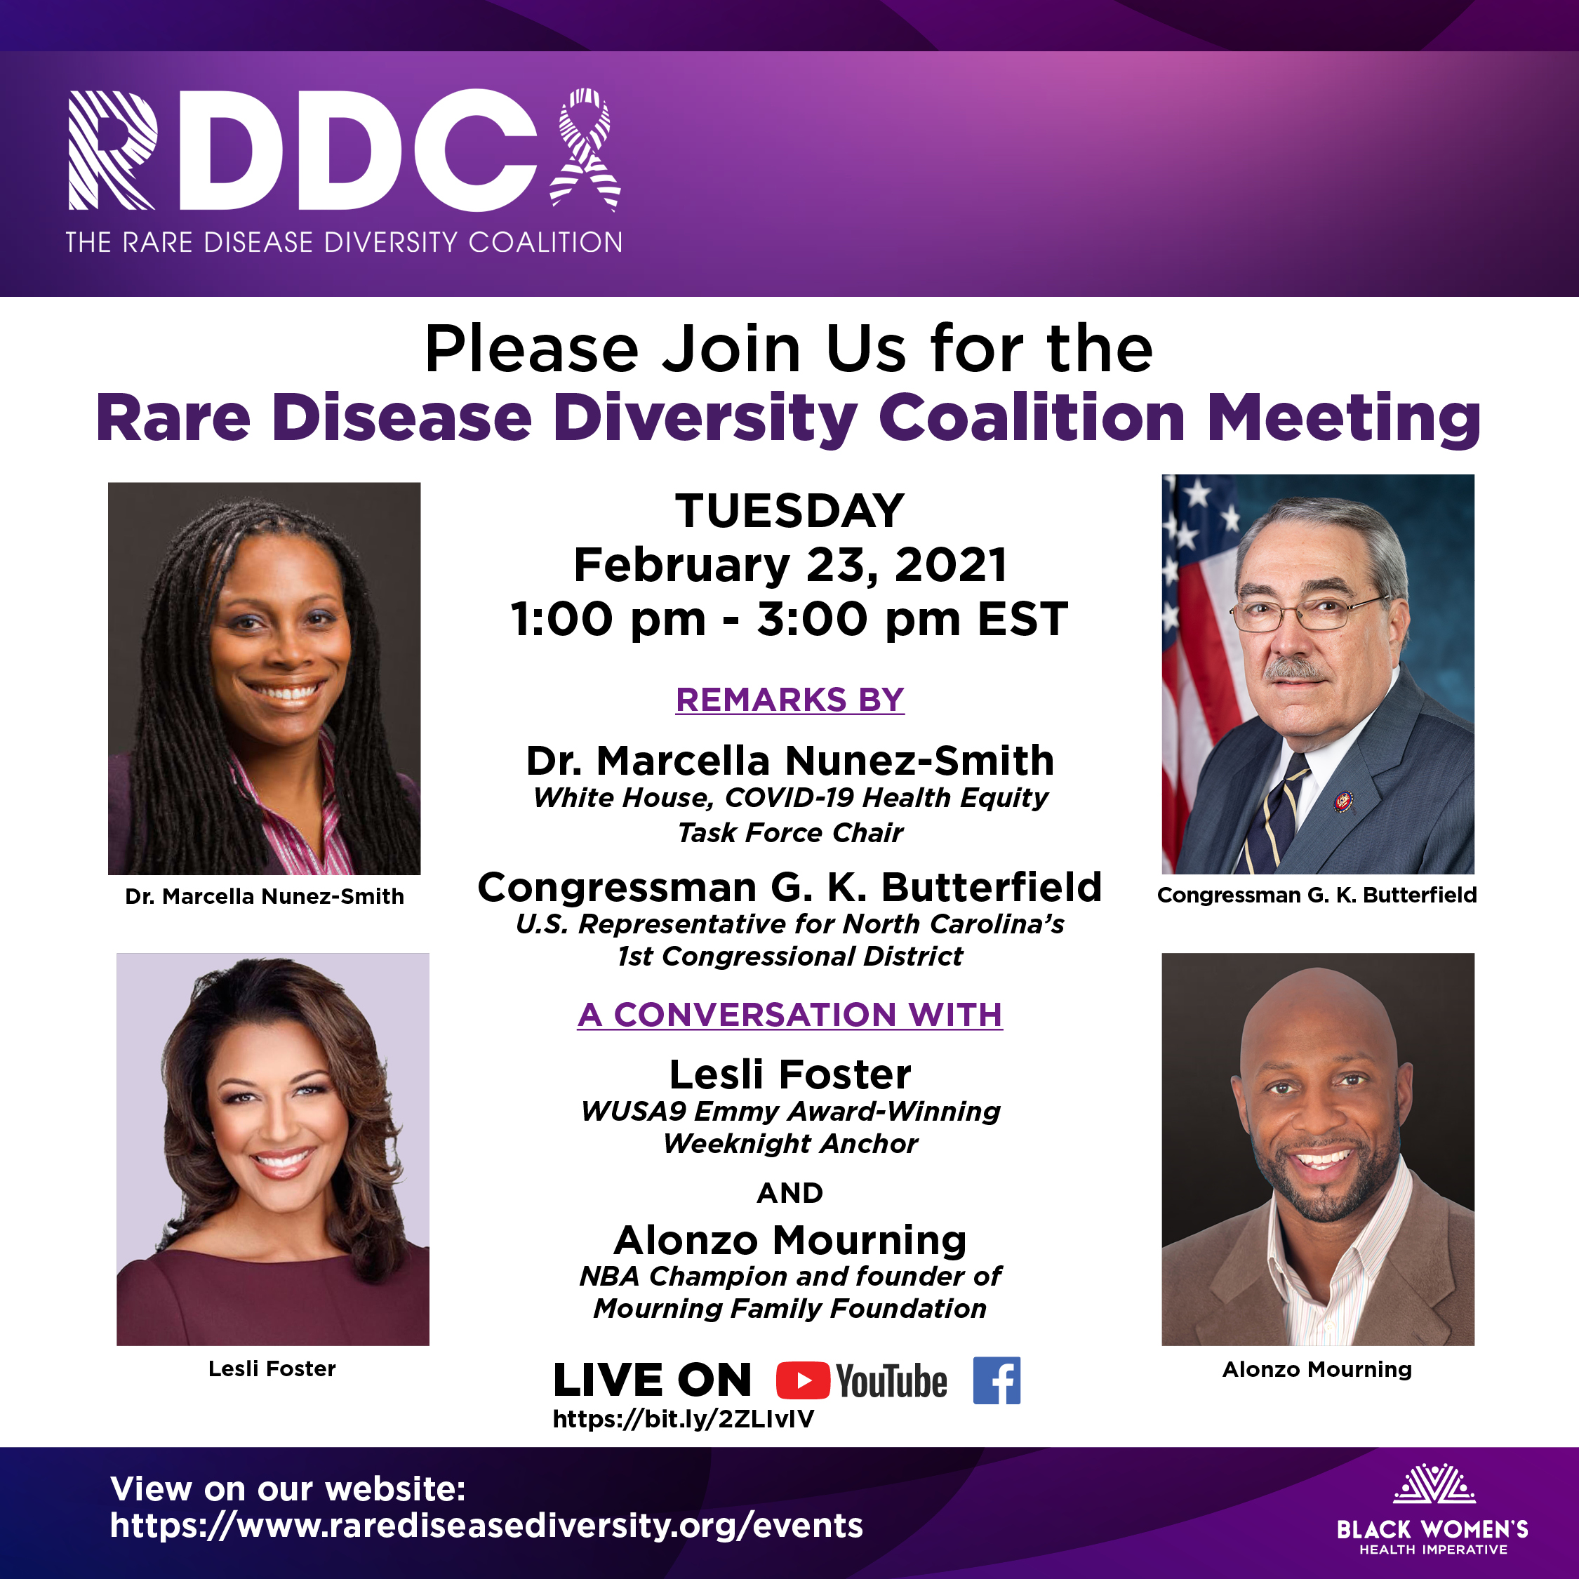
RDDC Launch Event

Slide 22
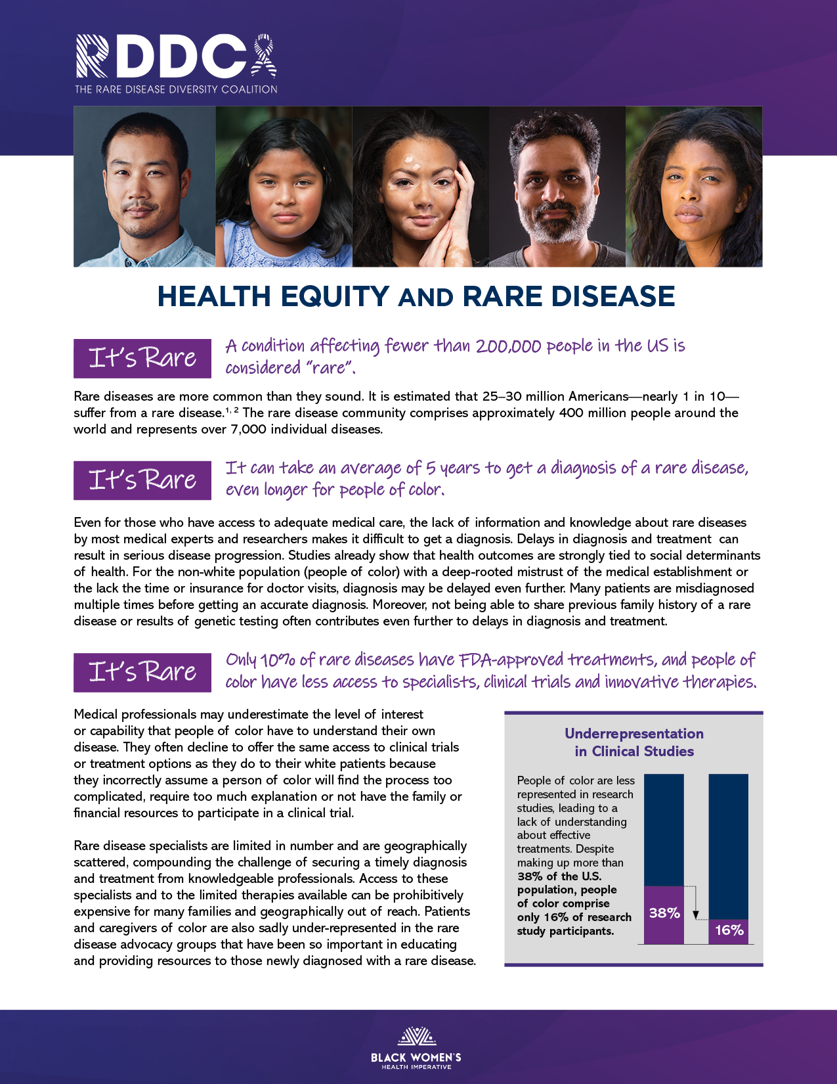
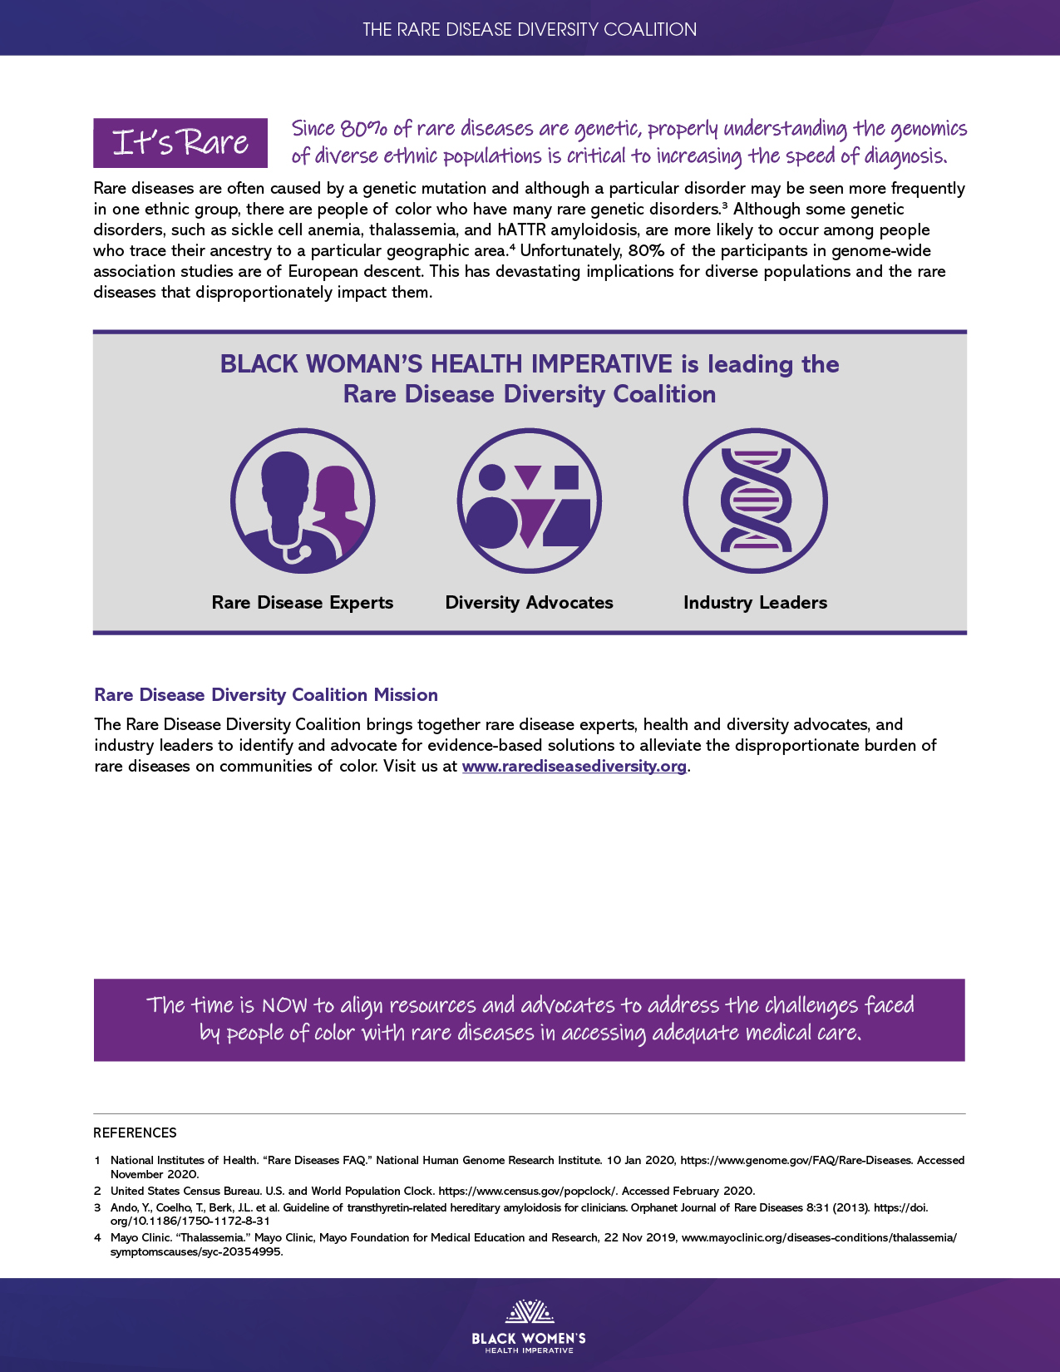
We continue to compile Rare Disease Fact Sheets showcasing the inequities communities of color face with respect to rare disease.

Slide 23
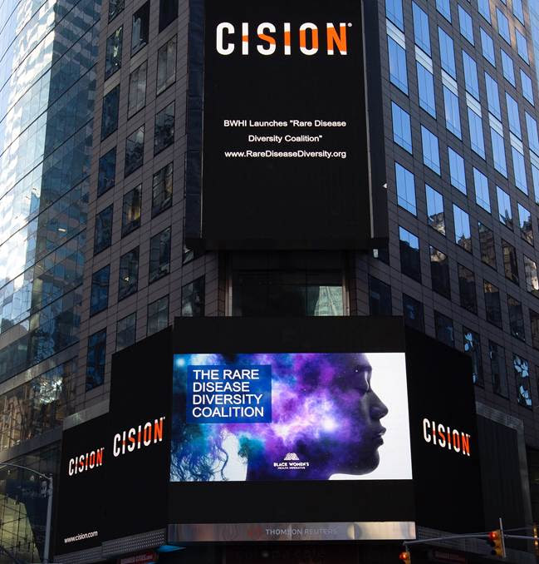
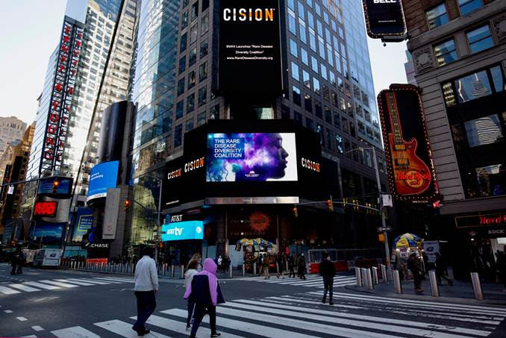
Commemorating Rare Disease Day 2021 –
RDDC Billboard in Times Square, New York City

Slide 24
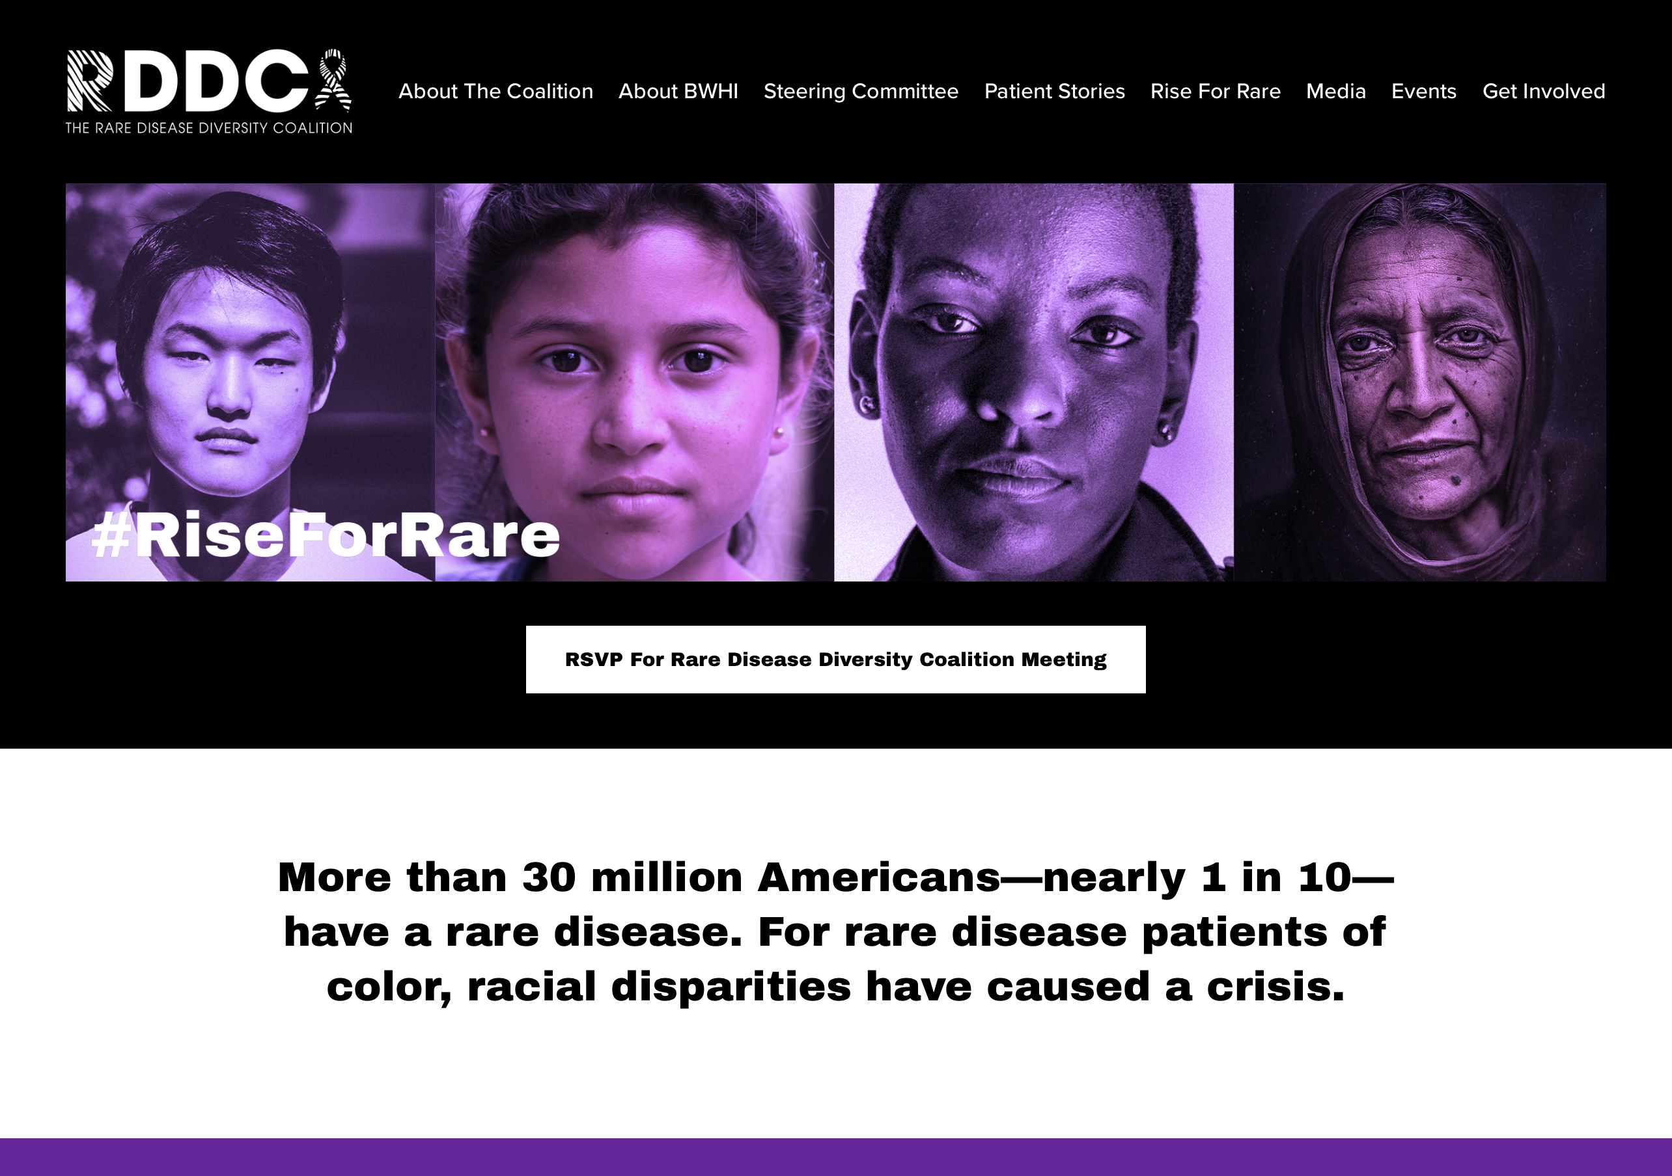
RDDC Website
The Rare Disease Diversity Coalition Website. This site serves as a digital hub to enable us to share resources, promote human interest stories, provide updates on the work of the Coalition and solicit support.
RareDiseaseDiversity.org

Slide 25
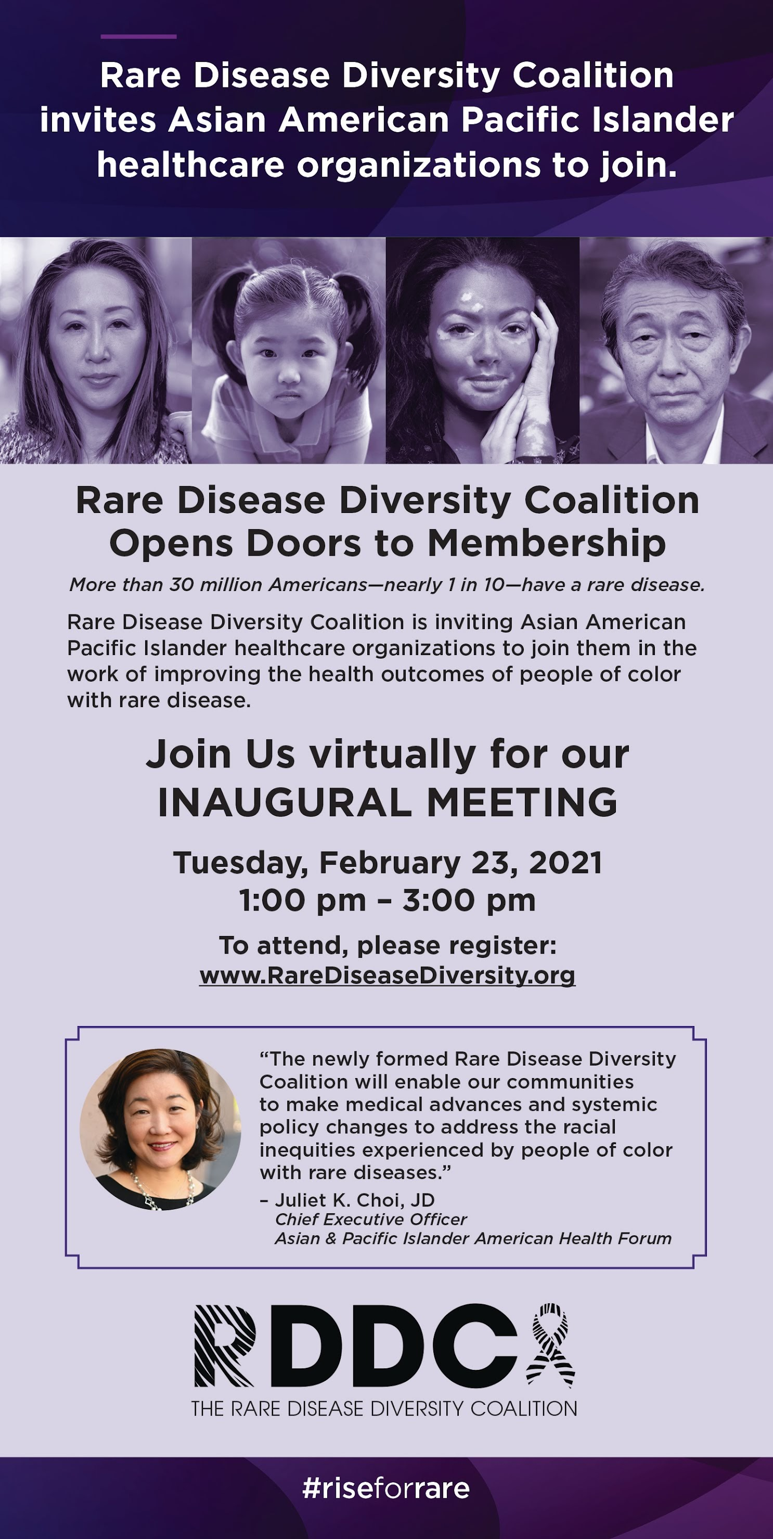
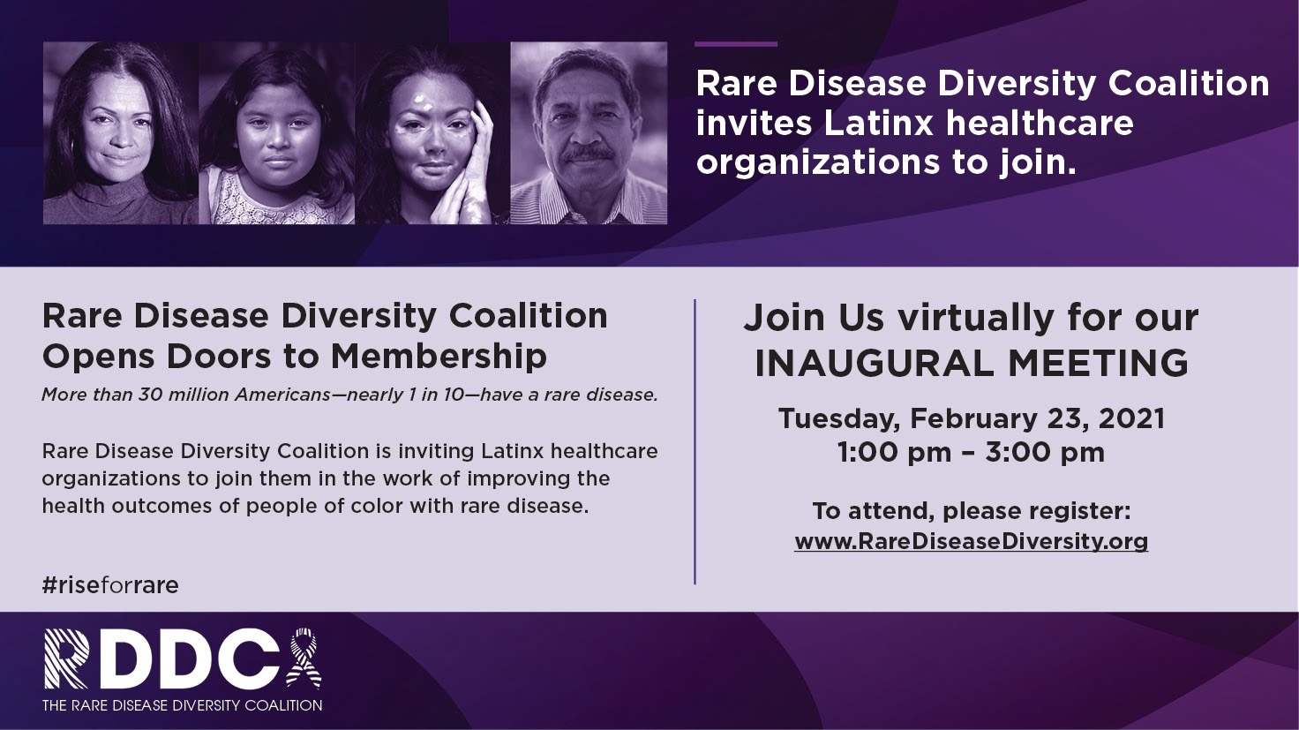
Early activities included print ads to broaden our outreach

Slide 26
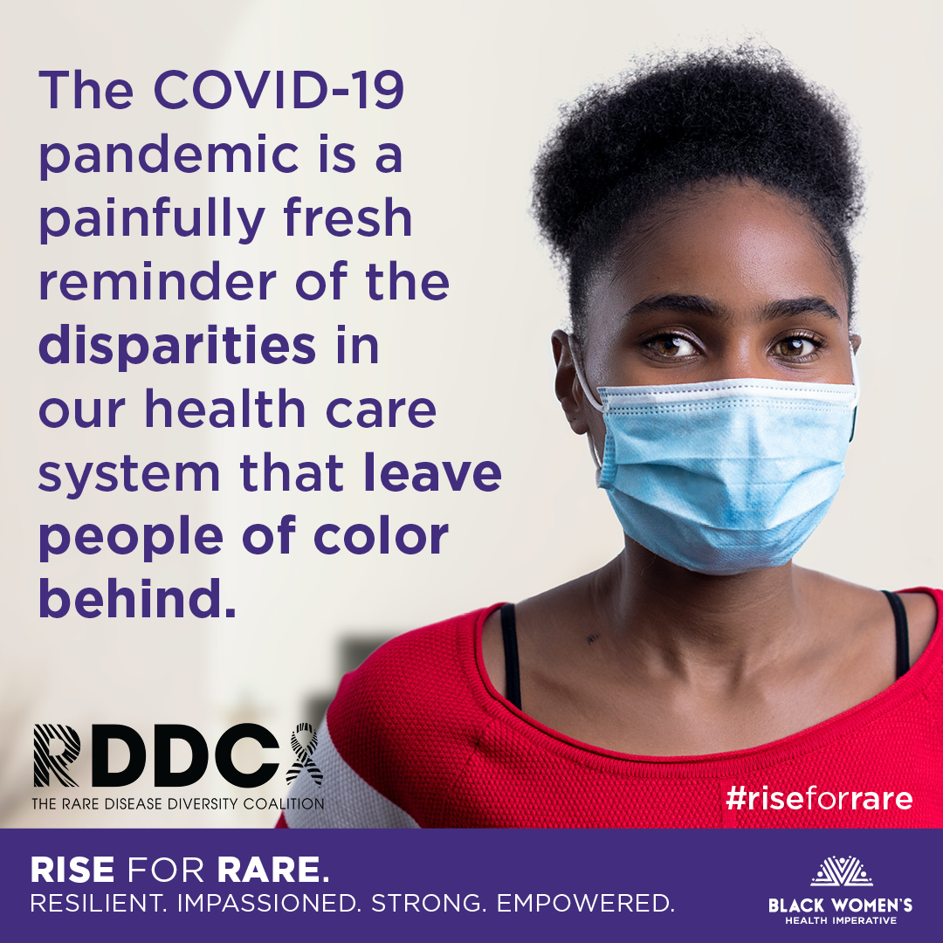
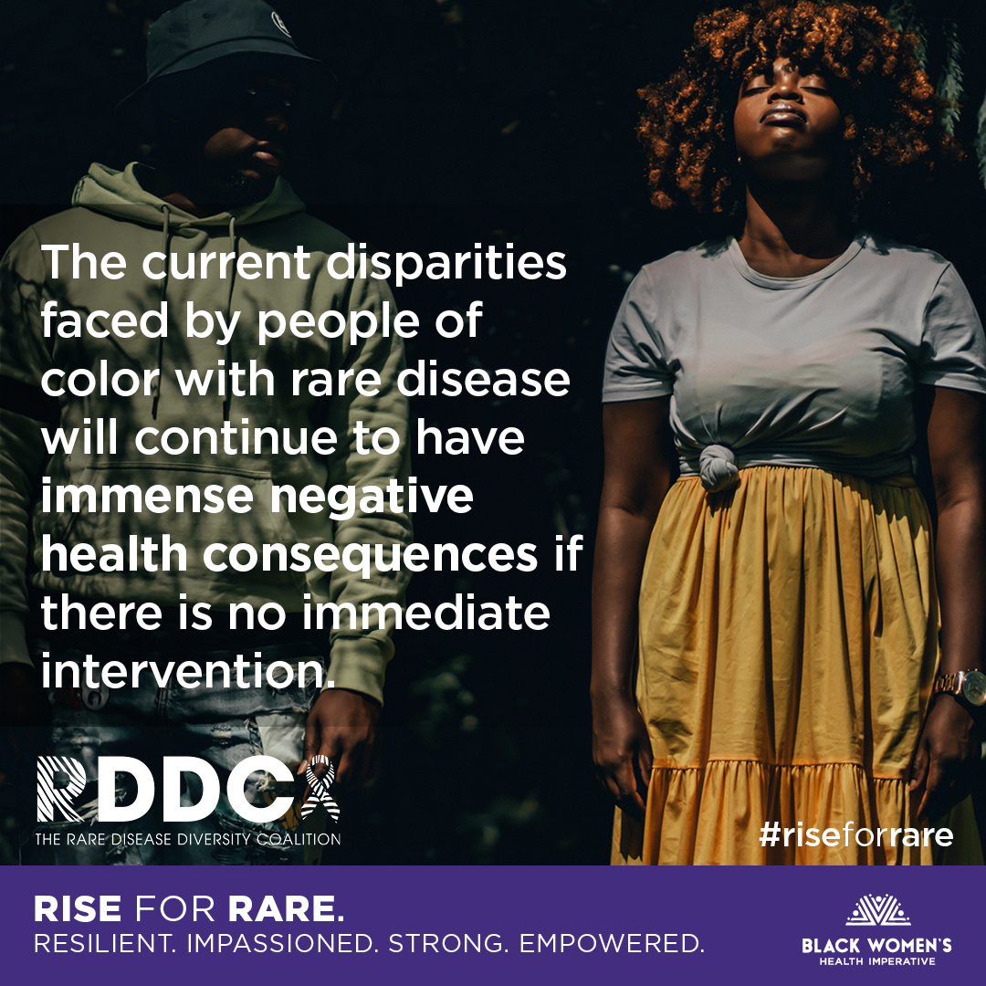
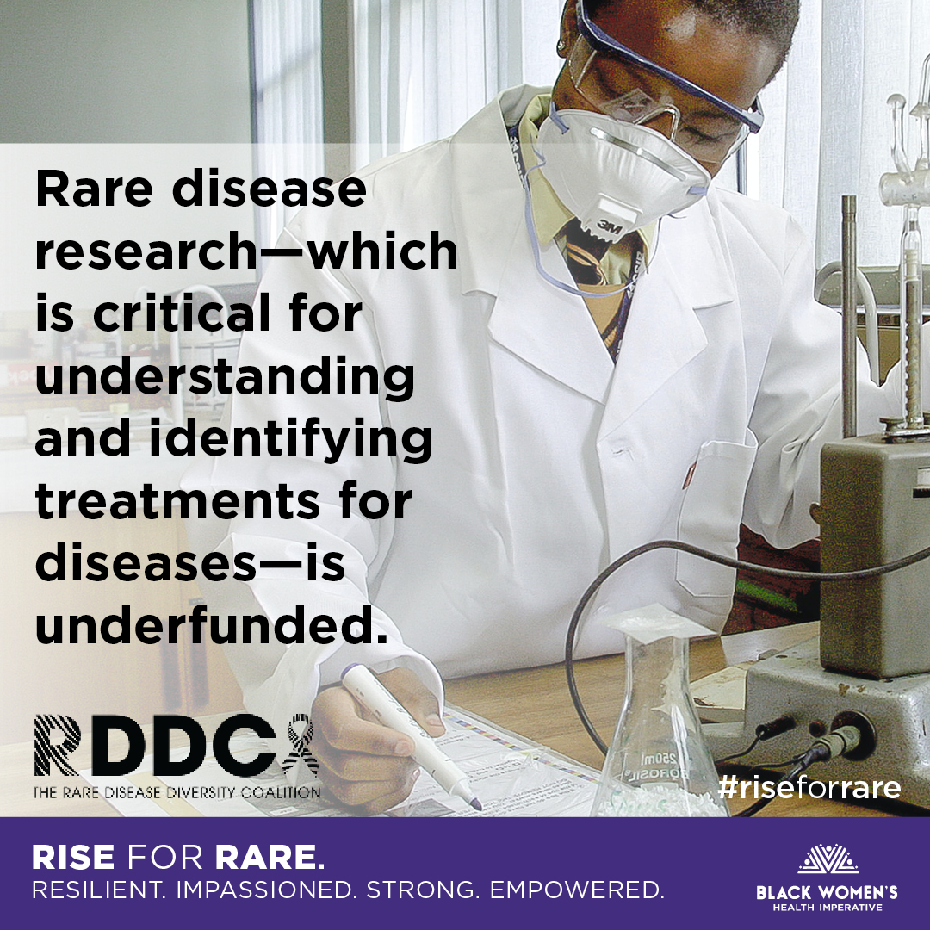
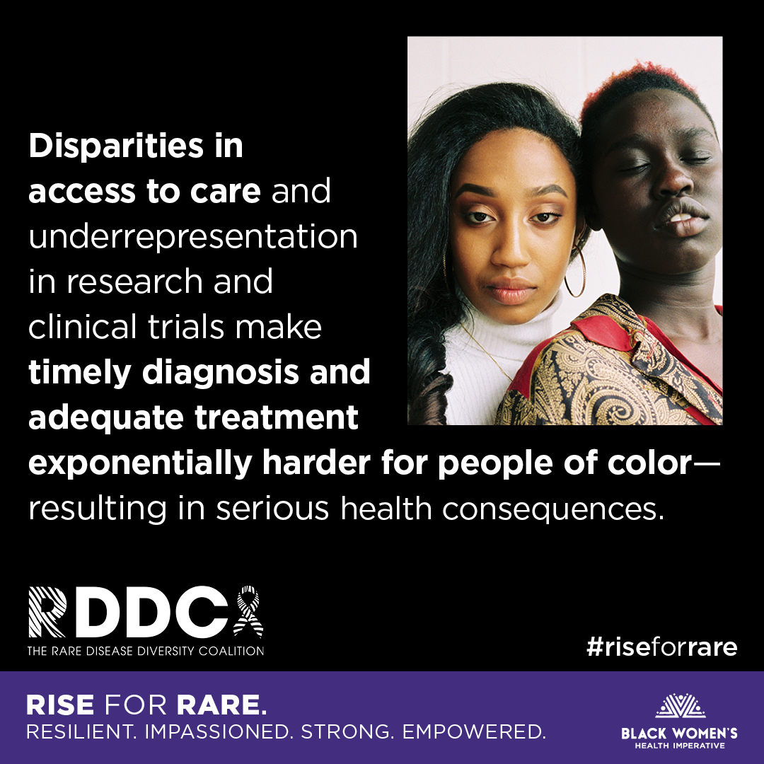
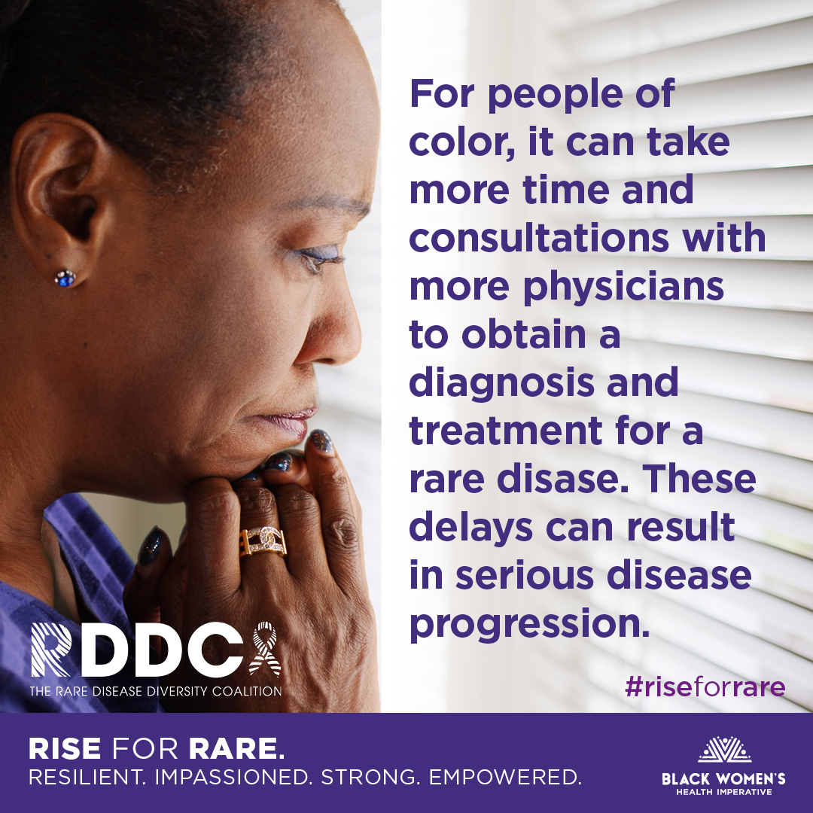
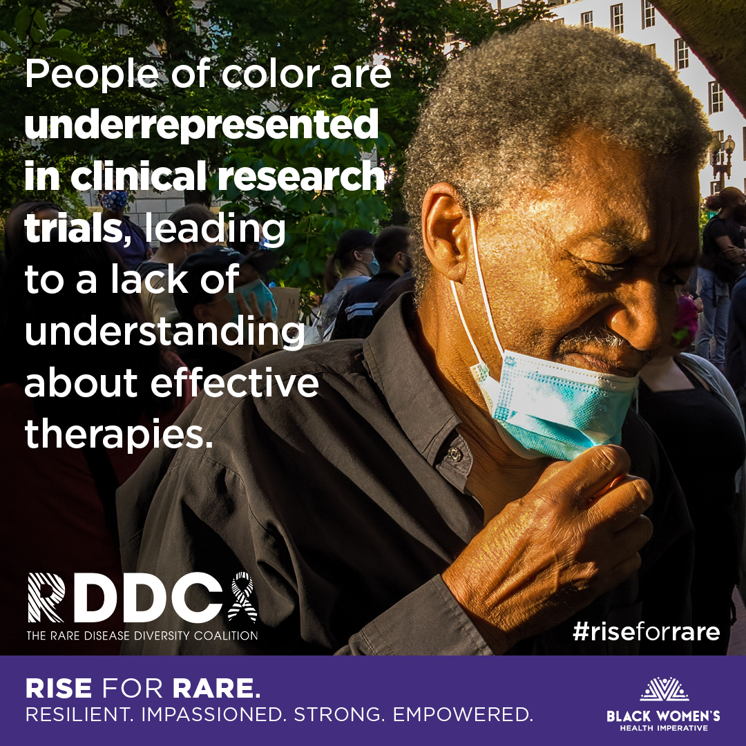
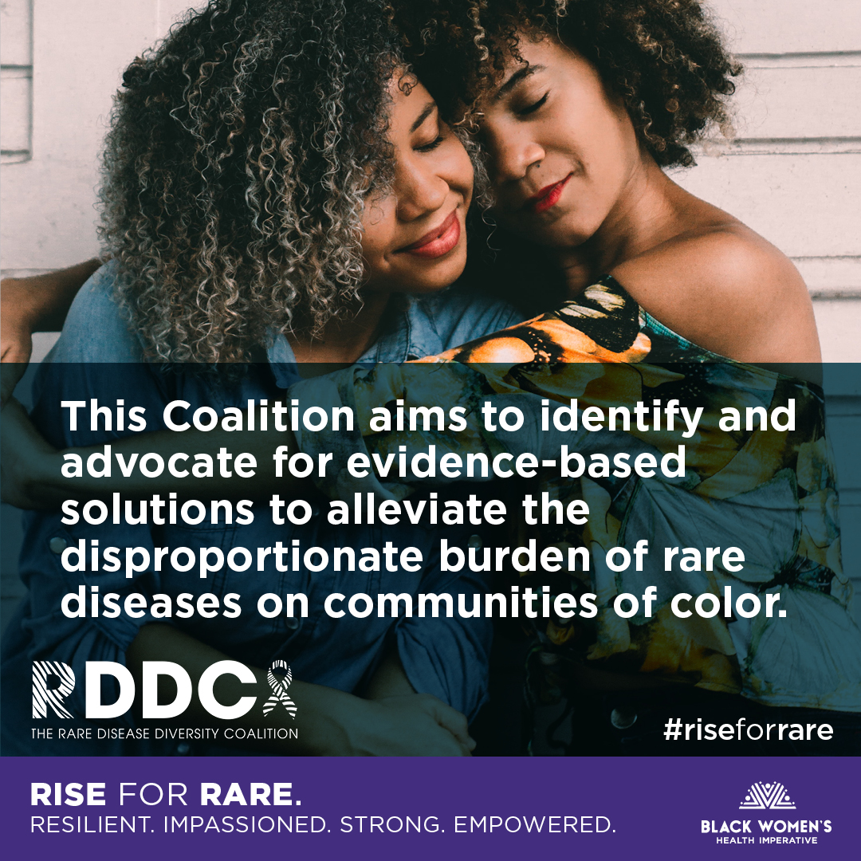
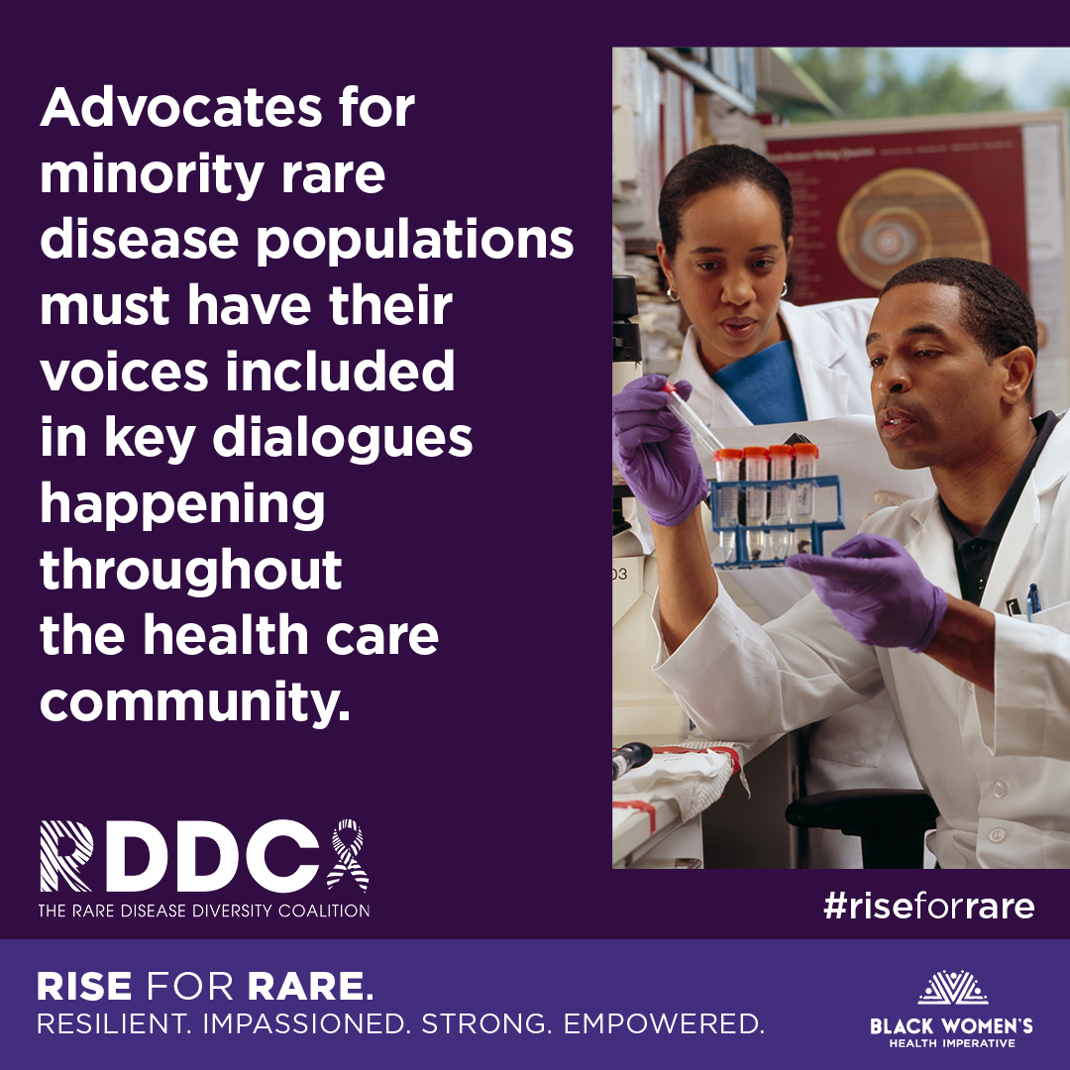
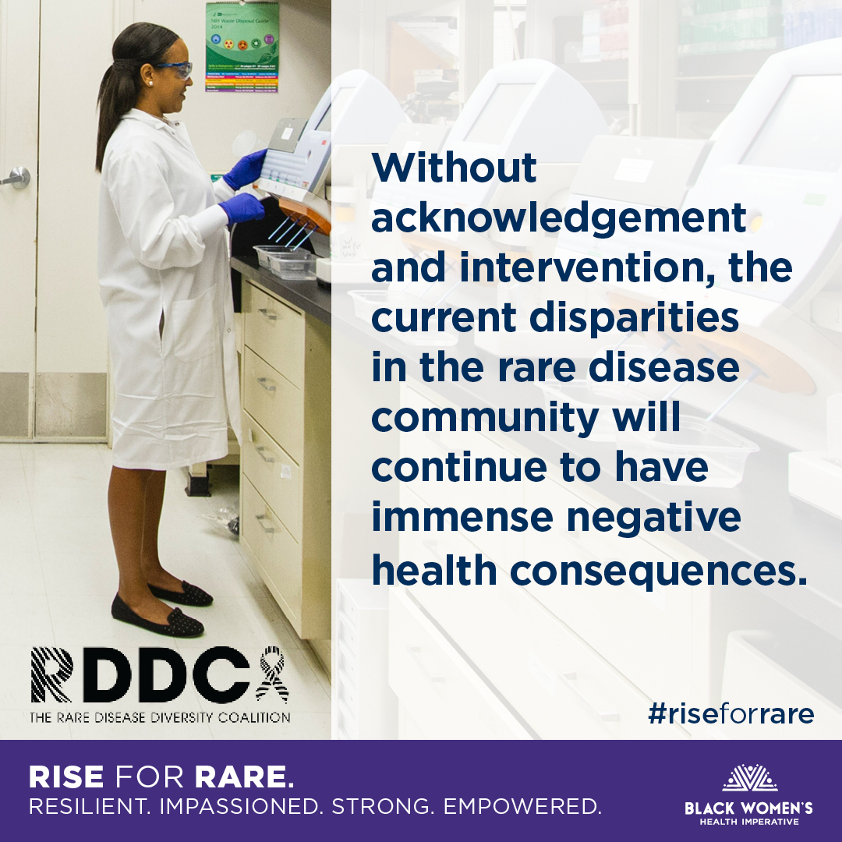
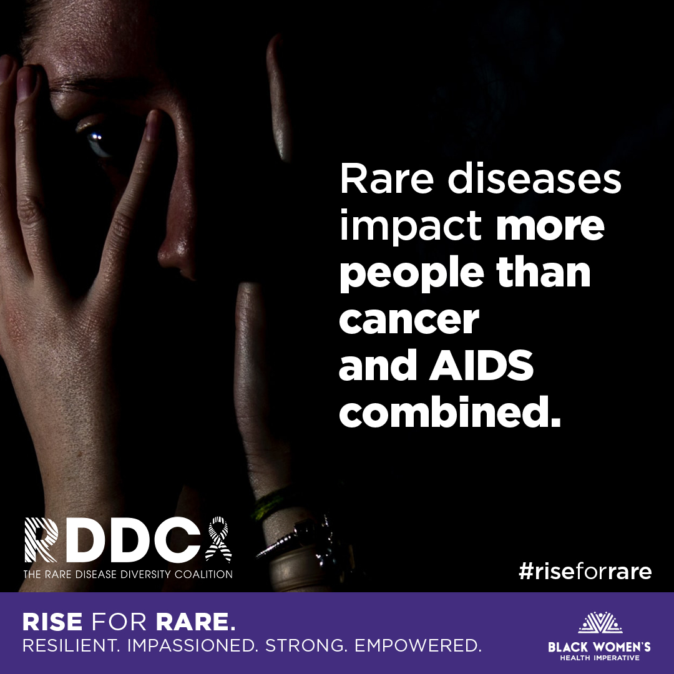
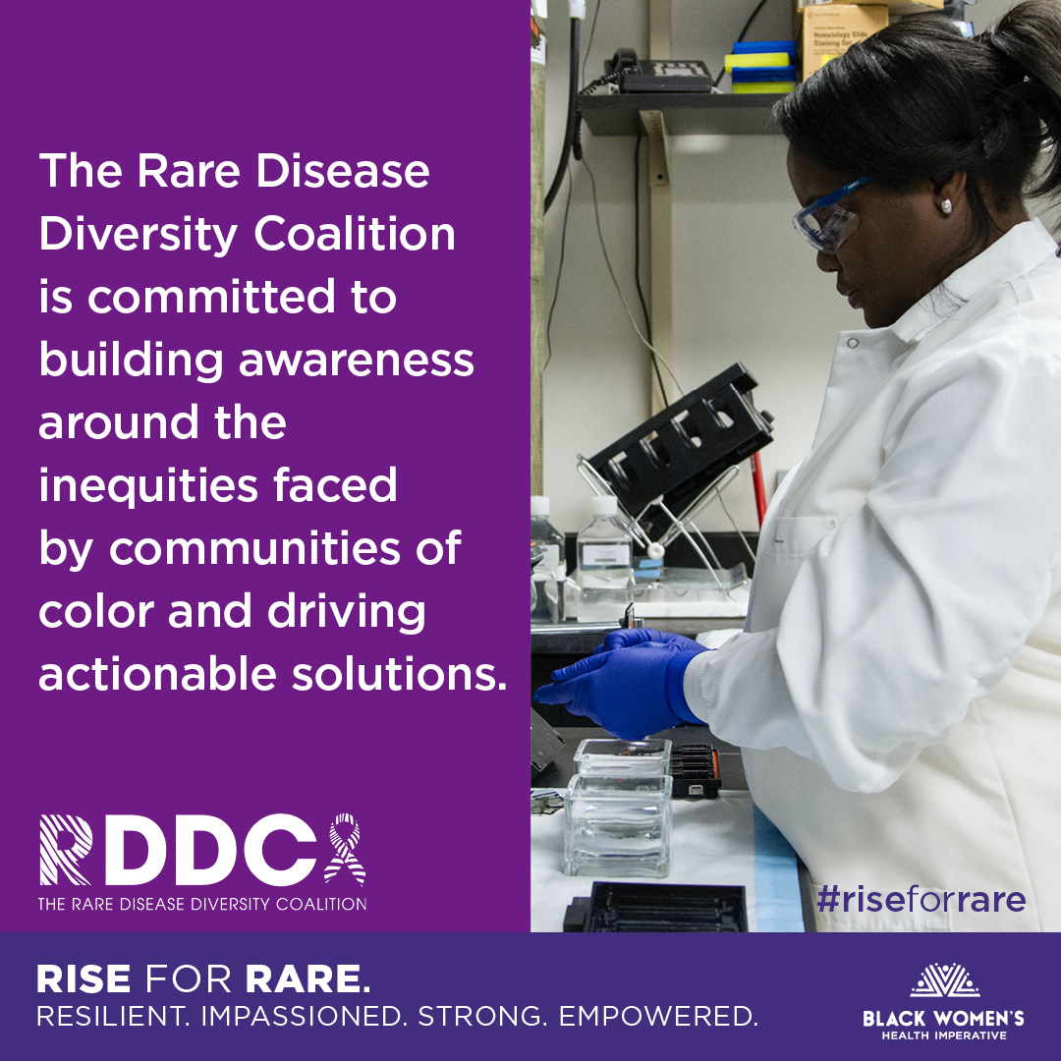
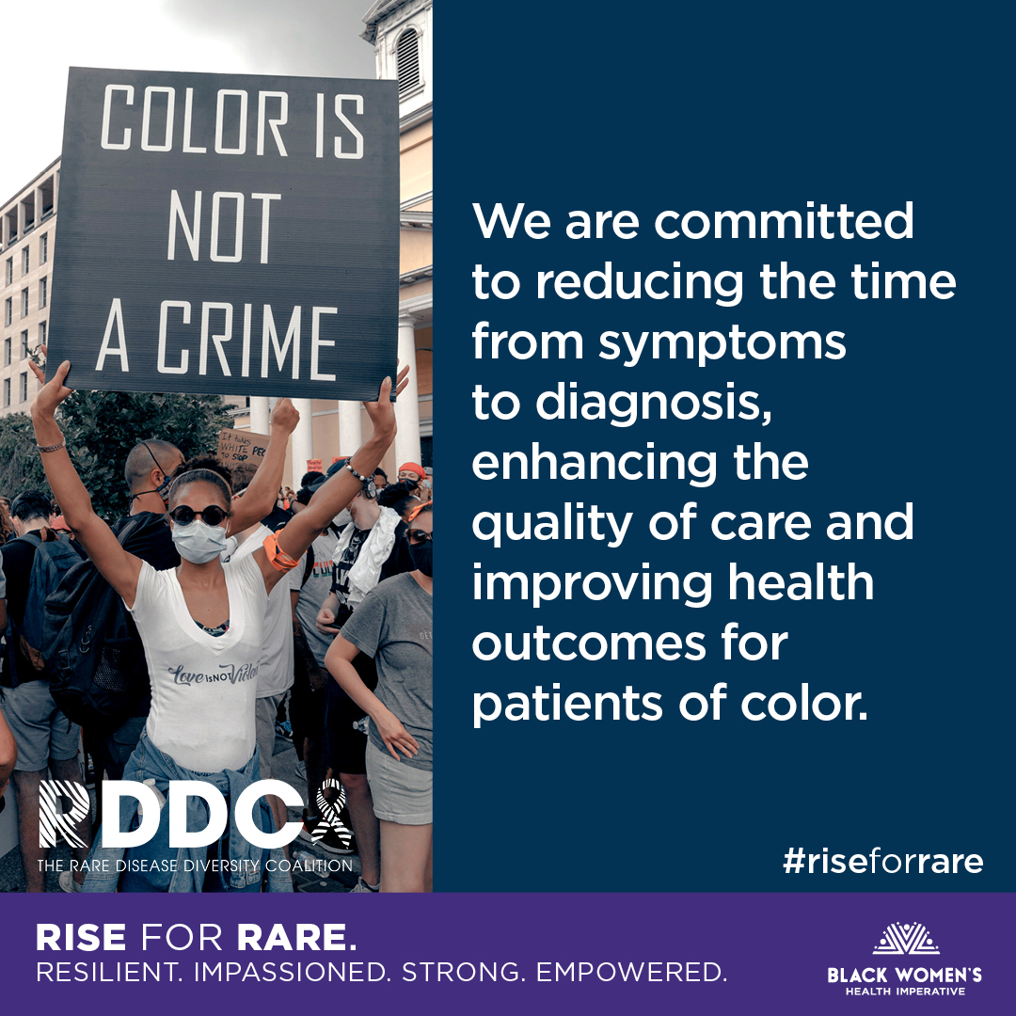


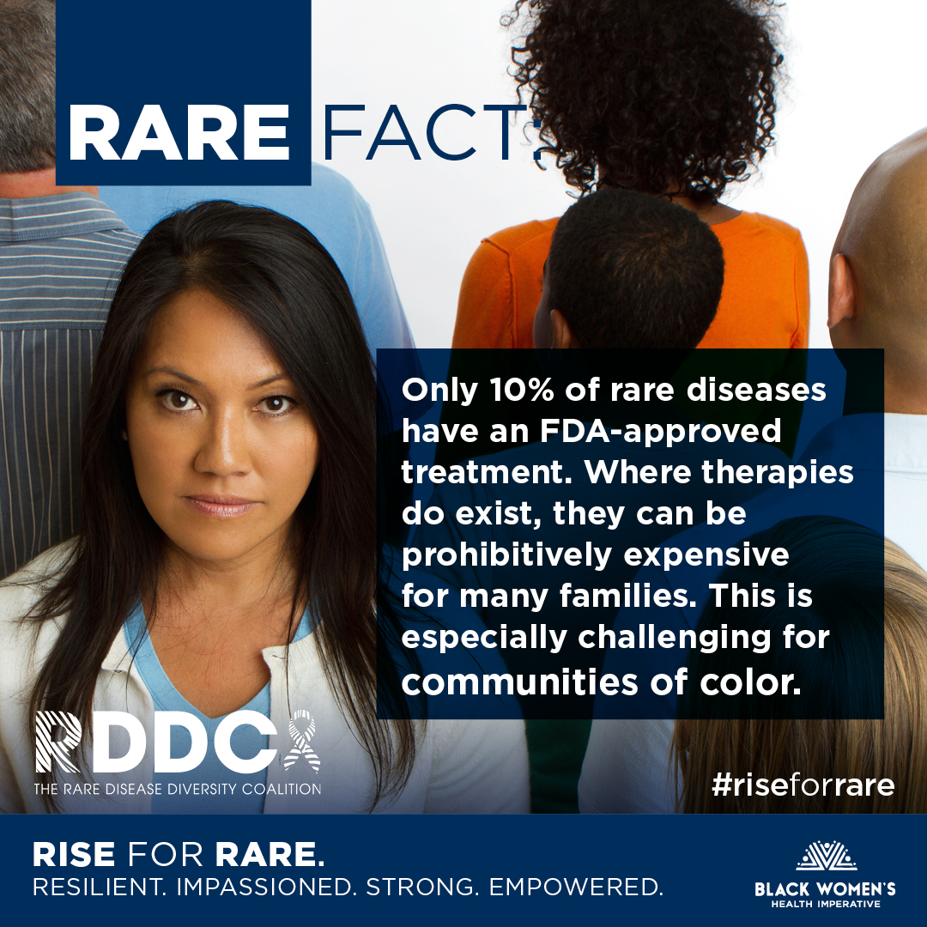
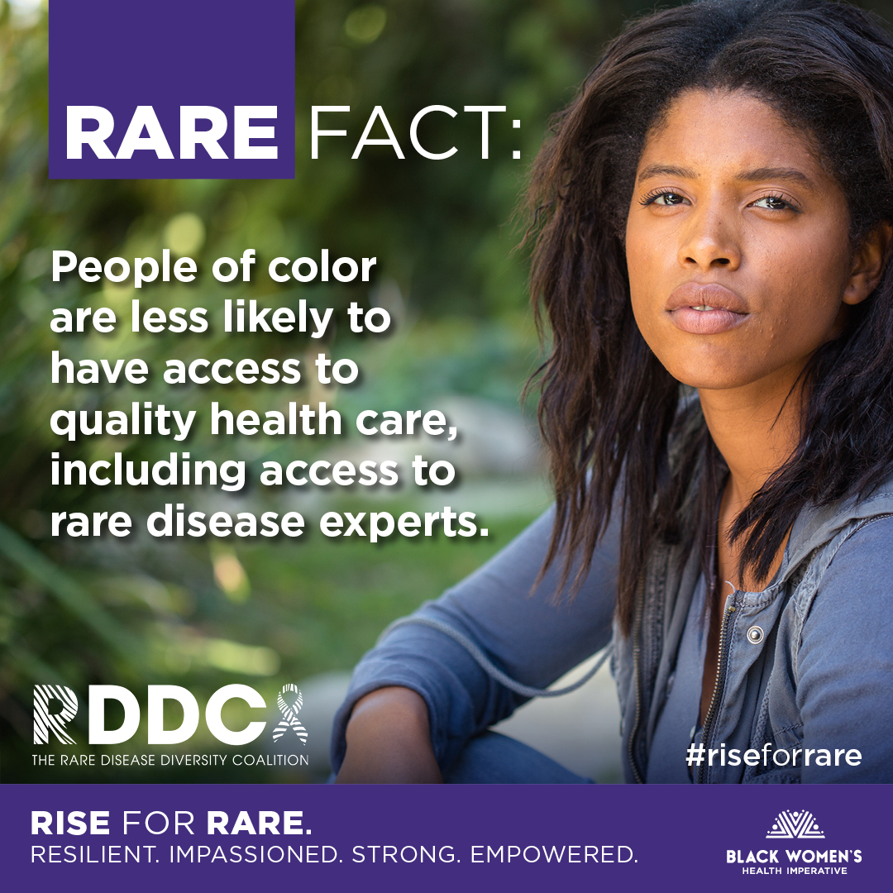
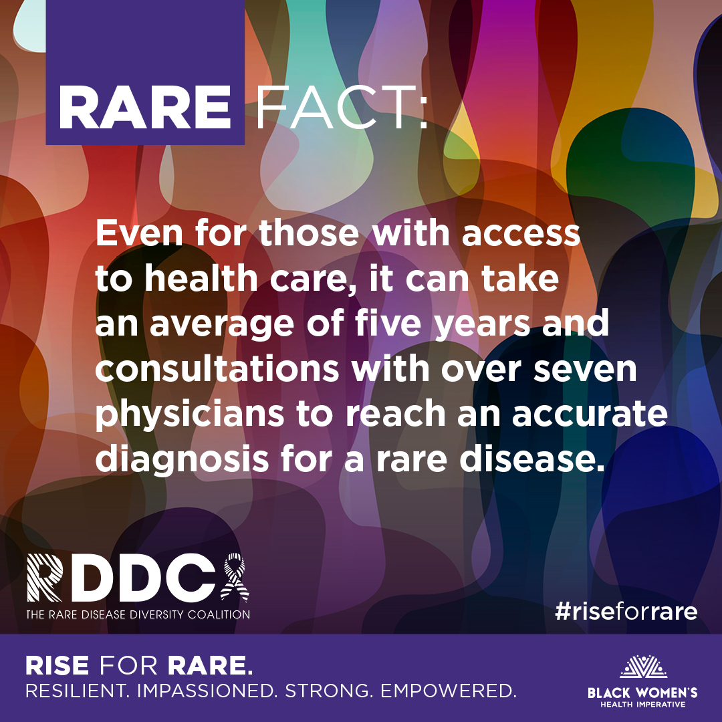
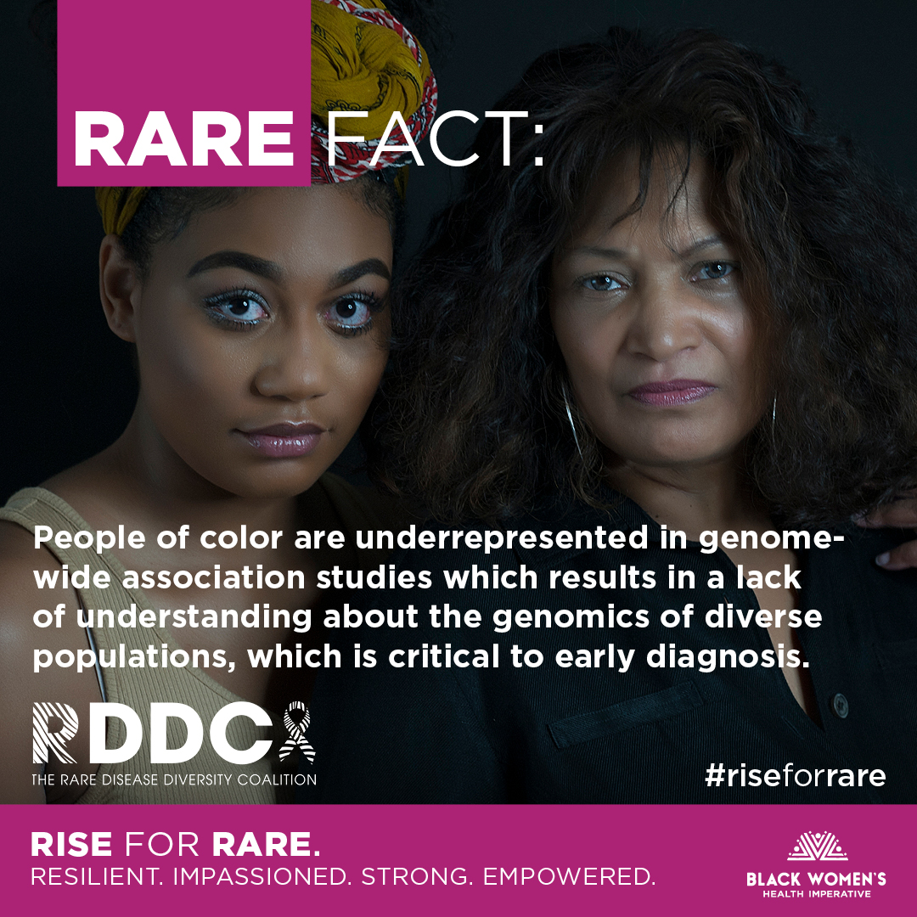
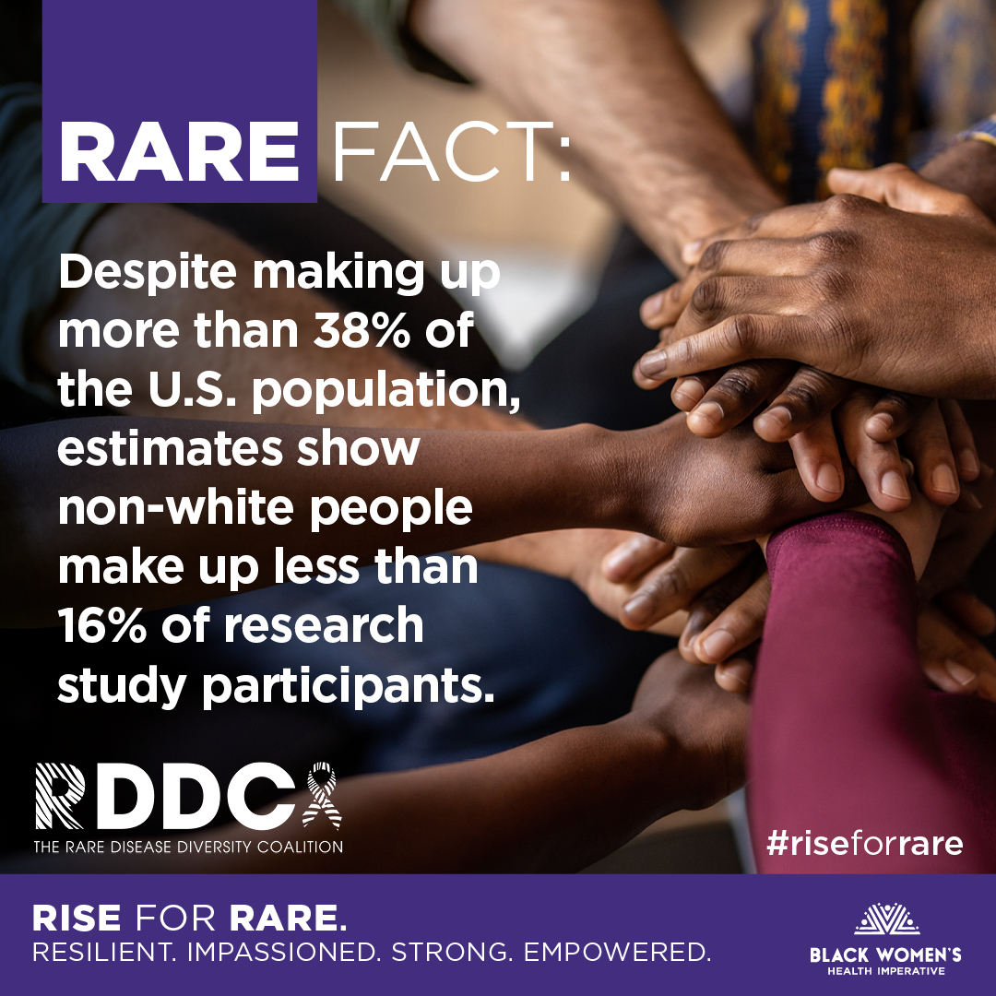
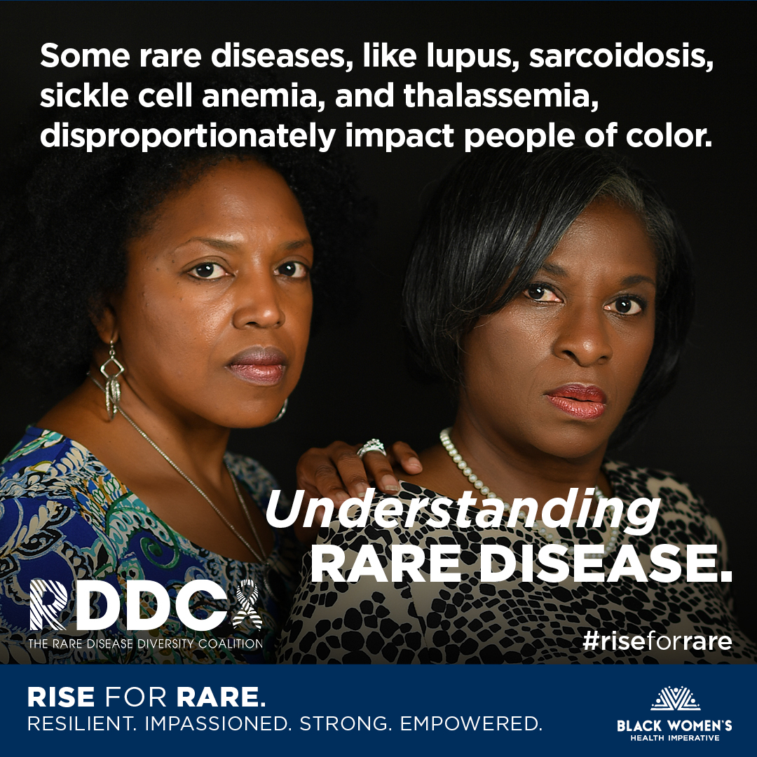
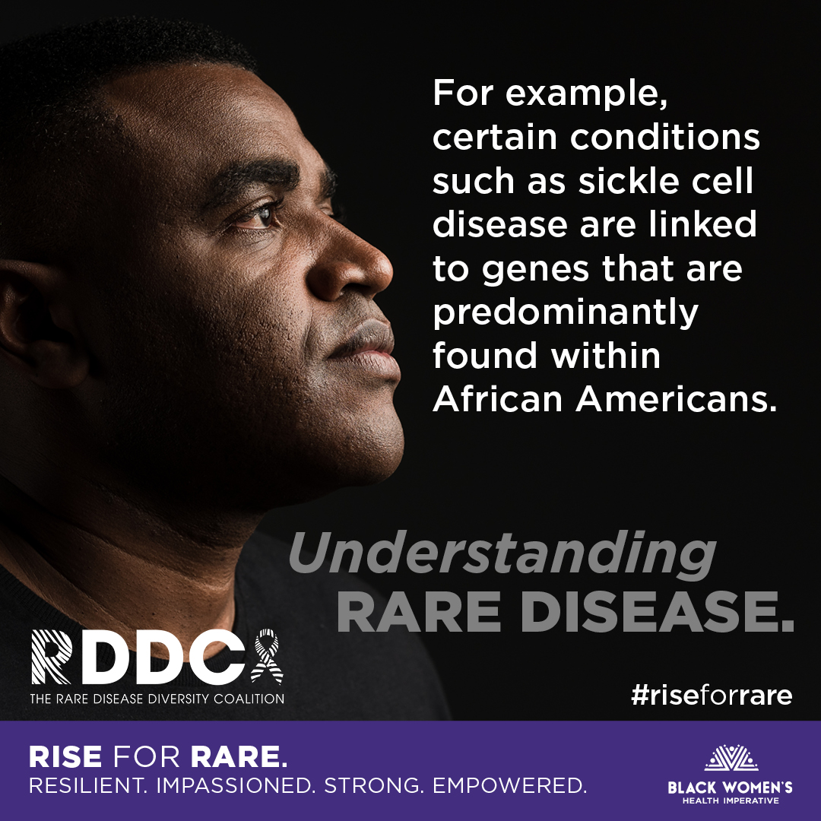
Social Media Content + Engagement

Slide 27

A Final Word…

Slide 28
Thank You!

