Slide 1
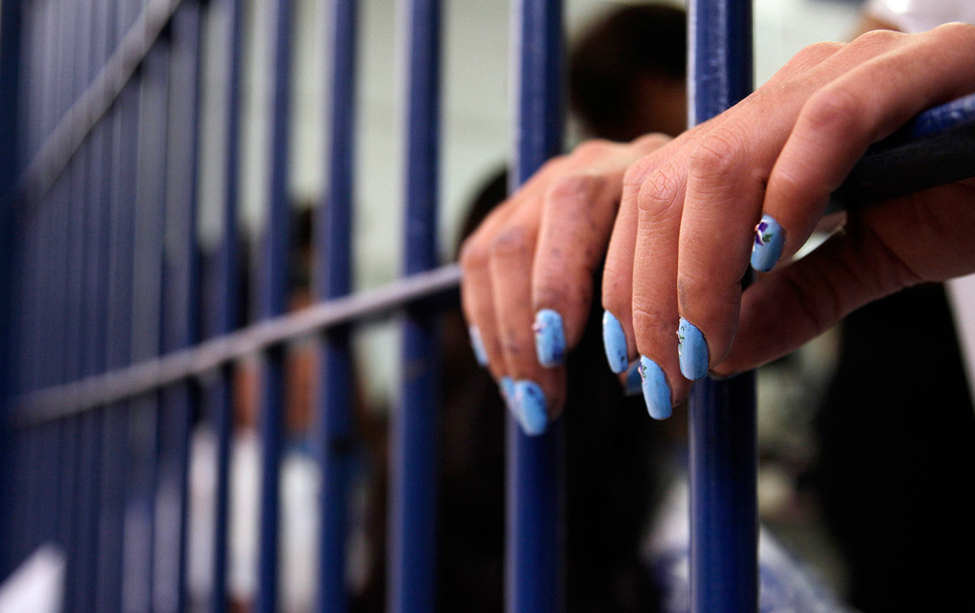
Understanding and Addressing the Unique Needs of Women and Girls in the Criminal Justice System
Lisa Broidy
University of New Mexico

Slide 2
Women and Girls in the System
Why should we care?
  Make up 15-20% of the system involved population, BUT, their proportion of the system involved population is on the rise
  System involvement has obvious economic costs, but it also has a host of hidden costs (collateral consequences) that are particularly notable for women and girls
  Costs to individual well being, children and families, and communities are amplified for women and girls in the system
  Most are incarcerated for non-violent offenses and the costs and consequences arguably outweigh the benefits of system involvement

Slide 3
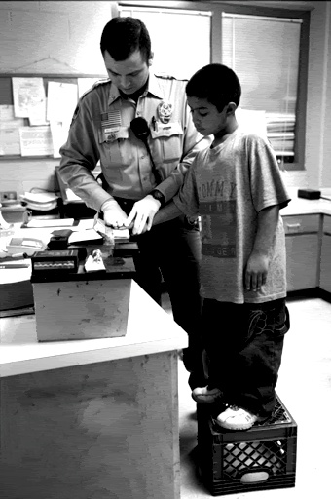
The Justice System
CJ and JJ systems built around behaviors and needs of men and boys
  te
Why does this matter?
Compared to women and girls, men and boys:
  Offend for different reasons
  Offend more often
  Engage in more violent offending
Why should we care?
A system designed to address the behaviors and needs of men and and boys is not likely well suited for addressing the behaviors and needs of women and girls.

Slide 4
Women and girls are the fastest growing CJ populations
To effectively address the needs of this population we need to understand the related:
Gender differences in causes of offending
Offending and incarceration trends
Broad risks and needs
Heterogeneity within this population
Promising strategies for intervention and prevention

Slide 5
1. Why females offend
Gender neutral explanations
  Criminological theory as a male specific
    But still maybe gender neutral?
    Yes and no
      Similar “causes” can play out in gendered ways
General Strain Theory example (Broidy and Agnew)
strain → negative emotions → coping / crime
  Generally true for males and females BUT manifests differently
  These difference help to explain gender gap in offending

Slide 6
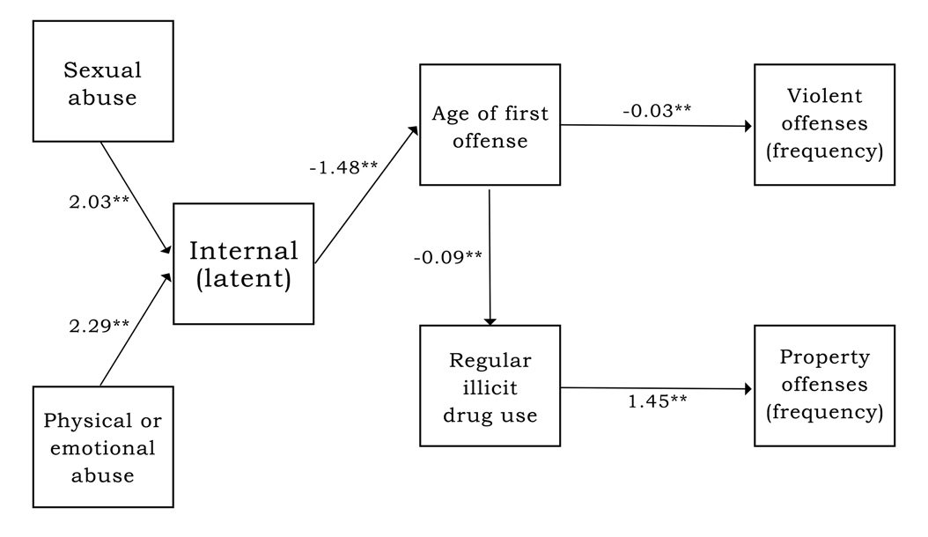
1. Why females offend
Female specific explanations
  Feminist Pathways Theory
  Women’s unique experiences as central to understanding their offending
  Central role of trauma, metal health, and substance use
  Helps explain WHY women offend
Broidy, Payne, and Piquero, 2018

Slide 7
2. Offending and incarceration trends (juveniles)
Source: OJJDP
Key take away—the gender gap is narrowing because arrests of boys is going down more quickly than arrests of girls

Slide 8
2. Offending and incarceration trends (juveniles)
Race/ethnicity differences among girls with system contact
Black girls are 2.7 times more likely than white girls to be referred to juvenile justice and are 1.2 times more likely to be detained.
Black girls are three times more likely to be removed from their homes and placed in state custody than are white girls.
Prosecutors are 20% more likely to formally petition in cases involving Black girls than in cases involving white girls.

Slide 9
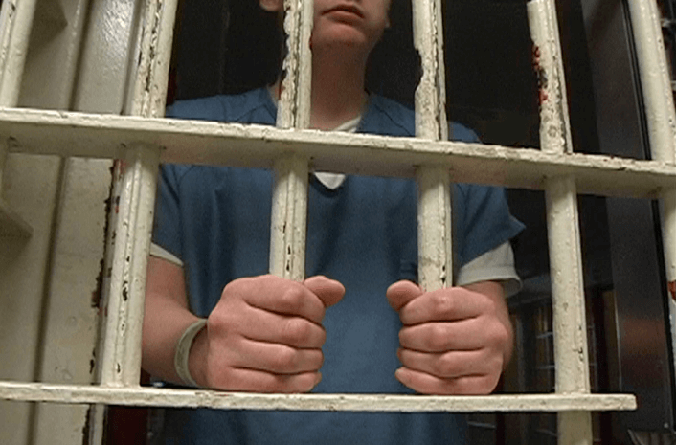
2. Offending and incarceration trends (juveniles)
  Why are girls’ arrests falling slower than boys?
  “Net-widening” policies:
    Broadening definitions of violence
      Police intervention in schools (SROs) and family management
    Less tolerance toward early female misbehavior
      Philosophy of preventative punishment

Slide 10
2. Offending and incarceration trends (adults)

Slide 11
Trend: Arrets going down for males and females, but faster for males.
Exceptions: Increases in female arrest for: Vagrancy, drug abuse violations, weapons violations, MV theft, murder/non-negligent manslaughter

Slide 12
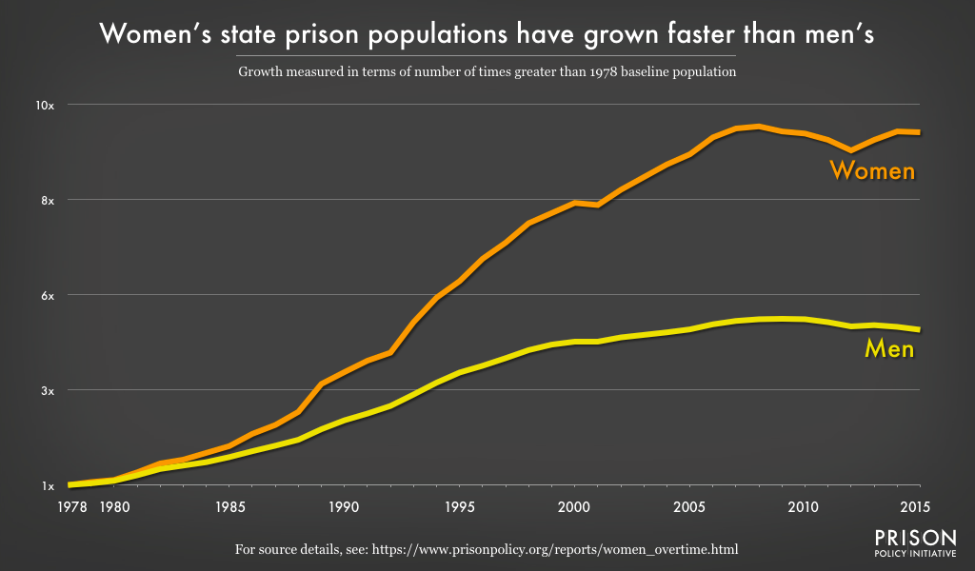
This is despite overall declines in arrest for women…and largely driven by drug arrests for women

Slide 13
2. Offending and incarceration trends (adults)
This reflects changes in practice/policy not changes in women’s offending behavior—largely the war on drugs

Slide 14
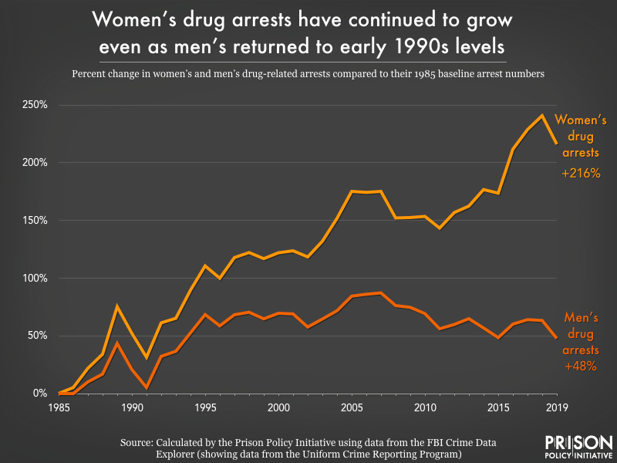
The war on drugs has been a war on women…

Slide 15
2. Offending and incarceration trends (adults)
Compared to white women, minority women are significantly more likely to get caught up in CJ system for drug offenses:
  Black women twice as likely to be incarcerated for drug offenses
  Latina’s 20% more likely
  Native American women 6 times more likely
Evidence suggests that this is a function of racialized criminalization processes NOT drug use trends across women from different racial/ethnic groups
Similarly, Black women are no more likely than white women to use illicit drugs during pregnancy, but they are far more likely to be reported to child welfare services for drug use.
  Imposition of chemical endangerment and child abuse laws

Slide 16
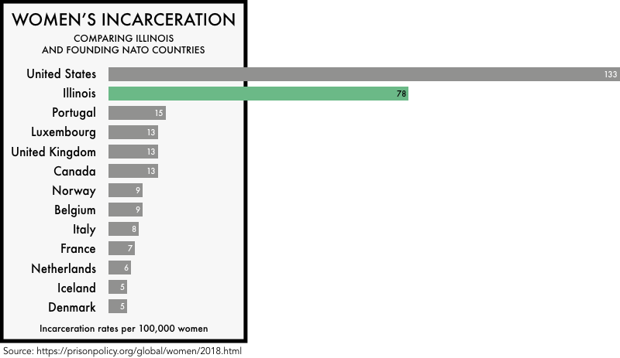
Offending and incarceration trends:
US status as an outlier in incarceration trends extends to women

Slide 17
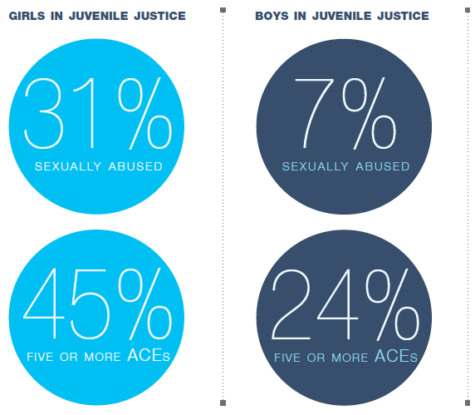
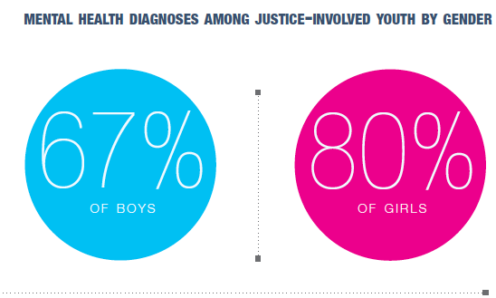
3. Broad risks and needs of females in the system
General overlap for males and females BUT important differences in both exposure and salience
Girls come from more dysfunctional family contexts and have more MH needs
Source: Saar et al. The Sexual Abuse to Prison Pipeline: The Girls’ Story. www.law.georgetown.edu/go/poverty

Slide 18
3. Broad risks and needs of females in the system
Baglivio et al. https://www.prisonpolicy.org/scans/Prevalence_of_ACE.pdf
Girls in the JJ system have moderately more exposure to every individual ACE and are significantly more likely to experience cumulative exposure to multiple ACEs (girls 45% at 5+; boys 24%)

Slide 19
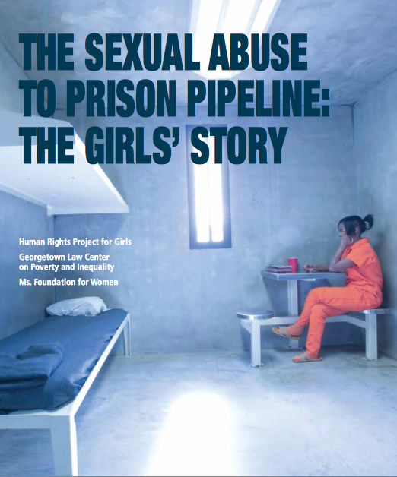
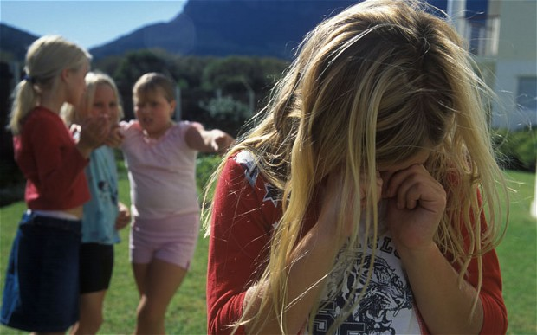
3. Broad risks and needs of females in the system
The problem behavior of girls and young women, more so than boys and young men, is linked to:
  Disrupted Interpersonal Networks
    Family problems, peers influences and relationships
  Trauma and Abuse
    Child abuse, exposure to DV, experiences of partner violence
  Mental Health Needs
    PTSD, Depression, anxiety
  Turbulent developmental transitions
    Problems navigating the transitions to adolescence and adulthood

Slide 20
3. Broad risks and needs of females in the system
Motherhood
  Majority of incarcerated women are mothers
  Significant risks and needs linked to motherhood status of incarcerated females
Ongoing research:
Interviews with mothers in jail
Being a “good mother” as central to their identities, but life circumstances challenge their abilities to be the mothers they want to be for their children
Needs:
  Substance abuse treatment—relationship between substance use and custody arrangements
  Material support—housing, employment, transportation
  Social support—from parents, partners,…
Jail does not address these needs

Slide 21
4. Heterogeneity within this population
Chronic/Persistent
Adolescent or YA Onset
Low-rate
Female offenders are not a homogenous group

Slide 22
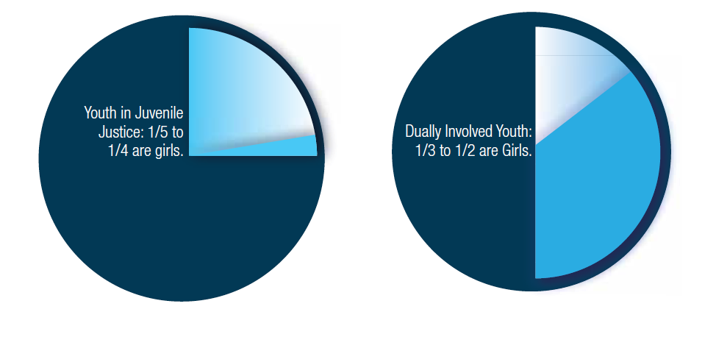
4. Heterogeneity within this population
Chronic/Persistent Female Offenders
  Early onset, multiple risk factors
Importance of Early Intervention
Tertiary interventions should include trauma-informed treatment for mental health and substance problems, building emotional resilience and coping skills, relationship building

Slide 23
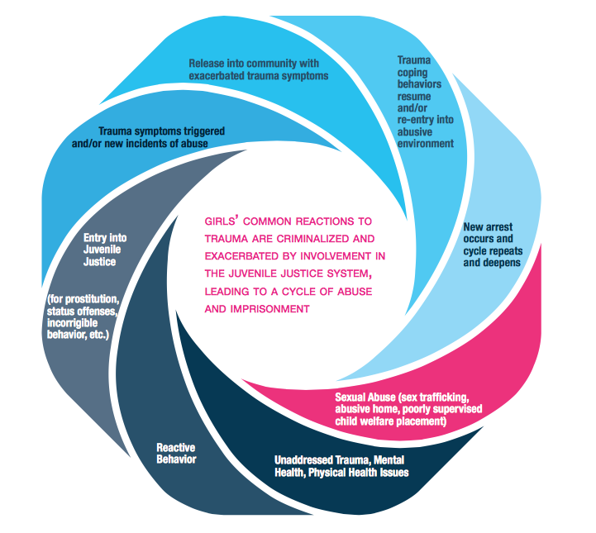
2015 Report by:
Human Rights Project For Girls
Georgetown Law Center on Poverty and Inequality
Ms. Foundation for Women

Slide 24
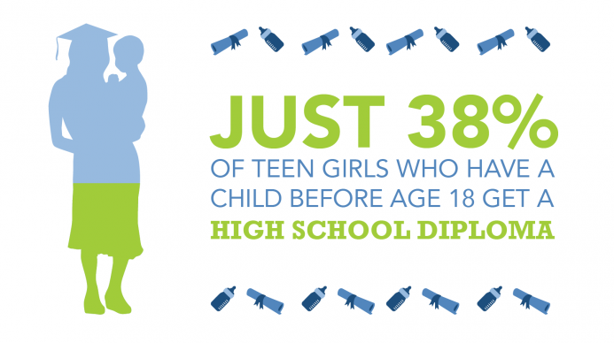
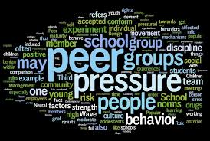
4. Heterogeneity within this population
Adolescent Onset
  Early puberty and precocious sexuality, family and peer conflict, maturity gap and identity crisis
  Risks of getting ensnared—teen pregnancy, abusive relationships, educational disengagement, alcohol and drugs
These girls and their families need help managing the transition to adolescence:
  Peer pressure and conflict
  Developing autonomy and independence
  Shifting parent/child relationships

Slide 25

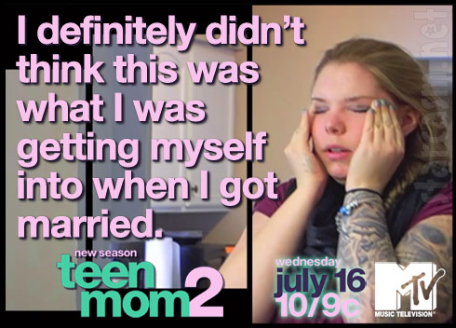
4. Heterogeneity within this population
Young Adult Onset
  Difficulties managing the transition out of adolescence—expectations and demands of adulthood—ill-equipped to handle independence
  Need help building job and relationship skills
  Need to strengthen emotional management skills and coping resources

Slide 26
5. Promising strategies for intervention and prevention
Intervention and prevention for girls and women is limited
  Not a priority for a system with limited resources and a substantially larger population of males with service/intervention needs
  Research / Evidence base for “what works” with females is growing, but programs remain mostly localized, small-scale, and largely understudied

Slide 27
5. Promising strategies for intervention and prevention
Unfortunately, there are few programs in Illinois geared toward at-risk girls in the juvenile justice system, particularly outside of Chicago. There are a few programs that address the unique needs of delinquent girls. In particular, the Girls Link Juvenile Female Offender Project, which is a collaboration among more than 20 public and private agencies, seeks to change policies and improve gender-responsive services to girls through advocacy, education, policy development, and programming. The group has sought specialized services for pregnant and/or parenting girls in the juvenile justice system. Girls Link has been recognized by OJJDP as a national model program.
Beyond the few programs for system-involved girls in Illinois, there are also a number local programs designed for all girls. These programs aim to promote girls' empowerment and positive development and lifestyles through a wide variety of projects and approaches. As mentioned, these are located primarily in Chicago.
https://www.dhs.state.il.us/page.aspx?item=51914

Slide 28
5. Promising strategies for intervention and prevention
A thorough review of current practices that funnel girls into the Juvenile Justice System
  Examples:
    Assess zero tolerance policies at schools—especially in relation to truancy and fighting
    Evaluate policing/arrest/detention strategies for girls who are generally high-needs but low-risk
    Is system contact/incarceration the best option???

Slide 29
5. Promising strategies for intervention and prevention
Gender-sensitive/gender-responsive interventions
  Address the role of victimization in the lives of girls and women in the system (or at risk of system involvement):
    Early intervention for girls exposed to abuse and other forms of victimization
    Trauma informed treatment for mental health and substance abuse problems
    Relationship building skills including empathy
    Promote self-worth and positive identities

Slide 30
5. Promising strategies for intervention and prevention
Gender-sensitive/gender-responsive interventions
  Promote/build healthy family relationships
  Provide consistent and continuous care outside the system—for both emotional and practical needs
  Use a range of strategies—cognitive, behavioral, affective and systemic
  Provide female role models and mentors of varying cultural backgrounds
  See PACE program in Florida and Georgia for a promising model
      https://www.pacecenter.org/blog/tag/community-support

Slide 31
Questions?
Lisa Broidy
lbroidy@unm.edu
University of New Mexico
Department of Sociology and Criminology

