Slide 1
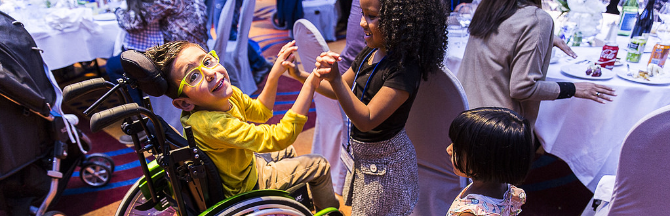


Online Workshop in Covering
Rare Diseases
National Press foundation
September 2020

Slide 2
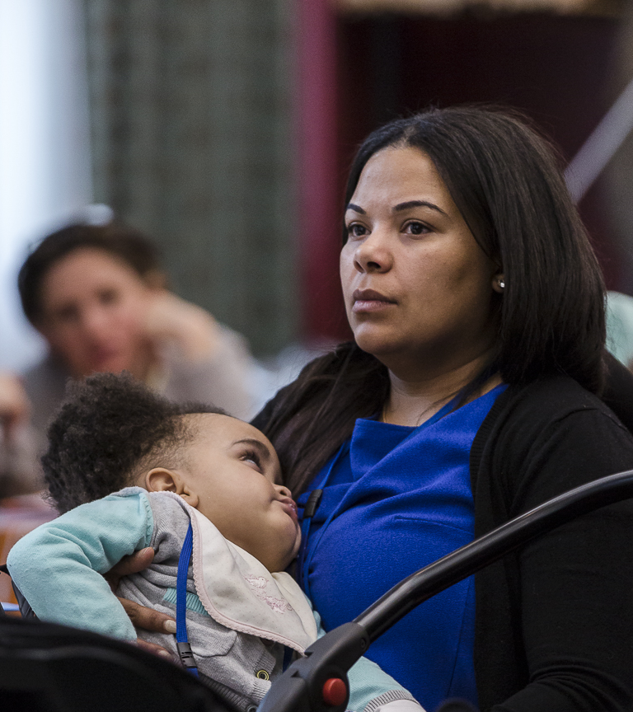
INTRODUCING THE
CATS FOUNDATION
Founded in 2011
Set-up after finding there was no charity providing support to families affected by Tay-Sachs and Sandhoff in the UK
Terminal disease
Three variants of Tay-Sachs and Sandhoff, and unfortunately they are life limiting diseases
Supports families affected by Tay-Sachs and Sandhoff
We focus on helping families with equipment, respite trips, funeral funding and providing a support network

Slide 3
ABOUT TAY-SACHS & SANDHOFF
The CATS Foundation supports children and adults who are affected
by Tay-Sachs and Sandhoff disease
TERMINAL DISEASES IN CHILDREN
AFFECTS 1 IN 320,000
Tay-Sachs and Sandhoff disease are terminal in children where they have a very short life expectancy
The carrier rate for the diseases is 1 in 300 and there are approximately 1 in 320,000 affected children born a year
REQUIRE 24 HOUR CARE
THREE DISEASE CLASSIFICATIONS
Children lose the ability to function independently, have regular seizures and require 24 hour care
Both diseases have an Infantile, Juvenile and Adult Onset form
GENETIC CONDITION
AVERAGE LIFE EXPECTANCY OF 5 YEARS OF AGE
They are both genetic conditions which are passed onto a child through autosomal inheritance
In the infantile form,the life expectancy is only 5 years of age whilst adults can live much longer but with support

Slide 4
ABOUT TAY-SACHS & SANDHOFF
The CATS Foundation supports children and adults who are affected
by Tay-Sachs and Sandhoff disease
TERMINAL DISEASES IN CHILDREN
AFFECTS 1 IN 320,000
Tay-Sachs and Sandhoff disease are terminal in children where they have a very short life expectancy
The carrier rate for the diseases is 1 in 300 and there are approximately 1 in 320,000 affected children born a year
This is a common rare story
REQUIRE 24 HOUR CARE
THREE DISEASE CLASSIFICATIONS
Children lose the ability to function independently, have regular seizures and require 24 hour care
Both diseases have an Infantile, Juvenile and Adult Onset form
GENETIC CONDITION
AVERAGE LIFE EXPECTANCY OF 5 YEARS OF AGE
They are both genetic conditions which are passed onto a child through autosomal inheritance
In the infantile form,the life expectancy is only 5 years of age whilst adults can live much longer but with support

Slide 5
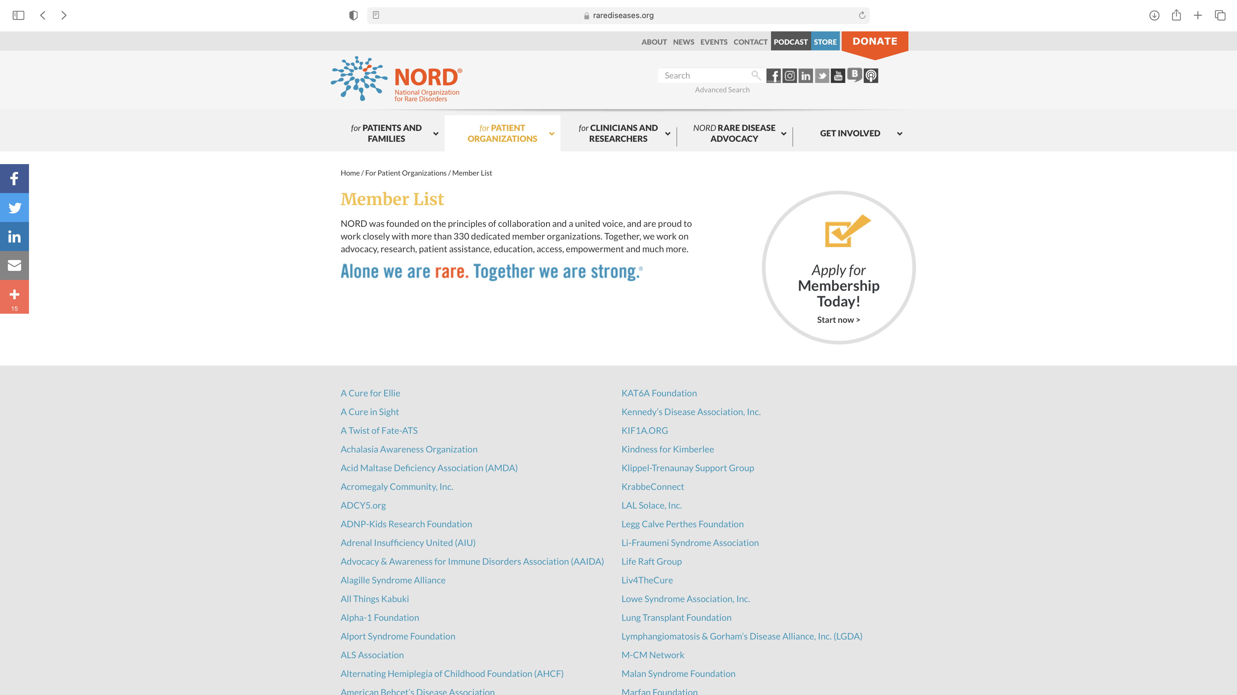
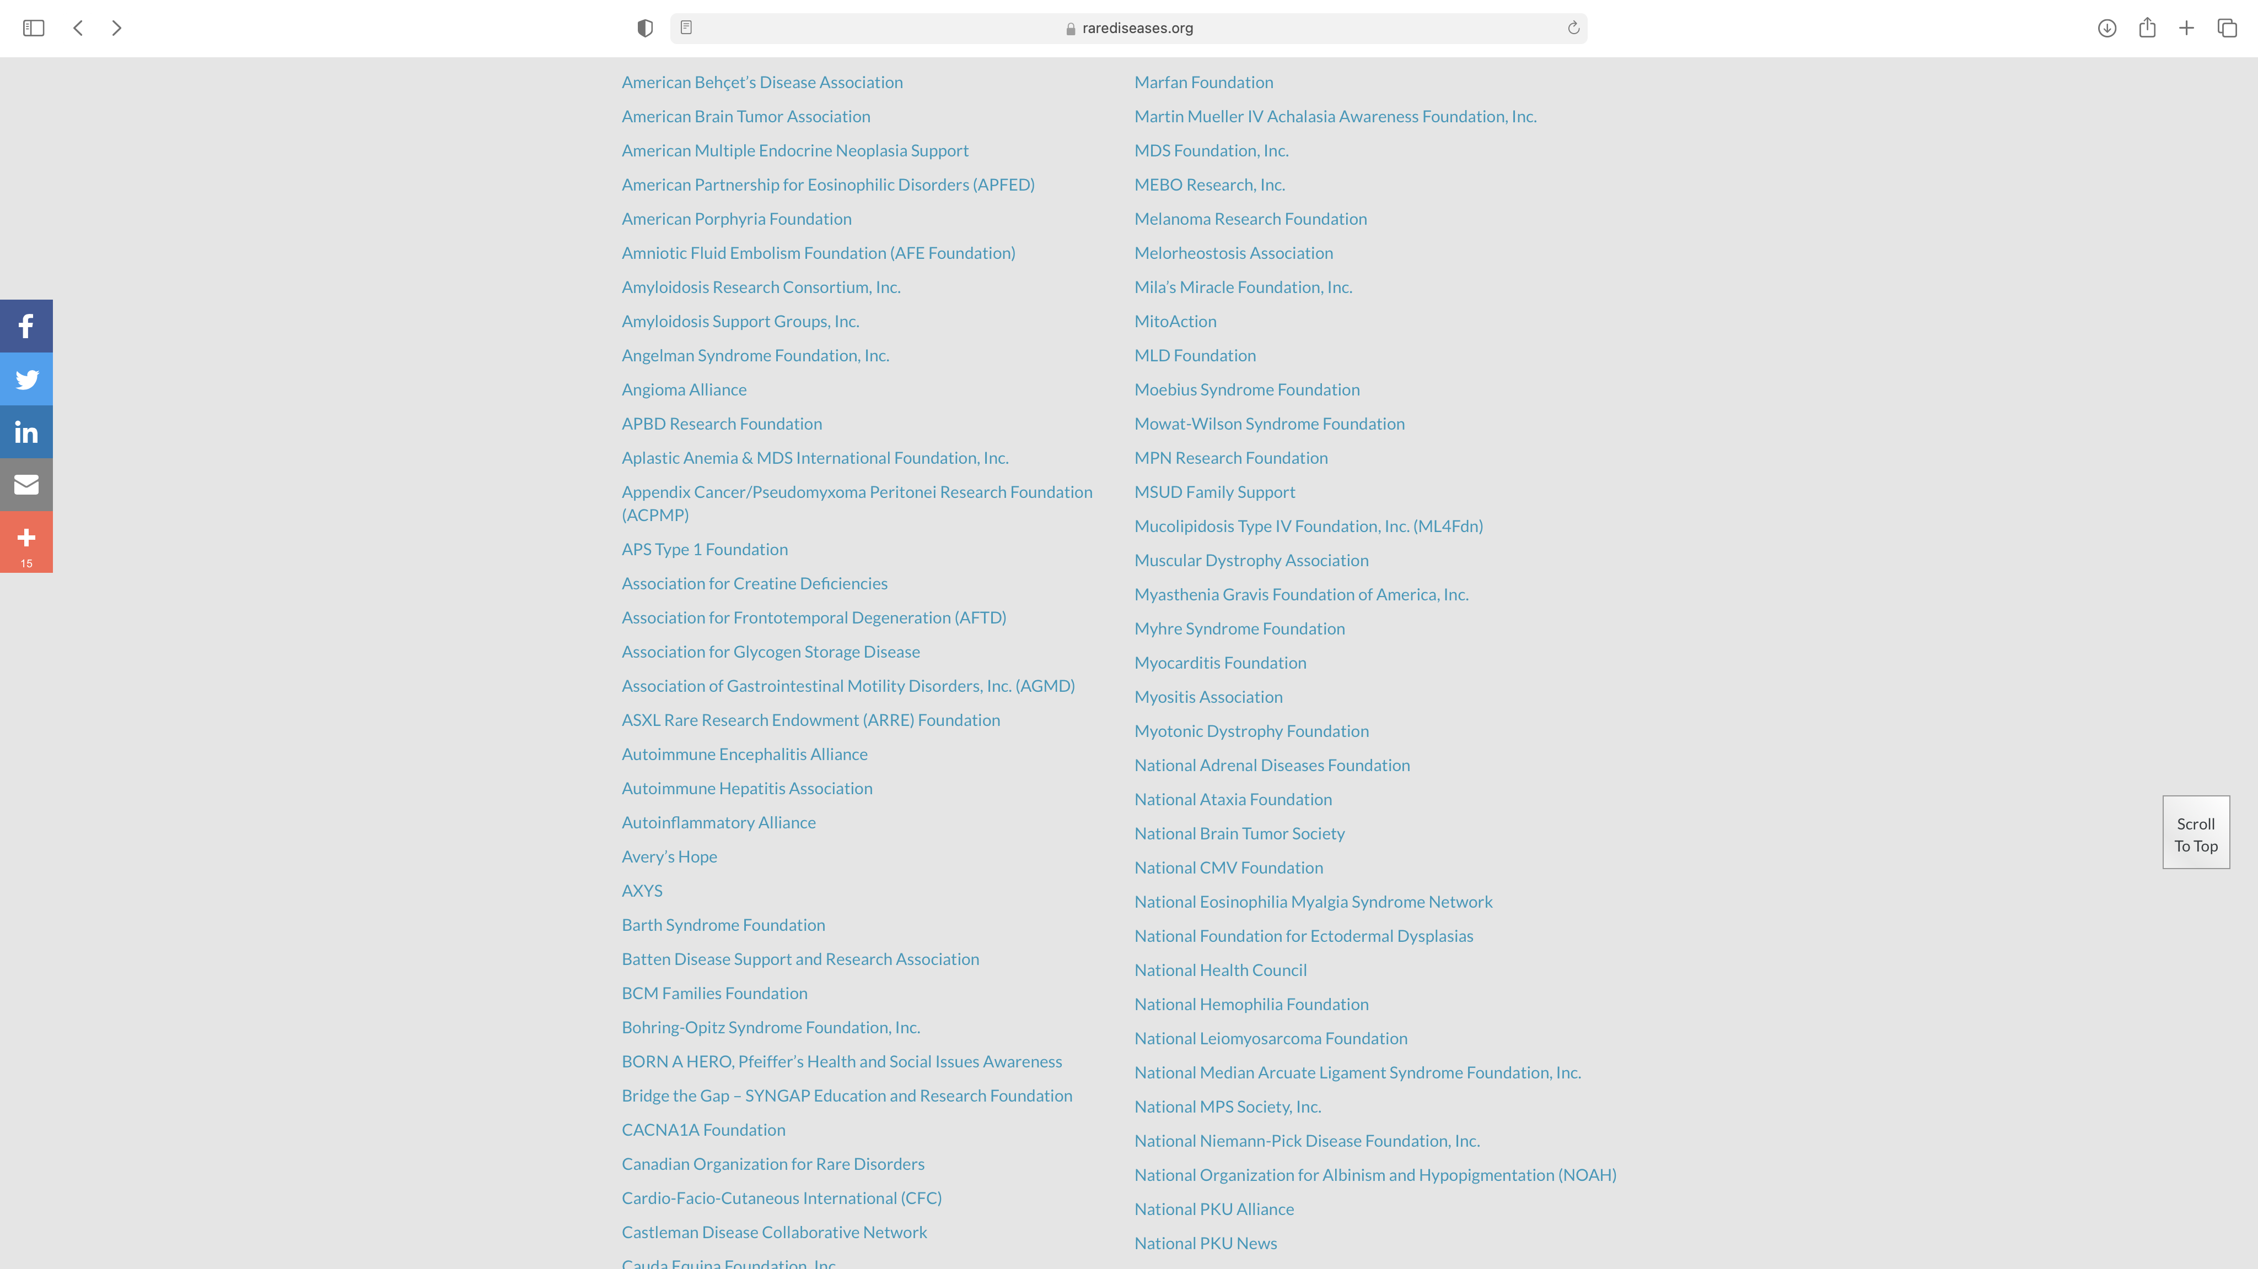
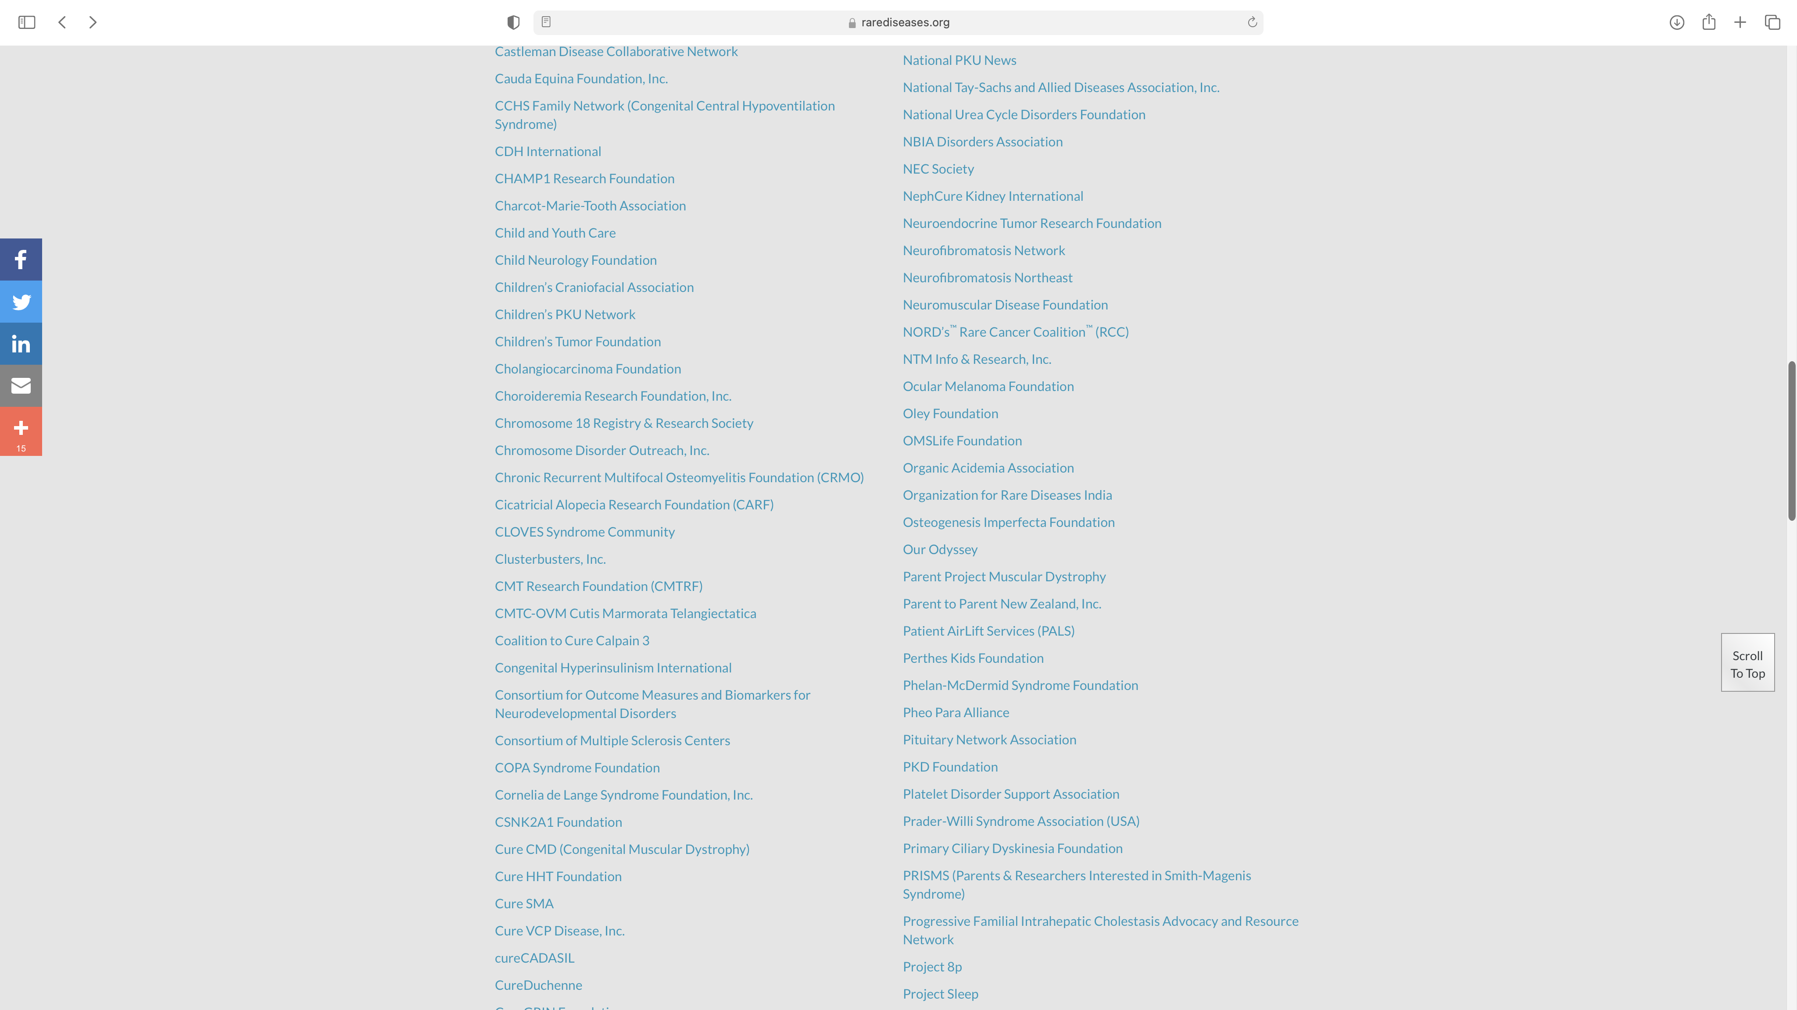
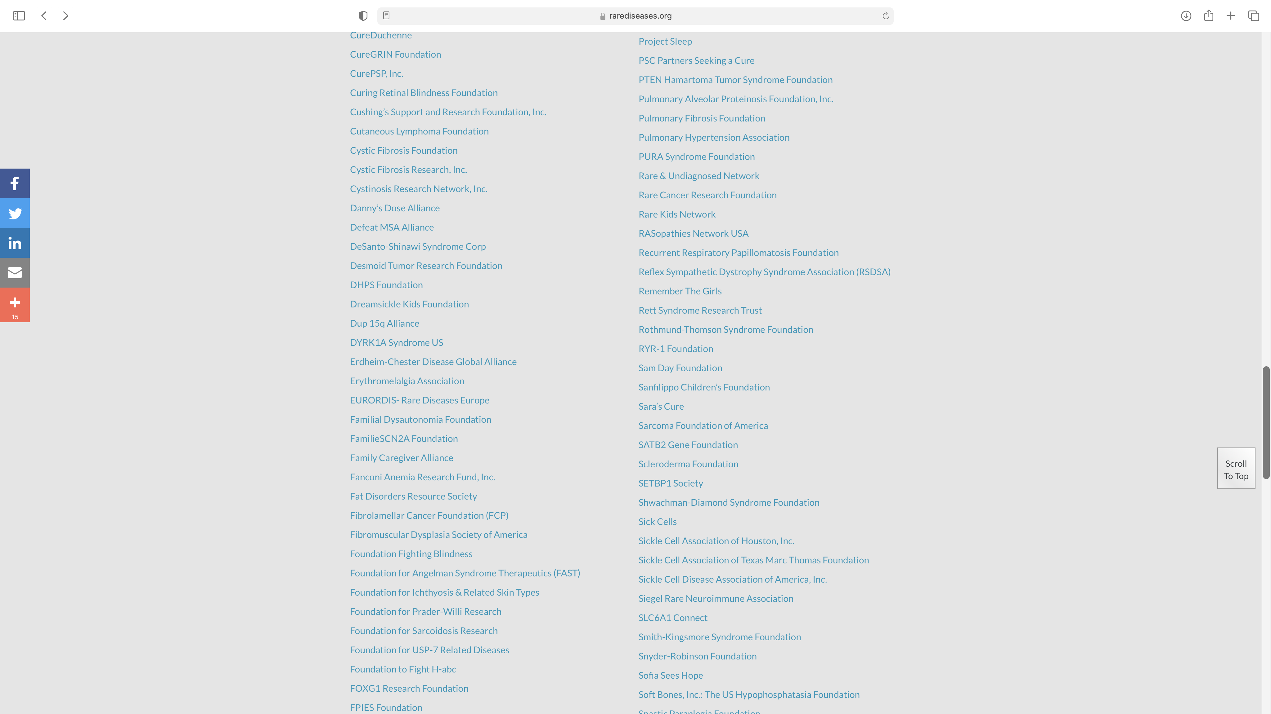
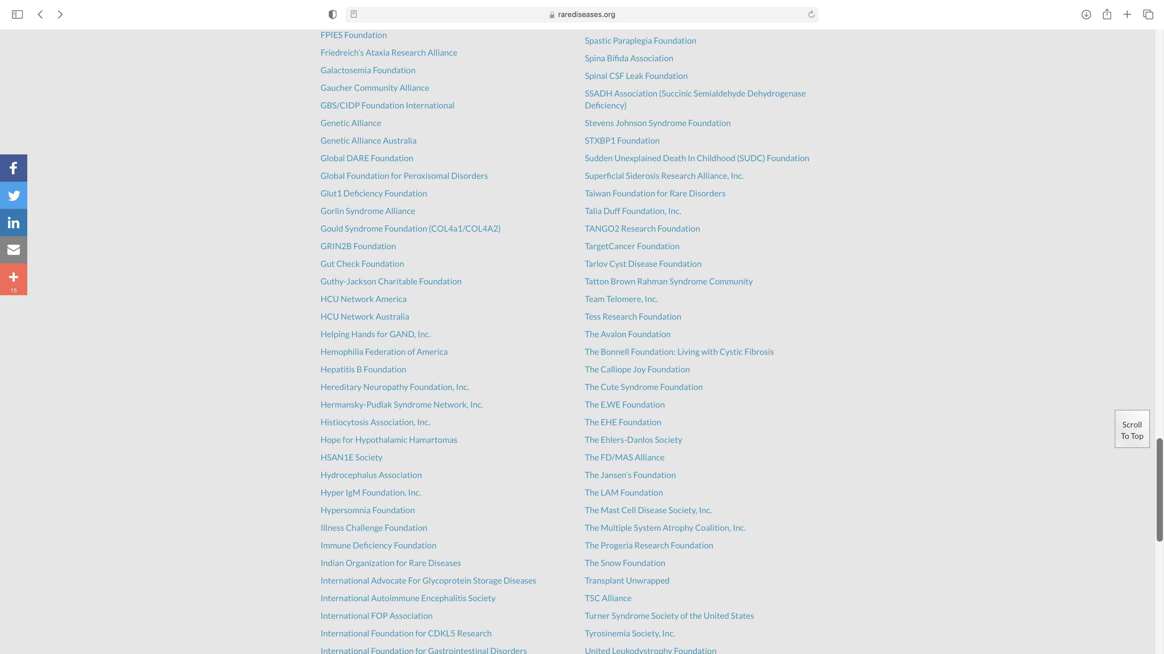
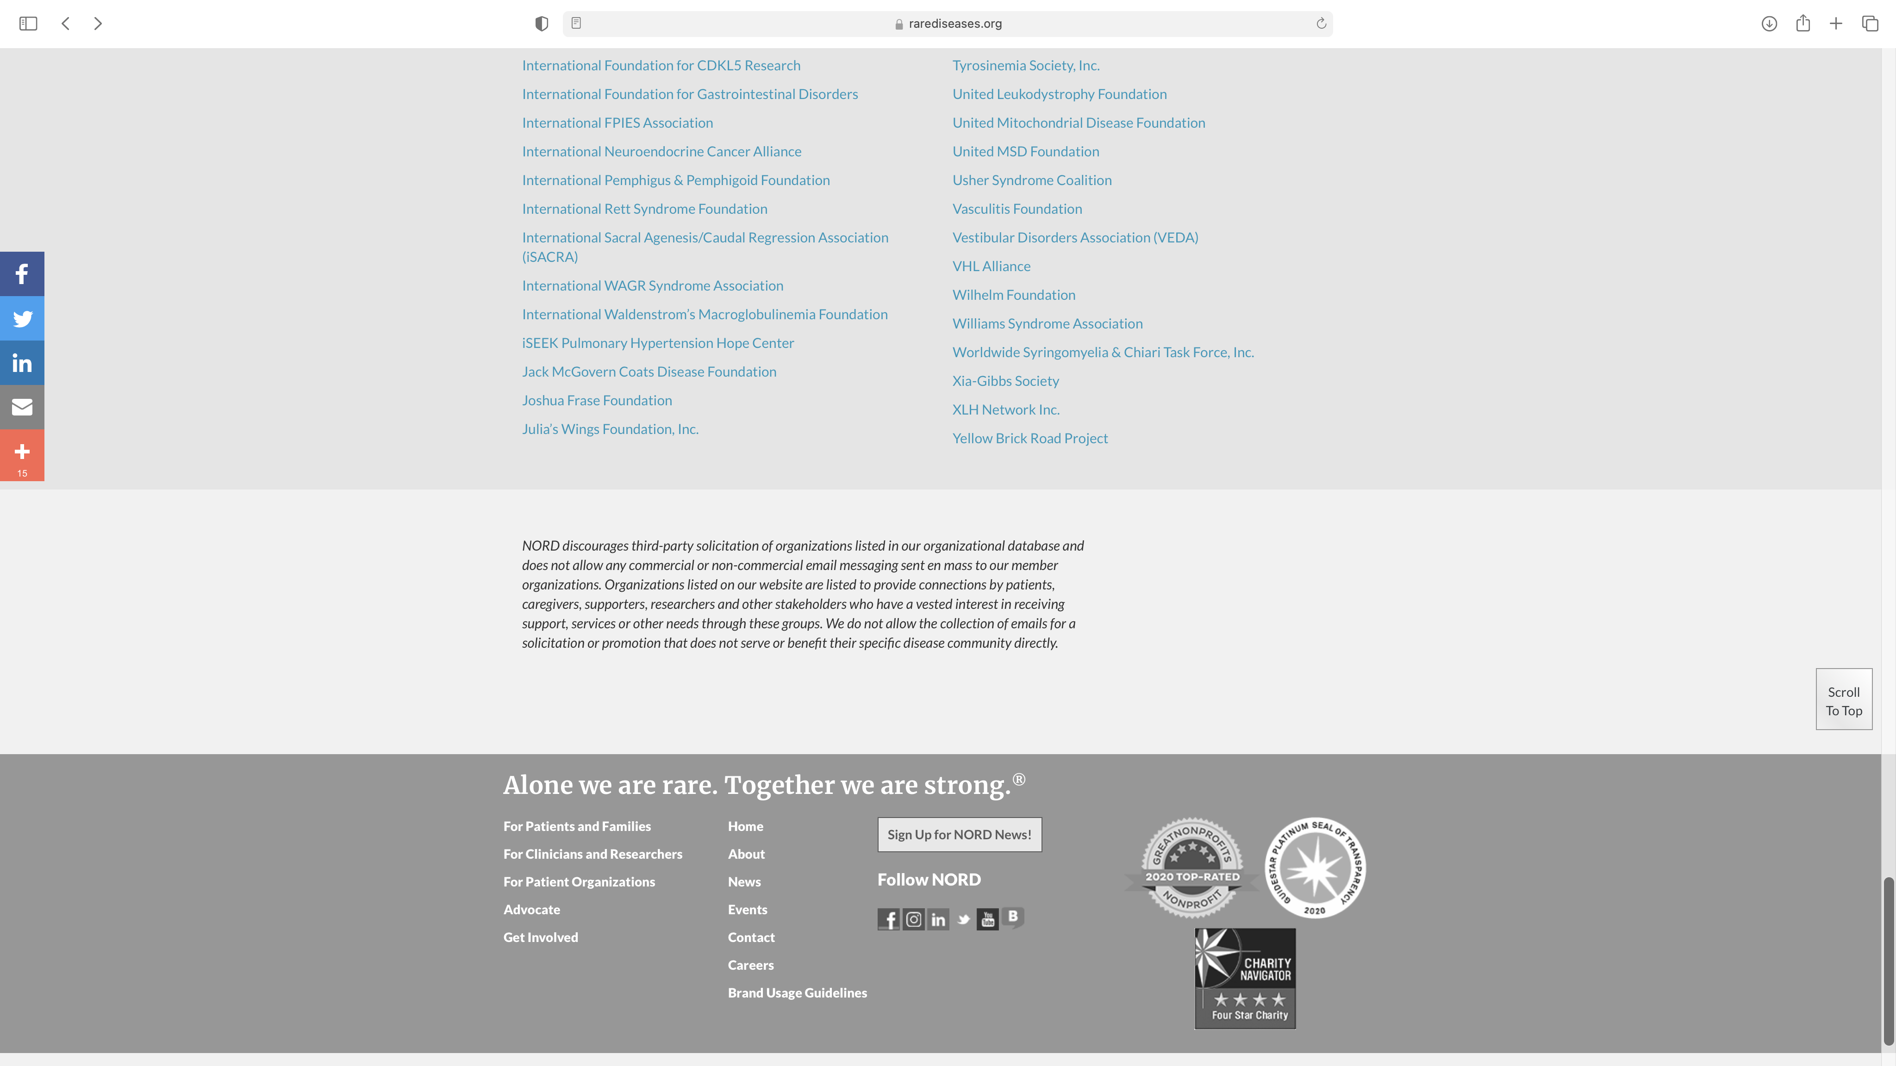
LOTS OF PATIENT GROUPS

Slide 6
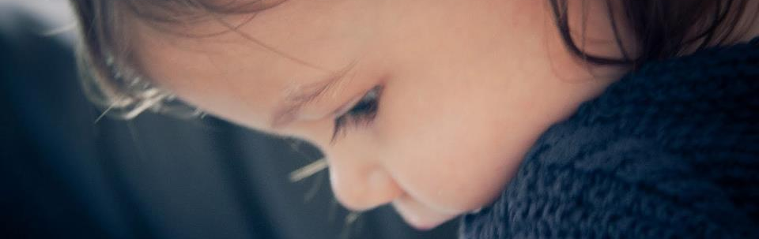
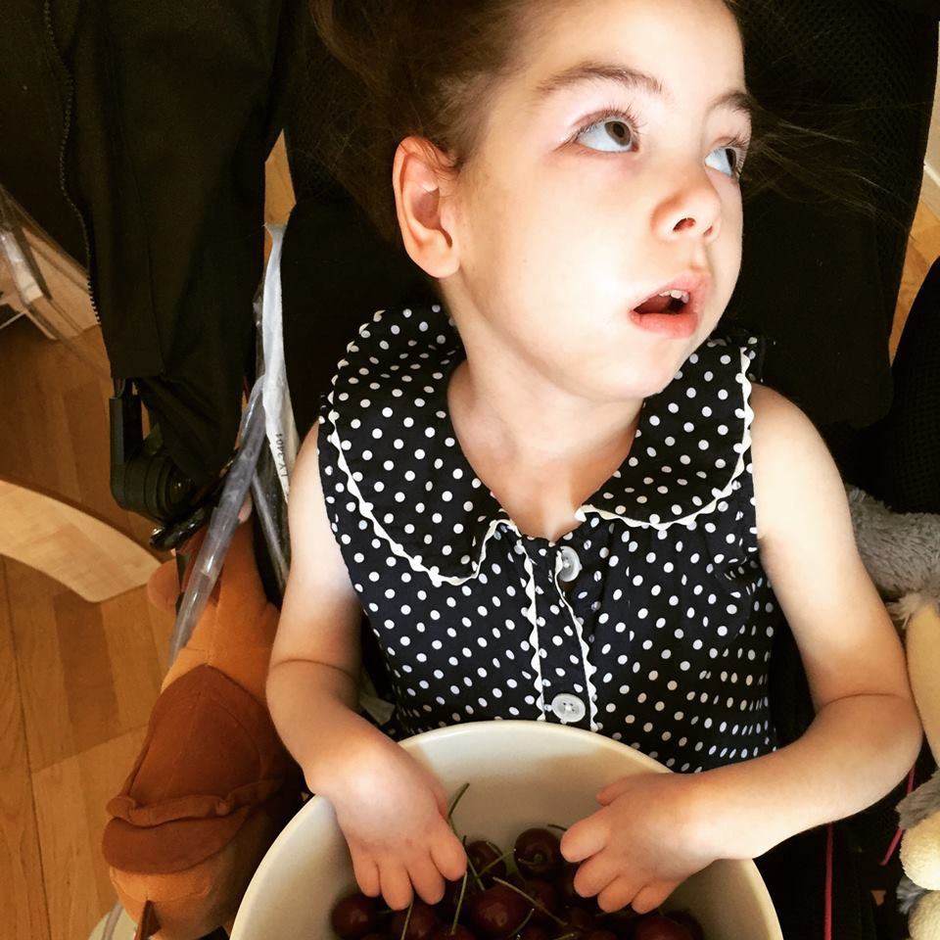
THE BEGINNING
OF OUR STORY AT
THE CATS FOUNDATION
Most small charities are started because of one person.
In our case it was Amélie.

Slide 7
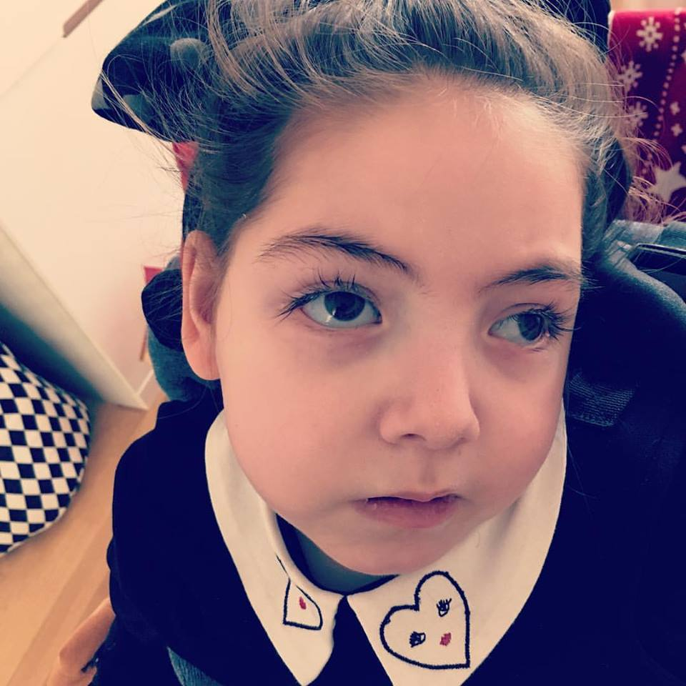
A COMMON STORY
DIAGNOSED AT 15 MONTHS
In 2011 Amélie started to have developmental issues and was diagnosed later that year
A RARE DISEASE
We were told we probably would not meet another child affected by Tay-Sachs and she would die by 3
NO CHARITY
We found that there was no charity in the UK or Europe providiing support to families affected by the disease

Slide 8
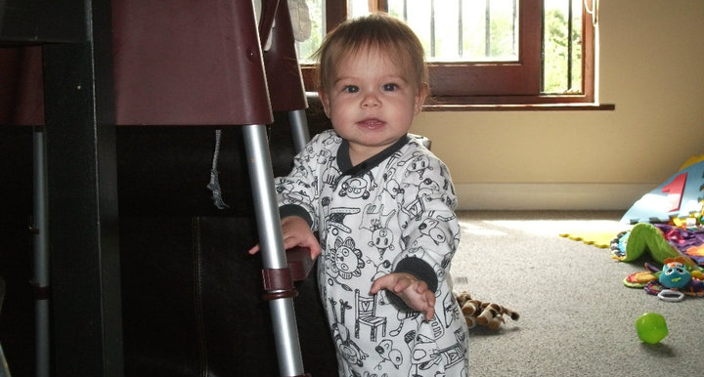
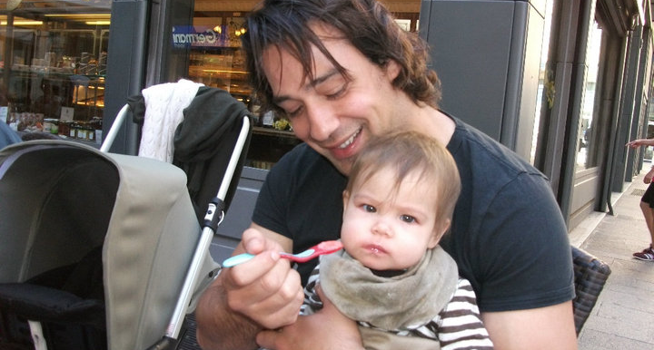
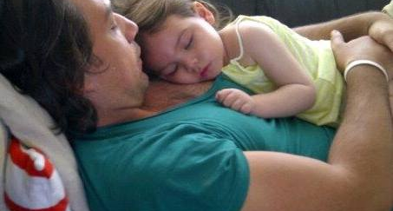
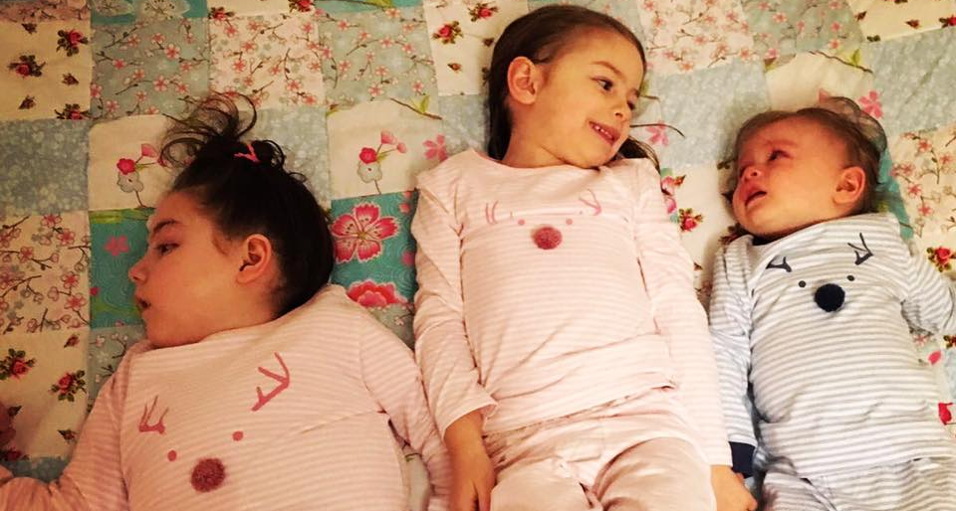
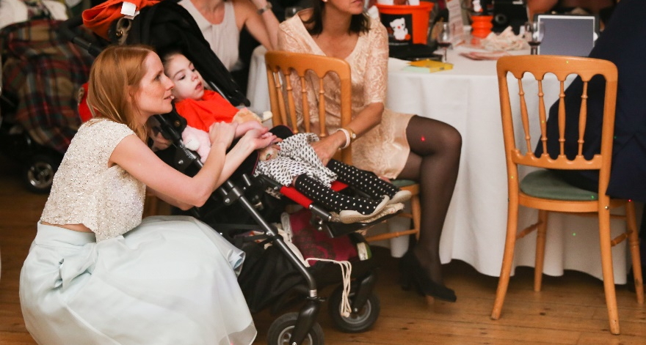
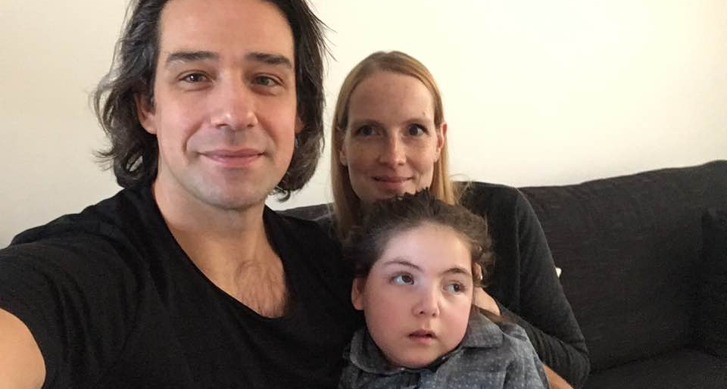
A DEGENERATIVE DISEASE
Tay-Sachs robbed Amelie of her future

Slide 9
THE CATS FOUNDATION WAS BORN
LOOKED INTO RESEARCH
Investigated what research was being undertaken into Tay-Sachs and Sandhoff disease
RAISED OUR PROFILE WITHIN THE COMMUNITY
We reached out to families across Europe to create a strong community to support each other
RAISED OUR PROFILE WITH RESEARCH
We reached out to all the research teams we found to let them know that we charity existed

Slide 10


THE FUTURE
You probably won’t meet another family with
a child affected by Tay-Sachs.

Slide 11
THE FUTURE
You probably won’t meet another family with
a child affected by [replace with any rare disease].

Slide 12
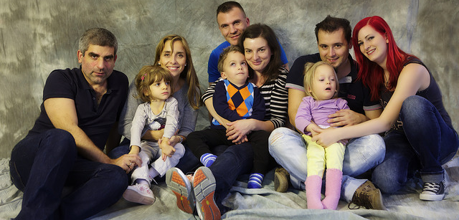
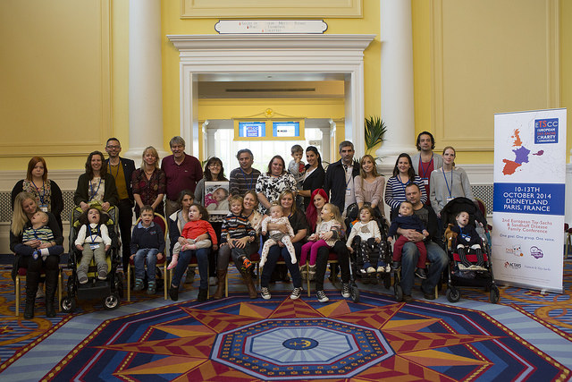
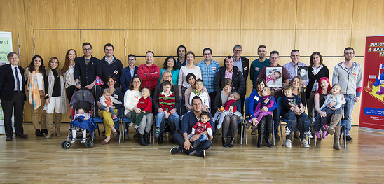
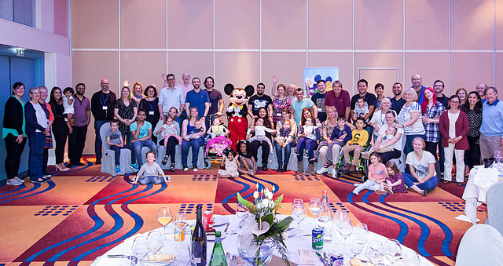
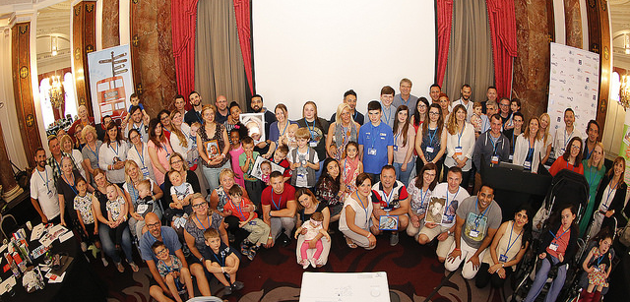
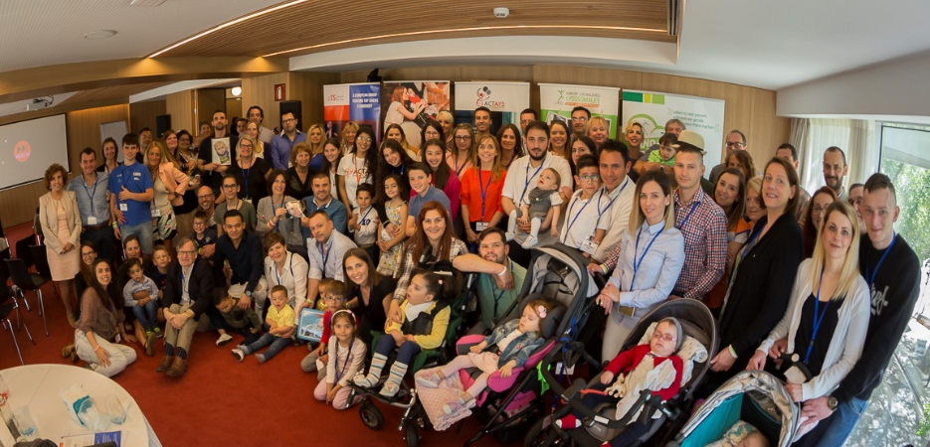
THEY WERE WRONG
Since 2013 we have held six Family Conferences for European families affected by Tay-Sachs and Sandhoff. These have taken place in Austria, France, Germany, England and Spain.

Slide 13
OUR GOAL
Our goal is to save children from Tay-Sachs and Sandhoff disease.
We want to give them an opportunity to have a future.

Slide 14
THE POWER OF A COMMUNITY
WE COULD SEE THE POTENTIAL
There were lots of families affected by the diseases in Europe and the research was gathering pace. We could see the potential of a unified group working together and finding that cure.

Slide 15

ARE WE THE EXPERTS?
YES WE ARE!!
Patients, carers and patient groups should be seen as the experts – we have so much knowledge to share.

Slide 16
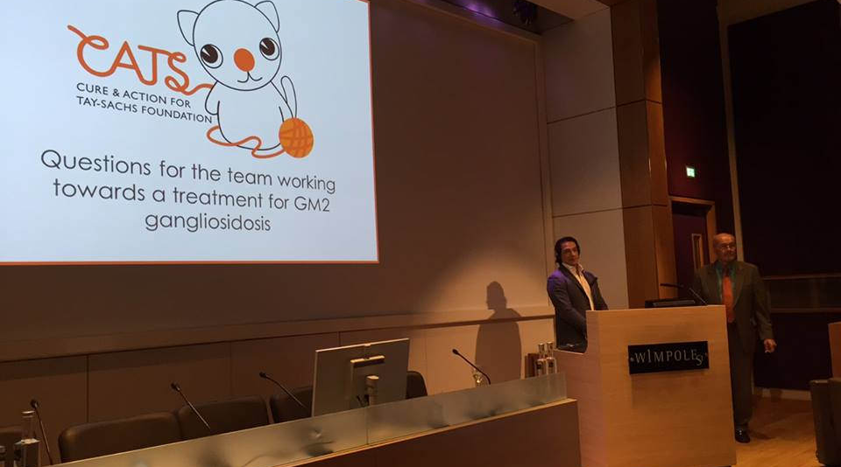
RESEARCH TEAMS
FAMILIES
Needed a charity to support them to secure funding
Needed a charity to help them identify patients
Needed a charity to raise awareness of the diseases
Needed a charity to provide a support network
Needed a research team to find a treatment
Needed someone to communicate with families

Slide 17

COLLABORATION
IS KEY
TOGETHER WE CAN
FIND THAT CURE
We work closely with international research teams and industry partners to develop treatment options.

Slide 18
DIFFERENT AUDIENCES
We reaslied we had to target different audiences with different messages
The disease community
General
public
Industry & researchers
1
2
3
We target them so as they need to know what we do and how we can help them
Our messaging is to raise awareness and to drive funding into the charity to help the community
We present at conferences and contact them directly to get them to develop treatments

Slide 19
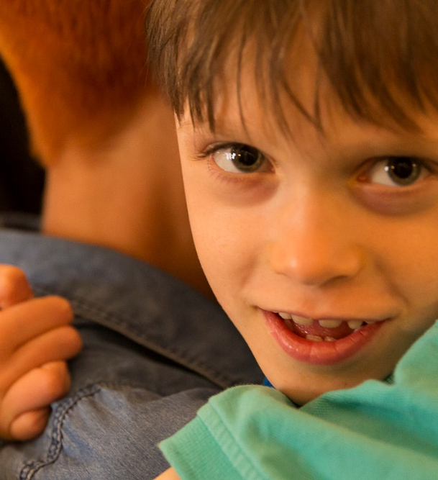
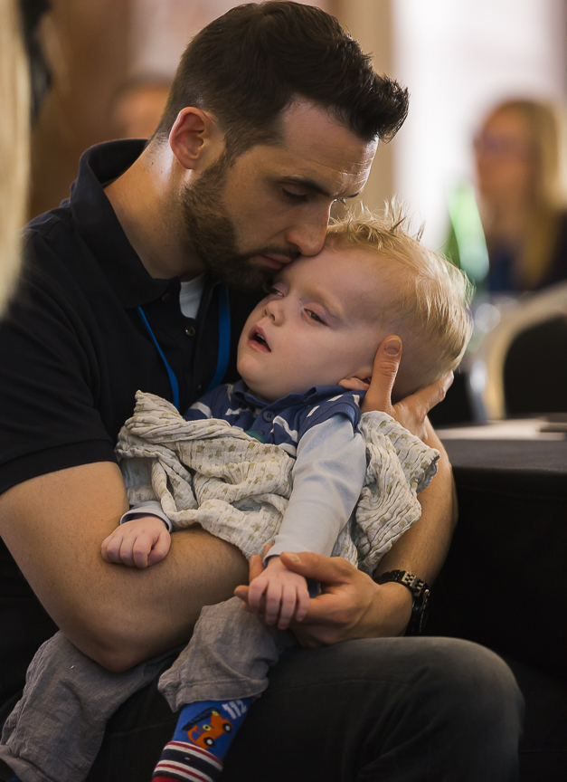

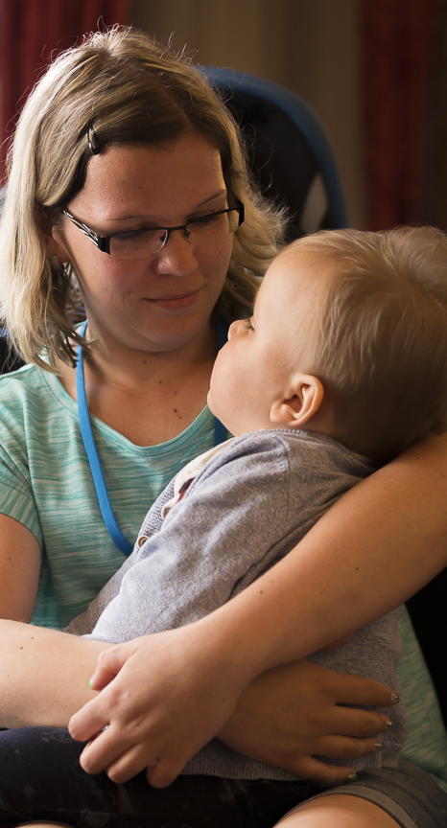
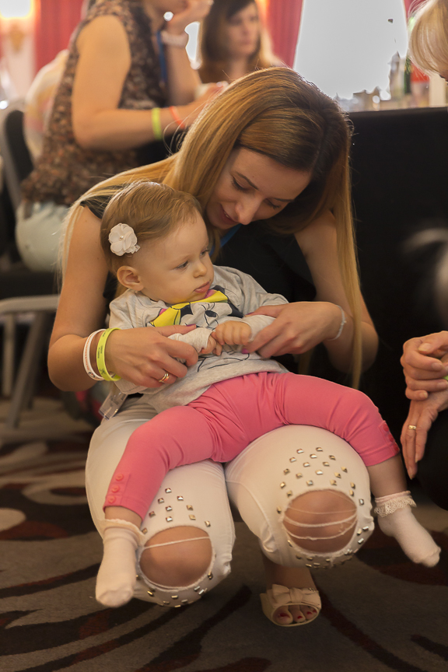
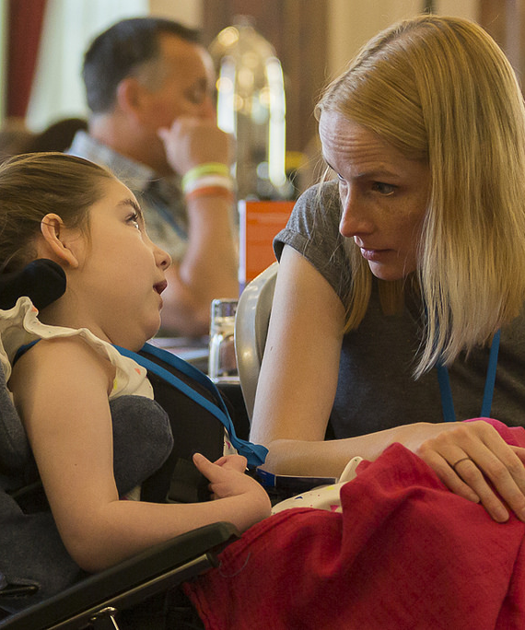
A FACE TO
THE DISEASE
WE SHOW THE HUMAN
SIDE OF THE DISEASE
The sad truth is that children have and will continue to die from these awful diseases until we have a cure. The charities will not stop until we are in a position to offer this to all the families which we support.

Slide 20
CHARITIES CAN BRING EVERYONE TOGETHER
RESEARCH
CHARITIES
The research teams are spread across Europe and are all focusing on different treatment options
We represent the patients on a national and international level where we provide support to families
RESEARCH
CHARITIES
FUNDING
PATIENTS
FUNDING
The most important part of all the discussions are the patients who are supported by the charities
PATIENTS
The charities fund and help find funding for the research projects that benefit the patients

Slide 21
SETTING THE FOUNDATIONS
RAISED AWARENESS
SET-UP EUROPEAN CHARITIES
Charities
We raised awareness within the pharmaceutical community to make people aware of the diseases
We could see the impact the power of numbers could have so we set-up charities throughout Europe and the ETSCC
Awareness
Registry
DISEASE REGISTRY
  JOINED THE RESEARCH COMMUNITY
We raised awareness of the diseases in the research community so they would be interested in our diseases
We developed the largest disease specific registry for Tay-Sachs and Sandhoff in Europe
Research

Slide 22

OUR
EUROPEAN
CONSORTIUM
Member charities of the European Tay-Sachs and Sandhoff Charity Consortium (ETSCC). Since it was established in 2012 the ETSCC has 5 different member organisations.

Slide 23
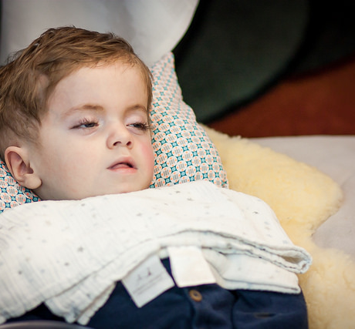
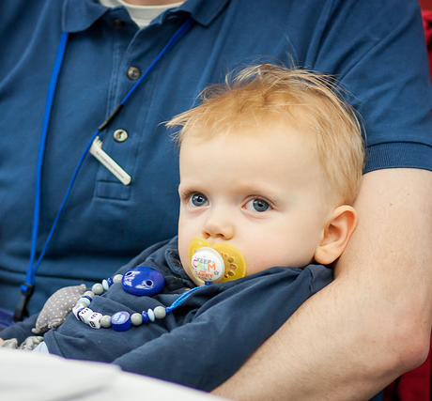
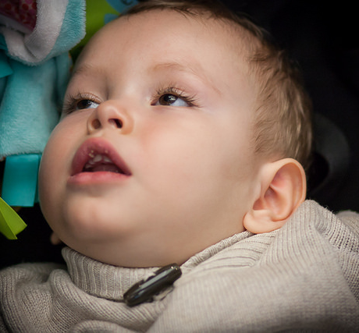
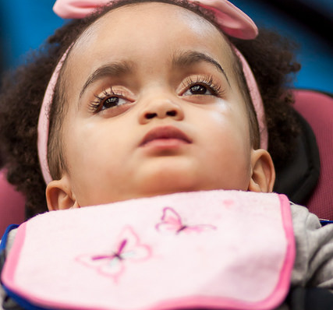
THESE GUYS
ARE VITAL
These people should not be forgotten – they are why we are all working together

Slide 24

PATIENTS ARE
THE KEY
YOU NEED TO SHOW THAT A
DIFFERENCE CAN BE MADE
When you are the family who is 1 in a million (or 1 in 320,000) it hurts when you are told your disease is too rare for research.

Slide 25
RESEARCH & TRIALS – 2011
In 2011 there was only one research project
1
Global
Gene therapy programme for GM2 Gangliosidosis - The University of Cambridge

Slide 26







RESEARCH & TRIALS – 2021
There are now multiple studies ongoing globally
Gene therapy programme for GM2 Gangliosidosis – The University of Cambridge
IB1001 clinical trial – drug repurposing
AMETHIST trial – substrate reduction
Gene transfer in a murine model of Sandhoff using AAV9
Deployment of chaperone treatment for Tay-Sachs
A new inflammasome complex treatment for GM2 Gangliosidosis
Investigation into gene & cellular therapy treatment for GM2
Investigation into gene & cellular therapy treatment for GM2
8
Europe
Gene therapy programme for GM2 Gangliosidosis - Taysha
Gene therapy programme for GM2 Gangliosidosis - Sio
IB1001 clinical trial – drug repurposing
AMETHIST trial – substrate reduction
4
US
3
Upcoming
Drug repurposing
New drug - Pharma company
New drug - Pharma company

Slide 27

HOW DID WE ACHIEVE THIS?

Slide 28



HOW DID WE ACHIEVE THIS?

Slide 29
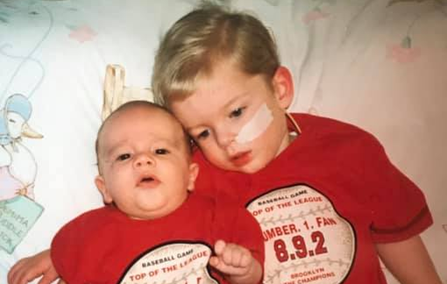
THE IMPACT
Families never met
Children and adults were diagnosed with Tay-Sachs and Sandhoff but as there was no registry their details were never shared
Thomas & Brandon
When Thomas was diagnosed with Tay-Sachs, his family never met another family diagnsoed with the same dsease

Slide 30
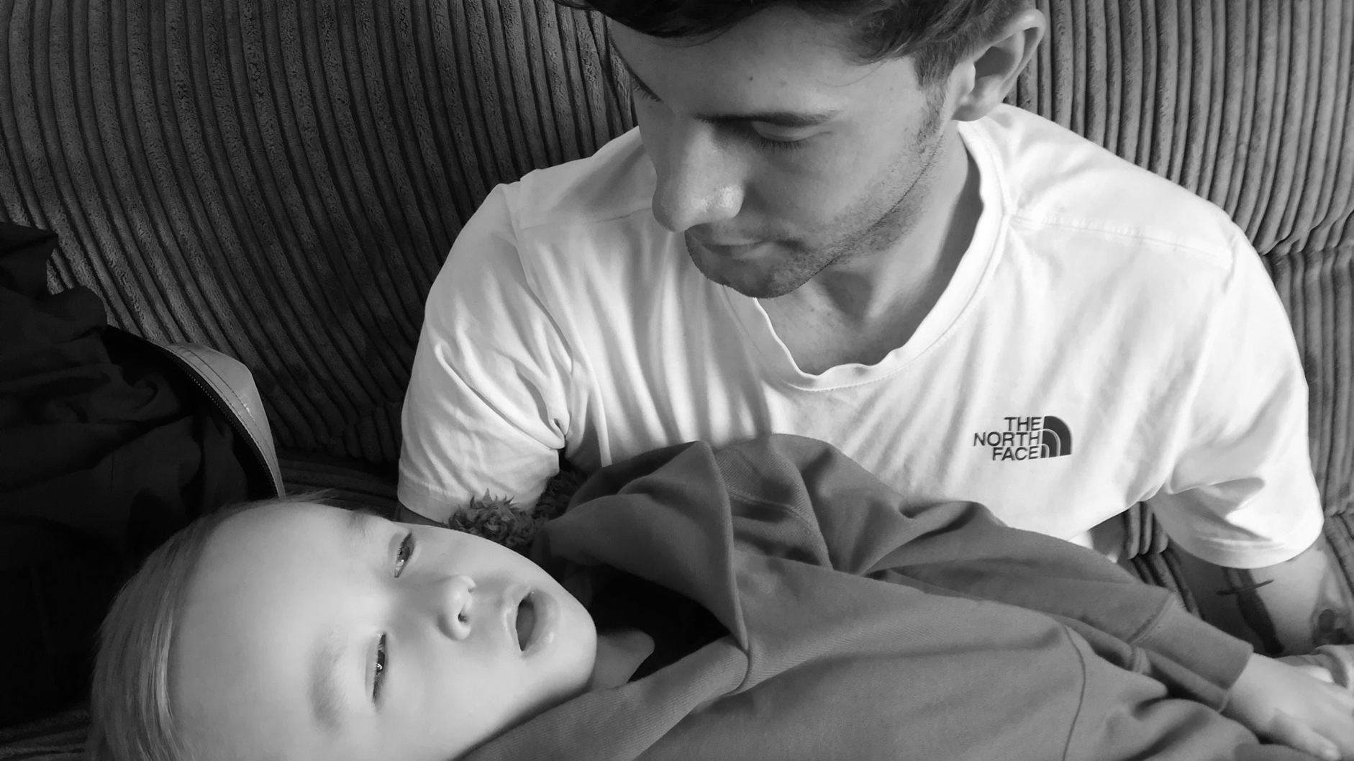

Slide 31
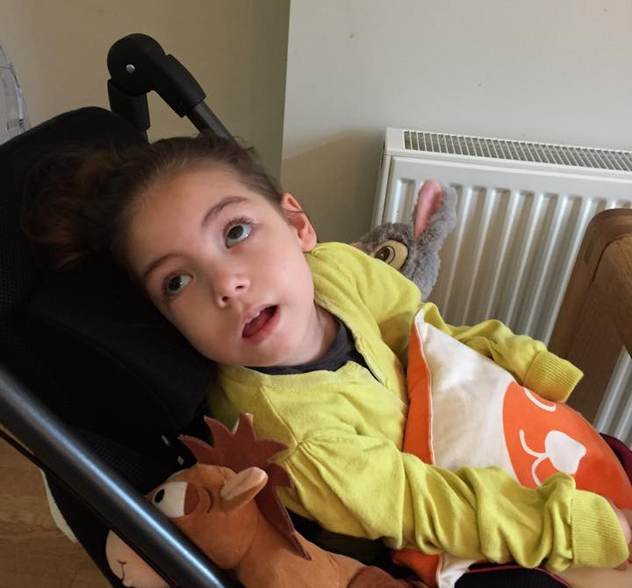
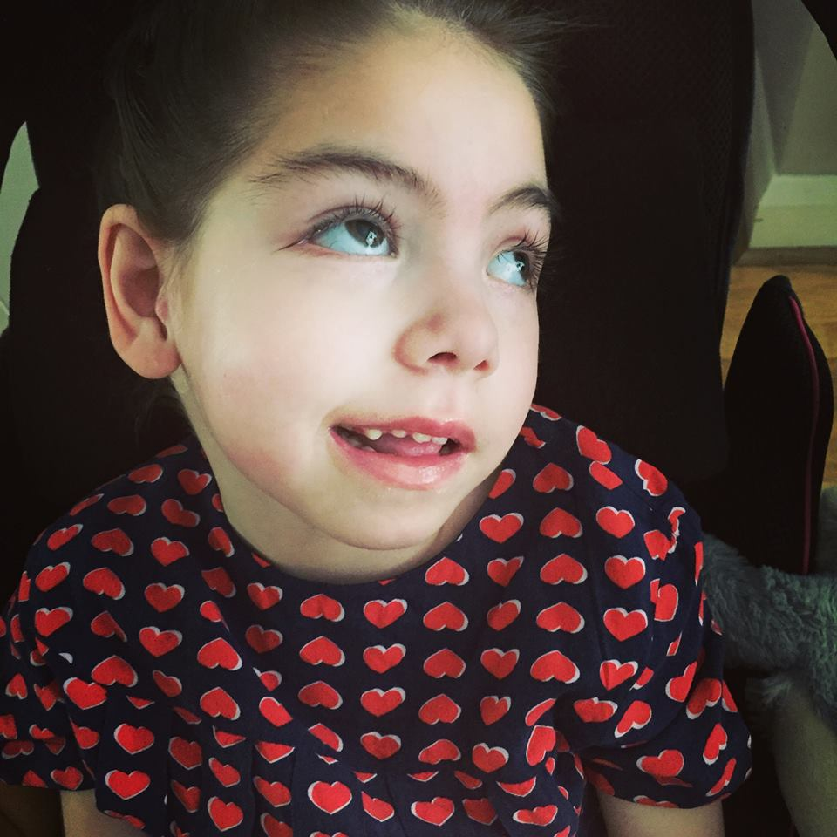
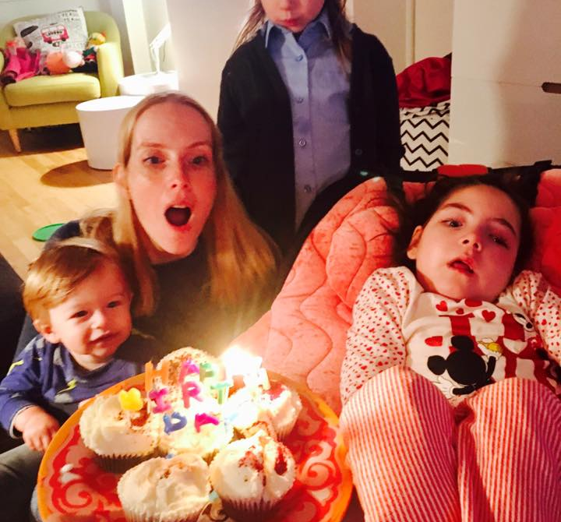
OUR
BEAUTIFUL
AMELIE
Sadly, Amélie died in December 2017 at the age of 8.
She lived a lot longer than we thought she would and did a lot in her short life.

Slide 32
THE DREAM IN 2031
You need to set goals
!
Global
Multiple treatments for Tay-Sachs and Sandhoff

Slide 33

WE WANT TO GIVE HOPE
THERE IS NOW LIGHT
AT THE END OF THE TUNNEL
We are now able to give families hope that there are treatments in the pipeline and that we are working towards giving people with Tay-Sachs and Sandhoff a future.

Slide 34

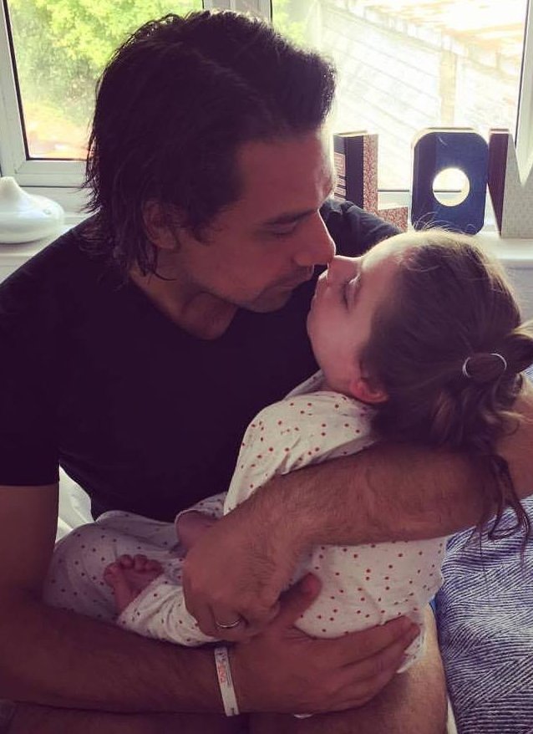
DANIEL LEWI
We will beat these awful diseases so no other family has to go through the experience of losing a child.
dan@cats-foundation.org

