Slide 1


Misdemeanor Justice in Missouri: The Role of Reform Post-Ferguson
Beth M. Huebner
University of Missouri-St. Louis
Acknowledgments. This research was funded by a grant to the University of Washington from Arnold Ventures (Alexes Harris, PI). Partial support for this research came from a Eunice Kennedy Shriver National Institute of Child Health and Human Development research infrastructure grant, P2C HD042828, to the Center for Studies in Demography & Ecology at the University of Washington. This work was also supported by the Data Collaborative for Justice at John Jay College.
Notes:
We argue instead that it is the economic and social features of the region that fuel the need for revenue generation and the court and legal structure of the state prevents adequate legal representation and remedies for resolving debt, and fragments information flow, ultimately leading to inequitable outcomes and increased state control.

Slide 2
Background
Misdemeanor arrests are the most prevalent form of social control and represent three-quarters of all criminal cases filed for a total of 13 million cases each year, most for relatively minor offenses (Stevenson and Mayson 2018).
Many see these cases as low stakes and are often hidden from view
2014 US DOJ investigated the Ferguson, MO Police Department after the killing of Michael Brown by a police officer.
Generation of revenue through law enforcement
Productivity = # of citations
Racialized application of fines and fees
Limit placed on excessive fines in 2015 – SB5 – Mack Creek’s Law
Cap (20%) of city budget’s which could be derived from fines and fees
Capping fines and fees for minor traffic violations at $225.00 (Section 479.353(1)(a))
Barring jail time for failure to pay court fees
Mandating community service as an alternative to financial payment
Page and Soss (2017, p. 142) contend, “what the DOJ discovered in Ferguson is not exceptional in relation to the past or present of US governance.”
Notes:
Unique structure of St. Louis county and city courts
Circuit courts act as primary trial courts
Hear misdemeanors, felonies, and civil matters with divisions for general, juvenile, drug, court, traffic etc.
Some circuits consist of a single county courthouse (e.g., St. Louis city) and some include multiple county courts
Municipal courts are special divisions of circuit courts and are subject to local rules
Primarily hear traffic and city ordinance violations
Sentencing process varies widely

Slide 3
Misdemeanor Justice & Economic Sanctions
Neoliberal ideals have normalized ‘user fees’ as a central part of funding of the criminal legal system (Page & Soss, 2017).
Legal financial obligations “reinforce poverty, destabilize community reentry, and relegate impoverished debtors to a lifetime of punishment because their poverty leaves them unable to fulfill expectations of accountability.” (Harris, 2016)
Municipal governments are often overlooked but have substantial power.
Misdemeanor justice acts as another means of social control through marking, procedural hassle, and performance (Kohler-Hausmann, 2013; 2018).

Slide 4
The Racialized History of the Criminal Legal System in St. Louis County
Parochial Criminal Justice System in St. Louis County
88 municipalities in St. Louis County
83 have independent courts to enforce municipal codes and ordinances and over 50 police agencies.
Traffic and motor vehicle offenses are processed in criminal court.
Disparity Index in Police Stops (2019 Attorney General Report)
Ferguson - 1.44 for Black persons, .24 for White persons
Rates have not significantly changed in 20 years.
St. Ann – 3.22 for Black persons , .45 for White persons
Notes:
The state of Missouri has the fourth highest number of municipalities of all fifty states and the District of Columbia, with 944 different municipalities. Missouri is preceded by Illinois, Texas, and Pennsylvania (each with more than 1,000 municipalities), suggesting that this phenomenon is not geographically unique. In comparison, the average number of municipalities possessed by each state or the District of Columbia is 382 (United States Census Bureau, 2017).
Disparity index = (proportion of stops / proportion of population). A value of 1 represents no disparity; values greater than 1 indicate over-representation, values less than 1 indicate under-representation.

Slide 5
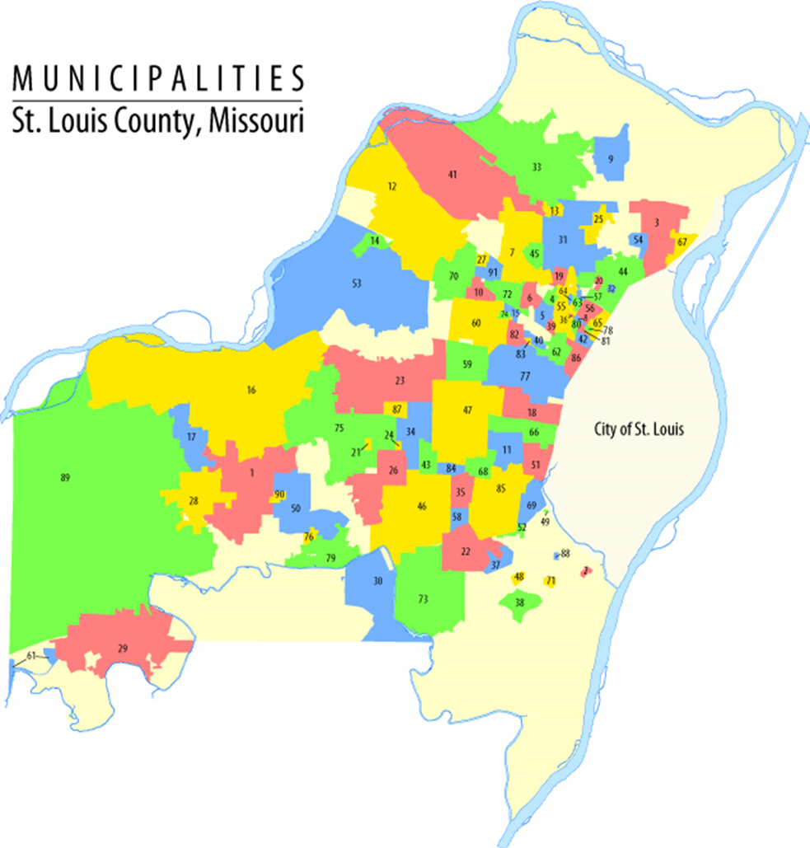
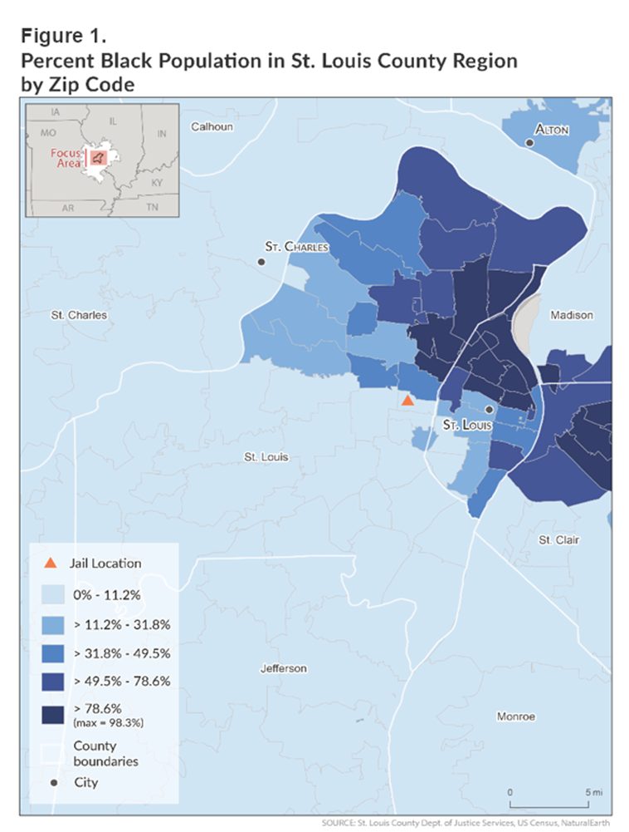
Notes:
Figure 2 illustrates the parochial structure of St. Louis County. The route marked on the map in blue shows a typical driving route from the Ferguson region to the county seat in Clayton. On the route, one passes through six communities, all with an independent police department and court, and an unincorporated area in a span of 5.48 miles. The drive would take approximately nineteen minutes by car and 80 minutes by bus. Limited public transportation in the region makes driving the preferred mode of conveyance.

Slide 6
Decline in Law Enforcement Activity in the Region Post-Reforms
See Slocum, Huebner, Rosenfeld, and Greene, 2018

Slide 7
Warrants are Commonplace After Reforms
150,423 warrants were issued in St. Louis County in 2019 (for a population of 1 million people).
Bellefontaine Neighbors, MO = 10K population – 3,795 warrants in 2019
75% of population is Black, median income is 40K, and less than 7% in poverty.
“Pocketbook Policing” (Pacewicz & Robinson, 2021)
About 20% of arrests in St. Louis City associated with warrant enforcement.
Missouri state law dictates that if an officer encounters a person with an open warrant, they must arrest that person.

Slide 8
Most Prevalent Charges Associated with Bench Warrants in 2019 in St. Louis City (~50% of warrants)
Driving without vehicle insurance
Driving without a valid license
Driving with a suspended license
Engage in public nuisance – panhandling
Data adapted from Slocum, Torres, and Huebner

Slide 9
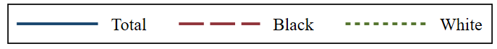
Rates of Arrests for Bench Warrants with No New Charges per 100,000 by Race
St. Louis
Black-to-White ratio = 4.2
Black-to-White ratio = 3.2
Table adapted from Slocum, Torres, and Huebner

Slide 10
The Current Study
How has misdemeanor justice changed in the St. Louis Region post-Ferguson reforms?

Slide 11
Multi-State Study of Monetary Sanctions
Funding from the Arnold Ventures
Sites include (research leaders): California (Bryan Sykes), Georgia (Sarah Shannon), Illinois (Mary Pattillo), Missouri, Minnesota (Chris Uggen), New York (Karin Martin), Texas (Becky Pettit), Washington
PI – Alexes Harris
Phase I – Legal Review (2015)
Phase II – Qualitative Research with Individuals with Legal Debt and Stakeholders (2016 and 2017)
96 individuals with legal debt in three locations
49 local stakeholders (probation, parole, judges, defenders, prosecutors)
Phase III – Court Ethnographies – 200 hours (2017)
Phase IV – Official Data (2018)

Slide 12
Selected Missouri Court Fees & Surcharges Outlined in RSMO & OSCA Court Rules
Surcharge or Court Fee | Amount/Application | Statute or Rule
Clerk fees | (variable); Typically $50.00 | COR 21.01
Court Automation Fund fee | $7.00 | COR 21.01
Crime Victims’ Compensation Fund surcharge | $7.50 for all criminal cases and infractions | RSMO 488.5339
Prosecuting Attorneys & Circuit Attorney’s Retirement Fund | $4.00 for all criminal cases and infractions | RSMO 488.026
Peace Officer Standards and Training Fund (POST) surcharge | $2.00 for all criminal cases and infractions | RSMO 488.5336.1
Prosecuting Attorney Training Fund (PAT) surcharge | $1.00 for all criminal cases and infractions | RSMO 488.5017.1
Sheriff’s fee | $6.00 for infractions | RSMO 488.5320.1
 | $10.00 for misdemeanors
 | $75.00 for felonies
Sheriff’s Retirement Fund surcharge | $3.00 for all criminal cases and infractions | RSMO 488.024
Brain Injury Fund surcharge | $2.00 for all criminal cases and infractions | RSMO 304.028
Motorcycle Safety Trust Fund surcharge | $1.00 for all criminal cases and infractions | RSMO 302.137
Spinal Cord Injury Fund Surcharge | $2.00 for all criminal cases and infractions | RSMO 304.017
Crime Analysis Fee | $150 for all criminal cases involving crime lab analysis of a controlled substance | RSMO 488.029
Jury Compensation | $18/per day per juror; $.07 per mile for travel | RSMO 488.040
Table adapted from Harris et al

Slide 13
Legal financial obligations and time to full payment for driving with a suspended license. Totals due immediately, and if paid in monthly $50 on-time payments.
State | Fine | Fees | Surcharges | Added charges | Amount due at sentencing | Total paid, $50 monthly payments | Months until paid
California | $300-$1000 | Incarceration costs | $1010-$2100 | - | $1310 - $4180 | $1310 - $4180 | 27-84
Georgia | $500-$1000 | $0 | $405-$805 | - | $905 - $1805 | $905 - $1805 | 19-37
Illinois | $0-$2500 | $310, Incarceration costs | $85-$1022.50 | - | $395 -$3832.50 | $395 -$3832.50 | 8-77
Minnesota | $200 | $3-$13 | $75 | $0 | $279.50 - $289.50 | $279.50 - $289.50 | 6
Missouri | $150-$500 | $12, Incarceration costs | $19.50-$44.50 | $25 | $206.50 - $582.50 | $206.50 - $582.50 | 5-12
North Carolina | $0-$200 | $125.50 | $35.50 | 4% interest | $188 - $388 | $214.52 - $431.31 | 5-9
New York | $200-$500 | $50 | $83 | - | $333-633 | $333-$633 | 7-13
Texas | $0-$500 | $62.10 | $0-$300 | $25 | $62.10-$862.10 | $87.10-$ | 2-18
Washington | $0-$1000 | $200 | $250 | 12% interest, $100 annual | $450 - $1450 | $686.85 - $2222.88 | 14-45
Reinstatement costs between $20 to $150
Table adapted from Harris et al., 2017
Notes:
SR22 – In some states

Slide 14
Routine, Racialized, & Costly Police Contact
Tickets (and often subsequent warrants) were commonplace.
Participants routinely denoted that they had half a dozen infractions from different small municipalities all with different rules and compliance requirements.
Reforms did not change or waive existing warrants or tickets issued before reforms.
Presumption of guilt and use of small infractions as probable cause
Traffic stops for unclear temporary license, perceived lack of seatbelt, smell of pot smoke, and false identification.
Notes:
Probation officer Phillips – more than half of the cases on his caseload have not been closed
The statute is vague, stipulating that a highway safety analysis must show that the area has a greater number of fatal or disabling car crashes than other comparable roadways (RSMo 304.590).

Slide 15
Localized & Structures of Governance and Fiscal Management
State statute allows for enforcement of safety zones and increased financial penalties.
Municipal ordinance violation for seatbelt violations
$10 fine as a safety measure
Most municipalities have enacted seatbelt laws that allow for a traffic stop based solely on seatbelt violations (2010-2018).
Neutral in their design but reinforce inequality in their application.
Unpaid legal financial obligations can trigger additional sanctions that vary in scope and severity.
Notes:
In addition, recent legal reforms that remove or reduce sanctions for moving violations do not address old warrants or tickets; therefore, the legacy of the earlier court systems continues.

Slide 16
Challenges with Compliance
Participants found it difficult to comply with sanctions that were often multi-layered, time delimited, and required frequent trips to court
Two Tier System of Justice
Individuals who can pay have little to no future contact with the system.
Costs for individuals who can not pay at the time of assessment.
Frequent court hearings.
Potential warrants for failure to appear
Lost work and wages

Slide 17
Extended Punishment & Tethering
Midemeanor “Pay Only Probation”
Individuals can be placed on probation to allow for more people to pay for their fines and fees.
Up to $60 per month cost – complete discretion of the judge
Private companies have complete discretion for violation reports in the municipal courts.
State statute mandates that private probation is completely “offender funded”.
Felony probation
Individuals can remain on probation until their fines and fees have been paid.
For people who can not pay, they are not eligible for earned compliance credit.
Probation can be extended one year for non-payment.
Voting, among other abilities,

Slide 18
Sustained Controls in an Era of Reform

Slide 19
Lack of Legal Representation
In Missouri, individuals who enter the municipal courts are not eligible for a public defender.
The independent nature of courts make rectifying tickets very difficult.
Increased risk of driver’s license suspension
Missouri allows for suspension for failure to appear charges.
Individuals without representation are less likely to be offered amendments to the number of points assessed (Arch City Defenders 2014).
Clients were offered less protections – under the guise that the sanctions were small.
Notes:
By statute, individuals in Missouri who fail to appear in municipal court on traffic charges involving moving violations or who have enumerated points for law violations will have their license suspended, and licenses can be barred for renewal for failure to pay. As part of the reforms, driver’s license suspension and renewal cannot be barred for minor traffic violations, classified as not having an accident or injury. However, individuals who can hire an attorney can get amendments to the number of points assessed against their license, making revocation less likely, while those that cannot pay are not typically offered such remedies (Arch City Defenders 2014).

Slide 20
Few Opportunities for Resolving Debt
State laws offer little relief or guidance for individuals who cannot pay in the municipal court.
Fines are rarely waived.
Reforms only require that community service be offered in lieu of monetary sanctions.
Defendants must ask for an indigence hearing.
No automatic assessment of ability to pay.
Small fines assessed for minor offenses can result in large total financial obligations.

Slide 21
Lack of Systematic Data on Court Requirements & Compliance
Participants routinely denoted that a fundamental challenge to compliance is the lack of information available on a case.
Most states do not mandate or maintain a centralized data system.
Reforms in Missouri mandate a standardized data system, but the reforms come as a cost to the client of $7.00 per municipal case (something not assessed on felony cases).
Lack of a central data system led some individuals to receive a failure to appear because they were incarcerated the day of court.

Slide 22
Conclusion
Although there has been a decline in police activities, a large number of people come into the court system for minor crimes.
Warrants are commonplace and there are few remedies for legal debt or legal representation. “statutory inequality”
Individuals remain tethered to the system.
Justice is local but state structures allow injustice to continue.
Patterns of revenue extraction have disproportionate effects on people of color.
Lack of oversight of the municipal court system.
The court reforms were largely symbolic in nature and did little to change the structure of the courts and the nature of the state court system.
Most municipalities did not earn more than 20% of local funding from economic sanctions.
Even small debts lead to large financial obligations (surcharges, jail board, costs).

Slide 23
Policy Suggestions
Reduce or eliminate jurisdictional reliance on funding from monetary sanctions.
Consolidation and enhanced oversight of the municipal courts.
Eliminate the suspension of driver’s licenses for unpaid costs and court non-compliance.
Since 2017, at least 13 states have enacted legislation ending debt-based driver’s license suspensions.
Routinely asses for indigence and ability to pay and allow fee waivers.
2018 Criminal and Traffic Assessments Act (CCTA) allows for waivers for court costs for people with incomes up to 400% of the poverty line (IL HB 4594)
Provide transparent and accessible data for defendants and local stakeholders and policymakers.
Protect individual data from improper use (see Lageson, 2020).

Slide 24
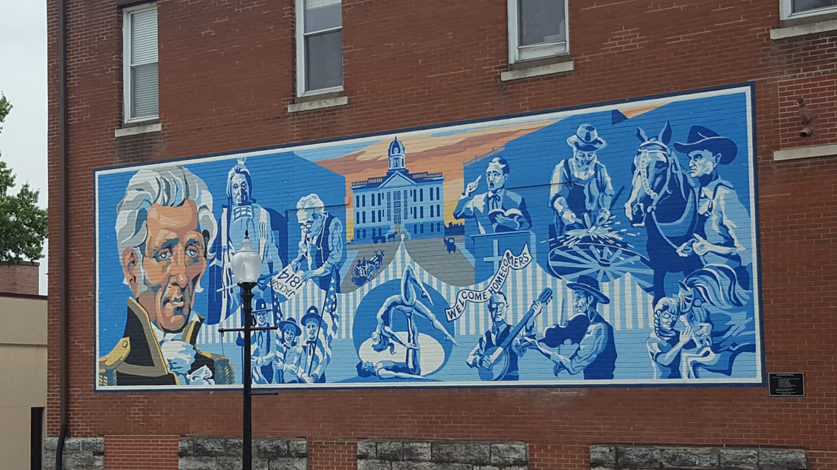
Thank you. Beth Huebner – huebnerb@umsl.edu
Many kudos to my research team
Kristina Thompson
Morgan McGuirk
Dale Dan-Irabor
Andrea Giuffre
Amanda Miller
Related Publications
https://datacollaborativeforjustice.org/work/communities/warrant-arrests-in-the-city-of-st-louis-2002-2019/
https://datacollaborativeforjustice.org/wp-content/uploads/2021/08/PEW_JAIL_REPORT_Final_St.LouisCounty1.pdf
https://escholarship.org/uc/item/64t2w833
https://ccjls.scholasticahq.com/api/v1/articles/9907-changes-in-enforcement-of-low-level-and-felony-offenses-post-ferguson-an-analysis-of-arrests-in-st-louis-missouri.pdf

